Slide 1

SAMSUNG PRISM
Generative AI
Hackathon
3rd Edition 2026 – 27
Theme ID - 2 (Guided Troubleshooting)
Team Name - SRM_ThinkLoop_Theme2
College Name - SRM Institute of Science and Technology
Member Name & Email 1- Visshva R (vr6123@srmist.edu.in)
Member Name & Email 2- N/A (solo)
Member Name & Email 3- N/A
Member Name & Email 4- N/A
Submission Github link - https://github.com/visshva-r/SRM_ThinkLoop_Theme2

Slide 2
Theme
Theme 2: Smart Guided Troubleshooting Engine
Problem: Convert a natural-language Galaxy issue + SIIS support text into a schema-valid troubleshooting plan with masked Settings deeplinks.
Constraints: no URL leaks, grounded steps from SIIS only, cache for repeats/paraphrases, generalize to unseen SIIS payloads, live API for judges.

Slide 3
Existing Solutions & Gaps
Existing: generic LLM chatbots, static FAQ pages, SIIS text dumps without structure.
Gaps we close:
- No schema enforcement → invalid goals/titles/descriptions fail automated gates
- Raw URLs / open links → G5 disqualification
- No cache → repeat/paraphrase latency fails A3
- Invented steps → not grounded in SIIS
- No deeplink catalog matching → auto actions missing actionable deeplinks

Slide 4
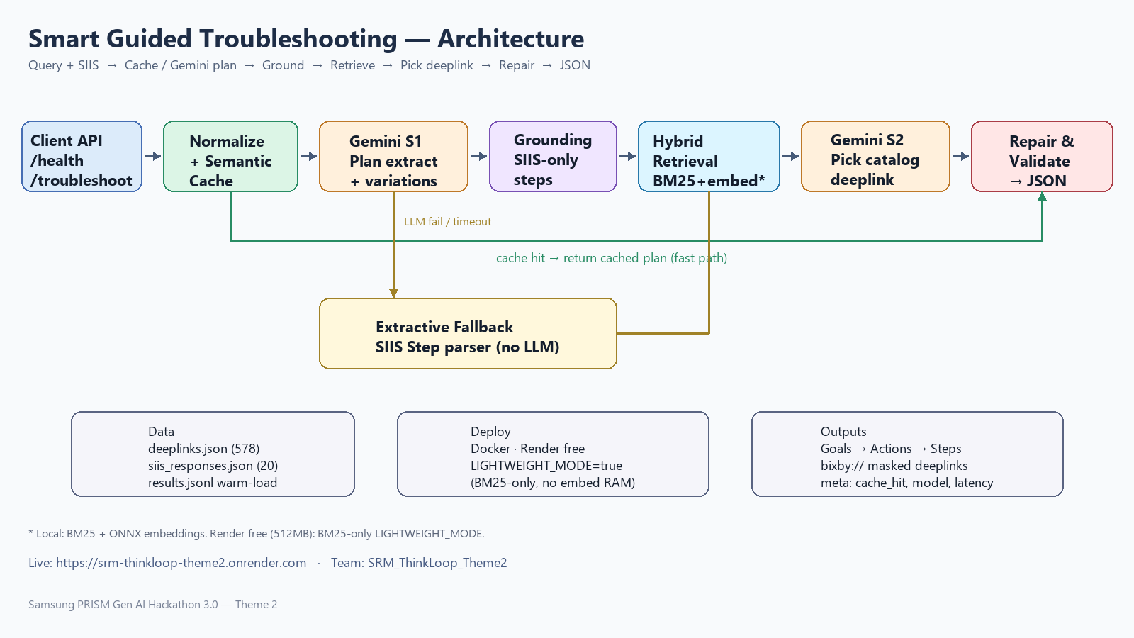
Our Solution & Architecture
Live FastAPI: GET /health · POST /v1/troubleshoot
Pipeline: Normalize → Cache → Gemini Stage1 plan → Grounding → Hybrid retrieval (BM25 + embeddings locally; BM25-only LIGHTWEIGHT on Render) → Gemini Stage2 deeplink pick → Repair/validate → JSON
Fallback: extractive SIIS Step parser when LLM fails/timeouts
Warm cache from results.jsonl (exact + paraphrase keys)
Deploy: Docker on Render free tier · https://srm-thinkloop-theme2.onrender.com
Our Solution & Architecture Diagram
FastAPI pipeline with Gemini planning, SIIS grounding, hybrid retrieval, repair/validate, extractive fallback, and warm cache. Live on Render (Docker).

Slide 5
Demo & Product Walkthrough
Demo video in repo: submission/Demo_Video.mp4
https://github.com/visshva-r/SRM_ThinkLoop_Theme2/blob/main/submission/Demo_Video.mp4
Walkthrough shown:
1) /health → {"status":"ok"}
2) Kit blank-display query → structured contexts + bixby:// deeplinks
3) Exact repeat → meta.cache_hit=true
4) Paraphrase → cache hit from warmed variations
5) Unseen Wi-Fi SIIS → gemini-2.5-flash, grounded steps, no URL leaks
Swagger UI: https://srm-thinkloop-theme2.onrender.com/docs

Slide 6
Tools and Tech Stack
Language / API: Python 3.11, FastAPI, Uvicorn, Pydantic v2
LLM: Google Gemini 2.5 Flash (google-genai) — Stage1 plan + Stage2 pick
Retrieval: rank-bm25, fastembed ONNX (local); LIGHTWEIGHT BM25 on Render
Cache: in-memory exact + paraphrase keys; semantic embeddings locally
Data: deeplinks.json (578), siis_responses.json (20), results.jsonl
Deploy: Docker, Render free, render.yaml + Dockerfile
Eval: scripts/eval_local.py (G2–G5, A1–A5), pytest

Slide 7
Impact & Use Case
Use case: Samsung support / Bixby-style guided fix flows for Galaxy devices.
User describes a blank screen, Wi-Fi failure, cracked display, etc.
System returns ordered Goals → Actions → StepGroups with masked deeplinks so an assistant can open the right Settings screen safely.
Impact: faster first-response troubleshooting, fewer invented steps, judge-safe outputs (schema + zero URL leaks), reproducible Docker deploy.

Slide 8
Innovation highlights, results and limitations
Innovation, Results & Limitations
Innovation: hedged JSON shape + repair layer; SIIS grounding; dummy deeplink policy; warm cache from offline results; Render LIGHTWEIGHT_MODE under 512MB.
Results: G2–G5 PASS; A1 15/15; A2 15/15; A5 5/5; A4 8/10; live black-box checks 6/6; cache_hit 100% on kit/paraphrase.
Limitations: Render free network latency (~700ms) vs 300ms A3 target; cold Gemini path slow on free tier; dense retrieval disabled on free RAM.

Slide 9
What’s Next
- Re-enable hybrid dense retrieval on a larger host for better deeplink precision
- Tighten cold-path p95 with response streaming / hedged timeouts
- Expand paraphrase embedding cache beyond exact keys on production memory
- Add more SIIS domains beyond the 20-kit scenarios
- Package as a PRISM worklet with Samsung mentor feedback

Slide 10
Differentiation (Brownie Points)
- Gemini + extractive fallback (works even if LLM is down)
- Programmatic repair for goal/title/description/category rules
- Zero URL leak scrubbing across the full JSON tree
- Cache warm-load so kit + variations hit immediately after deploy
- Free-tier deploy that still passes live health/schema/generalization checks
- Local scorer reproducing G2–G5 and A1–A5 for iteration speed

Slide 11
Checklist — Updated on Public GitHub
Working prototype code — public GitHub repo ………… YES
README with reproducible setup + Docker …………… YES
Demo video ≤5 min (in repo) ………………………… YES
→ submission/Demo_Video.mp4
Presentation file (PPT) ……………………………… YES
→ submission/SRM_ThinkLoop_Submission.pptx
AI Disclosure ………………………………………… YES
→ submission/LangAI3.0_AI_Disclosure.docx
Release tag PRISM_GENAI_HACKATHON_Y2026 …… YES (retagged on final commit)
Live API ……………………………………………… YES — https://srm-thinkloop-theme2.onrender.com
Working prototype code — public or shared GitHub repo (Y/N)
README with reproducible setup instructions (Y/N)
Demo video, max 5 minutes (YouTube or Drive link)
Presentation file (PPT or PDF) (Y/N)

Slide 12
Thank you
Organised by the Language AI Team and the PRISM Team, Samsung R&D Institute India
Notes:
Closing slide. Add the Google Form URL and a contact email before sharing. Edition 2 organising team for reference: Language AI - Sourabh Tiwari, Gaurav, Sanjeeth Pothireddy, Gorang Maniar; PRISM - Binny Lakra, Prakhar Chandrakar, Vishu Kumar; Kick-off and mentors - Giridhar Jakki, Deepraj Prabhakar Patkar (Language AI), Srimanu Prasad Nagaraju, Ashish Kumar (Tech Strategy).

