Slide 1

Indoor Air Quality for Smart Building Management
Vista Dwi Yulianti
Notes:
Good morning, and thank you for the opportunity to present today. My name is Vista Dwi Yulianti, and today I want to share with you my analysis on Indoor Air Quality and how it plays a critical role in smart building management.

Slide 2
Outline
1. Background
2. Objective
3. Research Questions
4. Material and Methodology
5. Results
6. Discussion
7. Conclusion
8. Recommendation

Slide 3












1. Background

Slide 4
Ideal Range for Each Parameter
Parameter | Ideal Range (Comfort/IAQ Zone) | Insight
Temperature | 21–24°C (70–75°F) | Thermal comfort — too cold or hot reduces productivity
Humidity | 40–60% RH | Prevents mold, dry air, discomfort, supports respiratory health
Lightintensity | 300–500 lux (general office work) | Eye comfort, alertness, productivity
CO₂ | < 1000 ppm | Higher = poor ventilation; 1000–1200 ppm is the warning zone
eCO₂ | < 1000 ppm (proxy) | Follows same logic as direct CO₂; higher = reduced air quality
TVOC | < 300 ppb | Low VOCs = healthy environment, less eye/respiratory irritation
IAQ Index | 0–100 (Good), 100–150 (Moderate) | Above 150 = poor air quality (ranges may vary). Lower number, better IAQ.
Movement | N/A (binary) | Used to infer presence/occupancy
Occupancy | N/A (binary) | Presence detection for ventilation, energy, usage optimization
Comfort_score | 8–10 (ideal) | Custom metric — higher = more comfortable

Slide 5
2. Objective
To analyze the impact of occupancy on indoor air quality and comfort score, and to identify strategies for improving both parameters

Slide 6
3. Research Questions
How does occupancy affect the indoor air quality and comfort score, and what measures can be implemented to improve them?
Sub-research questions:
What are the key patterns and trends observed between the Indoor Air Quality (IAQ), comfort score, and occupancy rate?
How do environmental parameters affect the IAQ and comfort score?
How is the occupancy rate in each room, and what are the IAQ and comfort score within that room?
How is the occupancy through time, and what are the IAQ and comfort score within that room?
Which sensor has the most missing data, and which parameter is most affected by missing values?

Slide 7
4. Material and Methodology
The following tables shows the parameters, the total data, and unit.

Slide 8
There are 8 different multisensors and it is assumed that each sensor is placed in a different room.

Slide 9
Methodology
Data loading
Initial Data Inspection
Data Cleaning
Data Transformation
Exploratory Data Analysis
Data Visualization
Data Analysis

Slide 10
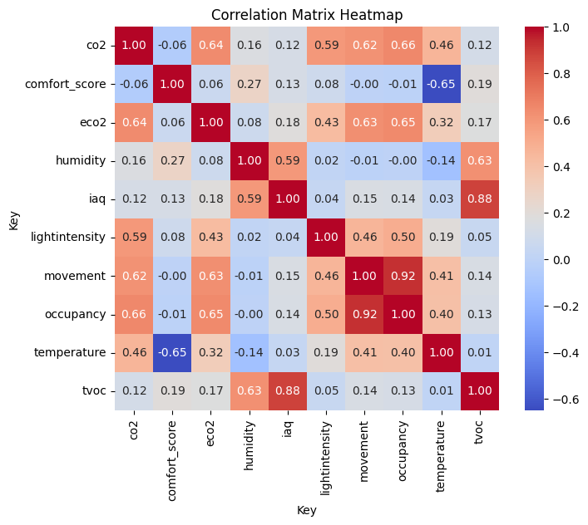
Results
IAQ shows strong correlation with TVOC (0.88) and humidity (0.59).
Comfort score is negatively correlated with temperature (-0.65).
Occupancy is strongly linked to CO₂ (0.66), eCO₂(0.65), light intensity (0.5), and movement(0.92).

Slide 11
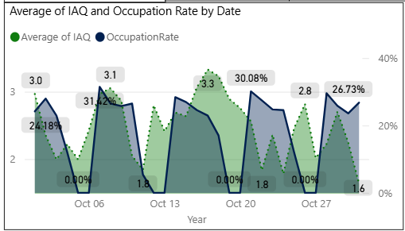
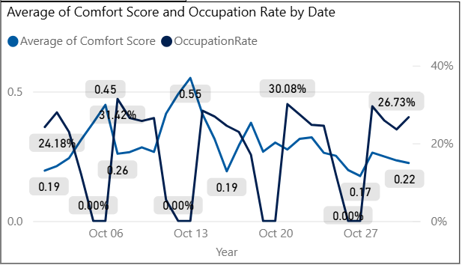
Based on the average IAQ and occupancy rate graph, there’s no consistent pattern—higher occupancy doesn’t always mean higher IAQ (worse IAQ). For example, 22 Oct showed higher occupancy with lower IAQ.
Based on the average Comfort Score and occupancy rate graph, there’s no consistent pattern—higher occupancy doesn’t always mean lower Comfort Score. For example, on the 20th of Oct, both increased together.

Slide 12
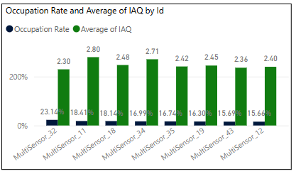
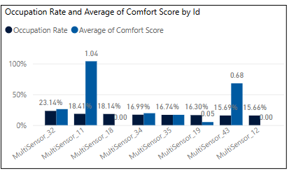
No clear link between occupancy rate and average IAQ; e.g., MultiSensor_11 shows high occupancy and high IAQ (worse IAQ), while MultiSensor_32 has the highest occupancy but lowest IAQ (better IAQ). It might be the HVAC system in the room with MultiSensor_32 performs better than the other rooms.
No pattern between occupancy rate and comfort score. Notably, MultiSensor_18 and _12 show an average comfort score of 0, which may indicate a data issue requiring further investigation. MultiSensor_11 shows high occupancy and high comfort score (better comfort score).

Slide 13
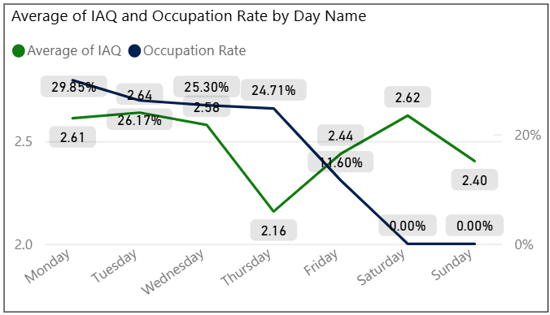
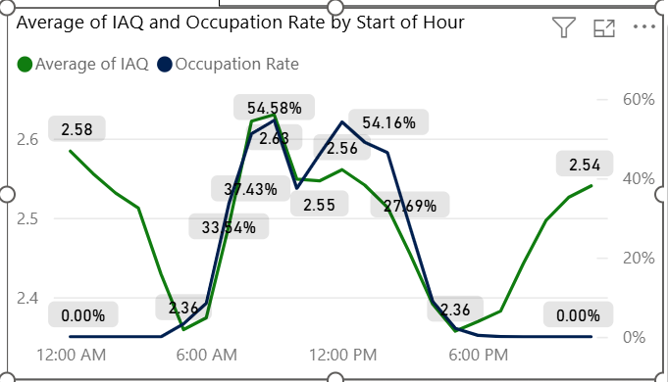
Weekday occupancy peaks on Monday and is lowest on Friday; weekends show 0% occupancy.
No clear link between occupancy and IAQ—e.g., higher occupancy on Thursday sees a sharp IAQ drop (better IAQ), while lower occupancy on Friday shows an increase in IAQ.
Occupancy rises at 6 AM and drops at 6 PM, with a linear IAQ pattern during these hours.
Peak occupancy occurs around 8-9 AM and 12 and 3 PM.
IAQ drops sharply when occupancy begins and rises again when it hits 0%. This might be explained as the HVAC system is turned off when people leave the building, and the indoor air quality becomes the ambient air quality.

Slide 14
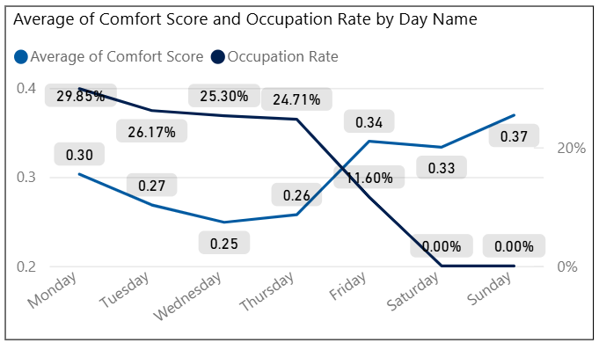
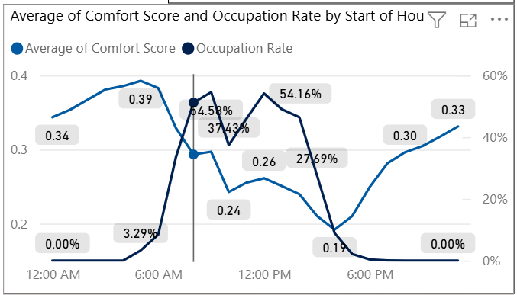
No clear pattern observed between comfort score and occupancy rate
(Similar trend observed with IAQ (previous slide)

Slide 15
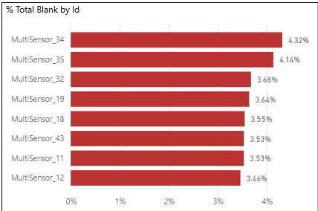
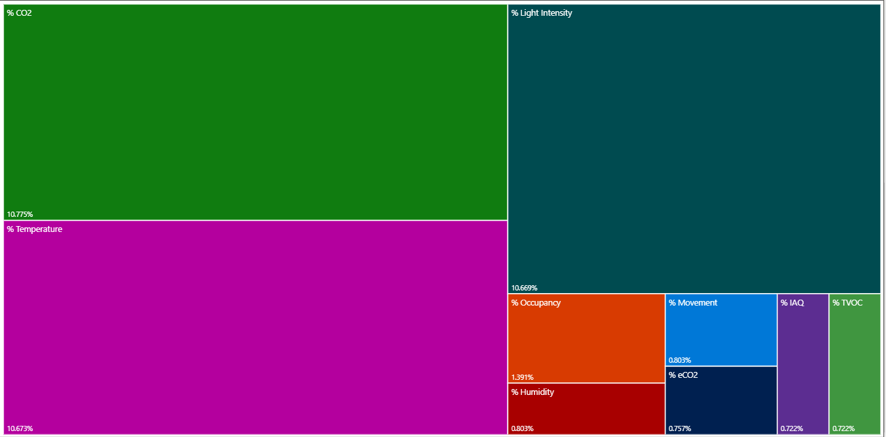
Total observed data = 857,748
MultiSensor_34 has the highest amount of missing values, while MultiSensor_12 has the least.
Most missing data points are for CO₂, Temperature, and Light Intensity.

Slide 16
Discussion
There is no strong correlation between occupation and IAQ or between occupation and comfort Score. Because there is no detectable correlation, this might mean that the HVAC system works well. Even though when it is crowded in the room, the room is able to maintain stable air quality and comfort levels.
Parameters like humidity and TVOC have direct impact to IAQ meanwhile temperature has direct impact to comfort score.
Based on the performance of the room, there is a room that has a better HVAC performance based on the data (assuming 0 error) like room with censor 32, even though this room has a high occupancy rate it still maintains a good IAQ and comfort score.

Slide 17
Conclusion
The correlation data suggests that occupancy has a weak relationship with both IAQ (Indoor Air Quality) and comfort score. This may be due to the HVAC systems functioning effectively, maintaining consistent IAQ and comfort levels regardless of occupancy variations.
Among the environmental parameters, IAQ shows the strongest positive correlation with humidity and TVOC, while comfort score has the strongest negative correlation with temperature.
The room monitored by Multisensor 32 recorded the highest occupancy rate but also had the lowest IAQ score. However, there is no clear pattern linking IAQ or comfort scores with occupancy rates.
Occupancy patterns indicate that Mondays have the highest rates during workdays, while weekends show the lowest. Among weekdays, Friday has the lowest occupancy. However, there is no clear pattern linking IAQ or comfort scores with occupancy rates.
Regarding data completeness, Multisensor 34 had the highest percentage of missing values (4.32%), while Multisensor 12 had the lowest (3.46%). The parameters most affected by missing data are CO₂, temperature, and light intensity.

Slide 18
Recommendations
Investigate multi-sensor data with 0 comfort score for proper conversion.
Improve sensor accuracy and placement to support reliable action.
Integrate energy usage and threshold data for optimization and efficiency.
Analyze high-occupancy rooms with good IAQ and comfort scores as benchmarks for other spaces.

