Slide 1
Audience Integration and Measurement Team
Prepared by:
John Mendez, MBDT Candidate

Slide 2
About Me
BS Business Administration.
Background in Process Analysis and Implementation.

Slide 3
Project Plan
Task | Description | Approximate Hours
Initial Coding | Develop web scrapping code. Develop working loop. Build Dashboard | 14
Debug | Assess and fix code issues | 2
Develop Strategy | Assess the solution/evaluate requirements. | 2
Build Presentation | Build Presentation Perfect Transitions Perfect Pitch | 4
Notes:
Mention how these hour are approximated. Actual hours for Coding was more. Additional estimate is no more than 6.

Slide 4
Technologies
Gathered and Assessed data with Python, Pandas and Beautiful Soup.
Build Dashboard with Plotly.
Build Dashboard with Tableau.
Code Sample:
Link to Code
Notes:
Gauge audiences response and see if you should go into displaying the code via github link.

Slide 5
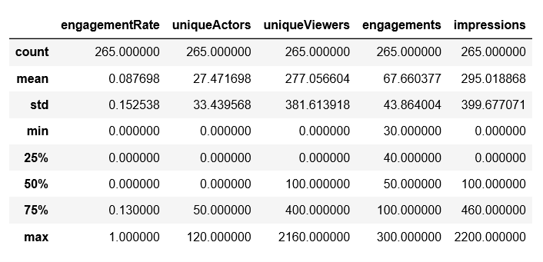
Findings
Notes:
The stats were developed from assessing the visuals.

Slide 6
Demonstration
Visual 1:
Demo
Visual 2:
Demo
Notes:
I will be displaying visual 2

Slide 7
Analysis
Word Cloud key themes include:
Energy, Connectivity, and Marketing.
Quantitative Data key themes include:
8.8% Engagement Rate based on a sample of 265. This can be understood as full engagement from 23 of the sources.
The average number of Unique Viewers actually exceeds the amount of the sample size.
The average number of Impressions exceeds the amount of the sample size.
Conclusions:
Based on the data that we have collected we can conclude that even though people are not engaging, Impressions are still being made on the users and key terms that contribute to this are Energy, Connectivity, and Marketing.

Slide 8
Learning
Learning:
Scraping with BeautifulSoup.
Building the initial syntax.
Iterating this syntax throughout the entire list of urls.
Effective time management.
Understanding scope of what was absolutely critical.

Slide 9
Challenges
Technical:
Getting BeautifulSoup to work in a continuous loop.
Isolating the urls.
Building the loop.
Iterating and writing the loop to a .csv file.
Soft:
Figuring out was critical given the amount of time we were given.

Slide 10
Next Steps
Work on Beautiful Soup Extraction.
Pass text data through an NLP program.
Complete Plotly visual.

Slide 11


Thank you

