Slide 1
Audience Integration and Measurement Team
Prepared by:
John Mendez, MBDT Candidate

Slide 2
About Me
BS Business Administration.
Background in Process Analysis and Implementation.

Slide 3
Project Plan
Task | Description | Approximate Hours
Initial Coding | Develop web scrapping code. Develop working loop. Build Dashboard | 14
Debug | Assess and fix code issues | 2
Develop Strategy | Assess the solution/evaluate requirements. | 2
Build Presentation | Build Presentation Perfect Transitions Perfect Pitch | 4
Notes:
Mention how these hour are approximated. Actual hours for Coding was more. Additional estimate is no more than 6.

Slide 4
Technologies and REsearch
Gathered and Assessed data with Python, Pandas and Beautiful Soup.
Build Dashboard with Plotly.
Build Dashboard with Tableau.
Code Sample:
Link to Code
Notes:
Gauge audiences response and see if you should go into displaying the code via github link.

Slide 5
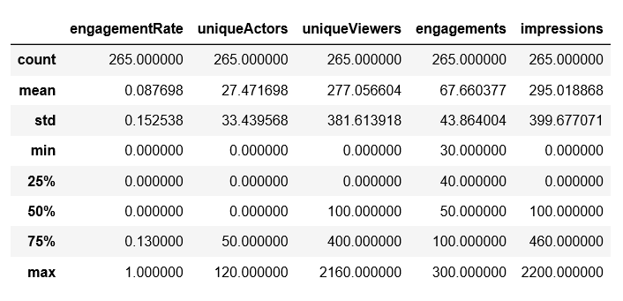
Findings
Notes:
The stats were developed from assessing the visuals.

Slide 6
Learning
Learning:
Scraping with BeautifulSoup.
Effective time management.
Understanding scope of what was absolutely critical.

Slide 7
Challenges
Technical:
Getting BeautifulSoup to work in a continuous loop.
Getting the Plotly dashboard to display hover-over urls (this is something to work on).
Soft:
Figuring out was critical given the amount of time we were given.

Slide 8
Next Steps
Work on Beautiful Soup Extraction.
Complete Plotly visual.

Slide 9
Demonstration
Visual 1:
Demo
Visual 2:
Demo
Notes:
I will be displaying visual 2

Slide 10


Thank you

