Slide 1
mrFlatMesh
V1.7 08/29/01
A.R. Wade wade@white.stanford.edu
Last updated: 08/29/01

Slide 2
What does it do?
1: Unfolds meshes generated by mrGray’s 3D visualisation routine
2: Maps gray layers to the unfolded mesh to generate a flat.mat file

Slide 3
How do I run it?
Type
mrFlatMesh
from the matlab prompt.
(mrFlatMesh brings up mrFlatMesh.fig)

Slide 4
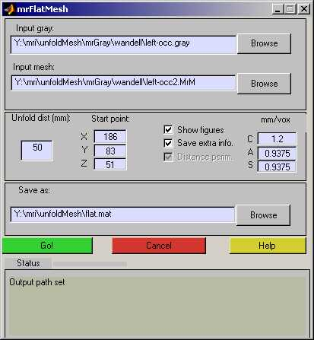
What does it look like?
Name of the .gray file
generated by mrGray
Name of the .MrM file
generated by mrGray
Coords of start point
(found in mrGray)
Mm per voxel in mrGray – default setting.
Minimum radius of the unfold
Output file path : “flat.mat” file
HTML help
Status indicator
Status messages

Slide 5
What does it want?
Three things:
A mesh file: This is generated when you run mrGray’s 3D visualisation routine.
A gray file: These are the gray nodes that will be mapped to the mesh. Save this out from mrGray.
An output filename: mrFlatMesh will save a “flat.mat” file. You can call it anything you like.

Slide 6
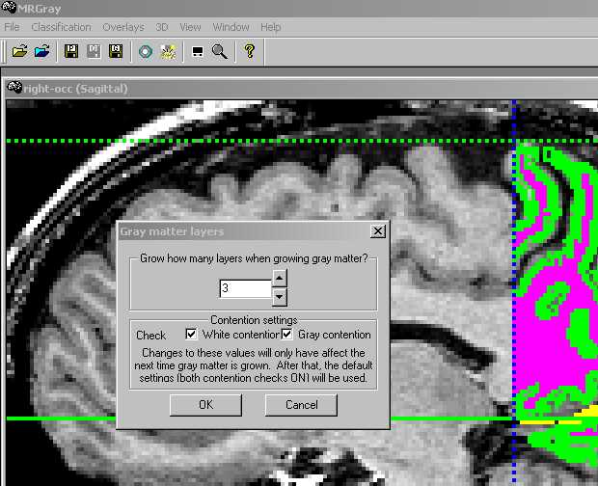
How do I make a mesh? 1
1: Once you’ve segmented your white matter in mrGray, grow 4 (or fewer) layers of gray matter. Save the gray matter in a file with a .gray suffix.

Slide 7
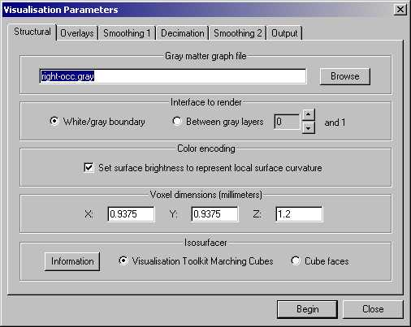
How do I make a mesh? 2
2: Then open the 3D visualisation menu. You will see a series of tabbed option screens….
Render the white/ gray boundary.
Use ‘marching cubes’.
Make a note of the voxel dimensions.

Slide 8
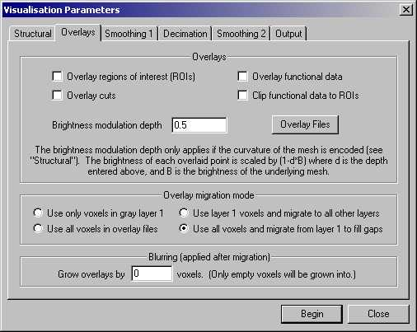
How do I make a mesh? 3
3: Don’t overlay any functional data.

Slide 9
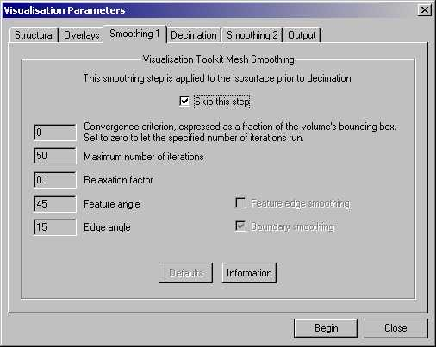
How do I make a mesh? 4
4: Don’t smooth

Slide 10
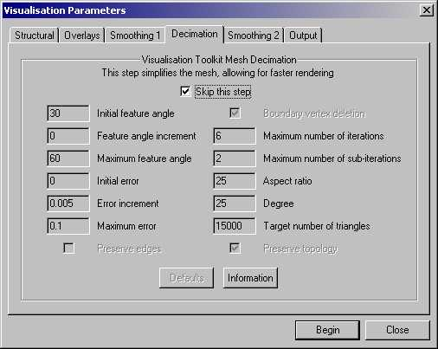
How do I make a mesh? 5
5: Don’t decimate

Slide 11

How do I make a mesh? 6
6: Don’t smooth here either

Slide 12
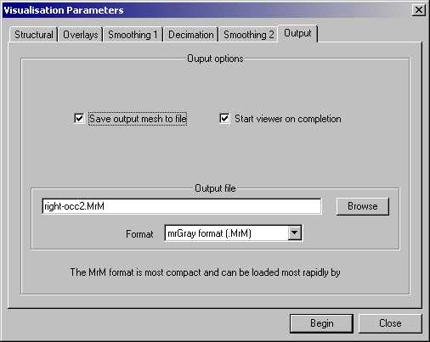
How do I make a mesh? 7
7: Make sure you save the mesh.
Use .MrM format
Then Begin…

Slide 13
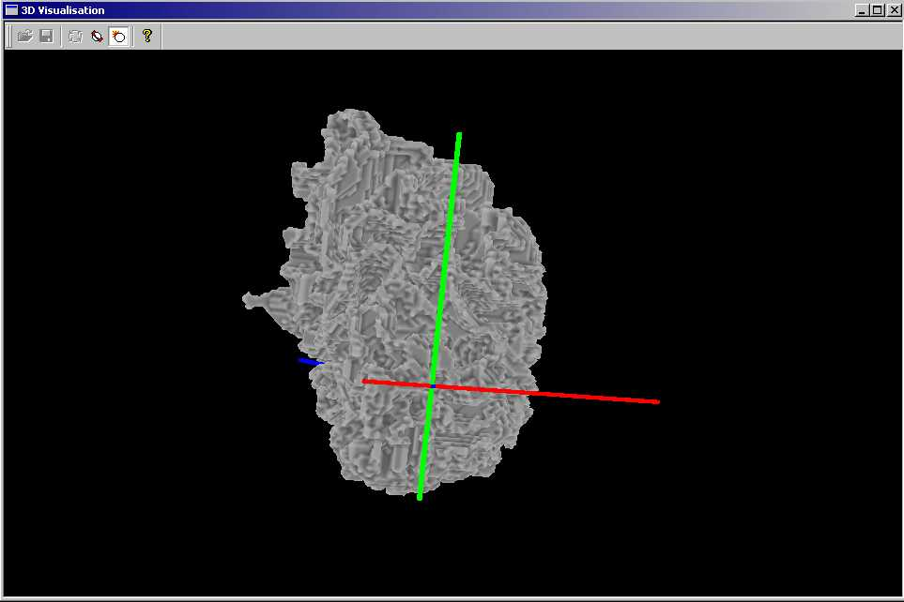
How do I make a mesh? 8
8: This is the sort of thing you’ll end up with.

Slide 14
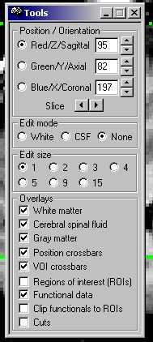
What now?
After making the mesh, pick a start point in mrGray.
Note the order of the coordinates: Z,Y,X

Slide 15
Now run mrFlatMesh
Select the relevant files, enter the appropriate start points and go!
GO!

Slide 16
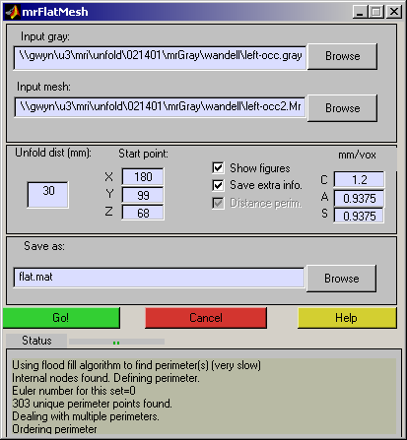
As it runs…
The status bar and status window will keep you informed about what’s going on.

Slide 17
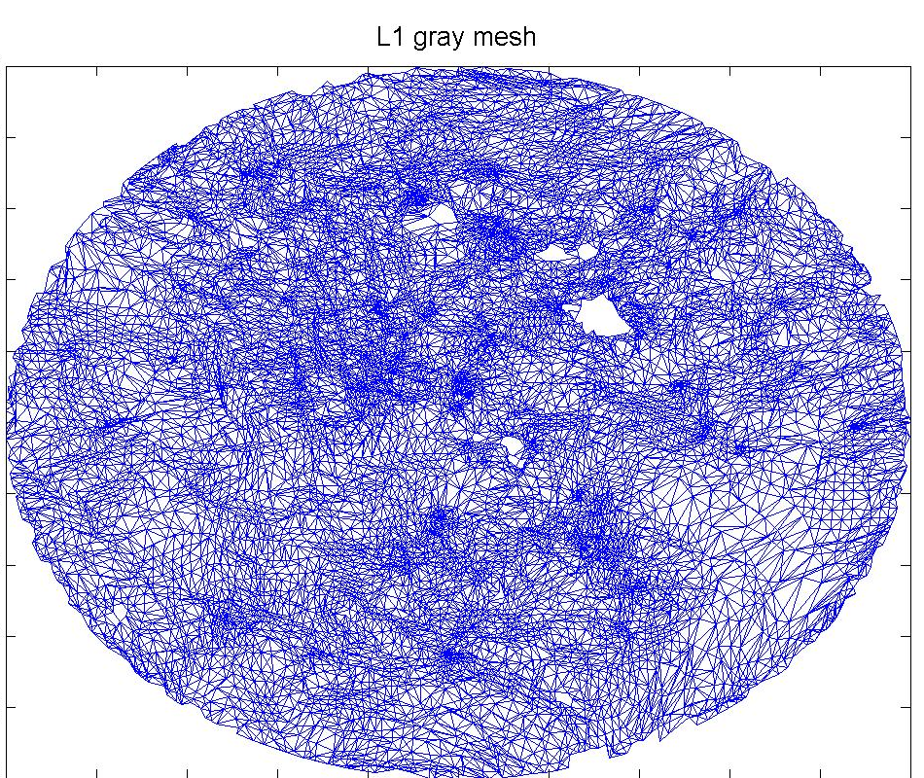
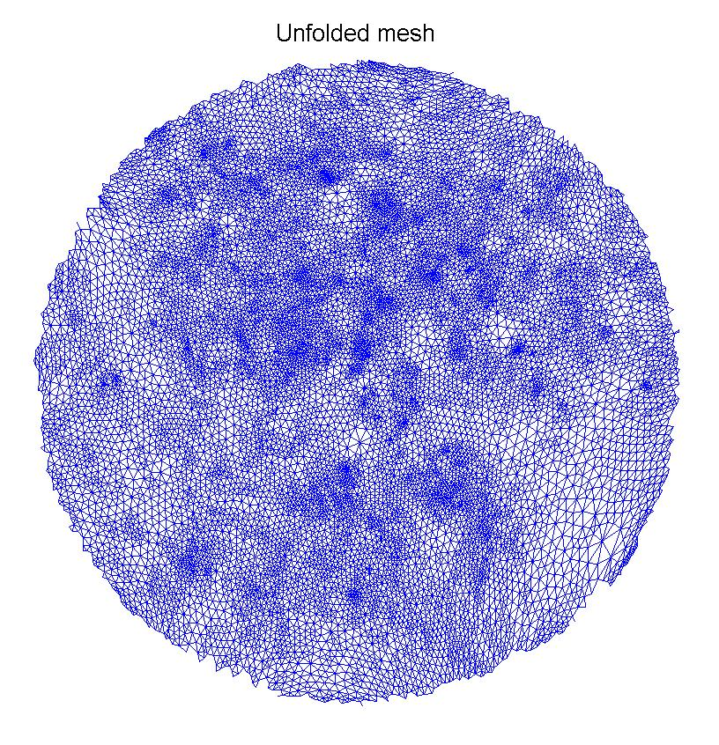
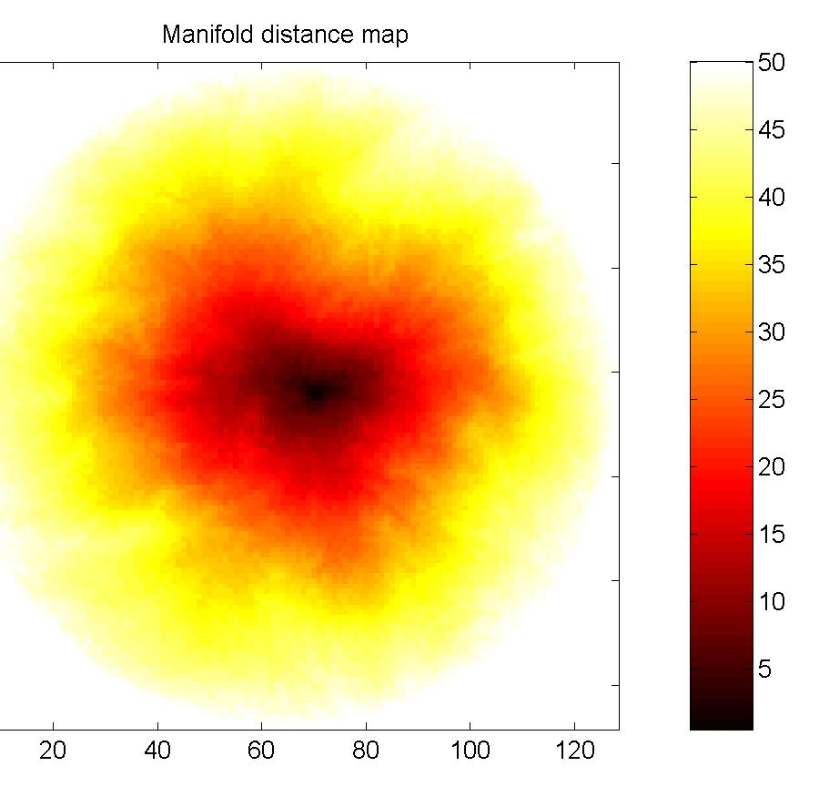
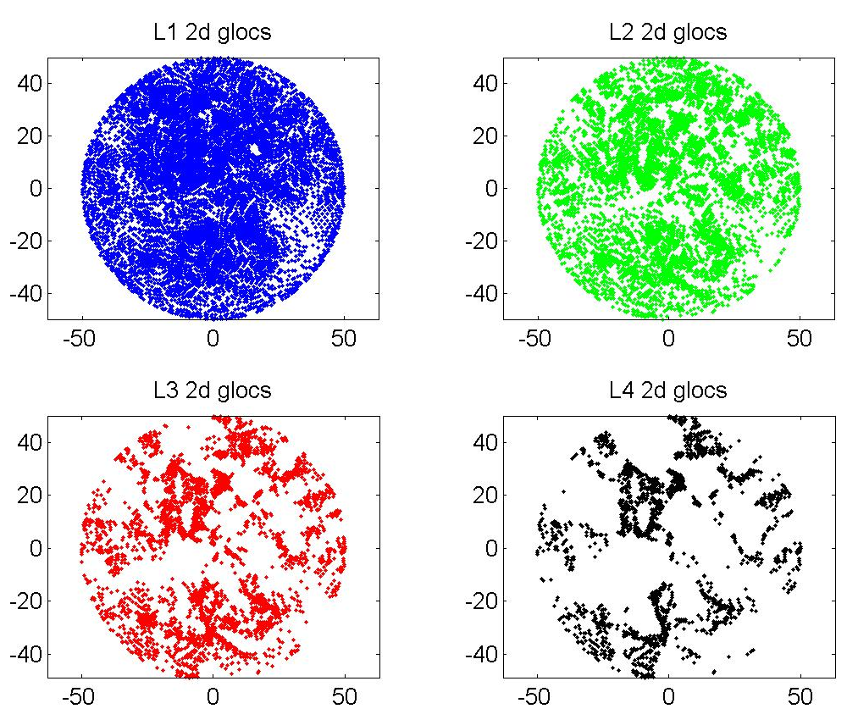
As it runs…
You get to see the unfolded mesh, the manifold distance map, the layer 1 gNodes (with their interconnections) and the 2D locations of all the gNodes.

Slide 18
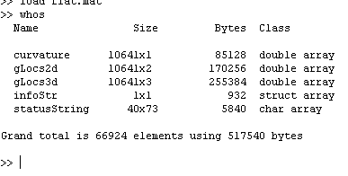
What’s in flat.mat?
Curvature map from mrGray – used to make flat anatomy
2d locations of flattened gray nodes
3d locations of gray nodes
Useful unfold params:
infoStr =
startTime: '20-Feb-2001 11:38:42'
endTime: '20-Feb-2001 11:44:51'
perimType: 1
meshFile: [1x56 char]
grayFile: [1x56 char]
Etc etc….
Everything that was printed in the status window during the unfold

Slide 19
Example data sets
Are in
/usr/local/matlab/toolbox/mri/mrFlatMesh/exampleData/

Slide 20
Csource code and mex files
Are in
/usr/local/matlab/toolbox/mri/mrFlatMesh/Csource/
There are two mex files required for mrFlatMesh
mrManDist: (Everyone’s favorite manifold distance routine)
NEW: Replaced by ‘djikstra’ in recent versions.
assignToNearest: Takes two sets of 3D coords and for each point in the first set, returns the index of the nearest point in the second set.
>> a=rand(10,3);
>> b=rand(5,3);
>> c=assignToNearest(a,b);
‘c’ is now a 5x1 vector containing and index into ‘a’ for each member of ‘b’

Slide 21
Help files
An online help system is provided
For those interested, the callback is
web1 = 'web([''file:///'' which(''unfoldMeshHelp.html'')],''browser'')';
web2 = 'web([''file:///'' which(''unfoldMeshHelp.html'')])';
eval(web1,web2);

Slide 22
Other questions 1:
Q:I don’t like GUIs
A:Try (and look at and copy and edit)
>>consoleUnfold
Q: Does it work?
A: It is much faster and it generates sane-looking retinotopies. I have no numbers on the relative distortions between mrUnfold and mrFlatMesh.

Slide 23
Other questions 2:
Q:It’s all gone wrong
A: Make sure you’ve made the mesh properly and that the voxel sizes in mrFlatMesh and mrGray match. Also, note that you must use the >new< version of mrGray (the one that saves out mesh voxel sizes). You can get this from
//red/u2/pc/dist/mrGray.exe if it’s not already in your path.
And remote users can download it from
http://white.stanford.edu/~brian/mri/segmentUnfold.htm
If you’re still stuck, email wade@white.stanford.edu

Slide 24
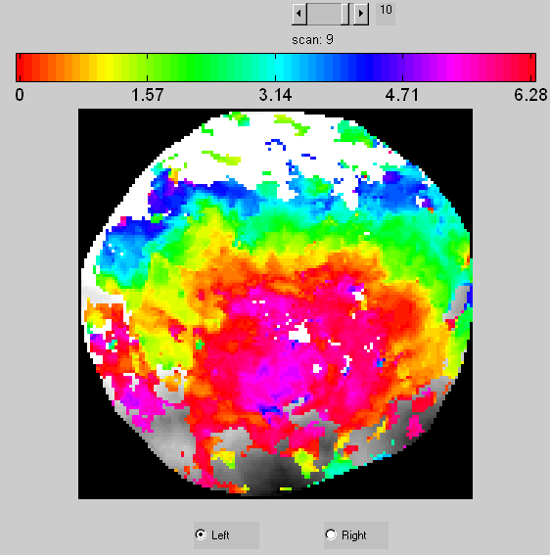
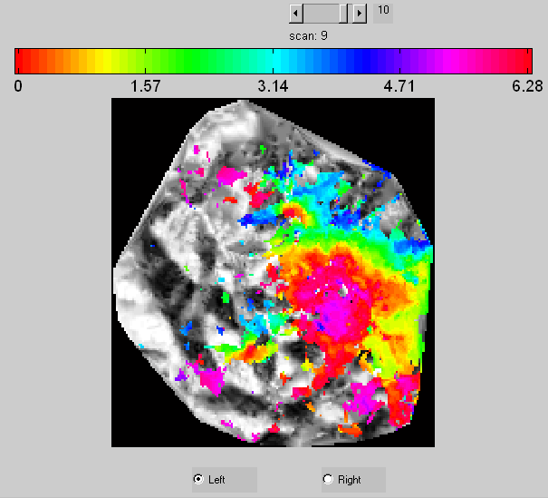
Comparison with mrUnfold
mrUnfold (50mm)
mrFlatMesh 1.0 (80mm)

Slide 25
Bugs and Features
A major bug was discovered in v1.0. This causes some layer 1 gNodes to become mis-assigned or removed altogether. In general, this makes the resulting flat maps a little ‘rougher’ or blurrier. There should not be any significant qualitative changes to the data. This bug is fixed in v 1.7.
mrFlatMesh is now believed to run under solaris 2.4.

