Slide 1
Kubernetes Mini Projects

Slide 2
Mini Projects
Kubernetes Deployment
Exposing Application Using Service
Exposing Application Using Ingress
Kubernetes Auto Healing
Kubernetes Rolling Upgrade(ZDT)
Kubernetes Auto Scaling

Slide 3



Introduction to Kubernetes
Kubernetes is an open-source container orchestration software.
It was originally developed by Google.
It was first released on July 21, 2015.
It is the ninth most active repository on GitHub in terms of number of commits.

Slide 4



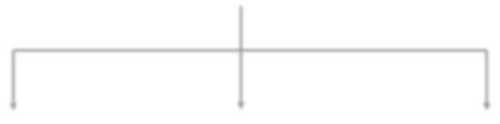







Kubernetes Architecture
Master Node
Slave Node
Slave Node
Slave Node

Slide 5
Kubernetes Deployment

Slide 6
Kubernetes Deployment
apiVersion: apps/v1
kind: Deployment
metadata:
name: my-demo-website
namespace: web
labels:
app: myweb
spec:
replicas: 3
selector:
matchLabels:
app: myweb
template:
metadata:
labels:
app: myweb
spec:
containers:
- name: myweb
image: vistasunil/devopsdemo:latest
ports:
- containerPort: 80
resources:
requests:
cpu: "250m"

Slide 7
Exposing Application Using Service

Slide 8
Exposing Application Using Services
apiVersion: v1
kind: Service
metadata:
name: my-website-svc
namespace: web
labels:
app: myweb
spec:
type: NodePort
selector:
app: myweb
ports:
- port: 80
targetPort: 80
protocol: TCP
name: http

Slide 9
Exposing Application Using Ingress

Slide 10
Kubernetes Ingress
apiVersion: networking.k8s.io/v1
kind: Ingress
metadata:
name: ingress-nginx
namespace: web
annotations:
kubernetes.io/ingress.class: "gce“
spec:
rules:
- http:
paths:
- path: /*
pathType: ImplementationSpecific
backend:
service:
name: my-website-svc
port:
number: 80
- path: /myweb
pathType: ImplementationSpecific
backend:
service:
name: my-website-svc
port:
number: 80

Slide 11
Kubernetes Auto Healing

Slide 12
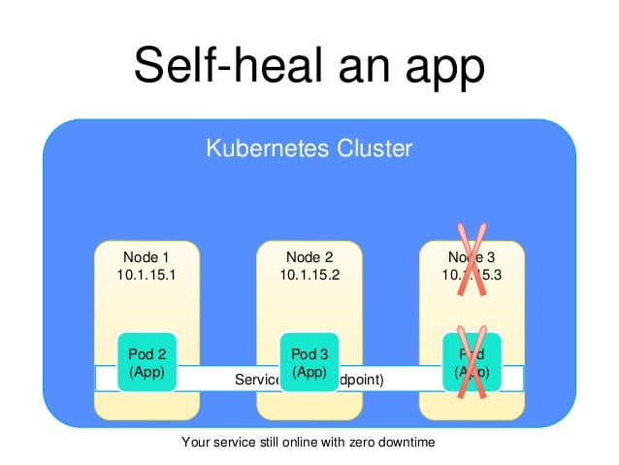
Kubernetes Auto Healing

Slide 13
Kubernetes Rolling Upgrade (ZDT)

Slide 14
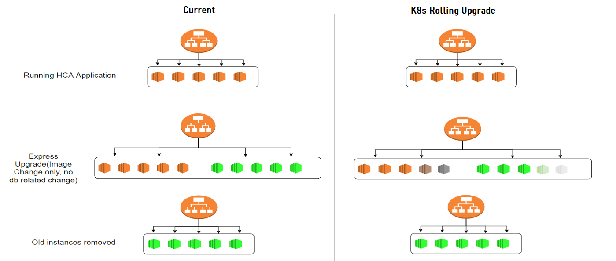
Kubernetes Rolling Upgrades

Slide 15
Kubernetes Auto Scaling

Slide 16
Kubernetes Auto Scaling (HPA)
apiVersion: autoscaling/v1
kind: HorizontalPodAutoscaler
metadata:
name: web-hpa
namespace: web
spec:
scaleTargetRef:
apiVersion: apps/v1
kind: Deployment
name: my-demo-website
minReplicas: 1
maxReplicas: 5
targetCPUUtilizationPercentage: 50

Slide 17
Got queries or need more info?
Contact us
T O A C C E L E R A T E Y O U R C A R E E R G R O W T H
For questions and more details:
please call @ +91 98712 72900 or
visit https://www.thecloudtrain.com/ or
email at join@thecloudtrain.com or
WhatsApp us >>

