Slide 1
Code Completion & Insight
JIA Dong
dong_jia@agilent.com
11/07/26

Slide 2
Agenda
  Introduction
  Code Completion
  Code Insight
  Enhancement
  Demo
  Future tasks

Slide 3
Introduction
Benefits any user who writes formula objects by reducing keyboard inputs, the need for memorization and external documentation.
Mainly include:
  Code Completion
  Code Insight
  Enhancement

Slide 4
Code Completion
  Introduction
  Shortcut keys
  Types

Slide 5
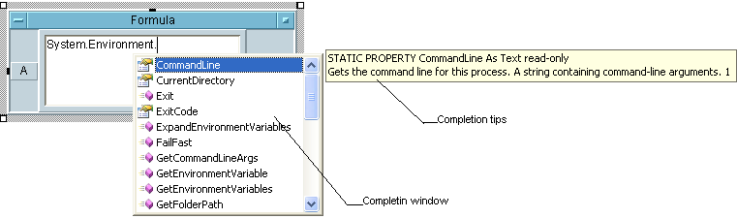
Code Completion - Introduction
  Show a Drop Down list box (called completion window) and users can select what they want
  Note: It requires ExecMode 5 or above

Slide 6
Code Completion – Shortcut keys
Trigger: Ctrl + Space
Selection: Double-click, Enter, Tab, Space
Cancellation: Esc

Slide 7
Code Completion – Types (1)
Variable completion
Function completion
Member completion
NOTE: Variable completion and function completion are mixed.

Slide 8
Code Completion – Types (2)
Variable completion
  Terminals
  Local to Context variables
  Local to Library variables
  Global variables

Slide 9
Code Completion – Types (3)
Function completion
  Built-in functions
  User functions
    Local user functions
    Imported user functions
      User Function
      Compiled Function
      Remote Function

Slide 10
Code Completion – Types (4)
Member completion
  .NET
    .NET Assemblies
    Interop Assemblies
  COM
  Record

Slide 11
Code Insight
  Introduction
  Shortcut keys
  Types

Slide 12
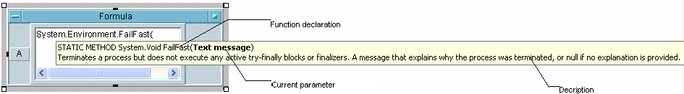
Code Insight - introduction
  Give a brief introduction of functions or methods,
  Note: It requires ExecMode 5 or above

Slide 13
Code Completion – Shortcut keys
  Trigger: (
  Cancellation: Esc
  Completion: )

Slide 14
Code Completion – Types
  Built-in functions
  User functions
    Local user function
    Imported user function
      User function
      Compiled function
      Remote function
  Member functions
    .NET
    COM

Slide 15
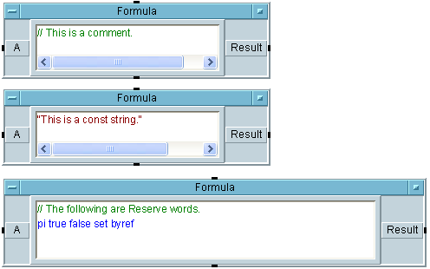


Other Enhancements
  Colors
  Matching brackets
  Error indicator

Slide 16
Demo
  Test cases in “\VEE\Main\TestSuite\Tests\devices\func\test_030”
  They are all manual cases

Slide 17
Future tasks
  Beta2
    Record
    Chained Expression
    RPC functions
    Compiled functions
    Icons
  Furture
    COM
    Assignment

Slide 18
Design
  Name space
  Symbol table
  Case study
Notes:
[aContext findClosestItemNamed:expr into:&nsItem]
Symbol table is a NVList

