Slide 1
ChurchMgnt(beta)

Slide 2
Introduction
SOFTWARE FOR THE UNIQUE NEEDS OF YOUR CHURCH
ACCESSIBLE ANYTIME,ANYWHERE

Slide 3
Challenges
Are you able to track important information?
Unique nature of fund accounting
Does your church have consistent and healthy growth?
Ease of use
Requirements for reporting and transparent
Manual accounting/ Using Microsoft excel for accounting
to generate helpful, high-level
Affordability
Costly error, if on premise system crash

Slide 4
ChurchMgnt Features
Completely web-based
Work anywhere, anytime
No software to download
Unlimited user logins
Download in Excel/ PDF
Free updates
Free support
Custom user permission groups
Turn information into insight.
Store your information securely.
Easy and intuitive navigation.
Comprehensive Reporting.
In-app feedback submission

Slide 5
ChurchMgnt Features
Contribution Report
Instantly download year end giving statements
Cloud
Access your site all the time. The cloud hosts with a 99.9% uptime.
Desktop, Tablet, or Phone
Run app on any device. The responsive design allows you access regardless of screen size.
Professional Support
Stuck? Support is included. Get support by phone or email.
Your Data is Secure
Secure connections ensure that no one else accesses your data.
Unlimited People
Add as many people to app as you desire .
Unlimited Accounts
Create accounts for staff, volunteers, members, and anyone else you desire.

Slide 6
ChurchMgnt Features
Offering
Management
Deposit
Management
Activity
Management
Expense
Management
Event
Management

Slide 7
Web site info
Please use Chrome Browser only
com
www.ChurchMgnt.com
User Id: pastor@gmail.com
Password: Church01
Role: Pastor
User id: treasurer@gmail.com
Password: Church01
Role Treasurer
User Id: dataentry@gmail.com
Password: Church01
Role: Data entry operator

Slide 8
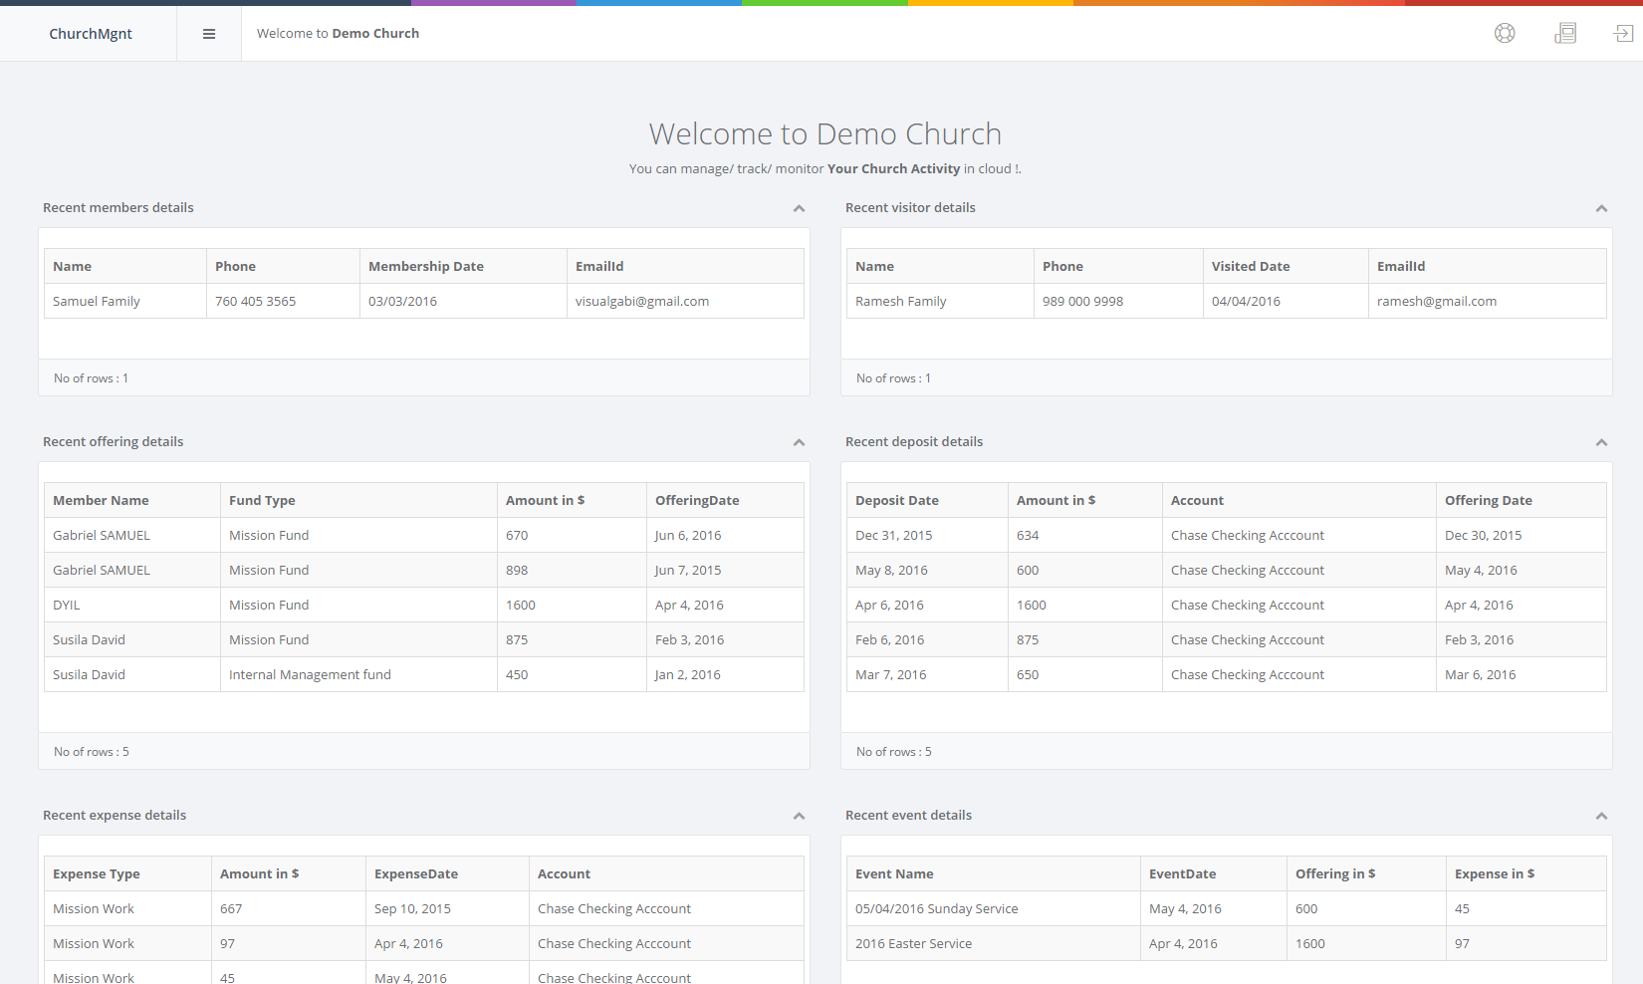
App quick view – Dashboard

Slide 9
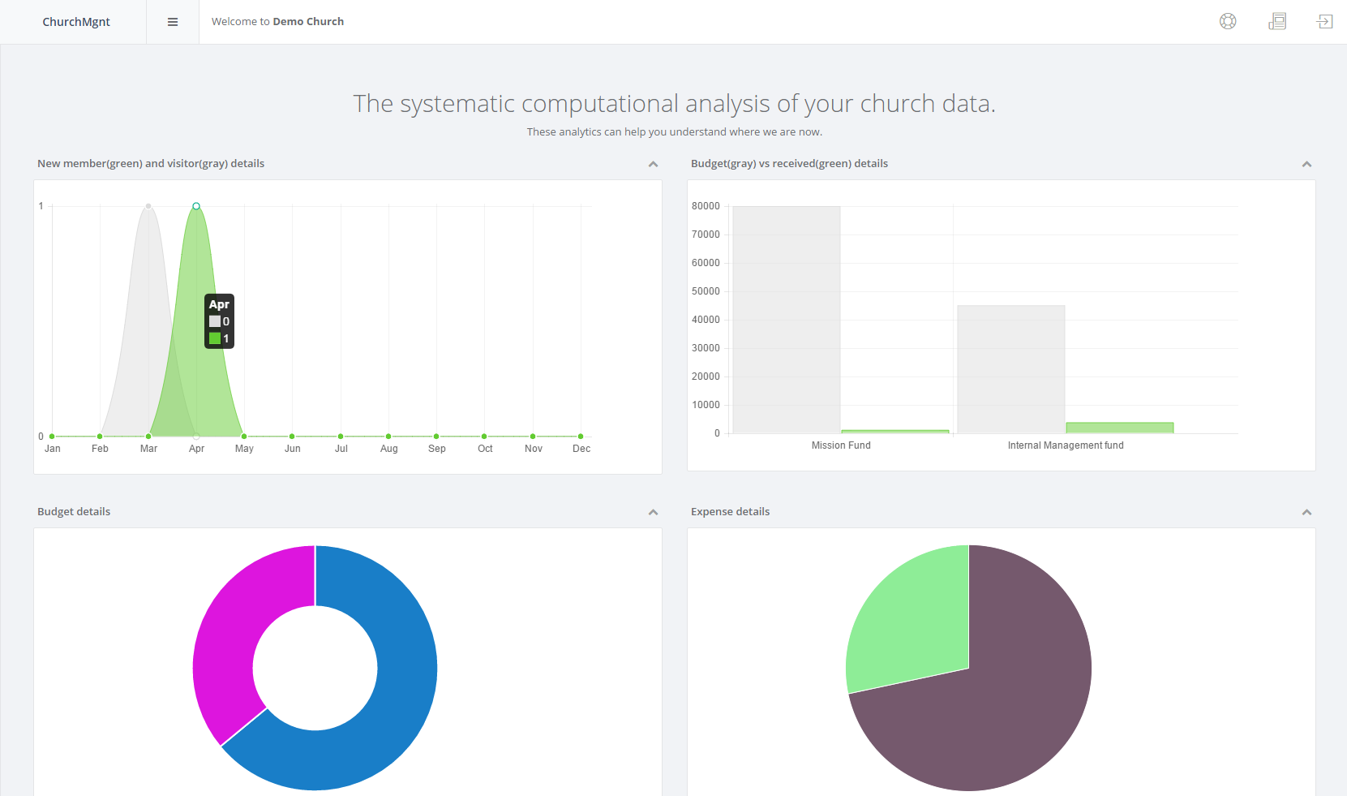
App quick view – Analytics

Slide 10
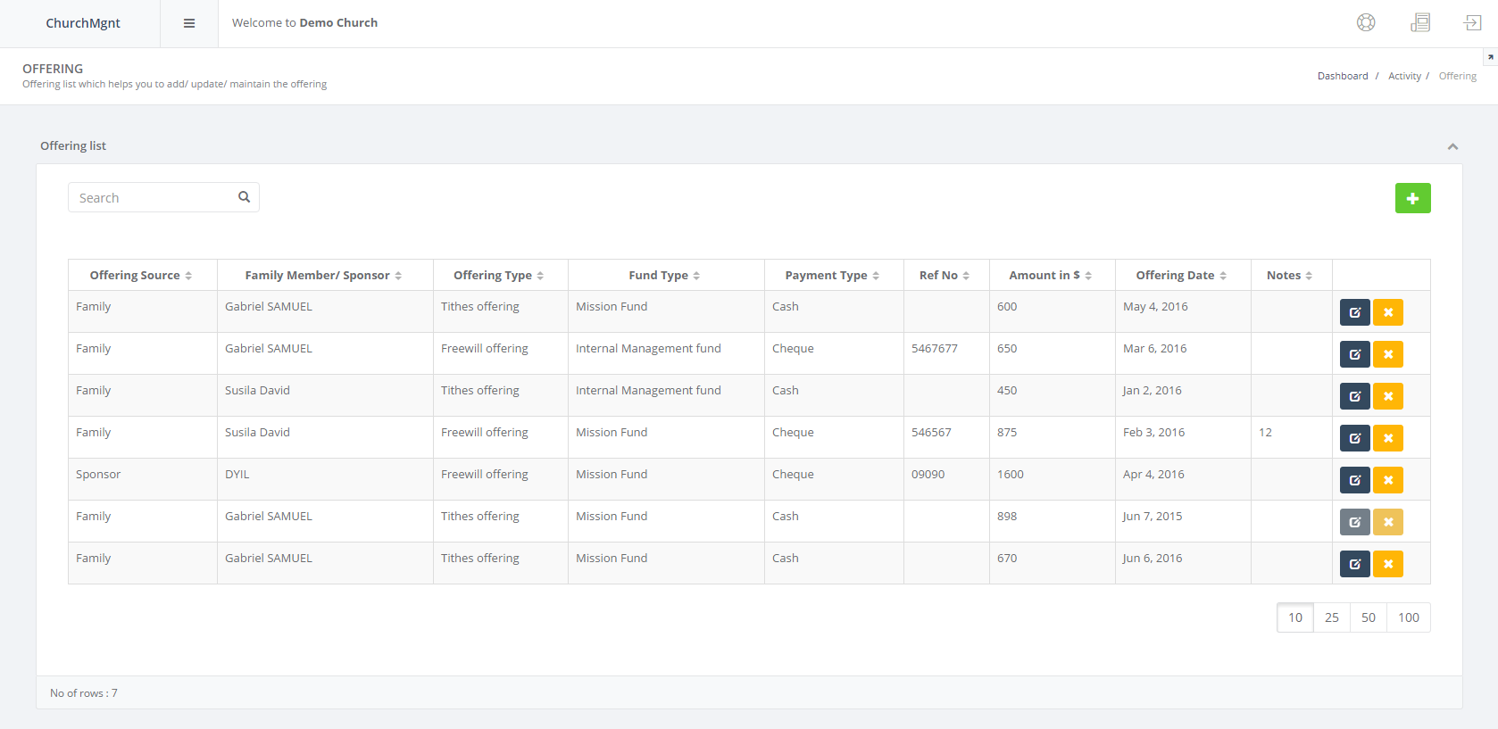
App quick view – Offering

Slide 11
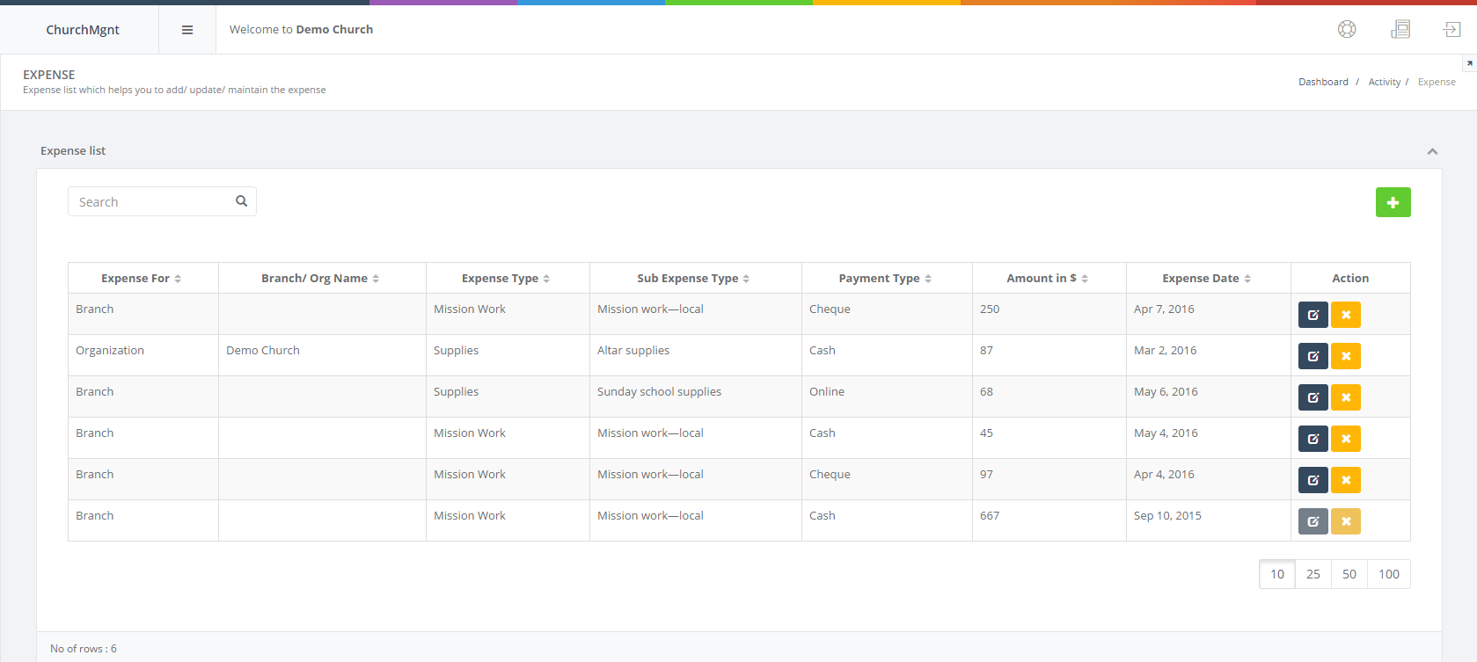
App quick view – Expense

Slide 12
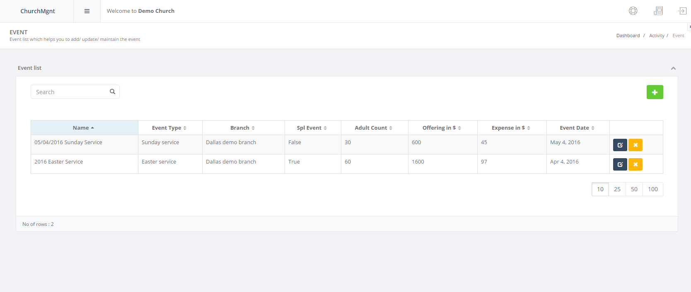
App quick view – Event

Slide 13
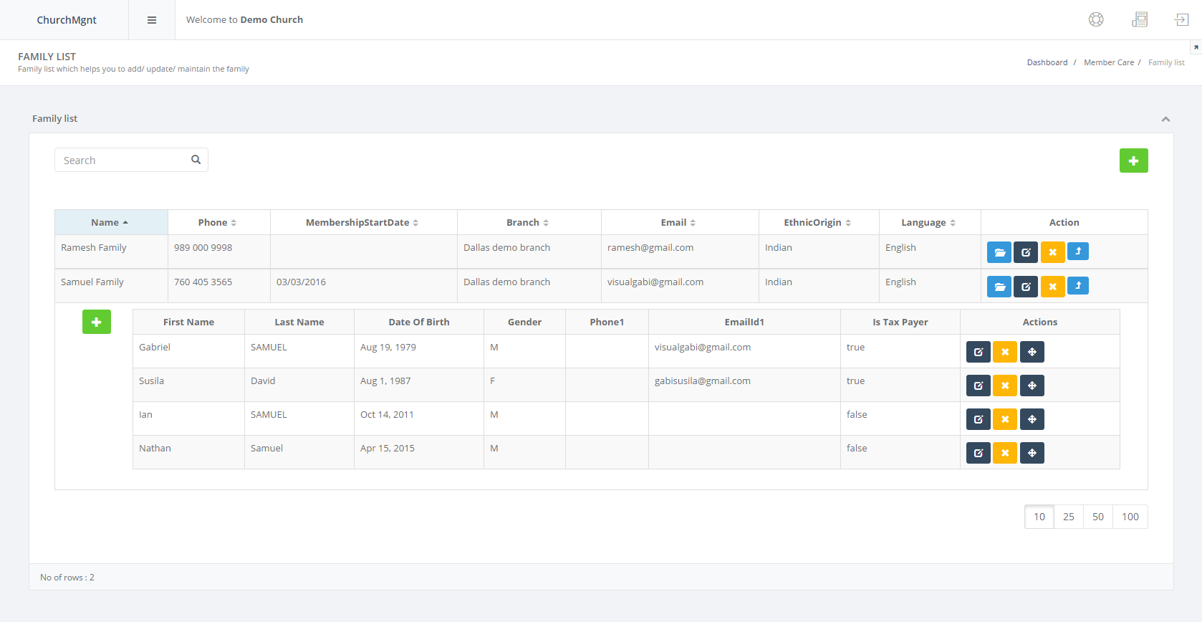
App quick view – Member care

Slide 14
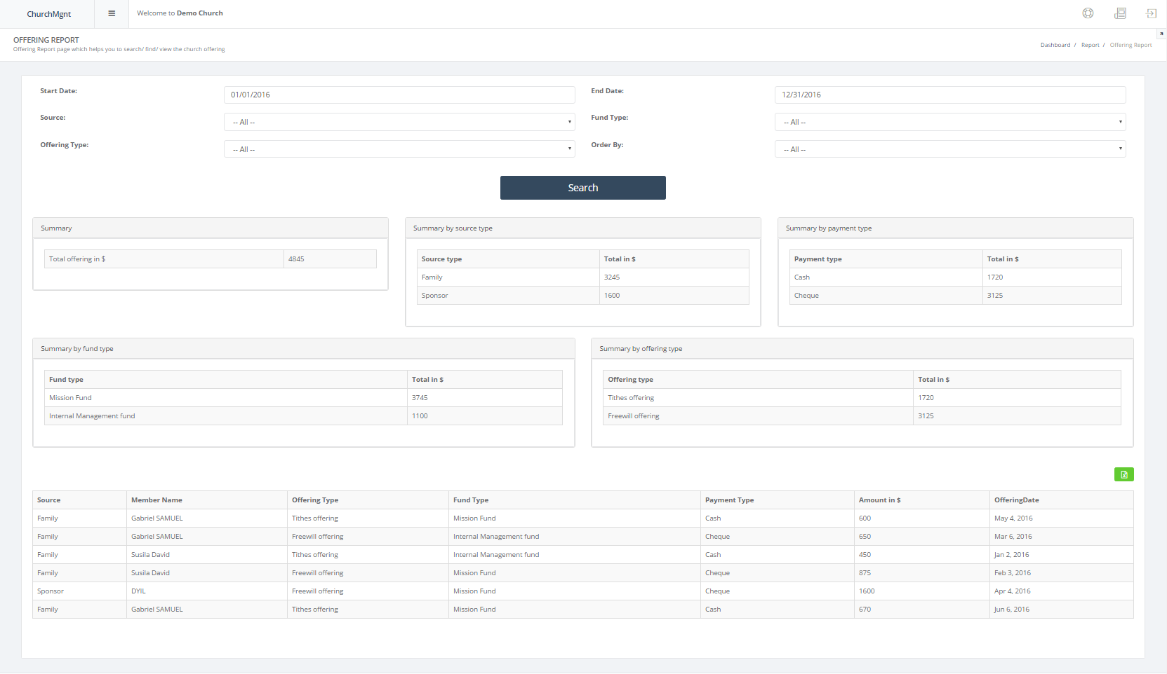
App quick view – Offering report

Slide 15
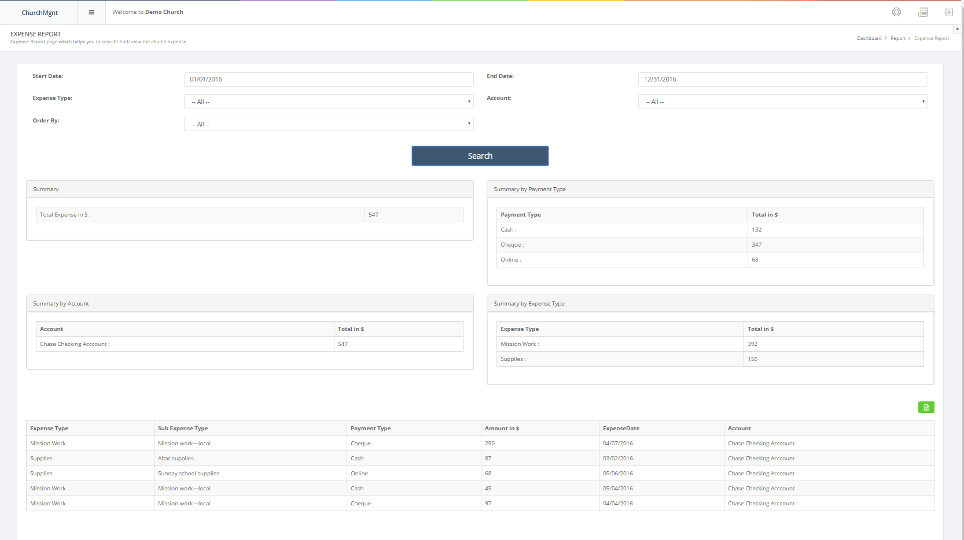
App quick view – Expense report

Slide 16
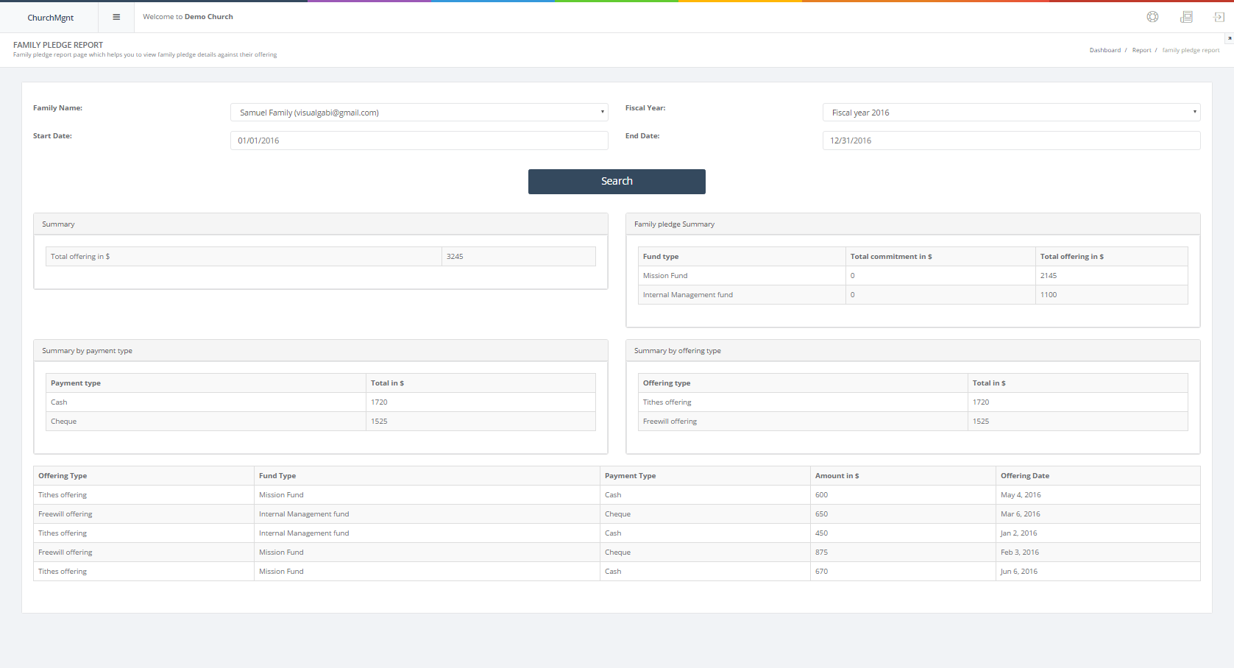
App quick view – Family Pledge

Slide 17
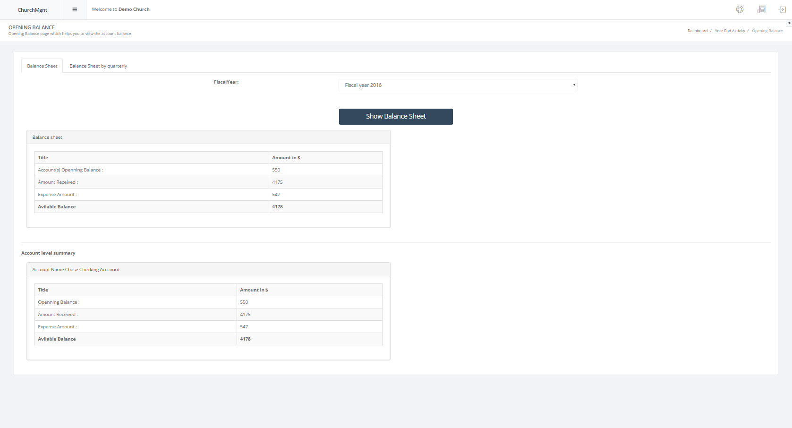
App quick view – Balance sheet

Slide 18
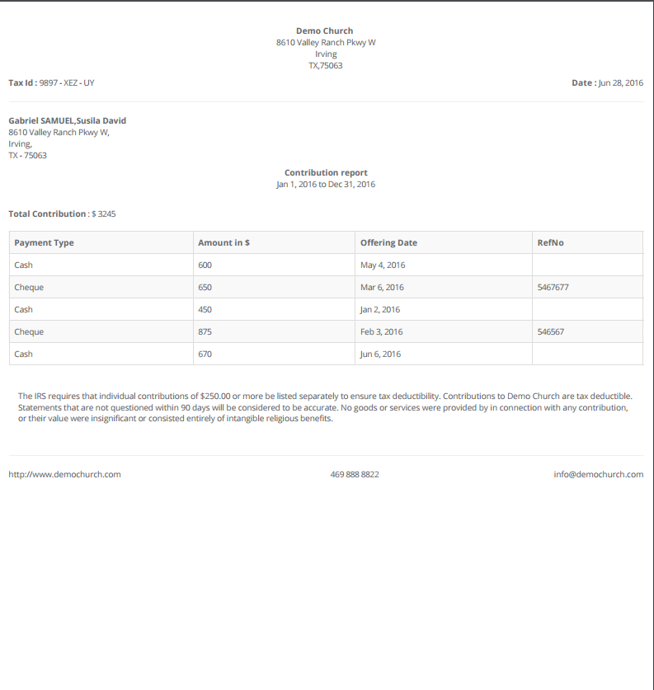
App quick view – Contribution report

Slide 19
Thank You!

