Slide 1


VisualizeFinance.io
Rabel Marte, Joshua Wu, Alex Hardwick

Slide 2
49% of Americans are not confident that they’ll
reach their financial goals by retirement
Only 14% of millennials seek financial advice from a financial advisor
40% of Americans cite not knowing what questions to ask as the barrier to a professional advisor

Slide 3
Problem
People know where they want to be in life but do not know what financial steps to take in order to get there.

Slide 4


Slide 5
Personalized Advice
Competition
On Your Own
Guidance
General Advice

Slide 6
Market Size
1.7 Trillion
600B
3M
Financial Technology
Total Available Market
Personal Finance
Serviceable Available Market
VisualizeFinance
Market Share

Slide 7
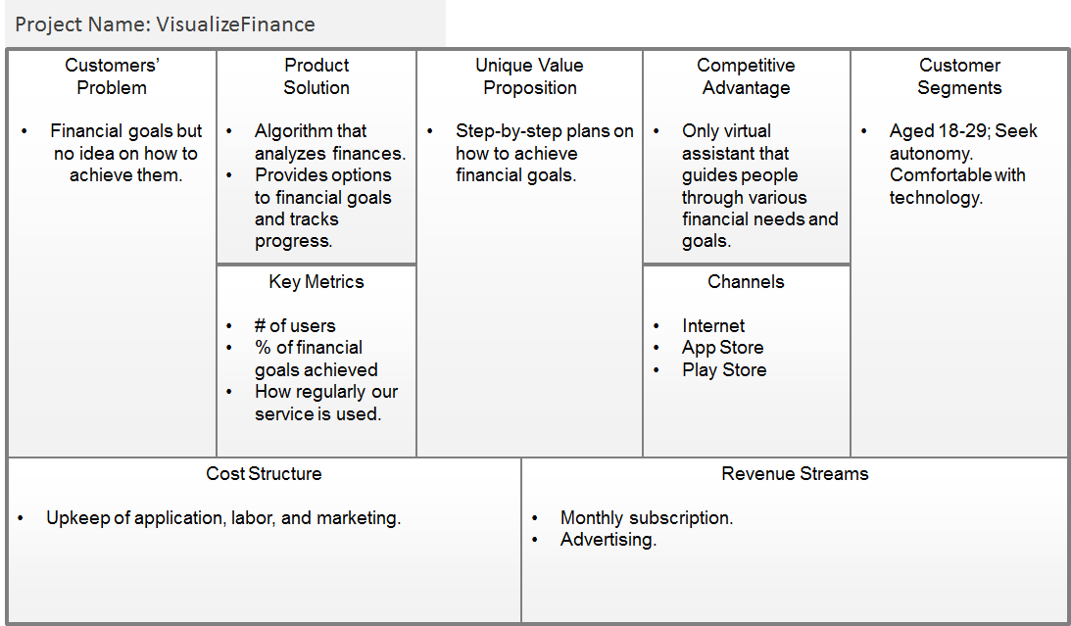
Business Model

Slide 8
Head of Engineering Head of Finances Head of Marketing www.visualizefinance.io
Team

Slide 9
Financials
Year
I II III
Sales $408,974 $1,226,922 $2,453,844
Expenses $523,571 $703,461 $706,759
Profits (Loss) -$114,597 $523,461 $1,747,085

Slide 10
VisualizeFinance.io
Everyone has a Point A
let us get you to your Point B

