Slide 1
Interpolation
Notes:
VTF Symposia 2019 | rerecorded in 2021 for youtube. -DC

Slide 2
What is it?
taking data only available at a specific geographic scale and estimating its value at a desired geographic scale.

Slide 3
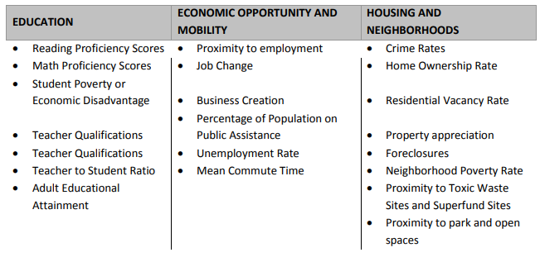
Composite index
Single score derived from multiple inputs.
http://www.kirwaninstitute.osu.edu/reports/2010/04_2010_KingCountyWAOpportunityMapping.pdf
Notes:
Kirwan Institute used 22 indicators of opportunity, 3 different opportunity areas: economic, education, and housing opportunity.

Slide 4
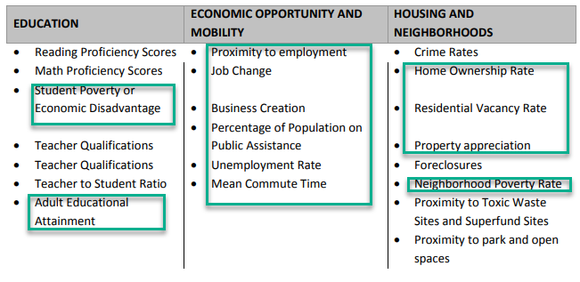
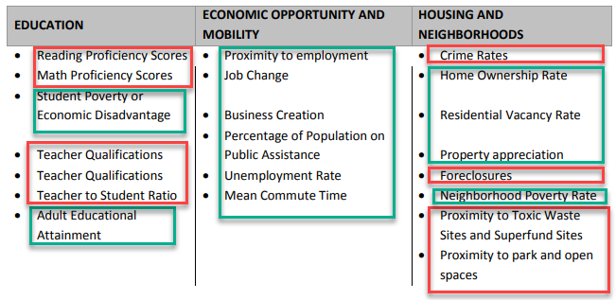
Data available at census tract level
http://www.kirwaninstitute.osu.edu/reports/2010/04_2010_KingCountyWAOpportunityMapping.pdf

Slide 5
Data at other geographic levels:
school district, police precinct, spatial point proximity
http://www.kirwaninstitute.osu.edu/reports/2010/04_2010_KingCountyWAOpportunityMapping.pdf

Slide 6

Interpolation:
technique to handle data only
available at overlapping geography.
(A and B are geographic areas.)

Slide 7
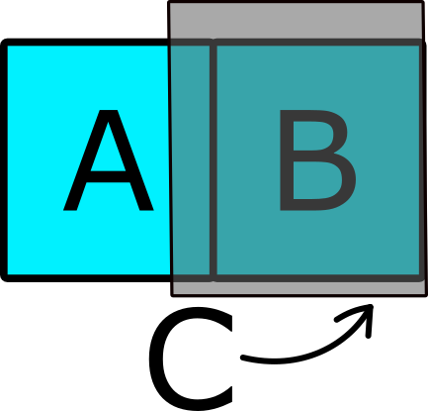
Interpolation:
Given data reported in C, but not A|B.
Percent of C area found in A.
Percent of C area found in B.

Slide 8
Interpolation & resource allocation :
If C = 500 students, perhaps:
~350 students in B
~60 students in A
~90 students to other geographies
…divide resources accordingly

Slide 9
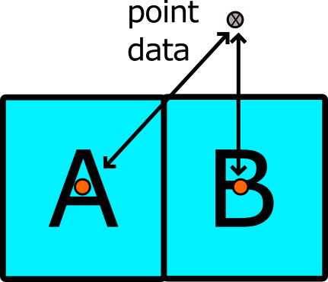
Interpolation (point data) :
Distance from polygon
centroid to point or centroid.

Slide 10
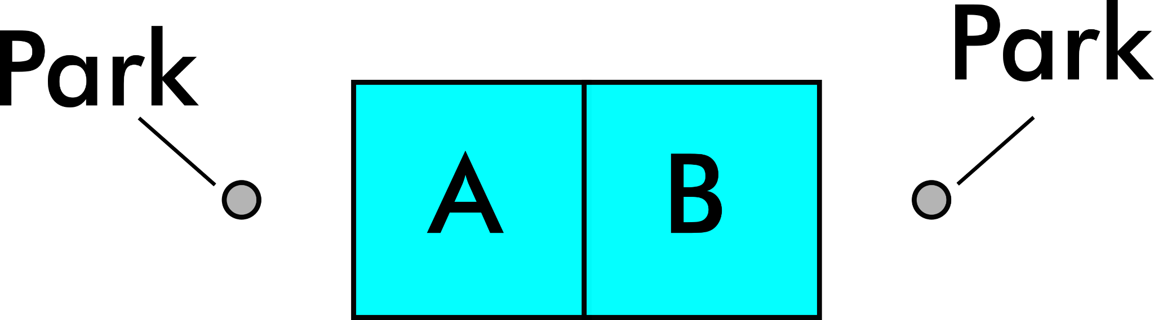
Multiple points:
Must consider quality of attribute.

Slide 11
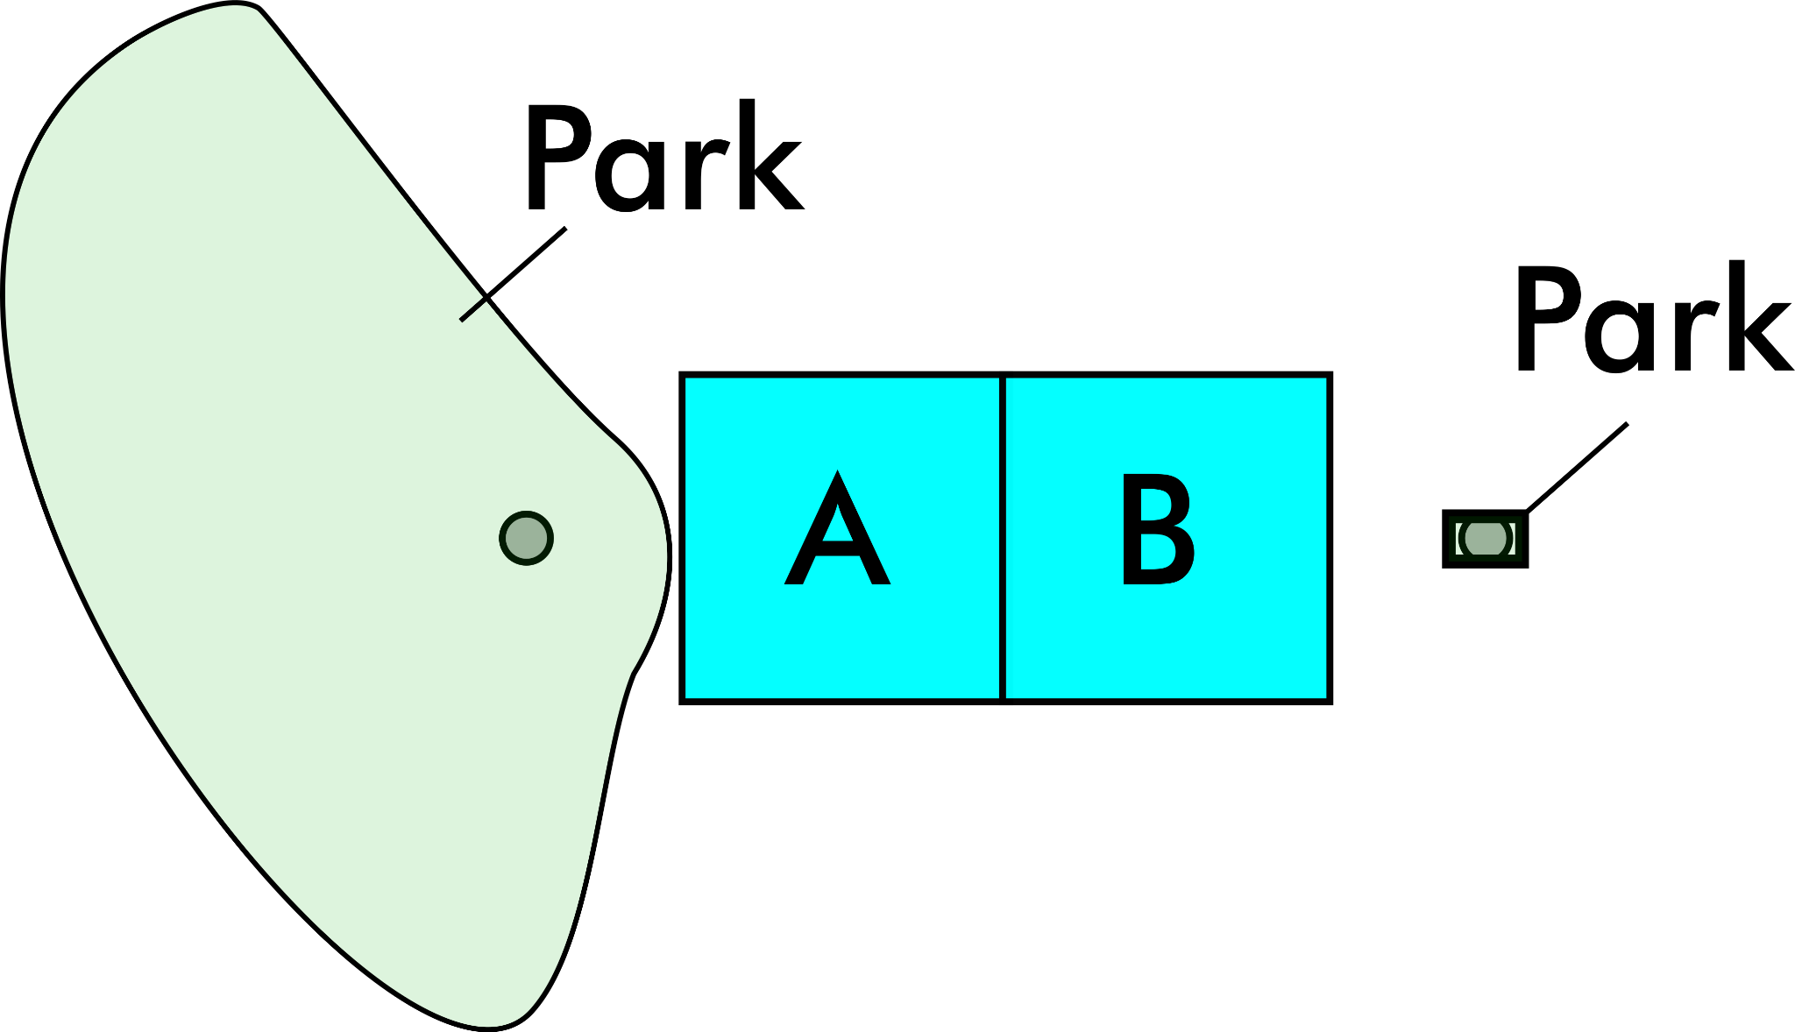

Slide 12
Be Critical…
90% of residents within 5 minute walk of ….[x]

Slide 13
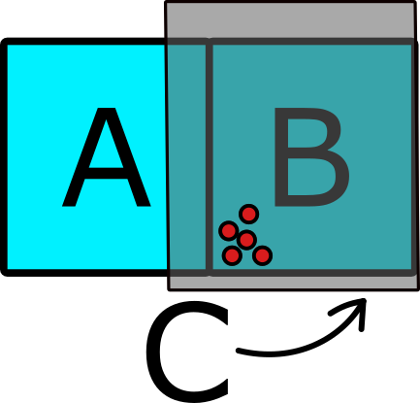

Slide 14
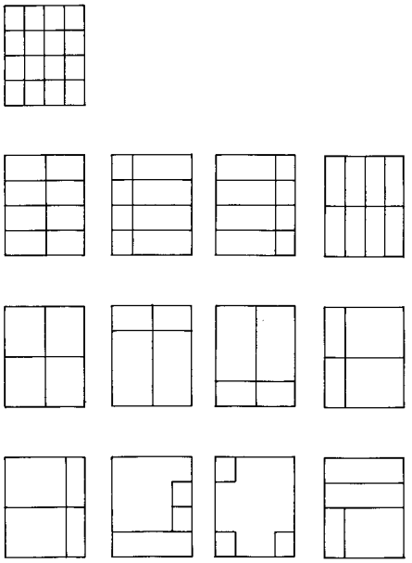
16 zones
Modifiable Areal
Unit Problem (MAUP):
Zone, and/or
Scale
8 zones
4 zones
4 zones
Openshaw, S. (1984) The modifiable areal unit problem. Concepts and Techniques in Modern Geography No. 38 Geo Books, Norwich https://www.uio.no/studier/emner/sv/iss/SGO9010/openshaw1983.pdf
Notes:
Unpredictable variation in aggregated spatial data based (areal) geographic:

Slide 15
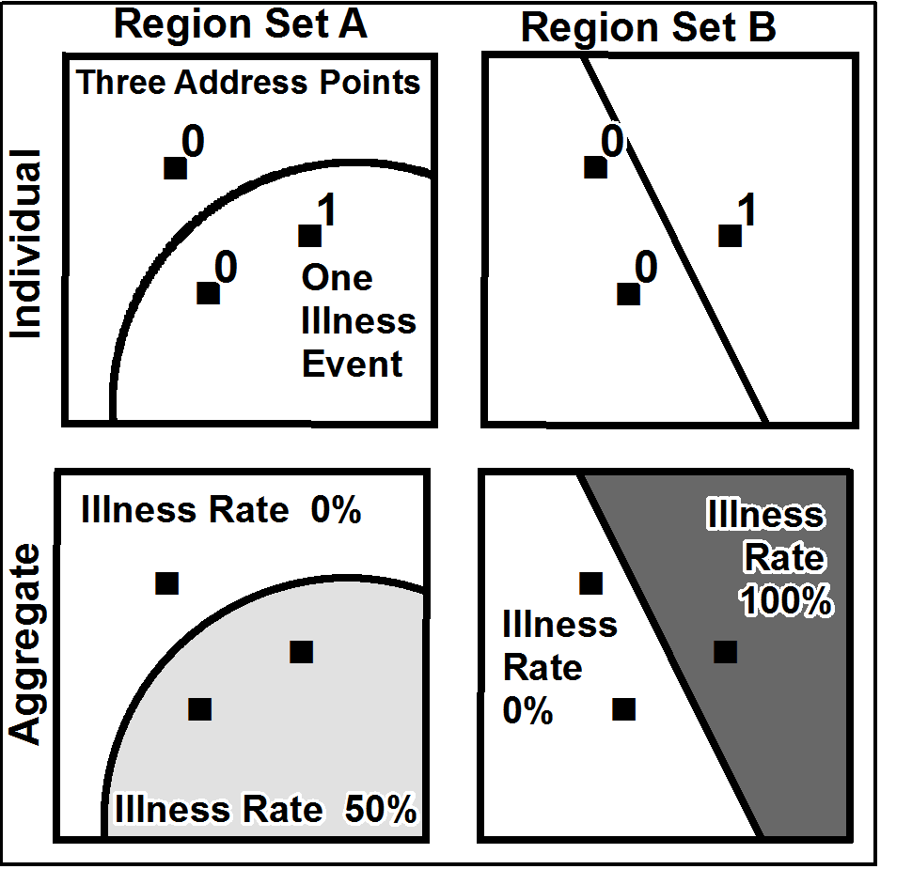
https://en.wikipedia.org/wiki/Modifiable_areal_unit_problem#/media/File:Maup_rate_numbers.png
Notes:
Maup rate numbers - Modifiable areal unit problem - Wikipedia

Slide 16
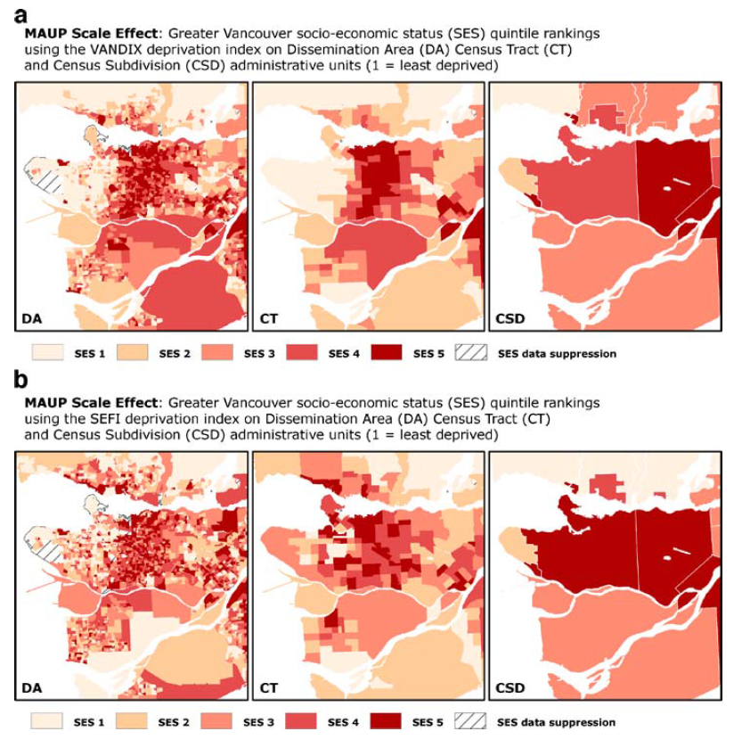
MAUP (scale example)
Vancouver, Canada area
Vandix and (b) SEFI index
at different scales.
Schuurman, N. (2007) Deprivation Indices, Population Health and Geography: And evaluation of spatial effectiveness
of indices at Multiple zones and scales. Journal of Urban Health. 84 (4):591-603. doi:10.1007/s11524-007-9193-3

Slide 17
Documentation
Non-technical summary of derived insights
Lineage of data
Replication (your raw data, etc)
Notes:
Replication & Scrutiny

