Slide 1
Building community discussion
“Viz and Tells” and “Coffee Breaks” for building engagement
Ryan Clement
Data Services Librarian, Middlebury
VTF Public Symposium 2021

Slide 2
Building a critical community
“Building on current work supporting data visualization in libraries, this grant aims to create a diverse community that will further advance data visualization instruction and use beyond hands-on, technology-based tutorials toward a nuanced, critical understanding of visualization as a research product and form of expression.”
Visualizing the Future CFP
“6. Lower walls between disciplines…
7. Create and support professional development opportunities…”
Proposal for The Middlebury Initiative for Data and Digital Methods (midd.data)

Slide 3
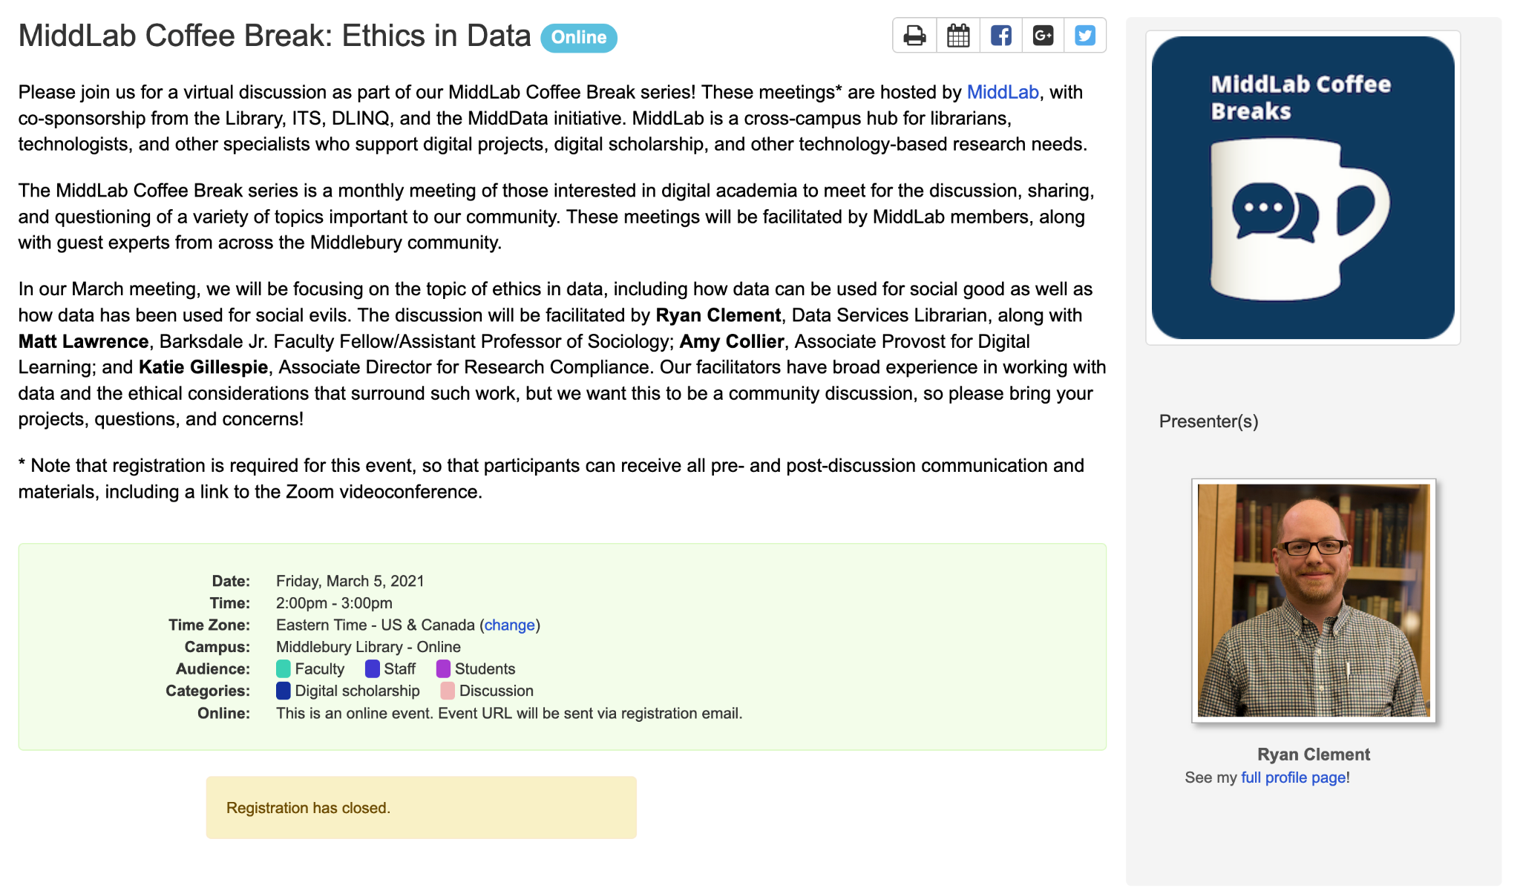
The Viz and Tell/Coffee Break model
Open to all
Discussion focused, not lectures/demos
Guest experts (as appropriate)
Low barriers to participation
Aimed at range of experience levels
No heavy pre-discussion requirements (for facilitators OR participants)
Community notes

Slide 4
What kind of topics do we cover?
VTF Viz and Tells
Visualization instruction
Visualization in library assessment
“Social” -> networking, keeping up with trends, career advice
Tools -> teaching, selecting, agnosticism
Show and tell
R & Python
VTF ethics instruction module
Data journalism
MiddLab Coffee Breaks
Open access/open data
Ethics and data
Virtual machines and access equity
Data management
Document accessibility
Information security
Data visualization tools
Web accessibility
Open source tools

Slide 5
Benefits and challenges
Benefits
Mixing of departments, fac/staff/students, experience/skill levels, locations
Gives exposure to unique areas of expertise
Not a lot of work for organizers or facilitators (beyond planning topics and email/communication)
Holding these online allows for a diversity of discussion styles
Challenges
Some folks really want a passive/consumer experience
Sometimes tough to get guest experts to understand this isn’t a “presentation”
Being online makes it tough to offer other incentives (e.g. coffee, snacks)
Zoom fatigue

Slide 6
Next steps
Viz and Tell about the Viz and Tells -> right after these lightning talks!
Coffee breaks -> at Middlebury, we plan to discuss our “calendar of topics” for next year, as well as figuring out if we should stay fully remote/go to a hybrid model
At Middlebury we’re also discussing the possibility of pairing the Coffee Break topics with a related workshop, at some other point in the month (or perhaps some online module(s))

