Slide 1
Elasticsearch
김종민
E-mail : kimjmin@gmail.com
Blog : http://kimjmin.net
Twitter : @kimjmin

Slide 2
Elasticsearch
Schema-free
Distributed & horizontally scalable
Restful API
JSON Document based
Open Source : Apache License 2.0
Written in Java
Apache Lucene.

Slide 3
Elasticsearch 1분만에 설치하기
wget https://download.elasticsearch.org/ ... /elasticsearch-1.0.1.tar.gz http://www.elasticsearch.org/download/
tar –xvfz elasticsearch-1.0.1.tar.gz
cd elasticsearch-1.0.1
bin/elasticsearch [-d]

Slide 4
살아있는지 체크 (curl & 브라우저)
$ curl localhost:9200
{
"status" : 200,
"name" : "Arcade",
"version" : {
"number" : "1.0.1",
"build_hash" : "5c03844e1978e5cc924dab2a423dc63ce881c42b",
"build_timestamp" : "2014-02-25T15:52:53Z",
"build_snapshot" : false,
"lucene_version" : "4.6"
},
"tagline" : "You Know, for Search"
}

Slide 5
데이터 구조
관계 DB | Elasticsearch
Database | Index
Table | Type
Row | Document
Column | Field
Schema | Mapping

Slide 6
데이터 입력
curl -XPUT host:port/<인덱스>/<타입>/[id]
$ curl -XPUT localhost:9200/books/book/1 -d '
{
"title" : "Elasticsearch Guide ",
"author" : "Kim",
"started" : "2014-03-14",
"pages" : 250
}'
{"_index":"books","_type":"book","_id":"1","_version":1,"created":true}
Notes:
curl -XPUT localhost:9200/books/book/1 -d '
{
"title" : "Elasticsearch Guide ",
"author" : "Kim",
"started" : "2014-03-14",
"pages" : 250
}'
curl -XPUT localhost:9200/books/book/2 -d '
{
"title" : "Elasticsearch Easy Guide 2",
"author" : ["Kim","Lee"],
"started" : "2014-03-20",
"pages" : 300
}'

Slide 7
데이터 수정
동일한 Index/Type/ID 로 데이터 입력
$ curl -XPUT localhost:9200/books/book/1 -d '
{
"title" : "Elasticsearch Guide",
"author" : ["Kim", "Lee"],
"started" : "2014-03-14",
"pages" : 250
}'
{"_index":"books","_type":"book","_id":"1","_version":2,"created":false}

Slide 8
데이터 확인
$ curl -XGET localhost:9200/books/book/1
{"_index":"books","_type":"book","_id":"1","_version":2,"found":true, "_source" :
{
"title" : "Elasticsearch Guide",
"author" : ["Kim", "Lee"],
"started" : "2014-03-14",
"pages" : 250
}
}

Slide 9
데이터 삭제
$ curl -XDELETE localhost:9200/books/book/1
{"found":true,"_index":"books","_type":"book","_id":"1","_version":3}

Slide 10
URI 검색
$ curl –XGET localhost:9200/books/book/_search?q=elasticsearch
$ curl -XGET localhost:9200/books/book/_search?q=easy
{"took":3,"timed_out":false,"_shards":{"total":5,"successful":5,"failed":0},"hits":{"total":1,"max_score":0.095891505,"hits":[{"_index":"books","_type":"book","_id":"2","_score":0.095891505, "_source" :
{
"title" : "Elasticsearch Easy Guide 2",
"author" : ["Kim","Lee"],
"started" : "2014-03-20",
"pages" : 300
}}]}}

Slide 11
URI 검색 (계속)
$ curl –XGET localhost:9200/books/book/_search?q=title:elasticsearch
$ curl -XGET localhost:9200/books/book/_search?q=author:elasticsearh
{"took":1,"timed_out":false,"_shards":{"total":5,"successful":5,"failed":0},"hits":{"total":0,"max_score":null,"hits":[]}}

Slide 12
Request Body 검색
$ curl localhost:9200/books/book/_search -d '
{
"query" : {
"term" : { "title" : "elasticsearch" }
}
}'
Notes:
curl -XGET localhost:9200/books/_search -d '
{ "query" :
{ "range" :
{ "started" :
{
"from" : "2014-03-10", "to" : "2014-03-15"
}
}
}
}'

Slide 13
Shard & Replicas (Head plugin)
bin/plugin -install mobz/elasticsearch-head
$ curl -XPUT localhost:9200/books -d '
{
"settings" : {
"number_of_shards" : 4,
"number_of_replicas" : 1
}
}'
$ curl -XPUT localhost:9200/magazine -d '
{
"settings" : {
"number_of_shards" : 2,
"number_of_replicas" : 0
}
}'

Slide 14
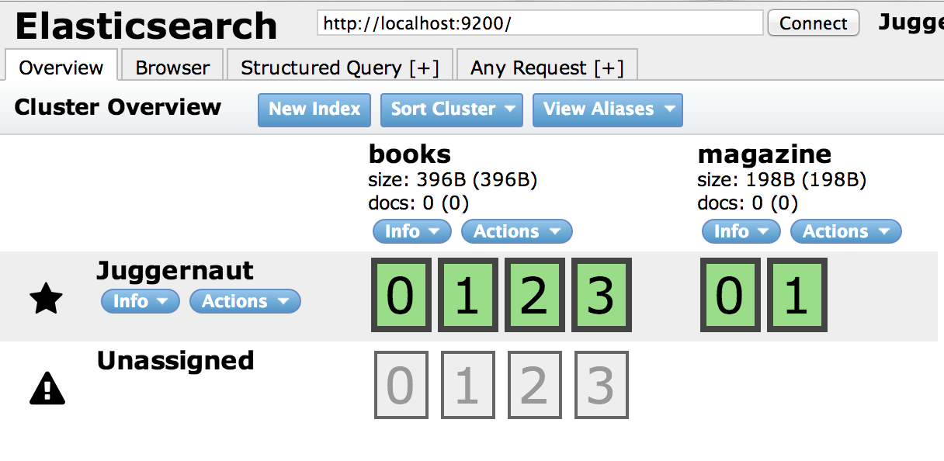
Shard & Replicas

Slide 15
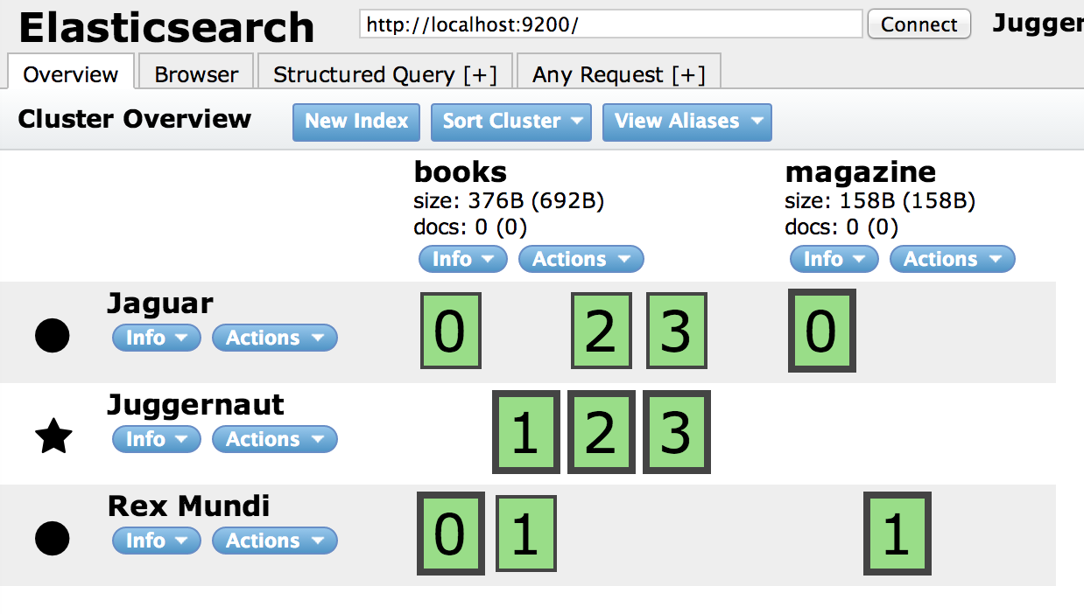
Shard & Replicas

Slide 16
환경 설정 - 노드명
config/elasticsearch.yml
cluster.name: elasticsearch
node.name: “node1”
bin/elasticsearch -Des.node.name=node1
bin/elasticsearch --node.name=node1

Slide 17
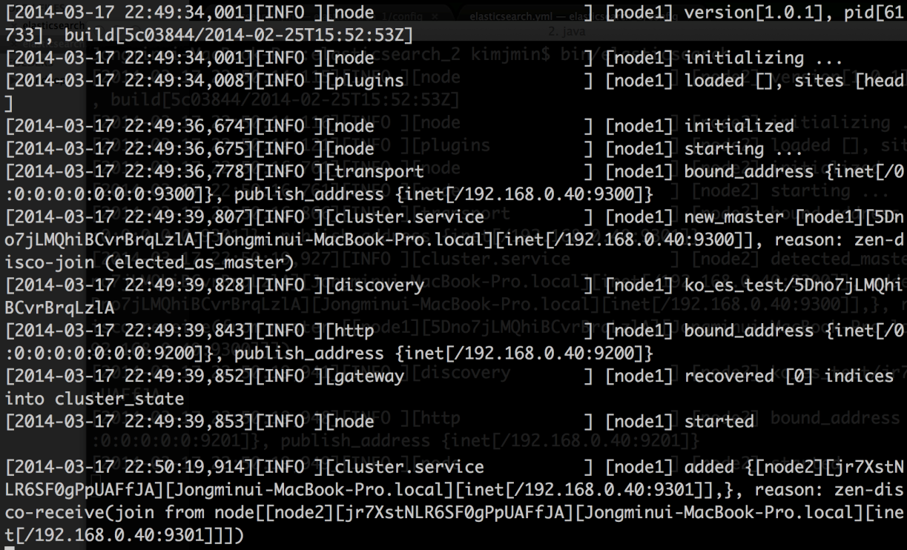
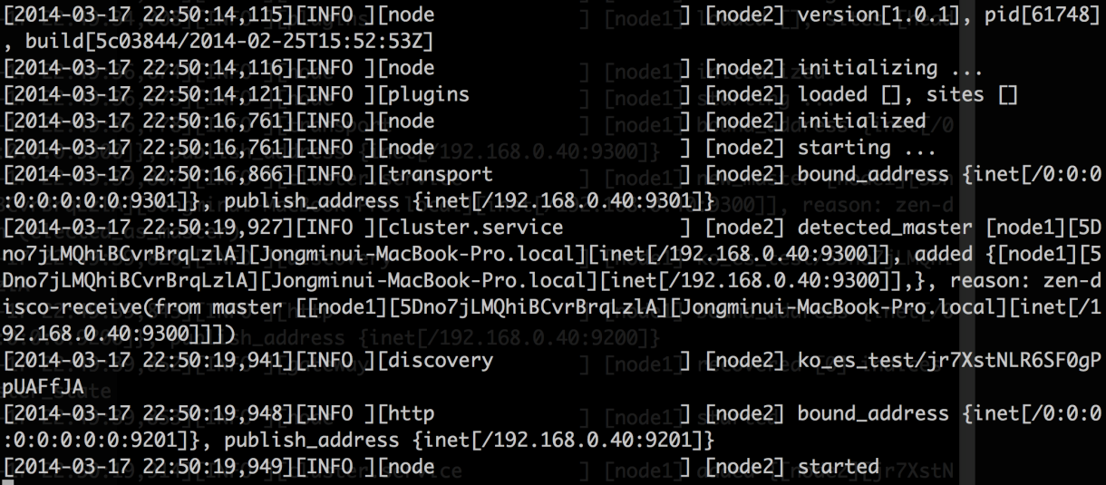
노드 바인딩
실행 포트 : 9200~
바인딩 포트 : 9300~

Slide 18
환경 설정 – 마스터노드, 데이터노드
config/elasticsearch.yml
node.master: false
node.data: true
bin/elasticsearch -Des.node.data=true
bin/elasticsearch --node.data=true

Slide 19
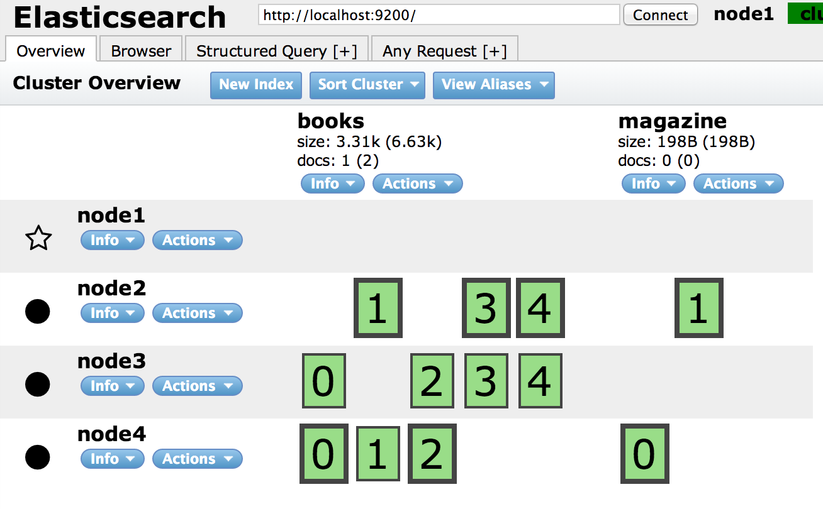
환경 설정 – 마스터노드, 데이터노드

Slide 20
감사합니다
http://elasticsearch.or.kr
한국 엘라스틱서치 유저그룹 https://www.facebook.com/groups/elasticsearch.kr/

