Slide 1
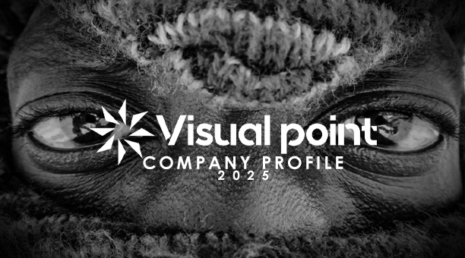
VISUAL POINT
See beyond the ordinary.

Slide 2
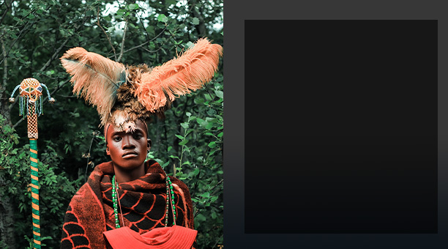
ABOUT US
“Visual Point” reflects our commitment to delivering powerful visuals that capture emotions, ideas and messages with clarity and impact. We believe that every story has a focal point, a moment that speaks louder than words that is why Visual Point exists to frame those moments, enhance perspectives, and make content not just seen but felt whether through photography, film or advertising, we ensure that every project we touch becomes a striking visual experience.We don’t just capture images—we tell untold stories. Through photojournalism and thought-provoking content, we document the raw, the beautiful, and the unheard, reshaping how the world sees our country.

Slide 3

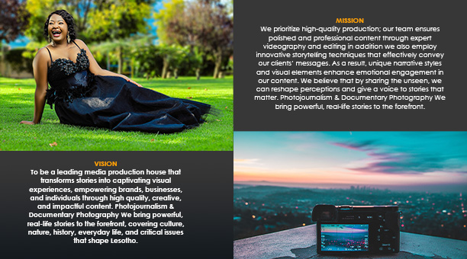

Slide 4
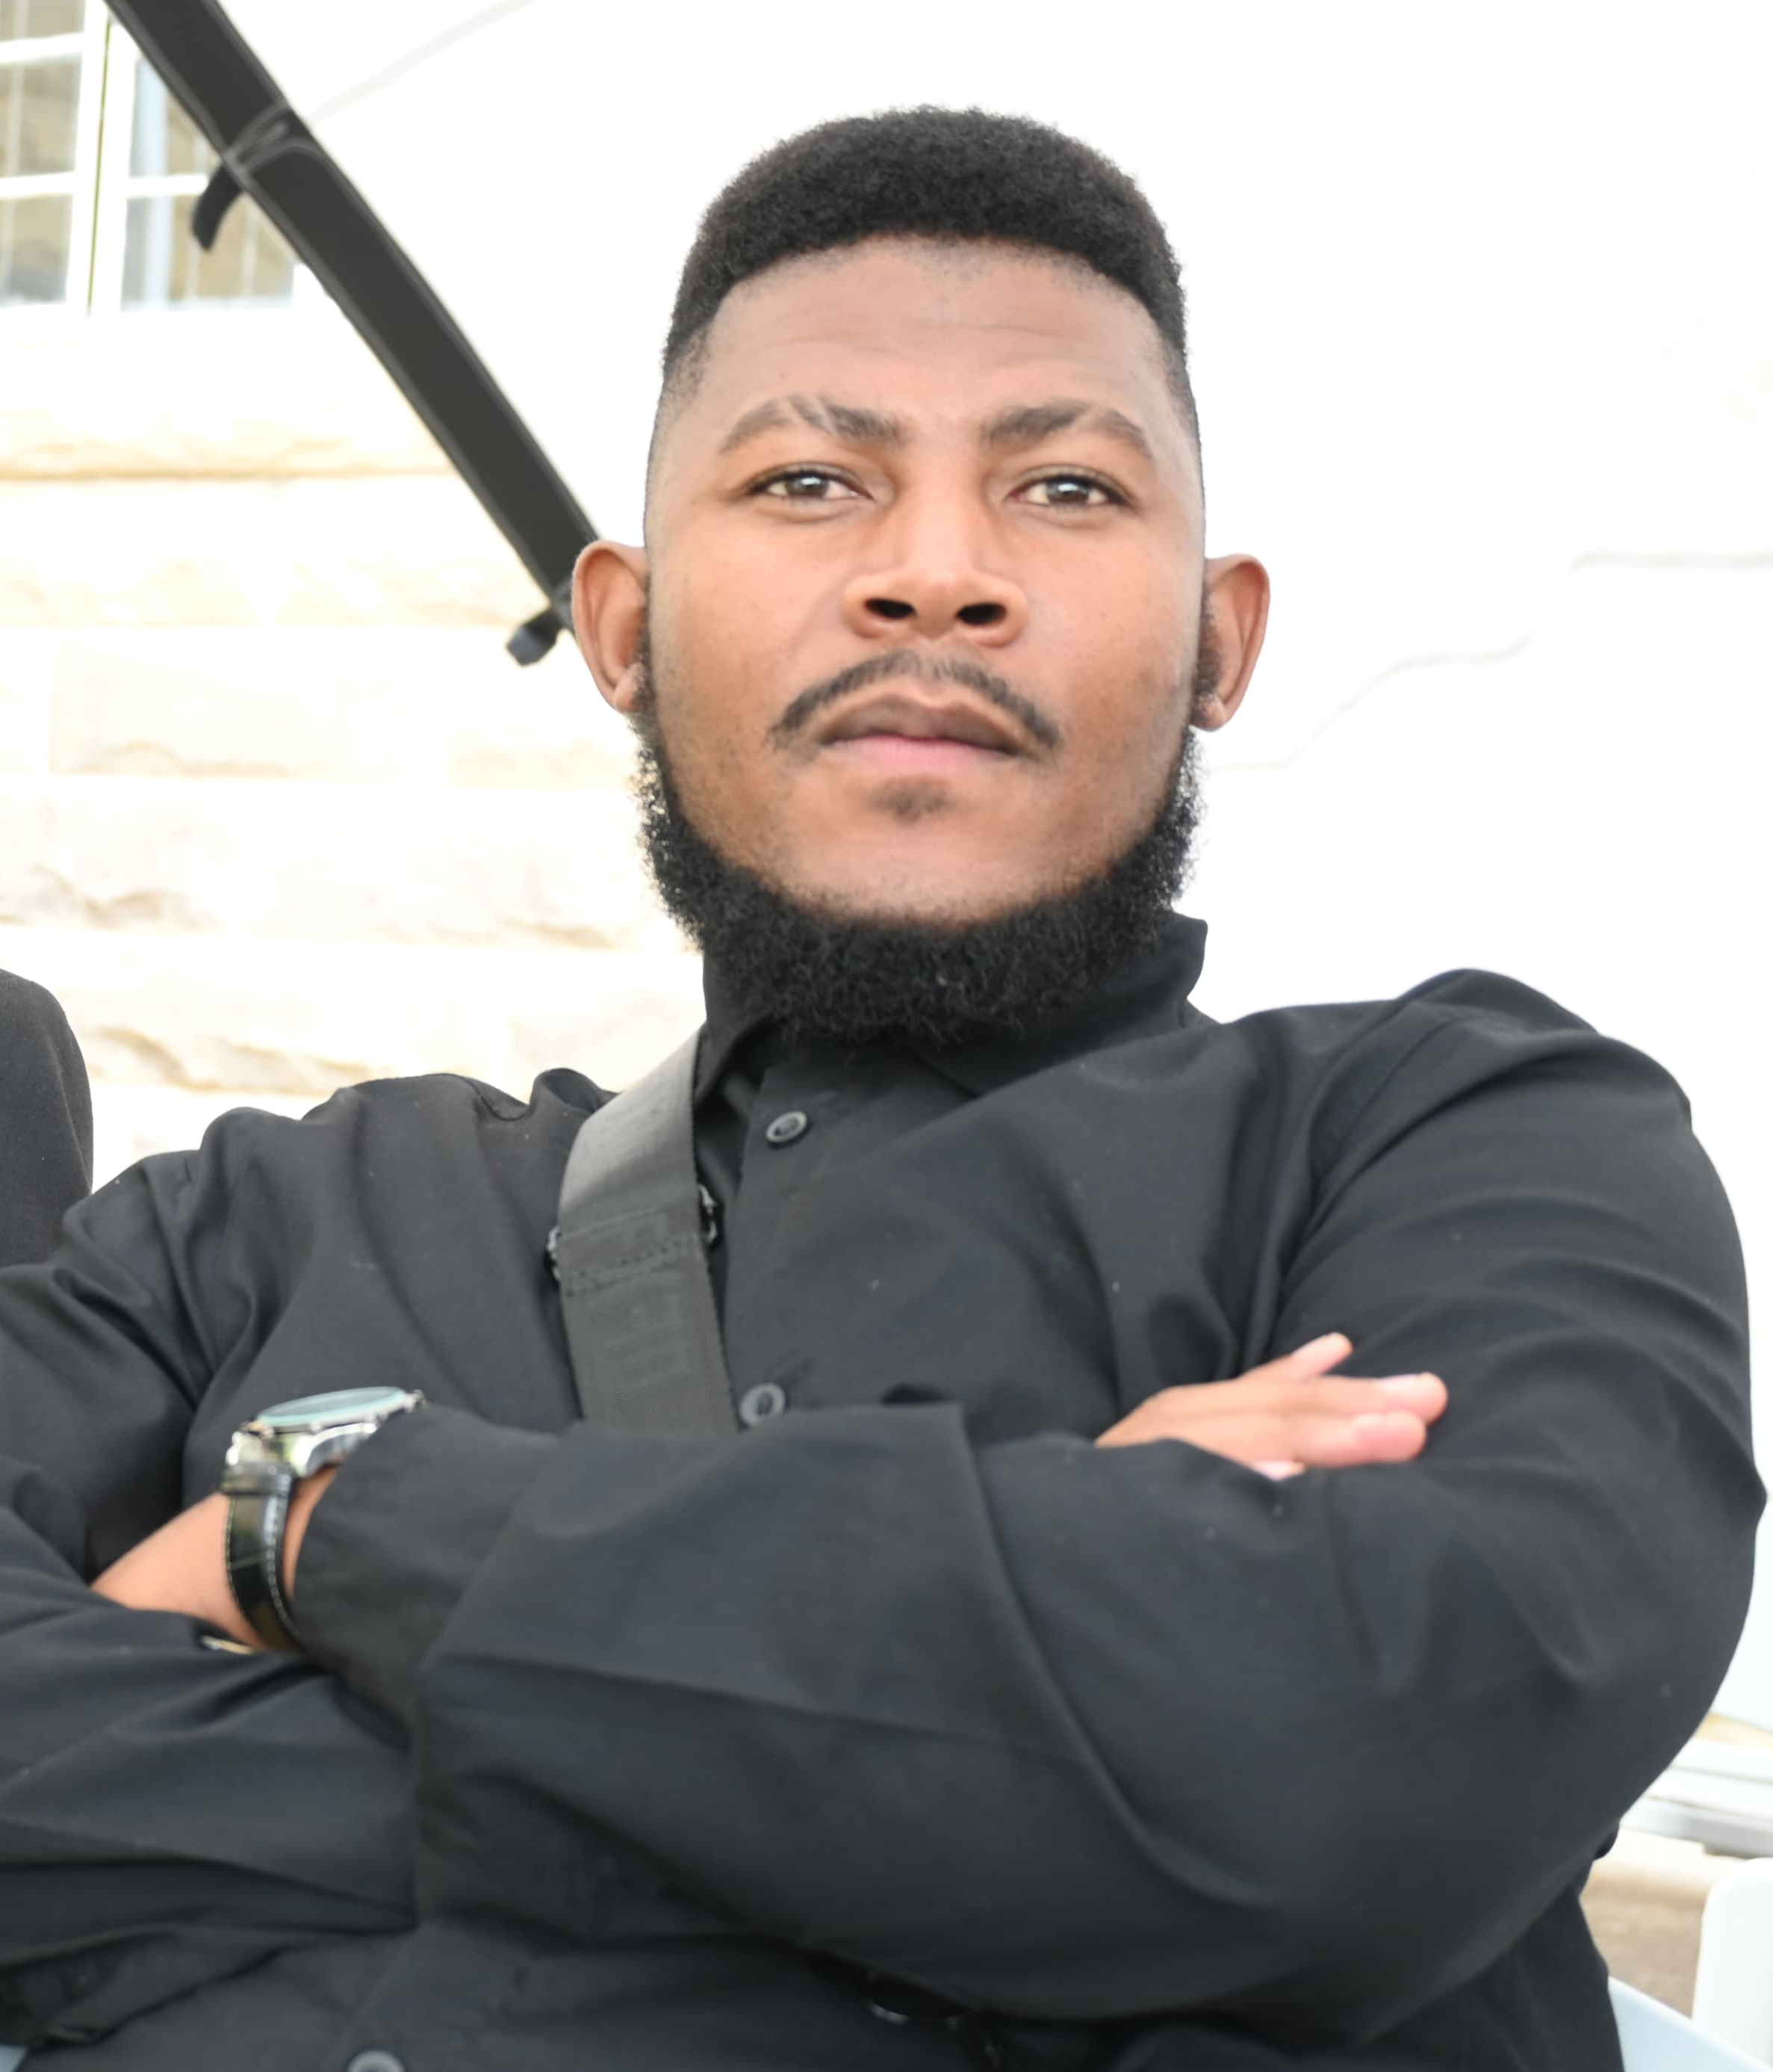
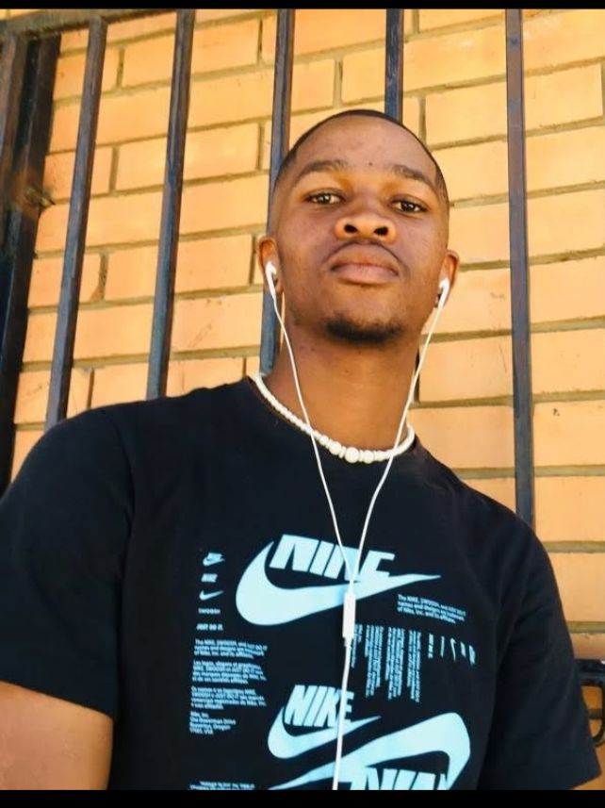
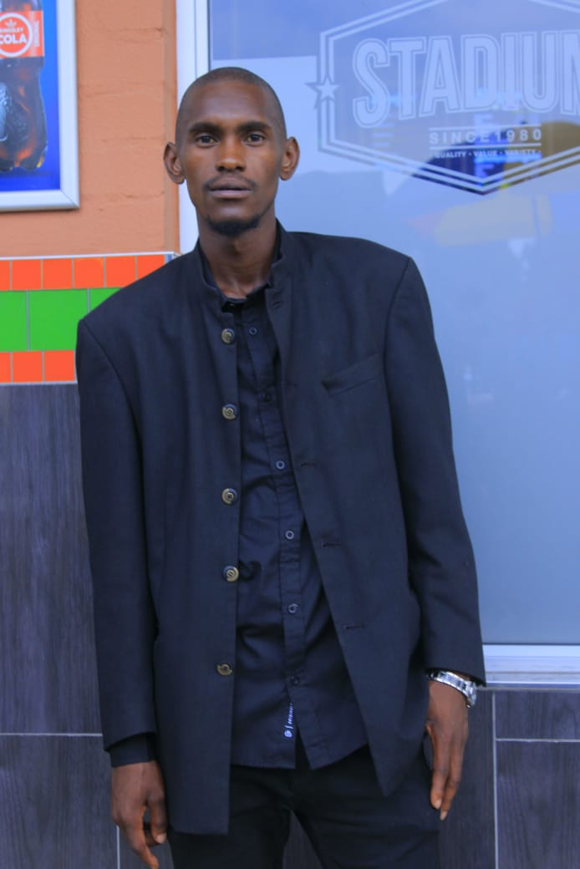
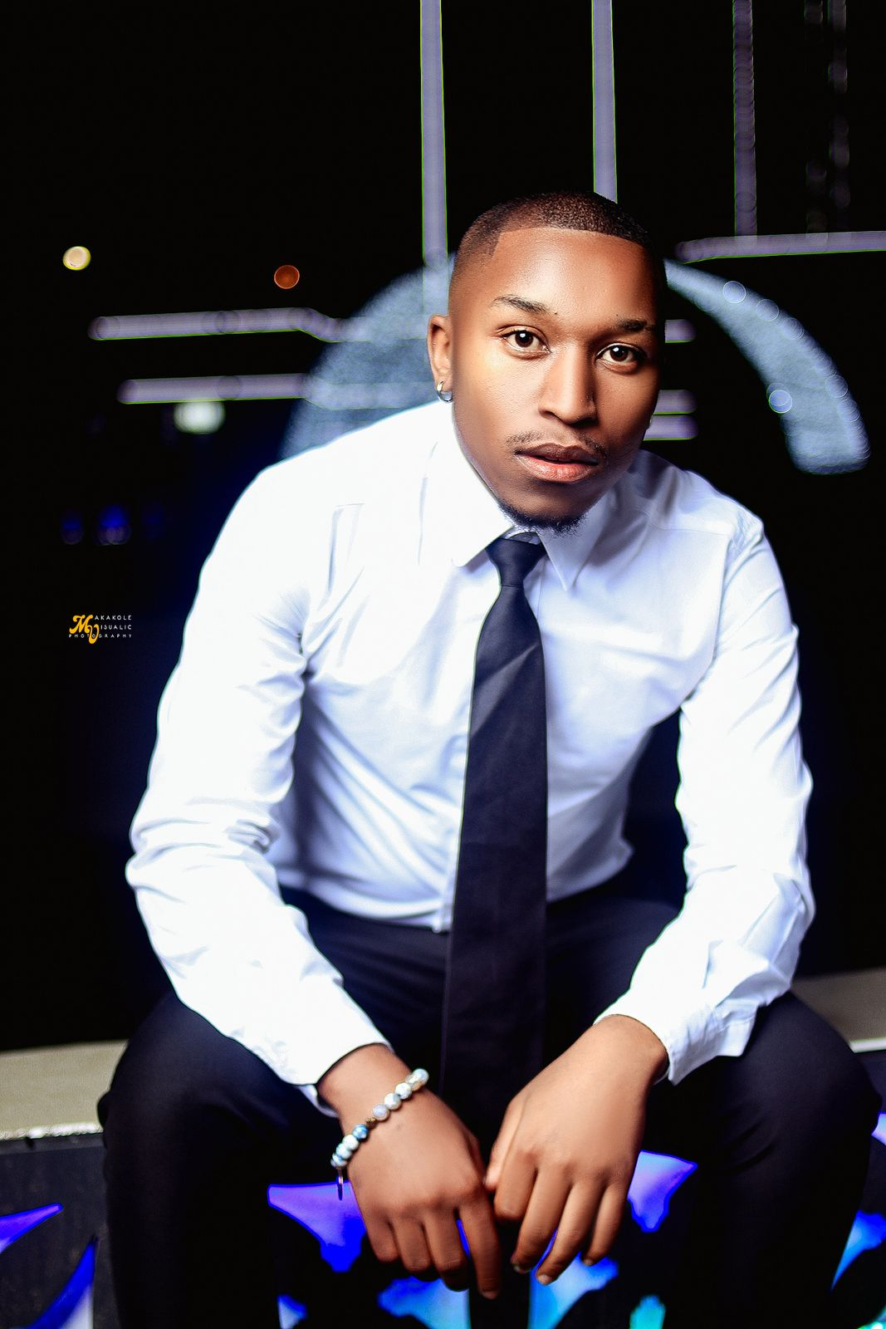
Sajene Makara (Business management)
Managing partner: Overseas overall business operations, finance and growth.
Handles client negotiations budgeting.
Ensures the business runs smoothly and remains profitable.
Thabo Kikine(Creative advertising )
Design logos, Brand identity materials and social media content.
Coordinates between creative, technical and business teams.
Editing
Tumelo Lekeletsane ( software engineering with multimedia)
Creates and manages company website, digital portfolio and tech infrastructure.
Ensures smooth operation of editing software, cloud storage and cyber security.
Develop tools automation and digital media management.
Lehloholono Raithule(Creative Advertising)
Develops marketing campaigns and brand strategies for the company and clients
Creates advertising concepts, storytelling ideas and commercial content.
Works with PR and business team to grow the brand ‘s presence.

Slide 5
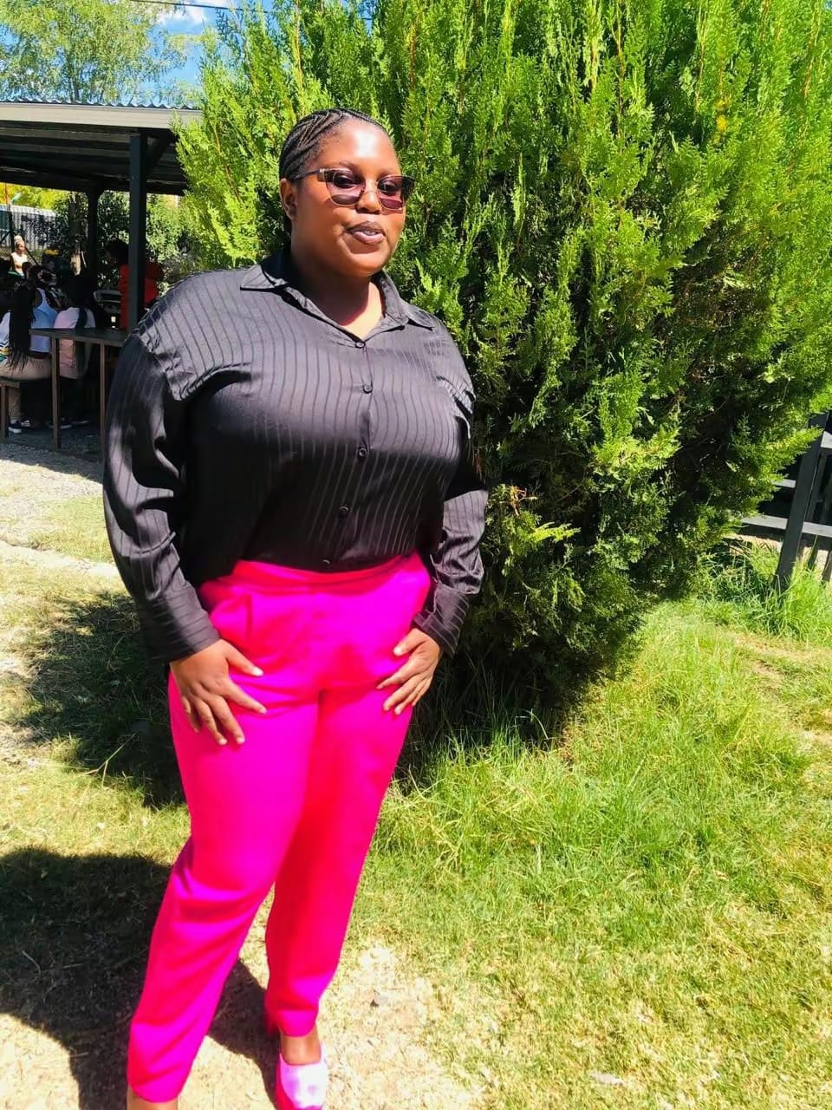
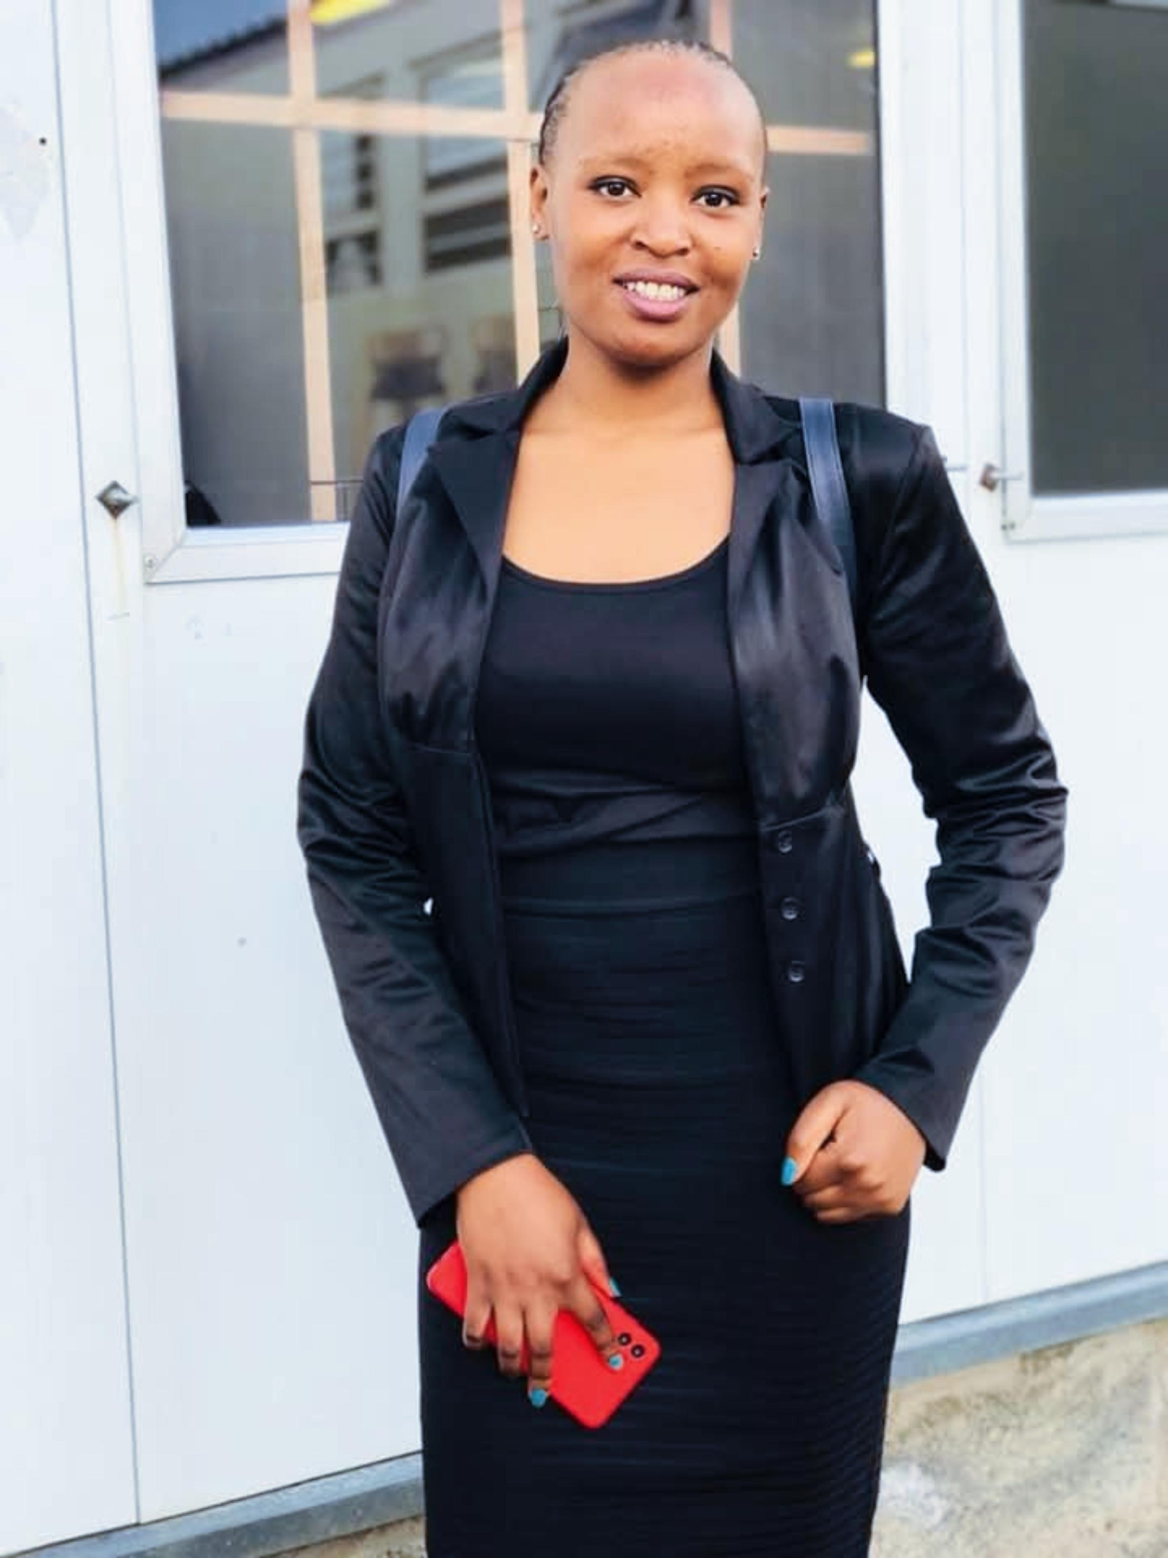
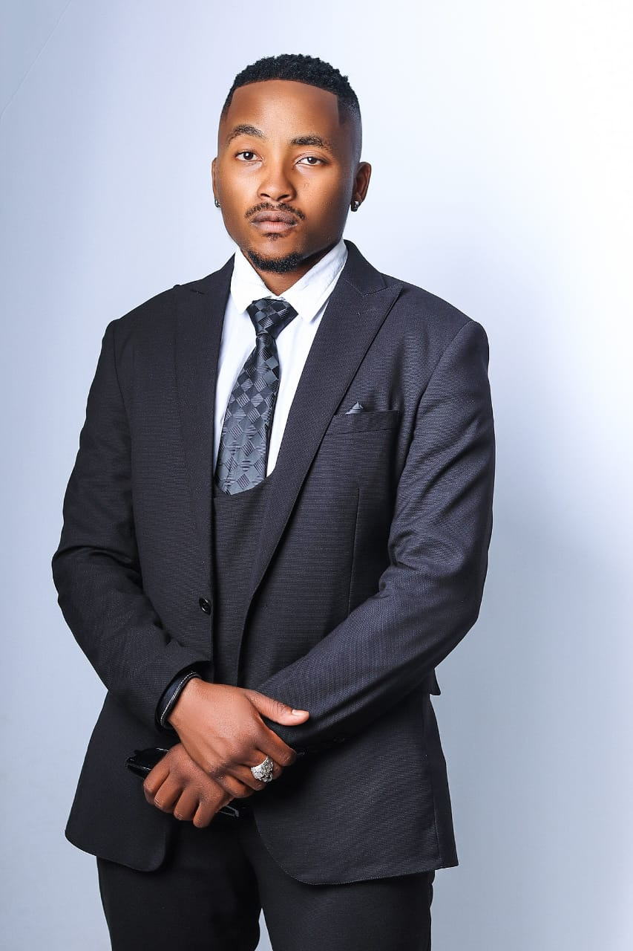
Tsitso Paneng (Public relations)
Manages the company’s public image, social media, and media relations
Writes press releases, blog content and promotional materials.
Engages with clients, influencers and target publics.
Monehela Nqhae (film Production)
Overseas all video and film productions
Directs video shoots, cinematography and post-productions Video editing.
Tsebo Makakole (Graphic designer)
Photography and shooting
Editing and post-production
Develop and execute

Slide 6
Our Services Relive Every Moment in Cinematic Detail
Your special moments deserve more than snapshots—they deserve a masterpiece. From weddings and corporate events to private celebrations, we capture the essence of every occasion with breathtaking photography and high-quality video production.
🎬 Brand & Commercial Content – Elevate Your Brand with Visual Storytelling
In today’s competitive market, strong visuals equal strong brands. Our team specializes in crafting compelling marketing campaigns, product shoots, and branded content that make your business impossible to ignore.
📱 Social Media Content – Stay Ahead with High-Impact Digital Visuals Social Media Marketer and Advertising Consultant
Engagement is everything! We create scroll-stopping content tailored for brands, influencers, and businesses looking to make waves on Instagram, Facebook, TikTok, and beyond.
🎞️ Professional Editing & Post-Production – Your Visuals, Perfected Post Production consultancy
From photo retouching to cinematic video editing, we ensure every frame is polished to perfection. Sharp details, vibrant colours, and seamless storytelling—because your content deserves the best.
🚁 Drone & Aerial Cinematography – See the Bigger Picture
Take your visuals to the next level with stunning aerial shots. Whether for real estate, events, or cinematic productions, our drone footage adds a breathtaking perspective.
📡 Live Streaming & 360-Degree Video – Engage Audiences in Real Time

