Slide 1
Visual Programming
Real Estate Management System Complete Property & Financial Management Solution

Slide 2
Group Member
Presented by:
Eisha Asim (243575)
Rasba Mazhar (243571)
Furqan Arshad (243583)
Ayesha Akhlaq (243553)

Slide 3
The Problems
Data Fragmentation
Information is spread across multiple files and formats, causing inconsistency and slow data retrieval.
Manual Calculations
Installments, commissions, and profits are calculated manually, increasing the risk of errors and disputes.
No Real-time Tracking
Plot availability, payment status, and receivables cannot be monitored in real time.
Inefficient Reporting
Reports require manual data compilation, making them time-consuming and unreliable.
Poor Customer Management
Customer records, payment history, and ledgers are not centralized or well organized.
Lack of Automation
Installment reminders, commission calculations, and profit distribution depend on manual effort.
Limited Management Visibility
Management lacks clear insight into project performance, plot status, and overall financial health

Slide 4
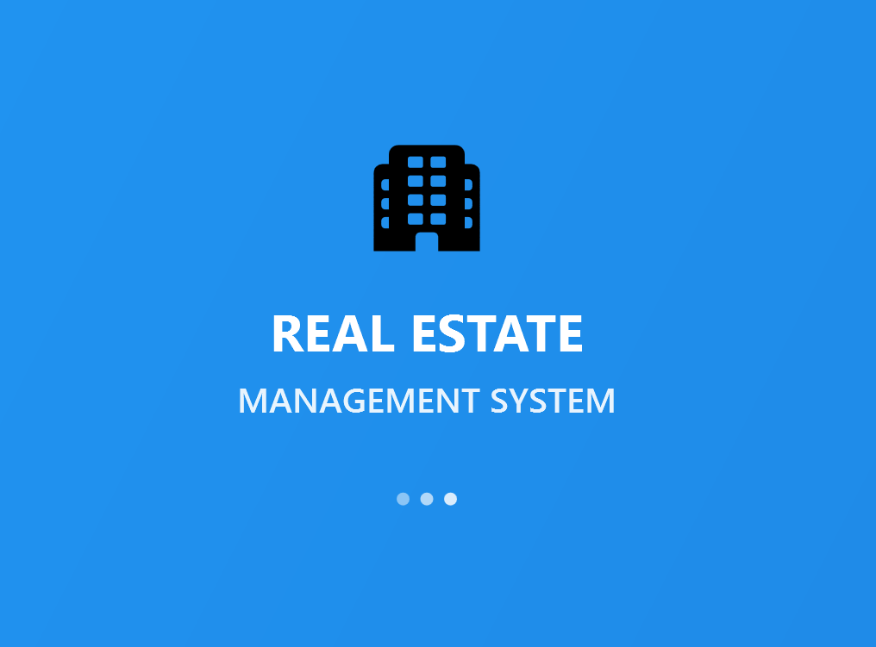
Our Solution
• Centralized database system
• Automated payment tracking
• Real-time financial reporting
• User-friendly desktop application
• Complete CRUD operations

Slide 5
Technologies Used
Frontend: WPF
Framework: .NET 8.0
Database: SQL Server Express
Data Access: Microsoft.Data.SqlClient(ADO.NET)
Architecture: 3-Tier Architecture

Slide 6
Architecture Overview
UI Layer (15+ Pages)
↓
Data Access Layer (10+ Classes)
↓
Database Layer (8 Tables)

Slide 7
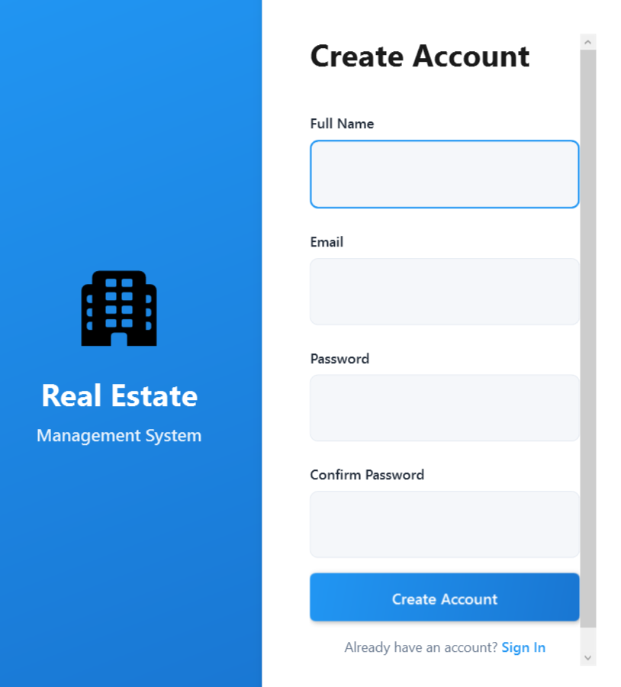
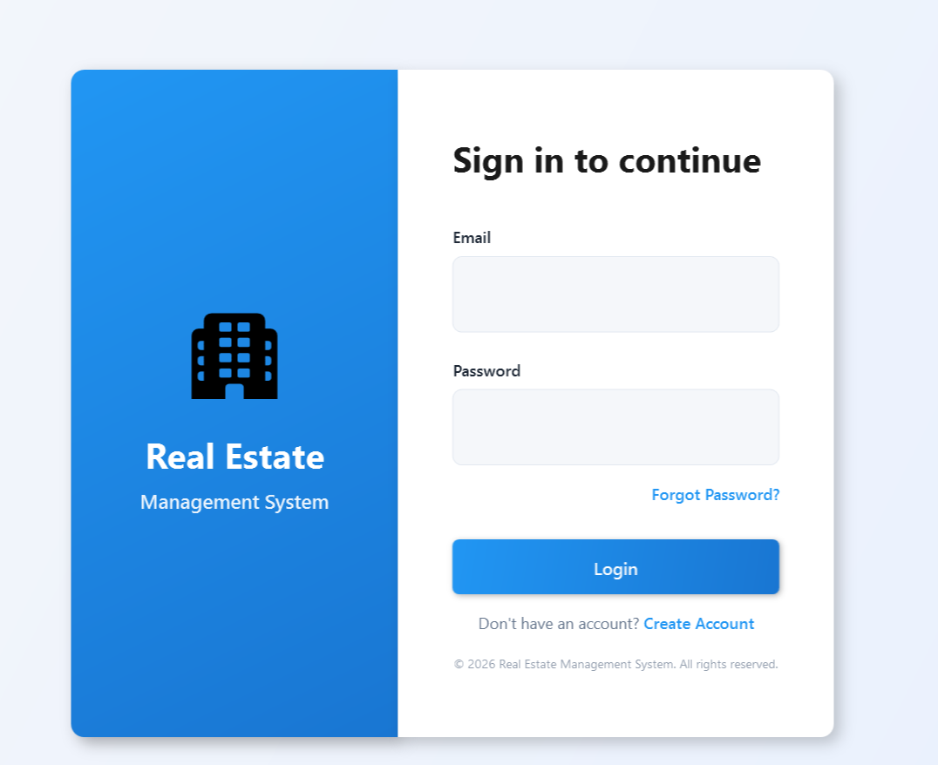
User Authentication
User needs to login by entering correct credentials to use the application features
User has the option to create account

Slide 8
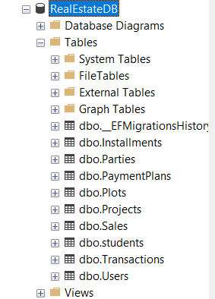
Database Schema
Users
Parties
Projects
Plots
Sales
PaymentPlans
Installments
Transactions

Slide 9
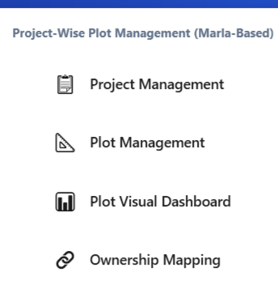
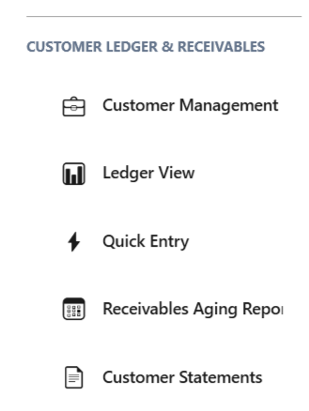
System Modules
Project-wise Plot Management(Marla Based)
Project Management
Plot Management
Plot Visualization Dashboard
Ownership Mapping
Customer Ledger & Receivables
Customer Management
Ledger View
Quick Entry
Receivables and Aging Report
Customer Statement

Slide 10
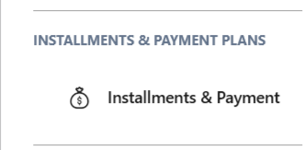
System Modules
Installments and Payment Plans
Installments and Payment Plans

Slide 11
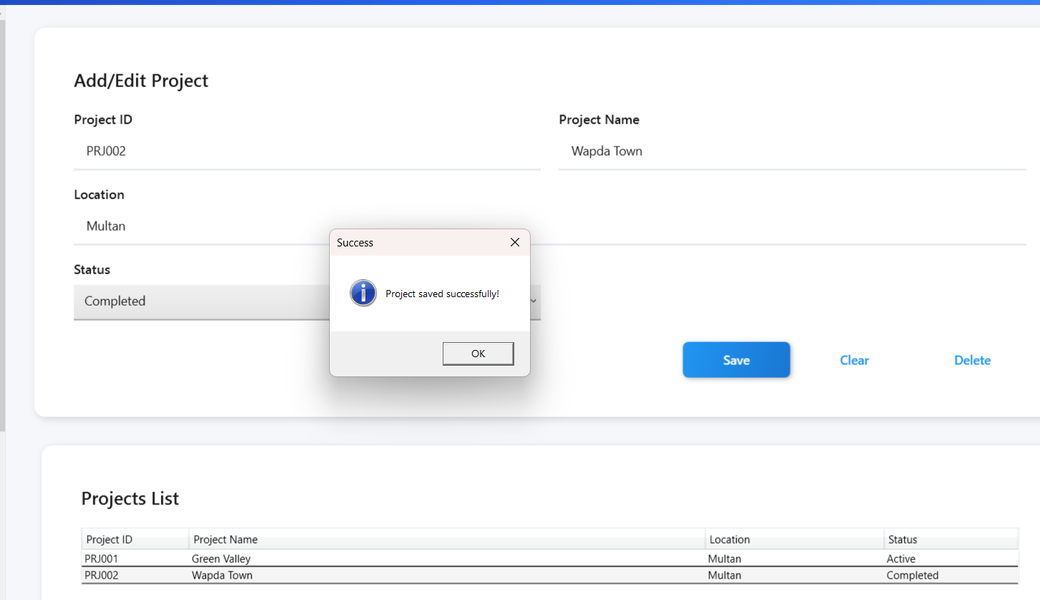
Project-wise Plot Management(Marla Based)
Project Management
Manage project details and information (Add, Delete, Update)
Gives a grid view

Slide 12
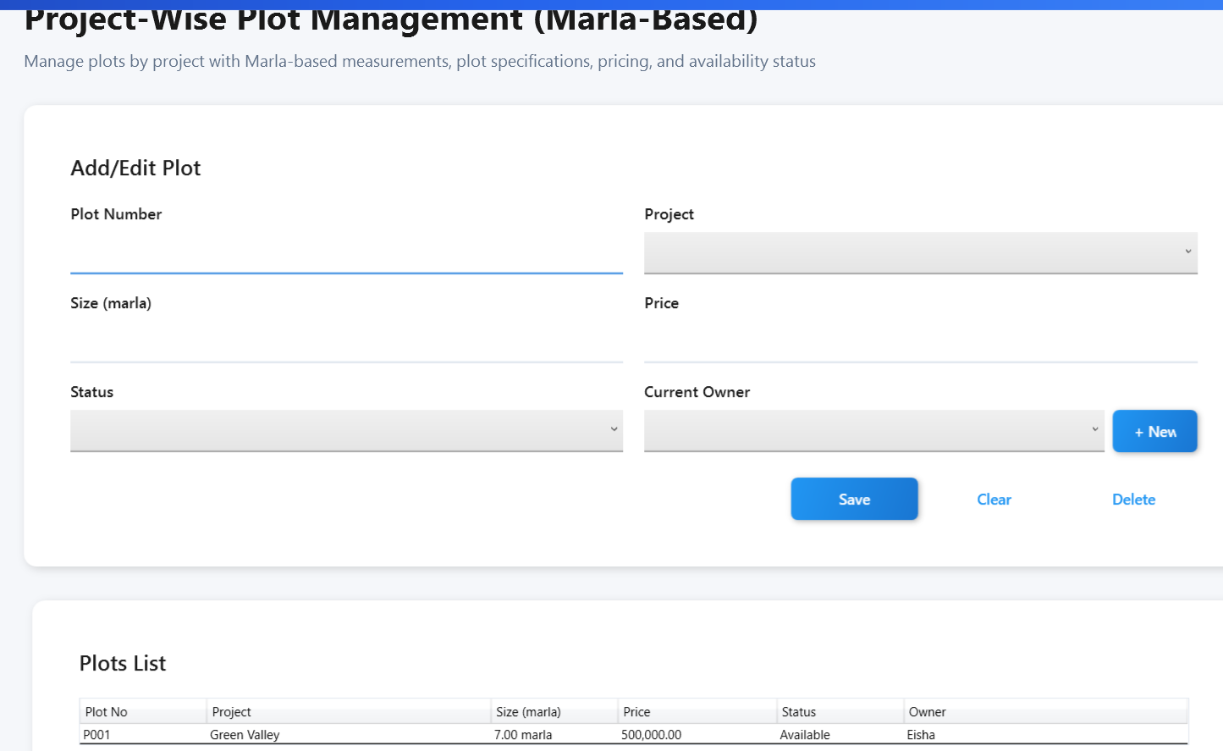
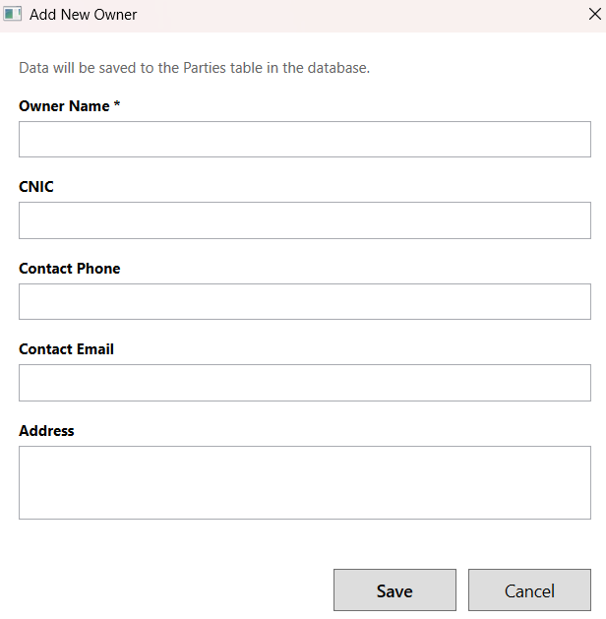
Project-wise Plot Management(Marla Based)
Plot Management
Add, Update and Delete options are available. Plot Owner can be added

Slide 13
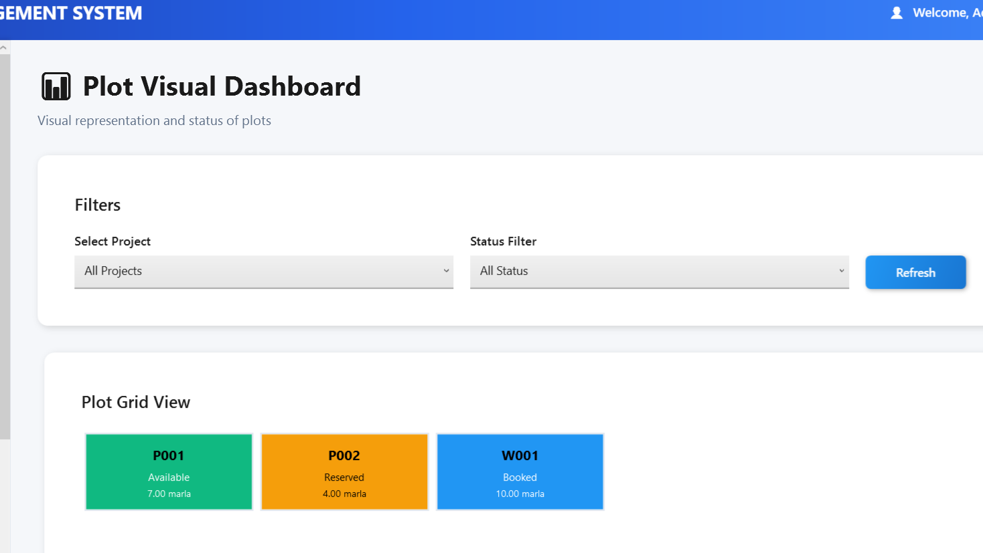
Project-wise Plot Management(Marla Based)
Plot Visual Dashboard
Visual representation of plots on the basis of filters and project wise

Slide 14
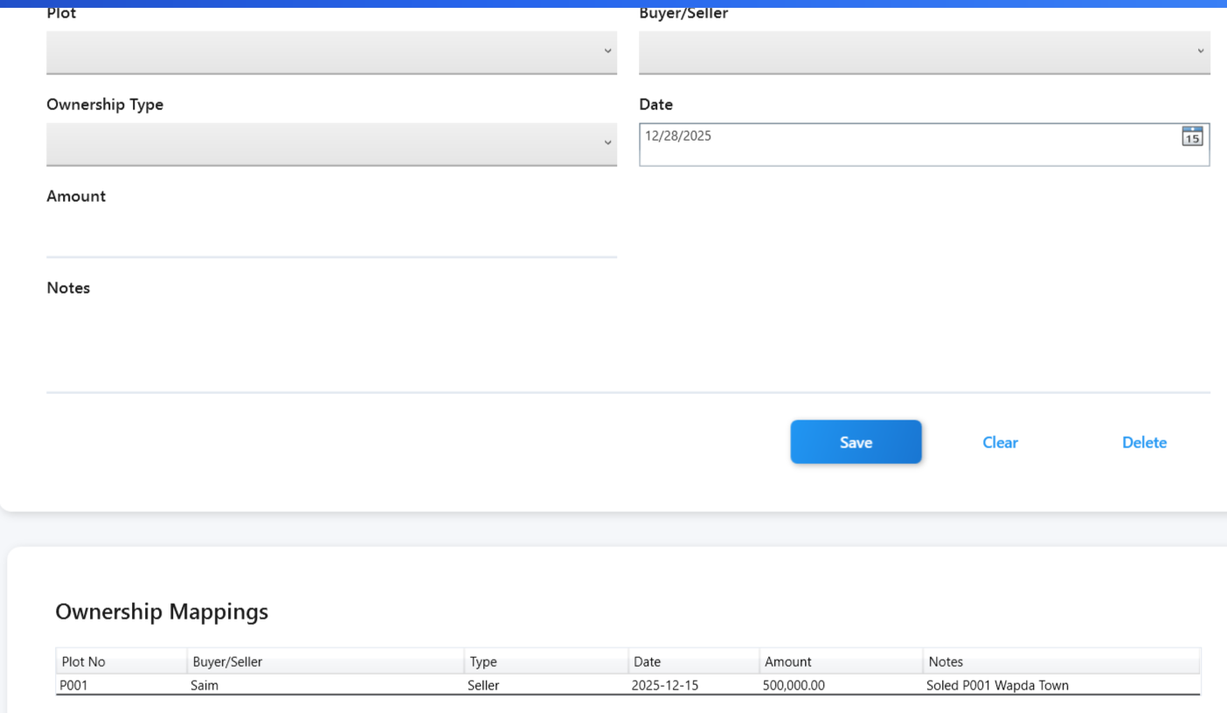
Project-wise Plot Management(Marla Based)
Ownership Mapping
Manage owners and map plot details

Slide 15
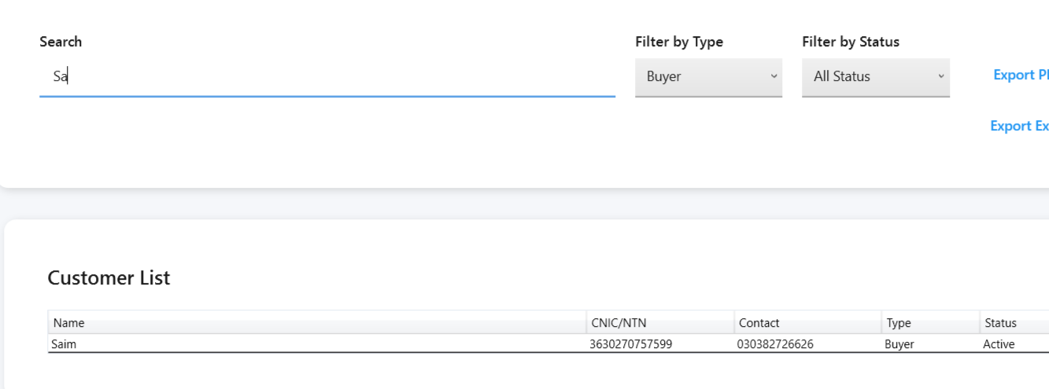
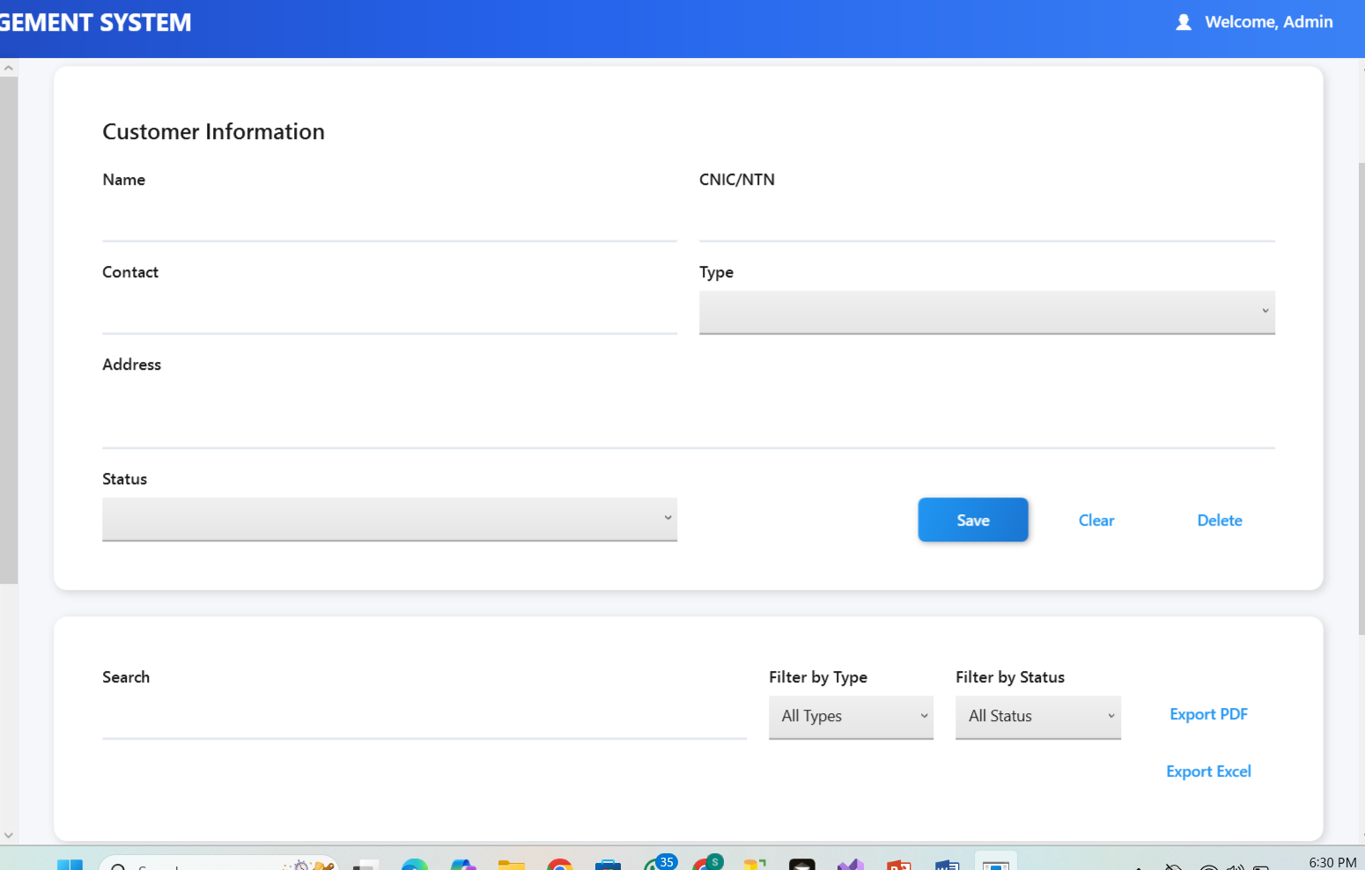
Customer Ledger & Receivables
Customer Management
Add, Update, Delete Customers
Provides Search and Fliter Facility

Slide 16
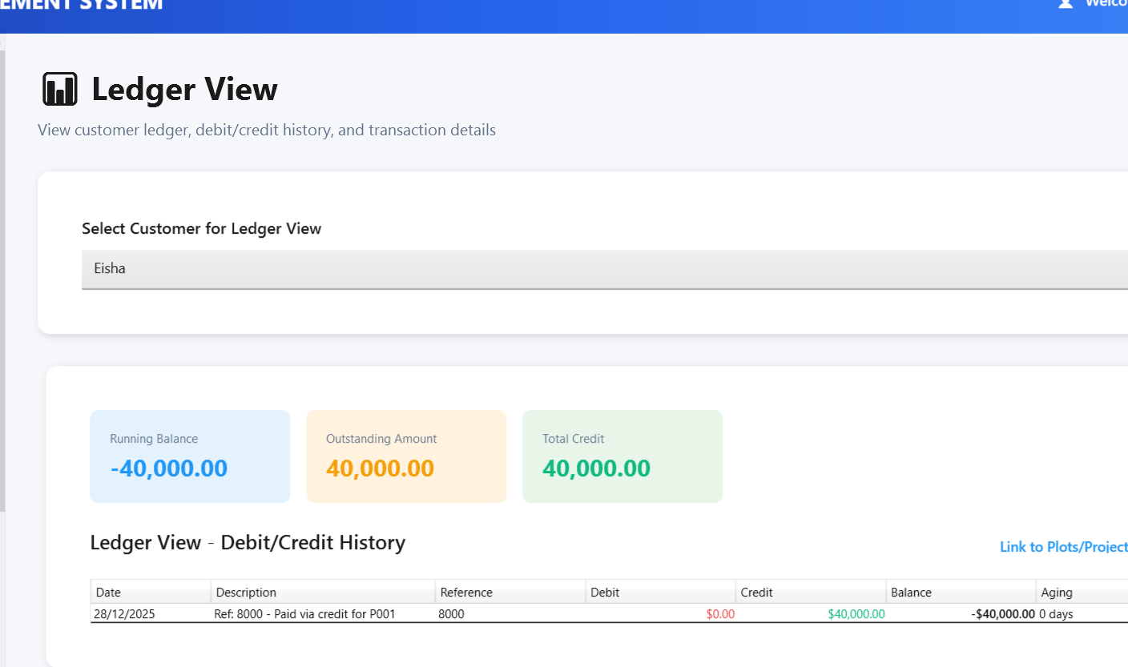
Customer Ledger & Receivables
Ledger View
Shows a complete and organized record of all financial transactions

Slide 17
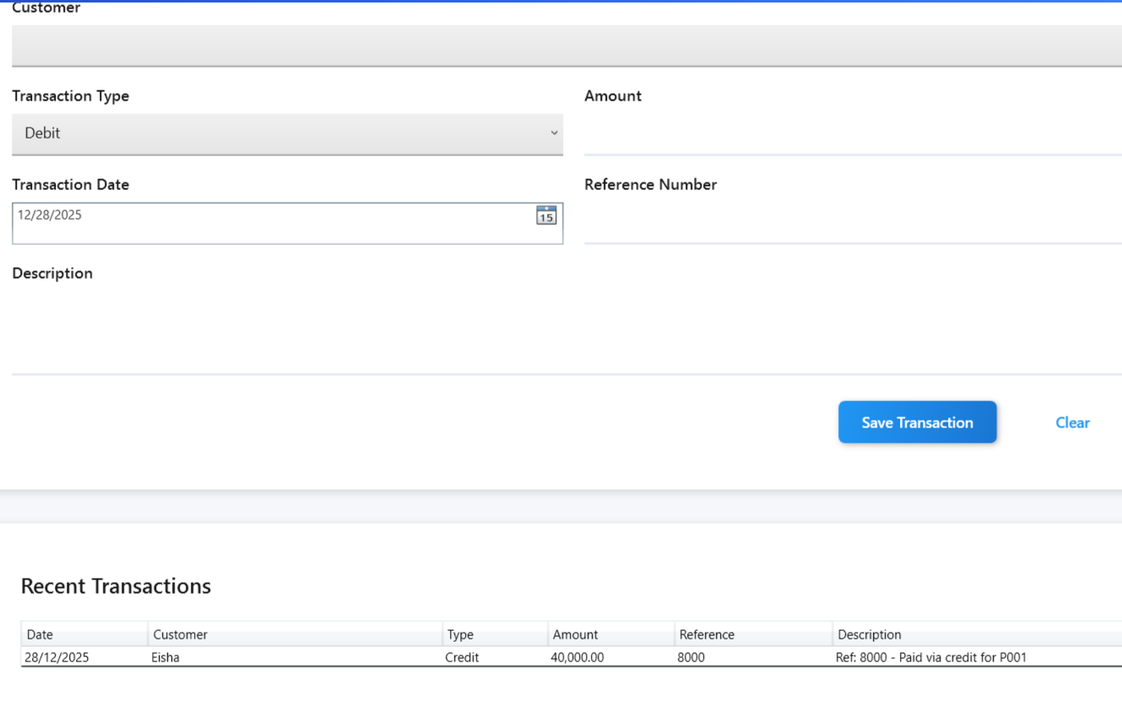
Customer Ledger & Receivables
Quick Entry
Manage quick transaction history of customer

Slide 18
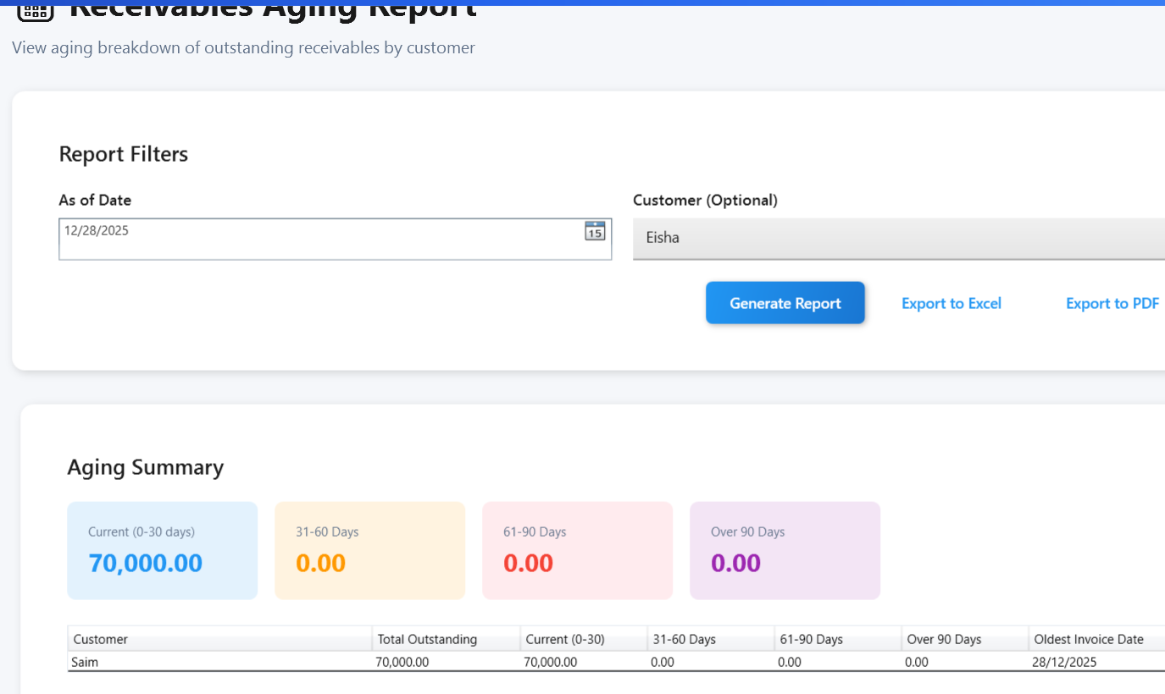
Customer Ledger & Receivables
Receivables-Aging Report
Shows how much money customers owe you, grouped by how long it's been unpaid.

Slide 19
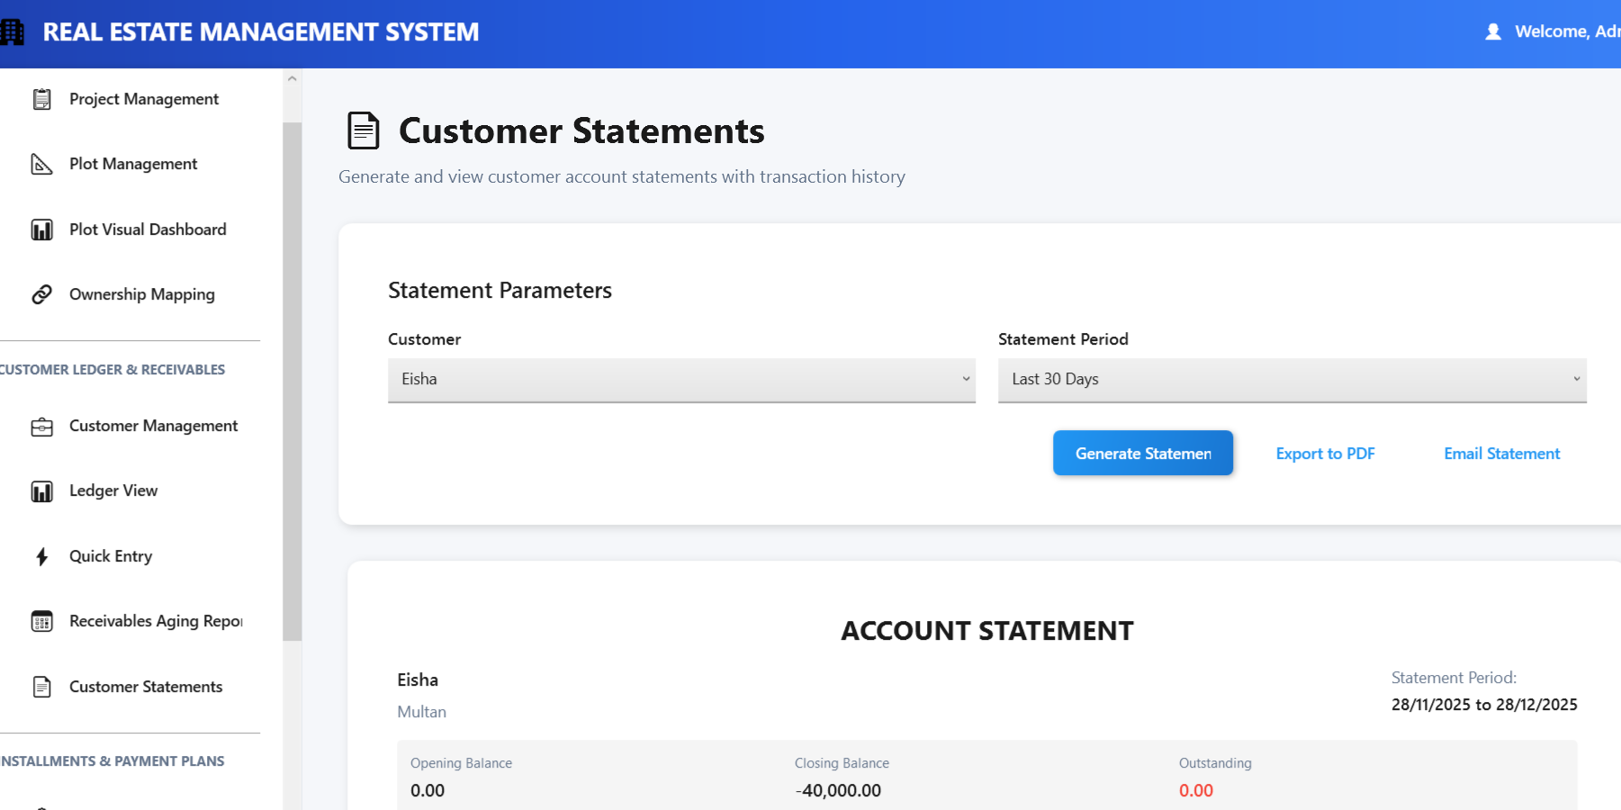
Customer Ledger & Receivables
Customer Statement
Generates account statements for customers showing their transaction history, balances, and what they owe.

Slide 20
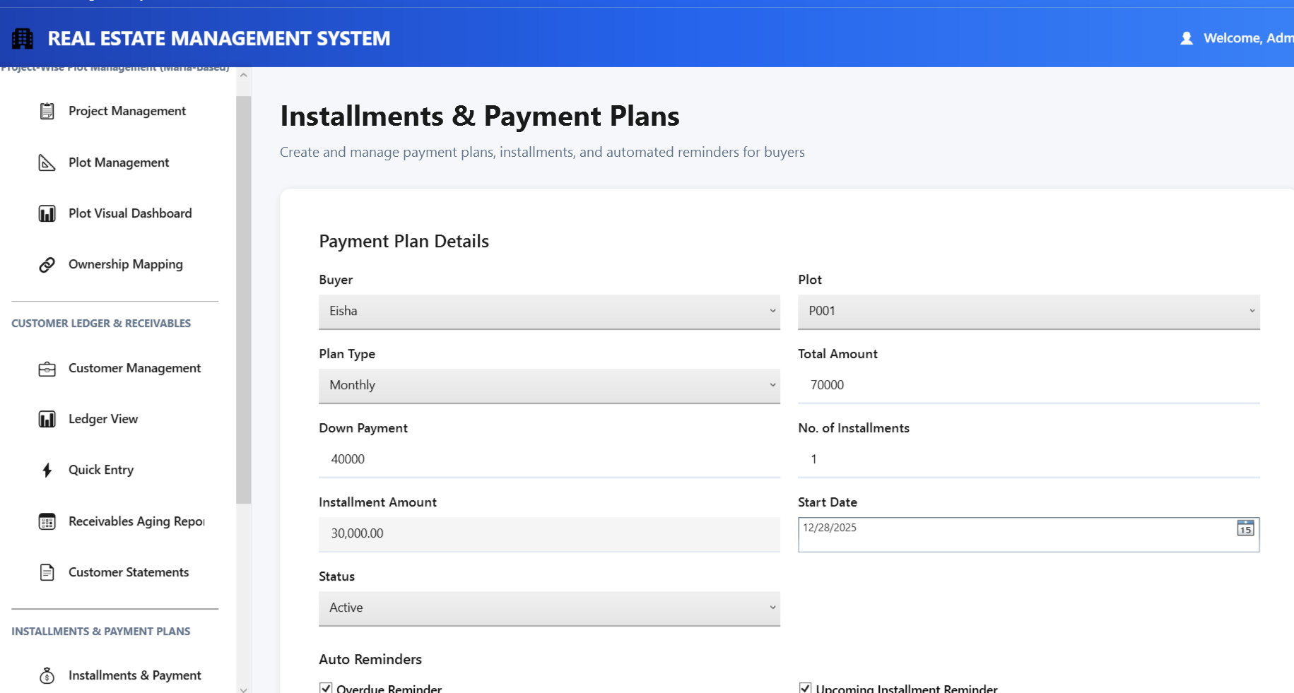
Installments & Payment Plans
Installments & Payment Plans
Creates and manages payment plans for property sales, automatically generates installments, and tracks payment schedule

Slide 21
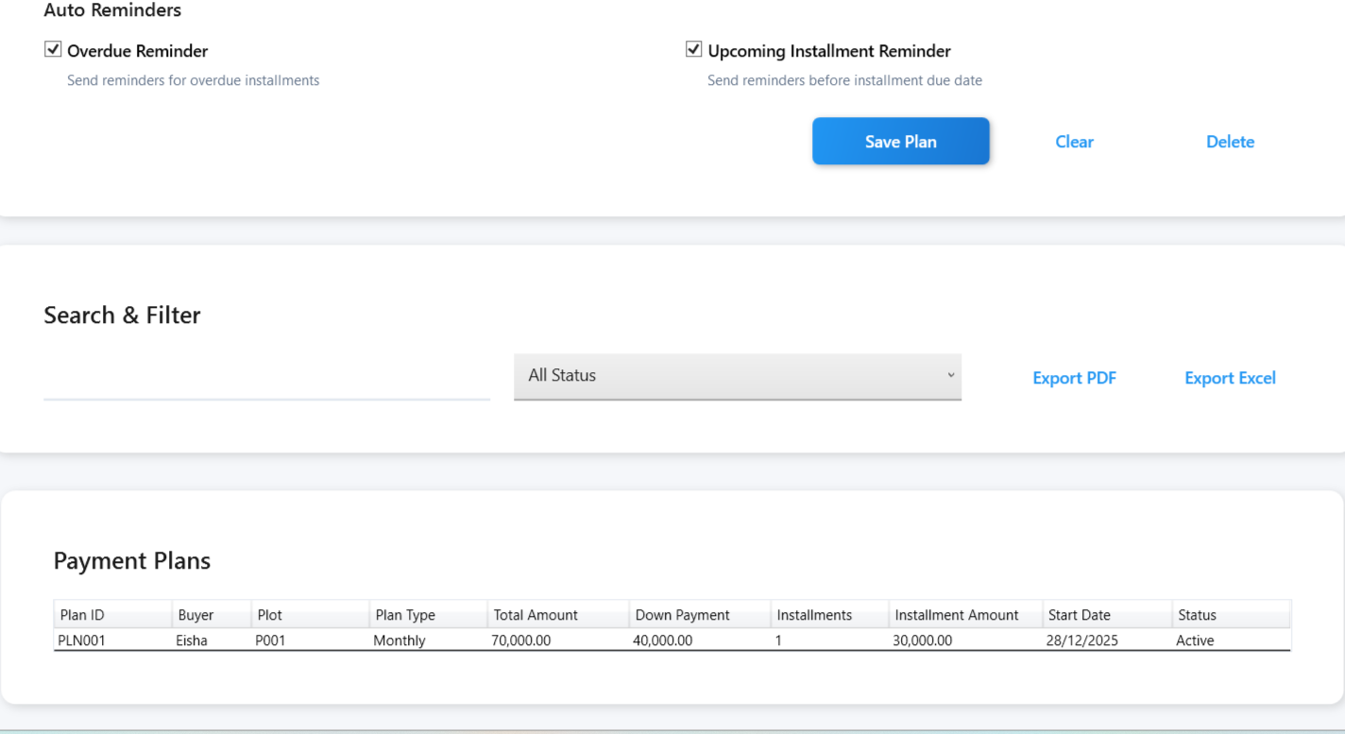
Installments & Payment Plans
Installments & Payment Plans
Provides Grid View and search filter options

Slide 22
Future Enhancements
PDF/Excel Export
Email Integration
Some Other Modules like Sales Report, Commission etc

Slide 23
Thank You!!!!

