Slide 1
CGB1201 – JAVA PROGRAMMING
Department of Artificial Intelligence and Machine Learning
Academic Year: 2024 – 2025 (Odd Semester)
Register Number : 2303811714821059
Name : VISVAJEET.R.S
Year : II
Semester : III
Section : A
Date : 25.11.2024

Slide 2
Title of the Project
The Library Management System

Slide 3
Abstract
The Library Management System is a Java-based application designed to streamline the management of books in a library. It allows users to perform essential operations such as adding, updating, deleting, and searching book records. With an intuitive interface and modular design, the system ensures efficient management of book details, including titles, authors, ISBNs, and availability statuses. The system demonstrates Java's object-oriented programming capabilities and sets the foundation for future enhancements, such as integration with databases for persistent storage.

Slide 4
Introduction
The Library Management System addresses the challenges of organizing and managing library resources effectively. Traditional methods often involve manual record-keeping, which is time-consuming and prone to errors. This project provides a software solution to manage book records efficiently, offering features like book searches and updates. Built using Java, the system emphasizes scalability, ease of use, and code reusability, making it suitable for libraries of various sizes.

Slide 5
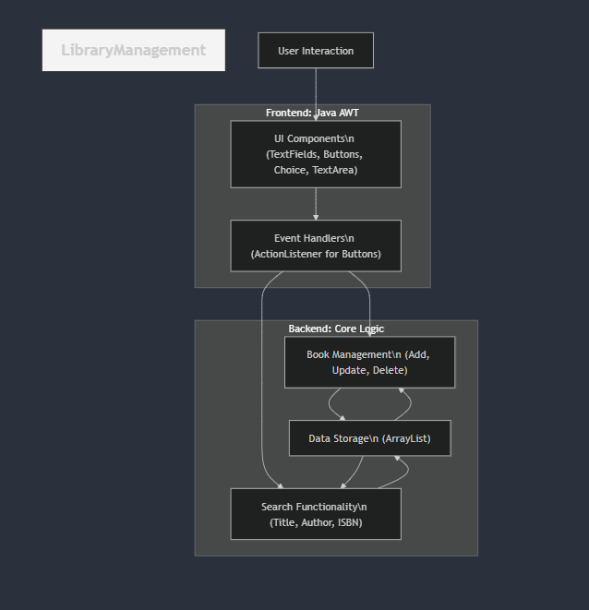
Proposed Architecture - Diagram

Slide 6
Proposed Architecture
The architecture is designed to manage book data dynamically and provide an interactive user interface for library operations. It follows a modular structure for separation of concerns, making the system efficient and scalable. The system includes:
Book Management: Handles CRUD (Create, Read, Update, Delete) operations for books.
Search Functionality: Enables users to find books based on title or author.
Interactive Menu: Provides a command-line interface for user interaction.

Slide 7
Proposed Architecture - Description
Core Components:
Book Class: Represents individual book entities with attributes such as title, author, ISBN, and availability status.
LibraryManagementSystem Class: Encapsulates operations like adding, updating, deleting, and searching for books.
Main Class: Provides a user-friendly menu for interaction.
Workflow:
Users interact with the system through a menu-driven interface.
Book records are dynamically managed using an ArrayList.
Operations like search and updates are executed using efficient methods.

Slide 8
Proposed Architecture - Description (Cont..)
Scalability:
Easily extendable to integrate with database systems like MySQL for persistent storage.
Additional features like user authentication, borrowing/returning books, and report generation can be added.
Error Handling:
Ensures robust performance by handling invalid inputs and maintaining data integrity.
Technology Stack:
Programming Language: Java
Tools: JDK

Slide 9
List of Modules
Book Management Module: Handles all operations related to book records.
Search Module: Provides functionality to search books by title or author.
Interactive Menu Module: Allows users to navigate and perform library operations.
Utility Module : For error handling and future enhancements like file storage.

Slide 10
Module Description
Book Management Module:
Manages CRUD operations for books.
Implements data encapsulation through getters and setters.
Search Module:
Searches books based on title or author.
Supports partial and case-insensitive matching for user convenience.
Interactive Menu Module:
Provides a menu-driven interface.
Uses input validation to ensure error-free user interaction.

Slide 11
Module Description (Cont..)
Utility Module :
Can handle advanced functionalities like saving data to files or databases.
Manages exceptions to improve user experience.
Future Extensions:
Adding user authentication for access control.
Implementing a borrowing/return system for better library management.

Slide 12
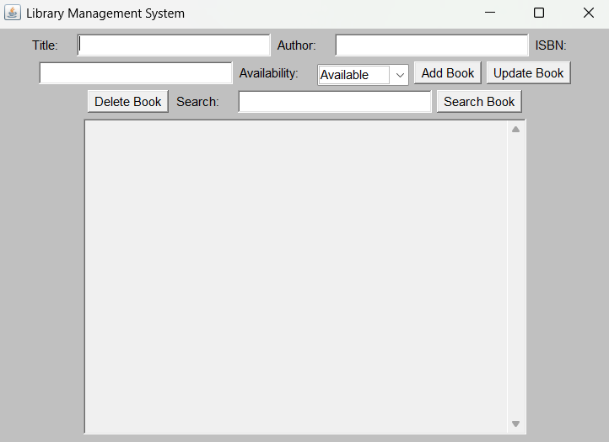
Results and Discussion

Slide 13
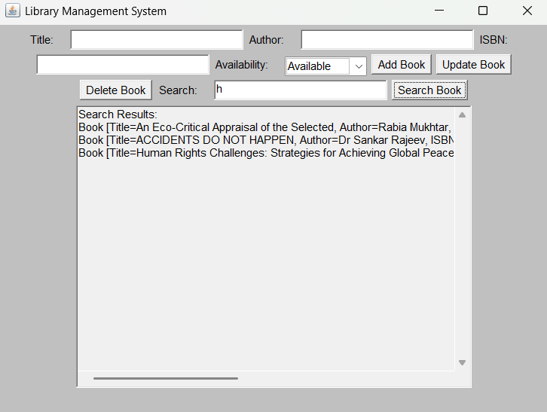
Results and Discussion (Cont..)

Slide 14
Conclusion
The Library Management System demonstrates an efficient and scalable solution for managing library resources. It utilizes Java's object-oriented programming principles to ensure modularity and flexibility. The project provides a robust framework for book management, with scope for future enhancements like persistent storage and user authentication. This system highlights the importance of automation in simplifying and improving library operations.

Slide 15
Thank You
ANY QUERIES???

