Slide 1

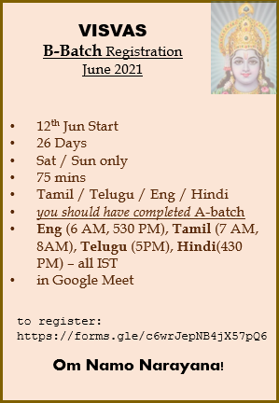
12th Jun Start
26 Days
Sat / Sun only
75 mins
Tamil / Telugu / Eng / Hindi
you should have completed A-batch
Eng (6 AM, 530 PM), Tamil (7 AM, 8AM), Telugu (5PM), Hindi(430 PM) – all IST
in Google Meet
VISVAS
B-Batch Registration
June 2021
to register:
https://forms.gle/c6wrJepNB4jX57pQ6
Om Namo Narayana!

Slide 2
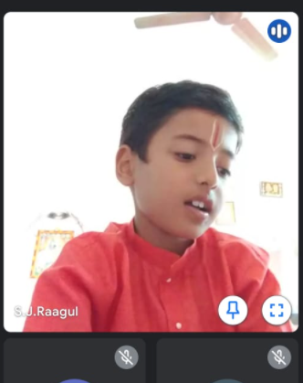
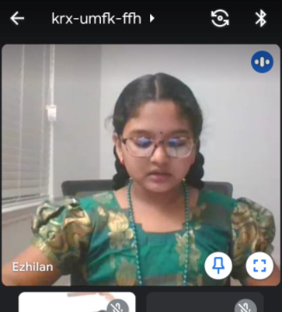
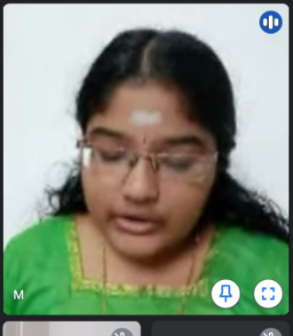
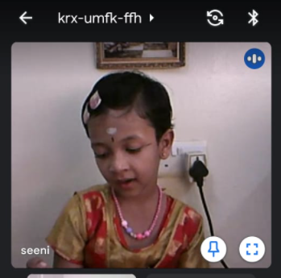
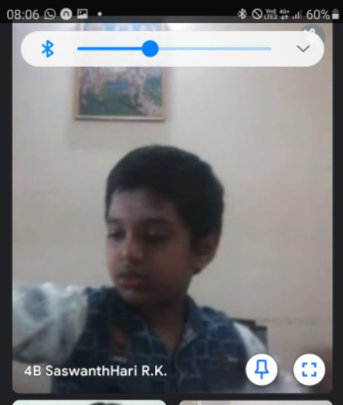
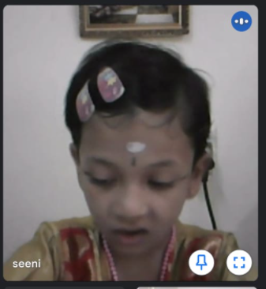
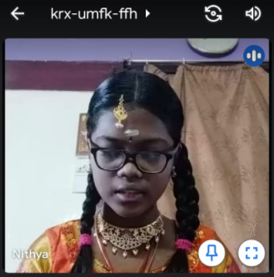
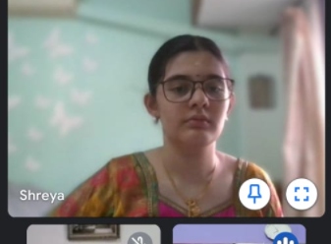
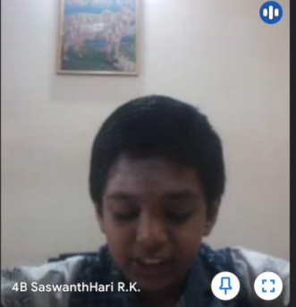

Slide 3
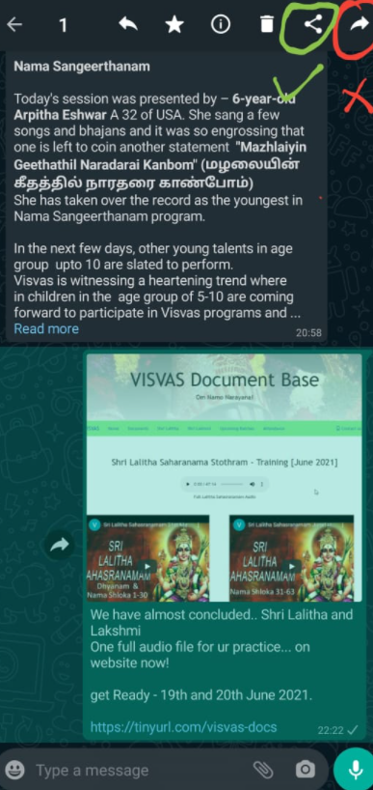
When I forward – only picture goes not the text.. ☹
We will solve ur issue!
Don’t FORWARD!
Hit Share (as in pic)
Select WhatsApp
Select contacts that you like / love to send
DONE!

Slide 4
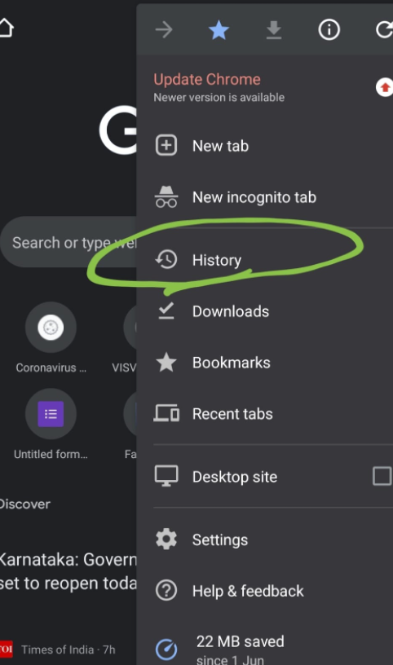
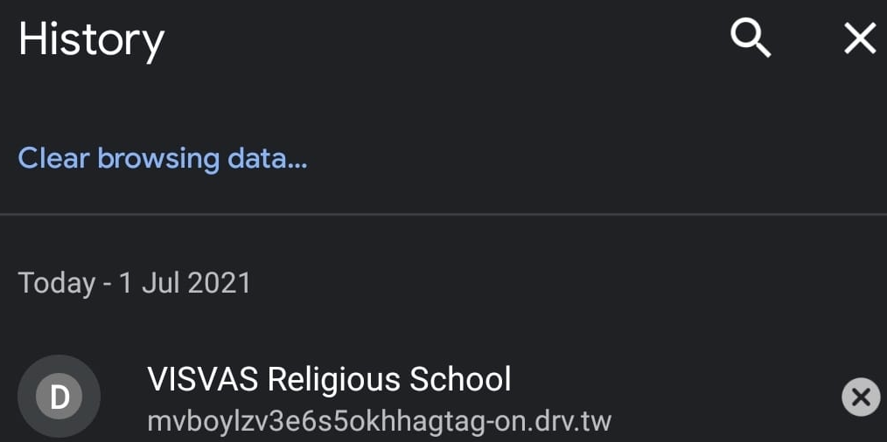
1
2
Mobile browser – open settings -> History -> Clear browsing data
Reload the link / url / page. Laptop browser – Shift + F5 (or) Ctrl + F5

Slide 5
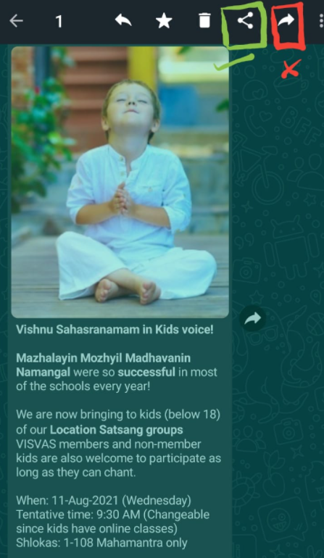
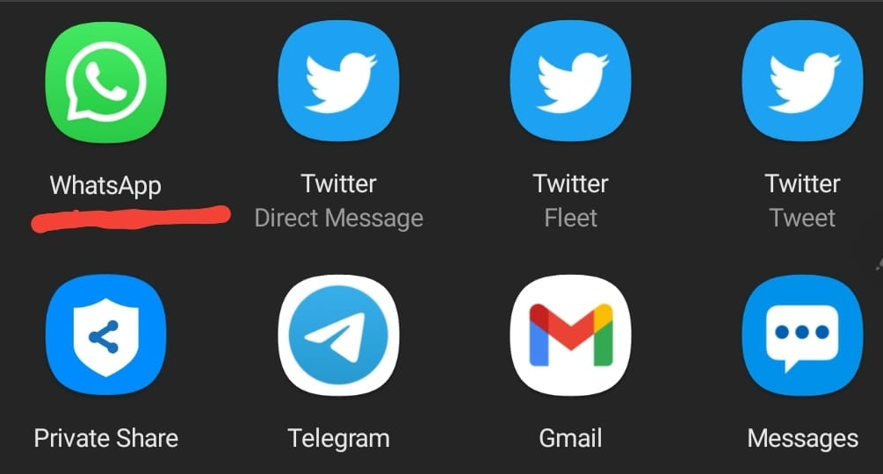
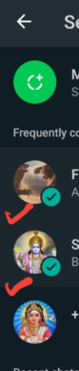
1
2
3

Slide 6



Om Shri Maathre Namaha!
VISVAS presents
1-week Sahasranama Stotram class
Timings: 10 AM – 10:45 AM IST
Date: 30-May-2021
VISVAS Welcomes you all for the Lalitha & Lakshmi Sahasranama Stothram class
Agenda:
Starting Prayer
Welcome Address
Guidelines for Online Classes
Ending Prayer
ZOOM Join link: https://us02web.zoom.us/j/4490291210?pwd=UHM0eFQ3b1ZuMENmcEZtMEMwZmNFdz09
ZOOM APP: Meeting ID: 449 029 1210 Passcode: visvas
5-D principles of VISVAS: Devotion, Discipline, Dedication, Determination, Development

