Slide 2
Problems faced in terrace farming
Narrow terrace, makes it difficult for farmers to navigate.
Lack of affordable tools for efficient operation.
Lack of inputs (moisture, humidity etc.) from the cultivated region to increase the crop of yield.

Slide 3
Features
Basic
Seeding
Watering
Ploughing
Harvesting

Slide 4
Tasks performed by the bot
PLOUGHING
SEEDING (done continuously as the bot moves).
WATERING (done relative to the moisture content already present in soil).
HARVESTING

Slide 5
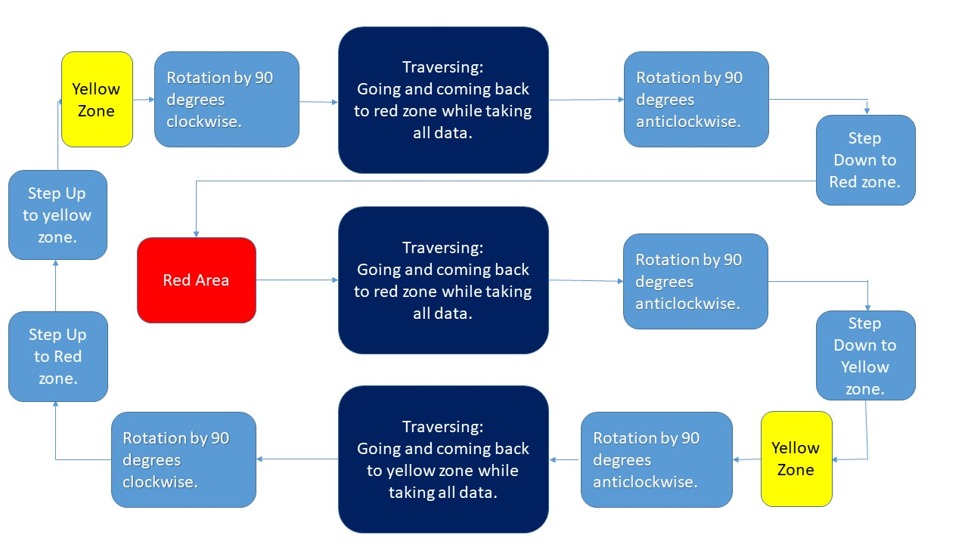
Task flow for bot navigation

Slide 6
TRAVERSING
Traversing occurs with the help of ultrasonic sensors. Which is used to maintain a constant distance from the wall.
After starting, the bot will stop successively after a fixed distance and take readings of various sensors and do watering.
Ploughing will occur automatically as the bot moves.
After detecting end bot will take 180 degree turn clockwise and move back to the red or yellow region.
After detecting red or yellow region, bot will do the required action.

Slide 7
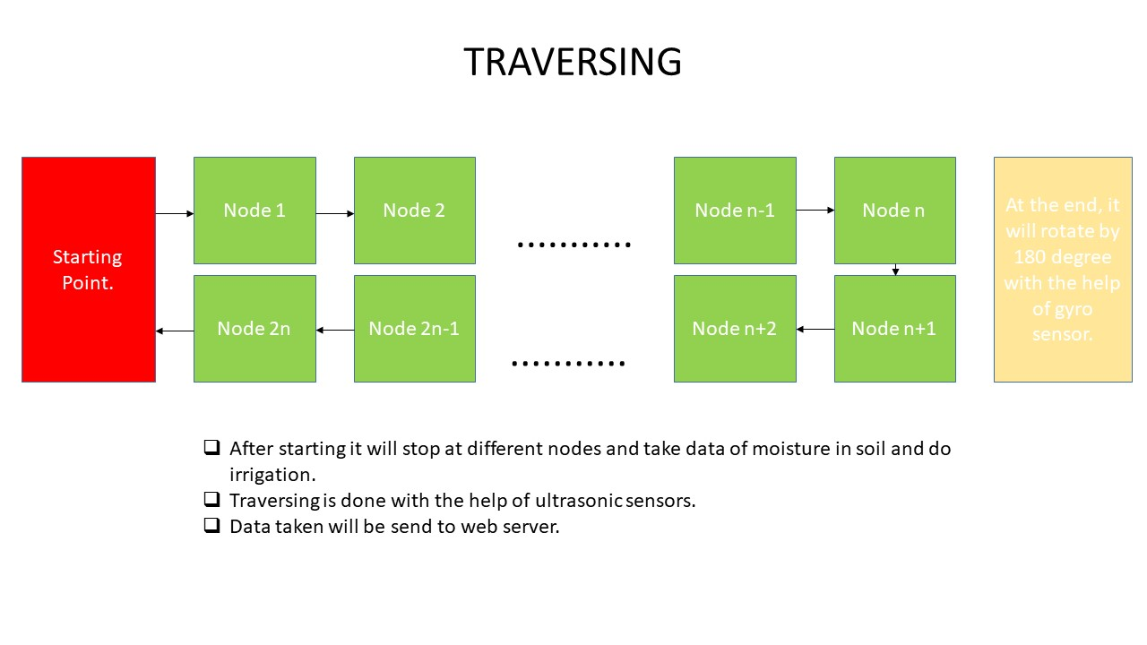

Slide 8
STEP DOWN MANEUVER
From red zone bot starts moving forward until color sensor 1 gives no color.
Then it stops and lead screw 1,2 go down until encoder 1 gives reading of 40 cm.
The bot moves forward until color sensor 2 gives no color.
Again it stops and lead screw 3,4 go down until encoder 2 gives reading of 40 cm.
And now it moves forward by 20 cm and then it stops.
Lead screw 5,6 come down until reading of encoder 3 gives reading of 40 cm.
STEP UP is the reverse of this.

Slide 9
SENSORS USED
ULTRASONIC SENSOR: 5 such sensors are used. Mainly used to maintain constant distance from wall while traversing.
COLOR SENSOR: 2 such sensors are used to detect the zones i.e. yellow zone and red zone.
SOIL MOISTURE SENSOR: 1 moisture sensor is used to take data inputs from the cultivated land.

Slide 10
SENSORS USED
TEMPERATURE SENSOR: 1 temperature sensor is used to get the temperature data from the field.
ENCODER: 4 encoders are used. They are used to keep track of the motor rotations.
MPU 9250 : 1 such sensor is used. It contains gyroscope, accelerometer and magnetometer. It is used to maintain the orientation of the bot.

Slide 11
Working of the IOT
Input data from different sensors (humidity, temperature, moisture etc. ) will be registered by the Arduino AT Mega micro controller.
The input data from the sensors will be sent to the esp8266 NODE MCU through UART communication.
The files received by the esp8266 NODE MCU through the serial monitor will be then sent to the database wirelessly.
The files in the database will be sorted according to the nodes present on the fields. (nodes are the points on the actual land where the bot will take the sensor readings)
The readings will be rendered to the web page depending upon the choice of the node the farmer wants to analyze.

Slide 12
Simplified flow chart
Receives data of different sensors from micro controller wirelessly
Stores the data in database sorted according to the nodes
A web-page displays the cultivated land divided into different nodes.
Farmer clicks on the node whose data is to be analyzed.
Data of the particular node is rendered to the website and displayed.

Slide 13
Wireless data transfer to Database
A set of code running on the NODE MCU will create a local server.
A python script will be running in the background and will be connected to the same server as created by the NODE MCU.
This python script will run on the computer where the database is to be created.
The data transfer from the NODE MCU to the database will take place through the common local server through which they are connected.
ESP_MICRO.h is an important micro header file for the NODE MCU which is essentially required for such data transfer.

Slide 14
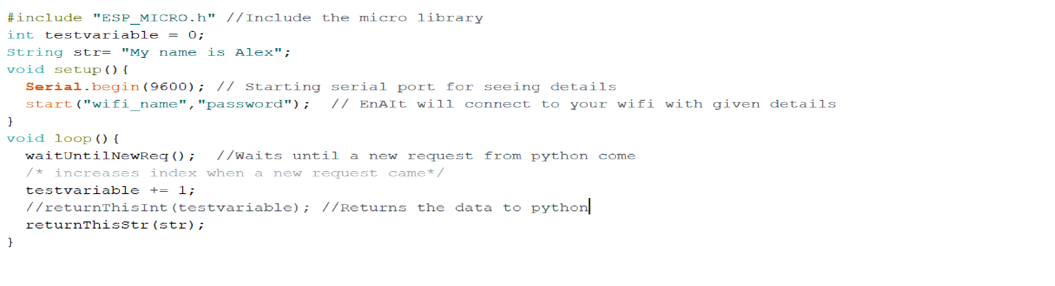
Sample esp8266 code
Following code will run on the esp8266 and will be responsible for creating the local server and transfer of data to the python script.

Slide 15
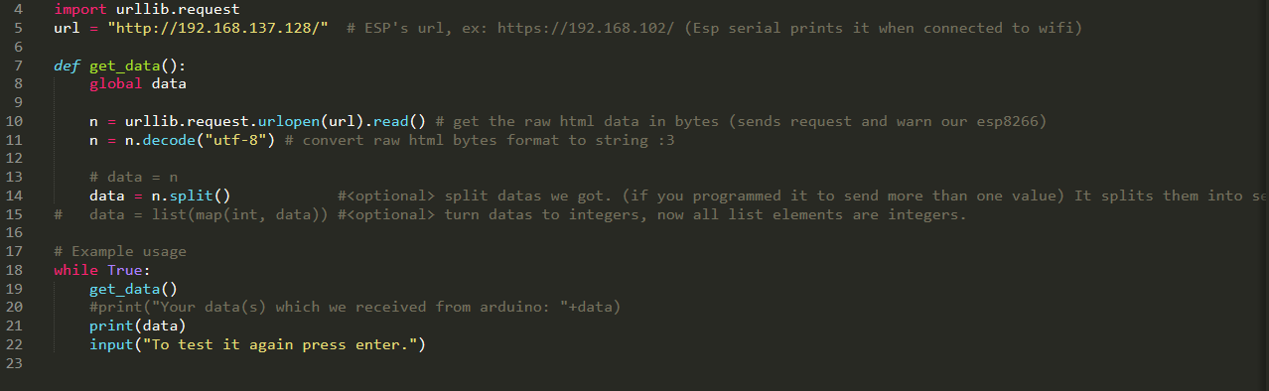
Sample Python Script
The following is a sample python code which will run on the computer where the database is located. The code will receive data from the esp8266 through the local server as shown.

Slide 16
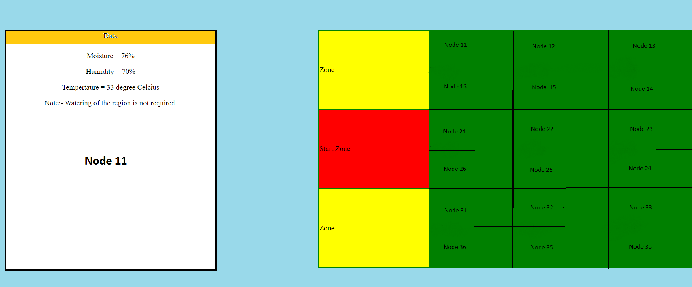
The Web Page
Below is the snapshot of the preliminary web page that will be accessed by the user.

Slide 17
Working
The right hand table in the web page is a 2 dimensional replica of the land under cultivation. In our case it is the arena for the problem statement.
The table is responsive and will respond to the click of the user.
Each step is divided into different nodes. It is the region where the Agri-tech bot will take the readings from the sensors.
The user has to click on the node whose readings he wants to analyze.
The data of the particular node will be displayed in the box present on the left hand side of the web page.
The data from the database will be rendered to the website using flask. A note/message can be delivered regarding what can be expected of the readings.

Slide 18
Importance of weed removal.
Reduce the yield and quality of rice by competing for nutrients, water and sunlight
Weeds intensify the pest and disease problem by serving as alternate
host
Reduce the efficiency of harvesting
Reduce the land value
Problems of water contamination
Upland direct seeded | 35-45 % reduction in yield
Direct seeded on puddle land | 20-25% reduction in yield
Transplanted rice | 10-15% reduction in yield

Slide 19
Automated weed detection
Removal of weed is a very labor intensive and time consuming process and thus requires to be automated.
A high resolution camera is mounted on the bot to capture live feed video.
The detection tool uses machine learning procedure based on support vector machines and blob analysis for effective classification of weed.
Training of the model is done based on 3 scenarios:-
Maximum crop sample
Maximum weed sample
Marginal weed and crop sample
The trained module is expected to achieve a success percentage of 59-95% to detect the weed.

Slide 20
Sample detection
Maximum weed sample
Marginal weed and crop
Model successfully detecting weed in the presence of maximum weed in the video frame.
Model successfully detecting weed in the presence of crop.

Slide 21
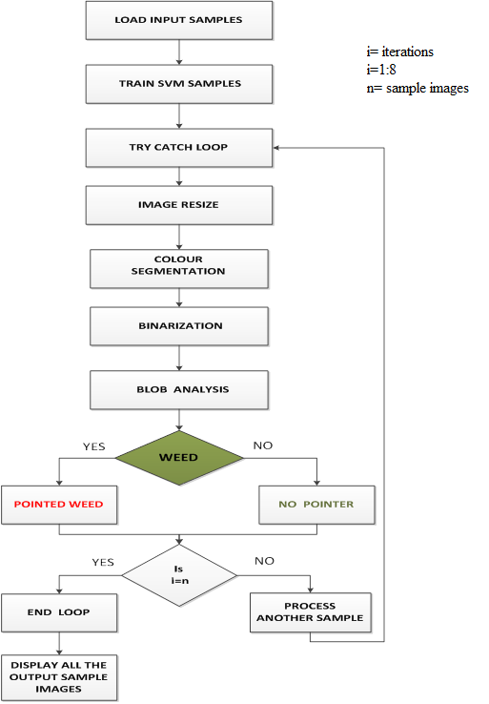
Task Flow

Slide 22
Features
Advanced
Sensors: Installed with advanced sensors like moisture, humidity, temperature etc. to get the data inputs.
IOT enabled: Display sensor data on a web page. The bot can be controlled as per user discretion.
Weed detection: The bot is capable of detecting weed and perform the required action to eliminate it.
Alert System: A centralized alert system governs the bot. It can alert the user in case of:-
Shortage of seeds
Low power
Internal damage
Solar powered: The bot can be customized to run on solar powered panels.

Slide 23
Features
Advanced
Sensors: Installed with advanced sensors like moisture, humidity, temperature etc. to get the data inputs.
IOT enabled: Display sensor data on a web page. The bot can be controlled as per user discretion.
Weed detection: The bot is capable of detecting weed and perform the required action to eliminate it.
Alert System: A centralized alert system governs the bot. It can alert the user in case of:-
Shortage of seeds
Low power
Internal damage
Solar powered: The bot can be customized to run on solar powered panels.

