Slide 1
Disney+HotStar Data
Analysis

Slide 2
Strategies for growth
Navigating the future

Slide 3
Business use Cases:
Content Strategy
Audience Segmentation
Marketing Campaigns
Historical Analysis
Additional Use Cases

Slide 4
1) Count of Movies in each Genre:
The Drama genre dominates with a significant count of movies, showcasing its strong appeal to a wide audience. The difference between the Drama genre and the second most prevalent genre is substantial, indicating its unmatched popularity.
Genres like Comedy, Romance, Action, and Thriller also hold significant counts, reflecting diverse audience preferences and potential for varied content offerings. Meanwhile, genres like Family, Animation, and Documentary have an average count, suggesting niche but steady demand.
Streaming platforms should prioritize a robust content strategy around Drama while diversifying with other high-performing genres to maximize audience engagement and satisfaction.

Slide 5
2) Average Running Time by Genre:
The Sports genre leads with the maximum average running time, while Shorts have the minimum. However, the average running time across genres shows minimal variation, with only a 10 to 20-minute difference between them.
This consistency in running times suggests that audience preferences are less about duration and more about content type.
Streaming platforms can use this insight to segment audiences based on genre rather than running time, tailoring recommendations and marketing strategies to focus on content type and thematic preferences, rather than just the length of content.

Slide 6
3) No of Movies Released in Each-year
The number of movie releases increased steadily after 2006 and experienced a rapid surge post-2014, reaching its peak in 2022. The 1990s, in contrast, had the minimum count of releases.
This trend highlights a significant growth in content production over the past two decades. For movie studios and streaming platforms, understanding this historical shift is crucial for forecasting future production needs, optimizing release schedules, and identifying potential market saturation points.
This insight can guide strategic decisions in content planning, ensuring a balanced and timely approach to movie releases that aligns with industry growth trends.

Slide 7
4) Top 10 Longest Running Time by Movies
The top 10 longest-running movies range from 229 to 180 minutes, showcasing a diverse mix of 11 genres.
Notably, Drama leads with 4 movies, followed by Animation with 3, and Action with 2. Other genres, including Fantasy, Superhero, Historical, Thriller, Concert Film, Animation, and Biopic, each have one movie represented.
This variety indicates that both intense storytelling (Drama, Action) and visually immersive experiences (Animation, Fantasy) can sustain longer viewing times. Streaming platforms can leverage this insight to curate special collections or feature marathons, catering to audiences who prefer longer, in-depth content across diverse genres.

Slide 8
5) Distribution of Movies by Age Rating
The distribution of movies by age rating reveals key audience segments: U/A 13+ dominates with 43.3% of movies, indicating a broad appeal to teenage and family audiences.
The U rating follows with 18.2%, catering to general audiences, while U/A 16+ and U/A 7+ account for 17.79% and 15.5% respectively, serving more specific age groups.
The A rating represents 5% of movies, targeting adult viewers. These insights help streaming platforms and content creators tailor recommendations and marketing strategies to different audience segments, ensuring content offerings align with the predominant viewing preferences of each age group.

Slide 9

Market expansion
Unlocking new horizons

Slide 10
6) Count of Movies by Year and Genre
When analyzing the count of movies by year and genre, Drama consistently leads with the highest number of releases, making it a prime genre for sustained marketing efforts.
Comedy and Reality genres show nearly equal release counts each year, offering opportunities for cross-promotional campaigns.
Other genres like Action, Romance, and more, while having fewer releases, can be targeted with niche marketing strategies that focus on specific audience interests. Leveraging these trends, marketing campaigns can be tailored to highlight dominant genres like Drama for broad appeal, while also capitalizing on the steady interest in Comedy and Reality for specialized outreach.

Slide 11
7) Count of Movies by Genre and Movie Type
When analyzing the count of movies by genre and type, Movies dominate in overall count compared to TV series.
However, Drama and Reality genres show significant representation in TV series, indicating strong viewer engagement in serialized content.
Other genres have a lower count in TV series, suggesting niche appeal. For marketing campaigns, focusing on the high volume of movies can drive broad audience engagement, while targeted promotions around Drama and Reality TV series can attract dedicated viewers.
This dual approach ensures a comprehensive reach, catering to both movie enthusiasts and TV series fans

Slide 12
8) Top 10 Genre over Period of Year
Over the years, the top 10 genres have been Action, Animation, Comedy, Documentary, Drama, Family, Reality, Sports, and Thriller.
Among these, Drama, Reality, Action, Comedy, and Documentary stand out as consistently dominant, reflecting strong audience demand across a wide range of content types.
Streaming platforms can leverage this insight by prioritizing these high-performing genres in their content acquisition and production strategies, ensuring a diverse and appealing content library that caters to both broad and niche audiences.

Slide 13
9) Movies with Maximum no of Episodes
Movies with the maximum number of episodes reach up to seven, but those with five, four, or three episodes are relatively rare.
In contrast, movies with one or two episodes are far more common. This trend suggests that audiences may prefer standalone or short-form content over extended multi-episode formats.’
Streaming platforms can use this insight to focus on promoting and producing single or double-episode movies, while selectively investing in longer episodic content to cater to niche audiences who prefer in-depth storytelling.

Slide 14
FUTURE INITIATIVES
Product enhancement. Introduce regular updates and features to enhance product offerings.
Technology integration. Explore emerging technologies for potential integration into our operations.
Collaborative partnerships. Foster collaborations with tech innovators and industry leaders to drive innovation.
Green supply chain
Reduced carbon footprint
Waste reduction
Water conservation

Slide 15

INNOVATIVE SOLUTIONS

Slide 16
Conclusion:
Content Strategy: Drama dominates in both movies and TV series, but there’s potential to diversify with genres like Action, Comedy, and Documentary, which also have strong audience appeal. Focusing on single and two-episode formats can cater to the majority preference, while selectively investing in longer episodic content.
Audience Segmentation: The U/A 13+ rating leads in movie distribution, suggesting a strong teenage and family audience base. Tailoring content recommendations and marketing strategies to these segments will enhance viewer engagement.
Marketing Campaigns: Consistent releases in Drama, Reality, and Comedy across both movies and TV series provide opportunities for targeted campaigns. Leveraging the steady interest in these genres can maximize reach and audience retention.
Historical Analysis: The rapid increase in movie releases since 2014, peaking in 2022, highlights the growing content demand. Understanding these trends can guide strategic planning for future content production and release schedules.

Slide 17
Improvement Solutions:
Expand Content Offerings: Increase investment in underrepresented genres within TV series, such as Animation and Family, to capture niche markets.
Tailored Marketing: Develop specific campaigns for high-performing genres, particularly Drama and Comedy, to maintain and grow viewer interest.
Optimize Content Formats: Focus on producing more single and double-episode movies, while strategically promoting extended content for dedicated viewer segments.
Future Content Planning: Use historical data to forecast demand and adjust production volumes, ensuring a balanced release strategy that meets audience expectations and market trends.

Slide 18
analytical Reports:

Slide 19
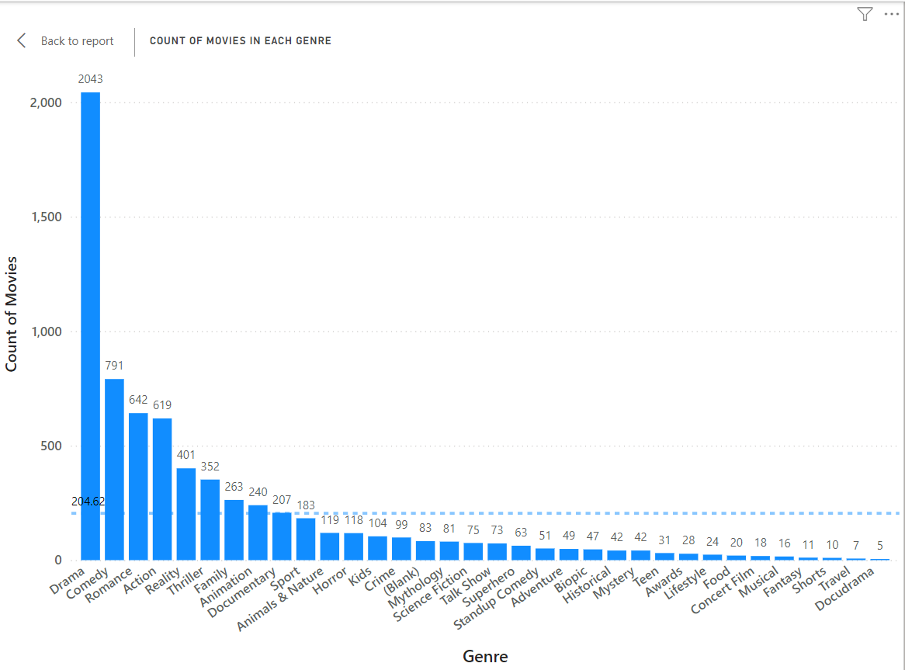

Slide 20
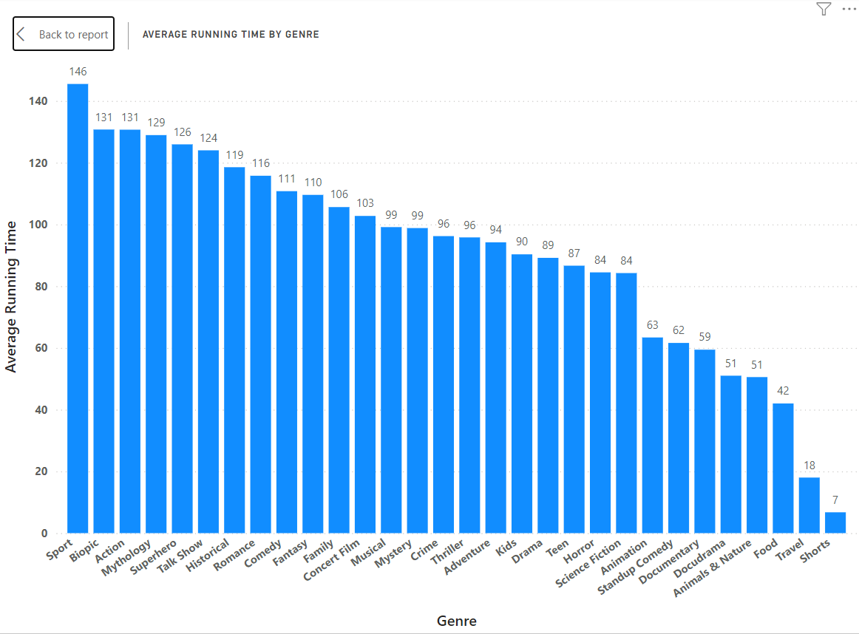

Slide 21
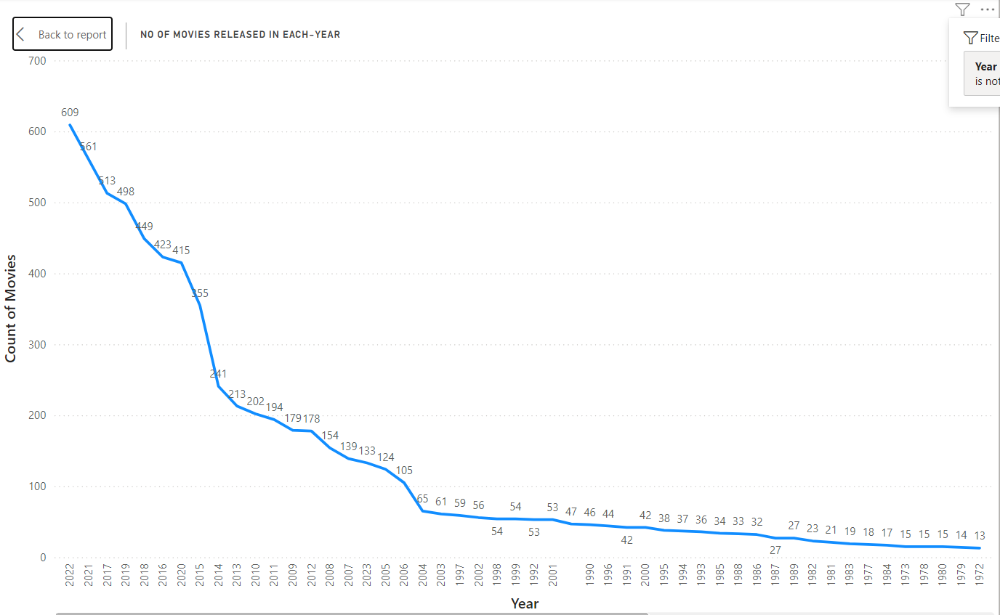

Slide 22
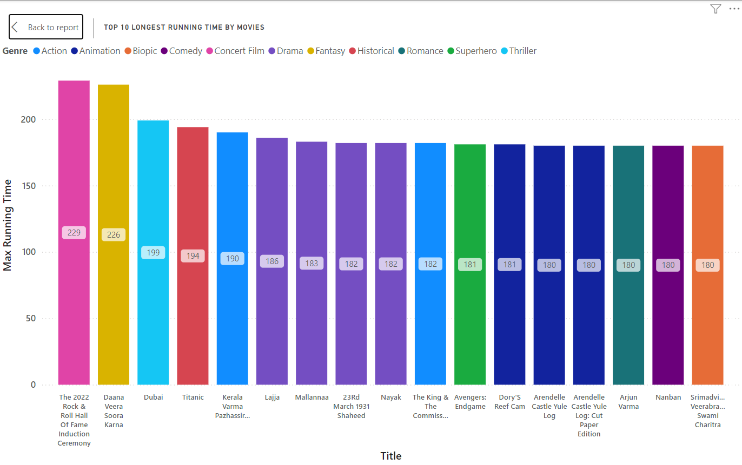

Slide 23
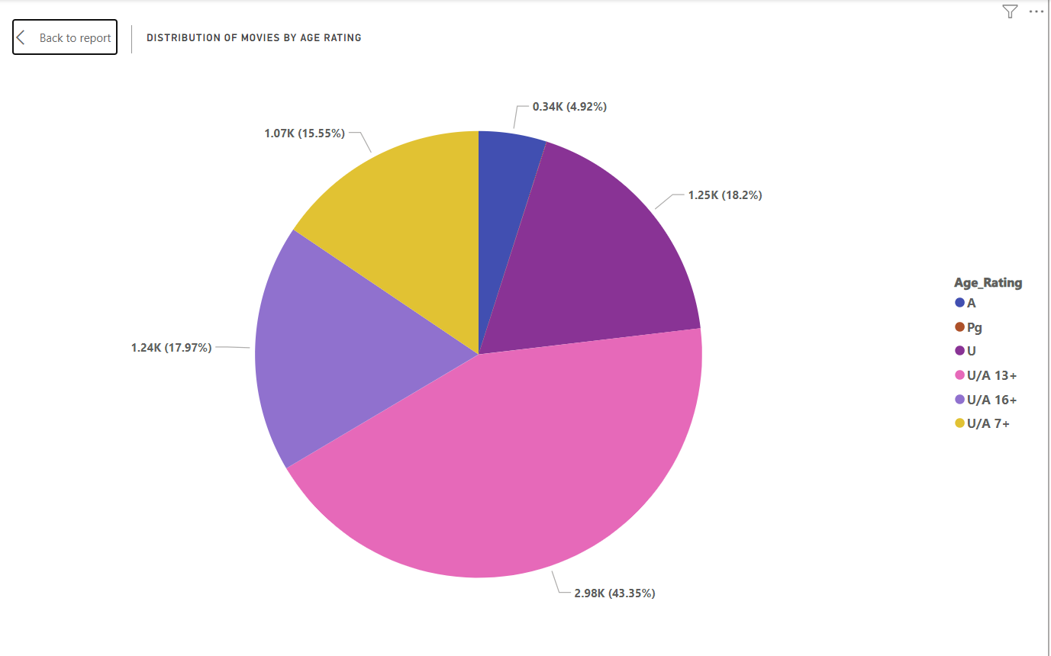

Slide 24
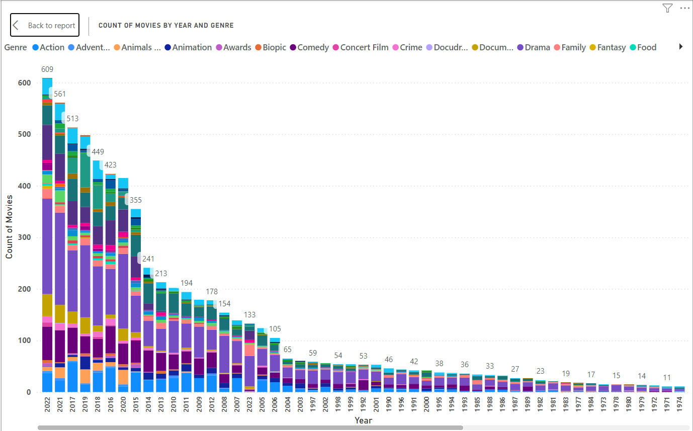

Slide 25
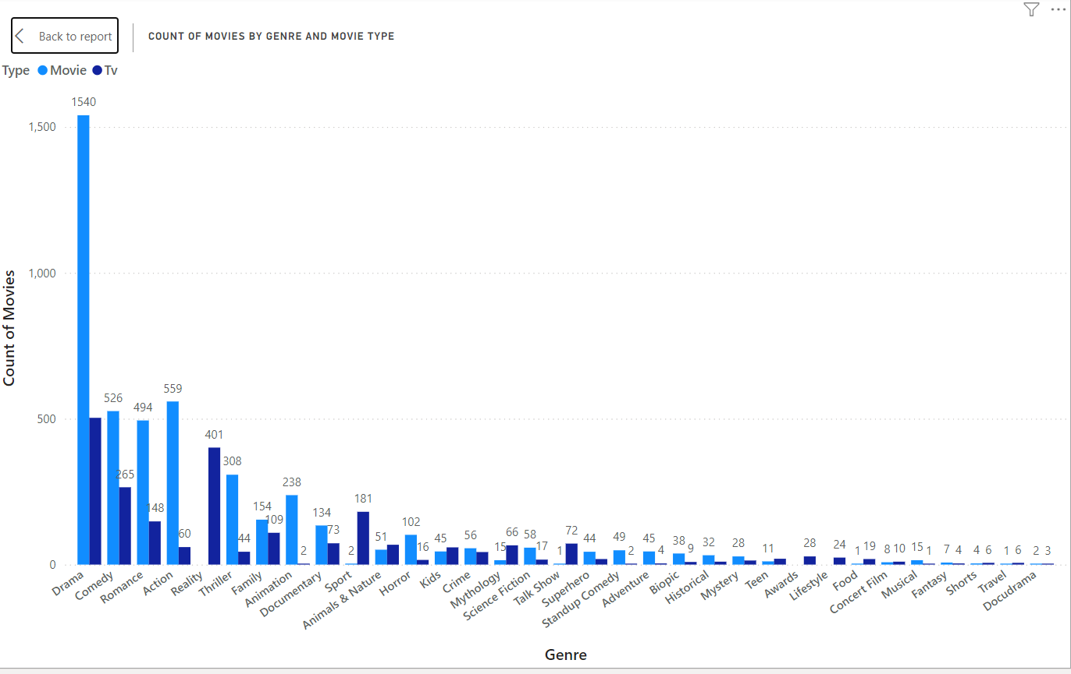

Slide 26
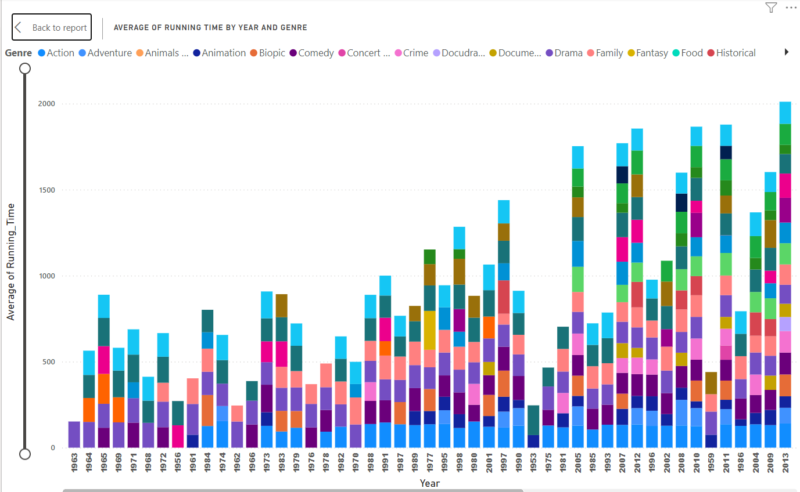

Slide 27
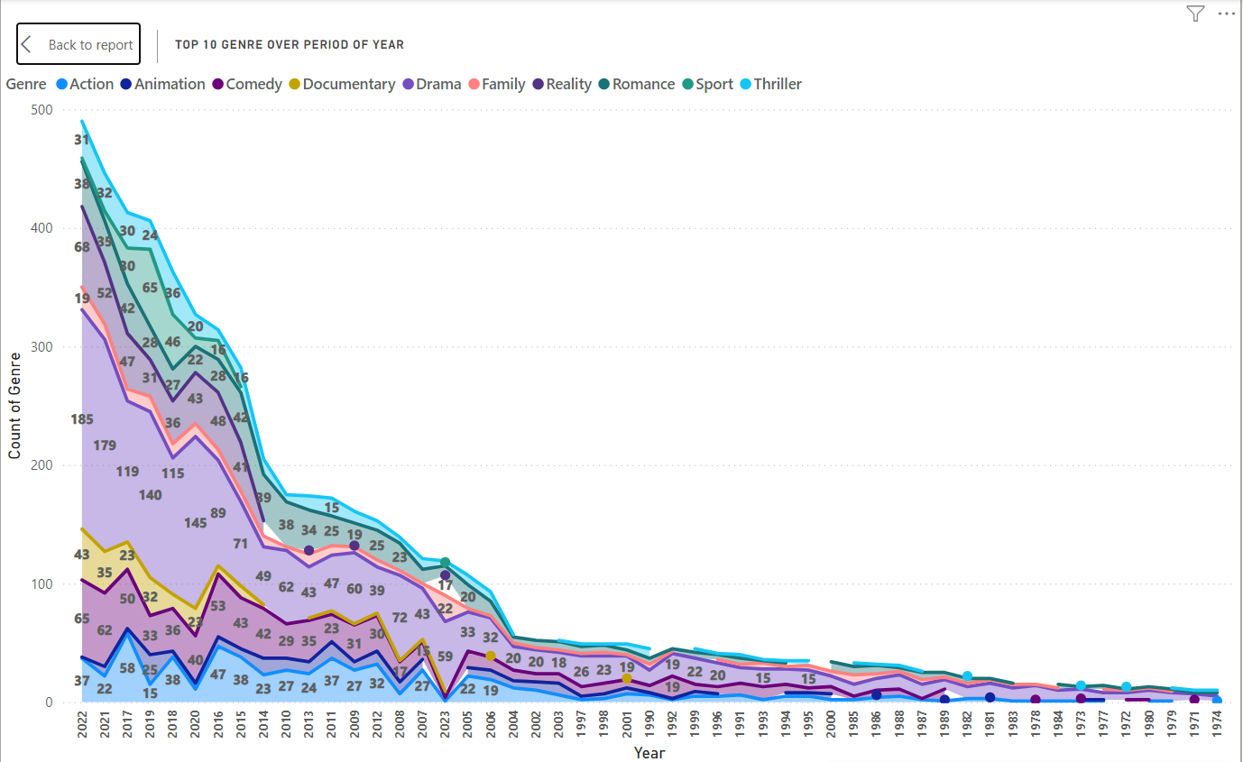

Slide 28
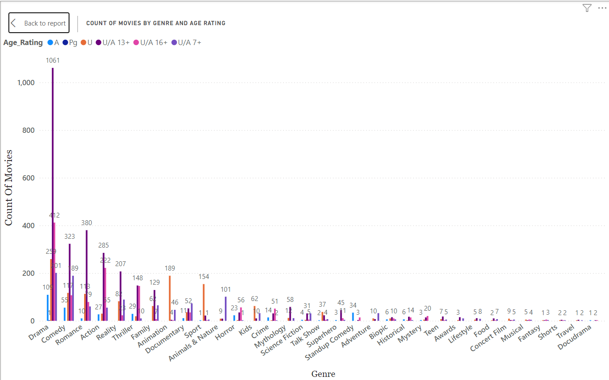

Slide 29
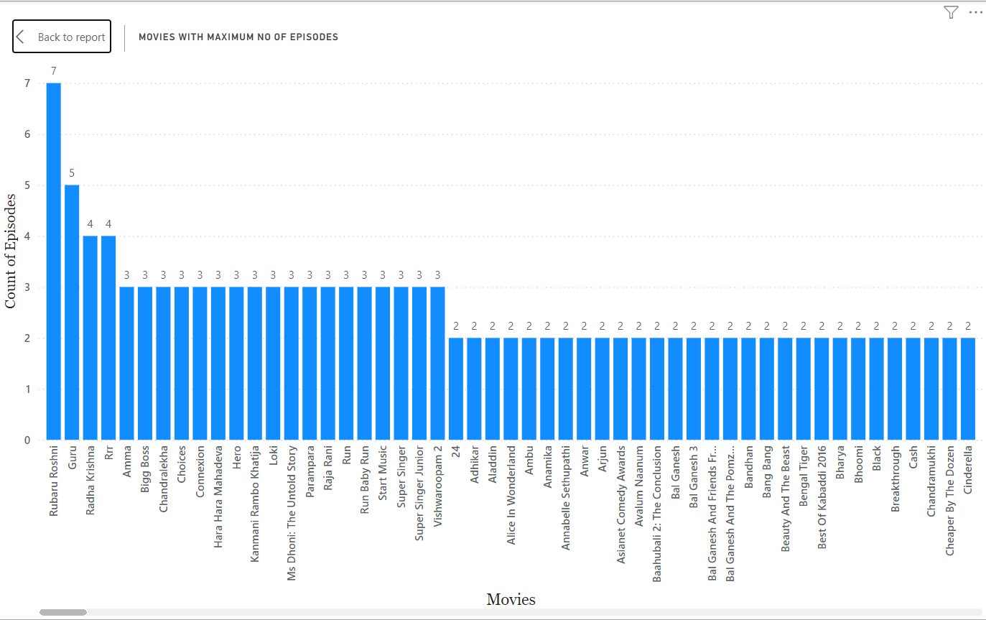

Slide 30
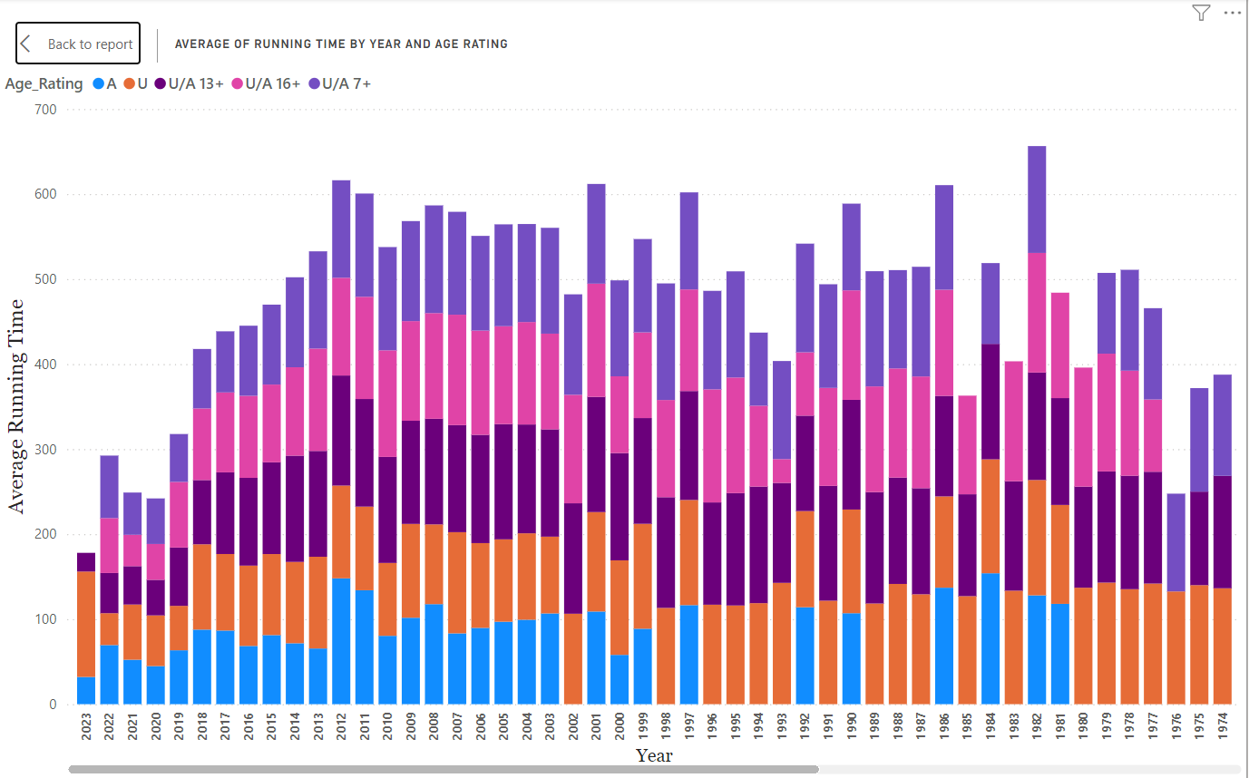

Slide 31
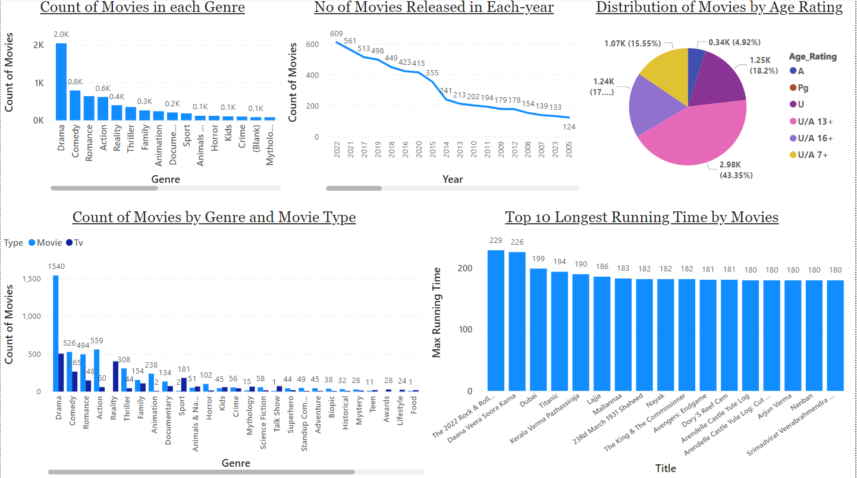

Slide 32
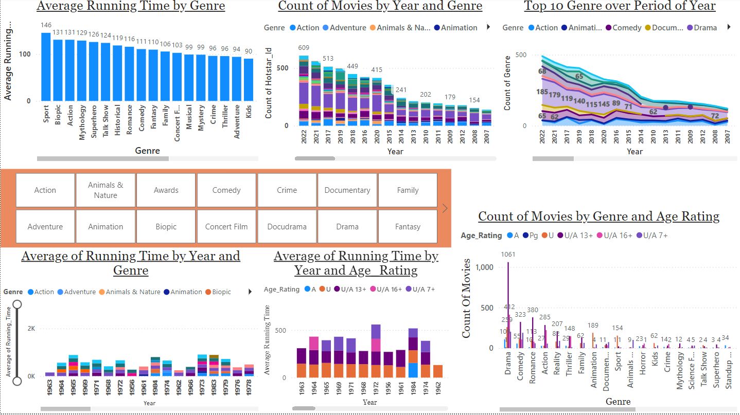

Slide 33
Thank you
Visvasprabhakar R
Master in Digital Marketing and Business Analytics | MBE9

