Slide 1
Business Analytics And Digital Marketing (MBE9)
Project 1: Swiggy Analysis
Name:
VisvasPrabhakar R
Email: visvasprabhakar170703@gmail.com

Slide 2
Data Exploration Process:
Loaded the Data
Imported the dataset for analysis.
Explored the Data
Conducted an initial examination to understand the dataset.
Dataset Characteristics
Recognized that the dataset belongs to a food ordering and delivery company.
Identified Data Attributes
Listed and reviewed the data types and column names.
Data Structure Analysis
Counted the number of rows and columns in the dataset.

Slide 3
Data Cleaning Process:
Check Data Types
Verify the data types of each column.
Correct any incorrect data types.
Handle Missing Data
Identify and remove any empty rows.
String Alignment
Use functions like PROPER and TRIM to standardize text data.
Convert Data to Table
Select the entire dataset and convert it into a table format.
Promote Headers
Set the first row as the header of the table.

Slide 4
Data Loading and Transformation in Power BI:
Load Data in Power BI
Open Power BI.
Before loading, choose to transform the data.
Transform Data Example
Column Splitting
Example: Column named "Food Type" contains both food items and cuisines.
Split the column using the delimiter "," (comma).

Slide 5
Handle Inconsistent Data:
After splitting, there may be inconsistencies and null values.
Remove rows with empty data.
Advanced Aggregations:
For complex aggregations, use the Advanced option in the Group By window.
Steps for Aggregations:
Group by: Select the columns for grouping.
New Column Name: Provide a name for each aggregated column.
Operation: Choose the aggregation operation (e.g., Sum, Average, Count Rows, etc.).
Column: Select the columns to aggregate.

Slide 6
Task 1: Top 10 Area with highest number of restaurant
Visualization Setup:
Place the Area column on the X-axis.
Place the Restaurant column on the Y-axis.
Note on Counting Restaurants:
Ensure the restaurant count is not a general count, To avoid counting the same restaurant names repeatedly.
Use a distinct count to get the number of unique restaurant values.
Top 10 Restaurant Counts:
The count of restaurants ranges from a maximum of 39 to a minimum of 18

Slide 7
Task 2: Most Popular Food served by Swiggy Each city
Create Measure:
Create a measure called Food Item Count.
Select Table for Visualization:
Choose a table visual for displaying the data.
Select the columns: Food Item, Food Item Count, and City.
Apply Top N Filter:
Apply a Top N filter to the Food Item column to display the top items.
Insights from the Visualization:
Circles: Indicate the most frequently served food items (60% to 100%).
Triangles: Indicate moderately served food items (33% to 60%).
Diamonds: Indicate less frequently served food items (above 30%).

Slide 8
Task 3: Top Rated Swiggy Restaurants (In Percentage)
Funnel Chart Selection:
Use a funnel chart to visualize the top-rated restaurants by percentage.
Identify Key Metrics:
Use Avg Rating and Restaurant for the visualization.
Set Rating Threshold:
Focus on restaurants rated above 90% to 100%.
Color Coding by Percentage:
Different percentages of rated restaurants are colored differently for clear distinction.

Slide 9
Task 4: Correlation affecting average rating
Objective:
Identify factors affecting the average rating of restaurants and the online delivery company.
Key Focus: (Delivery Time)
Delivery time significantly impacts the ratings of both the restaurant and the delivery company.
Visualization Tool:
Use a stacked bar chart to analyze the correlation.
Insights from the Analysis
Impact of Delivery Time on Rating:
Minimum Delivery Time: Not always associated with high ratings.
Maximum Delivery Time: Can receive good ratings if product quality and price are satisfactory.
Average Delivery Time: Often results in good ratings, indicating a balanced approach.

Slide 10
Task 5: Correlation between restaurant price and avg rating
Objective:
Analyze the correlation between average rating and price.
Visualization Tool:
Use a stacked bar chart for this correlation analysis.
Insights from the Analysis:
Average Rating and Price Correlation:
Average-Priced Foods: Quality can lead to high ratings.
Low-Priced Foods: Generally receive lower ratings.
High-Priced Foods: Maintain high ratings, reflecting good quality.
Conclusion: Quality is a crucial factor alongside price in determining ratings.

Slide 11
Task 6: City wise restaurant count
Objective:
Determine the number of restaurants in each city.
Visualization Tool:
Use a clustered column chart for this analysis.
Key Findings:
Restaurant Count Range:
The count ranges from 221 to 87 restaurants.
Cities with Above Average Restaurant Count:
Only five out of nine cities have more than the average count of restaurants.
Cities Needing Focus:
Hyderabad, Delhi, Ahmedabad, and Surat need to focus on increasing their restaurant count.

Slide 12
Task 7:Price Distribution Analysis among restaurants
Objective:
Analyze the distribution of restaurant prices.
Visualization Tool:
Use a pie chart for this analysis.
Key Findings:
Average Price Foods:
These occupy the maximum number of restaurants.
High Price Foods:
As the price increases, the count of restaurants decreases.
Low Price Foods:
Foods with minimum prices are also distributed in low ranges.

Slide 13
Task 8: Delivery time Analysis
Objective:
Analyze delivery times for restaurants.
Visualization Tool:
Use a clustered column chart for this analysis.
Key Findings:
Delivery Time Range:
Delivery times range from 35 minutes to 95 minutes.
Average Delivery Time:
The average delivery time maintained by Swiggy is 53 minutes.
Analysis with Average Line:
Restaurants with delivery times close to the average.
Restaurants with maximum and minimum delivery times.

Slide 14
Task 9: Cuisine Analysis
Objective:
Analyze the count of different cuisines among food items.
Visualization Tool:
Use a clustered column chart for this analysis.
Key Findings:
Cuisine Popularity
Identify cuisines that are most frequently ordered.
The dataset contains a total of 3,794 cuisine entries.
Highlight cuisines that are ordered more frequently than the average count.
Insights from the Analysis:
Some cuisines are ordered significantly more often than others.
Cuisines with above-average order counts stand out in the dataset.

Slide 15
Task 10 : Area wise restaurant analysis
Objective:
Determine the number of restaurants in each area.
Visualization Tool:
Use a stacked column chart for this analysis.
Key Findings:
Restaurant Count Range:
The count of restaurants in each area ranges from 1 to 39.
Busiest Location:
The area with the highest number of restaurants is the busiest location, leading to a
higher number of restaurants.
Below Average Areas:
Many areas have a below-average count of restaurants.
Average Count:
The average count of restaurants per area is 3.

Slide 16
Task 11:Correlation Analysis (Price, Avg rating, Total rating)
Objective:
Analyze the correlation between price, delivery time, and average rating.
Visualization Tools:
Use a line and stacked column chart for this analysis.
Chart Configuration:
Left Side: (Numerical Value)
Represents Price with a line chart.
Right Side: (Numerical Value)
Represents Delivery Time with a stacked column chart.
Bottom: (Downward Mapping)
Represents Average Rating mapped according to delivery time and price.

Slide 17
Key Findings:
Price and Delivery Time:
As price increases, delivery time tends to increase.
Price and Rating:
With increasing price, the average rating also tends to increase.
Price Decrease:
When price slightly decreases, both delivery time and rating tend to decrease gradually.
Insights from the Analysis :
Price vs. Delivery Time:
Higher prices are associated with longer delivery times.
Price vs. Rating:
Higher prices generally lead to higher average ratings.
Price Decrease Effect:
A decrease in price results in a gradual decrease in both delivery time and rating.

Slide 18
Task 12: Customer feedback analysis
Objective:
Analyze customer feedback based on average rating and total rating.
Key Metrics:
Total Rating: Ranges from 50 to more than 1000 ratings.
Average Rating:
Indicates the quality of the restaurant as perceived by customers.
Analysis Logic:
Example Comparison:
Restaurant A:
Total Rating: 200
Average Rating: 4.5
2. Restaurant B:
Total Rating: 5200+
Average Rating: 3.9

Slide 19
Conclusion:
Even though Restaurant B has a lower average rating, the higher total rating indicates a larger customer base and potentially more reliable feedback.
Key Metrics:
Total Rating
Average of total ratings is 2800.
Restaurants with more than 2800 total ratings get a minimal star.
Restaurants with more than 6000 total ratings get a maximum rating.
Insights from Example
Hyderabad:
Most restaurants have very good positive feedback.
Chennai and Delhi:
Each has one restaurant with high positive feedback.

Slide 20
Task 13: Geographical Mapping of restaurant location
Objective:
Map the geographical locations of restaurants and their counts in different areas.
Visualization Tool:
Use a geographical map to display restaurant locations.
Insights from the Mapping:
Restaurant Distribution:
Visual representation of restaurant density across different areas.
Geographical Insights:
Identify areas with high concentrations of restaurants.
Spot regions with potential for new restaurant openings based on lower densities.

Slide 21
Conclusion:
Restaurant Distribution:
The geographical mapping revealed that certain areas, like Hyderabad, have a high concentration
of restaurants, while others like Surat need more restaurants to meet demand.
Customer Feedback Analysis:
Total and average ratings indicated that restaurants with higher total ratings, even with slightly
lower average ratings, generally have more reliable feedback.
Hyderabad stands out with a large number of highly rated restaurants,
while Chennai and Delhi each have one notable restaurant.
Delivery Time Analysis:
There is a correlation between delivery time, price, and average rating. Restaurants that
manage to maintain an average delivery time of around 53 minutes generally receive better ratings.
Both very short and very long delivery times can negatively impact ratings, with an optimal balance being key.

Slide 22
Price Distribution Analysis:
Average-priced foods are the most commonly offered, while both high and low-priced foods are less common. This indicates a sweet spot for pricing that balances cost with quality and delivery time.
Cuisine Analysis:
Certain cuisines are more popular and frequently ordered, suggesting a preference trend among customers.
Business Recommendations:
Expand in Underrepresented Areas:
Focus on increasing the number of restaurants in cities like Surat, Ahmedabad, and Delhi to balance the restaurant distribution.
Optimize Delivery Times:
Aim to maintain delivery times around the average of 53 minutes. Implement measures to ensure timely deliveries while maintaining food quality.
Enhance Quality for All Price Ranges
Ensure that both high and low-priced foods maintain high quality to improve customer satisfaction and ratings.

Slide 23
Leverage Popular Cuisines:
Promote and possibly expand the variety of the most frequently ordered cuisines to cater to customer preferences and increase order volumes.
Monitor and Improve Customer Feedback:
Pay attention to both total and average ratings to gauge restaurant performance. Encourage customers to leave feedback to gather more reliable data.
Use Data-Driven Insights for Decision Making:
Utilize insights from geographical mappings, customer feedback, and delivery time analysis to make informed decisions on restaurant placements, pricing strategies, and operational improvements.

Slide 24
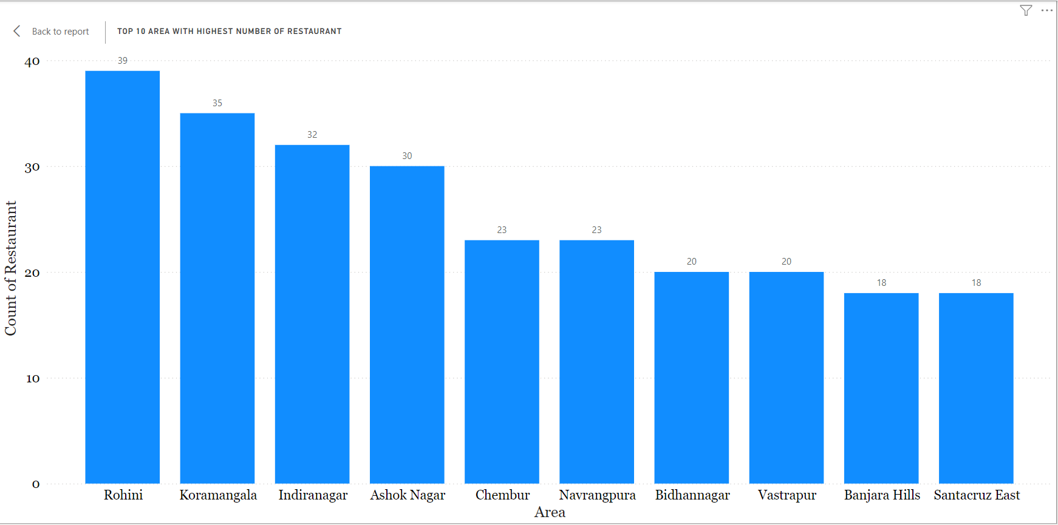
Task 1: Top 10 Area with highest number of restaurant

Slide 25
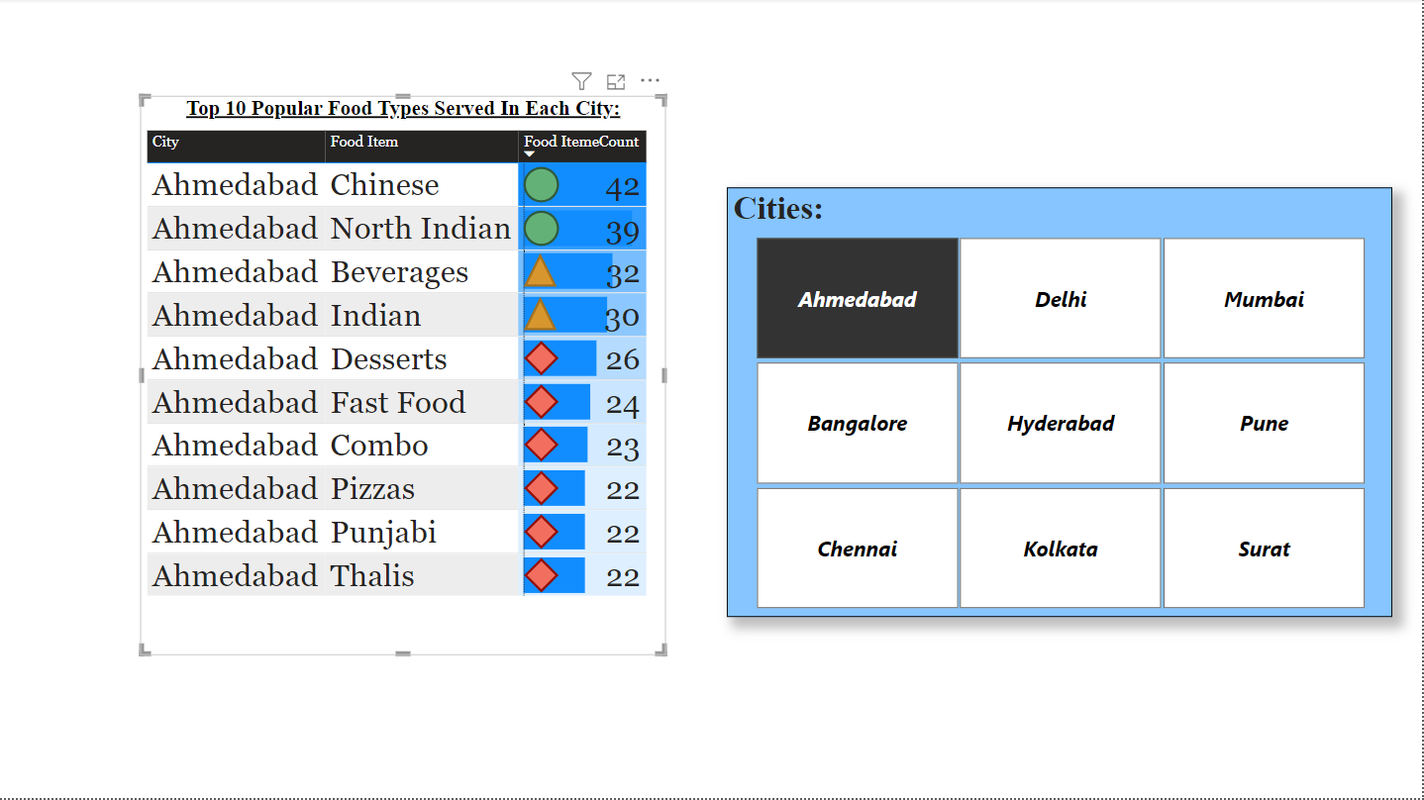
Task 2: Most Popular Food served by Swiggy Each city

Slide 26
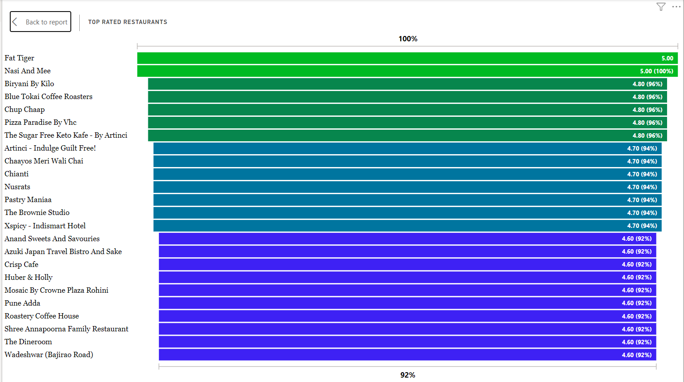
Task 3: Top Rated Swiggy Restaurants (In Percentage)

Slide 27
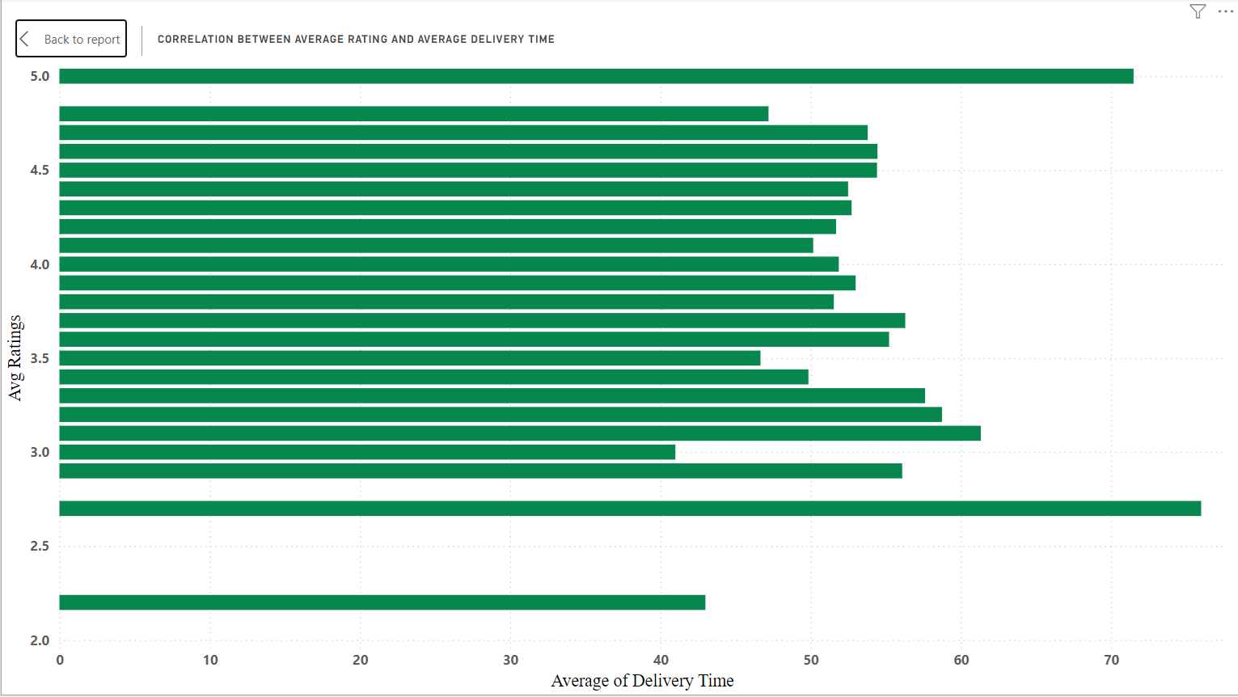
Task 4: Correlation affecting average rating

Slide 28
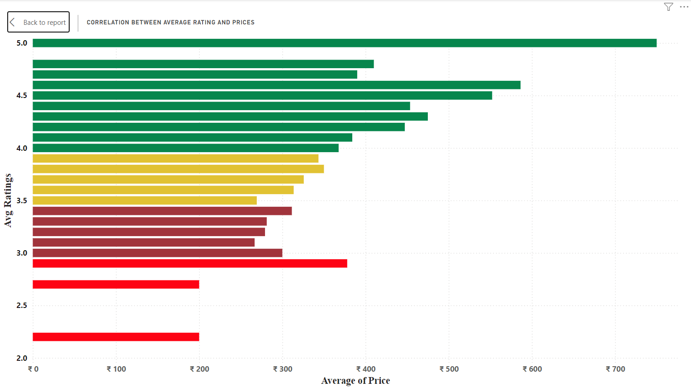
Task 5: Correlation between restaurant price and avg rating

Slide 29
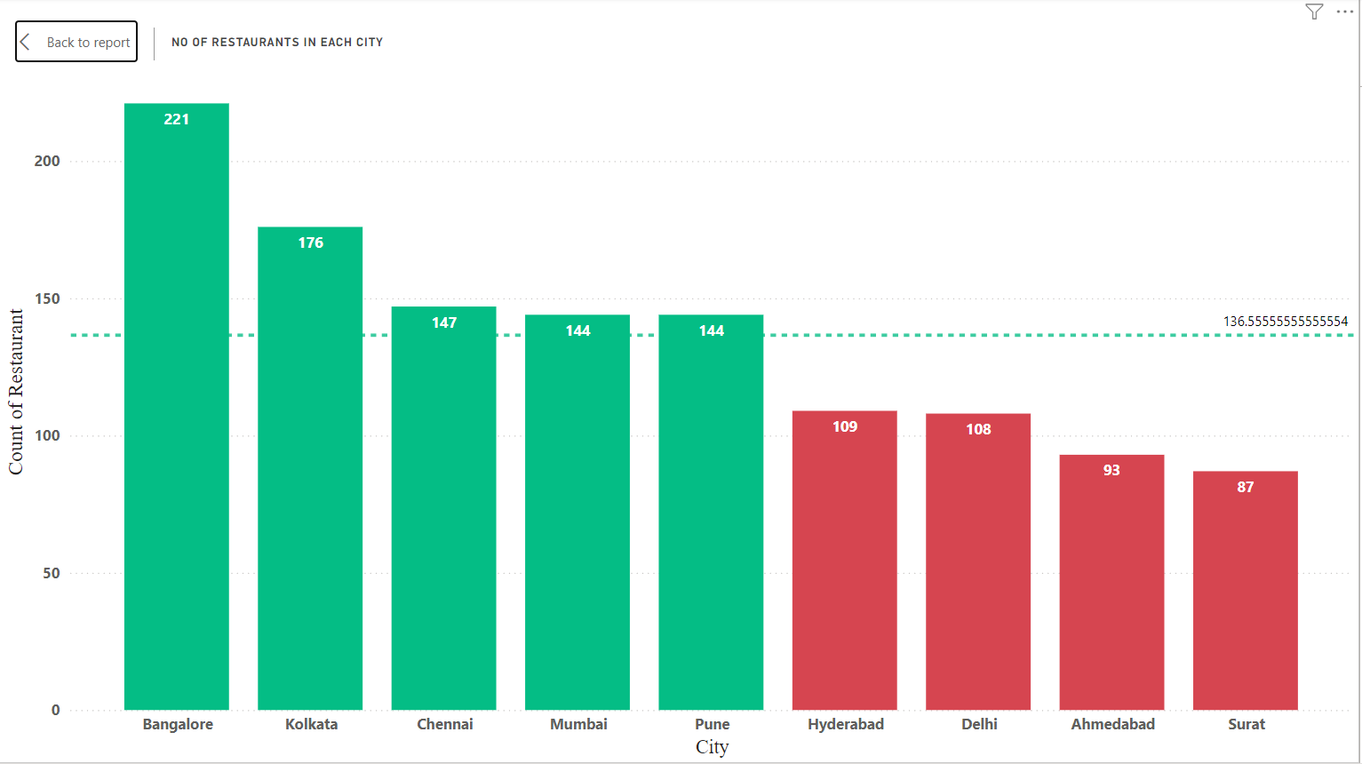
Task 6: City wise restaurant count

Slide 30
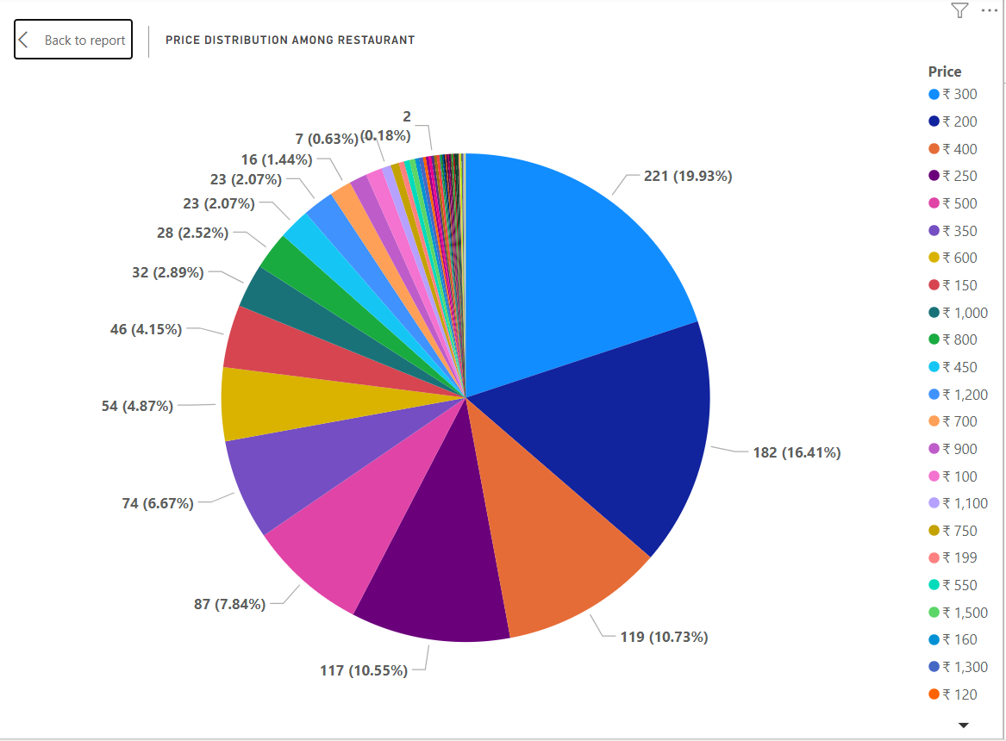
Task 7:Price Distribution Analysis among restaurants

Slide 31
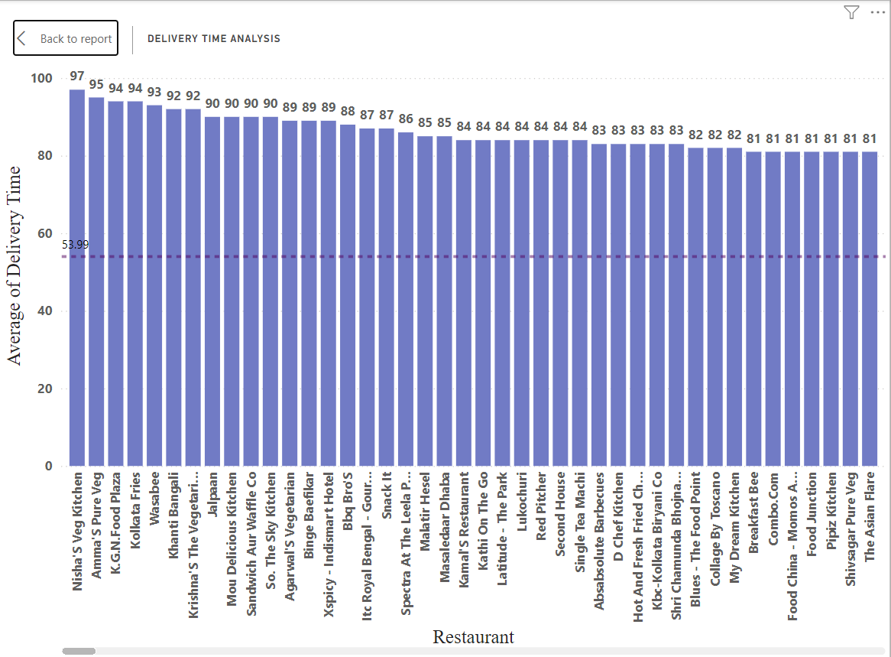
Task 8: Delivery time Analysis

Slide 32
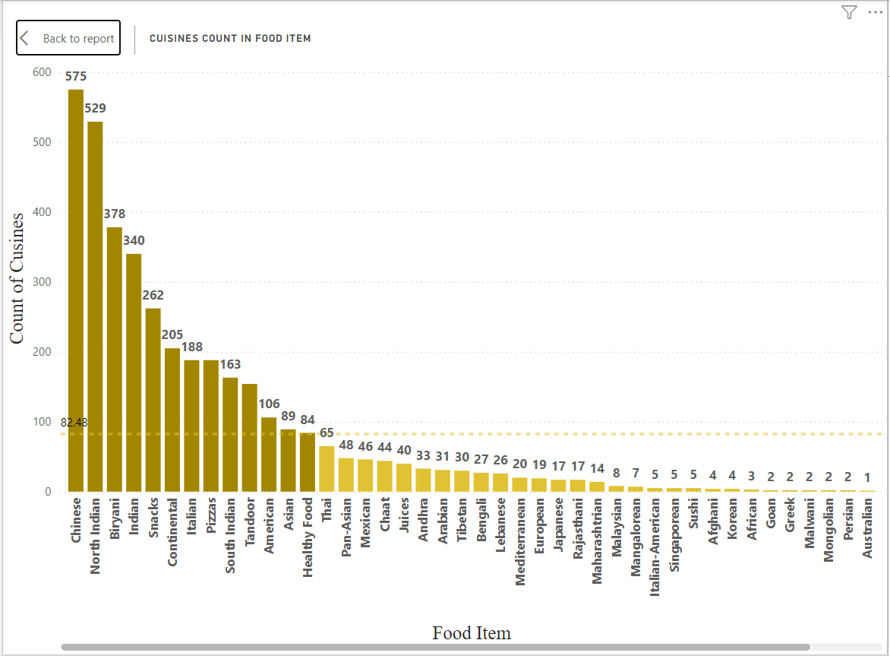
Task 9: Cuisine Analysis

Slide 33
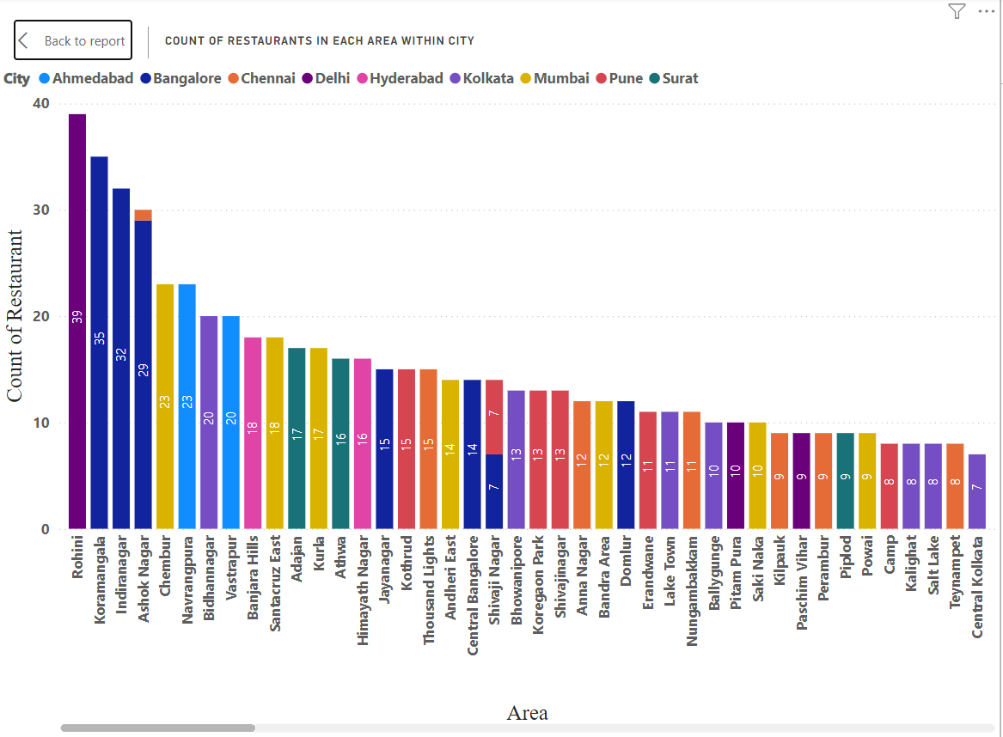
Task 10 : Area wise restaurant analysis

Slide 34
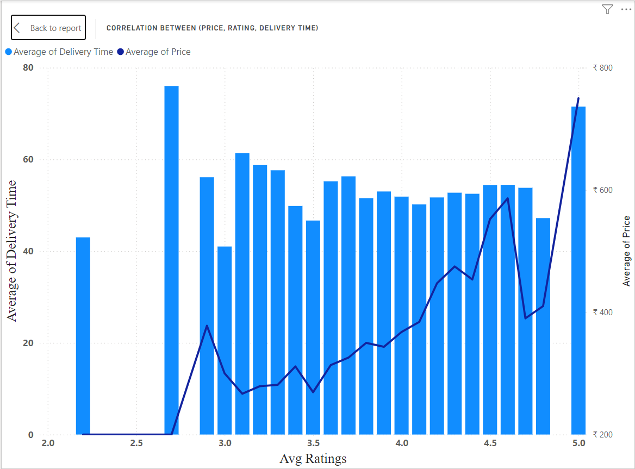
Task 11:Correlation Analysis (Price, Avg rating, Total rating)

Slide 35
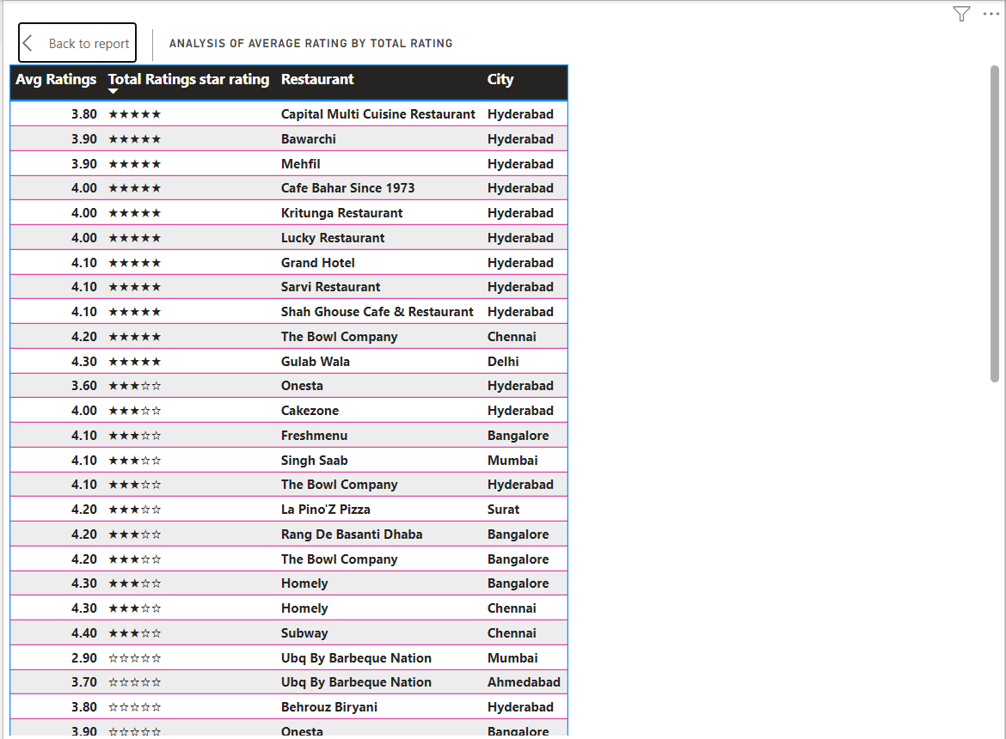
Task 12: Customer feedback analysis

Slide 36
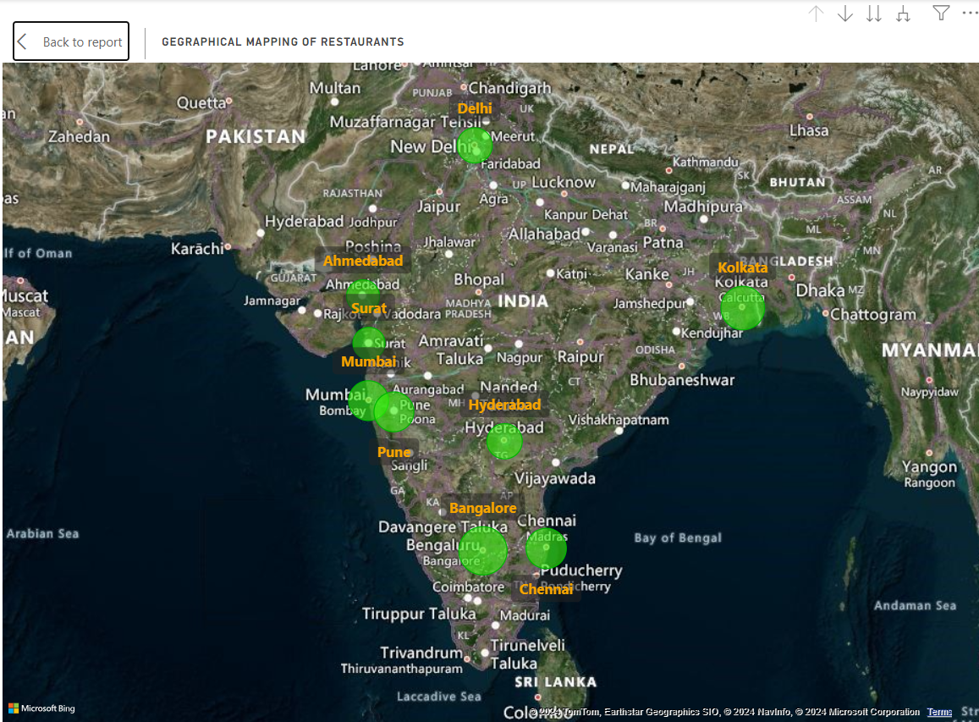
Task 13: Geographical Mapping of restaurant location

Slide 37
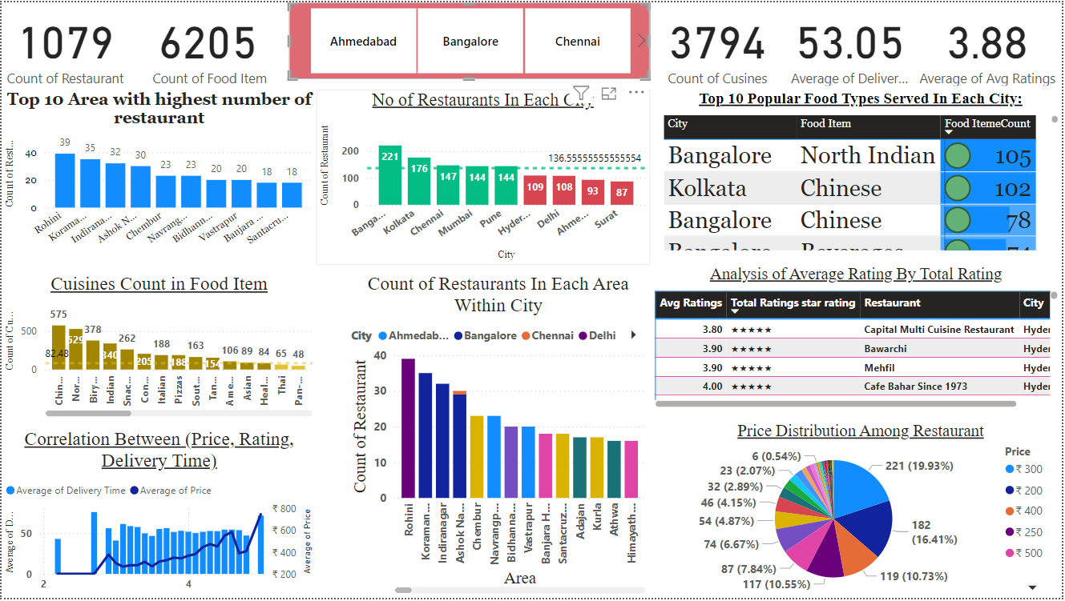
Conclusion: Dashboard-1

Slide 38
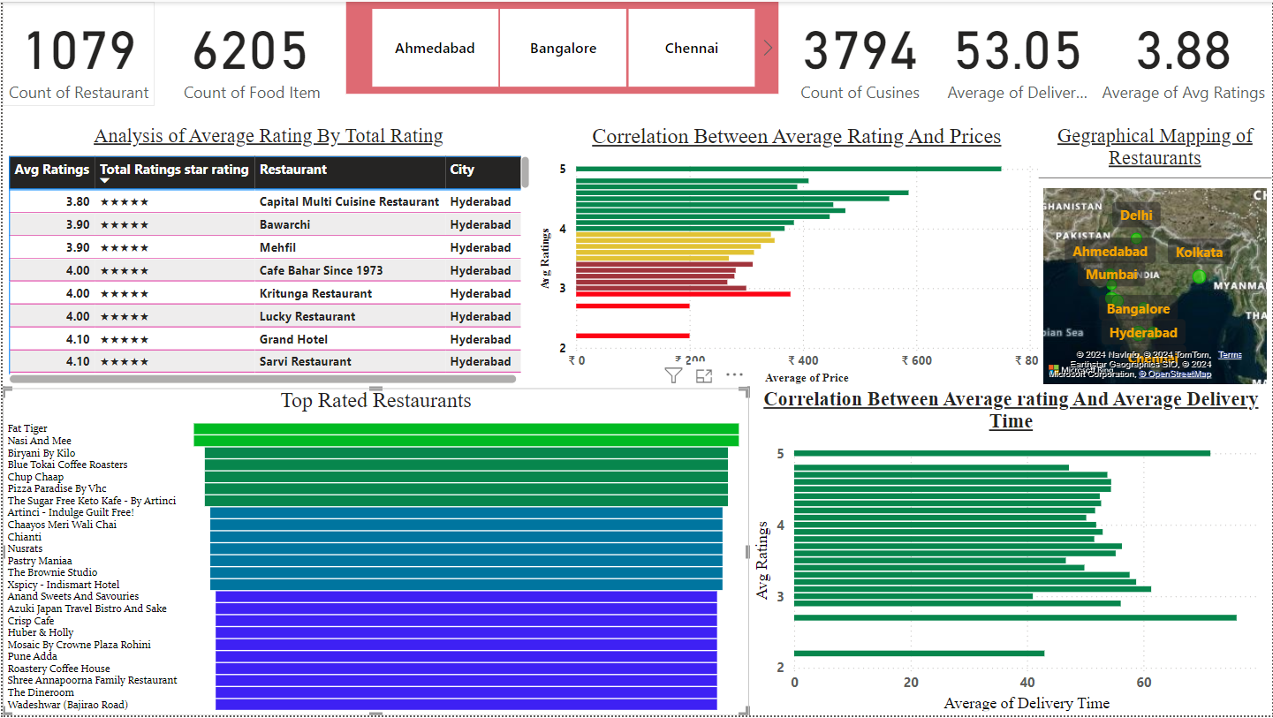
Conclusion: Dashboard-2

Slide 39
Thank You !!

