Slide 1
Churn Analysis

Slide 2
Most Common Contract Types Among Churned Customer
The most common contract type among churned customers is 'Month-to-Month.' This indicates that a significant number of customers who churn tend to have this type of contract, suggesting potential vulnerabilities or dissatisfaction in this segment

Slide 3
Distribution of Monthly Charges among churned Customer
Insight 2: The distribution of monthly charges among churned customers reveals that most of them spent between ₹68 to ₹106, with a high density in this range. The average monthly charge for these customers is approximately ₹81, indicating a concentration of churned customers within this pricing segment

Slide 4
No of customer most prone to churn According to Contract Types
Insight 3: Analyzing customers prone to churn based on contract types reveals that approximately 330 customers are likely to churn. Among these, those with 'Month-to-Month' contracts represent the highest proportion, further highlighting this contract type's higher risk of customer attrition compared to others

Slide 5
Customers Above 7K who have been Churned
Insight 4: Analyzing high-paying customers who have churned, focusing on those with total charges between ₹7,000 and ₹8,700, reveals that this segment includes a significant number of churned customers. By examining this group, we gain insights into the behaviors and factors contributing to the churn of customers who have invested heavily in the service.

Slide 6
Total Charges Distribution for Churned and Non-Churned Customers
Insight 5: Analyzing the distribution of total charges between churned and non-churned customers reveals that 80% of the charges, amounting to ₹11.3M, come from non-churned customers. In contrast, churned customers account for 19.4% of the total charges, representing a significant financial impact of ₹2.73M lost by the company due to churn

Slide 7
Average Monthly Charges by Contract Type among Churned Customer
Insight 6: When examining the average monthly charges by contract type among churned customers, it's evident that although 'Month-to-Month' contracts are more prevalent, the highest average monthly charges come from yearly contracts. This is expected, as the yearly contract typically involves a higher overall price, resulting in a higher average monthly charge for these customers.

Slide 8
Customers With Online Security And Online Backup Service
"Insight 7: Among the 4,835 customers analyzed, 3,249 are using both Online Security and Online Backup services. This indicates a strong preference for these bundled services among the customer base."

Slide 9
Most combination of service among churned customer
Insight 8: To understand the most common service combinations among churned customers, we identify that 'Internet Service' and 'Phone Service' are the most frequently used together. This combination appears 378 times among churned customers, indicating a significant overlap. Therefore, it's crucial to investigate potential issues or flaws in these services, as they might be contributing to the high churn rate.

Slide 10
Average of Total Charges by Gender and Married
"Insight 9: The analysis of average total charges distributed by gender and marital status reveals no significant disparities. Both genders contribute approximately equally to the total charges, with each gender averaging around 50% of the total. Similarly, the spending patterns are consistent across marital statuses, with both married and unmarried males and females spending similar average amounts on total charges. This suggests that gender and marital status do not significantly influence the total charges incurred

Slide 11
Average Monthly charges for Different Age Groups
Insight 10: Analyzing average monthly charges across different age groups reveals an interesting trend. Contrary to expectations that teens would be high spenders, those aged 60 to 80 have the highest average monthly charges at around ₹45,000. The second-highest spenders are in the 19-40 age group, with an average of ₹43,000, followed by the 40-60 age group, who spend approximately ₹41,000. This suggests that older age groups are significant contributors to higher monthly charges

Slide 12
Average age & Avg total charges with Multiple lines & Online Backup
Insight 11: When analyzing the average age and average total charges for customers using either 'Multiple Lines,' 'Online Backup,' or both services, we find that the average age across all four combinations falls between 45 and 49 years. The average total charges for these combinations range from ₹1,200 to ₹4,900. This suggests that customers in this age range consistently use these services, with their total charges varying based on the service packages they choose.

Slide 13
Contract type with highest churn rate among senior citizen 65 And Above
Insight 12: Among senior citizens aged 65 and above, the 'Month-to-Month' contract type exhibits the highest churn rate. This indicates a higher tendency for this age group to churn under monthly contracts. In comparison, 'Yearly' contracts show a slightly lower churn rate among senior citizens, suggesting that longer-term commitments might be more stable for this demographic.

Slide 14
Avg age & Avg Total charge for customers with different combination of Streaming service
Insight 13: When analyzing average age and total charges for customers using different combinations of streaming services (Streaming TV, Streaming Movies, Streaming Music), it is observed that the highest average total charge, around ₹4,400, is associated with customers using any combination of these services. Interestingly, the average age for those using Streaming Movies and Streaming TV, both combined and separately, is around 73 years. Conversely, customers in their 20s and 30s are particularly interested in Streaming TV and Streaming Music, while those around the age of 45 show minimal interest in any of the three streaming services.
.

Slide 15
Avg monthly charge for Streaming TV & Multiple Line
Insight 14: Analyzing the average monthly charges for Streaming Services and Multiple Lines reveals that the highest average monthly charge is ₹97 for customers using both services. Streaming services alone average ₹86, while Multiple Lines alone average ₹77 per month. Interestingly, customers who do not use Streaming TV but have Multiple Lines incur a lower average monthly charge of ₹64
.

Slide 16
Churned Customer Using Most Online Service
Insight 15: Among churned customers, 26 individuals were using all available online services. The total revenue generated by these high-value customers amounts to ₹35,22,974. Given their significant contribution, it's crucial to re-evaluate and understand the reasons for their churn to potentially recover these valuable customers.
.

Slide 17
Gender Distribution among customers who have churned on yearly Contacts
Insight 16: In the gender distribution analysis of customers who have churned on yearly contracts, males represent a higher percentage at 53%, while 47% of females have churned. Additionally, among yearly contracts, customers on one-year contracts exhibit a higher churn rate compared to those on two-year contracts

Slide 18
Churned customer Avg monthly charges and Total charges grouped by contract and Internet service
Insight 17: When analyzing churned customers' average monthly and total charges grouped by contract type and internet service, it becomes clear that Fiber-Optic Internet service has the highest turnover across all contract types (Month-to-Month, One-Year, and Two-Year). In contrast, Cable and DSL internet services exhibit similar average monthly and total charges, showing less variation and a lower churn rate compared to Fiber-Optic service.

Slide 19
Churned customer grouped by num of dependents.
Insight 18: Grouping churned customers by the number of dependents reveals that the majority of churned customers, 1,509, have no dependents. In contrast, only 31 churned customers have 1 dependent, 25 have 2 dependents, and 19 have 3 dependents. This suggests that customers without dependents are more likely to churn compared to those with dependents.

Slide 20
Churned Customers duration in months
Insight 19: The 'Month-to-Month' contract type has the highest churn rate, indicating a potential area of concern. It's crucial to thoroughly analyze these churned customers, as addressing their issues effectively could lead to a significant reduction in the overall churn rate.

Slide 21
Highest Monthly Charges in Each Contract Types
Insight 20: By identifying the highest monthly charges within each contract type, we can pinpoint our elite customers. These high-spending individuals represent a valuable segment, and understanding their needs and behaviors can help enhance customer retention strategies.

Slide 22
Identify High-value customers at risk of churning
Insight 21: We have identified ten high-value customers who are at risk of churning. It's imperative to focus on retaining these customers by addressing their concerns and enhancing their experience, as they represent a crucial segment for the business

Slide 23

Insights:
CHURN_ANALYSIS

Slide 24
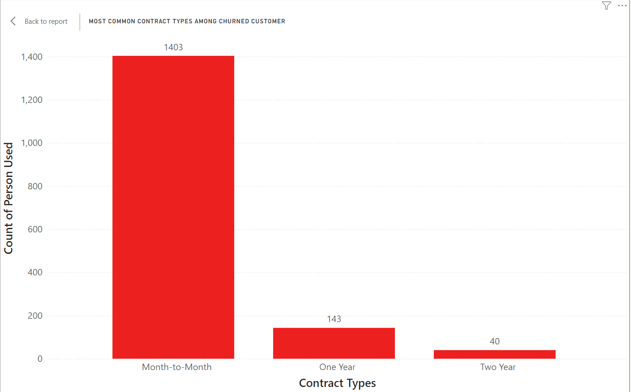
Most Common Contract Types Among Churned Customer

Slide 25
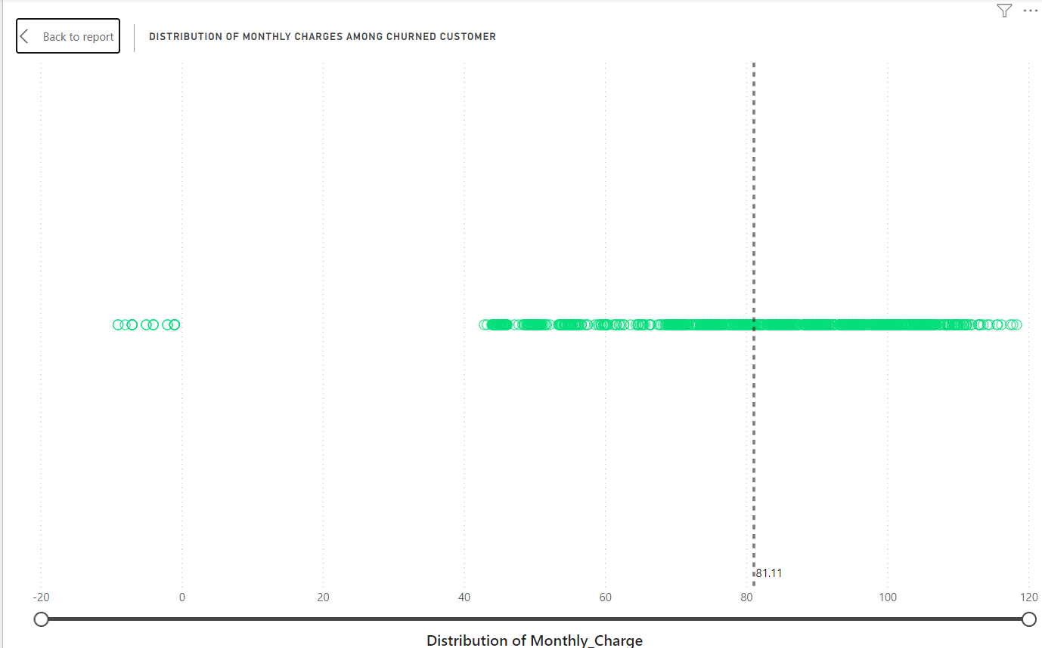
Distribution of Monthly Charges among churned Customer

Slide 26
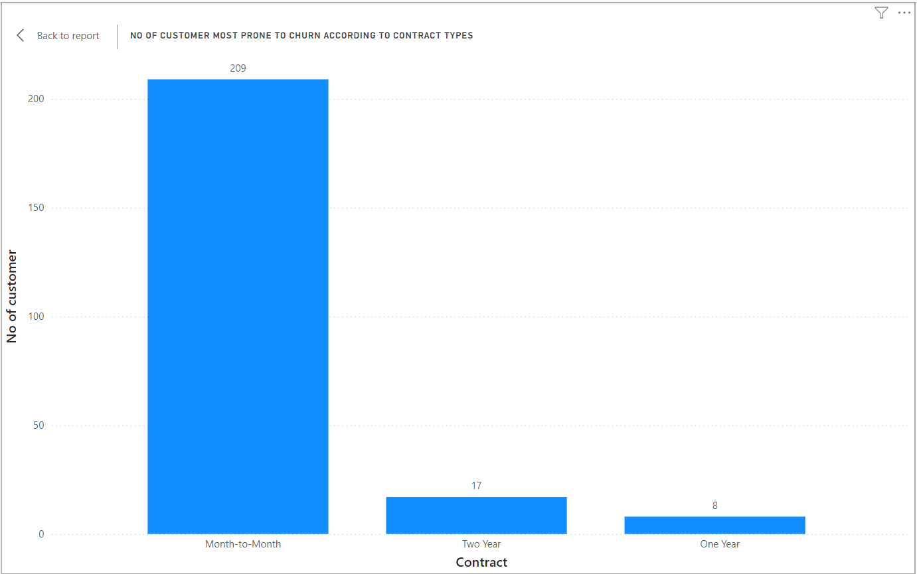
No of customer most prone to churn According to Contract Types

Slide 27
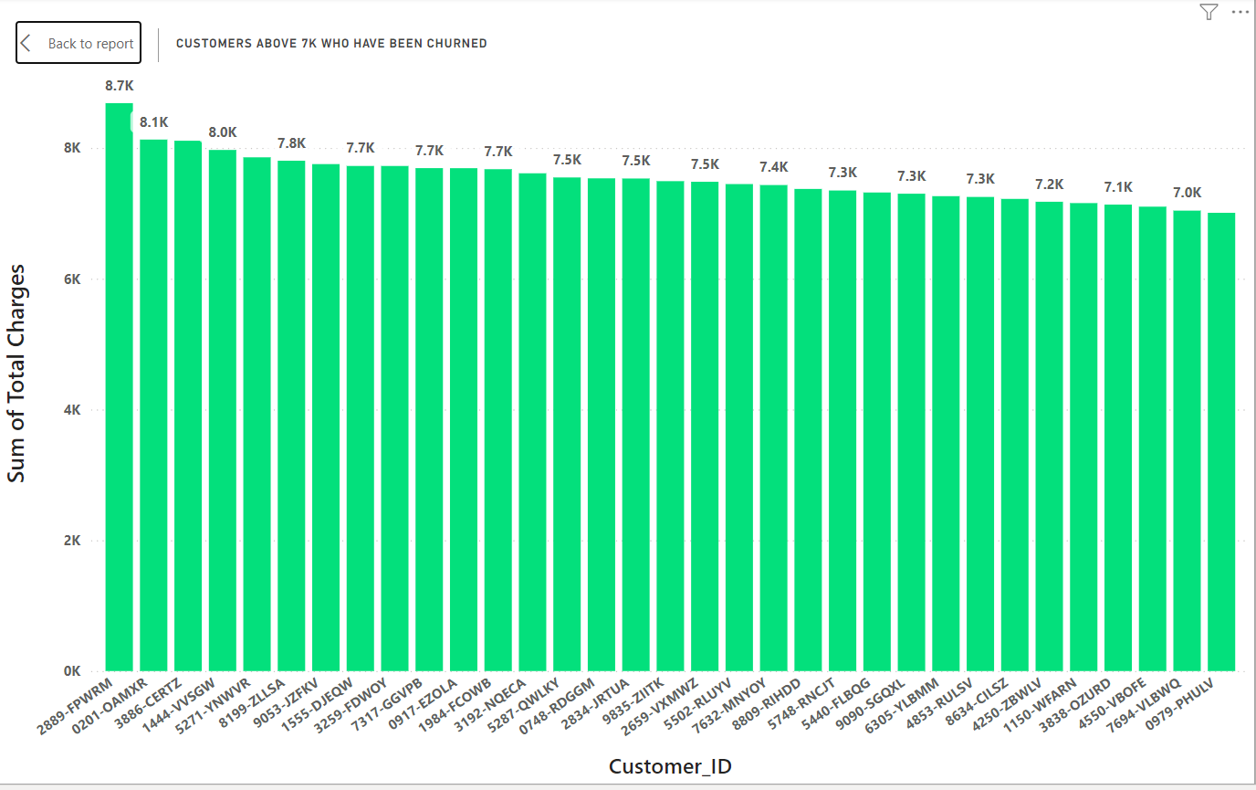
Customers Above 7K who have been Churned

Slide 28
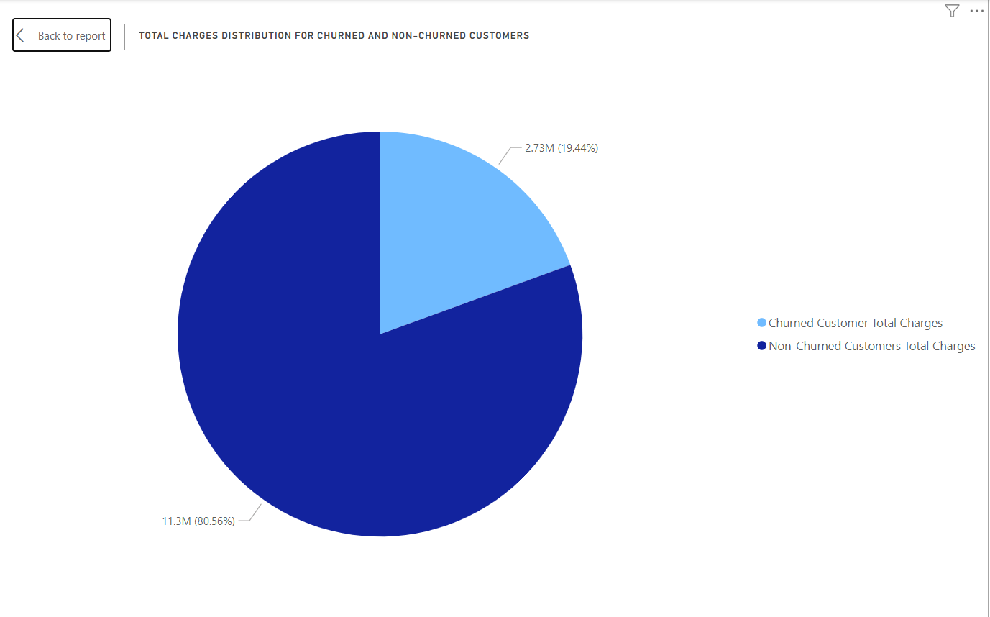
Total Charges Distribution for Churned and Non-Churned Customers

Slide 29
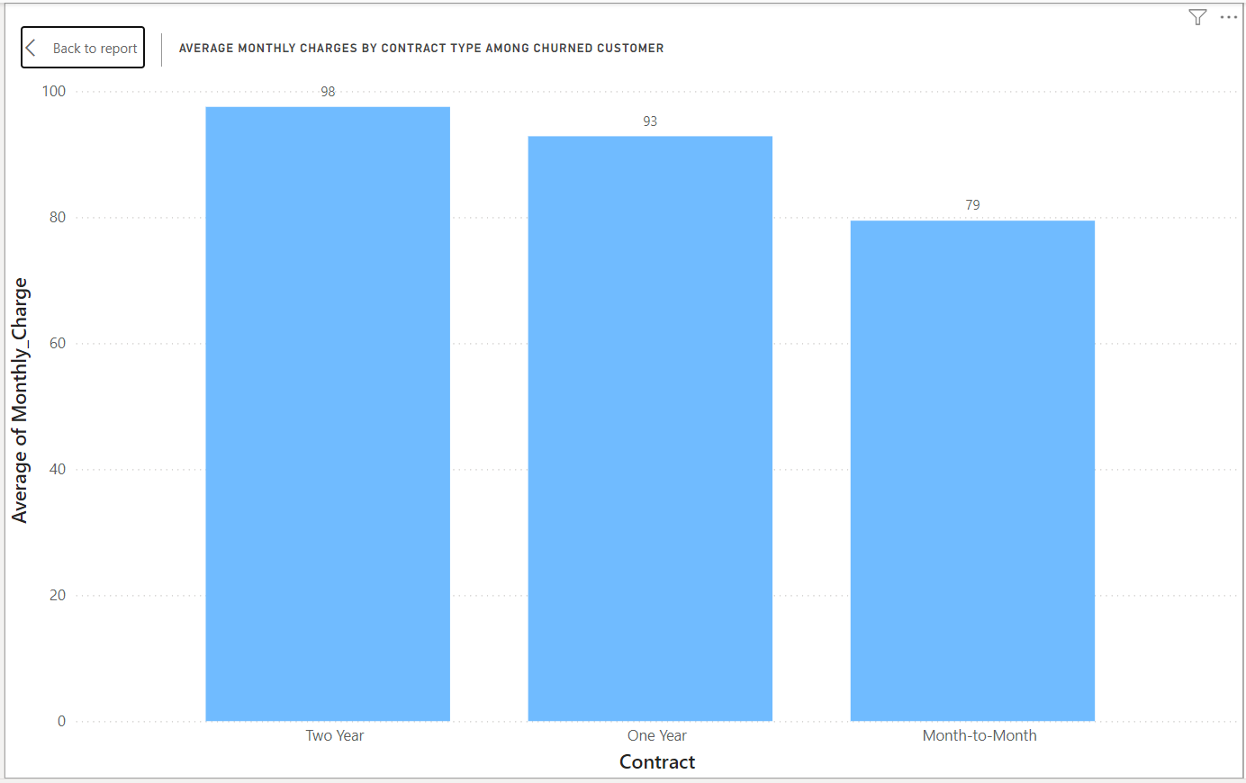
Average Monthly Charges by Contract Type among Churned Customer

Slide 30
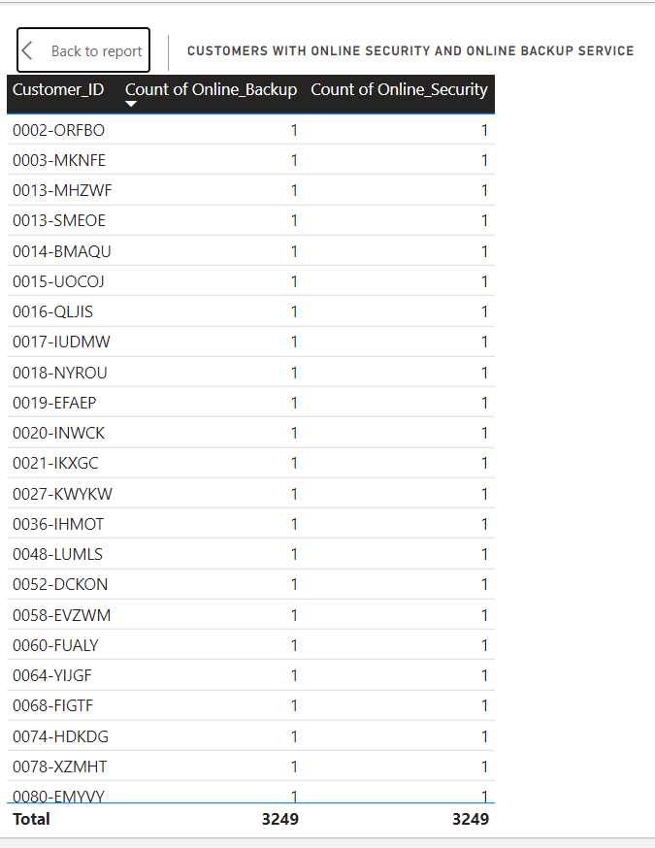
Customers With Online Security And Online Backup Service

Slide 31
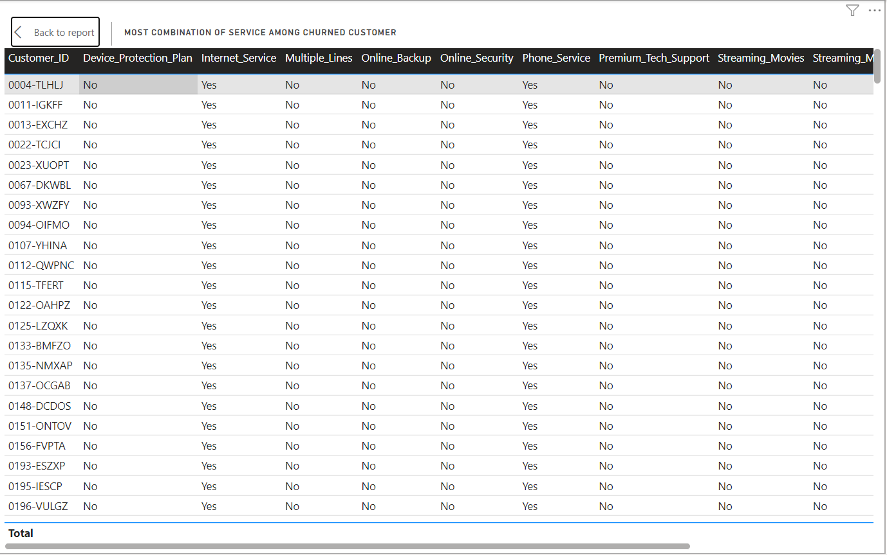
Most combination of service among churned customer

Slide 32
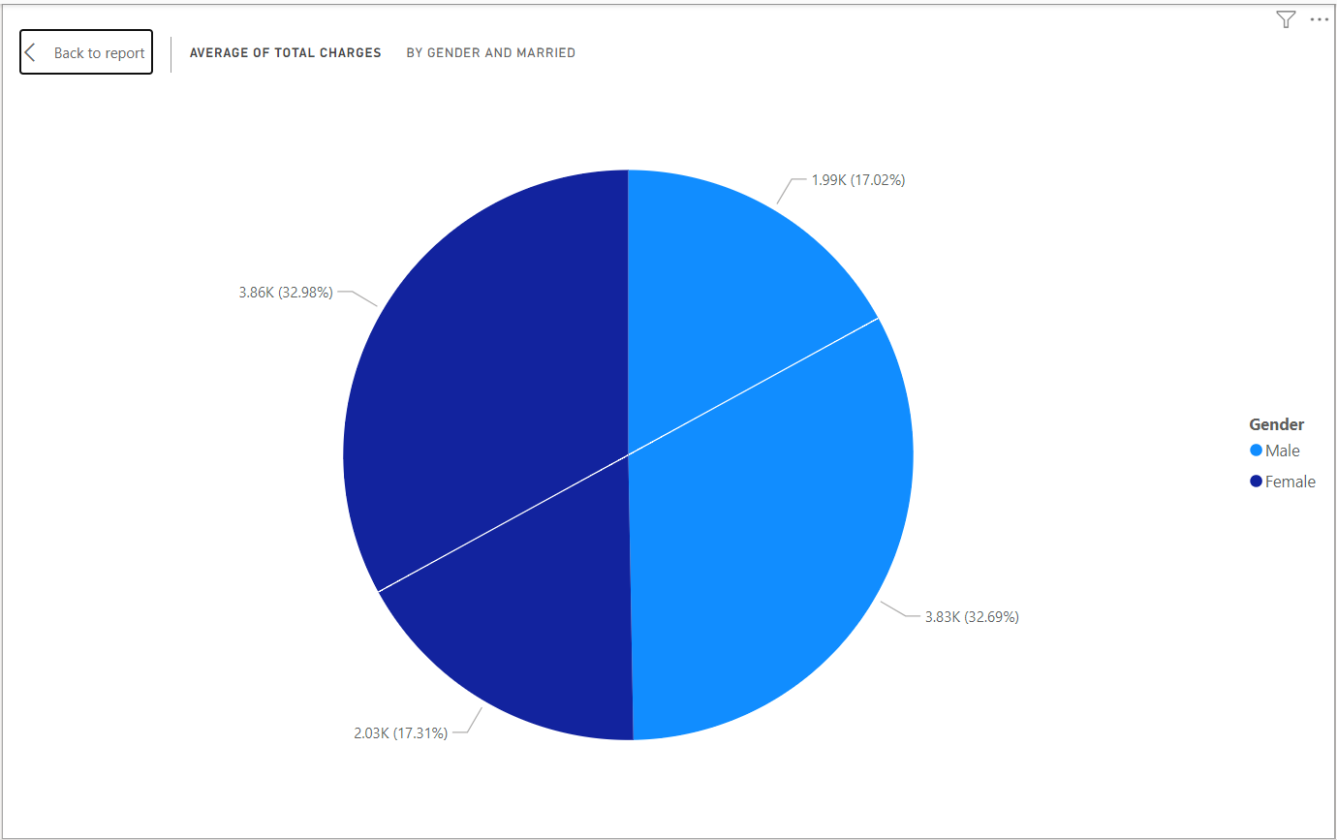
Average of Total Charges by Gender and Married

Slide 33
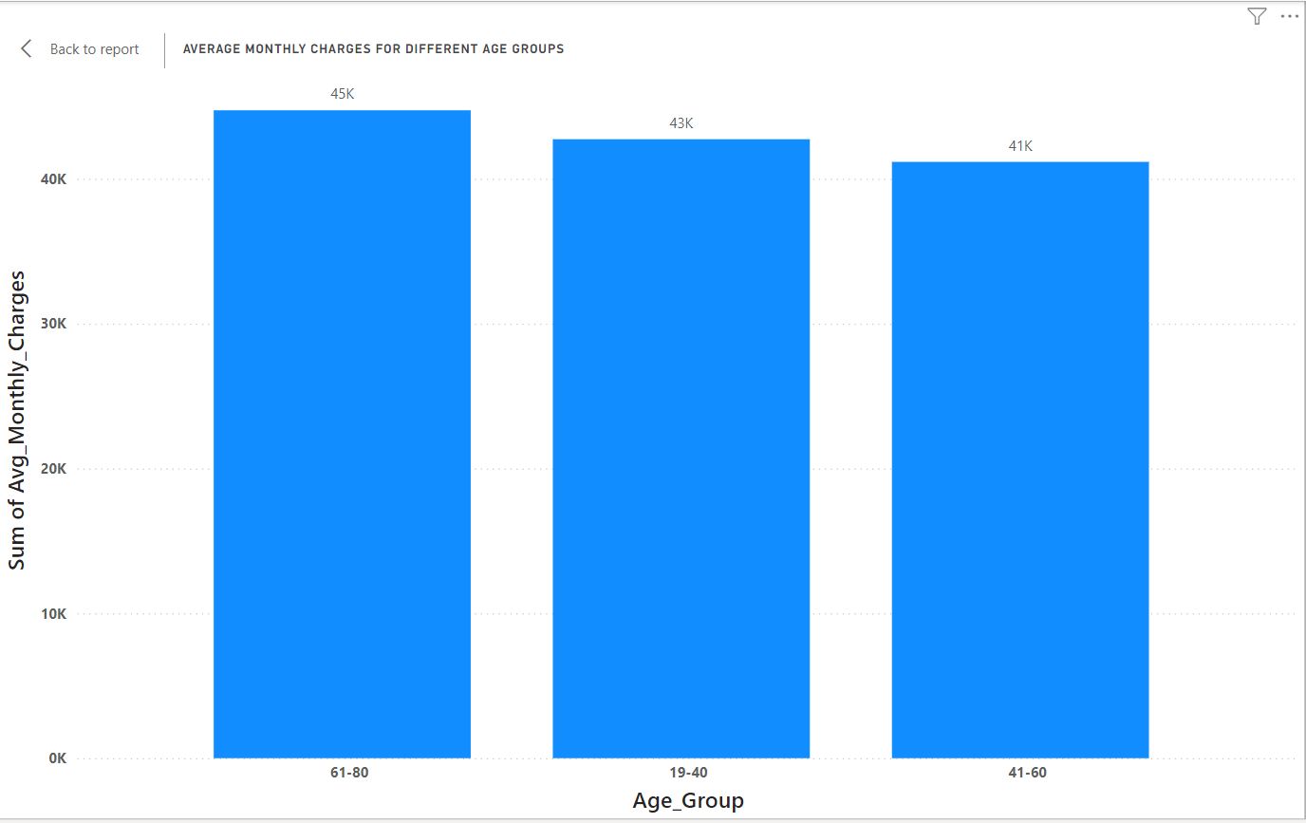
Average Monthly charges for Different Age Groups

Slide 34
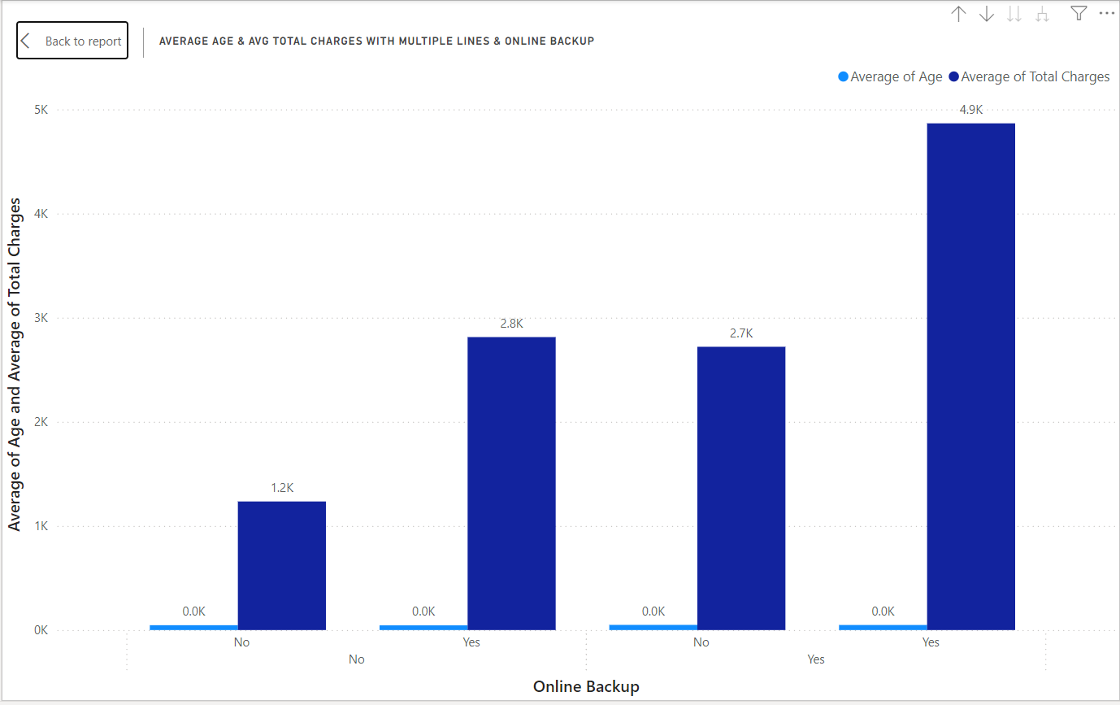
Average age & Avg total charges with Multiple lines & Online Backup

Slide 35
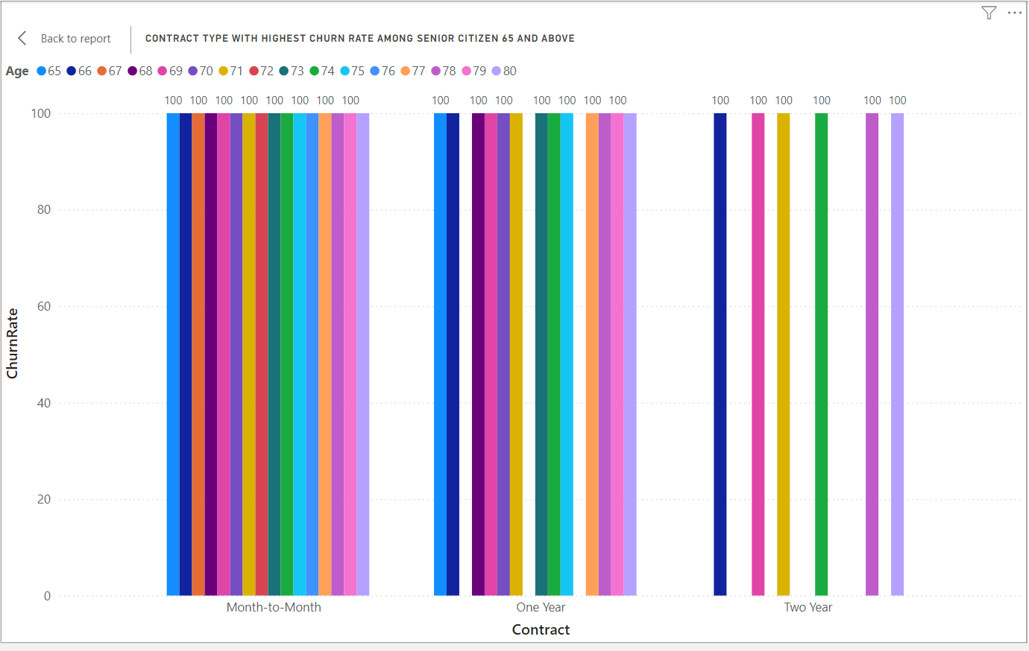
Contract type with highest churn rate among senior citizen 65 And Above

Slide 36
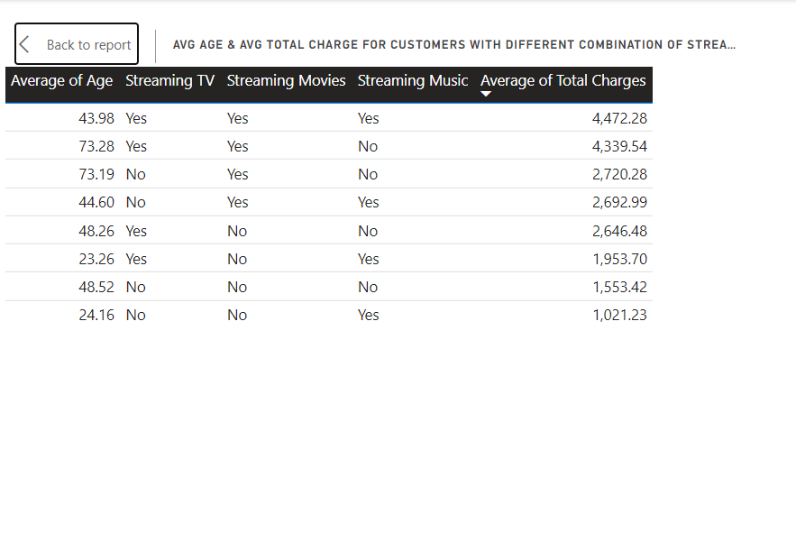
Avg age & Avg Total charge for customers with different combination of Streaming service

Slide 37
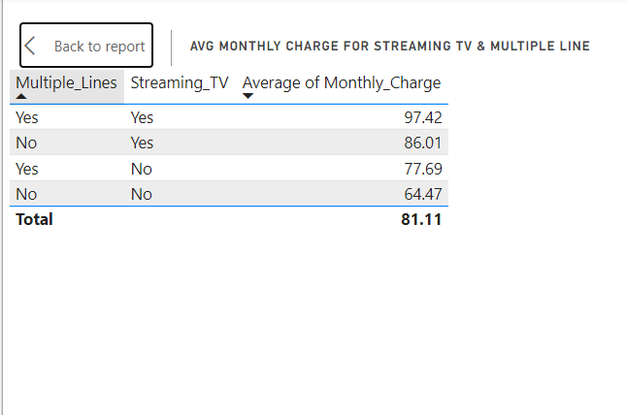
Avg monthly charge for Streaming TV & Multiple Line

Slide 38
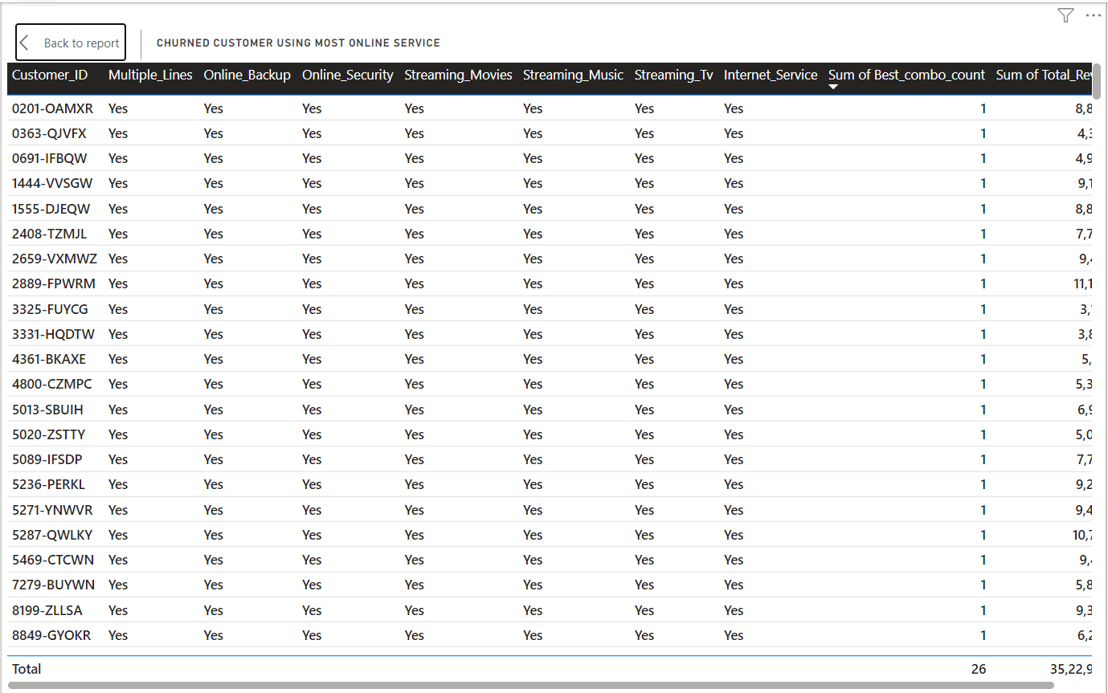
Churned Customer Using Most Online Service

Slide 39
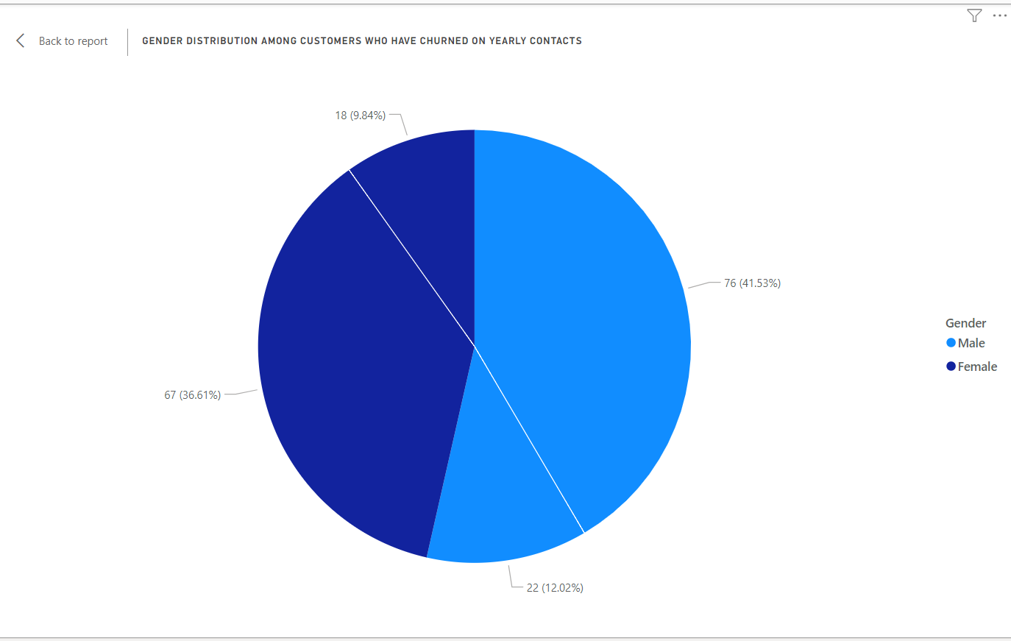
Gender Distribution among customers who have churned on yearly Contacts

Slide 40
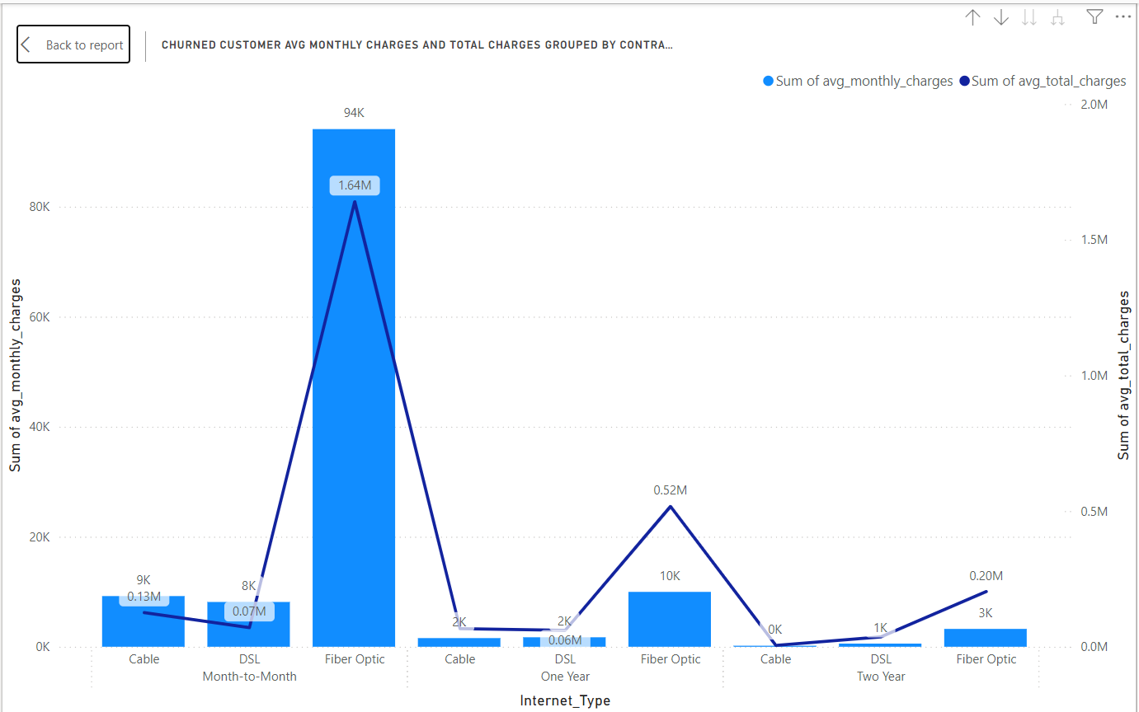
Churned customer Avg monthly charges and Total charges grouped by contract and Internet service

Slide 41
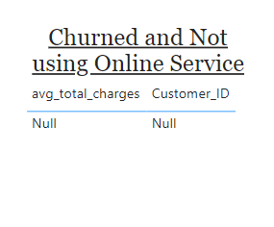
Churned and Not using Online Service

Slide 42
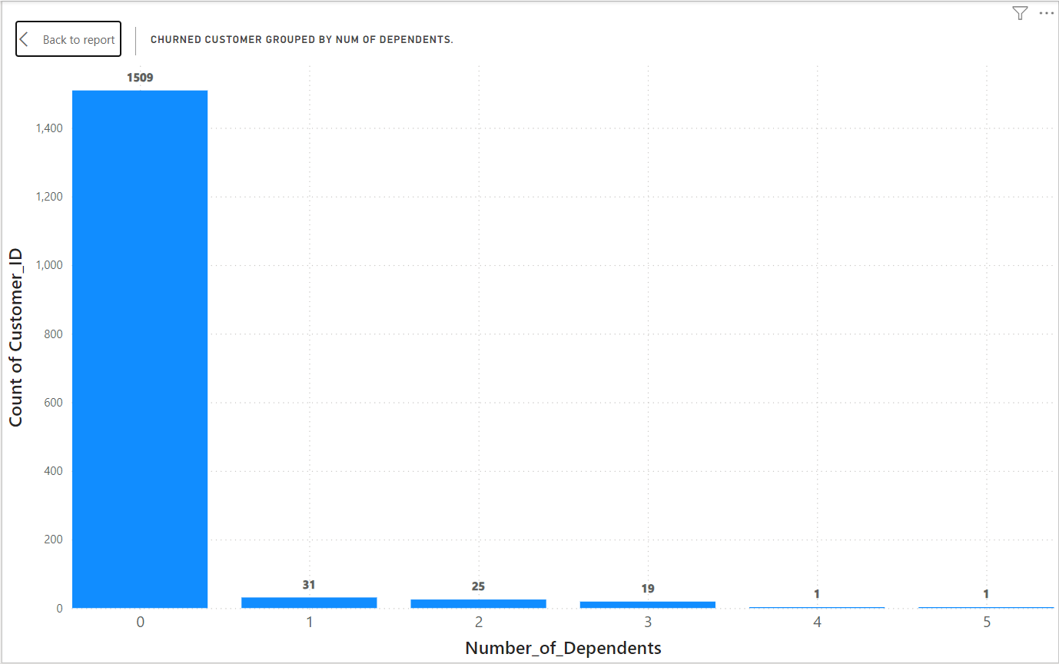
Churned customer grouped by num of dependents.

Slide 43
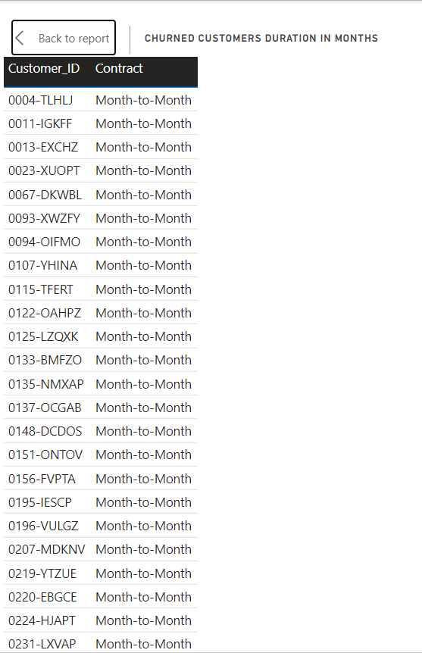
Churned Customers duration in months

Slide 44
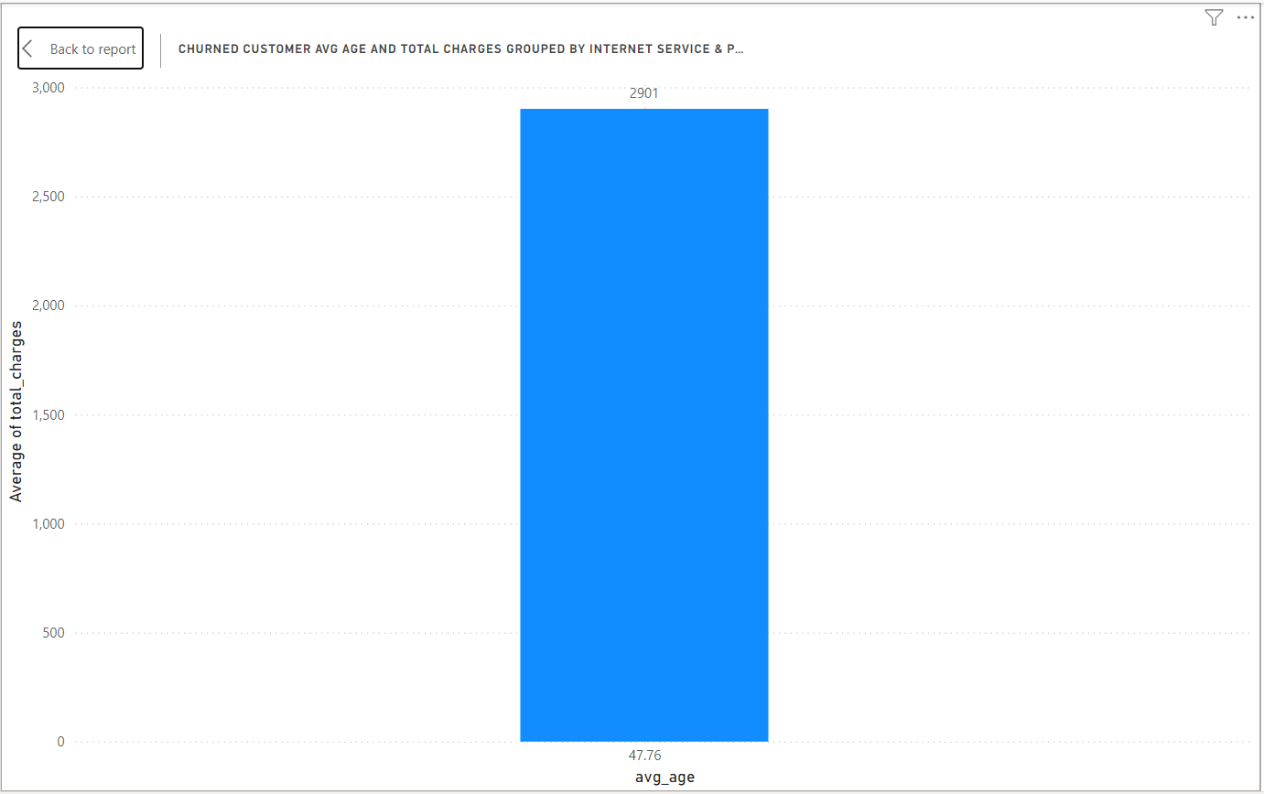
Churned Customer Avg age and Total charges Grouped by Internet Service & Phone Service

Slide 45
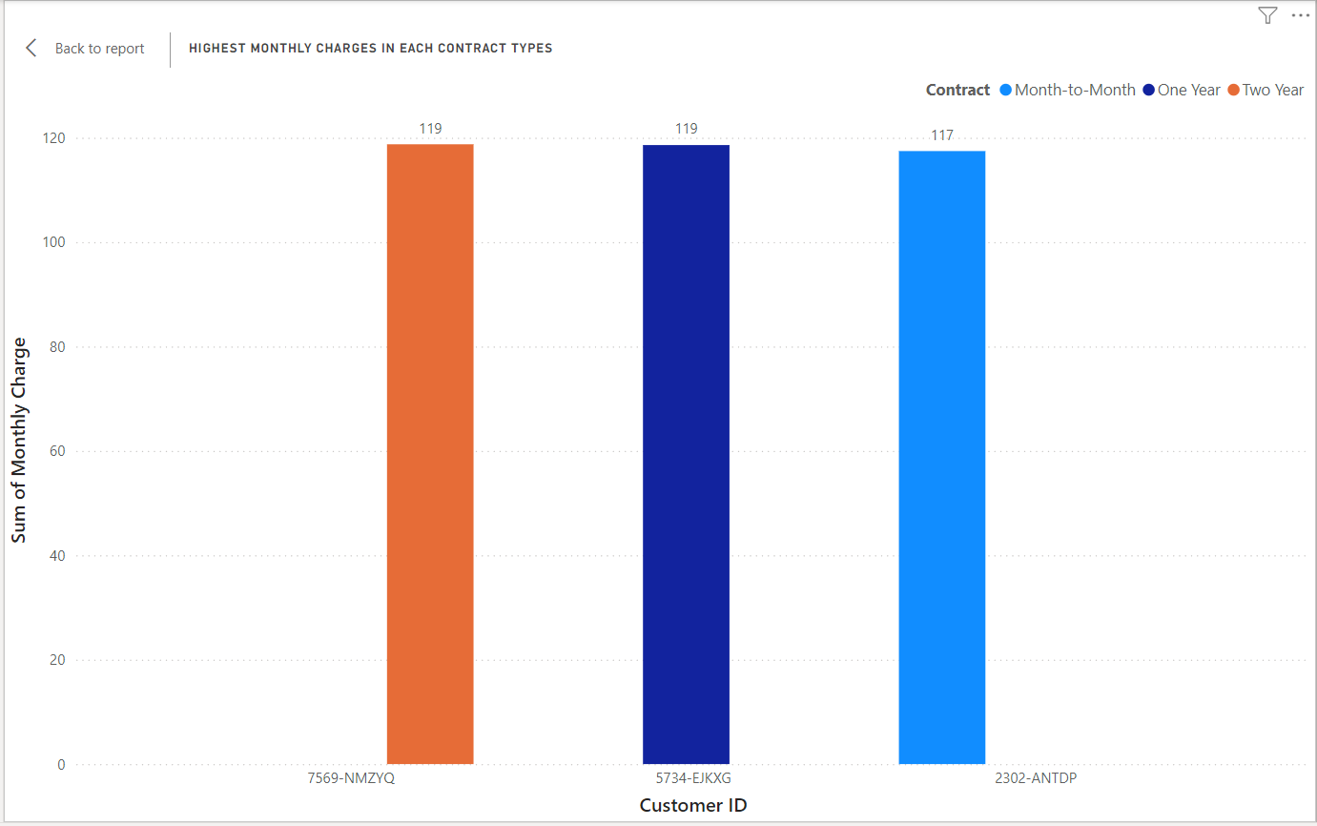
Highest Monthly Charges in Each Contract Types

Slide 46
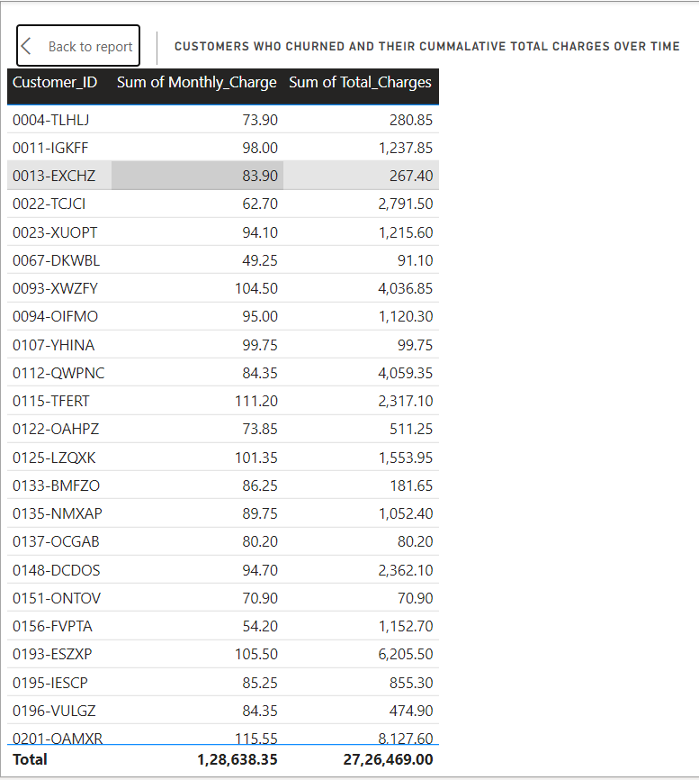
Customers who churned and their cumulative total charges over time

Slide 47
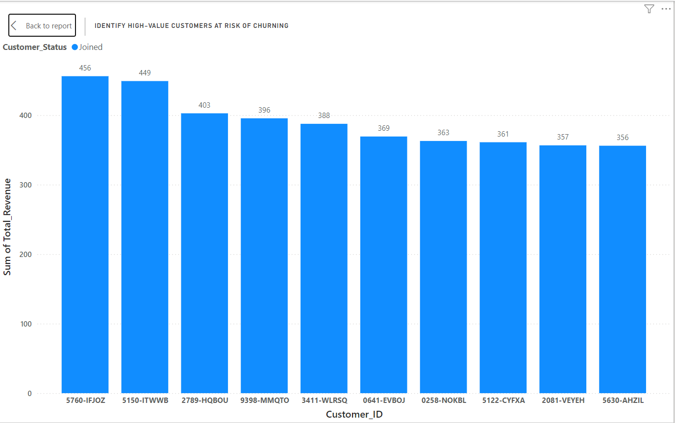
Identify High-value customers at risk of churning

Slide 48
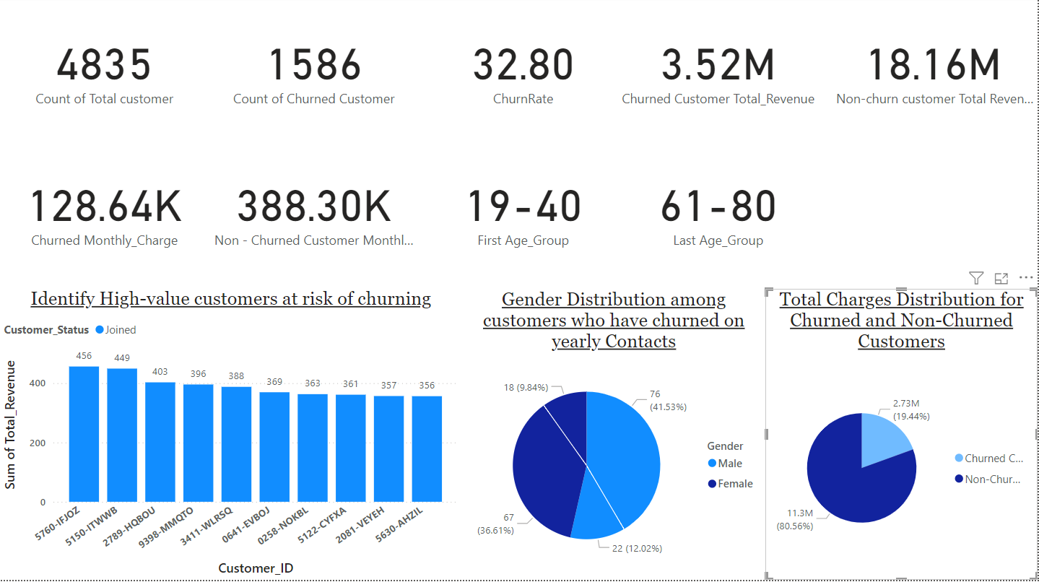
Dashboard-1

Slide 49
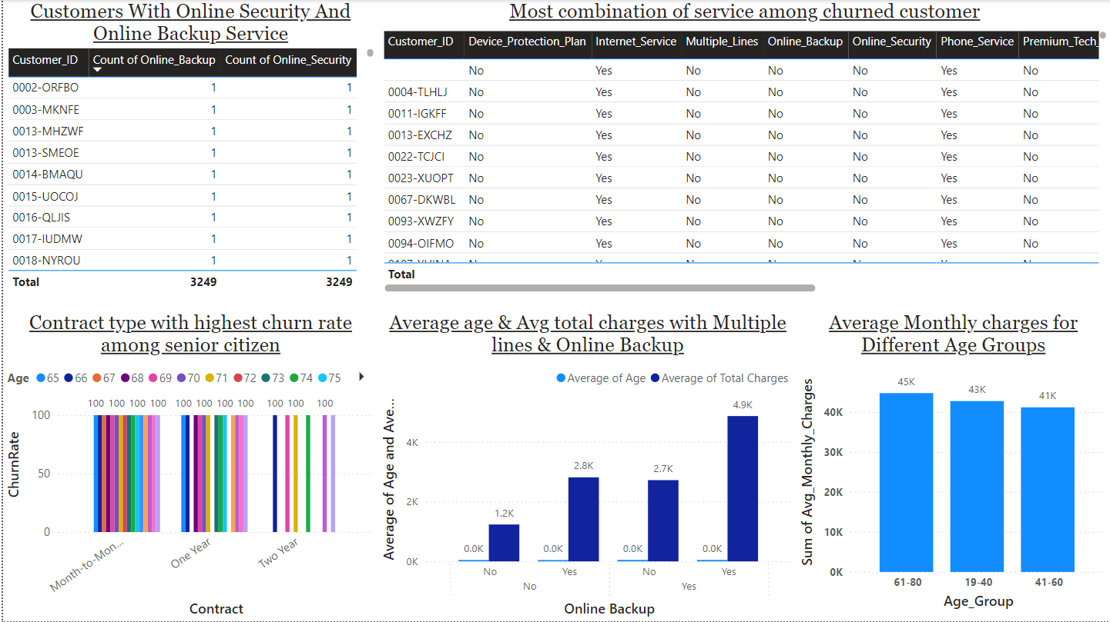
Dashboard-2

Slide 50
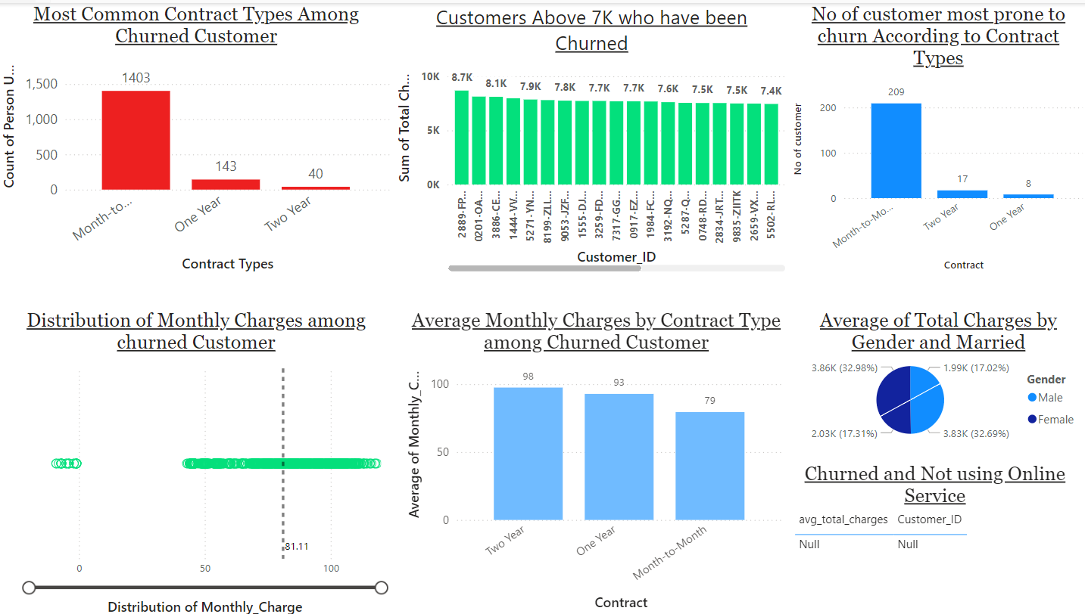
Dashboard-3

Slide 51
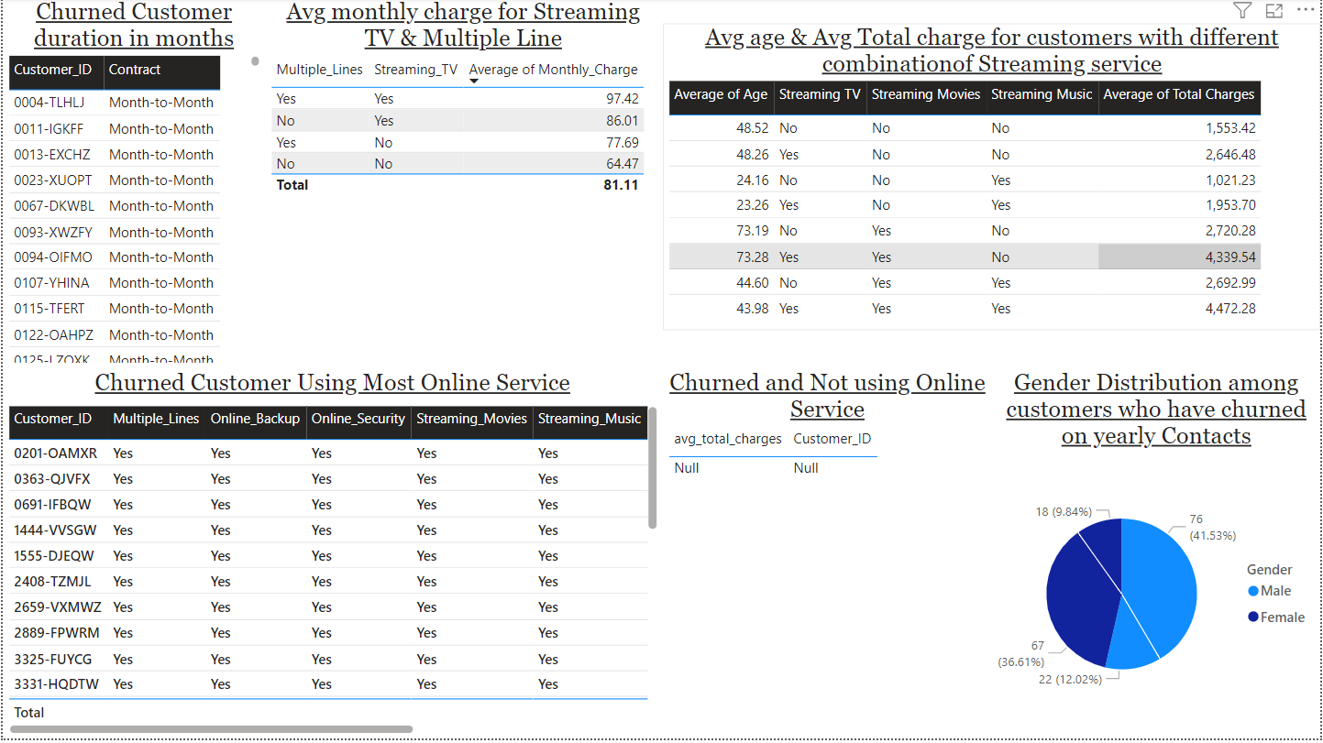
Dashboard-4

Slide 52
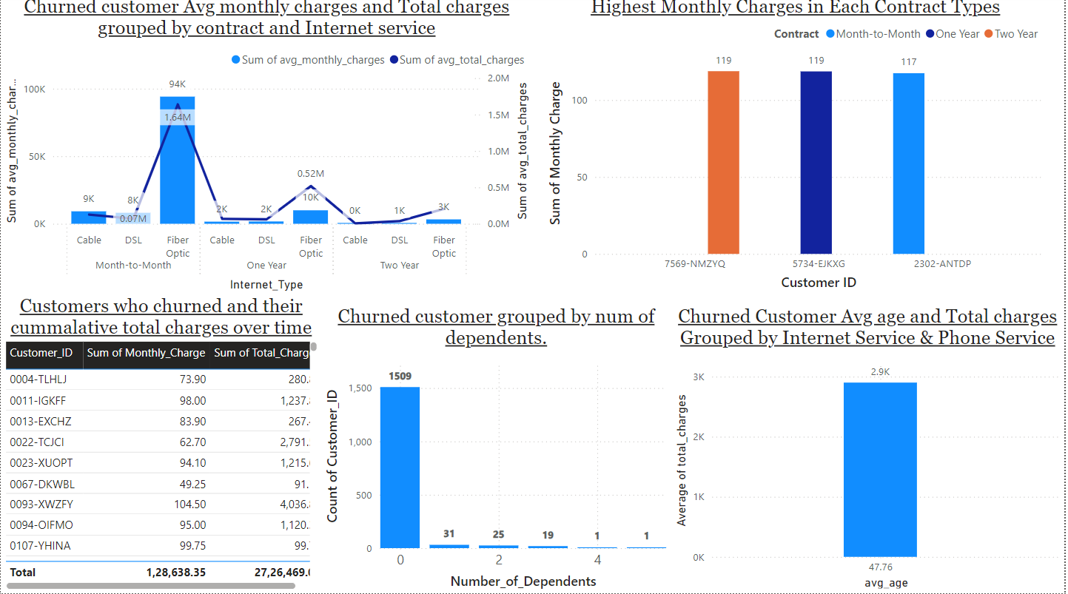
Dashboard-5

Slide 53
Thank you
Visvasprabhakar R
Master in Business Analytics And Digital Marketing (MBE9)
visvasprabhakar170703@gmail.com

