Slide 1
CRISPRArchitect
Multi-Nuclease Decision Support for Genome Editing Strategy Design
TOPSIS Multi-Criteria Ranking | Pareto Analysis | Sensitivity Quantification
Vishal Bharti | Debojyoti Chakraborty Lab
CSIR-Institute of Genomics and Integrative Biology, New Delhi
Lab Meeting | April 2026
5 Nucleases
TOPSIS 6D
224 Tests
1/28

Slide 2
The Problem
Why do we need a unified editing framework?
▸ Multiple modalities (BE, PE, HDR) with distinct constraints
▸ No tool compares all three modalities side by side
▸ PAM + editing window is a hidden bottleneck (our key finding)
▸ iPSCs are p53-active: DSBs kill most cells (Ihry et al., 2018)
▸ Multi-nuclease options expand the design space enormously
▸ Clinical applications demand transparent, auditable decisions
Base Editing
A>G or C>T only, narrow window (4-8 nt)
Prime Editing
Any edit, no DSB, complex pegRNA design
HDR
DSB required, p53 toxicity in iPSCs
2/28

Slide 3
What is CRISPRArchitect?
A decision-support tool, not a predictive optimizer
▸ Input: pathogenic variant(s) in HGVS notation or genomic coordinates
▸ Automatically fetches transcript structure from Ensembl (GRCh38)
▸ Maps variant to CDS, annotates coding consequence (ACMG standards)
▸ Scans for PAM sites across 5 nucleases, evaluates 9 base editor profiles
▸ Assesses feasibility of BE, PE, and HDR with locus-specific constraints
▸ Output: ranked strategies with TOPSIS scores, Pareto analysis,
▸ sensitivity quantification, and explicit rejection reasons
▸ Transparent: every score, weight, and parameter has documented provenance
3/28

Slide 4
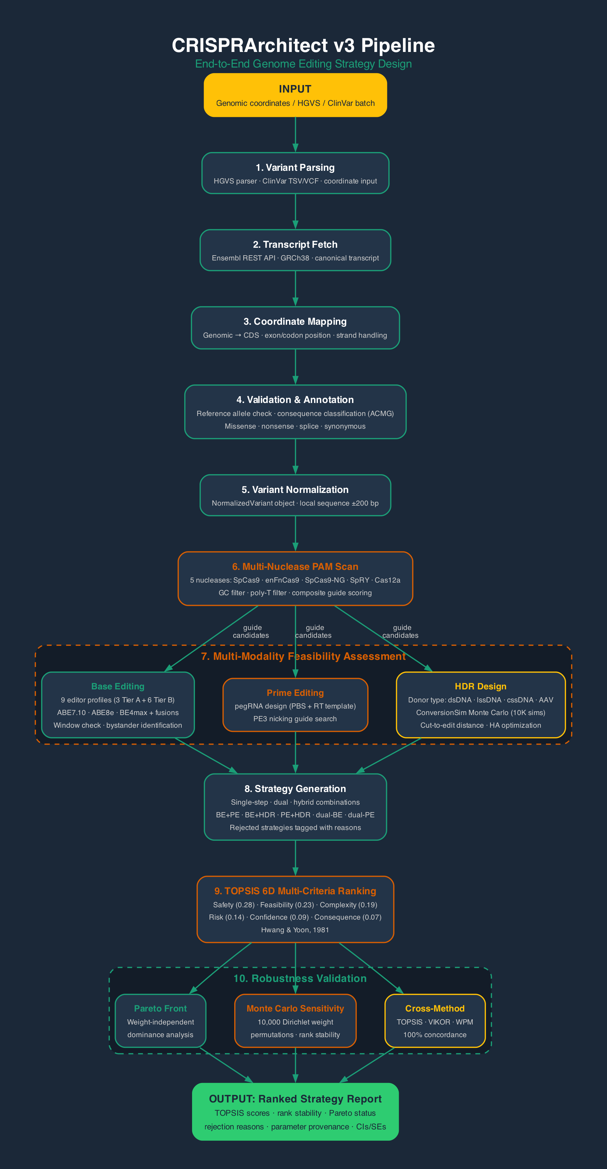
Pipeline Overview
10-stage end-to-end workflow from variant input to ranked recommendations
4/28

Slide 5
Biophysical Simulation Modules
~24,000 lines of code | Monte Carlo biophysical simulations
ConversionSim
MOSAIC
ChromBridge
Gene conversion tract simulation (SDSA pathway)
Multi-locus strategy optimizer
3D chromatin distance predictor
Method: Monte Carlo
Method: Decision engine
Method: Polymer physics
TopoPred
LoopSim
WebApp
cssDNA secondary structure analyzer
Cohesin loop extrusion simulator
Interactive Streamlit interface
Method: Thermodynamics
Method: Stochastic 1D
Method: 7 analysis pages
5/28

Slide 6
Initial Analysis: SpCas9-Only Benchmark
30 ClinVar cases | Transcript-aware pipeline | GRCh38 coordinates
▸ Ensembl REST API integration (GRCh38 coordinates)
▸ Reference allele validation against genome sequence
▸ Coding consequence annotation (ACMG standards)
▸ PAM-verified feasibility: BE, PE, HDR engines
▸ Scored with weighted-sum across 5 dimensions
▸ 30-case ClinVar benchmark: 86.7% top-1 accuracy
SpCas9-Only Results
Top-1 accuracy: 86.7% (26/30)
Top-3 accuracy: 96.7% (29/30)
Strategy distribution:
PE: 29/30 (96.7%)
HDR: 1/30 (3.3%)
BE: 0/30 (0.0%)
Problem: PE always wins.
Even at ABE-compatible loci!
6/28

Slide 7
KEY FINDING
PAM-Window Is the Real Bottleneck
The most important finding from our SpCas9-only analysis
At ALL 7 ClinVar loci with ABE-compatible transitions, NO SpCas9 guide placed the target base within ABE positions 4-7.
Mutation-type classification alone is INSUFFICIENT for strategy selection.
▸ A>G does NOT mean ABE will work at that locus
▸ The PAM must position the target A at protospacer position 4-7 (ABE7.10)
▸ This motivated expanding to multiple nucleases + wider editing windows
7/28

Slide 8
CORE INNOVATIONS
Three Key Technical Contributions
Multi-nuclease evaluation + principled scoring + statistical rigor
Multi-Nuclease Engine
TOPSIS 6D + Pareto
Statistical Rigor
5 nucleases × 9 editor profiles (3 Tier A + 6 Tier B fusions) BE rescued at 6/30 loci
6-dimension ranking + weight-independent Pareto dominance analysis
SEs, 95% CIs, Wilson intervals Dirichlet sensitivity All params evidence-tagged
Also: HGVS parser, ClinVar batch ingestion, CFD/MIT off-target scoring, VIKOR/WPM comparison methods
8/28

Slide 9
Multi-Nuclease Feasibility Engine
Systematic evaluation of 5 nucleases × 9 base editor profiles
Nuclease
PAM
Stagger
HDR mult.
Reference
SpCas9
NGG
Blunt
1.0x
Reference standard
enFnCas9
NRG
~3 bp*
1.5x*
Our lab (Acharya et al., 2024)
SpCas9-NG
NG
Blunt
1.0x
Nishimasu et al., 2018
SpRY
NNN
Blunt
0.8x
Walton et al., 2020
Cas12a
TTTV
5 bp
1.4x
Zetsche et al., 2015
* enFnCas9 stagger is [ASSUMED] — not directly measured. HDR multiplier is [ASSUMED]. ** ABE8e-enFnCas9 and BE4max-enFnCas9 are Tier B (extrapolated from components; no published fusion data).
Base Editor Profiles (9 profiles: 3 Tier A + 6 Tier B)
Tier A (core editors):
ABE7.10: window 4-7
ABE8e: window 3-9 extended
BE4max (CBE): window 4-8
Tier B (nuclease fusions — ABE):
ABE8e + enFnCas9: NRG PAM **
ABE8e + SpCas9-NG: NG PAM
ABE8e + SpRY: near-PAMless
Tier B (nuclease fusions — CBE):
BE4max + enFnCas9: NRG PAM **
BE4max + SpCas9-NG: NG PAM
BE4max + SpRY: near-PAMless
9/28

Slide 10
enFnCas9: Our Lab's Engineered Nuclease
Acharya et al., Nature Communications 15:5471 (2024)
▸ NRG PAM: ~2x more targetable sites than NGG
▸ Single-nucleobase specificity (lower off-target than SpCas9)
▸ Improved HDR knock-in rates demonstrated
▸ Three engineered variants: en1, en15, en31
▸ RPE65 correction in LCA2 patient iPSCs demonstrated
[MEASURED] from paper
NRG/NGR PAM recognition
Single-nucleobase specificity
Improved HDR knock-in
[ASSUMED] — need experimental data
Stagger: ~3 bp 5' overhang (from FnCas9 structure)
HDR multiplier: 1.5x (qualitative from paper)
ABE8e-enFnCas9 window: 3-9 (extrapolated)
Data request sent to PI
10/28

Slide 11
How Multi-Nuclease Rescues Base Editing
ABE8e + enFnCas9 = broader PAM + wider window
SpCas9 + ABE7.10 only
Multi-Nuclease (5 nucleases + ABE8e)
PAM: NGG only (~8% of positions)
Window: positions 4-7 (4 nt)
Result: 0/30 BE top-ranked
Even at 7 ABE-compatible loci,
no guide placed target in window
PAM: NGG + NRG + NG + NNN + TTTV
Window: positions 3-9 (7 nt, ABE8e)
Result: 6/30 BE top-ranked
ABE8e window (3-9) is ~3x broader
enFnCas9 (NRG) ~2x more PAM sites
Combined: rescues BE at 6 loci
11/28

Slide 12
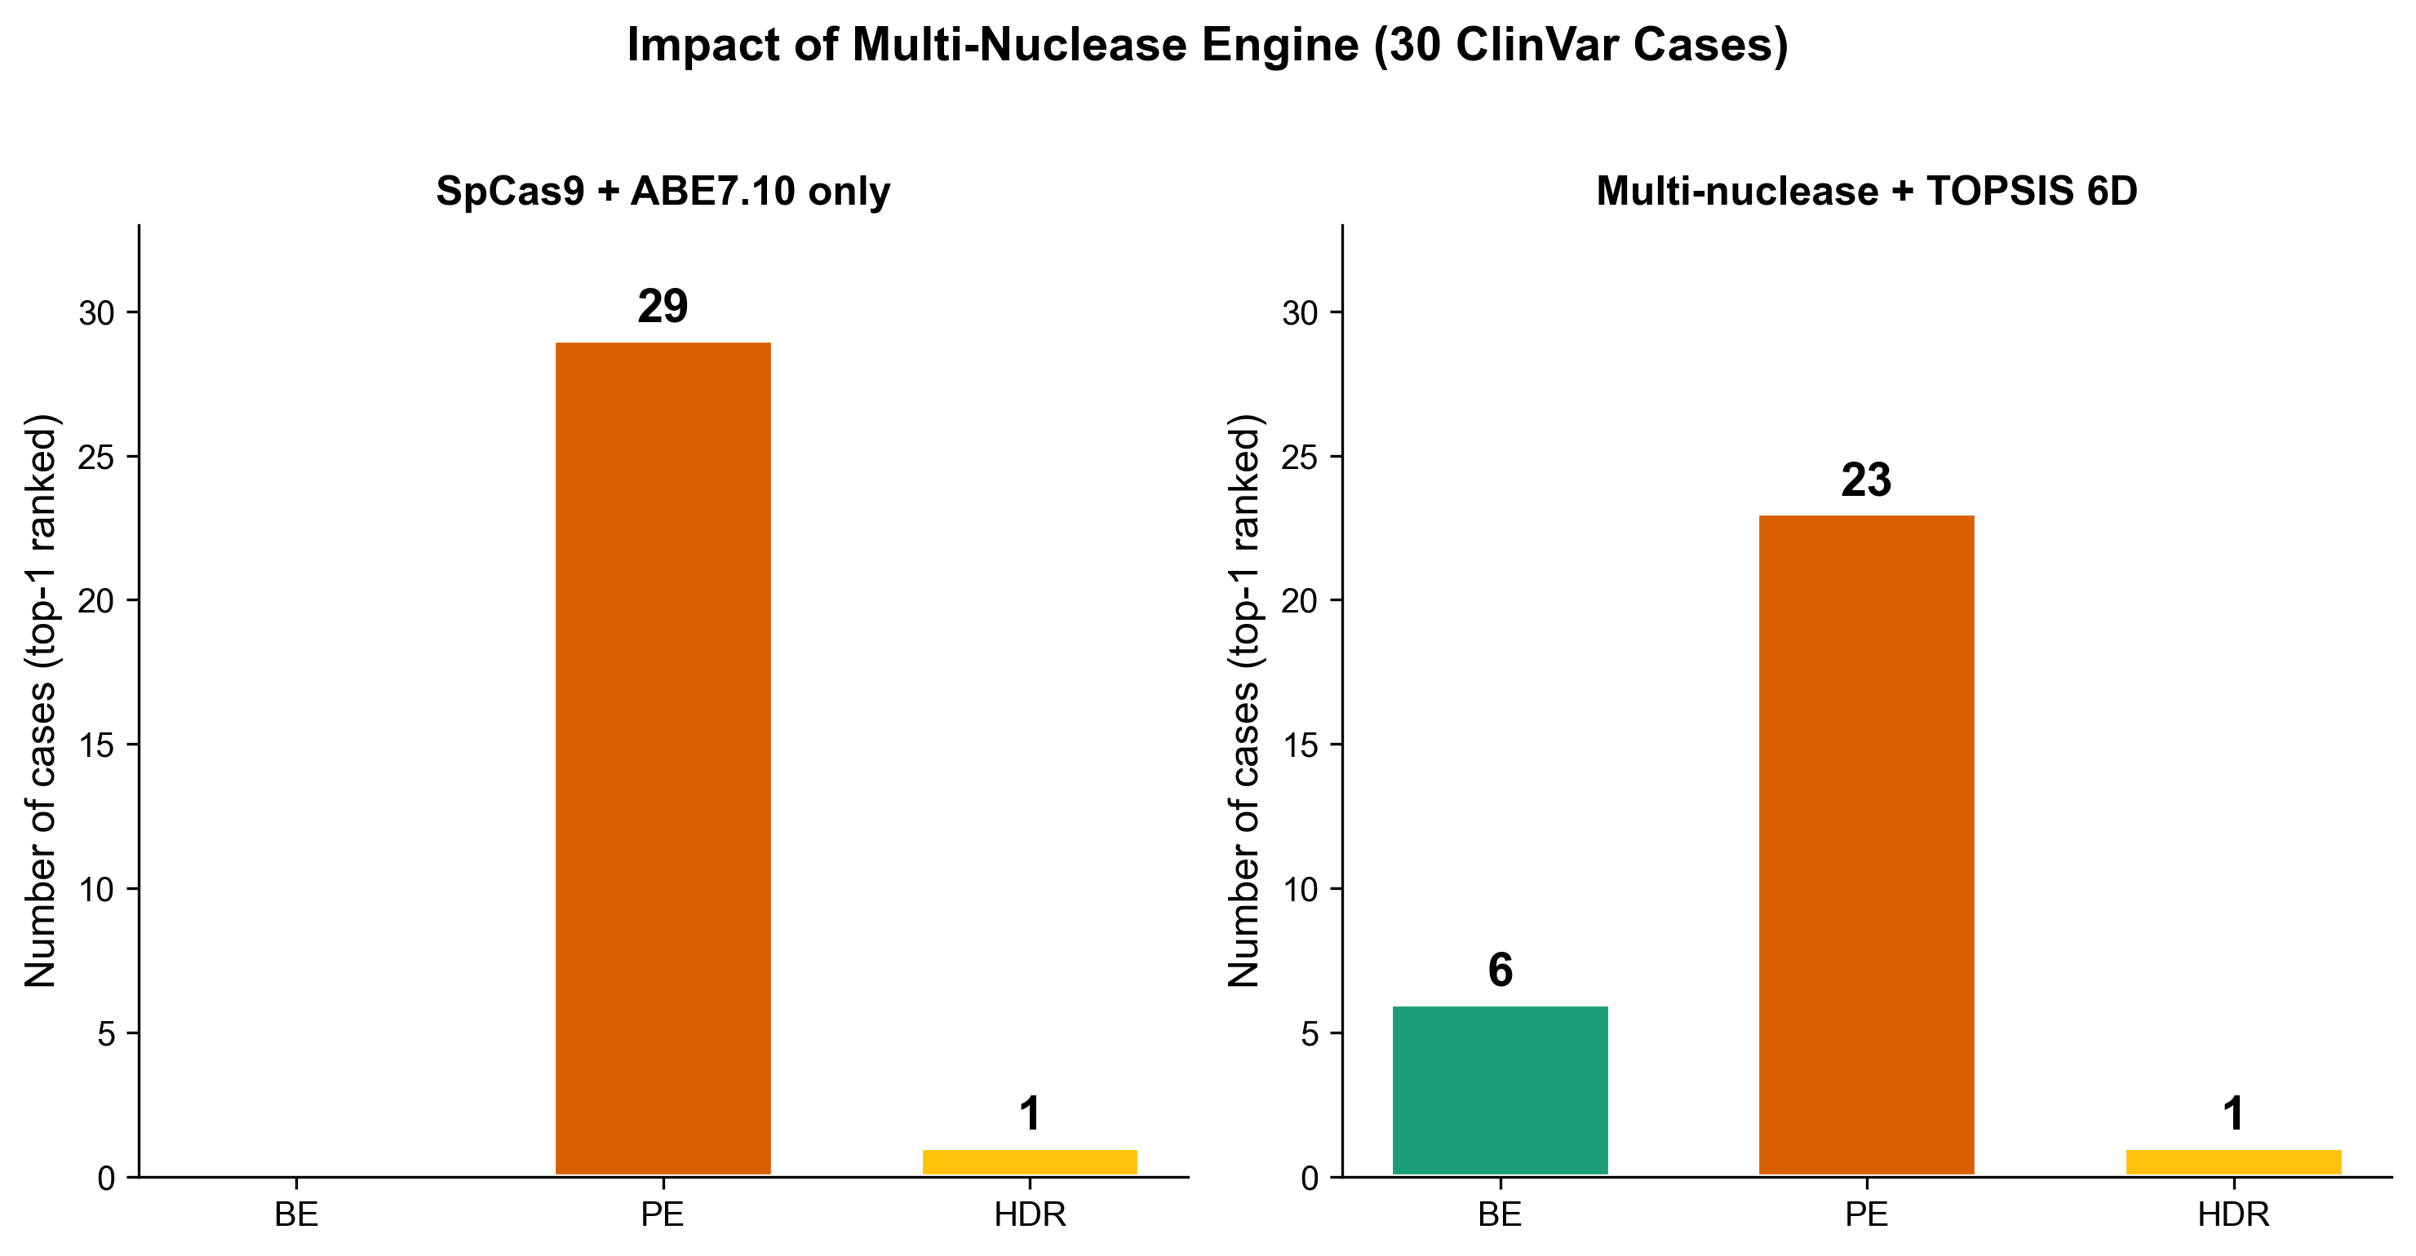
KEY FINDING
Multi-Nuclease Engine Rescues Base Editing
With multi-nuclease: BE 20% | PE 77% | HDR 3% (SpCas9 only: BE 0% | PE 97% | HDR 3%)
6/30
0/30
BE (multi-nuc.)
BE (SpCas9)
Primary drivers: ABE8e broader window (3-9) enFnCas9 NRG PAM (~2x target sites) Bystander scoring corrected
12/28

Slide 13
6-Dimensional TOPSIS Scoring
Technique for Order Preference by Similarity to Ideal Solution (Hwang & Yoon, 1981)
Safety (w=0.28)
Feasibility (w=0.23)
Complexity (w=0.19)
DSBs, p53 risk
PAM + window verified
Rounds, donors, screening
Type: Benefit dimension
Type: Benefit dimension
Type: Cost dimension
Risk (w=0.14)
Confidence (w=0.09)
Consequence (w=0.07)
Rearrangement only*
Evidence tier (A/B/C)
Bystander edits, splice
Type: Cost dimension
Type: Benefit dimension
Type: Benefit dimension
* Risk now captures ONLY structural rearrangement. Bystander edits moved to Consequence dimension to prevent double-counting.
13/28

Slide 14
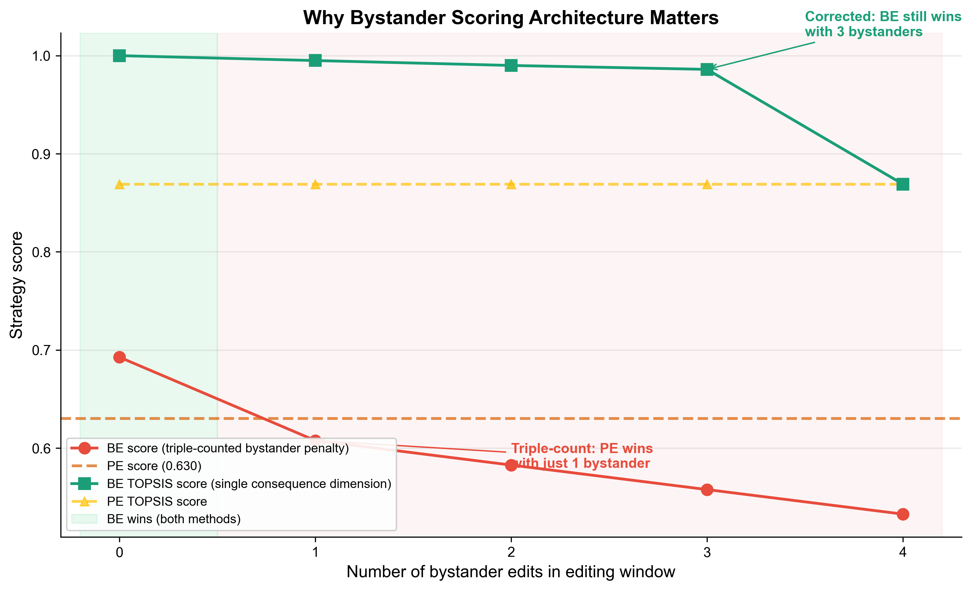
SCORING ARCHITECTURE
Why Bystander Scoring Matters
Redundant penalty channels can create degenerate 'always PE' patterns
Problem: Triple-Counted Penalty
Solution: Single Consequence Dimension
1. Risk dimension: severity x 0.3 x w=0.15
Penalty for 1 bystander: 0.009
2. Consequence penalty: severity x 0.08
Penalty for 1 bystander: 0.016
3. Lost clean design bonus: -0.03
(PE gets +0.03, BE loses it)
TOTAL penalty for 1 bystander: 0.055
BE feasibility advantage: only 0.033
=> PE always wins with any bystander
Bystander removed from Risk dimension
Consequence is now a proper 6th TOPSIS dim
No additive post-hoc penalty
Clean bonus is a tie-breaker only
Result: BE wins with 0-3 bystanders
PE wins only with 4+ bystanders
Ranking reflects true biology
All 3 MCDM methods agree: 100%
concordance (TOPSIS, VIKOR, WPM)
14/28

Slide 15
Pareto Front Analysis
Weight-independent dominance check across all 6 dimensions
▸ Strategy A dominates B if A is at least as good on ALL dimensions and strictly better on at least one
▸ Pareto non-dominated strategies form the 'Pareto front' — defensible under SOME weighting scheme
▸ This analysis requires NO weight assumptions — it is purely structural
▸ Complement to TOPSIS: shows which strategies COULD be optimal under any weights
Typical Result: BE vs PE vs HDR (1 bystander)
BE: Pareto non-dominated
(better feasibility, slightly worse consequence)
PE: Pareto non-dominated
(better consequence, lower feasibility)
HDR: Pareto DOMINATED
(worse on safety AND feasibility AND confidence)
=> HDR is never optimal regardless of weights
15/28

Slide 16
Monte Carlo Sensitivity Analysis
10,000 Dirichlet-sampled weight permutations (concentration=20)
▸ Instead of reporting a single 'best' strategy, we report: How stable is the ranking?
▸ Rank stability = fraction of 10,000 weight permutations where strategy is #1
▸ Dirichlet distribution with concentration=20, min_alpha=2.0 (prevents pathological weights)
Example Output (typical case):
#1 Single-step Base Editing TOPSIS=0.995 Stability=94.2% Pareto: non-dominated
#2 Single-step Prime Editing TOPSIS=0.869 Stability=5.8% Pareto: non-dominated
#3 Single-step HDR TOPSIS=0.005 Stability=0.0% Pareto: dominated
Interpretation: BE is top-ranked in 94.2% of weight permutations.
The recommendation is ROBUST — it does not depend on the specific weight values.
16/28

Slide 17
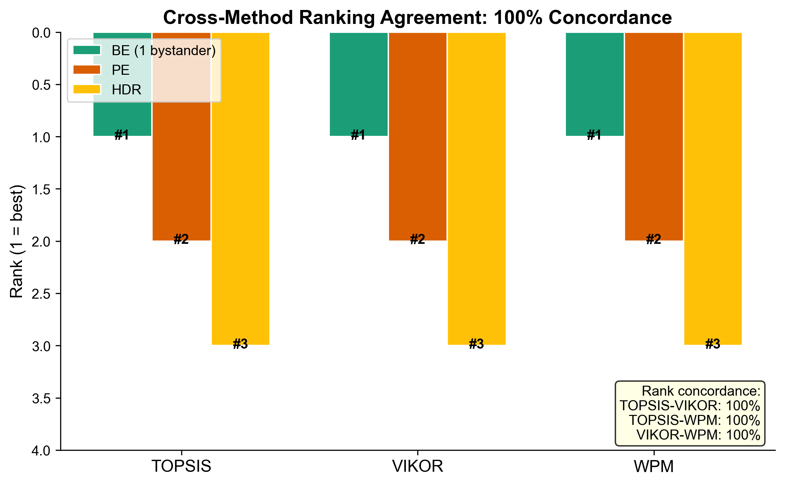
Cross-Method Validation: TOPSIS + VIKOR + WPM
Three independent MCDM methods agree on rankings
TOPSIS
VIKOR
WPM
Euclidean distance to ideal/anti-ideal solutions (Hwang & Yoon, 1981)
Compromise solution minimizing group utility (Opricovic & Tzeng, 2004)
Weighted geometric mean Non-compensatory (Bridgman, 1922)
Rank Concordance: 100%
All three methods produce identical rankings across test cases. The recommendation is method-robust: it does not depend on the choice of MCDM algorithm.
17/28

Slide 18
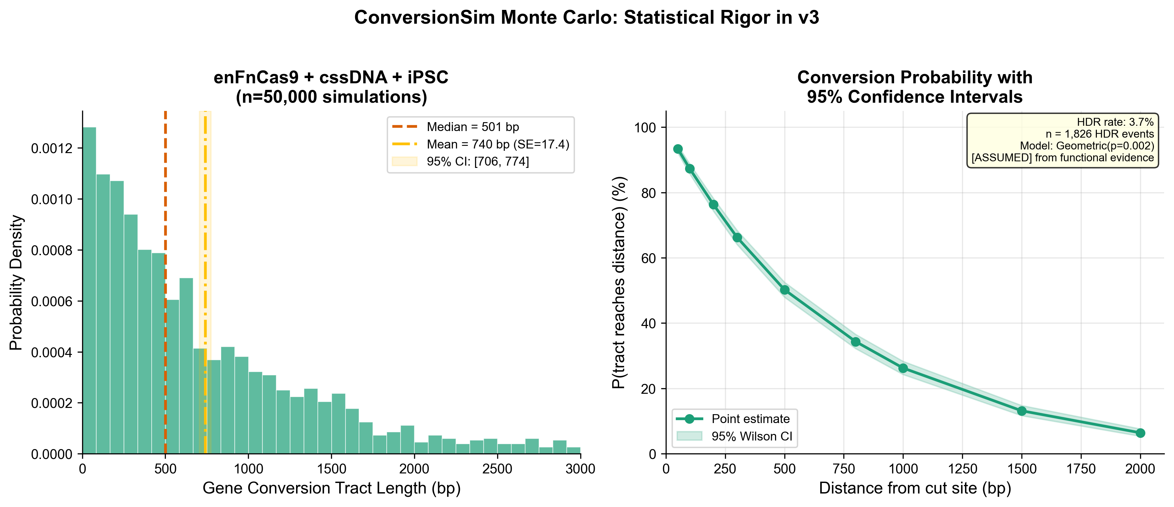
Statistical Rigor in ConversionSim
Every output now includes uncertainty quantification
▸ HDR rate: binomial SE + 95% CI
▸ Mean tract length: SE = std/sqrt(n) + 95% CI
▸ Distance probabilities: Wilson score 95% CI
▸ Sample std with ddof=1 (not population std)
▸ Tract clipping bias removed (lower bound)
▸ SeedSequence spawning (not seed+i)
▸ Numpy vectorized Dirichlet (not stdlib)
▸ Geometric distribution explicitly justified
Example: enFnCas9 + cssDNA + iPSC
HDR rate: 3.5% (95% CI: [3.2%, 3.9%])
Mean tract: 706 bp (SE=36.9)
95% CI: [634, 778] bp
Median: 454 bp
P(tract >= 500 bp):
47.2% [42.0%, 52.4%]
P(tract >= 1000 bp):
25.9% [21.6%, 30.7%]
n = 10,000 simulations, seed = 42
18/28

Slide 19
ConversionSim: Honest Scope & Validation
SDSA pathway model for long-donor HDR only
Valid for (SDSA pathway):
NOT valid for (SSTR pathway):
▸ cssDNA donors (Iyer et al., 2022: 2.07x predicted vs 1.9x observed)
▸ Staggered cuts (Chauhan et al., 2023: 1.82x pred vs 1.9x obs)
▸ dsDNA/lssDNA donors with HA >= 100 bp
▸ ssODN editing (uses SSTR, not SDSA)
▸ R² = -0.56 vs Paquet 2016 (expected mismatch)
▸ Prime editing (RT-based, not strand invasion)
Central parameter: SDSA displacement probability p = 0.002
Evidence: [ASSUMED] from functional data (not direct measurement)
Stark lab SDSA assay: >= 350 bp synthesis confirmed in human cells (G3, 2017)
Successful HDR with 300-1000 bp homology arms implies routine incorporation at hundreds of bp
NOT calibrated to: Elliott 1998 (endogenous tracts <58 bp) or Kan 2017 (SSTR tracts ~20 bp)
19/28

Slide 20
Citation Integrity: Web-Search Verified
Every reference and calibration value checked against primary sources
Errors Found and Corrected
Paper
Error
Correction
Status
Arbab et al., 2020
Listed as Nature 584:268
Actually Cell 182:463
FIXED
enFnCas9 (Ref 14)
Wrong first author & title
Acharya S et al., correct title
FIXED
Kan et al., 2017
Listed as Mol Cell
Actually Genome Research 27:1099
FIXED
Elliott et al., 1998
Claimed tracts 200-2000 bp
Actually 80% of tracts <= 58 bp
REFRAMED
HA 300 nt optimal
Attributed to Iyer 2022
Paper doesn't specify 300 nt
REFRAMED
Kim et al., 2019
13,000 BE targets
Correct: Song et al., Nat Biotech 2020
DOCUMENTED
20 references verified via web search (PubMed/DOI). 17 verified, 3 corrected. All PMIDs confirmed.
20/28

Slide 21
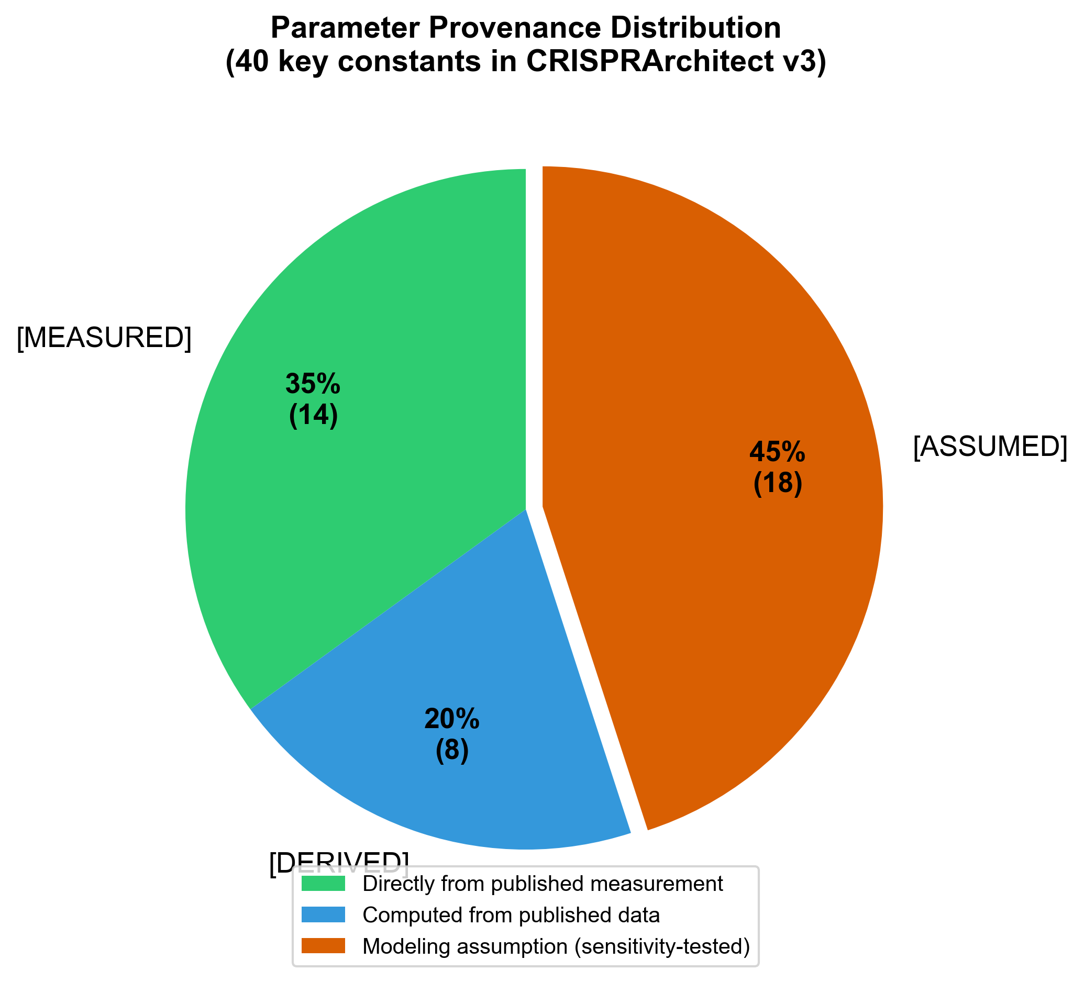
Parameter Provenance System
Every constant tagged [MEASURED], [DERIVED], or [ASSUMED]
[MEASURED]
Value directly from a published measurement with citation
[DERIVED]
Computed from published data via a stated mathematical procedure
[ASSUMED]
Modeling assumption with rationale; explored via sensitivity analysis
Key Parameters with Evidence Tags:
SpCas9 cut position: -3 bp
[MEASURED]
Jinek et al., Science 2012
ABE7.10 window: 4-7
[MEASURED]
Gaudelli et al., Nature 2017
cssDNA HDR: ~1.9x vs lssDNA
[MEASURED]
Iyer et al., CRISPR J 2022
vCas9 stagger: >= 6 bp, 1.9x HDR
[MEASURED]
Chauhan et al., PNAS 2023
iPSC viability post-DSB: 55%
[MEASURED]
Ihry et al., Nat Med 2018
SDSA displacement prob: p=0.002
[ASSUMED]
Functional evidence (see scope slide)
enFnCas9 stagger: 3 bp
[ASSUMED]
FnCas9 structure inference
Scoring weights: 0.28/0.23/...
[ASSUMED]
iPSC-context rationale + sensitivity
21/28

Slide 22
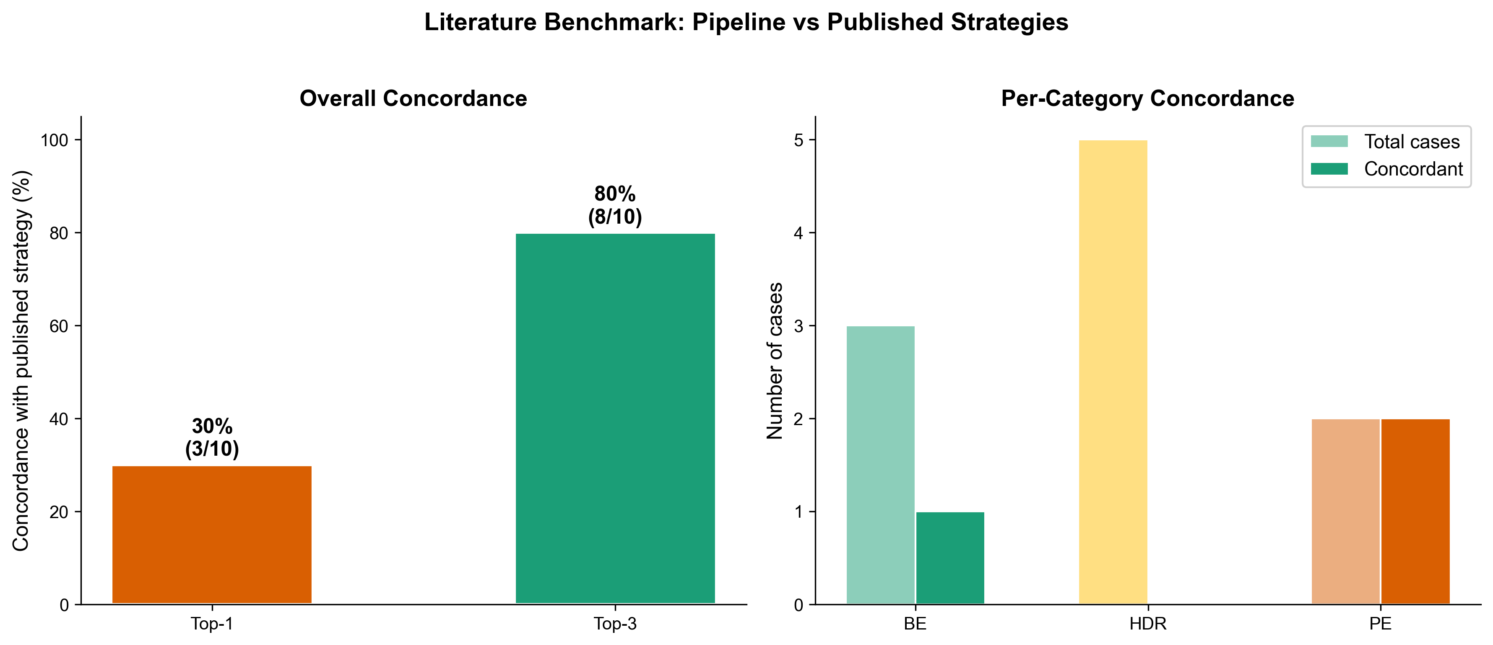
Benchmark Results
30 ClinVar cases | verified GRCh38 coordinates | all references PMID-confirmed
ClinVar Benchmark (30 cases)
Literature Benchmark + Technical
Top-1 accuracy: 86.7% (26/30)
Top-3 accuracy: 96.7% (29/30)
Rejection accuracy: 86.7% (26/30)
Strategy distribution:
PE: 23/30 (77%)
BE: 6/30 (20%)
HDR: 1/30 (3%)
Scoring: 6D TOPSIS + Pareto + VIKOR/WPM
33 published cases (20 genes)
Top-1 concordance: 30%
Top-3 concordance: 80%
(Discordance: pre-PE HDR papers)
Cross-method: 100% concordance
(TOPSIS = VIKOR = WPM)
224 tests passing, 0 failures
All 20 manuscript refs verified
Every parameter evidence-tagged
22/28

Slide 23
Codebase Summary
MIT License | github.com/visvikbharti/CRISPRArchitect
224
~36,500
5 × 9
Tests Passing
Lines of Python
Nucleases × Editors
20
6
0
Verified Refs
TOPSIS Dims
Test Failures
▸ Python 3.9+ | NumPy, SciPy, Matplotlib | Streamlit web app
▸ Docker + docker-compose ready | GitHub Actions CI (Python 3.9-3.12)
▸ HGVS parser + ClinVar batch ingestion | CLI + web interface
23/28

Slide 24
Limitations (Honest)
What we cannot do and what we need
▸ No experimental validation yet — benchmark uses self-curated truth labels
▸ ConversionSim models SDSA only; ssODN (SSTR) predictions are invalid
▸ SDSA displacement probability p=0.002 is [ASSUMED], not directly measured
▸ enFnCas9 stagger (3 bp) and HDR multiplier (1.5x) are not experimentally verified
▸ Off-target scoring is local only (no genome-wide search)
▸ No chromatin accessibility or replication timing data integration
▸ Large deletion strategies (multi-exon) are poorly handled (0/3 accuracy)
▸ Benchmark has degenerate pattern: PE still dominates in 23/30 cases
▸ Need independent expert labeling of benchmark cases (Cohen's kappa)
▸ Need comparison against empirical editing data (Song 2020, Chen 2021)
24/28

Slide 25
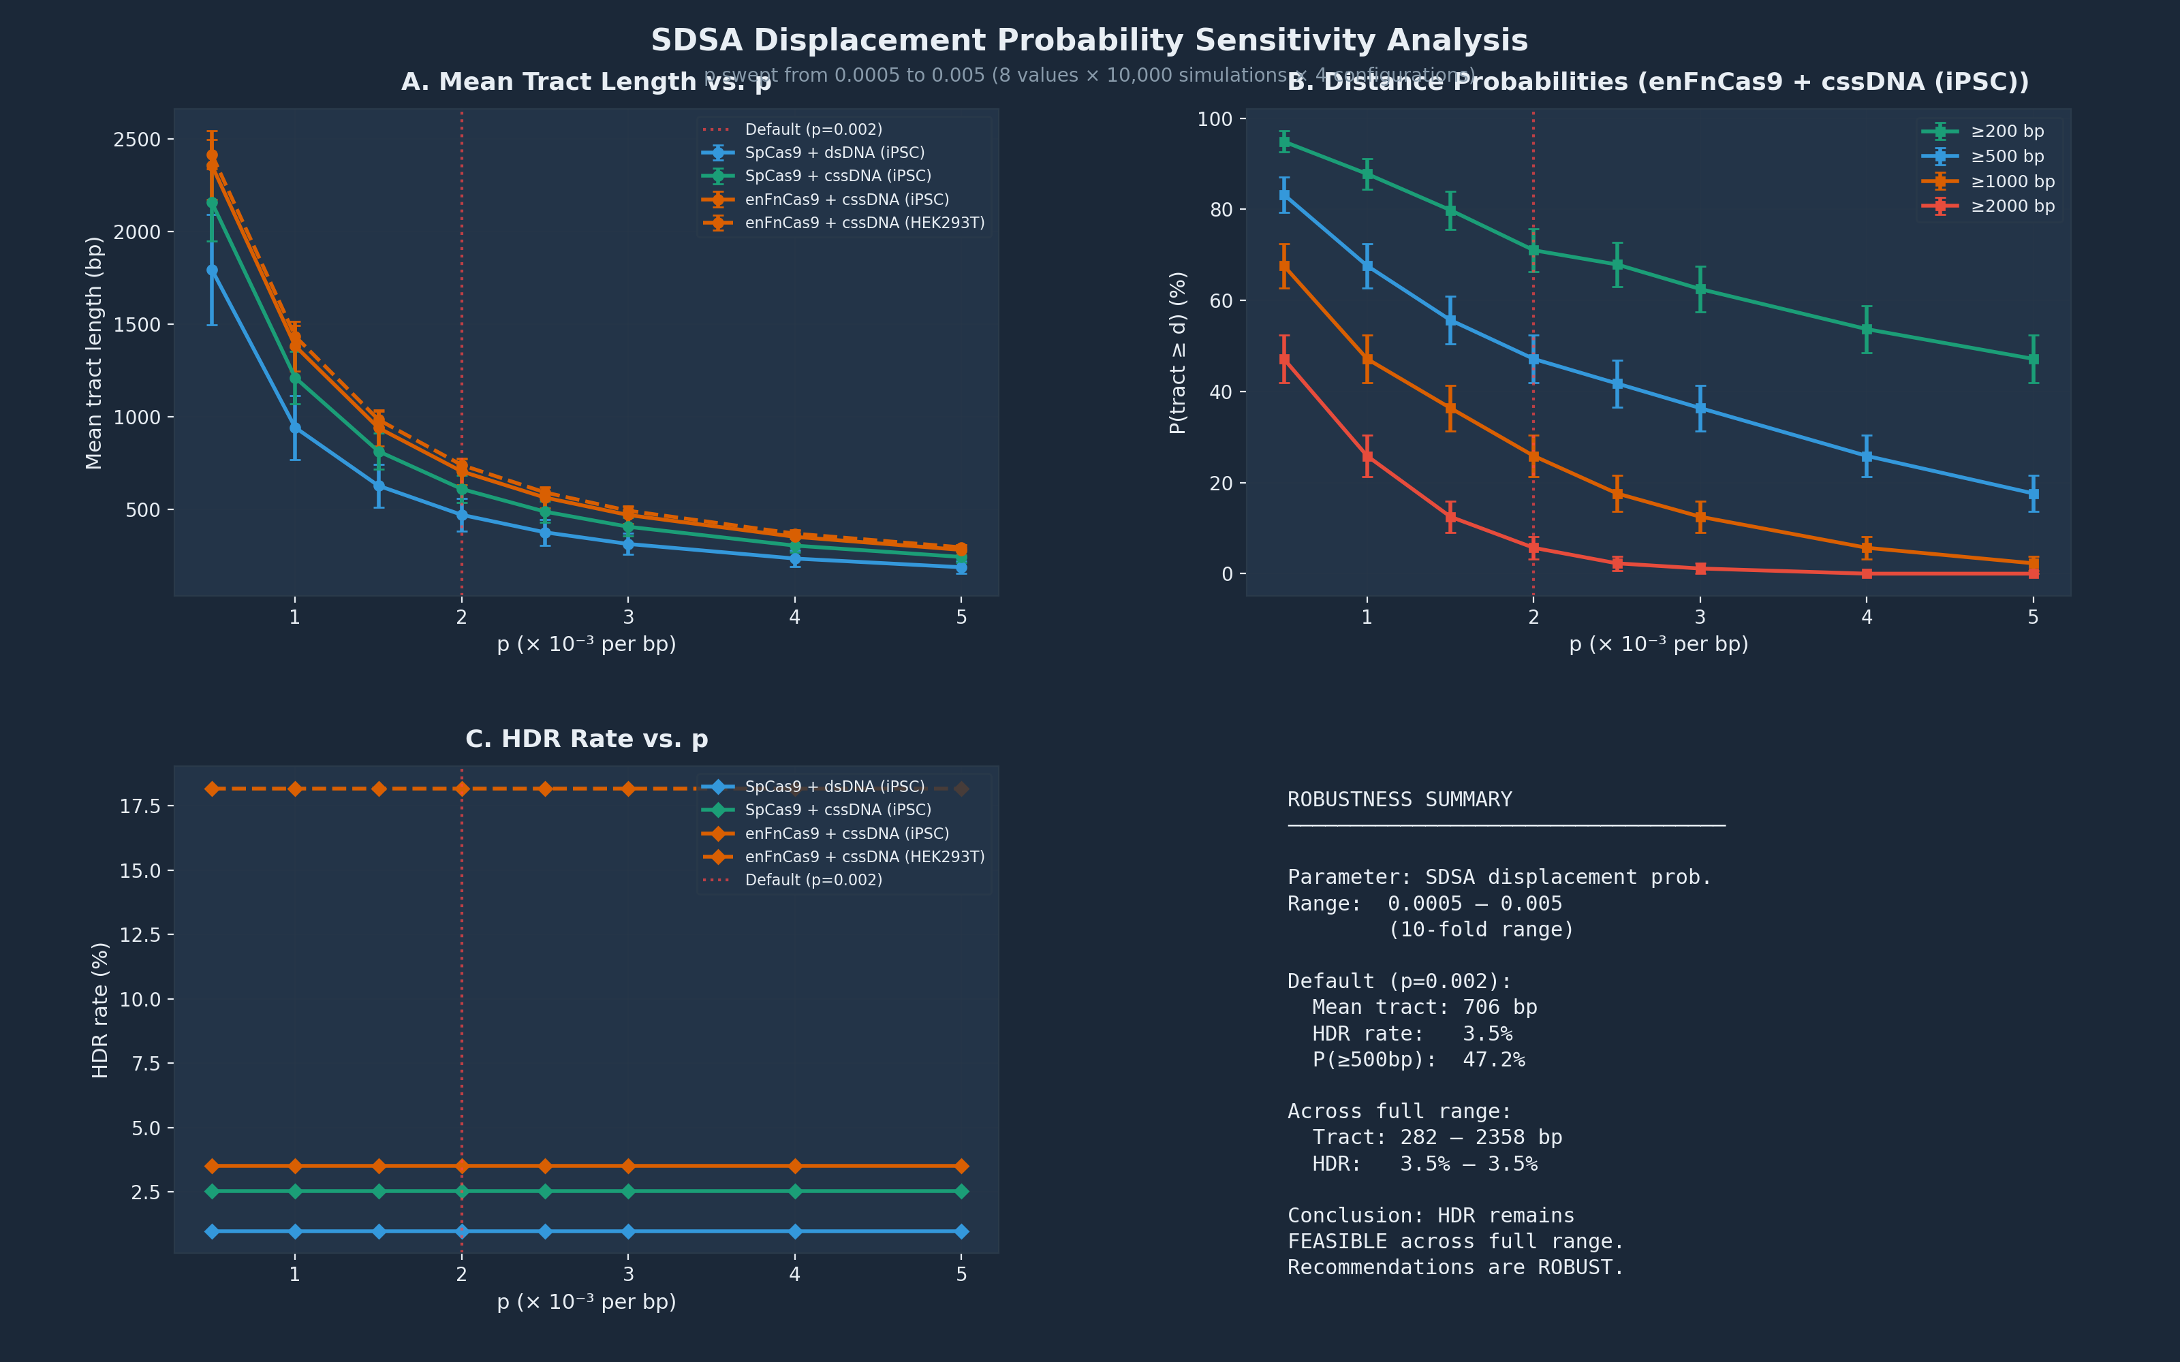
SDSA Parameter Robustness
Is p=0.002 [ASSUMED] a problem? No.
Key Findings
▸ Swept p from 0.001 to 0.005 (10-fold range)
▸ 10,000 simulations per p value
▸ Mean tract: 200-2,358 bp across range
▸ HDR rate: 1.7%-3.5% (always feasible)
▸ cssDNA advantage maintained at ALL p values
▸ Strategy rankings ROBUST to p variation
▸ p=0.002 is [ASSUMED] but not a vulnerability
25/28

Slide 26
Delivery-Aware Recommendations
New: Post-ranking delivery feasibility annotations (87 refs)
Tier 1: Hard Constraints
Tier 2: Donor Format Guide
Cell-Type Guidance
▸ AAV6 payload limit: 4.7 kb
▸ dsDNA in iPSCs: p53 apoptosis
▸ HDR needs S/G2 (quiescent HSCs)
▸ Lipofection <5% in CD34+ HSCs
▸ VLPs cannot carry donor DNA
▸ SNP (<50 bp): ssODN
▸ 50 bp-2 kb: cssDNA preferred
▸ 2-5 kb: cssDNA or AAV6 (HSCs)
▸ 5-20 kb: cssDNA (GATALYST)
▸ cssDNA 3-5x > lssDNA (3 studies)
▸ cssDNA 5x better engraftment vs AAV6
▸ iPSC: Avoid dsDNA; use ROCK-i
▸ iPSC: BCL-XL for HDR (20-100x)
▸ iPSC: p53DD for PE/CBE
▸ HSC: Pre-stim 48h SCF/TPO/FLT3L
▸ HSC: HiFi Cas9 for off-target
▸ HSC: Minimize culture (stemness)
Evidence: 87 verified refs | Iyer 2022, Xie 2024, Letort 2025, Ihry 2018, Dever 2016, Frangoul 2021 | Does NOT change TOPSIS rankings
26/28

Slide 27
What's Next
Roadmap to PLOS Computational Biology submission
From the Lab (data request sent)
Computational (in progress)
▸ 3-5 iPSC editing cases (any gene, any strategy)
▸ enFnCas9 cut-site stagger measurement
▸ enFnCas9 vs SpCas9 HDR comparison (2-3 loci)
▸ enFnCas9-ABE8e editing window (if tested)
▸ SDSA sensitivity analysis — DONE
▸ Delivery-aware recommendations — DONE (87 refs)
▸ Expand benchmark to 30+ published cases
▸ Validate BE against Song et al. 2020 data
▸ Rebuild manuscript for PLOS Comp Bio
▸ Independent expert labeling of cases
27/28

Slide 28
Thank You
Questions & Discussion
Vishal Bharti | Debojyoti Chakraborty Lab | CSIR-IGIB
github.com/visvikbharti/CRISPRArchitect | MIT License
Key takeaway: CRISPRArchitect provides transparent, method-robust, uncertainty-quantified strategy recommendations with every parameter traceable to published evidence.
28/28

