Slide 1
Computational Validation of
FMC63-CD19 Interface Residue Selection
Manpreet Kour | PI: Dr. Kausik Chakraborty | Co-PI: Dr. Ankesh Kumar Jaiswal
CSIR-IGIB | AcSIR
Structure: PDB 7URV (Singh et al., 2023, Science Immunology)

Slide 2
Computational Validation Approach
Question: Are Tyr260, Tyr261, Ser214 the right residues to mutate?
Two independent validation approaches:
Approach 1: Structural Analysis (BioPython + FreeSASA)
• Contact mapping — which residues touch CD19?
• Hydrogen bond identification — which contacts are strongest?
• Buried surface area — how much interface does each residue contribute?
Approach 2: Machine Learning Prediction (mCSM-AB2)
• Predicts ΔΔG (change in binding free energy) for each mutation
• Trained on 1,810 antibody-antigen mutations (Myung et al., 2020, PMID: 31665262)
• Accuracy: Pearson r = 0.73-0.74 on blind tests
Both validated against published experimental data:
• Y260A → no binding (Singh et al., 2023, Science Immunology)
• Y261A → KD = 682.5 nM, 152× weaker (Singh et al., 2023)

Slide 3
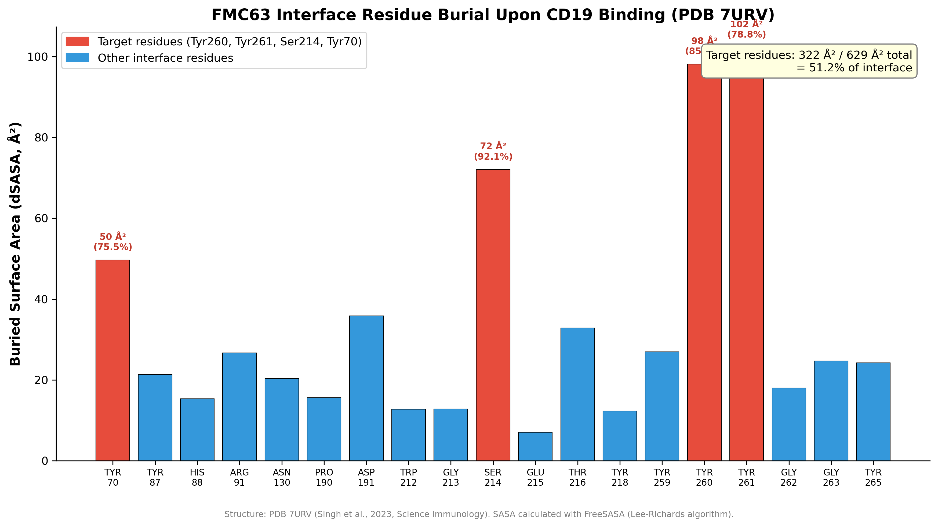
Target Residues Dominate the Binding Interface
4 target residues = 51.2% of total FMC63 interface buried area (322/629 Å²). FreeSASA on PDB 7URV.

Slide 4
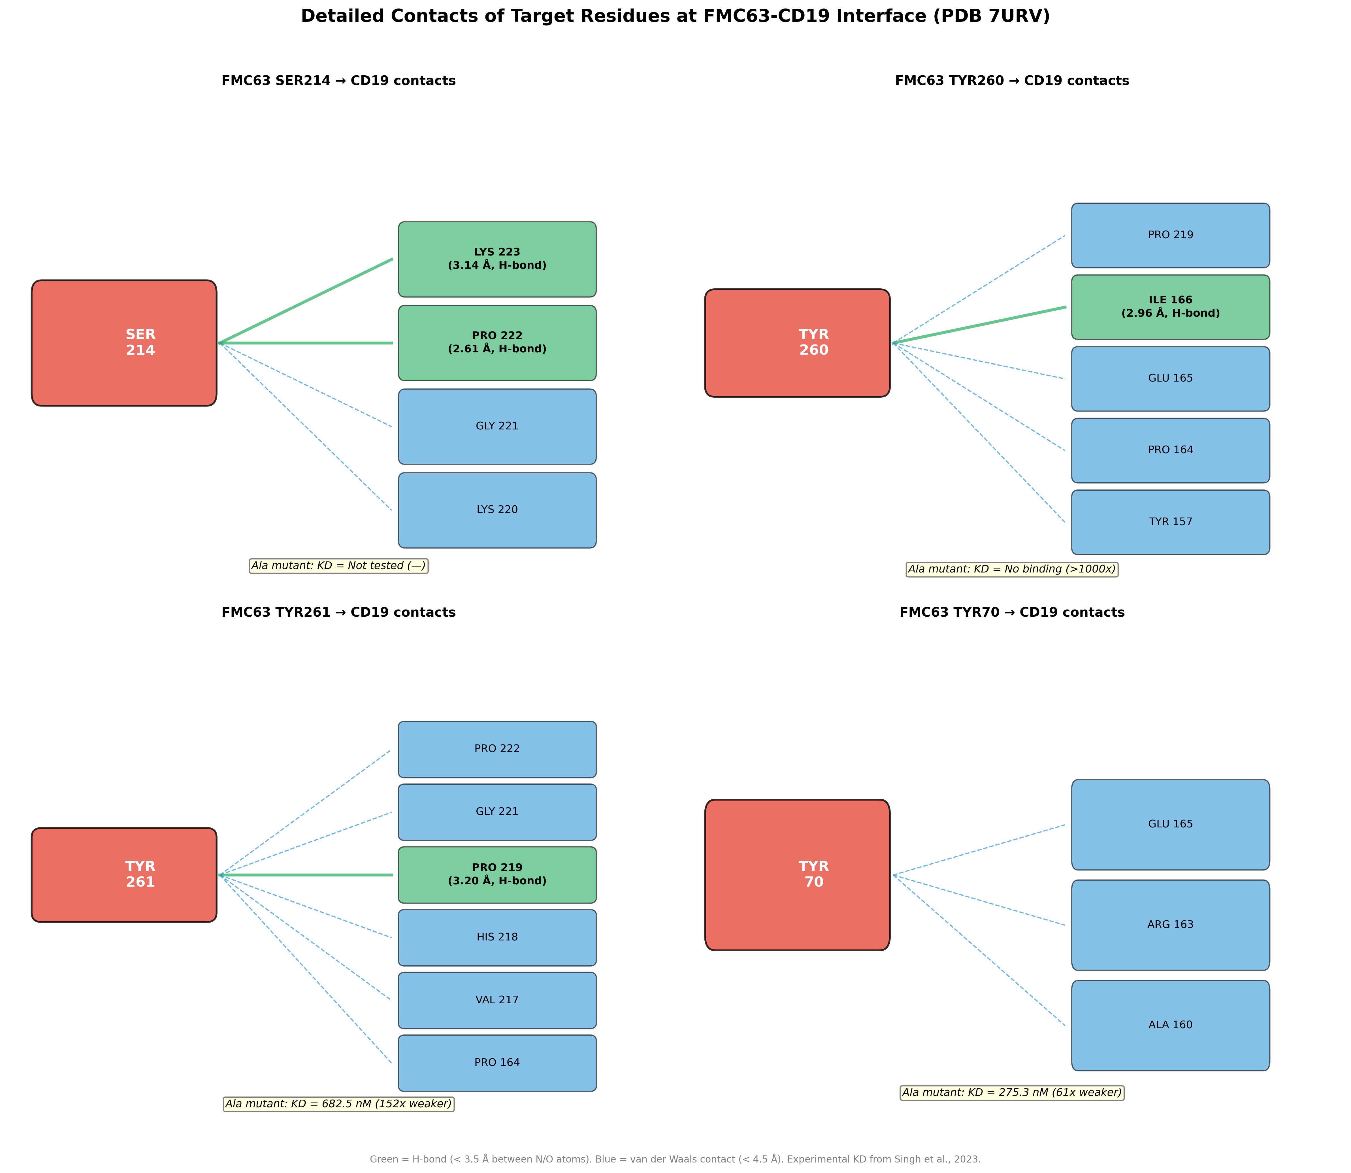
Detailed Contacts at Target Residues
Green = H-bonds (< 3.5 Å). Blue = van der Waals (< 4.5 Å). Exp. KD from Singh et al., 2023.

Slide 5
H-Bond Analysis Explains Published Experimental Results
Critical insight: Side-chain H-bonds are destroyed by Ala mutation,
backbone H-bonds are preserved.
TYR260 → Ala:
• Side-chain OH forms H-bond to Ile166.N (2.96 Å) — DESTROYED by Ala
• Result: NO DETECTABLE BINDING (Singh et al., 2023)
TYR261 → Ala:
• H-bond is through backbone N to Pro219.O (3.20 Å) — PRESERVED in Ala
• Result: KD = 682.5 nM, 152× weaker but not abolished
TYR70 → Ala:
• No H-bonds, only van der Waals contacts
• Result: KD = 275.3 nM, 61× weaker (mildest effect)
SER214 → Ala (PREDICTION):
• Side-chain OG H-bond to Pro222.O (2.61 Å) — WILL BE DESTROYED
• Backbone O H-bond to Lys223.NZ (3.14 Å) — will be PRESERVED
• Our prediction: significant but not catastrophic affinity loss

Slide 6
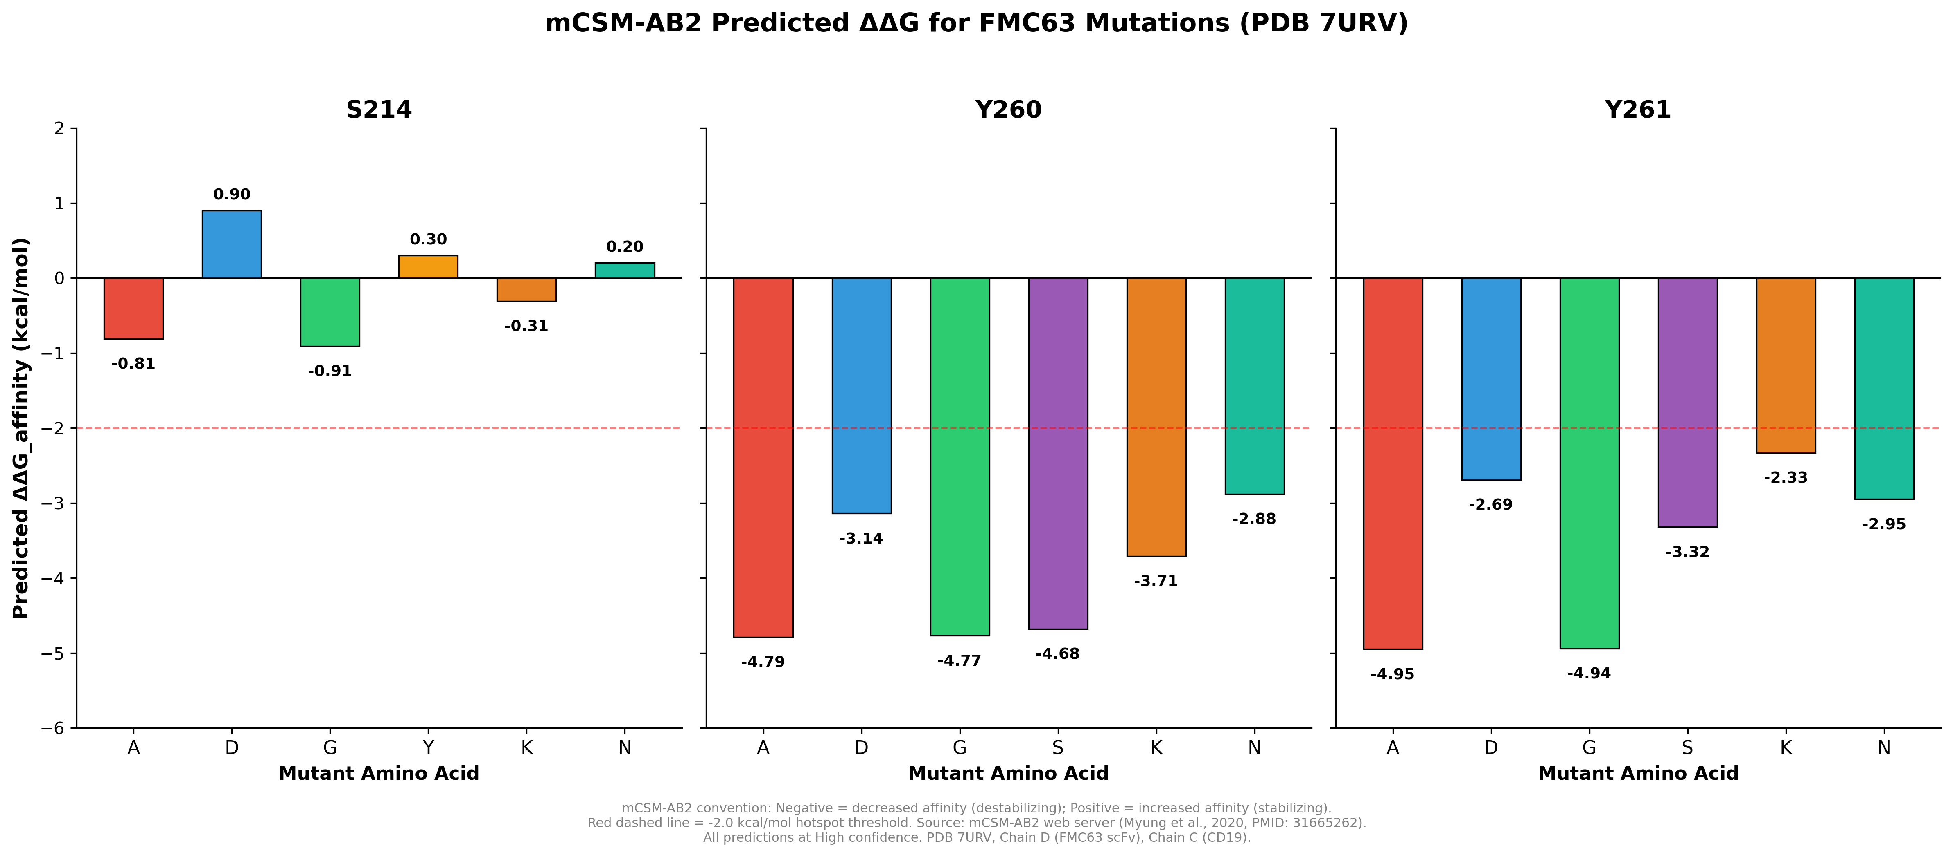
mCSM-AB2 Predicted ΔΔG for 18 Mutations
All predictions High confidence. Negative ΔΔG = decreased affinity. Red dashed line = -2.0 kcal/mol hotspot threshold.

Slide 7
Interpretation of mCSM-AB2 Predictions
Three positions, three different stories:
SER214 — THE FINE-TUNER (ΔΔG: -0.91 to +0.90 kcal/mol)
• All mutations produce SUBTLE effects — none are hotspots
• S214D predicted to INCREASE affinity (+0.90) — potential gain-of-function
• Ideal for mapping the affinity-function relationship in the 'tunable zone'
TYR260 — THE CRITICAL ANCHOR (ΔΔG: -2.88 to -4.79 kcal/mol)
• ALL 6 mutations are hotspots — tyrosine is irreplaceable here
• Y260A prediction (-4.79) matches published 'no binding' result
• Y260 is in CDR-H3 (Chothia H98) — the most important CDR loop
TYR261 — THE MAJOR CONTRIBUTOR (ΔΔG: -2.33 to -4.95 kcal/mol)
• ALL 6 mutations are hotspots, but with wider dynamic range
• Y261K is least severe (-2.33) — lysine partially compensates
• Y261A prediction (-4.95) matches published 152× weaker

Slide 8
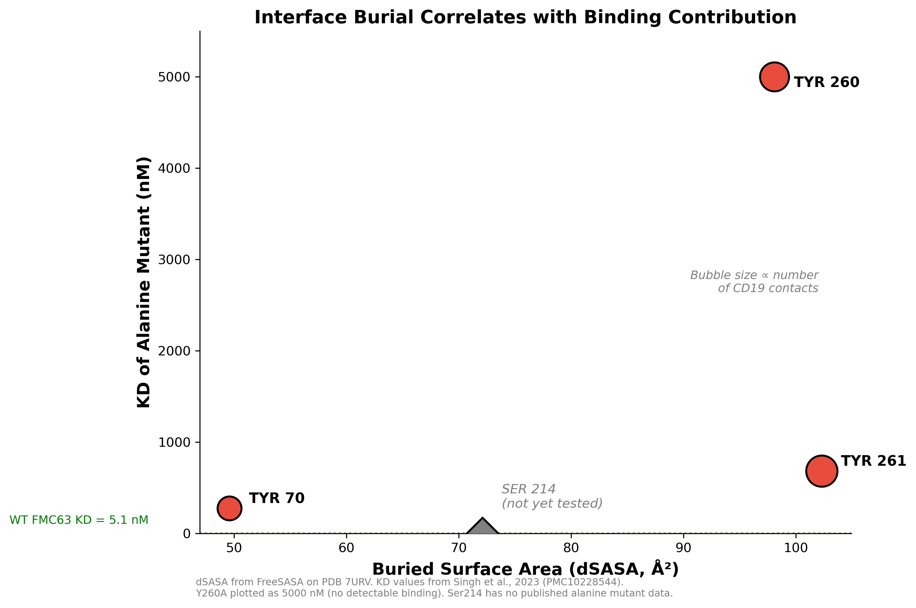
Interface Burial Correlates with Binding Contribution
dSASA from FreeSASA. KD from Singh et al., 2023. Ser214 not yet tested experimentally.

Slide 9
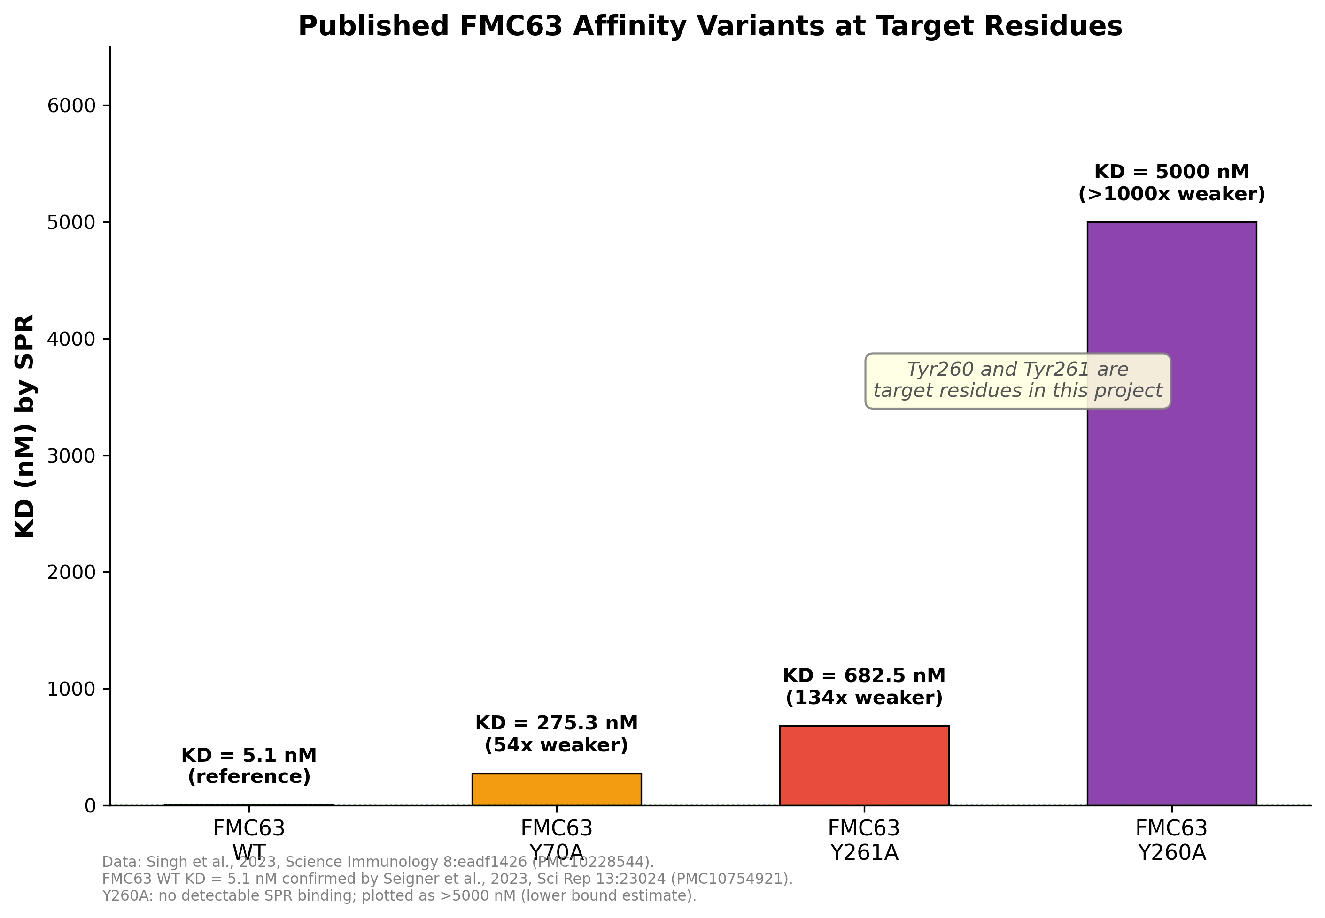
Published FMC63 Affinity Variants Validate Target Residues
Data: Singh et al., 2023, Science Immunology (PMC10228544). Seigner et al., 2023, Sci Rep (PMC10754921).

Slide 10
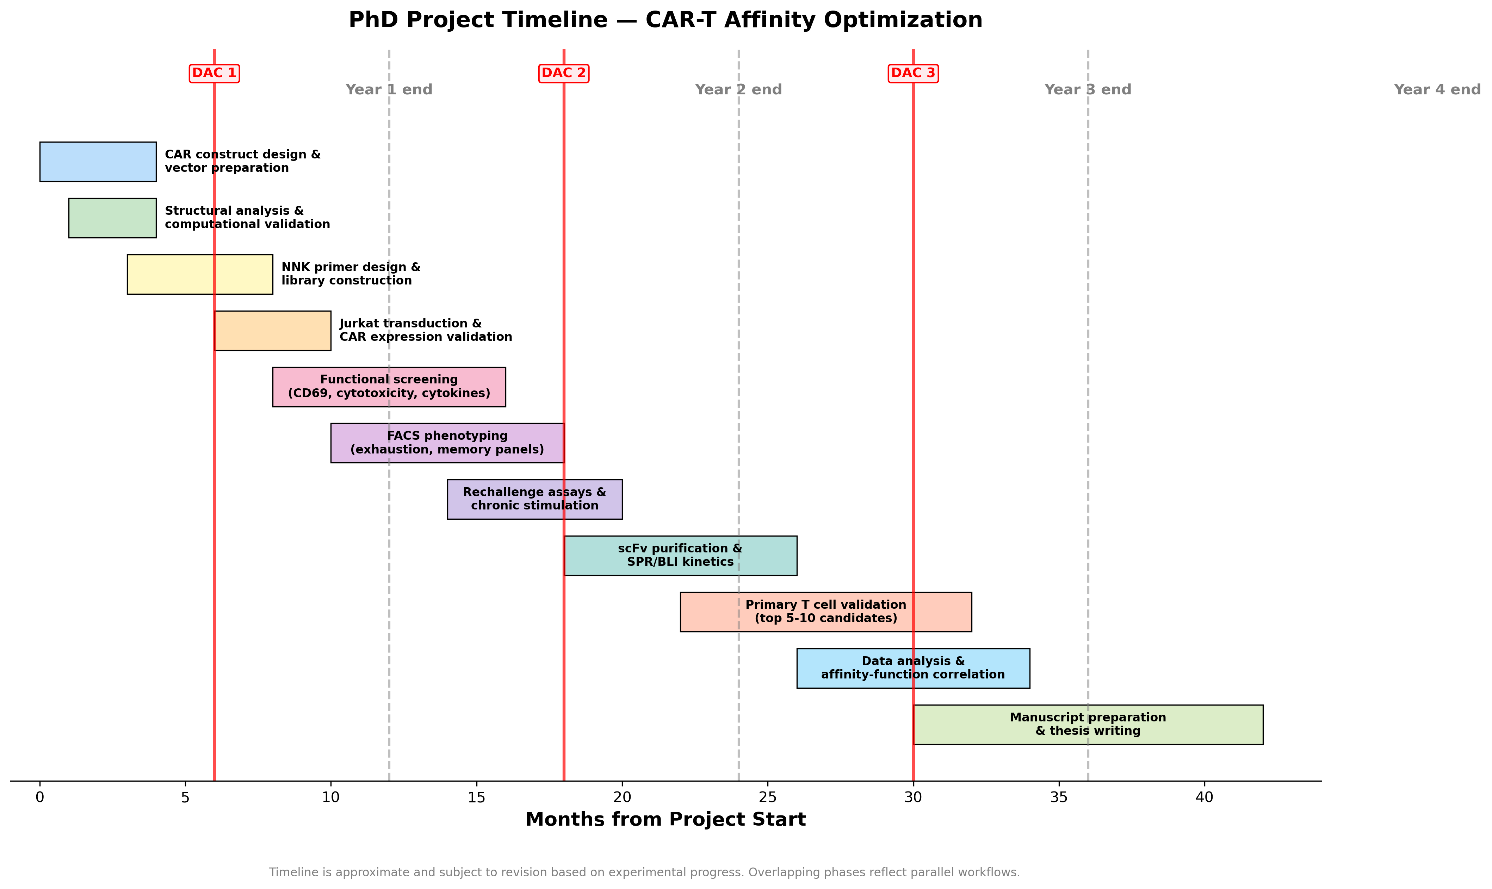
PhD Project Timeline
Timeline is approximate. DAC meetings marked in red.

Slide 11
Conclusions: Computational Validation
Three independent approaches converge:
1. Structural analysis (contacts, SASA, H-bonds):
• Target residues are the top 4 most-connected at the interface
• They account for 51.2% of total buried surface area
2. Machine learning prediction (mCSM-AB2):
• Y260 and Y261 are critical hotspots (all mutations severe)
• S214 tolerates mutations — ideal for affinity fine-tuning
• S214D may enhance affinity (+0.90 kcal/mol)
3. Published experimental data (Singh et al., 2023):
• Y260A = no binding; Y261A = 152× weaker; Y70A = 61× weaker
• Predictions match experiments, validating our approach
Ser214 is the most exciting target — no published data exists,
and computational predictions suggest a tunable affinity range.

Slide 12
Thank You
PI: Dr. Kausik Chakraborty | Co-PI: Dr. Ankesh Kumar Jaiswal
Manpreet Kour | CSIR-IGIB | AcSIR Reg. 10BB25J02028

