Slide 1
Advancing CAR-T Cell Therapy by Understanding the Kinetics of Ag-Ab Interaction Parameters
First DAC Meeting
Presented by: Manpreet Kour PhD Scholar, CSIR-IGIB AcSIR Reg. - 10BB25J02028
Principal Investigator: Dr. Kausik Chakraborty Co-Principal Investigator: Dr. Ankesh Kumar Jaiswal
DAC Members: Dr. Arpan Parichha | Dr. Chetana Sachidanandan | Dr. Sheetal Gandotra

Slide 2
Presentation Outline
1. Background: Evolution of Cancer Therapeutics
2. T Cell Receptor Complex & Signaling
3. TCR-pMHC Binding Kinetics: KD, kon, koff
4. Kinetic Proofreading & Optimal Dwell Time
5. TCR Clustering & Serial Engagement Model
6. Mechanical Forces: Catch Bonds vs Slip Bonds
7. Self vs Non-Self: TCR Affinity Windows
8. Engineering CAR-T Cells & CAR vs TCR Signaling
9. The Affinity Mismatch Problem in CAR-T
10. Hypothesis & Objectives
11. Experimental Design & Workflow
12. Expected Outcomes & Timeline

Slide 3
Evolution of Cancer Therapeutics
1890-1950s Surgery, Radiation & Chemotherapy
1940s Hormonal Therapy
1976 BCG Immunotherapy
1986 FDA-approved Interferon Therapy
1997-2017 Monoclonal Antibodies & Small Molecule Inhibitors
2015-2018 Immune Checkpoint Therapies (Anti-PD-1, Anti-PD-L1)
2017 First FDA-approved CAR-T Cell Therapy (Kymriah)
Current Challenges: Tumor relapse, TME immunosuppression, off-target toxicity, early exhaustion, lack of precision
Milestones in Cancer Research and Discovery, NCI; Jangavali et al., 2025

Slide 4
The T Cell Receptor Complex
TCR: heterodimer of α and β chains, each with variable (V) and constant (C) domains
Associated with CD3 signaling subunits: CD3εγ, CD3εδ, and CD3ζζ
CD3ζ contains 3 ITAMs (Immunoreceptor Tyrosine-based Activation Motifs)
Six CDR loops (CDR1-3 from each chain) form the binding interface:
• CDR1 & CDR2 (germline-encoded): contact MHC α-helices
• CDR3 (somatically rearranged): contacts the peptide - determines specificity
TCR-pMHC binding is weak (KD: 1-100 μM) compared to antibody-antigen (nM)
ERM proteins (Ezrin, Radixin, Moesin) anchor TCR on microvilli
Shah et al., 2021, Signal Transduct Target Ther; Ghosh et al., 2020, Cell Reports; Rossjohn et al., 2015, Annu Rev Immunol

Slide 5
TCR-pMHC Binding Kinetics: The Key Parameters
KD (Equilibrium Dissociation Constant)
• Ratio of koff/kon; reflects overall binding strength
• CD8+ T cells: 13 ± 11 μM | CD4+ T cells: 52 ± 33 μM
kon (Association Rate)
• Range: 600 - 400,000 M⁻¹s⁻¹
• Relatively slow (requires induced-fit conformational adjustment)
koff (Dissociation Rate) — THE KEY PARAMETER
• Range: 0.009 - 0.975 s⁻¹
• Determines dwell time (t½ = ln2/koff)
• Better predictor of T cell activation than KD
• "TCR-ligand koff is a robust and stable biomarker of CD8+ T cell potency"
Stone et al., 2009, Immunology; Aleksic et al., 2007, J Immunol; Hebeisen et al., 2017, JCI Insight

Slide 6
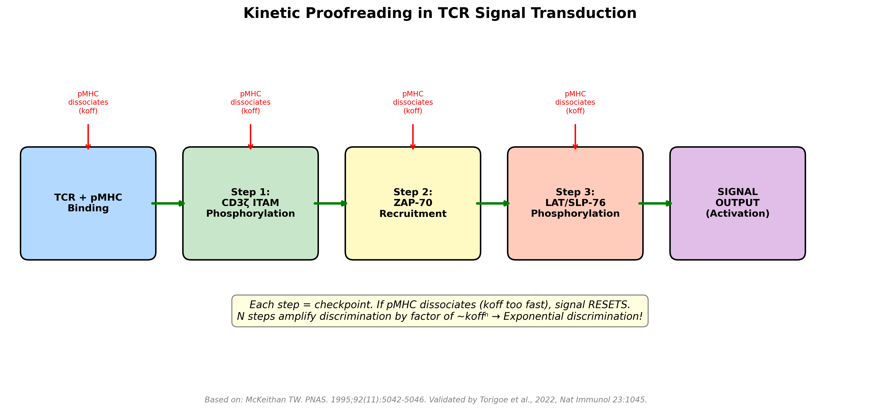
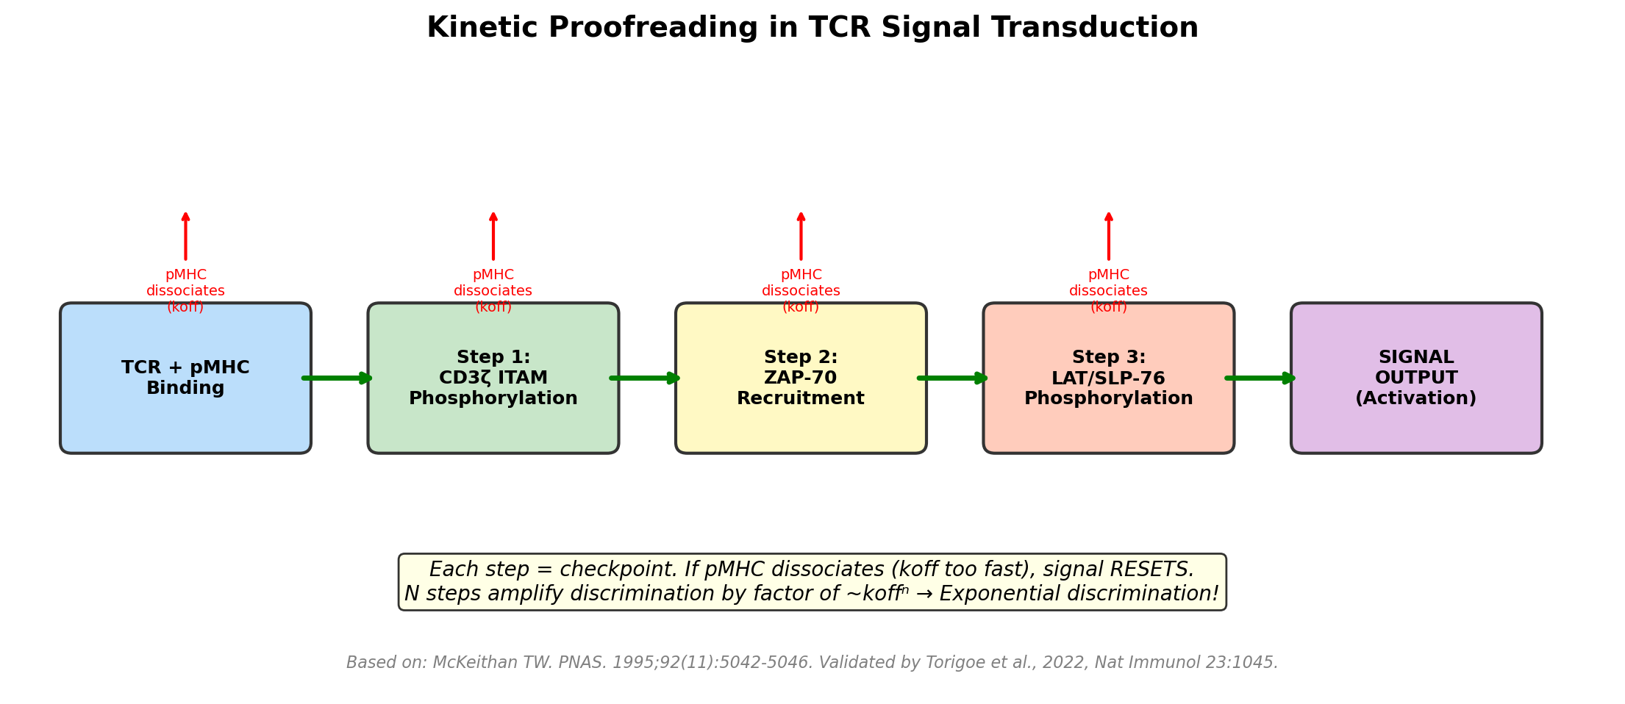
Kinetic Proofreading Model (McKeithan, 1995)
Each phosphorylation step acts as a checkpoint. If pMHC dissociates before completion, signal RESETS. N steps amplify koff differences exponentially (∼ koff^N) → Exquisite discrimination between self and foreign.
McKeithan TW, 1995, PNAS 92:5042-5046; Torigoe et al., 2022, Nat Immunol 23:1045-1056

Slide 7
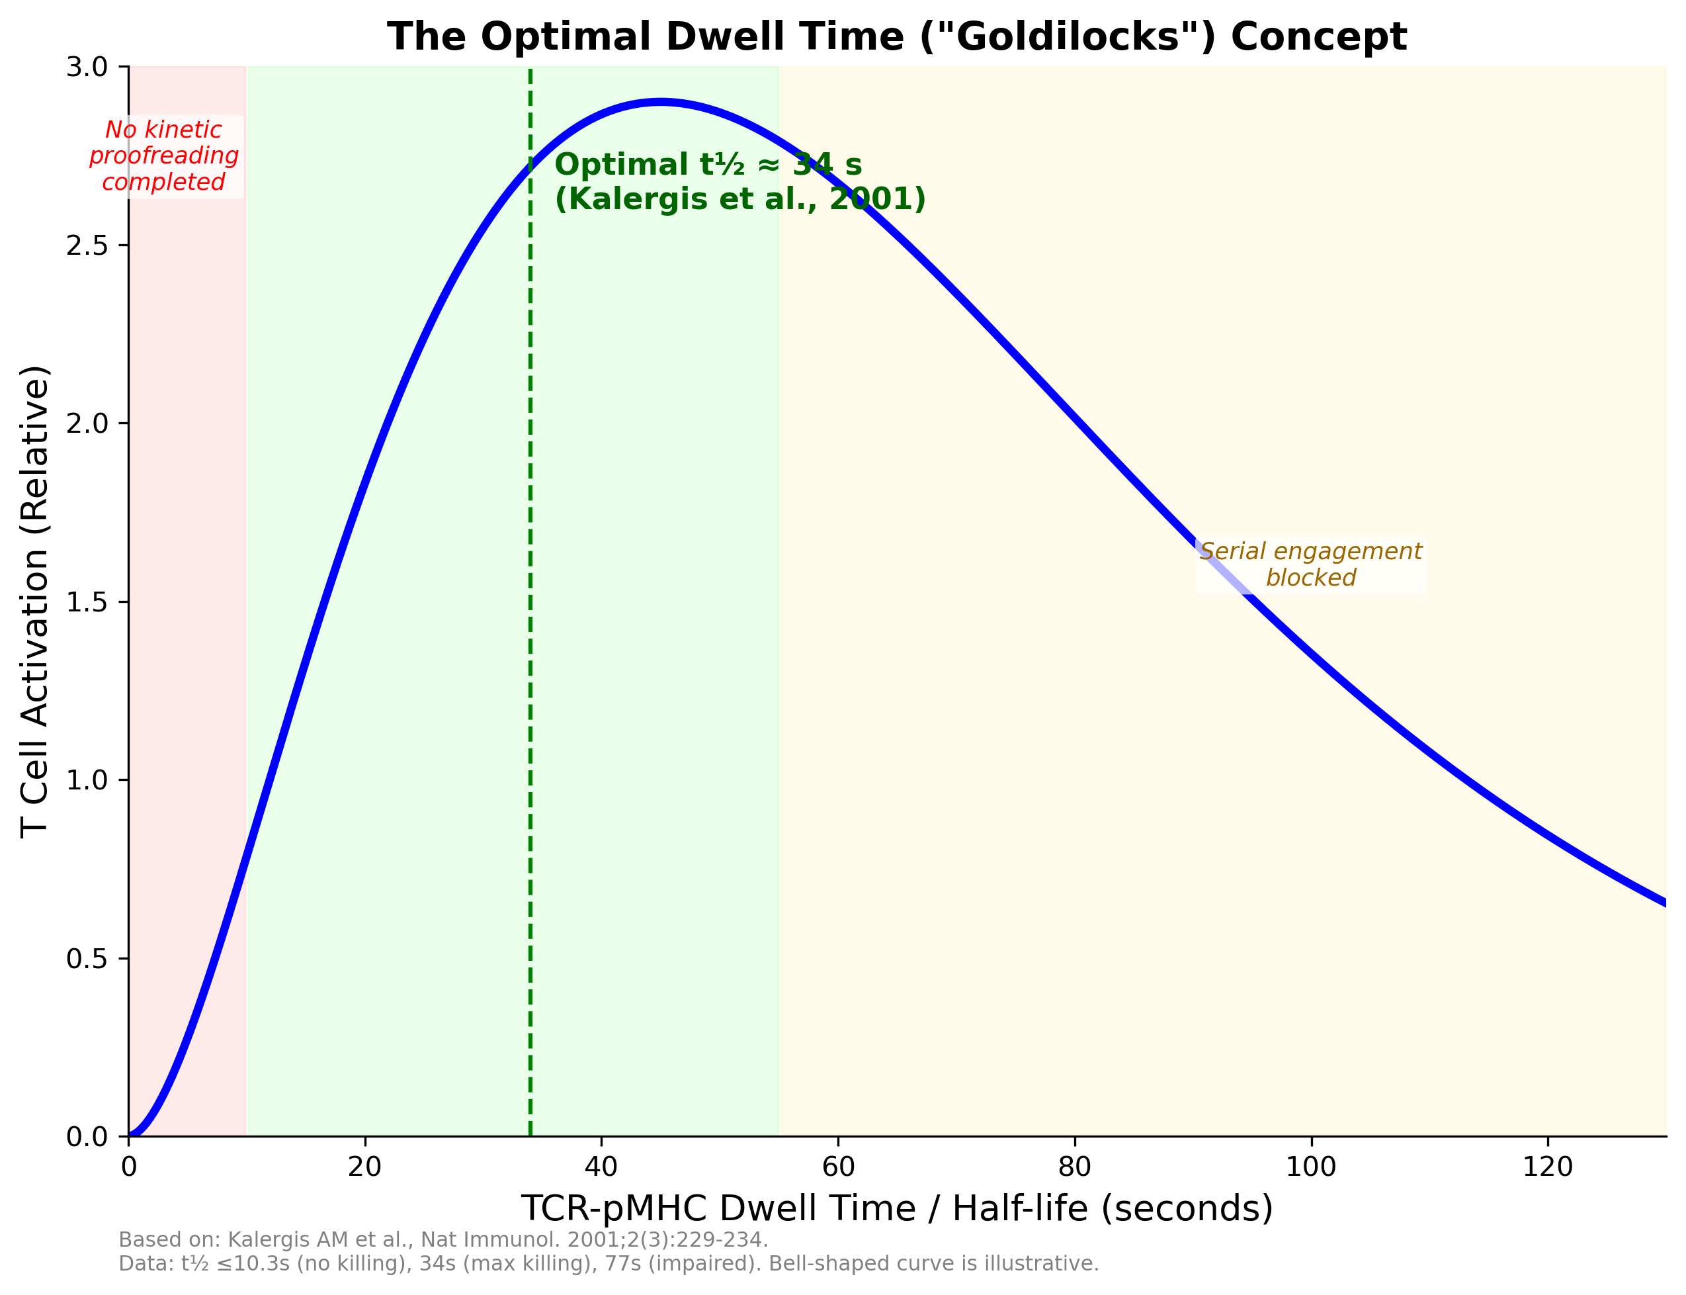
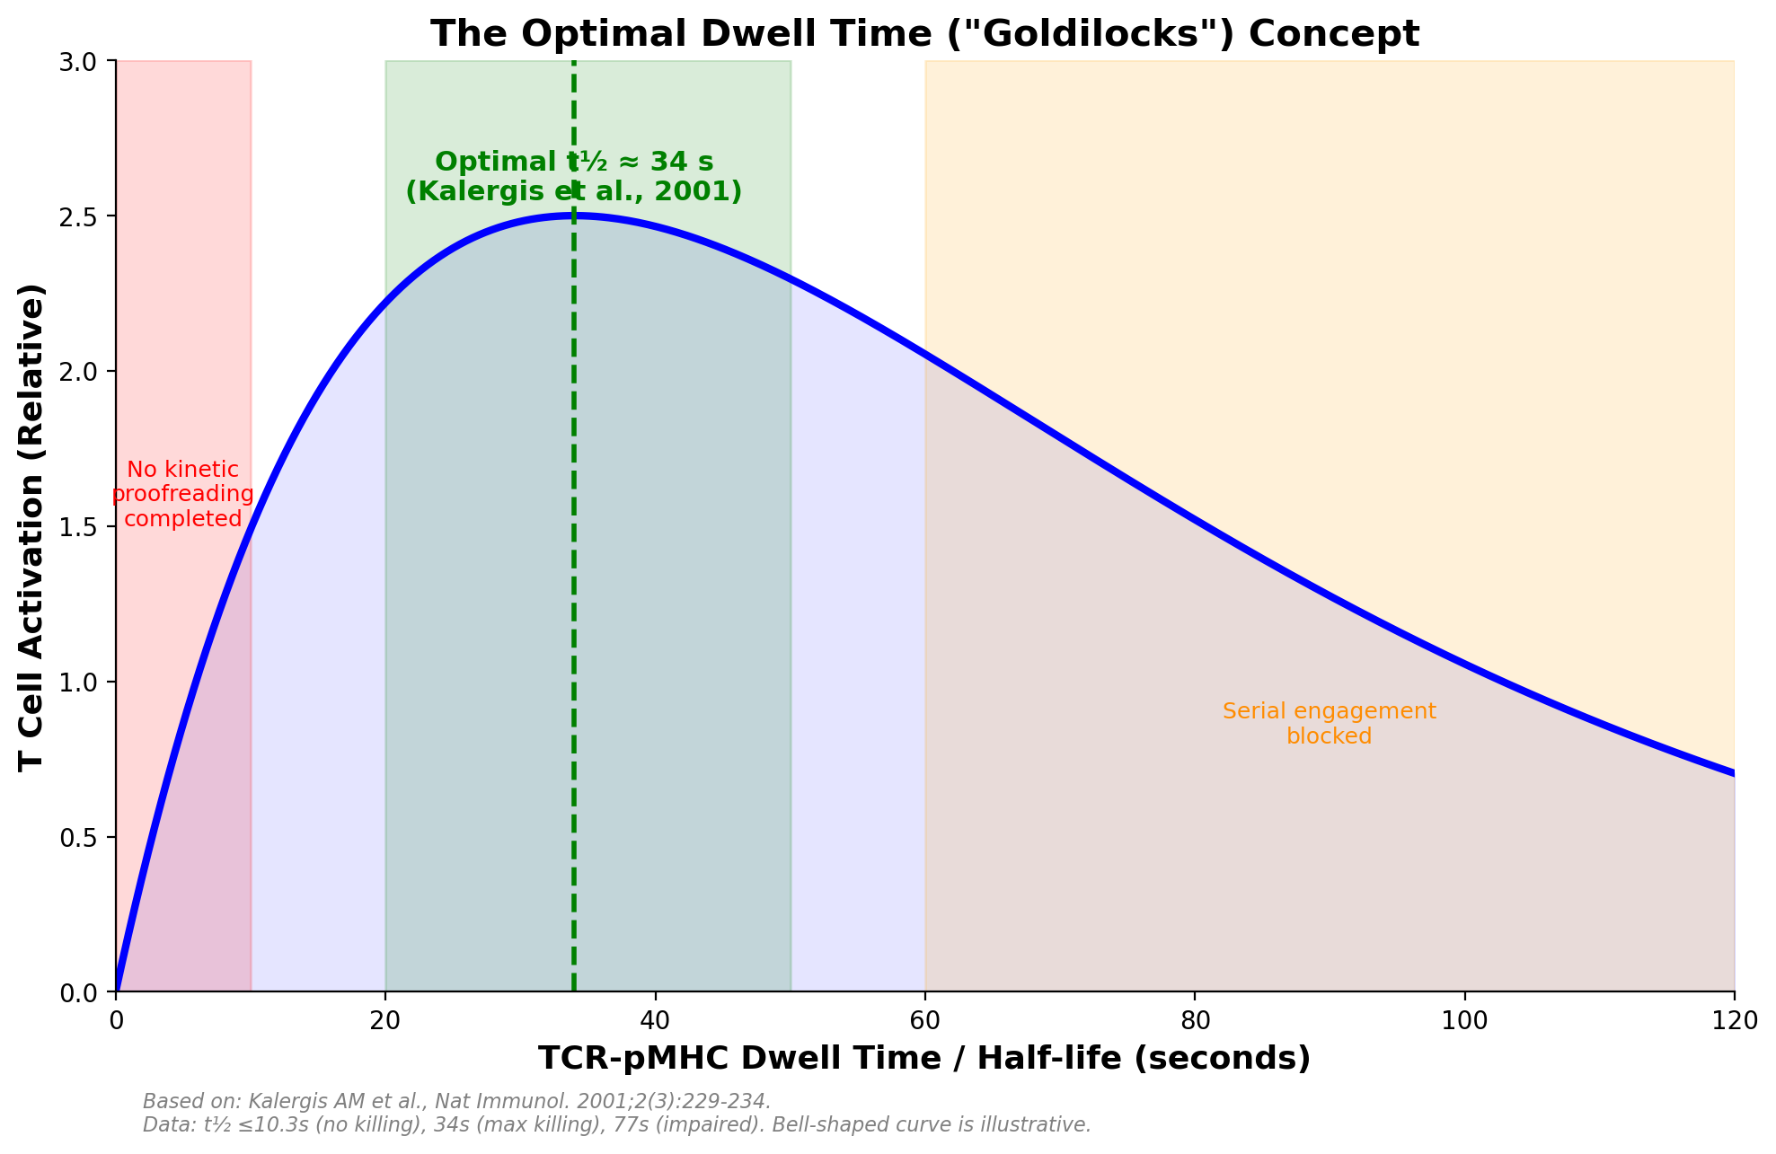
The Optimal Dwell Time ("Goldilocks") Concept
Too SHORT (< 10 s):
Kinetic proofreading incomplete
No productive signaling
OPTIMAL (∼ 34 s):
Signal completion + serial
engagement both satisfied
Too LONG (> 60 s):
Blocks serial engagement
Impairs signal amplification
Kalergis et al., 2001, Nat Immunol 2:229-234; Colf et al., 2010, PLoS Biol 8:e1000482

Slide 8
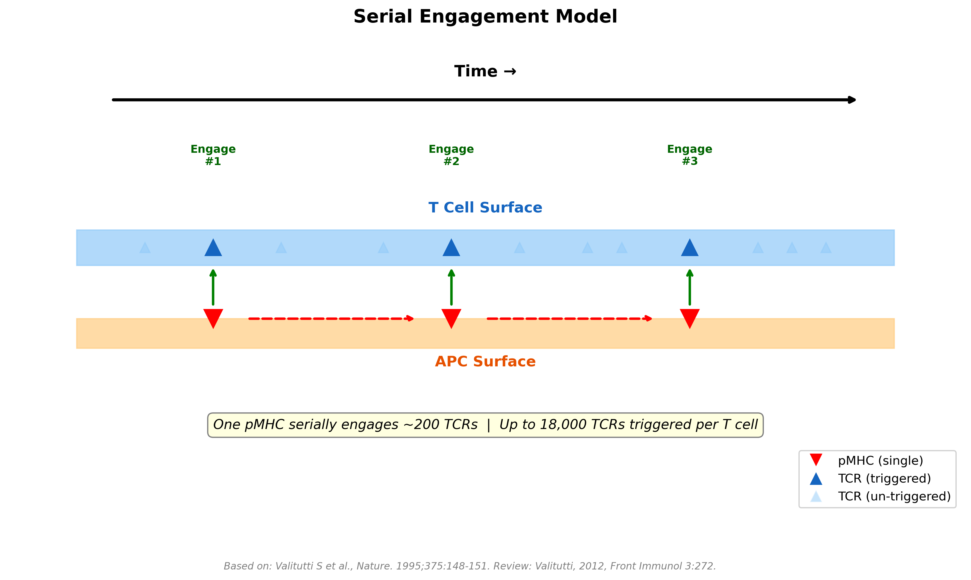
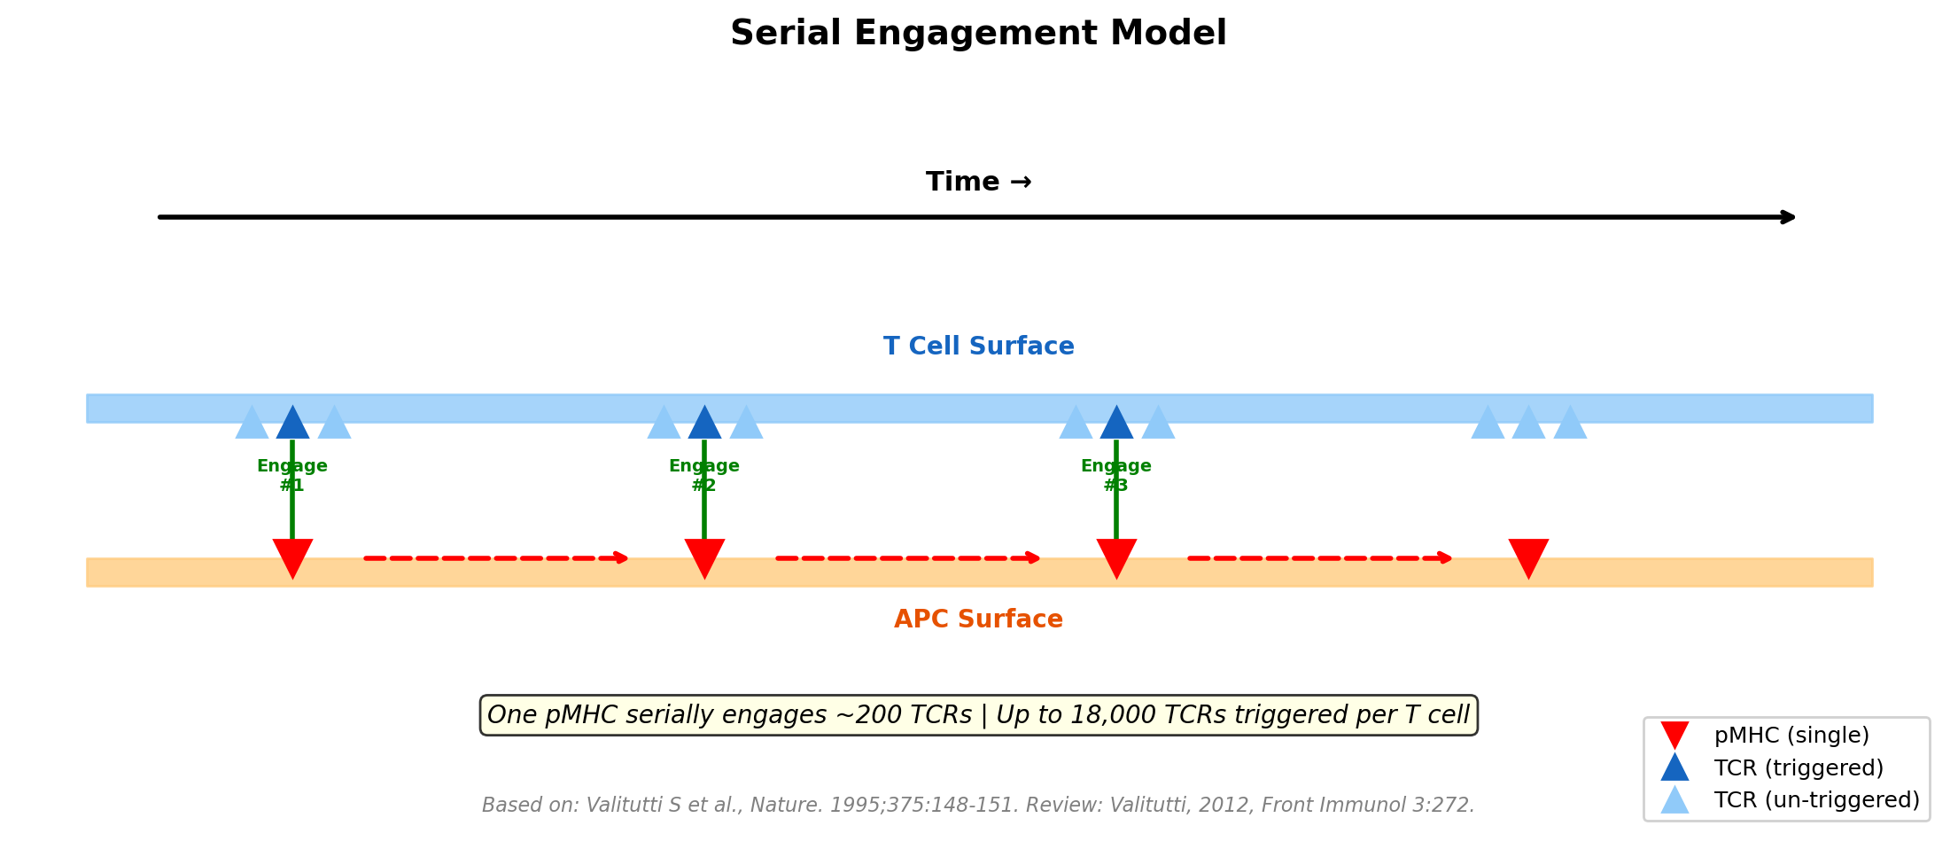
The Serial Engagement Model (Valitutti et al., 1995)
• One pMHC can serially engage and trigger ∼200 TCRs
• With ∼100 pMHC on APC, up to 18,000 TCRs are triggered per T cell
• Creates tension with kinetic proofreading: serial engagement needs fast koff, proofreading needs slow koff
• Resolution: optimal dwell time window balances both requirements
• 2D off-rates are up to 8,300× faster than 3D, with agonist pMHC dissociating fastest (Huang et al., 2010)
Valitutti et al., 1995, Nature 375:148-151; Huang et al., 2010, Nature 464:932-936

Slide 9
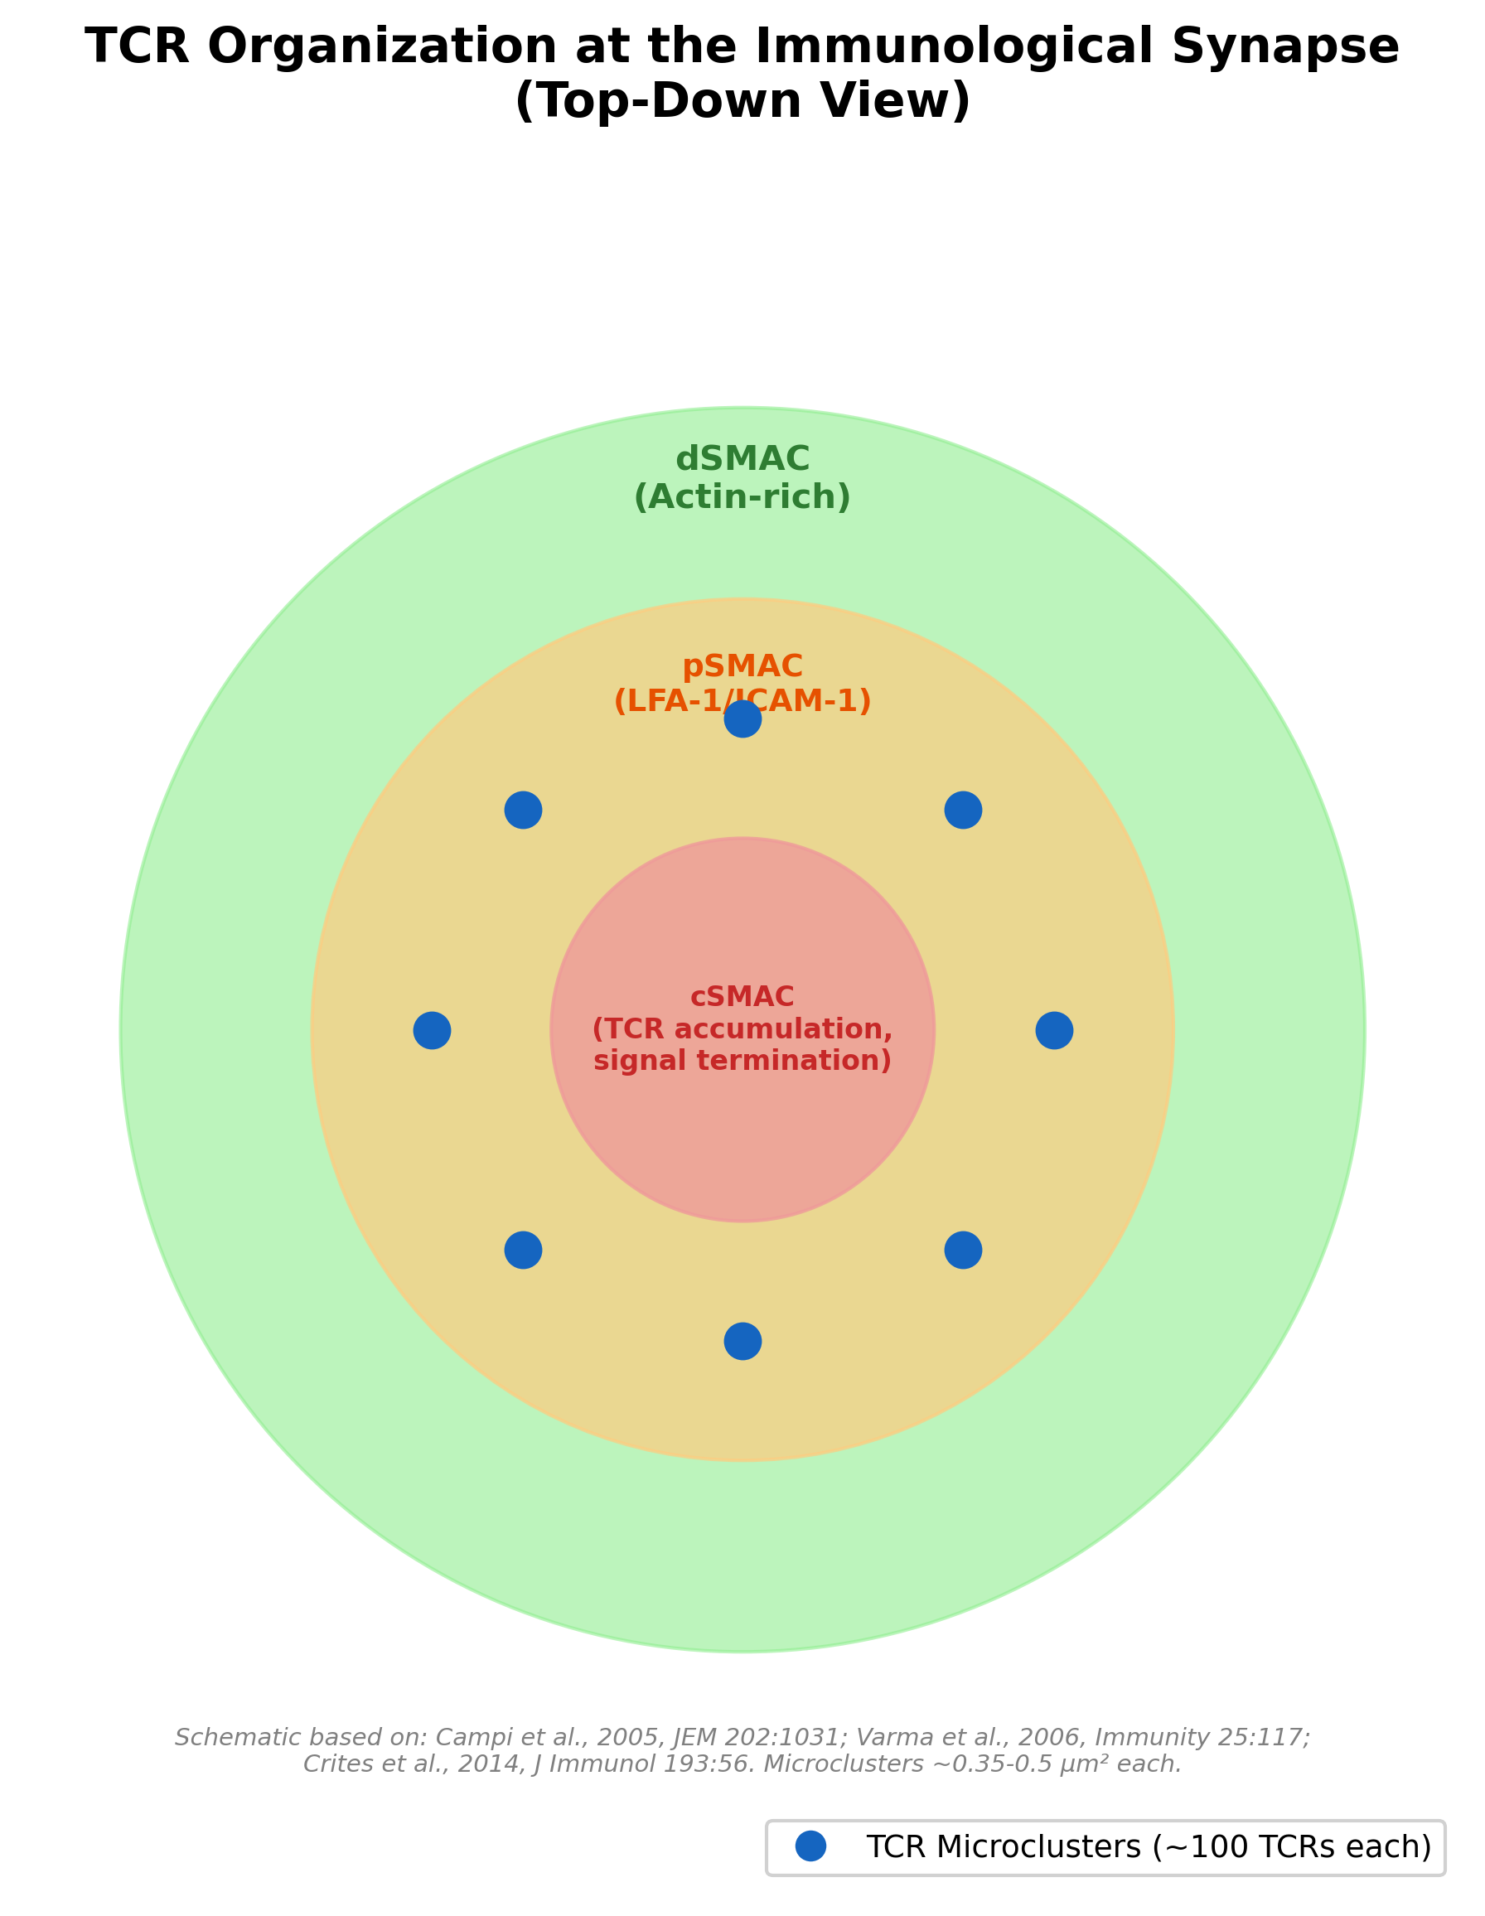
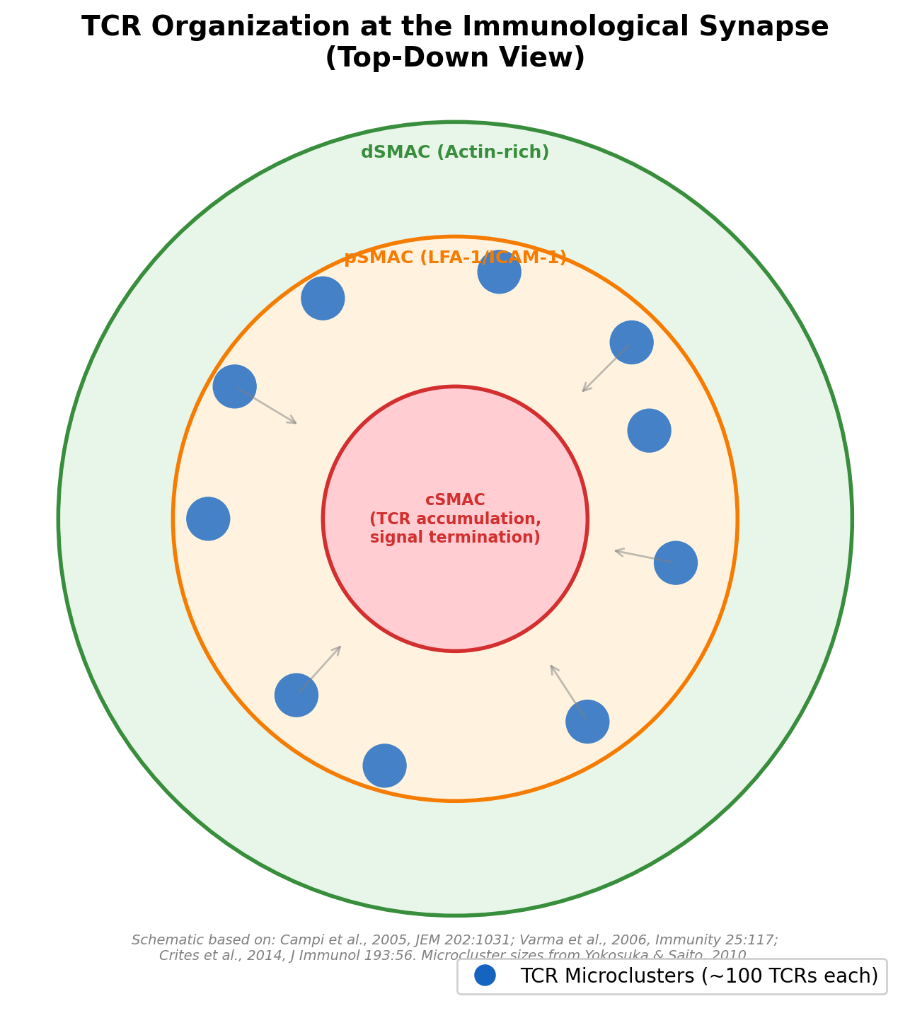
TCR Microclusters: The Signaling Units
TCR Microclusters:
• ~50-300 TCR molecules each (∼100 typical)
• Size: 0.35-0.5 μm²
• Contain: TCR, LAT, Grb2, ZAP-70
• CD45 constitutively EXCLUDED
• Pre-exist before antigen encounter
TCR Nanoclusters (pre-clustering):
• 7-30 TCR molecules; 35-70 nm radius
• Require cholesterol + sphingomyelin
• Localize to NON-raft domains
• Enhance sensitivity via cooperativity
Total TCRs per T cell: ~20,000-30,000
T cells detect as few as 1-10 pMHC on an APC
Crites et al., 2014, J Immunol; Campi et al., 2005, JEM; Molnar et al., 2012, JBC; Schamel et al., 2015, BBA

Slide 10
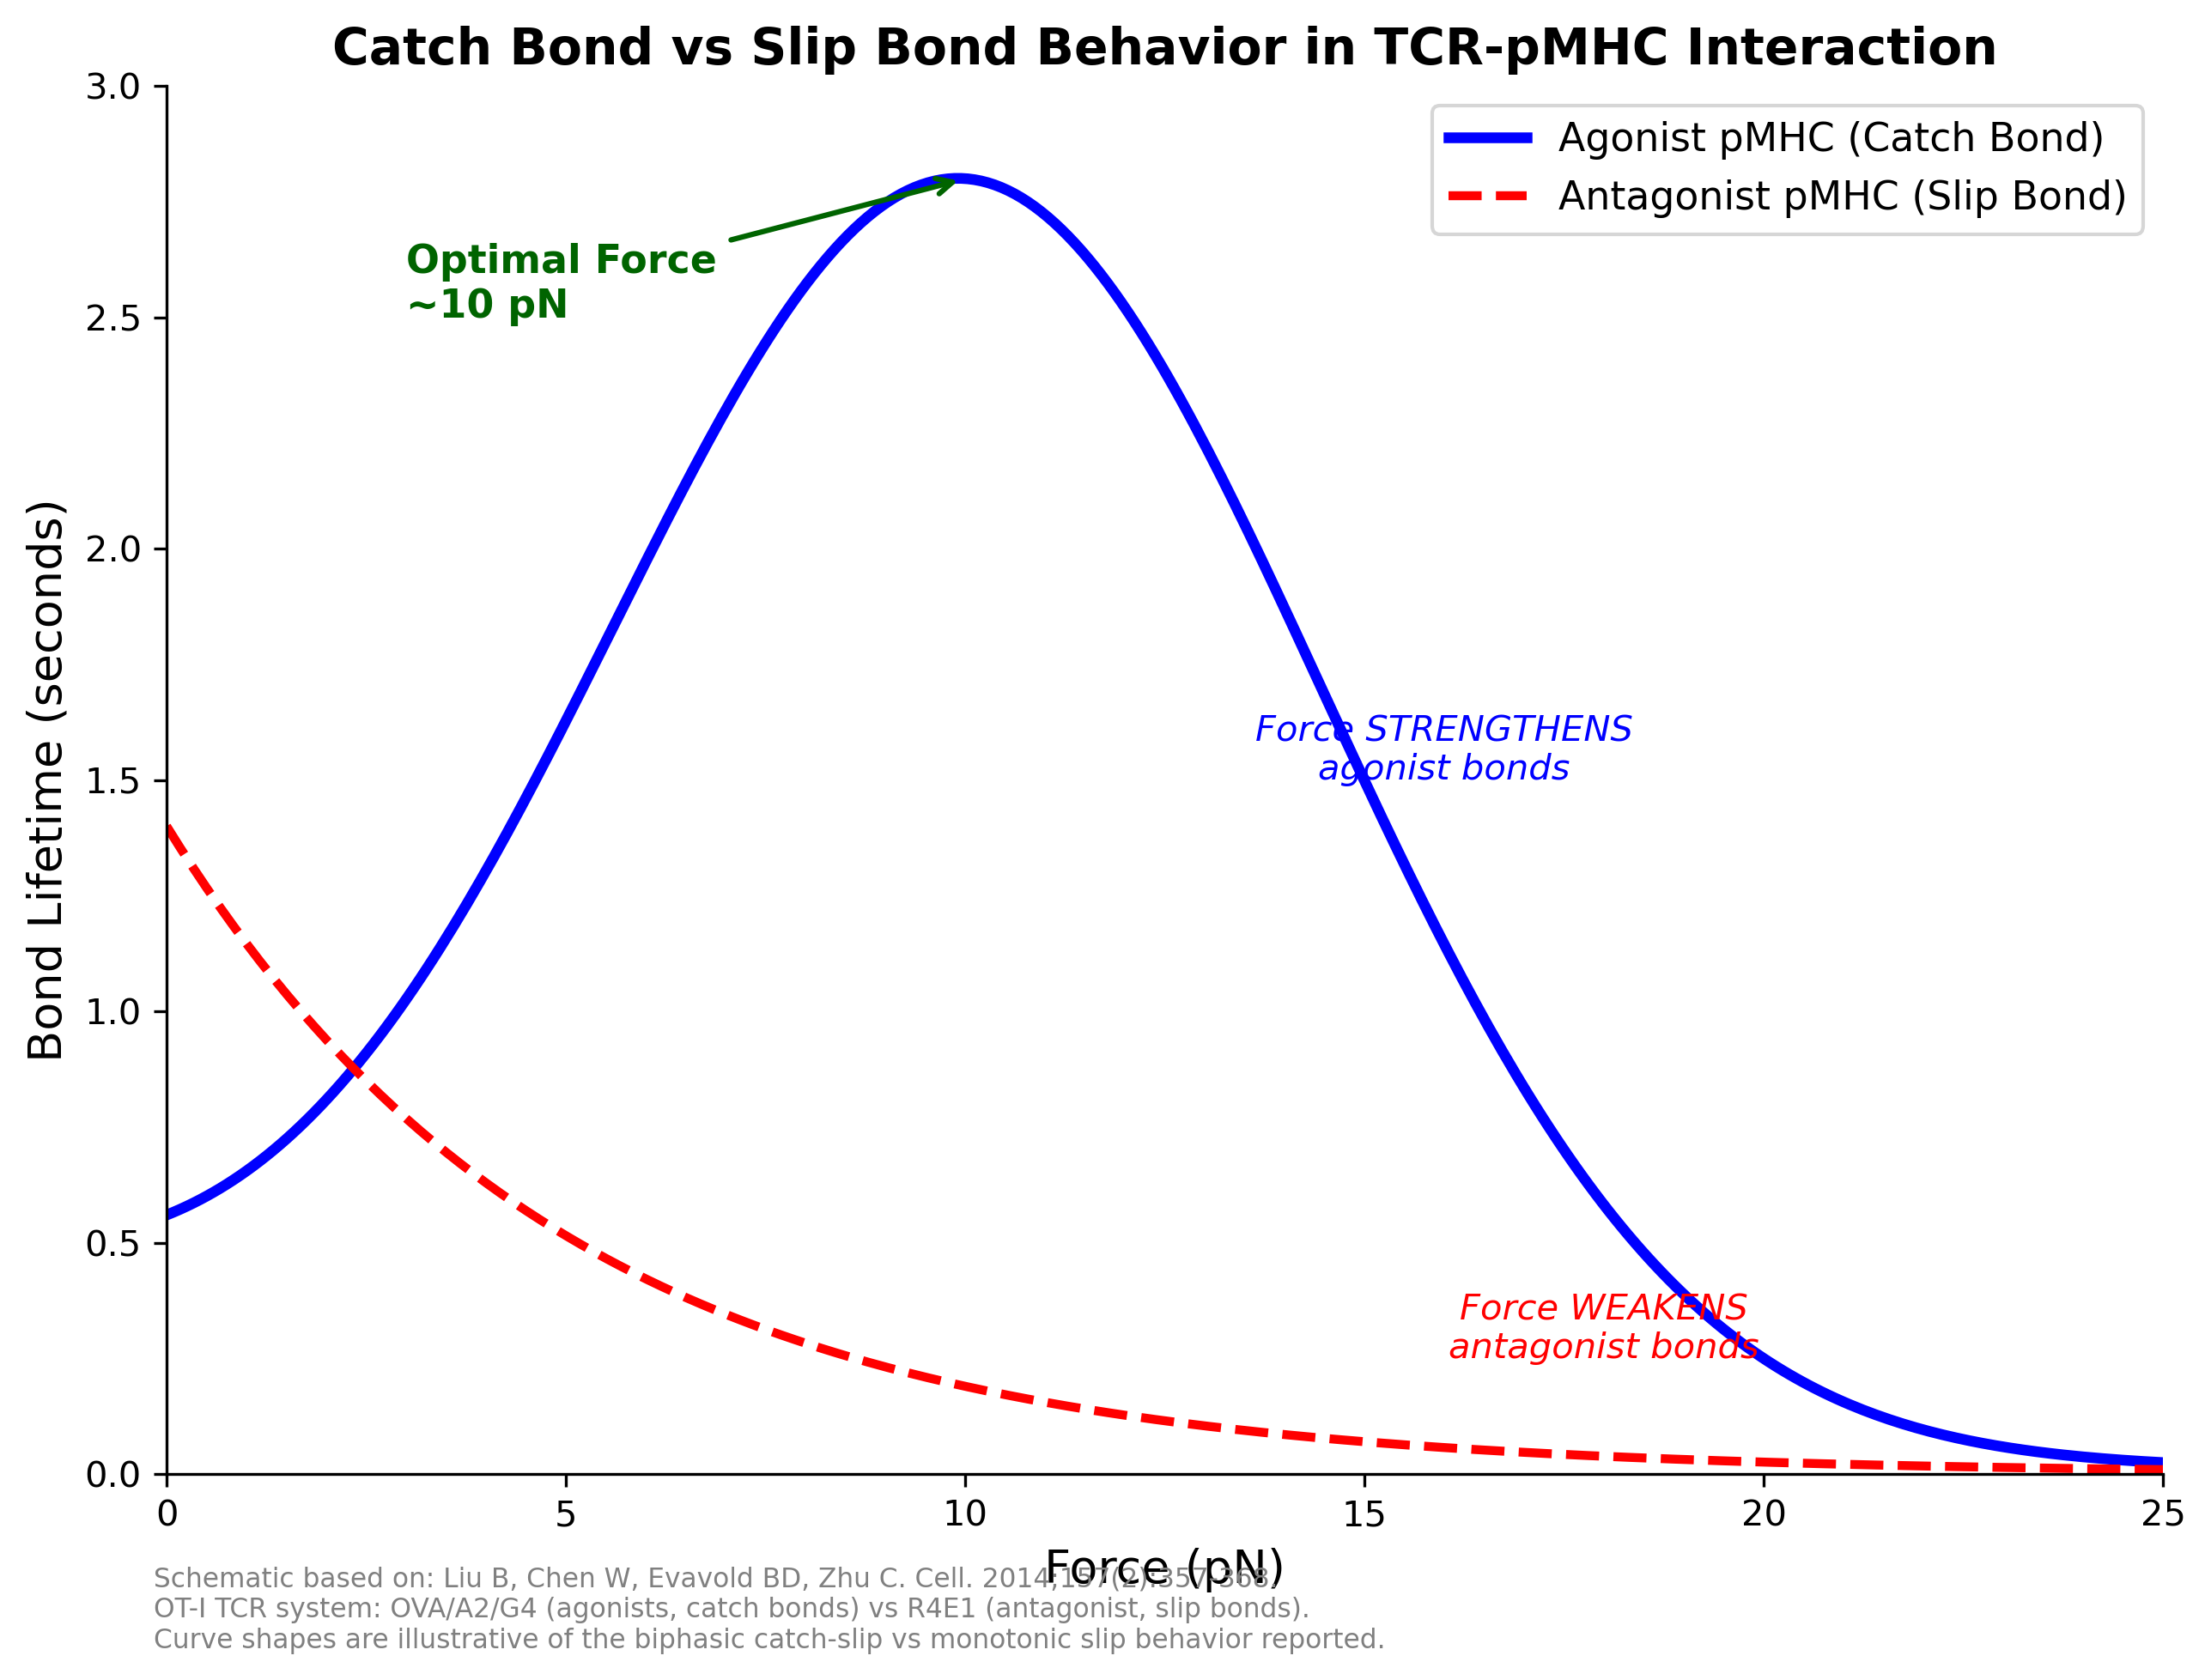
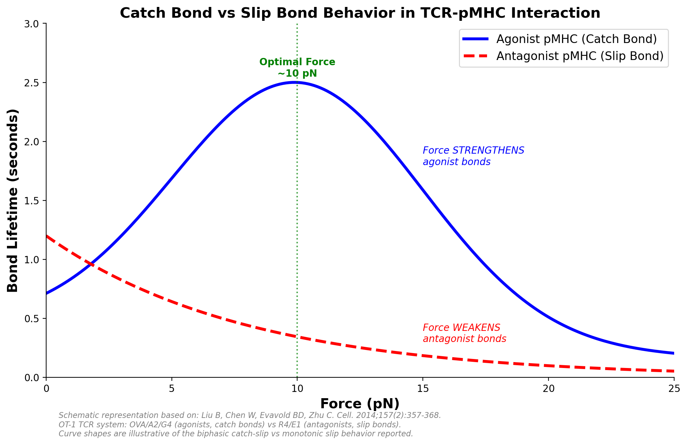
Catch Bonds vs Slip Bonds in TCR-pMHC Interaction
CATCH BOND (Agonist):
Force STRENGTHENS the bond
Biphasic: lifetime increases
then decreases with force
Peak at ∼10 pN
SLIP BOND (Antagonist):
Force WEAKENS the bond
Monotonic decrease in lifetime
Key: Force acts as a "molecular
stress test" for antigen quality
OT-1 TCR: OVA, A2, G4 → catch
R4, E1 (antagonists) → slip only
Liu et al., 2014, Cell 157:357-368; Pettmann et al., 2023, Nat Commun 14:2346

Slide 11
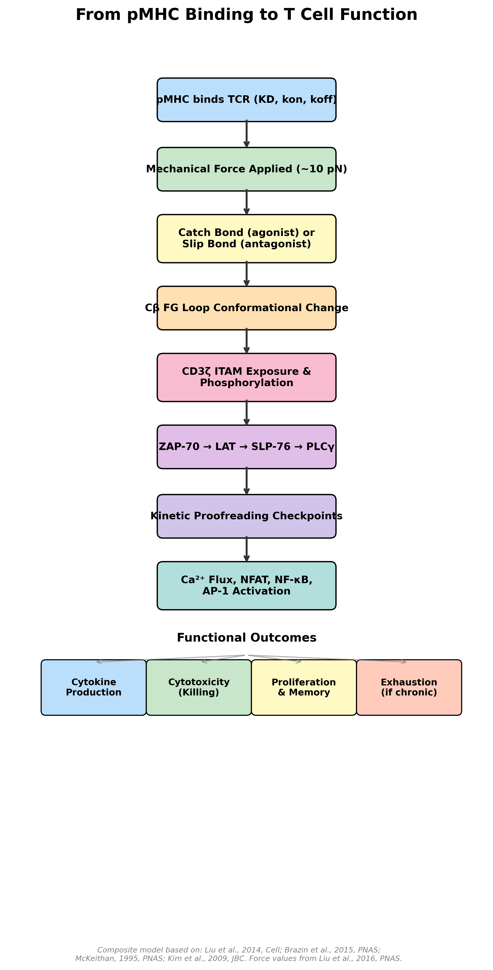
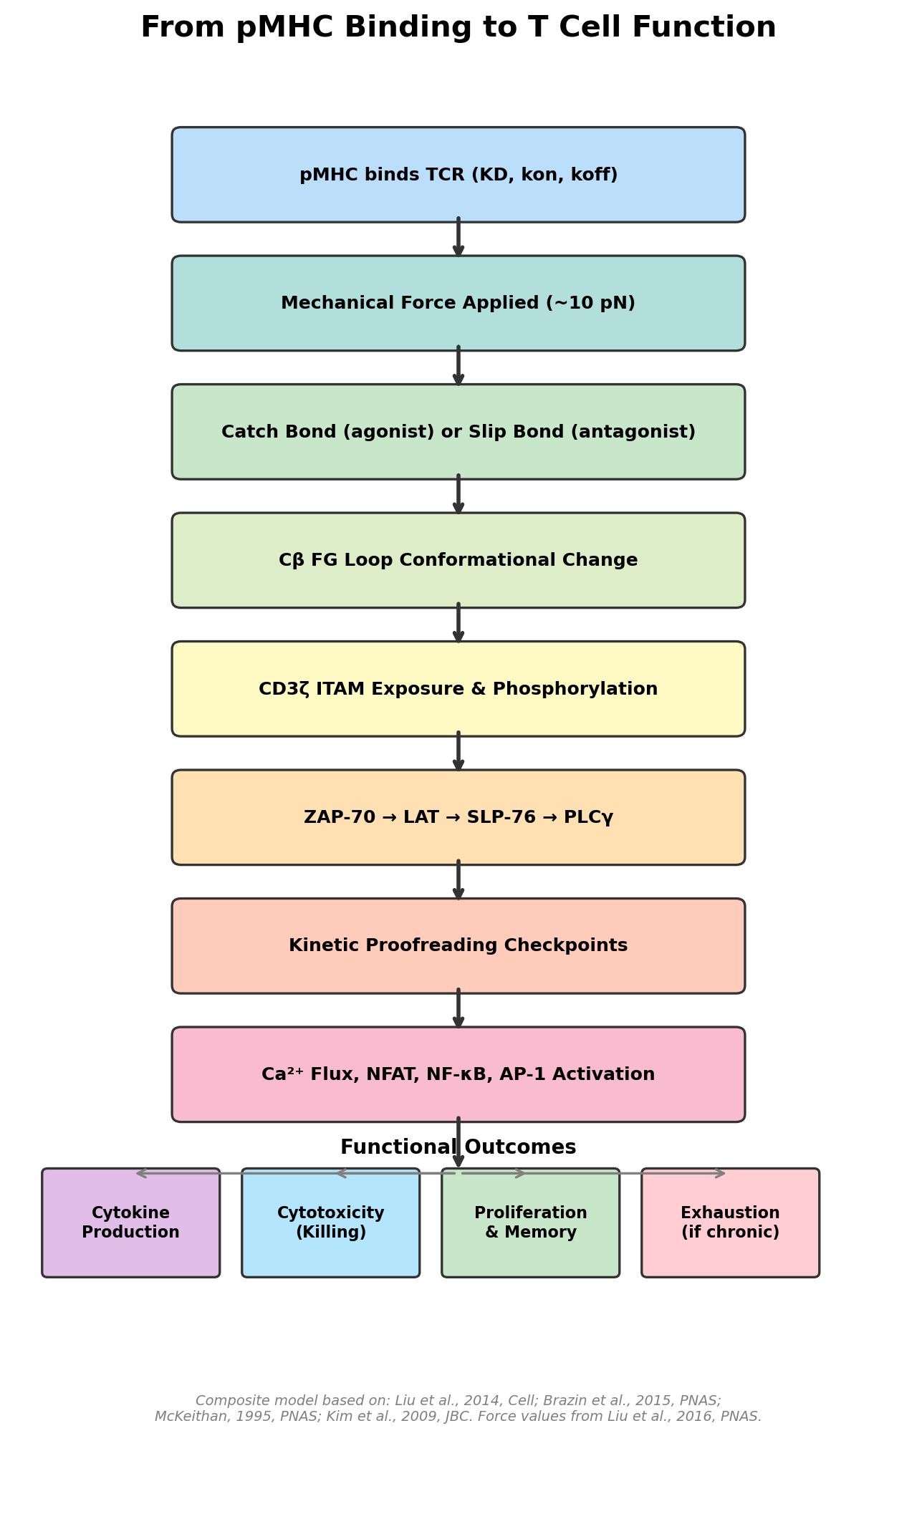
TCR Mechanotransduction: From Force to Signal
The Cβ FG Loop — A Molecular Lever:
• Unique bulky loop on TCRβ constant domain
• Transfers force from pMHC-TCR to TCR-CD3 interface
• Horizontal force → vertical force (lever mechanism)
• TCRβ TM segment acts as fulcrum
ITAM Exposure ("Safety Catch"):
• Resting: CD3ζ ITAMs sequestered in membrane
• Force: conformational change releases ITAMs
• Exposed ITAMs → Lck phosphorylation → ZAP-70
Force Measurements (DNA tension probes):
• TCR samples pMHC with >4.7 pN force
• Naive T cells: 12-19 pN within seconds
• Precedes calcium signaling
Brazin et al., 2015, PNAS; Kim et al., 2009, JBC; Liu et al., 2016, PNAS; Ma et al., 2019, PNAS

Slide 12
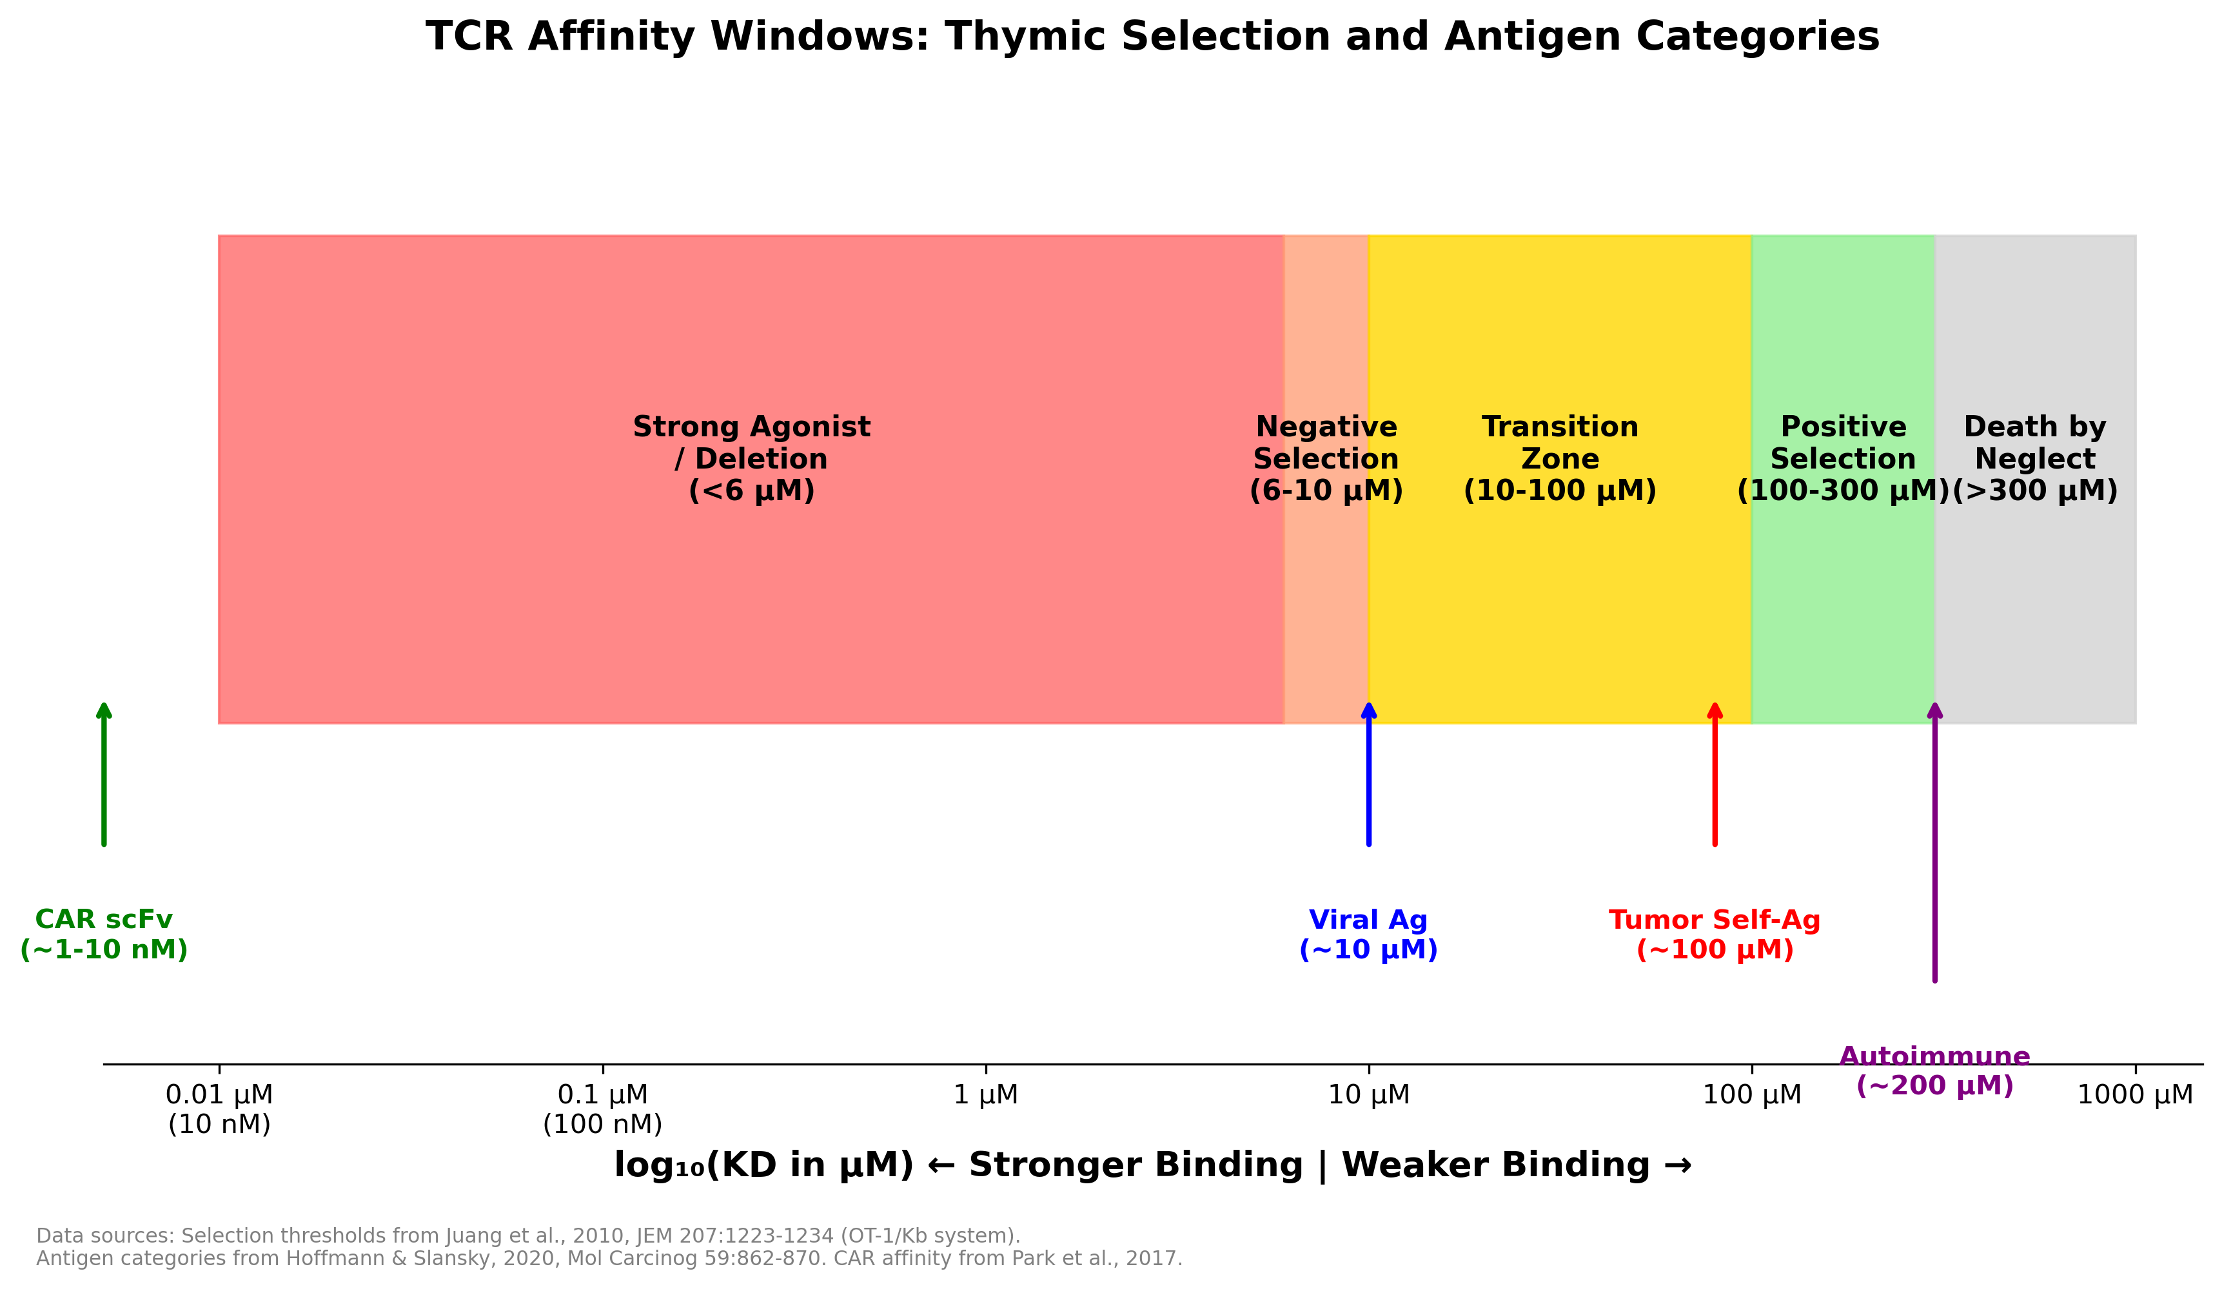
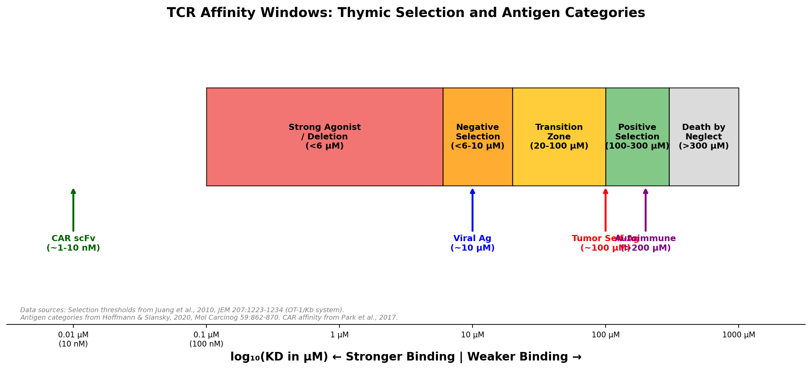
Self vs Non-Self: TCR Affinity Windows
• Positive selection (survival): KD ∼ 100-300 μM (Catnb-Kb: 136 μM, Cappa1-Kb: 211 μM)
• Negative selection (deletion): KD < 6-10 μM ("danger zone" at ∼6 μM)
• Viral antigen TCRs: mean KD ∼ 10 μM | Tumor self-antigen TCRs: mean KD ∼ 100 μM
• 10× affinity gap between viral and tumor antigens explains poor anti-tumor T cell responses
Juang et al., 2010, JEM; Hoffmann & Slansky, 2020, Mol Carcinog 59:862-870

Slide 13
Engineering CAR-T Cells
Why CAR-T?
• No TCR-MHC requirement → overcomes MHC downregulation
• Direct antigen recognition via scFv/nanobody
• Tunable signal amplitude via costimulatory domain choice
CAR Architecture (Generations):
• 1st Gen: scFv - hinge - TM - CD3ζ (signaling only)
• 2nd Gen: + one costimulatory domain (CD28 or 4-1BB)
• 3rd Gen: + two costimulatory domains
• 4th Gen: + cytokine/checkpoint modulator ("armored CARs")
Key Design Choices That Affect Signaling:
• scFv affinity and kinetics (kon, koff)
• Hinge length and flexibility
• Costimulatory domain (CD28 vs 4-1BB)
• Number and position of ITAMs in CD3ζ
Tokarew et al., 2018, Br J Cancer; Jogalekar et al., 2022

Slide 14
CAR Synapse vs TCR Synapse: Key Differences
Feature
TCR Synapse
CAR Synapse
Structure
Classical "bull's-eye" rings
Disorganized, nonclassical
Lck pattern
Organized, central
Disorganized multifocal
LFA-1
Distinct peripheral ring
No distinct ring
LFA-1 dependence
Highly dependent
Killing unimpaired by blockade
Granule recruitment
Standard timing
Faster recruitment
Killing kinetics
Standard
Faster killing & detachment
Affinity regime
1-100 μM (micromolar)
0.1-10 nM (nanomolar)
Bond type under force
Catch bond (agonist)
Likely slip bond (unknown)
Davenport et al., 2018, PNAS 115:E2068-E2076

Slide 15
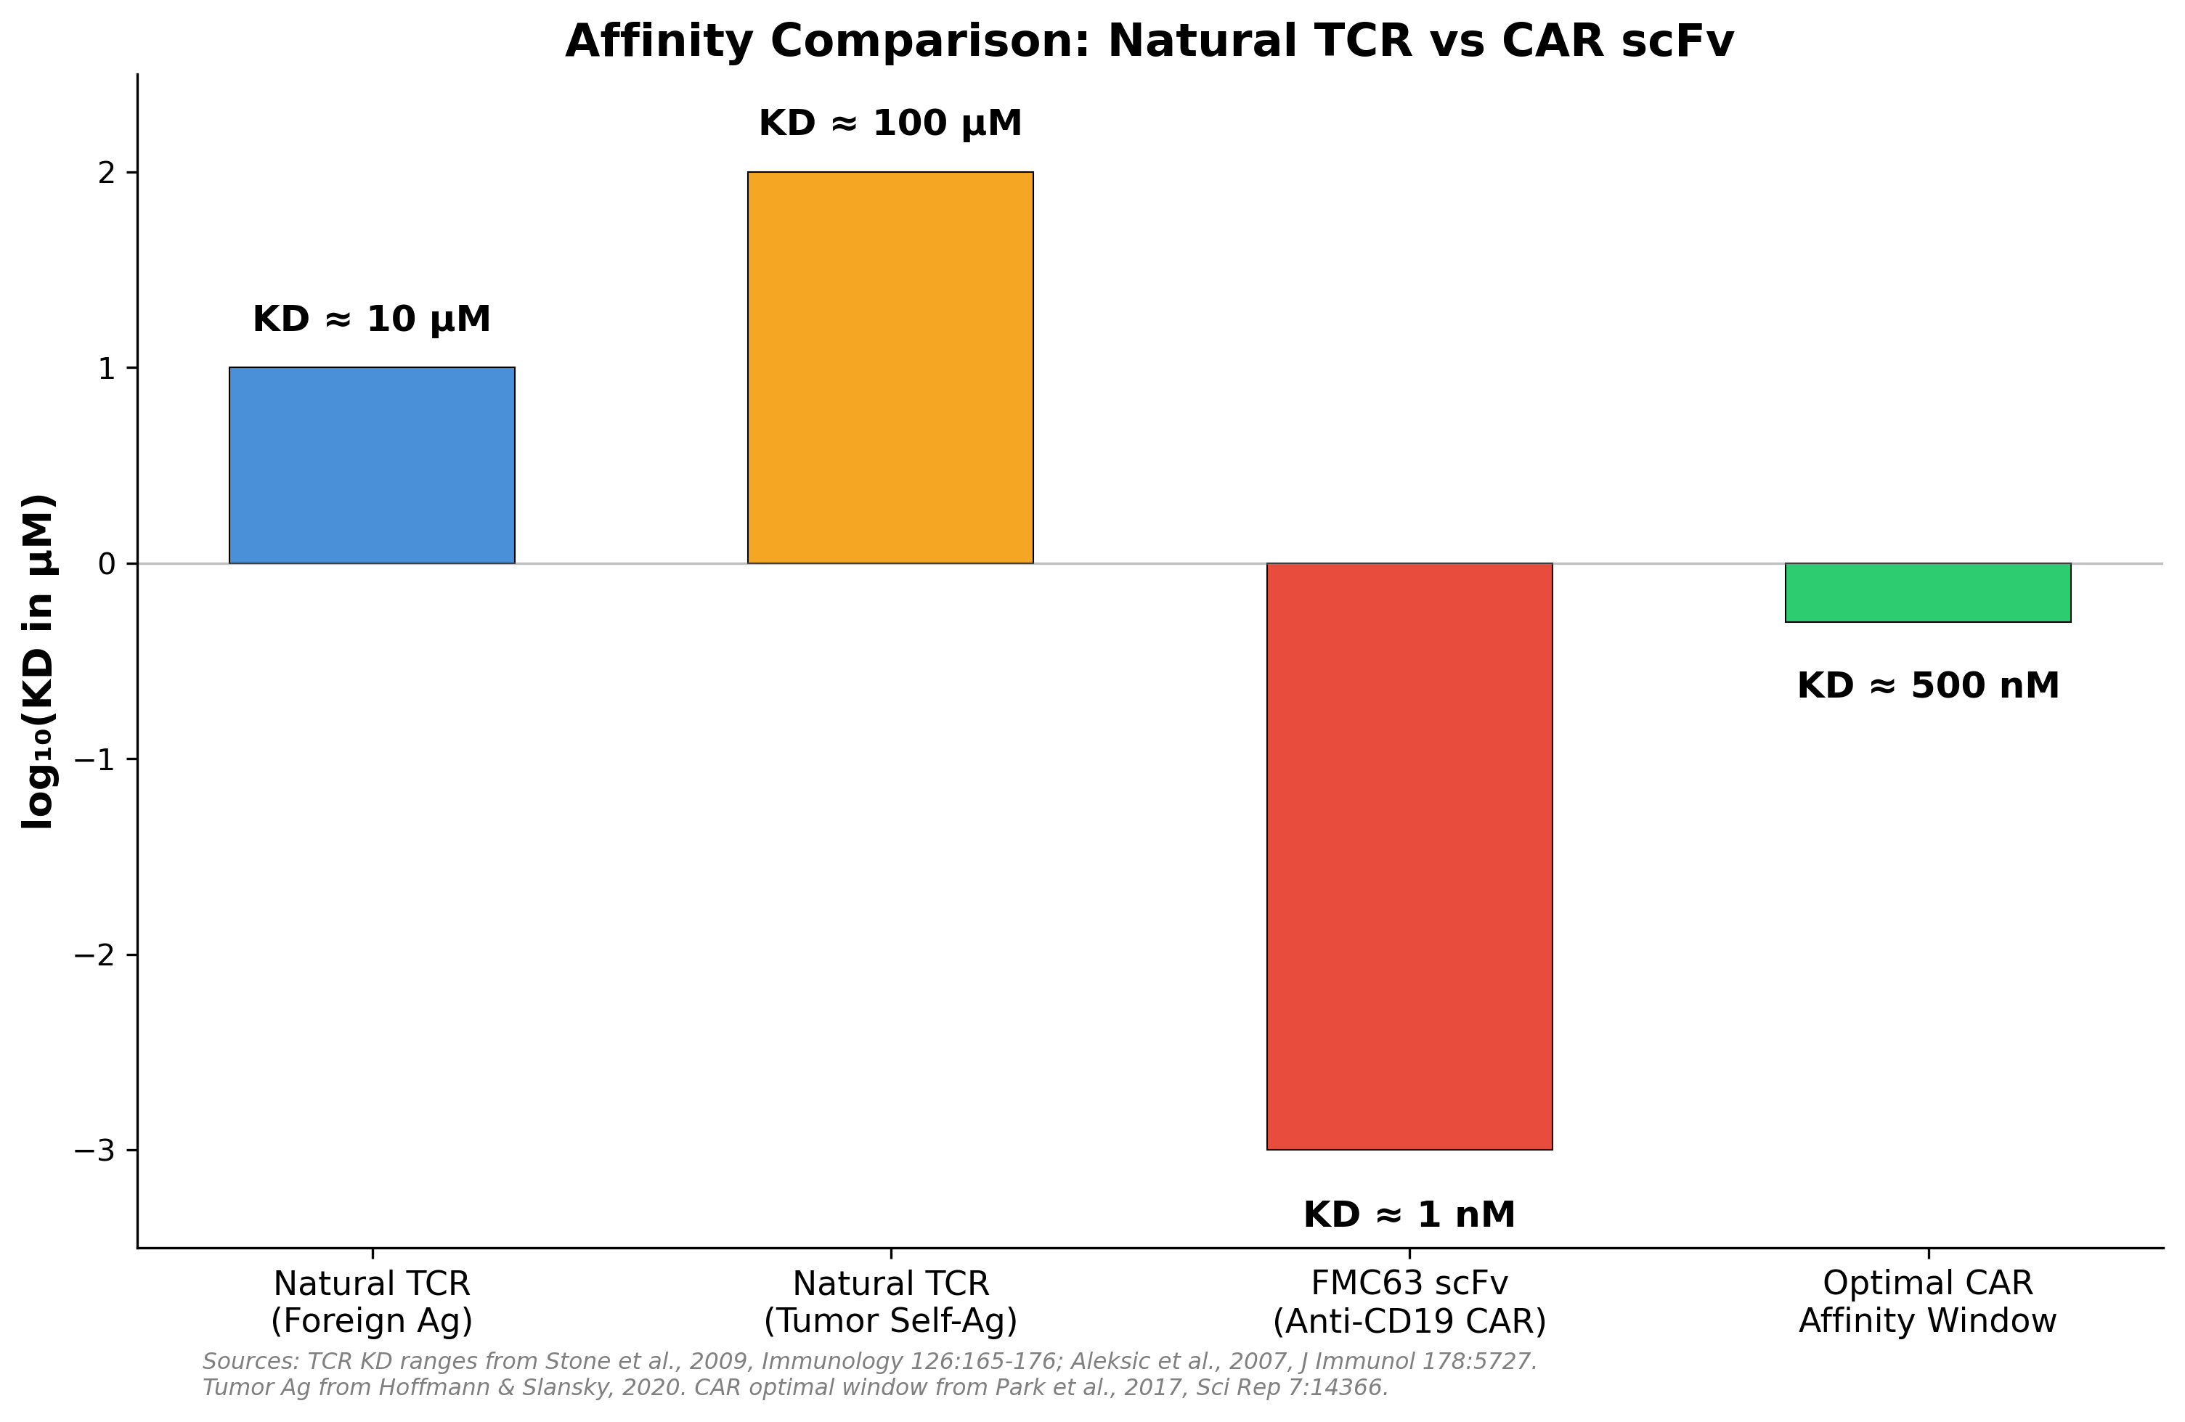
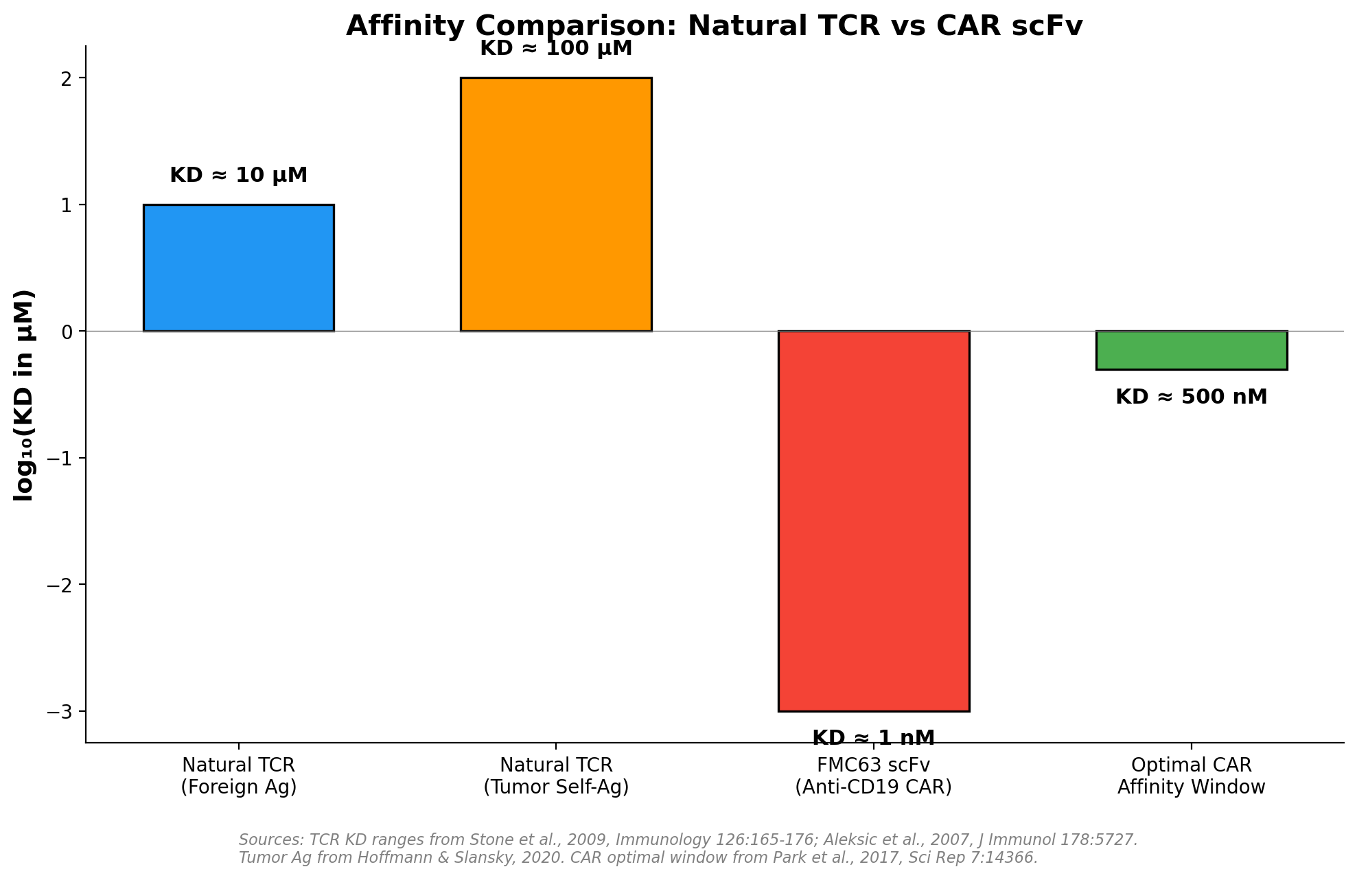
The Affinity Mismatch Problem in CAR-T Therapy
Consequences of Supraphysiological
CAR Affinity:
• Reduced serial killing
(slow koff blocks disengagement)
• Early exhaustion
(sustained signaling → PD-1, TIM-3)
• Off-tumor toxicity
(detects low Ag on normal tissue)
• Reduced memory formation
Evidence: Lower-affinity CARs
can OUTPERFORM higher-affinity
(Ghorashian, Park et al.)
Park et al., 2017, Sci Rep 7:14366; Ghorashian et al., Nat Rev Clin Oncol 2019

Slide 16
HYPOTHESIS
Specific biophysical features of the antigen–scFv interaction — particularly affinity, kinetic rates, and force-dependent bond stability — determine the magnitude of mechanical tension applied to the CAR complex. This mechanical tension modulates CAR geometry, regulates CD3ζ ITAM exposure, and ultimately controls the strength and quality of downstream signaling. Therefore, rational tuning of these interaction parameters will yield CAR constructs with optimized signaling efficiency.
Supported by: Catch bond studies (Liu et al., 2014) | Mechanosensor studies (Kim et al., 2009) | Affinity optimization evidence (Park et al., 2017; Ghorashian et al., 2019) | Kinetic proofreading theory (McKeithan, 1995)

Slide 17
OBJECTIVES
Objective 1:
To understand the parameters of Ag-Ab binding which affect the
amplitude of the signal (KD, kon, koff, force-dependent behavior)
Objective 2:
To design affinity-optimized CAR constructs via site-saturation
mutagenesis of key scFv-antigen interacting residues
Objective 3:
To evaluate CAR-T cell activation, exhaustion, and memory
phenotypes as a function of binding kinetics, and identify the
optimal affinity window for anti-CD19 CAR-T therapy

Slide 18
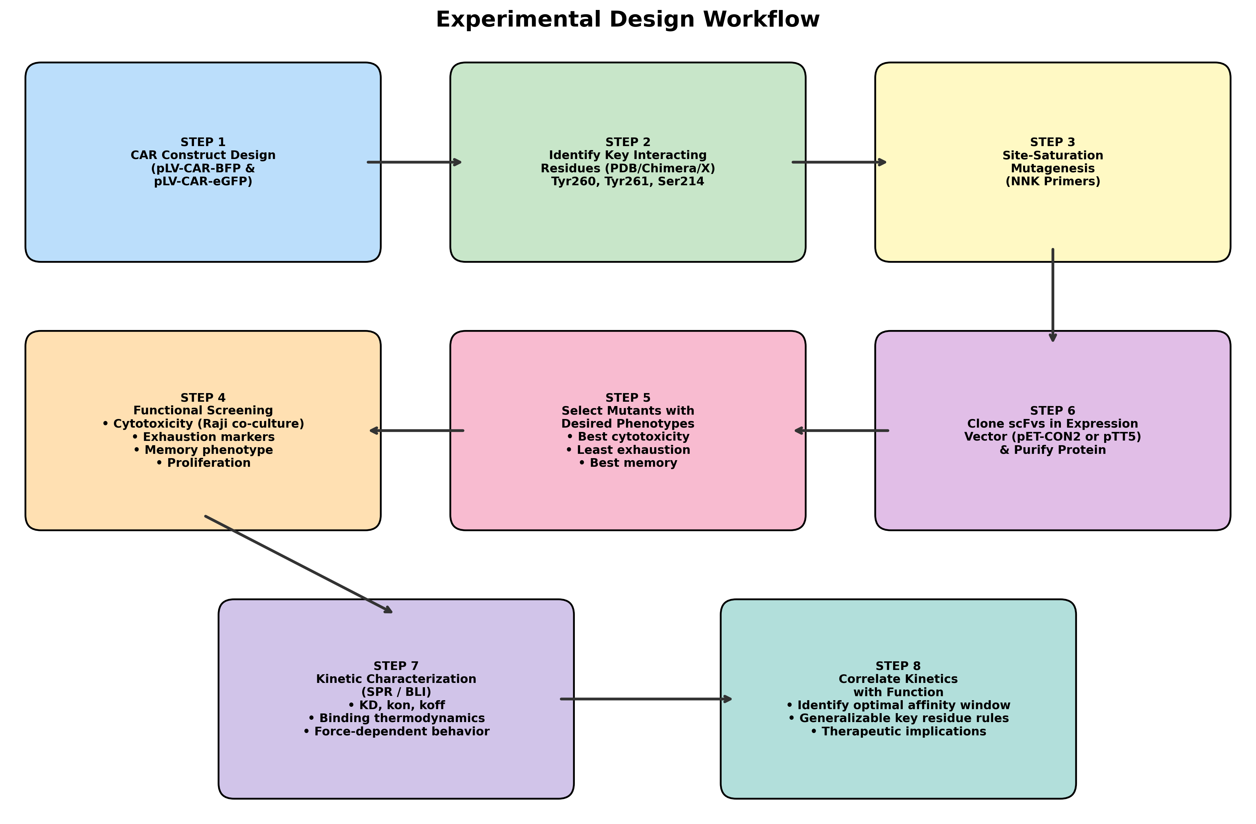
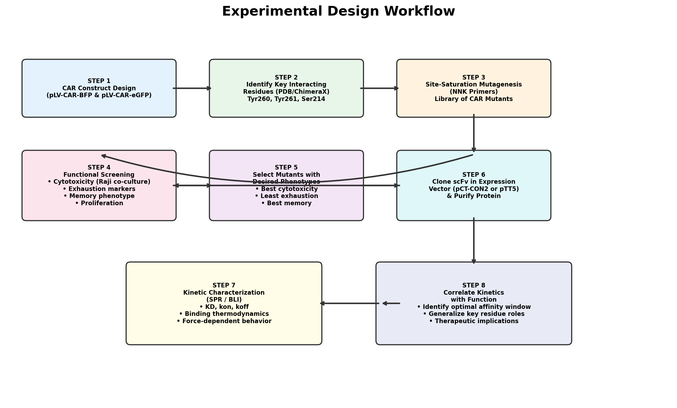
Experimental Design: Overall Workflow

Slide 19
CAR Construct Design & Key Interacting Residues
CAR Constructs:
• pLV-CAR-BFP (commercial construct)
• pLV-CAR-eGFP (for mutagenesis)
• Anti-CD19 scFv: FMC63
Antigen: CD19 (PDB: 7URV)
Key Interacting Residues (buried SASA > 35 Å):
• Tyrosine 260 (codon: TAC, positions 3607-3609)
• Tyrosine 261 (codon: TAC, positions 3610-3612)
• Serine 214 (codon: AGT, positions 3469-3471)
Identified via PDB structure analysis and ChimeraX
molecular visualization of the FMC63-CD19 complex

Slide 20
Site-Saturation Mutagenesis Strategy
NNK Primer Design:
• NNK codons cover 32 codons encoding all 20 amino acids
• Minimizes stop codon frequency (only TAG possible)
• For 95% coverage: ≥98,164 colonies must be screened (Pines et al., 2022)
Primers Designed for Each Residue:
• Ser214: Forward 5'-NNKTACGGTGGTAGCTATGCTATGGACTACTGG-3'
• Tyr260: Forward 5'-NNKGAAACCACATACTATAATTCAGCTCTCAAA-3'
• Tyr261: Forward 5'-NNKGGTGGTAGCTATGCTATGGACTACTGGGGT-3'
PCR Conditions:
• Phusion DNA polymerase, 20 cycles
• Sanger sequencing for verification
Output: Library of single-residue CAR mutants at positions 214, 260, 261
Jain et al., 2013; Pines et al., 2022

Slide 21
Functional Screening of CAR Mutants
Pipeline for Each Mutant:
1. Plasmid preparation (Qiagen EndoFree Maxi Kit)
2. Transfection optimization (Lipofectamine + P3000)
3. Viral titre determination (Lenti-X qRT-PCR)
4. Transduction of Jurkat cells (polybrene 8 μg/ml, 48-72h)
5. Surface CAR detection (anti-G4S linker antibody, FACS)
Functional Assays:
• Cytotoxicity: CAR-Jurkat + Raji co-culture (E:T = 1:1, 2:1)
• Rechallenge assay: Serial Raji exposure → measure persistence
• Exhaustion markers: PD-1, TIM-3, LAG-3 (FACS panel)
• Memory markers: CD45RA, CCR7, CD62L
• Cytokine profile: IL-2, IFN-γ, TNF-α
Controls: Un-transduced Jurkat + Raji | CAR-Jurkat + K562 (irrelevant)

Slide 22
Target Phenotypes & Selection Criteria
Mutants Will Be Selected Based On:
✔ Desired cytotoxicity (efficient target killing)
✔ Maximum proliferative capacity
✔ Strong memory formation (CD45RO+, CCR7+)
✔ Minimal exhaustion markers (low PD-1, TIM-3, LAG-3)
Selected mutants (and those with dramatically different phenotypes)
will proceed to kinetic characterization (SPR/BLI)
This creates a dataset linking:
Binding Kinetics (KD, kon, koff) ↔ Functional Outcome
Enabling identification of the OPTIMAL AFFINITY WINDOW
for anti-CD19 CAR-T cell therapy

Slide 23
Kinetic Characterization: SPR / BLI
Selected mutant scFvs will be:
1. Cloned into expression vector (pCT-CON2 or pTT5)
2. Expressed in yeast (S. cerevisiae) or mammalian cells
3. Purified and characterized
Surface Plasmon Resonance (SPR — Biacore):
• Gold standard for label-free kinetics
• Provides: KD, kon, koff, thermodynamic parameters
Bio-Layer Interferometry (BLI — Octet):
• Orthogonal validation; higher throughput
• Can use unpurified samples
Goal: Correlate specific kinetic parameters with the
functional phenotypes observed in the screening assays
to identify generalizable rules for CAR design

Slide 24
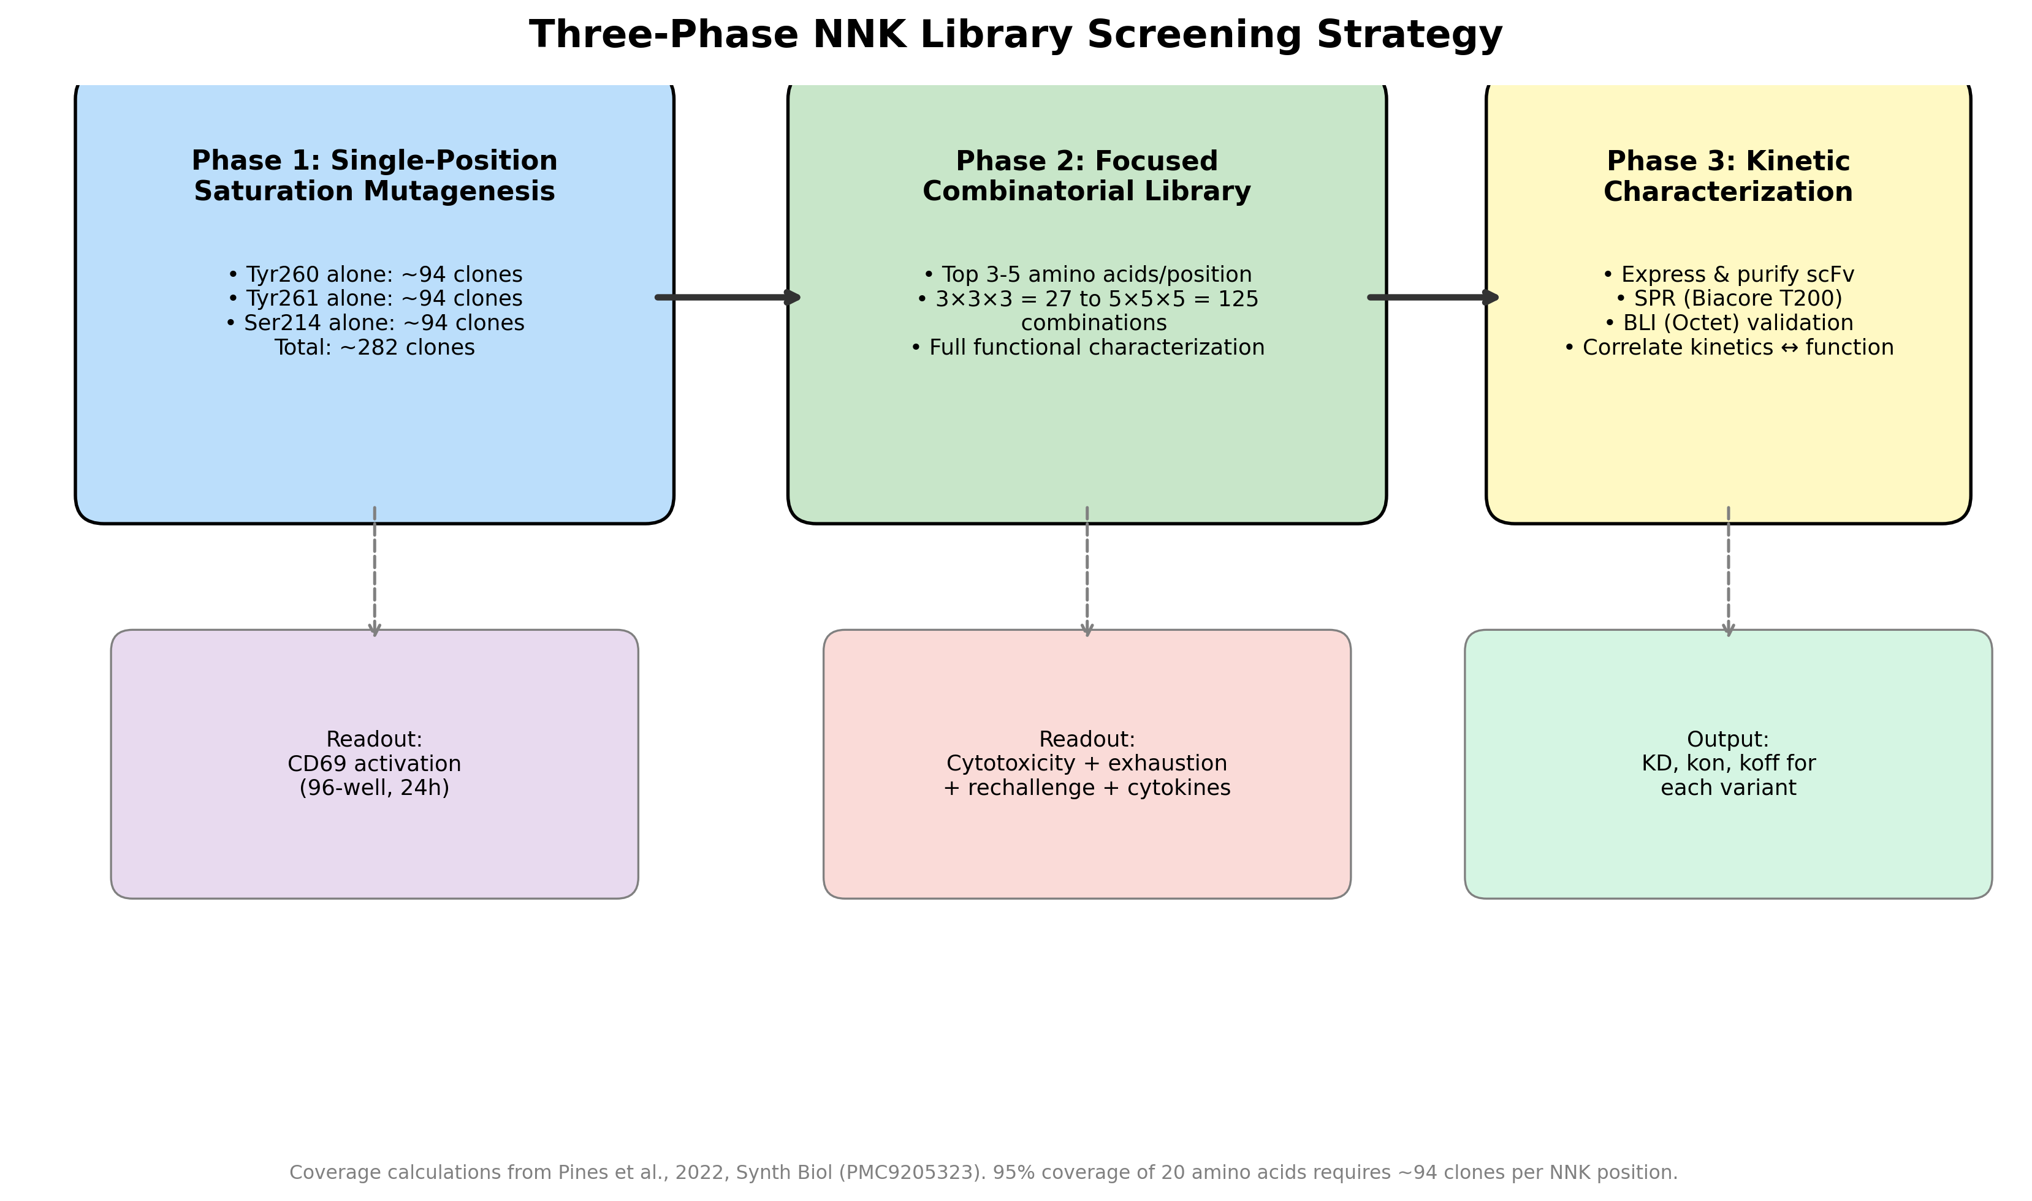
Three-Phase NNK Library Screening Strategy
Coverage: Pines et al., 2022, Synth Biol (PMC9205323)

Slide 25
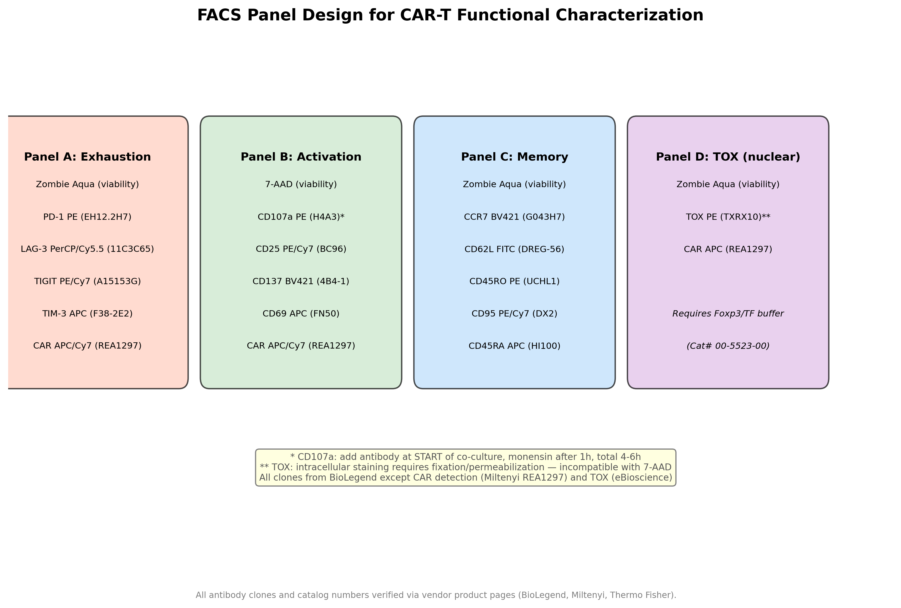
FACS Panel Design for CAR-T Characterization
All clones verified via BioLegend, Miltenyi, Thermo Fisher product pages

Slide 26
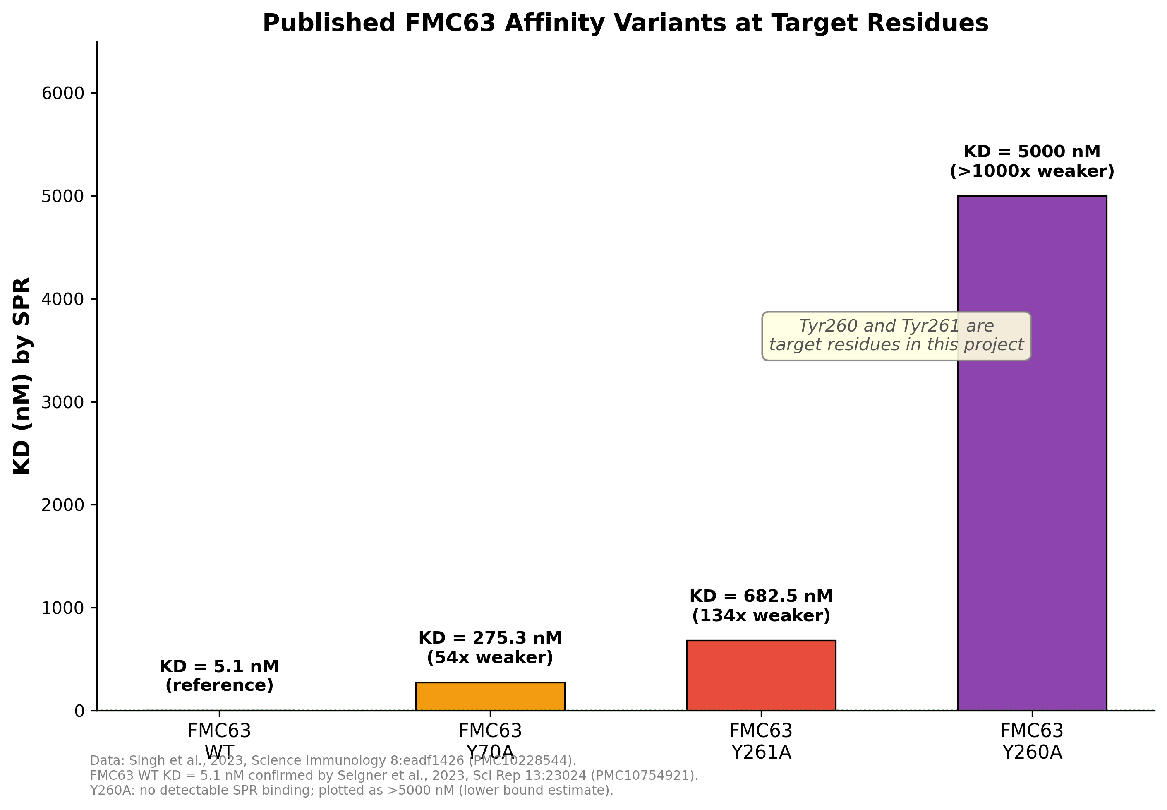
Published FMC63 Affinity Variants at Target Residues
Data: Singh et al., 2023, Science Immunology (PMC10228544); Seigner et al., 2023, Sci Rep (PMC10754921)

Slide 27
Rechallenge Assay & Essential Controls
Rechallenge Protocol (Wang et al., 2019, J ImmunoTher Cancer):
• E:T 1:4 → fresh Raji added every 2 days → 4 rounds over 7 days
• Readouts: activation (CD69, 4-1BB), exhaustion (PD-1/TIM-3/LAG-3), memory (CD45RO/CD62L)
Essential Controls (8 conditions):
• Un-transduced Jurkat + Raji (non-specific activation baseline)
• Mock-transduced (empty vector) + Raji (transduction effect)
• CAR-Jurkat + K562 (CD19-negative specificity control)
• CAR-Jurkat alone (tonic signaling assessment)
• Raji alone (spontaneous death)
• WT FMC63 CAR + Raji (positive benchmark)
• PMA/ionomycin-treated Jurkat (maximum activation)
Statistics: One-way ANOVA + Dunnett's post-hoc (many-to-one vs WT)
• n=3 independent transductions; triplicate wells

Slide 28
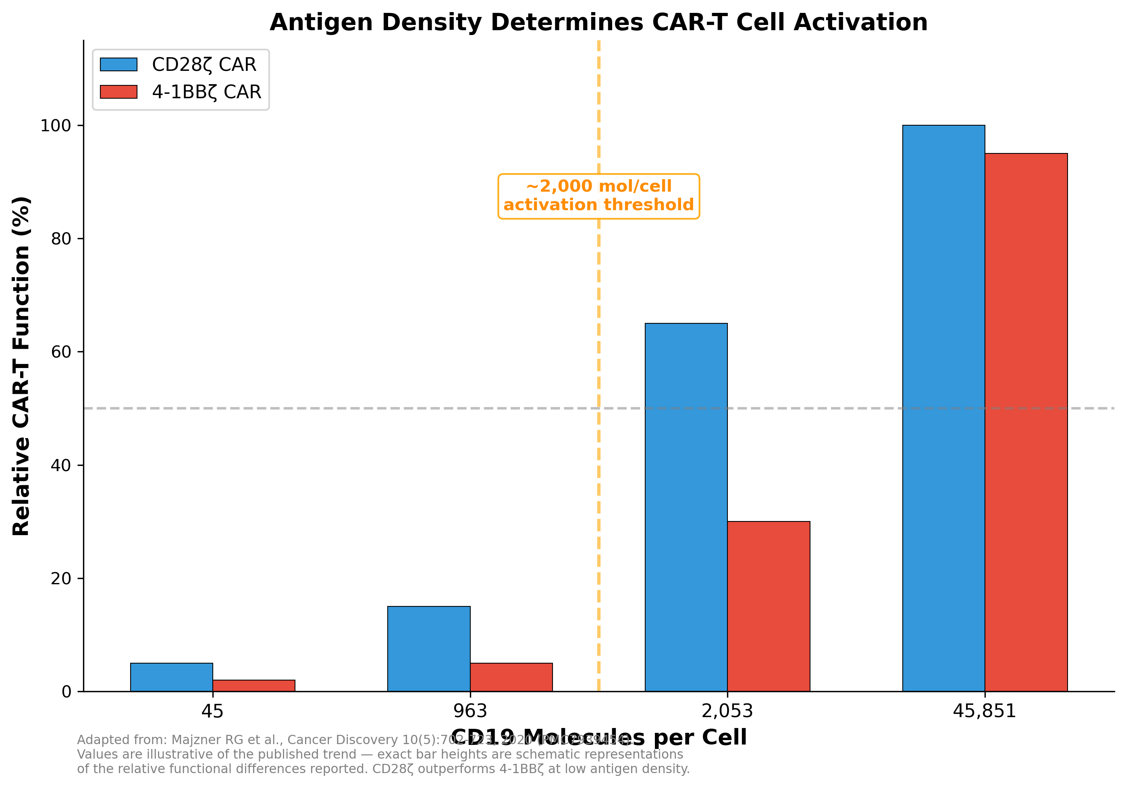
Antigen Density Determines CAR-T Activation
Adapted from: Majzner et al., 2020, Cancer Discovery (PMC7939454)

Slide 29
Alternative Systems for Comprehensive Validation
Raji limitations: fixed CD19 density, FACS quantification challenges
Proposed complementary systems:
• Raji-GFP-Luc2 (ATCC CCL-86-GFP-LUC2) — immediate: GFP for FACS + luciferase for killing
• NALM-6 CD19-KO + graded re-expression — tunable CD19 density (45-45,851 mol/cell)
(Majzner et al., 2020, Cancer Discovery 10:702)
• CHO-CD19 Low/Med/High — adherent targets for real-time xCELLigence monitoring
FACS solutions:
• Counting beads (BioLegend Precision Count Beads) for absolute quantification
• CellTrace Violet pre-labeling of targets for surface marker-independent gating
Advanced (future):
• Supported lipid bilayers + TIRF for CAR synapse imaging
• 2D kinetics (micropipette/BFP) — no published data for ANY CAR system (novelty)

Slide 30
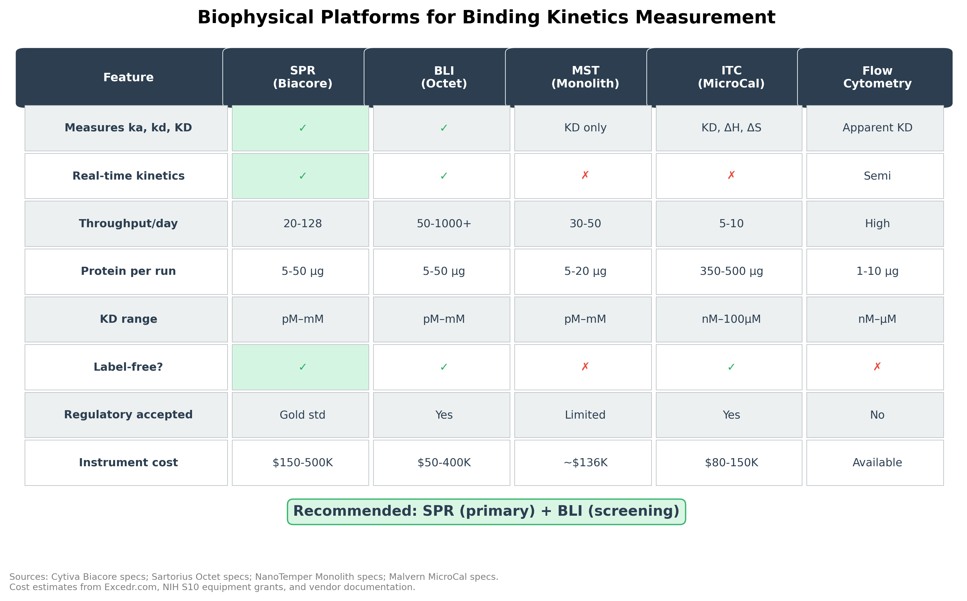
Binding Kinetics: SPR vs BLI Platform Comparison
FMC63-CD19 KD = 5.1 nM (Seigner et al., 2023, Biacore T200)

Slide 31
Nanobody/VHH-Based CARs: Future Direction
VHH: single-domain antibody (~15 kDa) from camelid heavy-chain-only Ab
(Hamers-Casterman et al., 1993, Nature 363:446)
Advantages over scFv for CAR-T:
• Reduced tonic signaling — no VH-VL mispairing/aggregation
• Higher thermal stability, simpler engineering (single gene, no linker)
• Convex paratope accesses cryptic epitopes inaccessible to scFv
• Easier bispecific/multi-targeting (tandem VHH format)
Clinical milestone: Cilta-cel (CARVYKTI) — first FDA-approved VHH CAR-T
(tandem VHH anti-BCMA, 97.9% ORR, Feb 2022)
Published anti-CD19 VHH clones: KD = 15-87 nM
(SRB-37/SRB-85: Banihashemi 2018; GR37/GR41: Ganji 2023)
Relevance: VHH is a logical next step after establishing the scFv
affinity-function framework in this project

Slide 32
Expected Outcomes & Significance
Expected Outcomes:
• Library of anti-CD19 CAR variants with systematically altered kinetics
• Comprehensive functional characterization (activation, exhaustion, memory, serial killing)
• Quantitative kinetic data (KD, kon, koff) via SPR/BLI
• Published data validates residue choice: Y260A/Y261A (Singh et al., 2023)
• Definition of the optimal affinity window for anti-CD19 CAR-T therapy
Significance:
• Bridges TCR-pMHC biology with translational CAR-T design
• Rational framework for affinity-optimized CAR engineering
• 2D kinetics of CAR-antigen: unexplored territory (potential novelty)
• Generalizable approach applicable to CARs targeting other antigens
• Foundation for VHH-based CAR optimization (future direction)

Slide 33
Thank You
PI: Dr. Kausik Chakraborty | Co-PI: Dr. Ankesh Kumar Jaiswal
DAC Members: Dr. Arpan Parichha | Dr. Chetana Sachidanandan | Dr. Sheetal Gandotra
Manpreet Kour | CSIR-IGIB | AcSIR Reg. 10BB25J02028

