Slide 1
Presented by
Manpreet Kour
PhD Scholar, CSIR-IGIB
AcSIR Reg. - 10BB25J02028
Principal Investigator:
Dr. Kausik Chakraborty
Co-Principal Investigator:
Dr. Ankesh Kumar Jaiswal
DAC members:
Dr. Arpan Parichha
Dr. Chetana Sachidanandan
Dr. Sheetal Gandotra

Slide 2
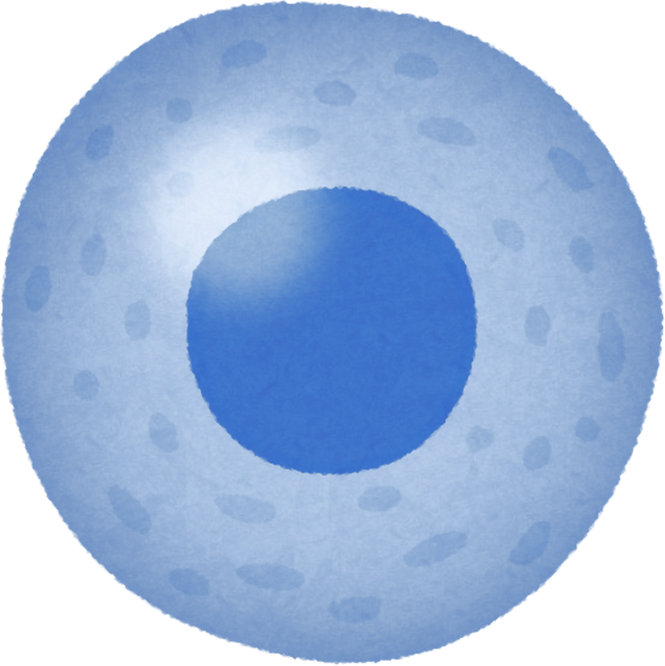
Advancing CAR-T Cell Therapy by Understanding
the Kinetics of Ag-Ab Interaction Parameters
First DAC meeting
Presented by:
Manpreet Kour
PhD Scholar, CSIR-IGIB
AcSIR Reg. - 10BB25J02028
Principal Investigator:
Dr. Kausik Chakraborty
DAC members:
Dr. Arpan Parichha
Dr. Chetana Sachidanandan
Dr. Sheetal Gandotra
Co-Principal Investigator:
Dr. Ankesh Kumar Jaiswal

Slide 3
Evolution of Cancer Therapeutics
2017 – First FDA approved CAR-T cell therapy - Kymirah
1890 – 1950s – Surgery, Radiation & Chemotherapy
1976 - BCG immunotherapy
1997-2017 –Antibodies & Inhibitors
----------------
-----
-----
-----
-----
-----
-----
-----
-----
-----
-----
1940s – Hormonal therapy
1986 – FDA approved Interferon therapy
2015-2018 -Immune checkpoint therapies (PD-1, PDL-1)
Challenges – Tumor relapse, Tumor Microenvironment (TME) immunosuppression, lack of precision etc.
Milestones in Cancer Research and Discovery, NCI

Slide 4
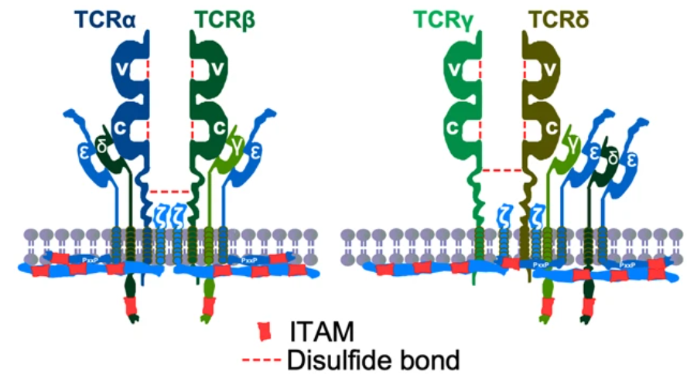
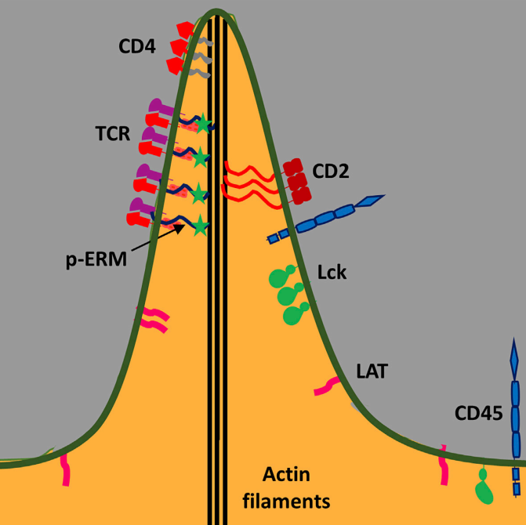
T cell Receptor Complex
ITAM – Immunoreceptor Tyrosine-based Activation Motif
ERM - Ezrin, Radixin, Moesin
Shah et al., (2021). Signal Transduction & Targeted Therapy
Ghosh et al., (2020). Cell Reports

Slide 5
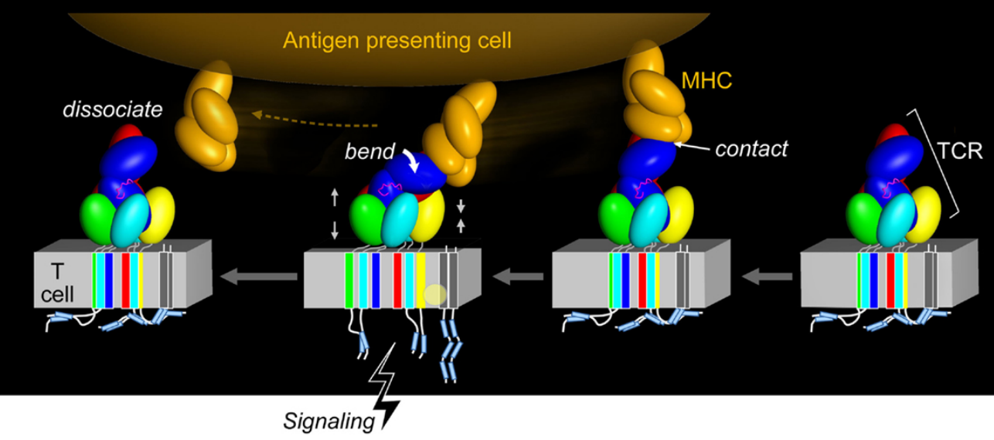
Force Initiated TCR Signaling
Brazin, et al. (2015). Frontiers in Immunology

Slide 6
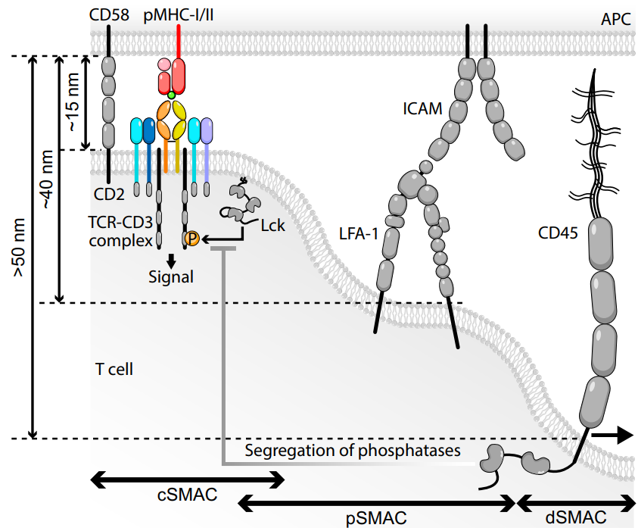
Formation of Immunological Synapse
SMAC – Supramolecular Activation Cluster
Travaglino et al. (2026). Experimental and Molecular Medicine

Slide 7
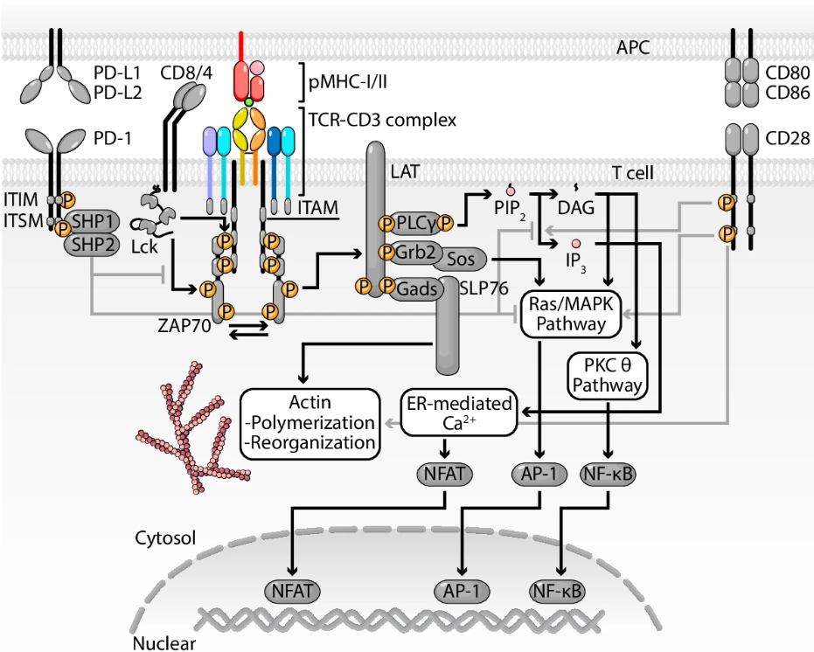
T cell Signaling
Travaglino et al. (2026). Experimental and Molecular Medicine

Slide 8
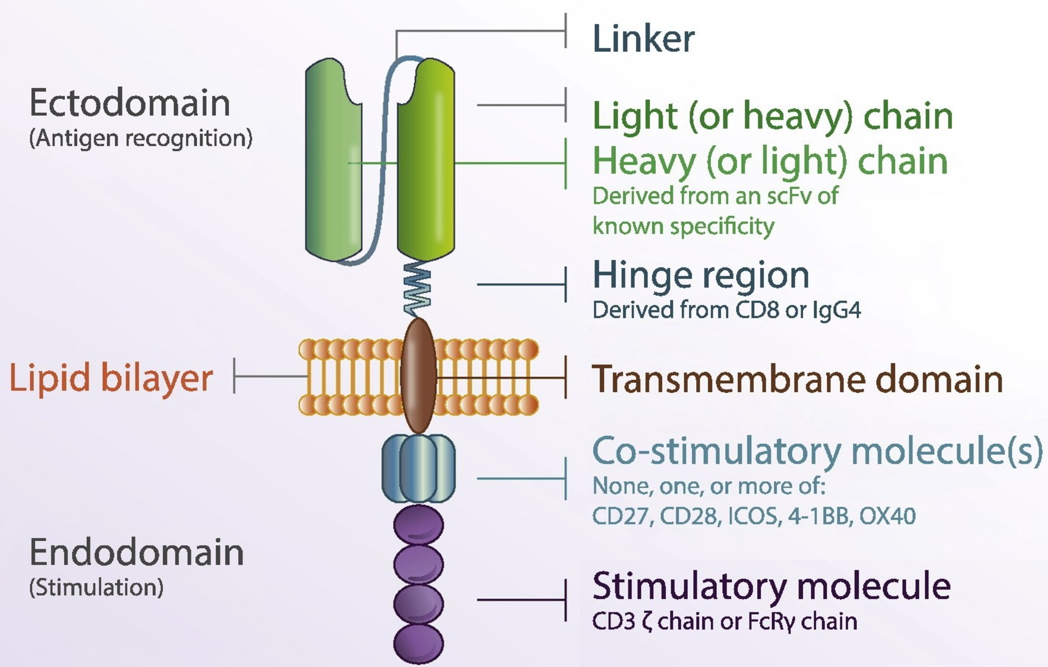
Engineering of CAR-T cell
Tariq et al., (2018). Springer Nature

Slide 9
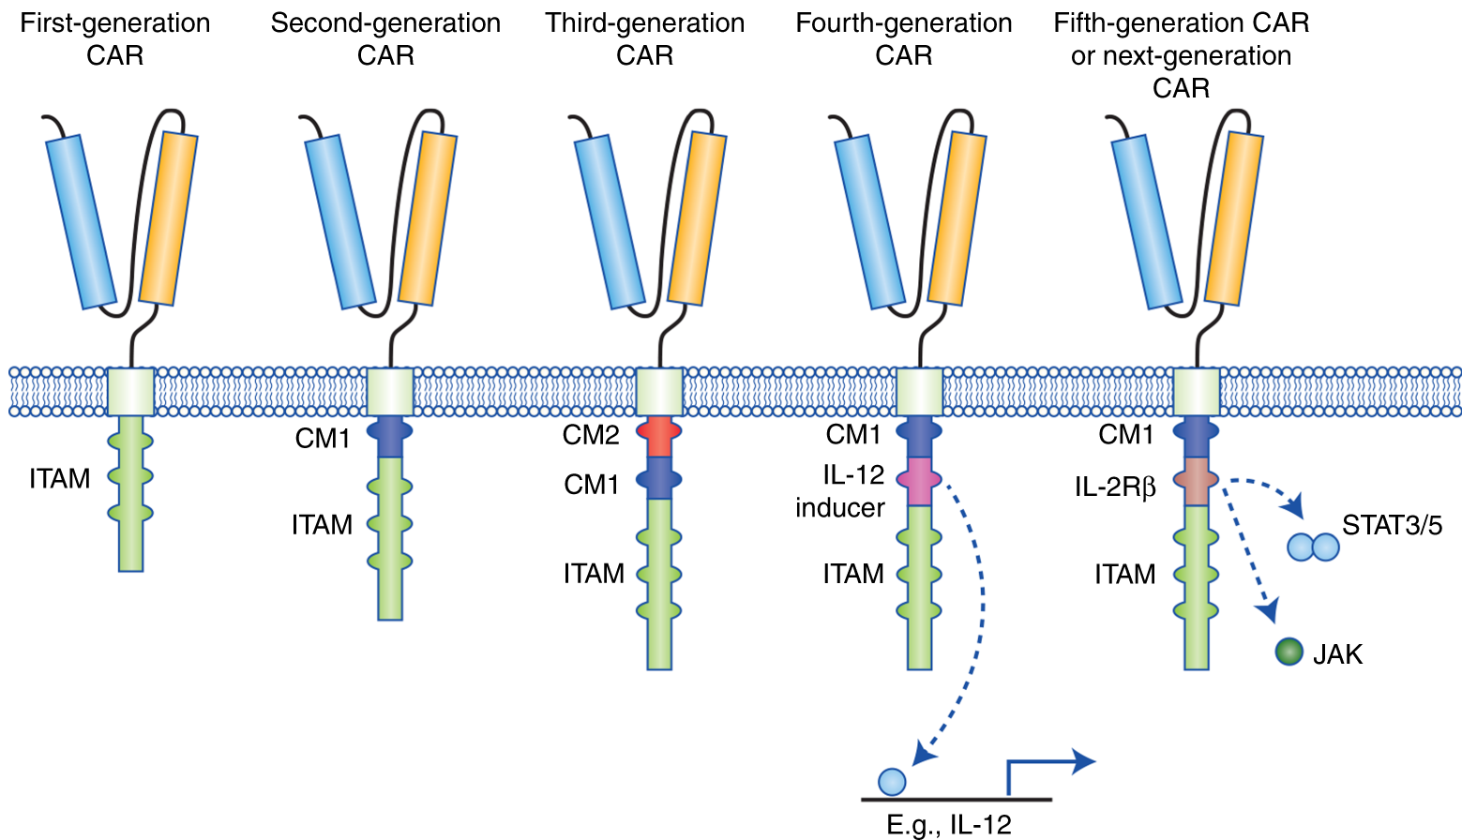
Engineering of CAR-T cell
Tokarew et al., (2018). British Journal of Cancer

Slide 10
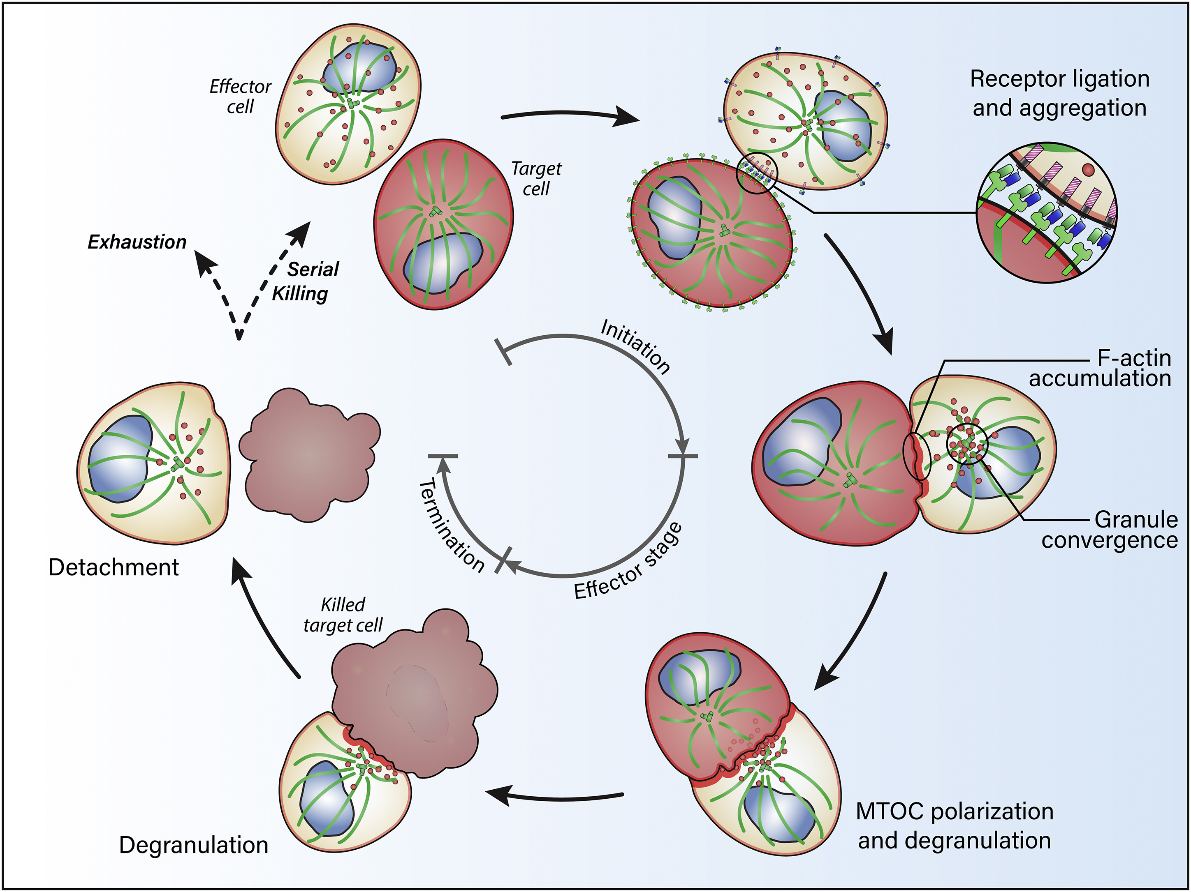
How does a CAR-T Cell Signal?
Mukherjee et al., (2017). Molecular Therapy.

Slide 11
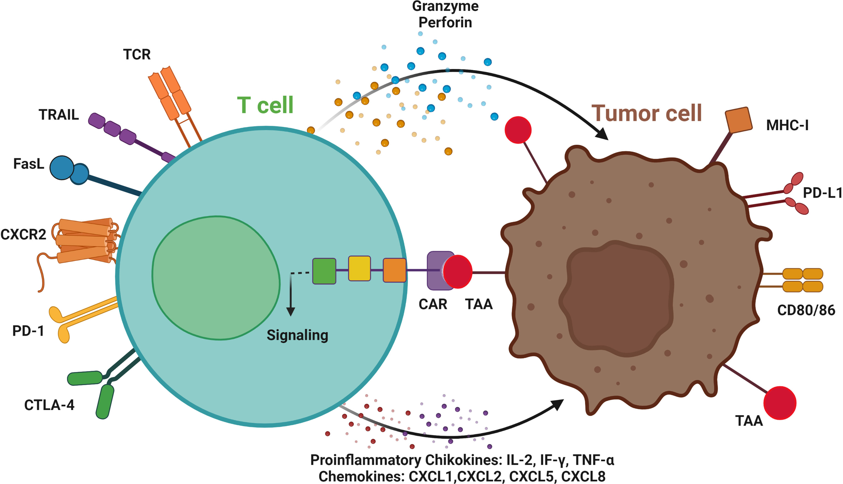
How does a CAR-T Cell Signal?
Proinflammatory cytokines: IL-2, IF-γ, TNF-α
Chemokines: CXCL1, CXCL2, CXCL5, CXCL8
Jogalekar, et al. 2022

Slide 12
Difference between TCR and CAR

Slide 13

Challenges in Current CAR-T Cell Therapy

Slide 14
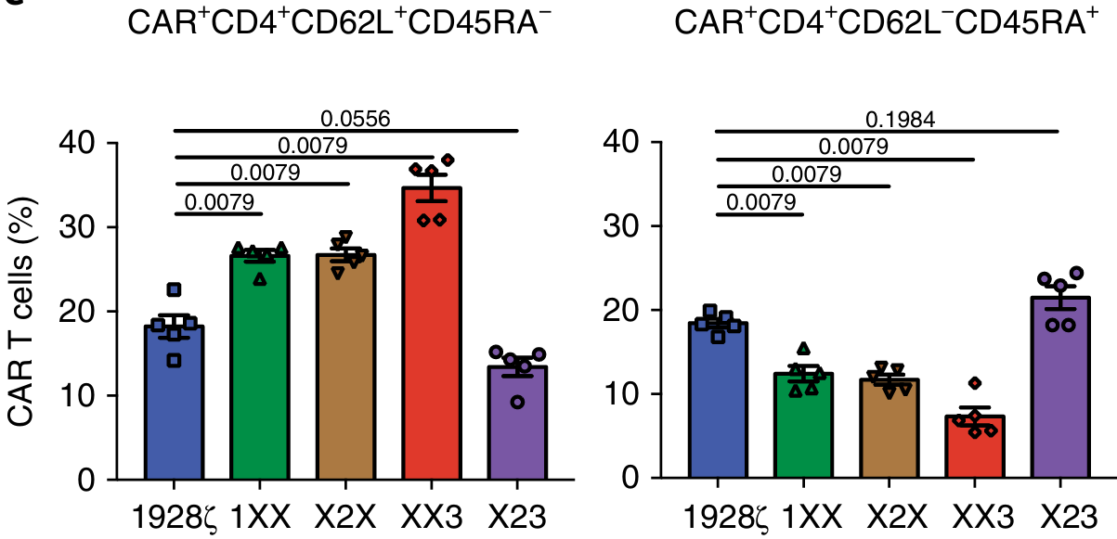
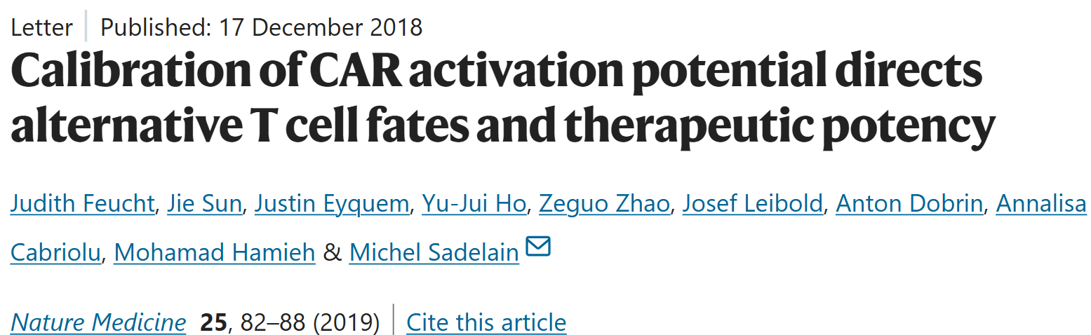
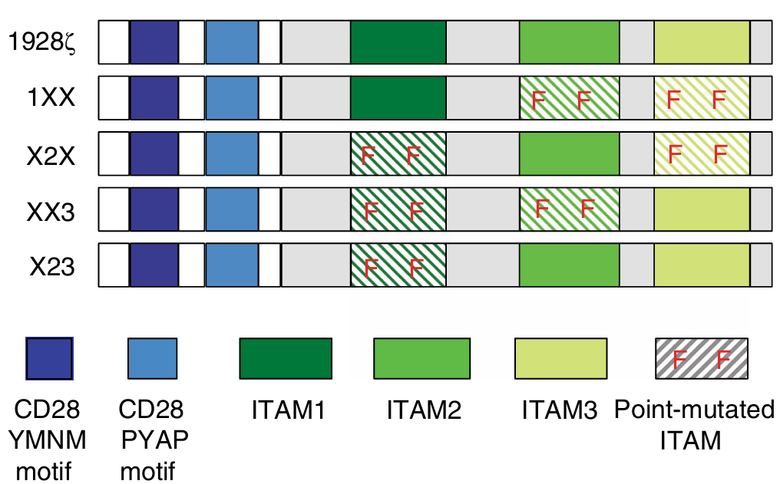
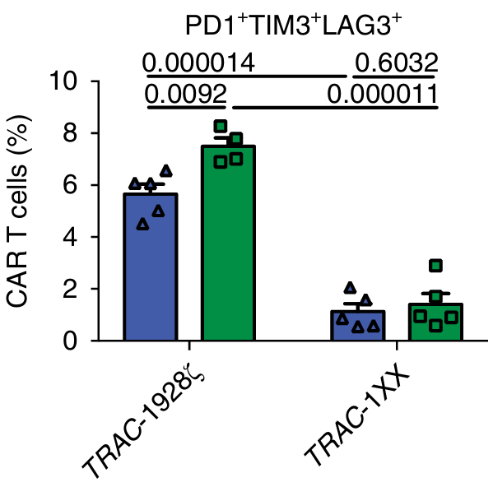
Literature Review
Rules out the requirement of all three ITAMs as well as their location for the desired effector function of T cell

Slide 15
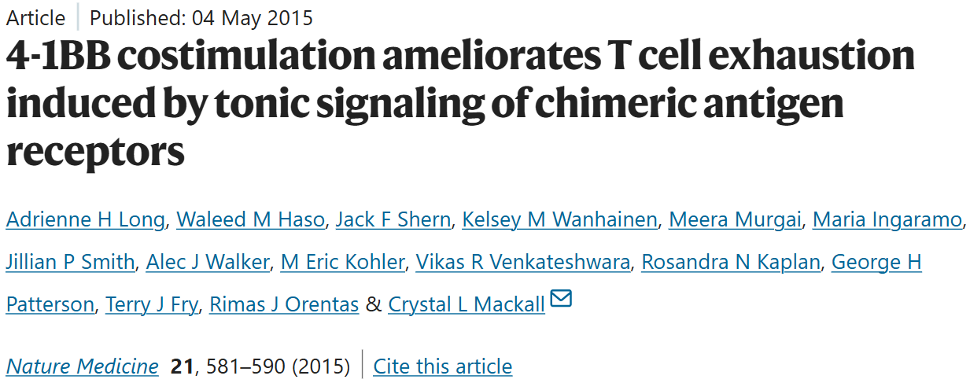
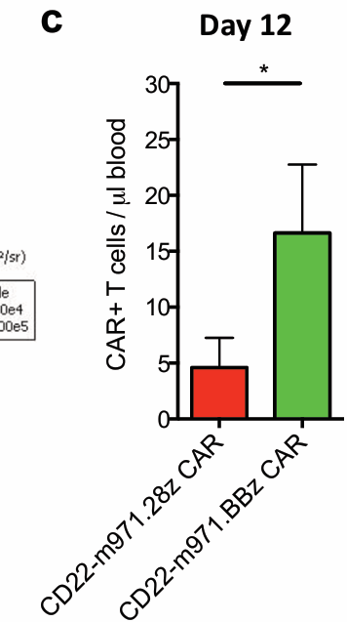
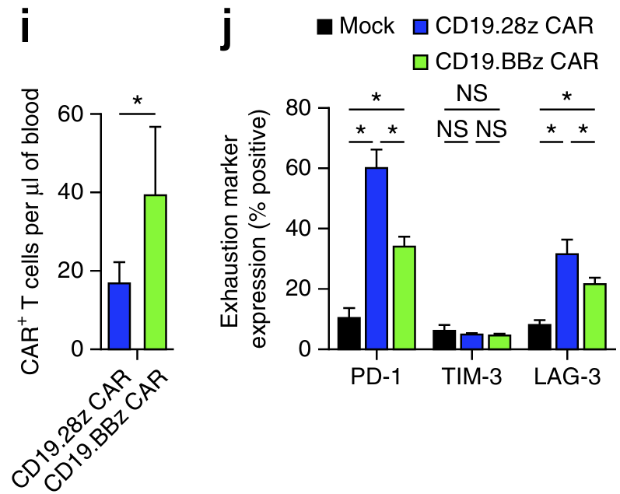
Literature Review
4-1BB costimulation improves the persistence of CAR-T cells
Notes:
Day 12: Quantification of T cells within the blood of mice from (a) on day 12 and 20 following adop ve transfer. n=10 mice/group.
Quantification of T cells within the blood of NSG mice inoculated with 106 NALM6-GL followed by adoptive transfer of 5 × 106 CAR T cells 3 d later. T cells were quantified on day 8 after adoptive transfer. n = 5 mice per group. (j) Exhaustion marker expression of CAR T cells from i.

Slide 16
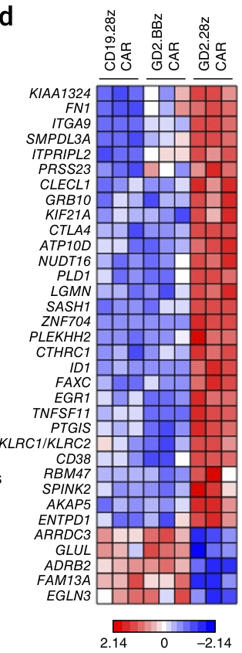

Literature Review
Hypoxia (EGLN3, EGR1, PTGIS, ID1),
Apoptosis (ID1) and
Metabolism (GLUL, ATP10D, SMPDL3A),
Or T cell suppressive pathways (CTLA4, CD38, LGMN, CLECL1, ENTPD1, KLRC1/2)
4-1BB Costimulation Counteracts Exhaustion

Slide 17
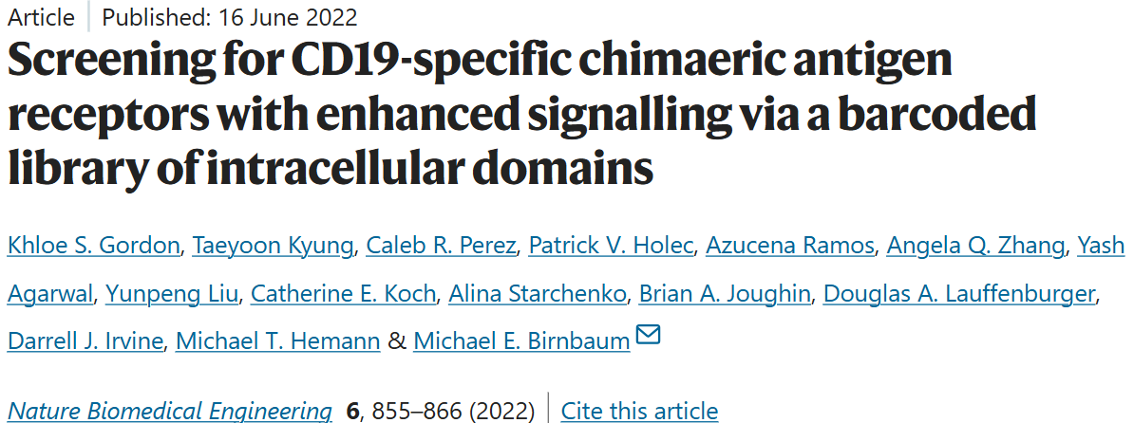
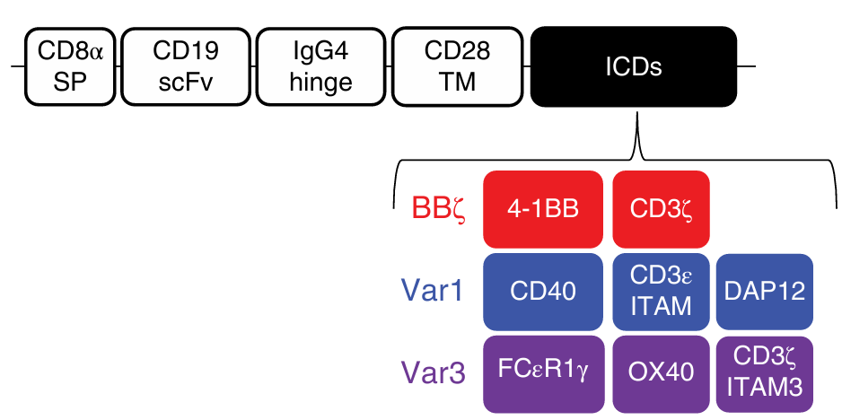
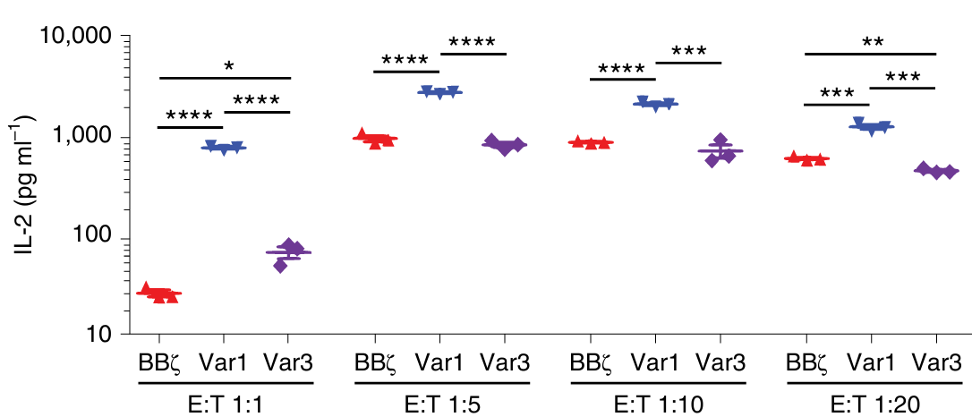
Literature Review
Notes:
First result is IL-2 levels determination by ELISA when CD8+ CAR T cells were co cultured with NALM6.

Slide 18
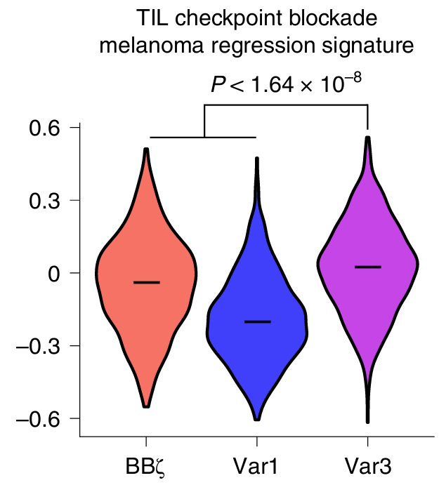
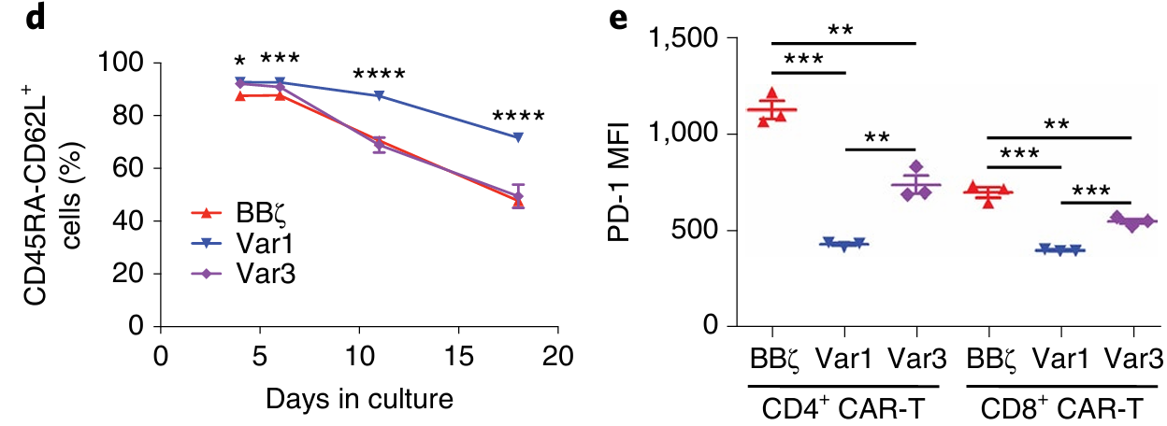
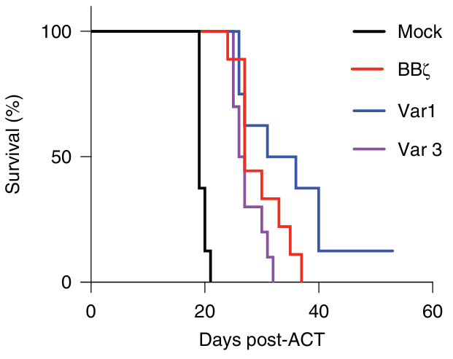
Literature Review
(in vivo)
Notes:
CAR-T cell co cultured with NALM6 at high E:T ratio and scRNA-seq done followed by sc-GSVA

Slide 19
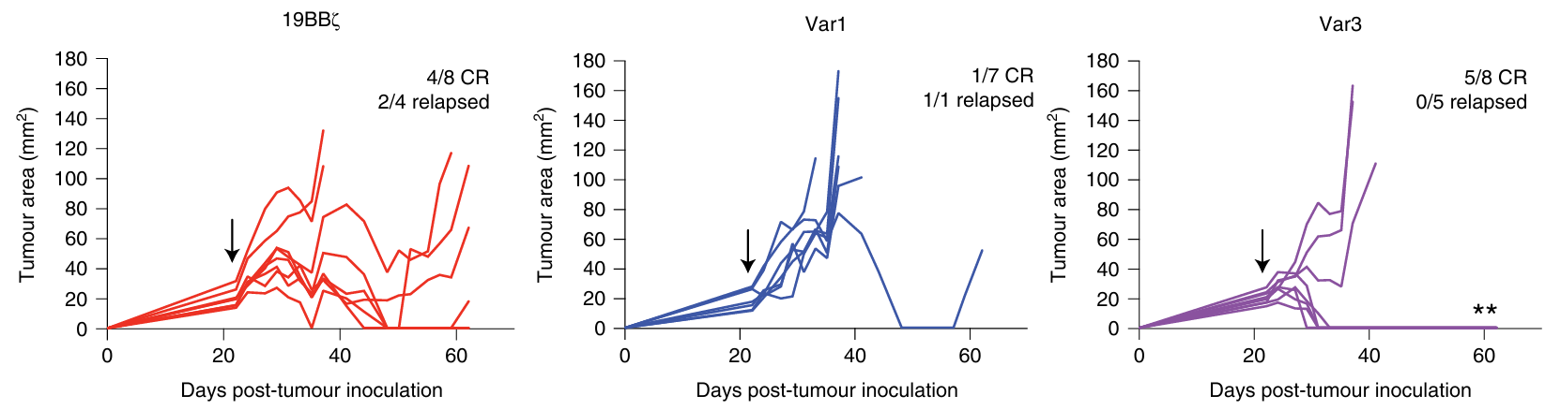
Literature Review
Var 1 group dominates Var 3 in in vitro settings but vice-versa in in vivo settings due to chronic nature of cancer in in vivo.
Provides systemic strategy for signalling domain optimization.

Slide 21
OBJECTIVES
1
To Understand the Parameters of Ag-Ab Binding which Affects the Amplitude of the Signal
2
To design an Affinity-optimized CAR construct to
3
To evaluate the CAR-T

Slide 22
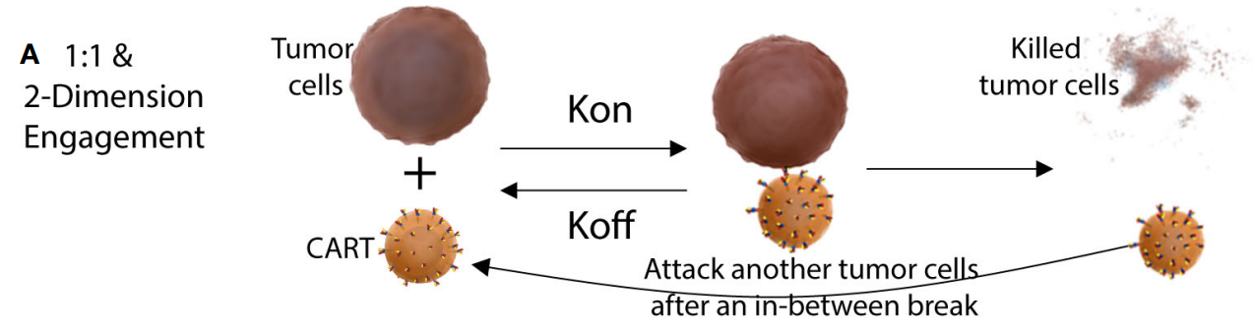
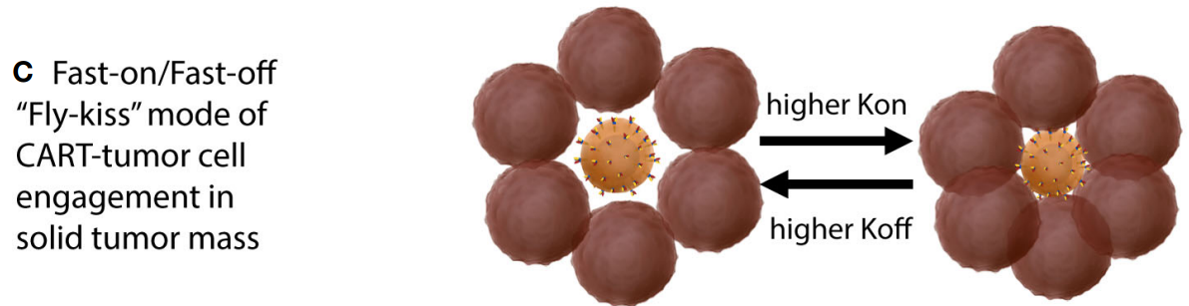
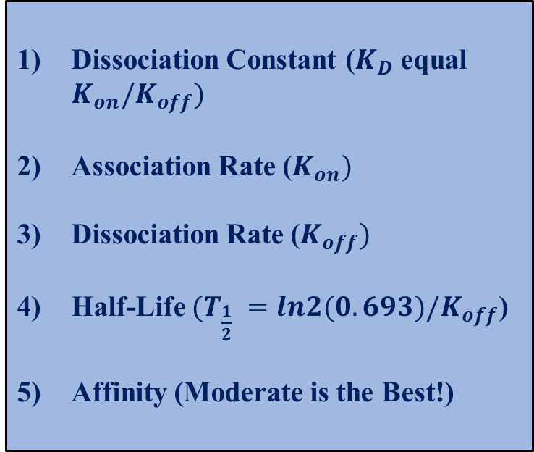
Parameters Affecting Ag-Ab Interaction
Dissociation Constant ($K_{D} \text{equal} K_{on}/K_{off})$
Association Rate ($K_{on})$
Dissociation Rate ($K_{off})$
Half-Life $(T_{\frac{1}{2}} =ln2(0.693)/K_{off}$)
Affinity (Moderate is the Best!)
Mao, et al. 2022

Slide 23
Experimental Design
Objective 1
Development of Anti-CD19 CAR construct (VectorBuilder) – pLV CAR-BFP (commercial CAR construct) & pLV CAR-eGFP.

Slide 24
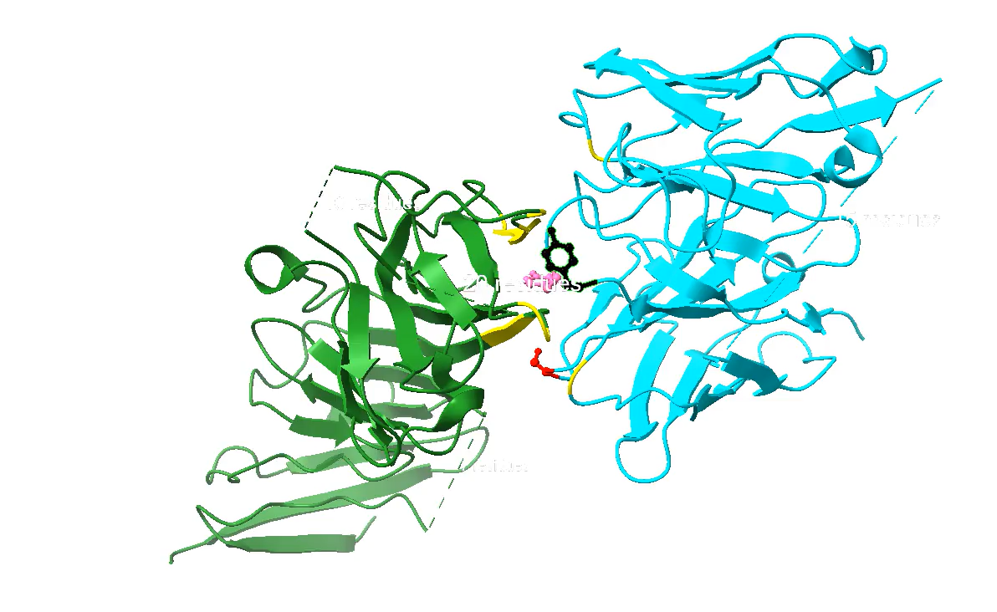
Experimental Design
2) To determine the interacting residues of Ag-Ab complex formed between CD19 & anti-CD19 scFv
Anti-CD19 scFv (FMC63)
CD19 (7URV)
Interacting residues selected from Anti-CD19 scFv (based on greater interacting surface i.e, buried SASA = 35Å):
Tyrosine, 260
Tyrosine, 261
Serine, 214
PDB & ChimeraX

Slide 25
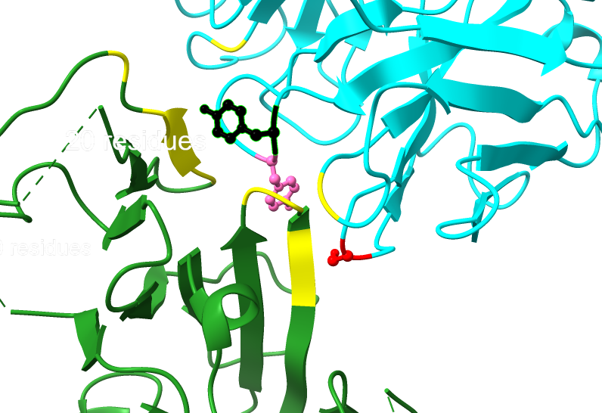
Experimental Design
2) To determine the interacting residues of Ag-Ab complex formed between CD19 & anti-CD19 scFv
Anti-CD19 scFv (FMC63)
CD19 (7URV)
Interacting residues selected from Anti-CD19 scFv (based on greater interacting surface i.e, buried SASA = 35Å):
Tyrosine, 260
Tyrosine, 261
Serine, 214
PDB & ChimeraX

Slide 27
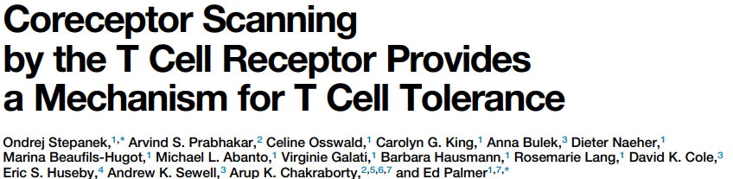
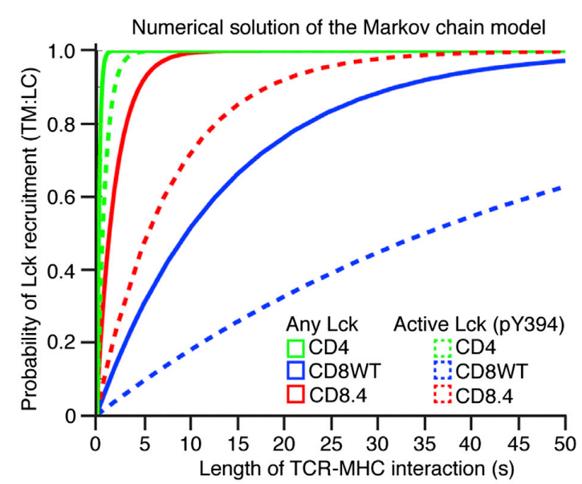
Higher frequency of CD4 molecules are coupled to catalytically active Lck compared to CD8

Slide 28
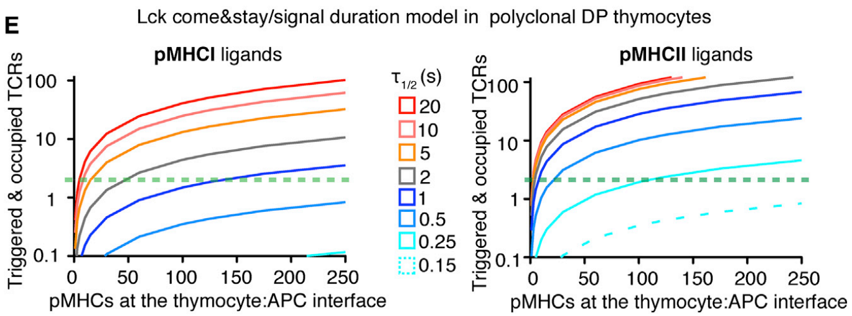
MHCII-restricted receptors have a shorter dwell-time

Slide 29
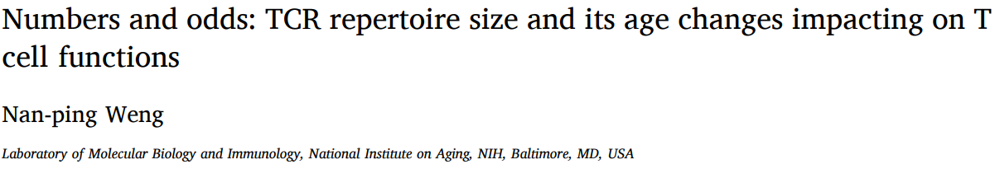
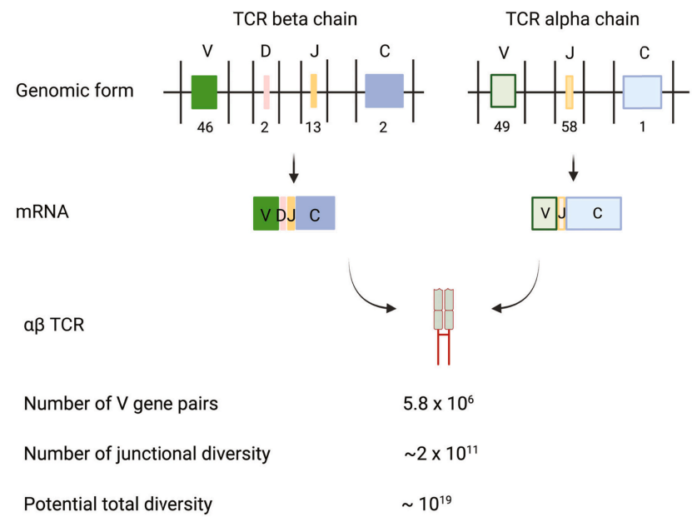

Slide 30
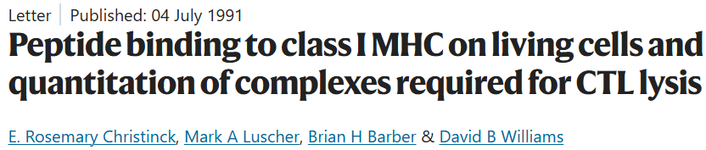
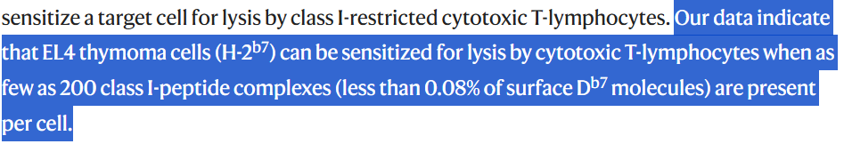

Slide 31

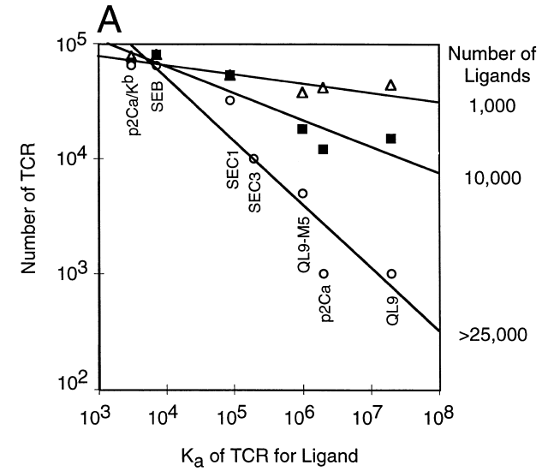
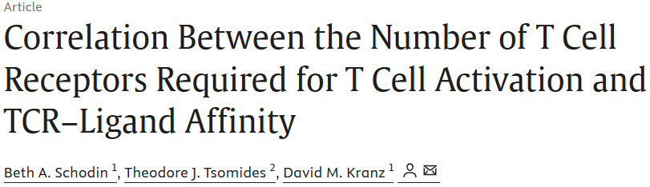
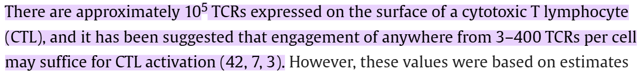
If the stoichiometry of TCR & pMHC is 1:1

Slide 32
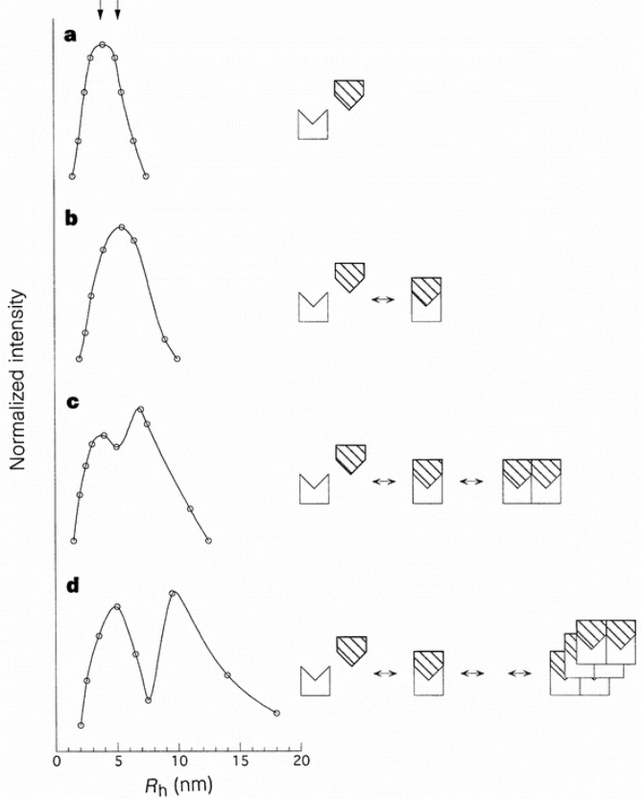
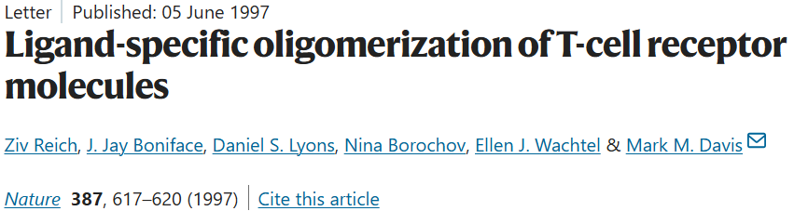
Quasi-elastic light scattering (QELS)
TCR/peptide–MHC complexes oligomerize in solution
Form oligomers at concentrations near the dissociation constant of the binding reaction.

Slide 33
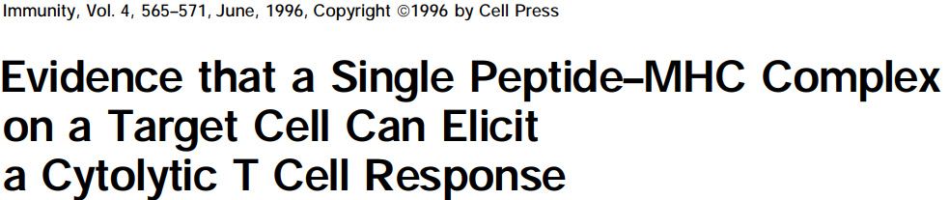
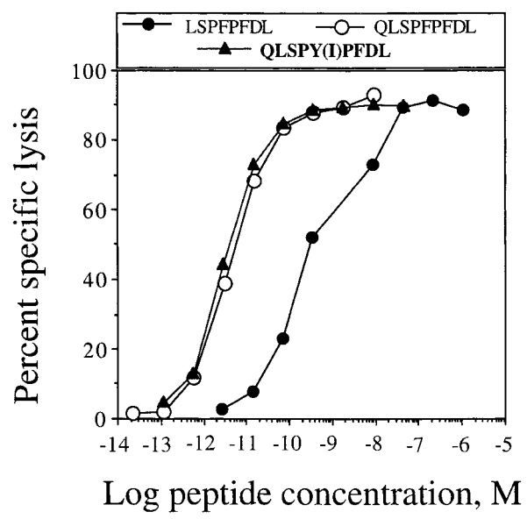
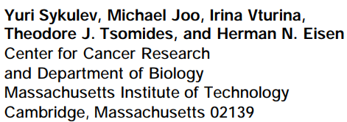
Peptide concentration of 5-10pM causes half-maximal lysis of target cells by a cytolytic T lymphocyte (CTL) clone

Slide 34
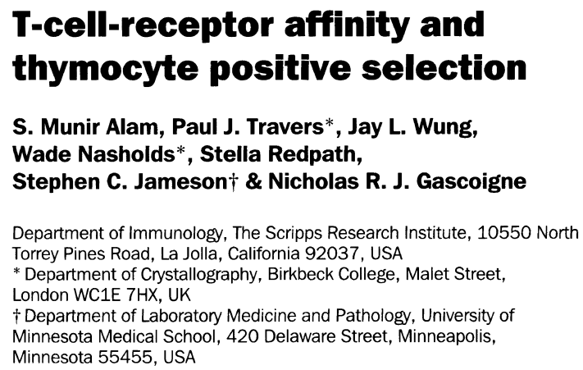

Slide 35
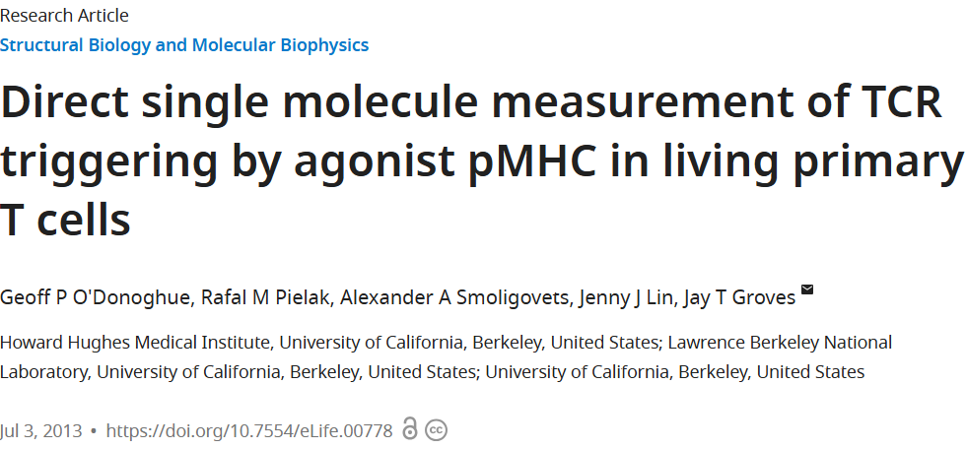
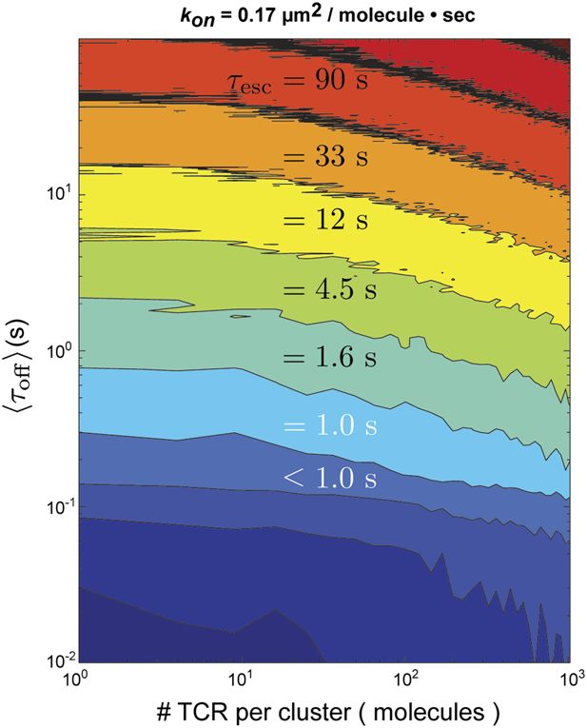

Slide 36

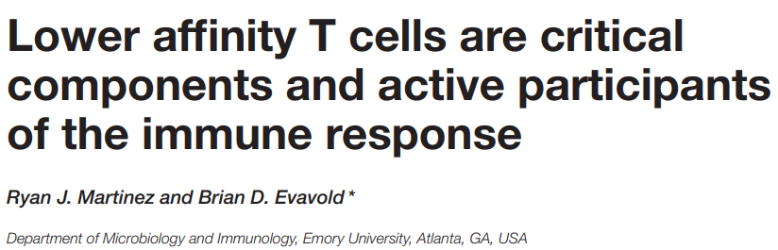

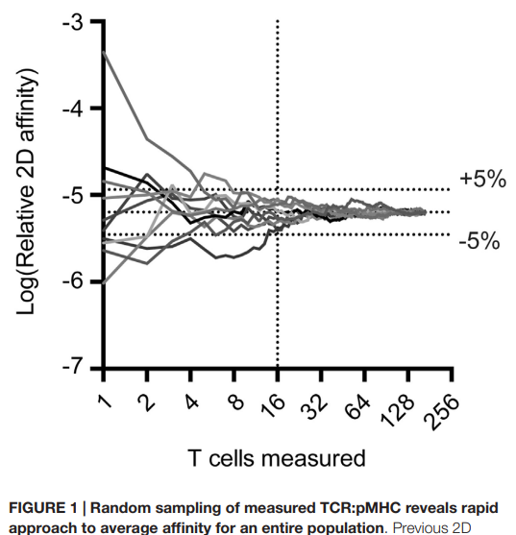
Addressed how many cells need to be measured to find the average affinity of an antigen-specific polyclonal T cell population, i.e 16 in number.

Slide 37


Slide 38


Slide 39





Slide 40




