Slide 2
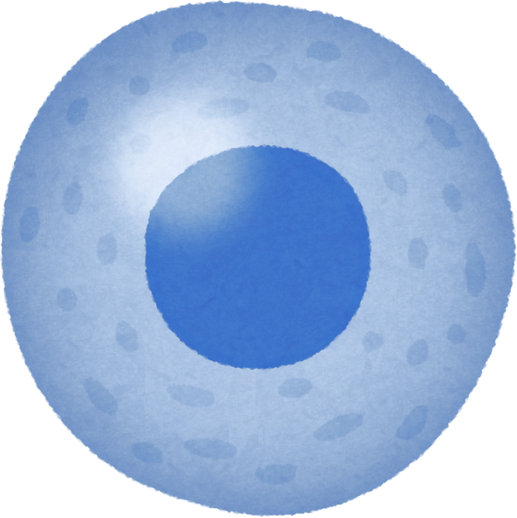
Advancing CAR-T Cell Therapy by Understanding
the Kinetics of Ag-Ab Interaction Parameters
First DAC meeting
Presented by:
Manpreet Kour
PhD Scholar, CSIR-IGIB
AcSIR Reg. - 10BB25J02028
Principal Investigator:
Dr. Kausik Chakraborty
DAC members:
Dr. Arpan Parichha
Dr. Chetana Sachidanandan
Dr. Sheetal Gandotra
Co-Principal Investigator:
Dr. Ankesh Kumar Jaiswal

Slide 3
Evolution of Cancer Therapeutics
2017 – First FDA approved CAR-T cell therapy - Kymirah
1890 – 1950s – Surgery, Radiation & Chemotherapy
1976 - BCG immunotherapy
1997-2017 –Antibodies & Inhibitors
----------------
-----
-----
-----
-----
-----
-----
-----
-----
-----
-----
1940s – Hormonal therapy
1986 – FDA approved Interferon therapy
2015-2018 -Immune checkpoint therapies (PD-1, PDL-1)
Challenges – Tumor relapse, Tumor Microenvironment (TME) immunosuppression, lack of precision etc.
Milestones in Cancer Research and Discovery, NCI

Slide 4
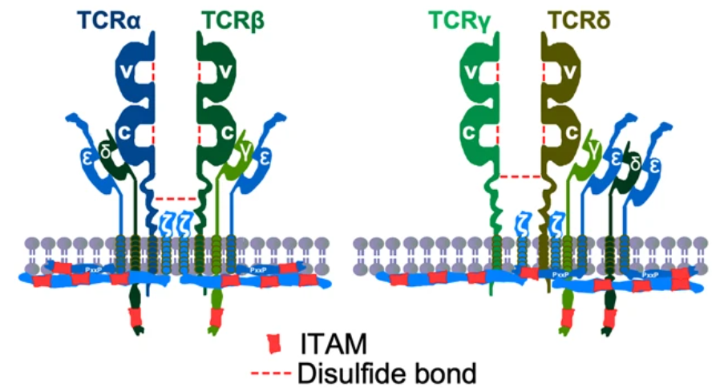
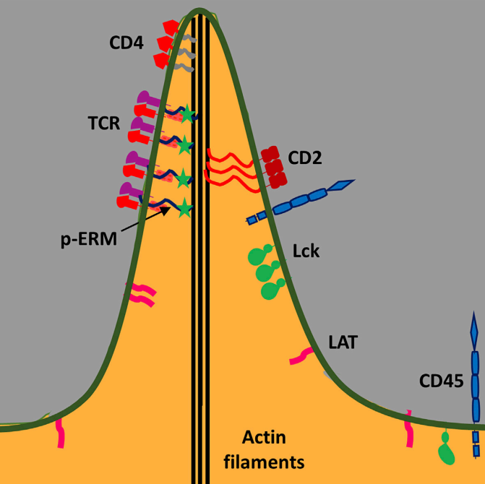
T cell Receptor Complex
ITAM – Immunoreceptor Tyrosine-based Activation Motif
ERM - Ezrin, Radixin, Moesin
Shah et al., (2021). Signal Transduction & Targeted Therapy
Ghosh et al., (2020). Cell Reports

Slide 5
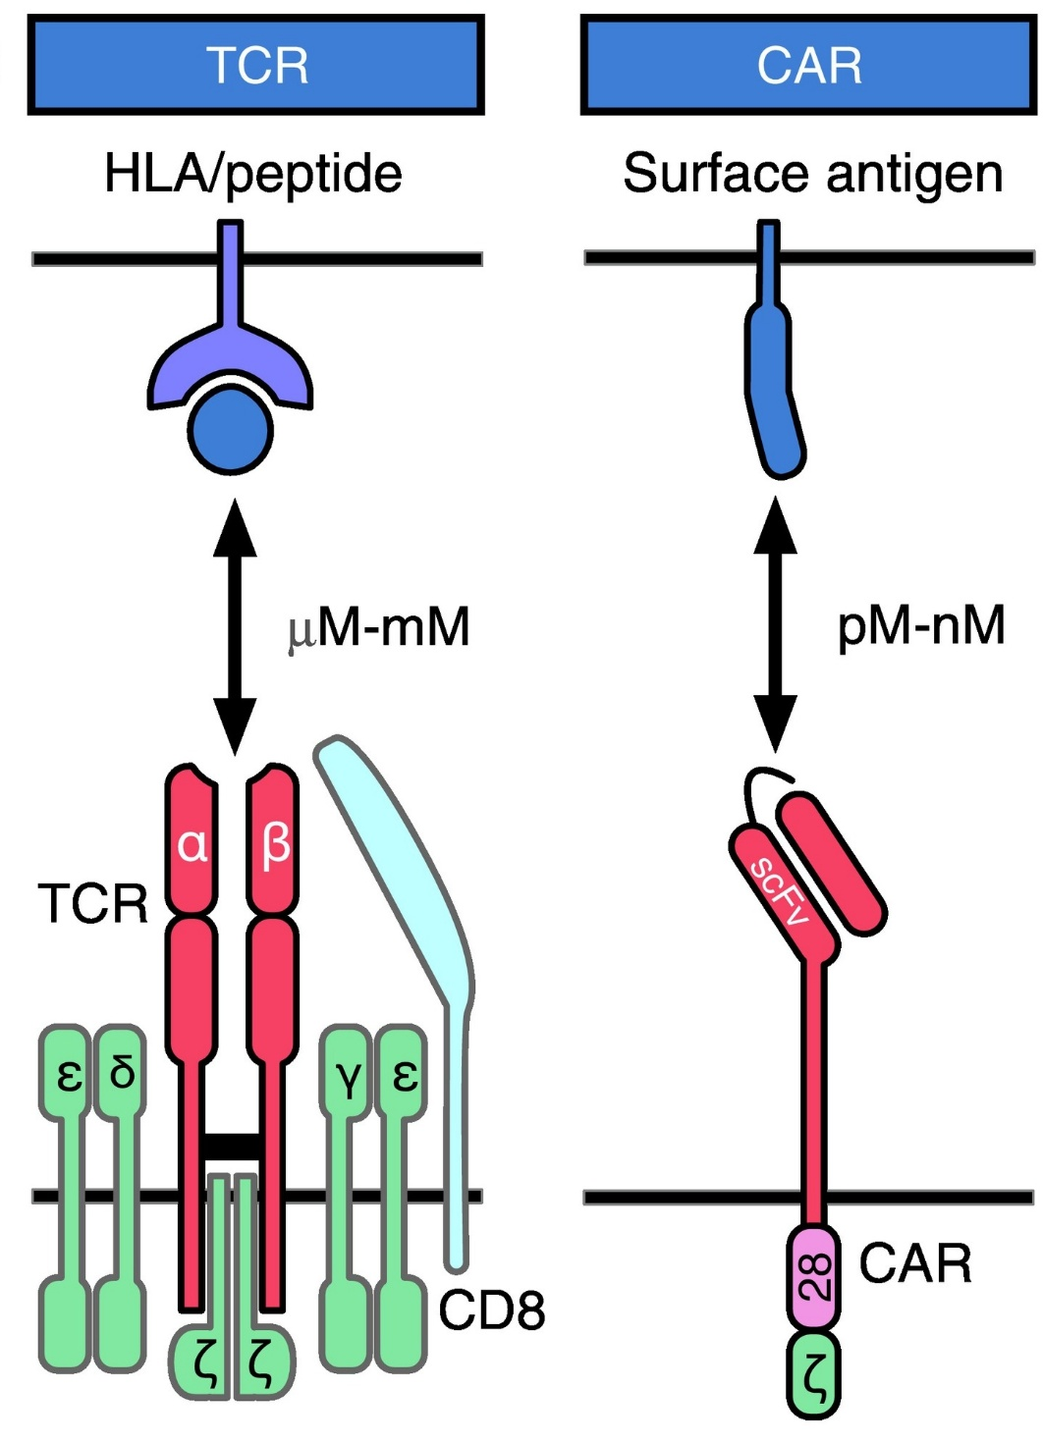
Role of affinity in the signal strength
Mause, et al (2022). Trends in Biotechnology.

Slide 6
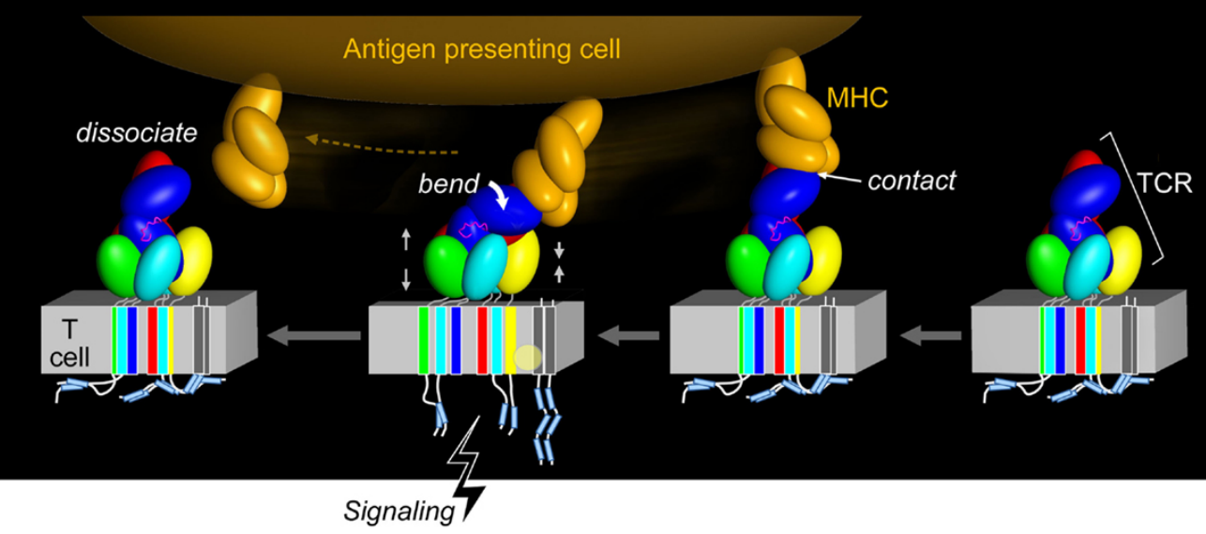
Force Initiated TCR Signaling
Brazin, et al. (2015). Frontiers in Immunology

Slide 7
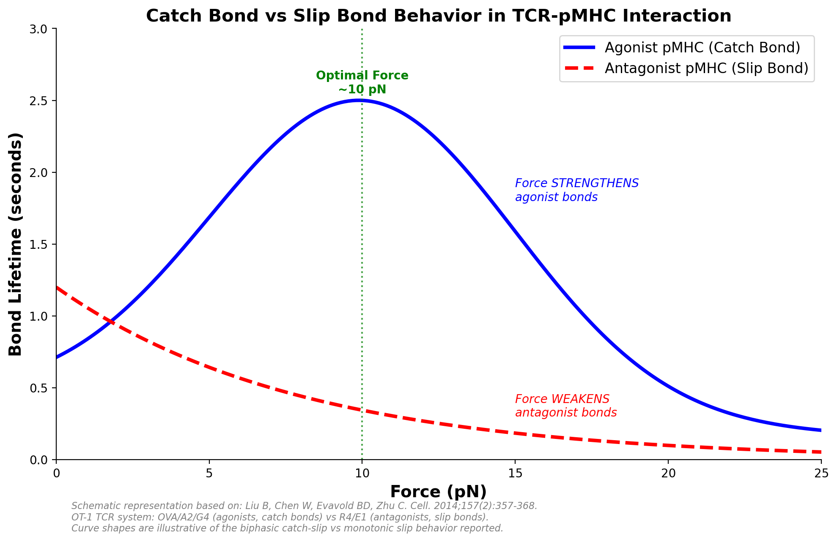
Force Initiated TCR Signaling
Brazin, et al. (2015). Frontiers in Immunology
Liu, et al. (2014). CellPress

Slide 8
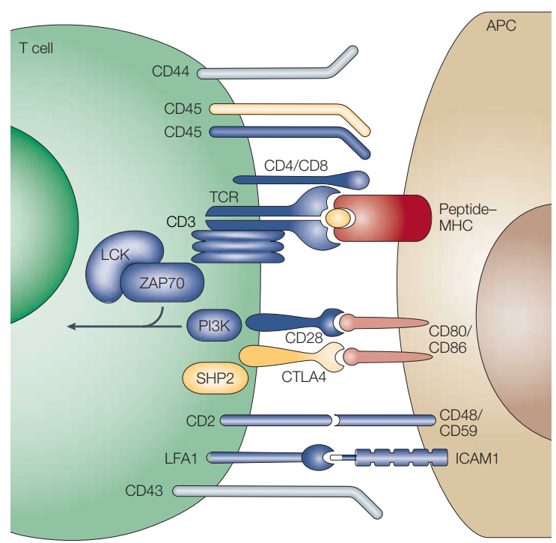
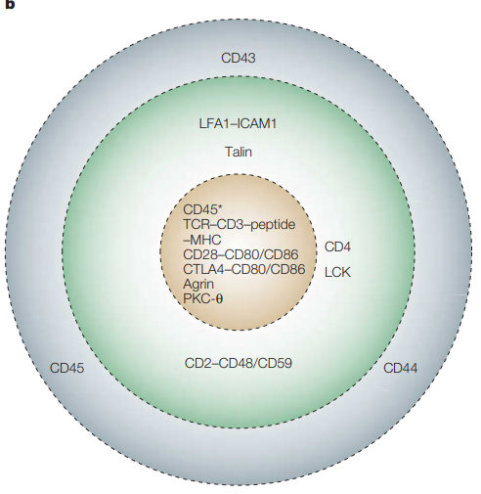
Formation of Immunological Synapse
Formation of new micrclusters will keep taking place at pSMAC
Older ones migrate centripetally to coalescence in cSMAC
cSMAC
pSMAC
dSMAC
Huppa, et al. (2003). Nature Reviews Immunology

Slide 9
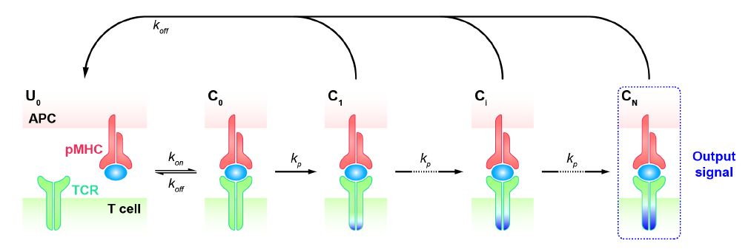
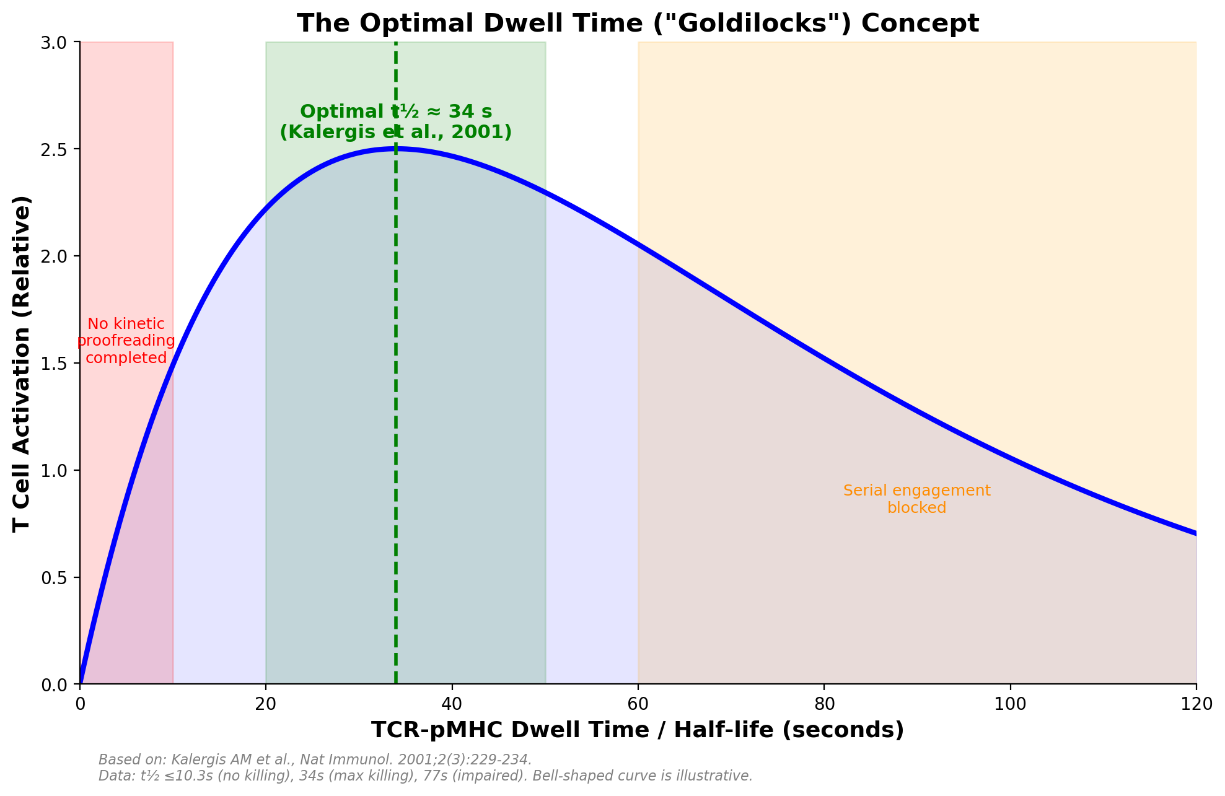
Time as the Gatekeeper: Kinetic Proofreading in T Cell Activation
Kalergis et al. (2001). Nature Communications
Shi, et al. (2024). Frontiers in Immunology
Notes:
Given by TIMOTHY W. MCKEITHAN

Slide 10
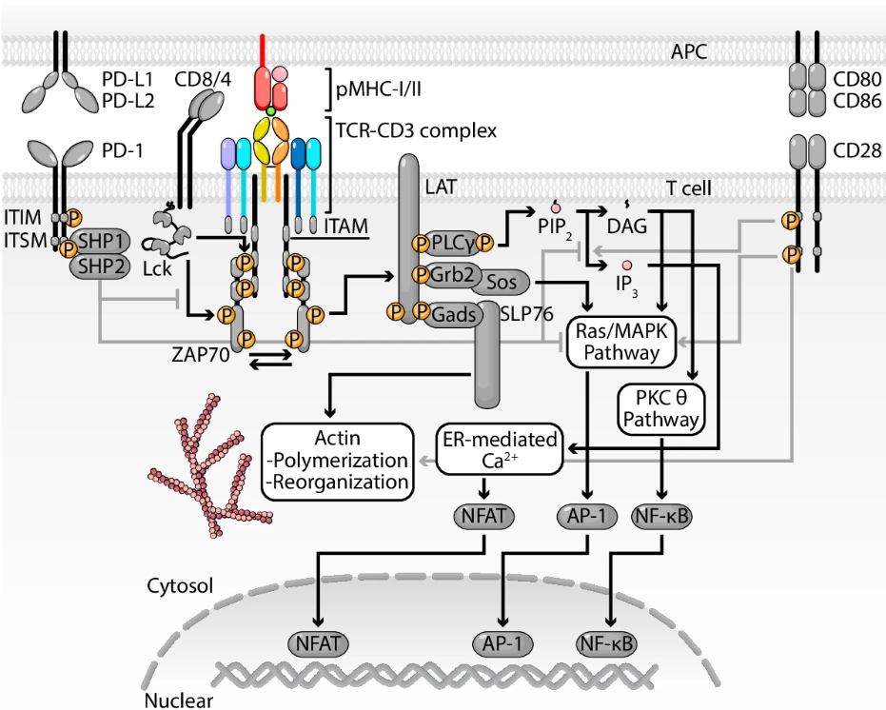
T cell Signaling
Travaglino et al. (2026). Experimental and Molecular Medicine

Slide 11
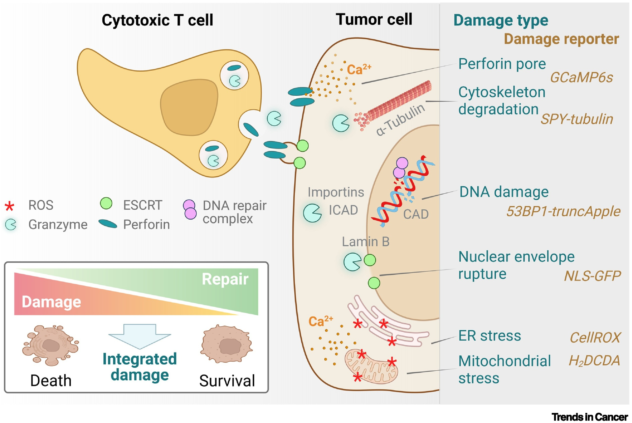
T cell Signaling
Weigelin et al. (2022). Trends in Cancer

Slide 12
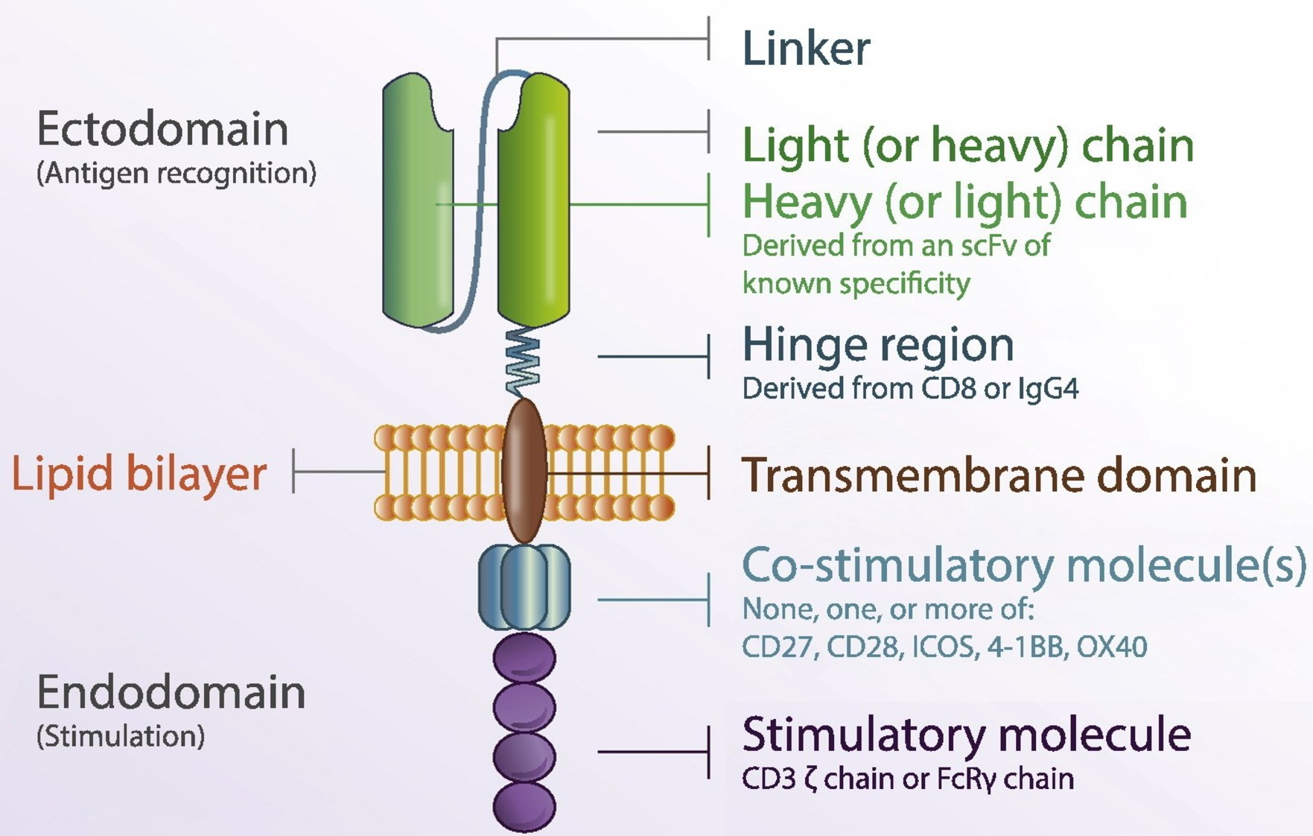
Engineering of CAR-T cell
Tariq et al., (2018). Springer Nature

Slide 13
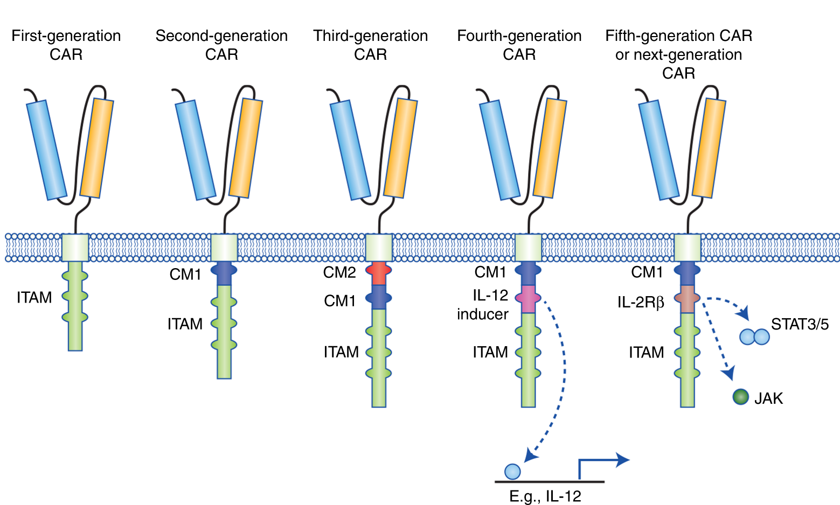
Engineering of CAR-T cell
Tokarew et al., (2018). British Journal of Cancer

Slide 14
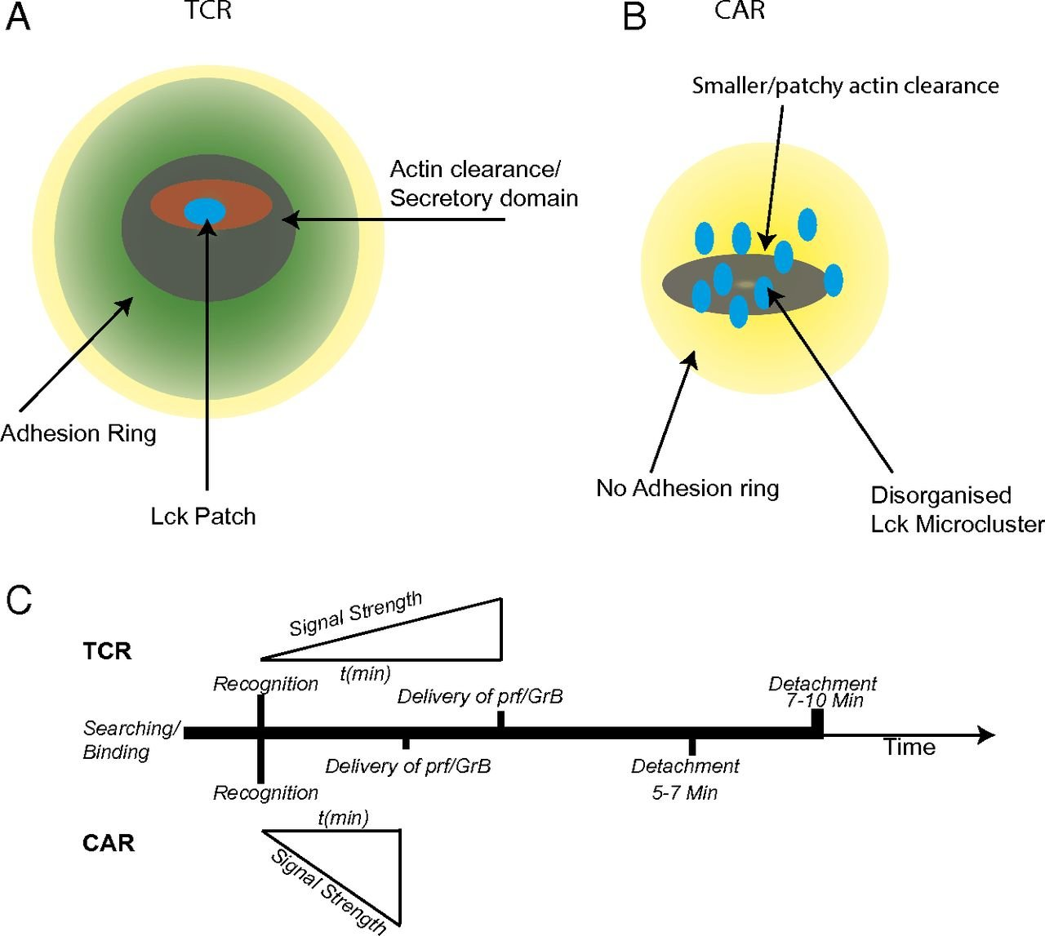
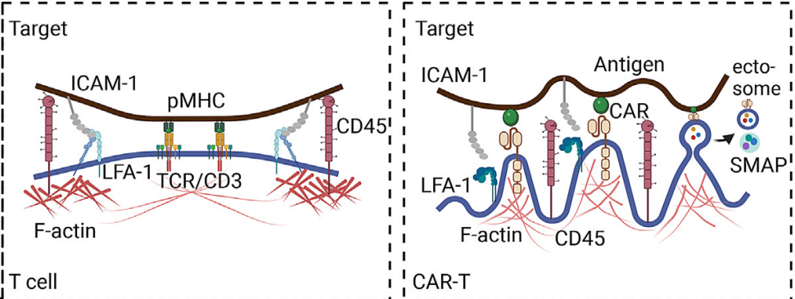
Landscape of Synapses
Davenport et al. (2018). PNAS
Xiong et al. (2023). Biophysical Journal

Slide 15

Challenges in Current
CAR-T Cell Therapy

Slide 16
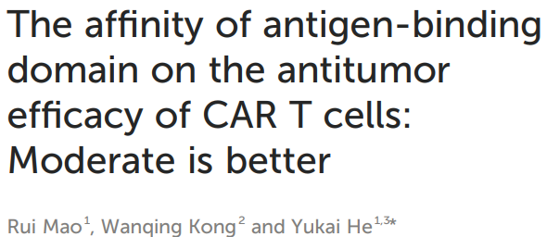
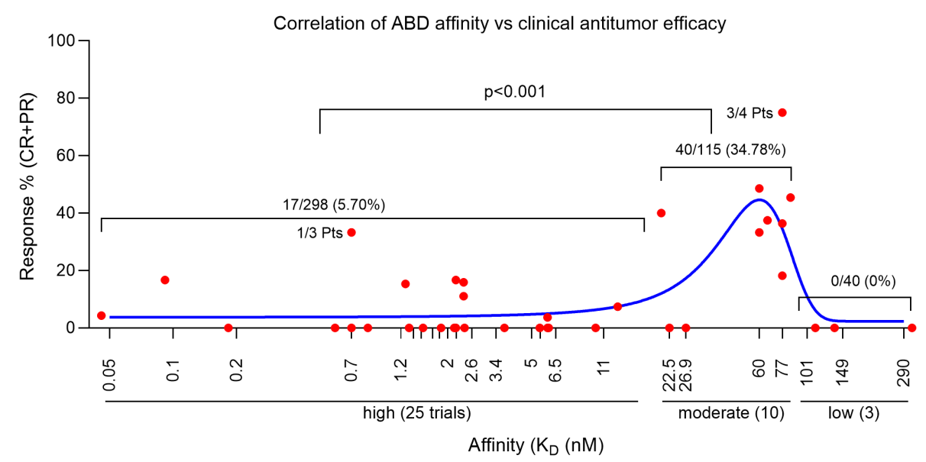

Literature Review

Slide 17
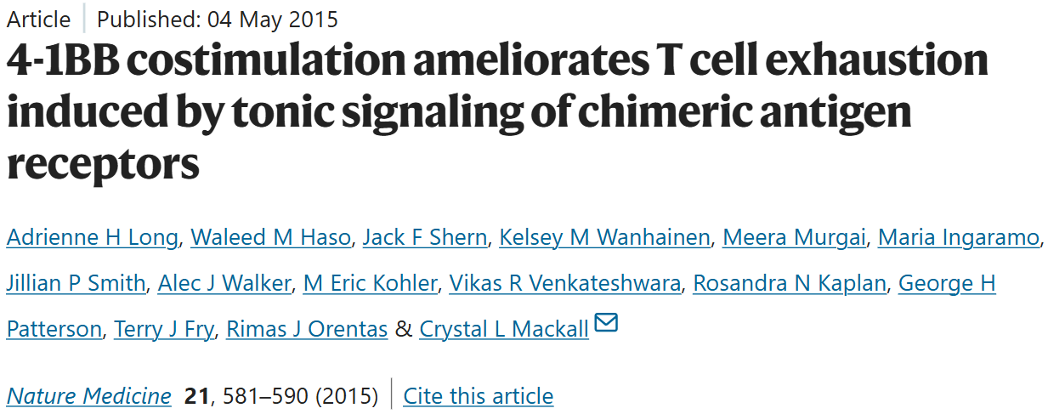
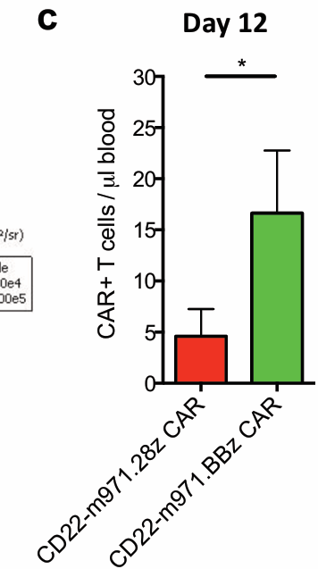
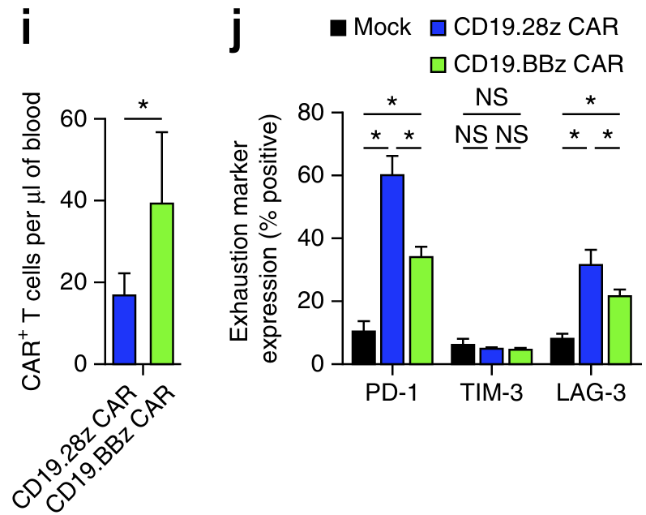
Literature Review
4-1BB costimulation improves the persistence of CAR-T cells
Notes:
Day 12: Quantification of T cells within the blood of mice from (a) on day 12 and 20 following adop ve transfer. n=10 mice/group.
Quantification of T cells within the blood of NSG mice inoculated with 106 NALM6-GL followed by adoptive transfer of 5 × 106 CAR T cells 3 d later. T cells were quantified on day 8 after adoptive transfer. n = 5 mice per group. (j) Exhaustion marker expression of CAR T cells from i.

Slide 18
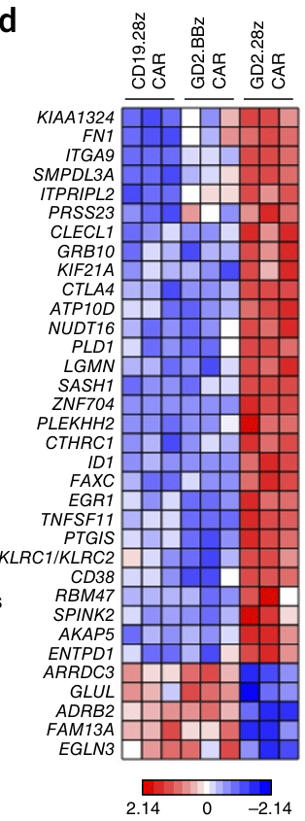

Literature Review
Hypoxia (EGLN3, EGR1, PTGIS, ID1),
Apoptosis (ID1) and
Metabolism (GLUL, ATP10D, SMPDL3A),
Or T cell suppressive pathways (CTLA4, CD38, LGMN, CLECL1, ENTPD1, KLRC1/2)
4-1BB Costimulation Counteracts Exhaustion

Slide 19
HYPOTHESIS

Slide 20
OBJECTIVES
1
To determine CAR-T cell efficacy in vivo and in vitro using scFv mutant CAR library
2
To do biophysical characterization of scFv mutants which performed better in vivo as well as in vitro
3
To Understand the Parameters of Ag-Ab Binding which Affects the Amplitude of the Signal

Slide 21
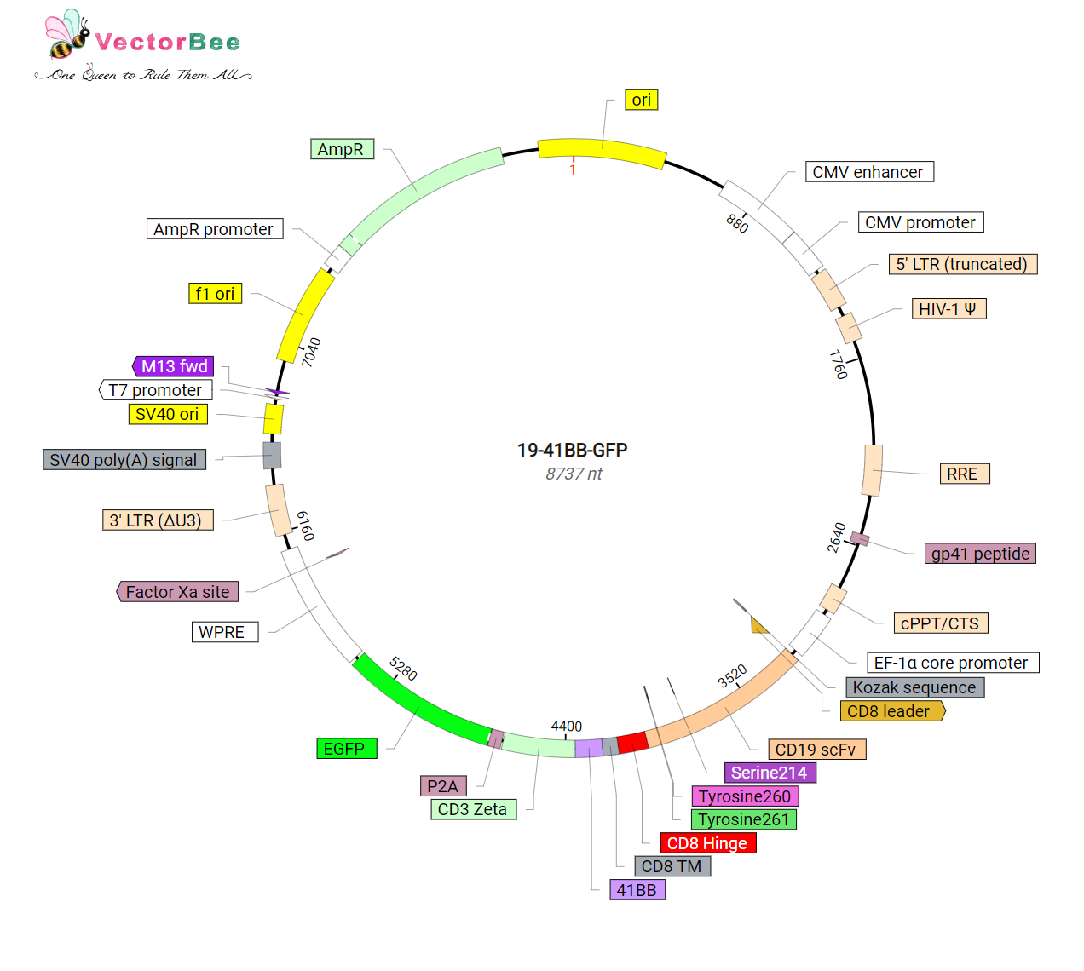
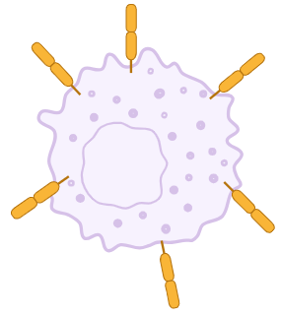
OBJECTIVE 1.1 To develop scFv mutant library of CAR & make mutant CARPOOL T cells
CD19
CD19 as target antigen: B cell malignancies
FDA approved CAR-T cell therapies (includes Kymirah, Yescarta) target CD19

Slide 22
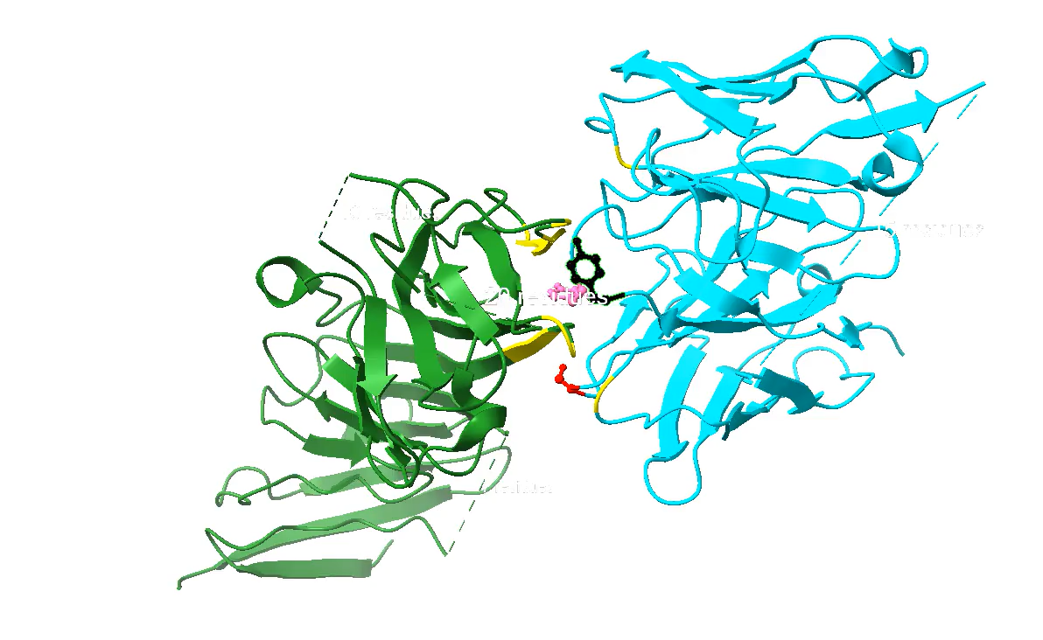
OBJECTIVE 1.1 To develop scFv mutant library of CAR & make mutant CARPOOL T cells
Anti-CD19 scFv (FMC63)
CD19 (7URV)
Interacting residues selected from Anti-CD19 scFv (based on greater interacting surface i.e, buried SASA = 35Å):
Tyrosine, 260
Tyrosine, 261
Serine, 214
PDB & ChimeraX

Slide 23
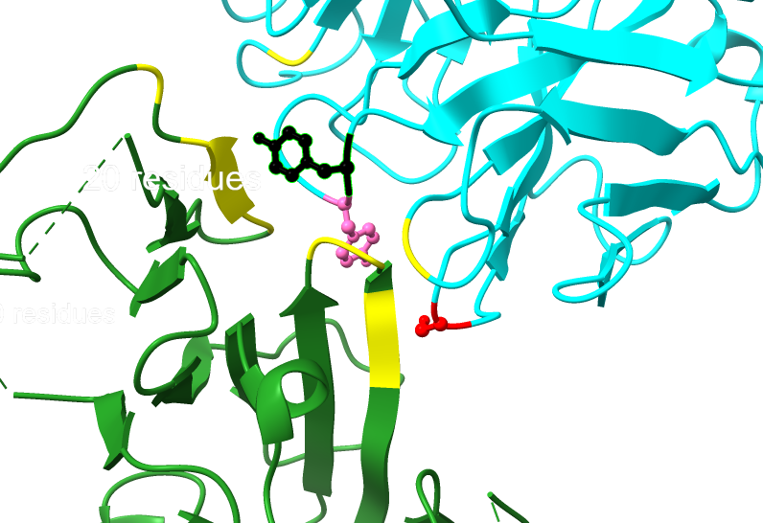
OBJECTIVE 1.1 To develop scFv mutant library of CAR & make mutant CARPOOL T cells
Anti-CD19 scFv (FMC63)
CD19 (7URV)
Interacting residues selected from Anti-CD19 scFv (based on greater interacting surface i.e, buried SASA = 35Å):
Tyrosine, 260
Tyrosine, 261
Serine, 214
PDB & ChimeraX

Slide 24
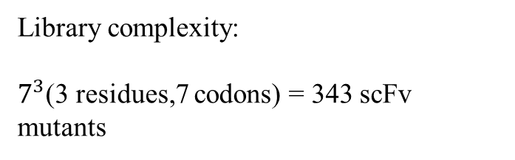
OBJECTIVE 1.1 To develop scFv mutant library of CAR & make mutant CARPOOL T cells
Creating scFv mutant library
S. No. | Residues to be mutated | Mutation | Mutant Residue
1 | Serine(AGT), Tyrosine(TAT) | GCT | A
2 | Serine(AGT), Tyrosine(TAT) | GAG | D
3 | Serine(AGT), Tyrosine(TAT) | GGT | G
4 | Serine(AGT), Tyrosine(TAT) | AAA | K
5 | Serine(AGT), Tyrosine(TAT) | AAC | N
6 | Tyrosine(TAT) | TCT | S
7 | Serine(AGT) | TAC | Y
Library complexity:
$7^{3}$(3 residues,7 codons) = 343 scFv mutants

Slide 25
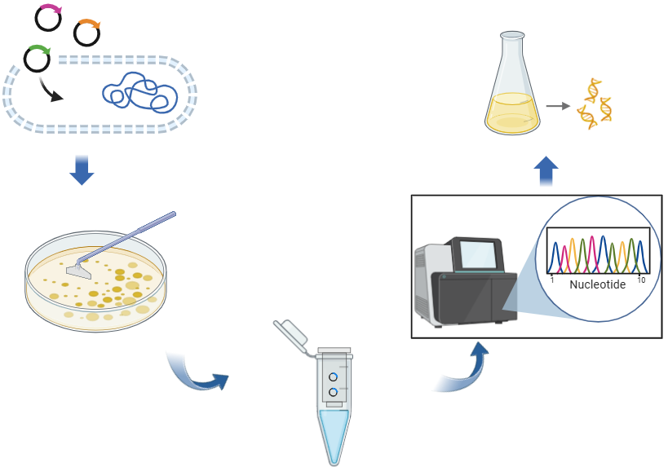
OBJECTIVE 1.1 To develop scFv mutant library of CAR & make mutant CARPOOL T cells
Creating scFv mutant library

Slide 26
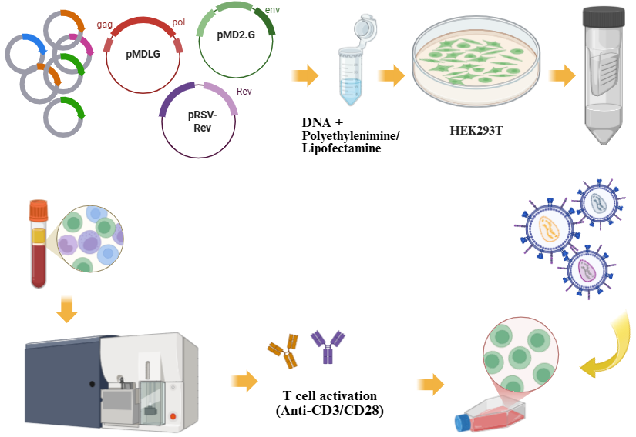
OBJECTIVE 1.1 To develop scFv mutant library of CAR & make mutant CARPOOL T cells

Slide 27
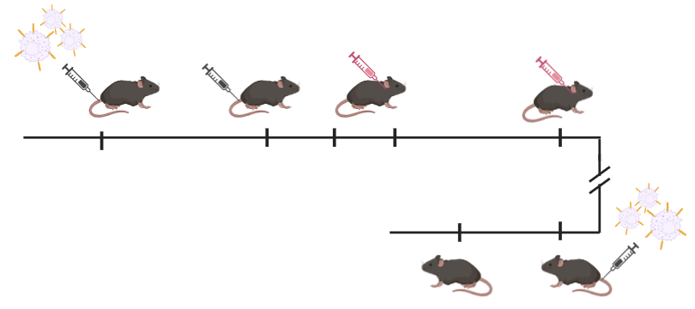
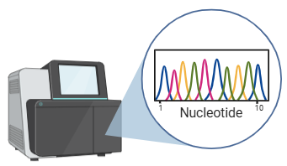

OBJECTIVE 1.2 To test mutant CARPOOL T cells in vivo using luciferinized NALM-6 mouse model
Collect spleen, Lymph node & bone marrow & Sacrifice moribund ones
Inject Luciferinized NALM6 cells
Inject CAR-T pool
Collect blood
Day 0
Day 4
Day 0
Day 0
Day 0
Day 0
Day 0
Sacrifice at day 14.
Collect spleen, Lymph node & bone marrow
Collect blood
Rechallenge after 21 days

