Slide 1
Manuscript-Verification Module + Meta-Research Census
Status briefing — 2026-06-26 Vishal Bharti · PI: Debojyoti Chakraborty (CSIR-IGIB)

Slide 2
The steer (from the lab meeting)
Internal-consistency flagging (statcheck-style) is NOT the goal — it’s a fallback signal only.
The module must verify each reported statistic against the authors’ RAW DATA, or explicitly return “insufficient data to verify” (a first-class result).
It must also check whether the authors’ statistical assumptions actually hold (e.g. normality / variance before a t-test / ANOVA).
This is the harder, honest tool — and the one editors/publishers would care about.

Slide 3
Two deliverables
Verification engine (the product) — re-run a paper’s statistics on its data → per-claim verdict.
Meta-research census (a parallel paper) — apply the no-data tier at scale to measure how verifiable the open-access literature actually is.
Both built on a shared regex extractor + statcheck-style recompute core.

Slide 4
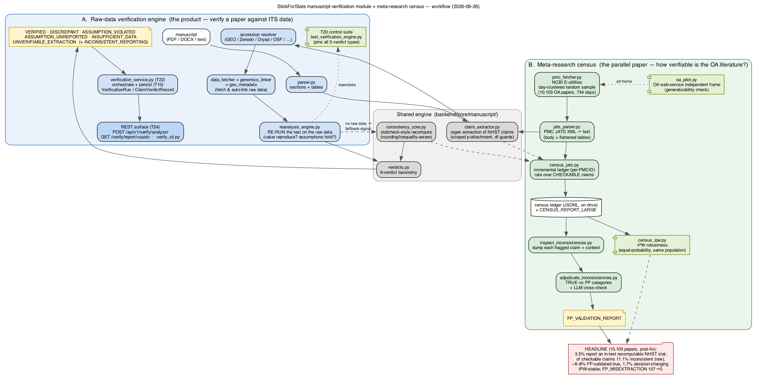
The complete workflow
Verifier engine (A) + meta-research census (B), with the shared engine and the robustness arms.

Slide 5
The verdict taxonomy
VERIFIED · DISCREPANT · ASSUMPTION_VIOLATED · ASSUMPTION_UNREPORTED · INSUFFICIENT_DATA · UNVERIFIABLE_EXTRACTION (+ secondary INCONSISTENT_REPORTING)
INSUFFICIENT_DATA is first-class — most papers land there because raw data are not deposited.
All 5 primary verdicts are pinned by a control suite (T20, the Phase-A exit instrument).

Slide 6
What’s built (engine)
Django REST surface (T24): POST /verify/analyze/, token-gated GET /verify/report/<uuid> — no network egress by default.
Persistence (T10): VerificationRun / ClaimVerdictRecord / LinkedDataset.
Genomics auto-linker: a gene-level claim → its GEO data, fully automatic (gene + group resolution, series-matrix alignment). Genome-scale proof on real GSE271517.
Benchmarked vs statcheck 1.5.0: recall 97.7%, precision 98.1%, F1 97.9%.

Slide 7
What’s built (census)
PMC fetcher (NCBI E-utilities, day-clustered random sample) + JATS parser + incremental census.
10,103 OA biomedical papers across 744 random days.

Slide 8
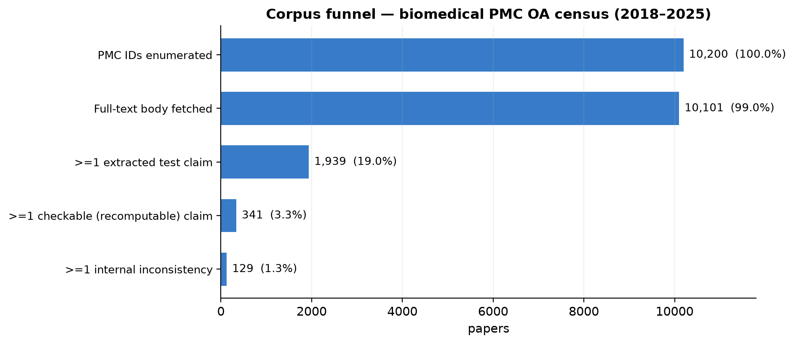
Corpus funnel (10,200 → 341)
10,200 enumerated → 10,103 with body → 1,939 with a test claim → 341 with a checkable claim.

Slide 9
Census headline (10,103 papers)
Metric | Value
Report an in-text recomputable NHST statistic | 3.5% (most stats live in tables/figures)
Of checkable claims, internally inconsistent (raw) | 11.1%
FP-validated true inconsistency rate | ≈ 6–8%
Decision-changing | 1.7%

Slide 10
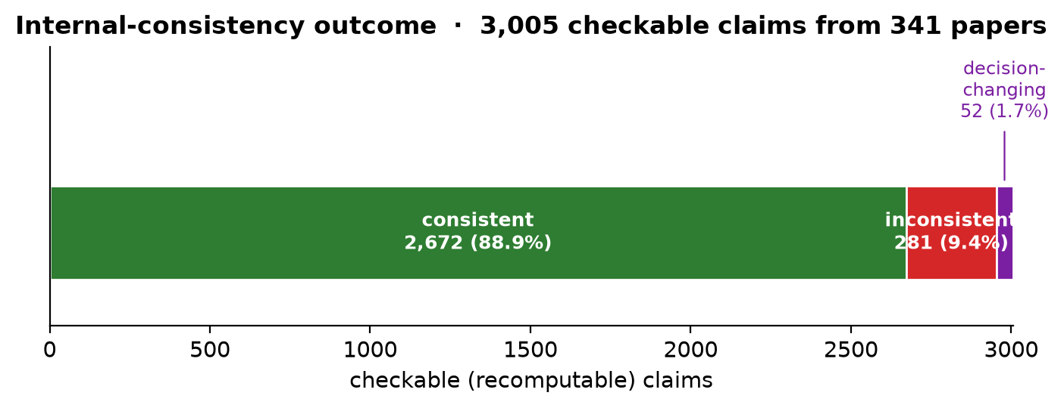
Outcome over 3,005 checkable claims
Consistent vs inconsistent (333, 11.1%) vs decision-changing (52, 1.7%).

Slide 11
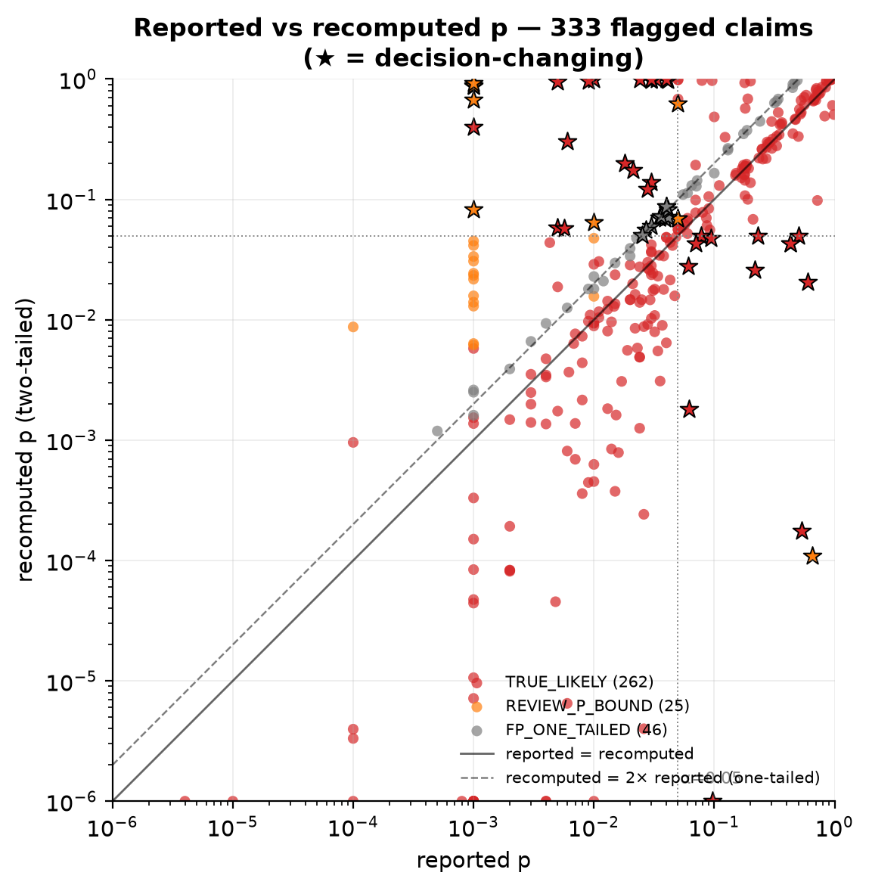
Reported vs recomputed p (333 flags)
Log-log; ★ = decision-changing; colored by false-positive category.

Slide 12
Two robust, novel headlines: (1) only ~3.5% of biomedical OA papers report an in-text recomputable statistic; (2) of those, a single-digit % are genuinely internally inconsistent.

Slide 13
Today’s fix: extractor false positives (the scientific crux)
The dominant census false positive was 5 distinct extractor bugs, not one (each traced to a real PMCID): mis-paired far p · t(1,644) two-df · effect-size d_z / Z(Y) · p=1→0.1 · semicolon/fractional-df results dropping their p.
Apples-to-apples on the same 10,103 papers (pre-fix via git stash):

Slide 14
 | PRE-FIX | POST-FIX
FP_MISEXTRACTION | 157 (35% of flags) | 0
Inconsistent (raw) | 14.5% | 11.1%
Decision-changing | 4.2% | 1.7%
Clear false-positive rate | 45% | 14%

Slide 15
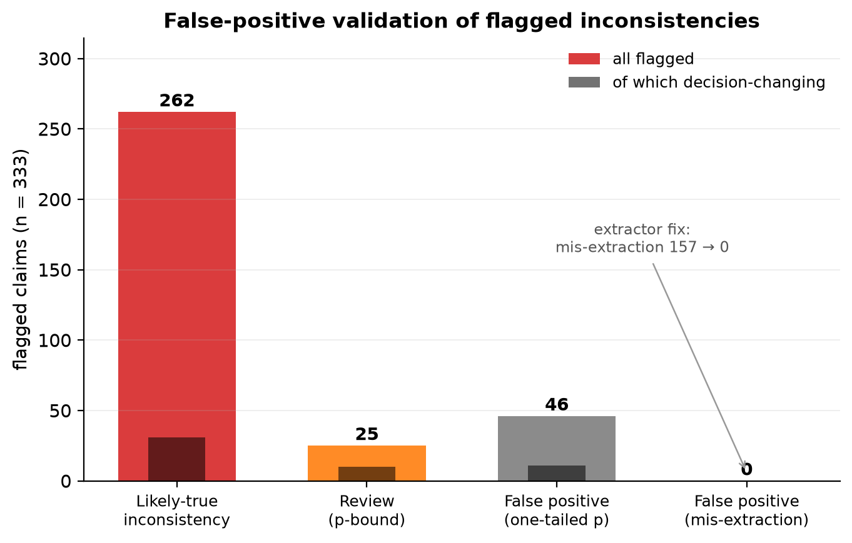
False-positive validation of the 333 flags
TRUE_LIKELY 262 · REVIEW 25 · one-tailed 46 · mis-extraction 0 (was 157).

Slide 16
No statcheck regression; +26 regression tests (each tied to a real PMCID).

Slide 17
Robustness (already done)
IPW (inverse-probability weighting): correcting the day-cluster design — same population, no new fetch — moves the headline ≤ 0.6 pp (inconsistent 11.1%→10.5%). Day-clustering did not bias the rate.
Adversarial review: 21-agent workflow → verdict SAFE; 4 minor follow-ups found + fixed; the precision wins (window / directionality / df-guard) confirmed to lose zero genuine inconsistencies.
Independent OA-web-service frame (oa_pilot.py): implemented; a generalizability pilot is accumulating (directional — the same-population robustness is the IPW result).

Slide 18
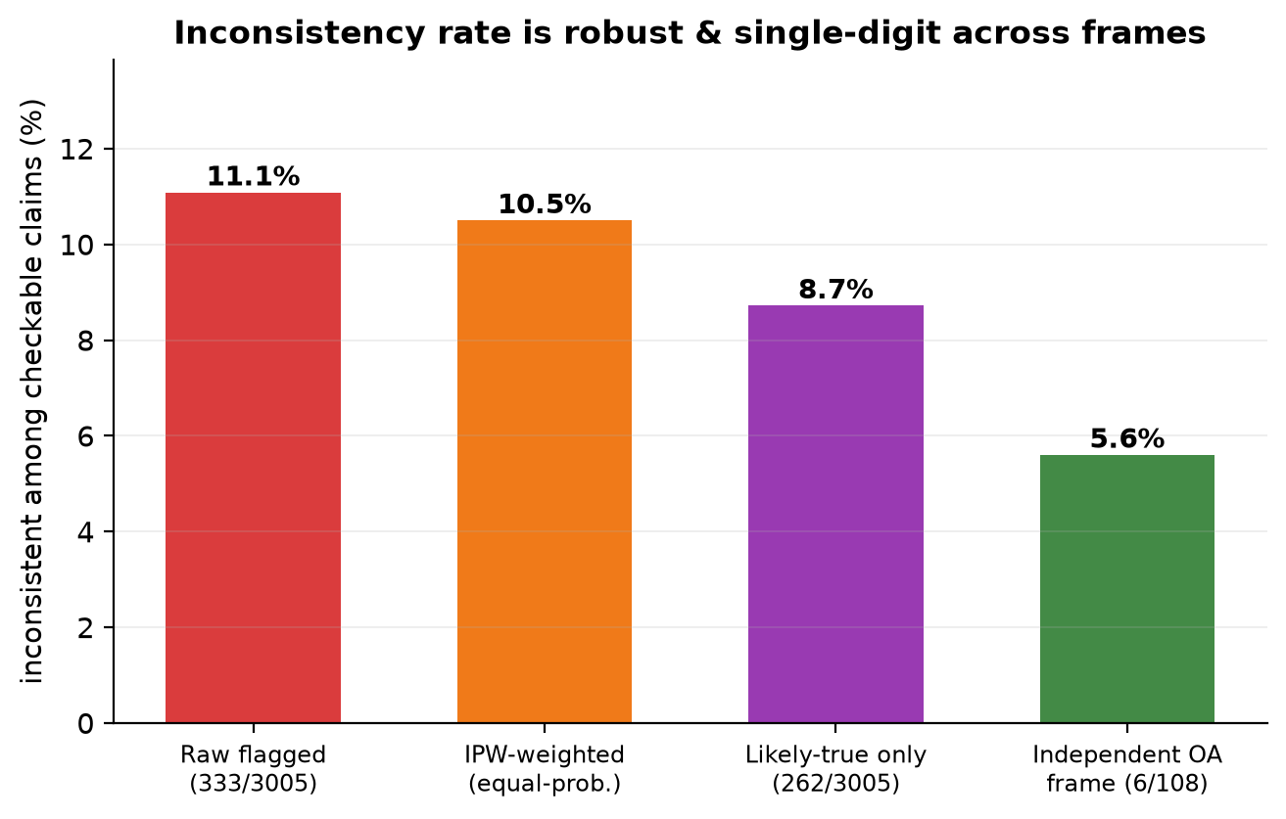
The rate is single-digit across every frame
Raw 11.1% · IPW 10.5% · likely-true 8.7% · independent OA 5.6%.

Slide 19
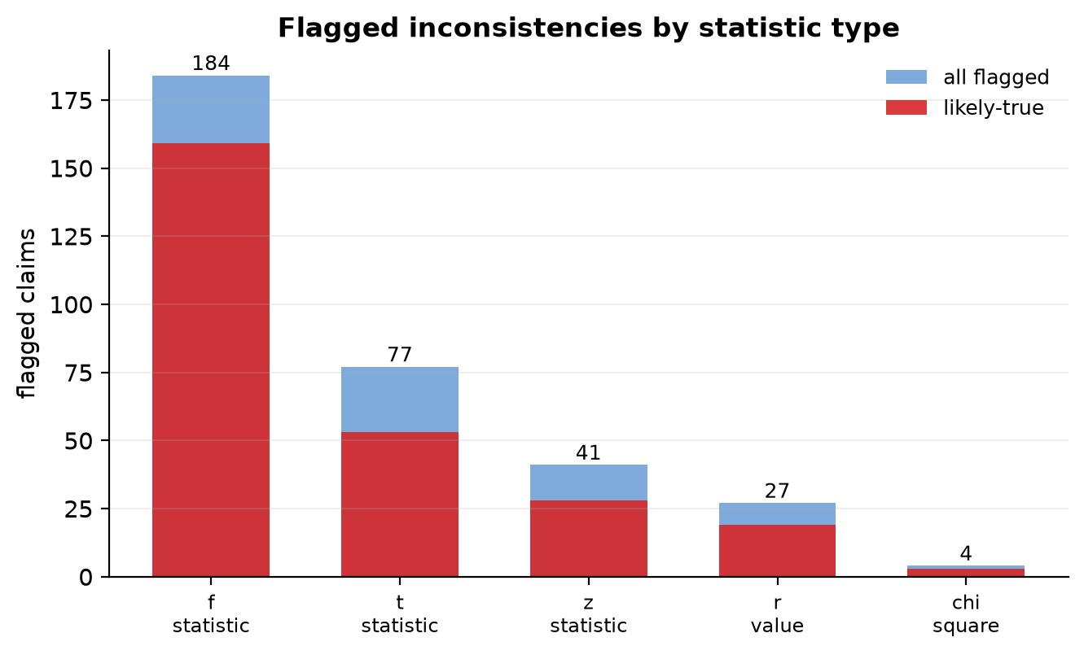
Flagged inconsistencies by statistic type
t / F / r / z / chi-square — all flagged vs likely-true.

Slide 20
Status
Verifier module Phase A: 18/24 (T20 added today). Remaining engineering: T07/T08/T16/T17/T18 (provenance, consistency-demote, effect-size normalization, assumption-unreported detector).
All work committed + pushed to origin/docs/plos-compbio-submission (not merged to main).

Slide 21
Decisions for the PI
OSF pre-registration — resolve the 10 [PI DECISION] items in §11 of the draft (year window, field scope, target N, the two human coders, DISCREPANT tolerance, κ threshold, …) before the FORMAL confirmatory census.
Venue for the census paper (PLOS ONE / PeerJ / GigaByte / BMC Bioinformatics — soundness-not-novelty).
κ double-coding — assign 2 human coders for a gold subset.
bioRxiv v2 — the Case Study 4 “Group B” correction (still gated).

Slide 22
What to read (in order)
docs/MANUSCRIPT_MODULE_PLAN_2026-06-24.md — the design + the lab steer.
paper/replication/verification/REPRODUCTION.md — reproduce everything end-to-end.
CENSUS_REPORT_LARGE + FP_VALIDATION_REPORT + CENSUS_IPW_REPORT — the numbers.
docs/SESSION_HANDOFF_2026-06-26.md — today’s fix in full.
docs/MANUSCRIPT_VERIFY_OSF_PREREG_DRAFT_2026-06-25.md — the PI decisions.

