Slide 1

राष्ट्रीय प्रौद्योगिकी संस्थान आंध्र प्रदेश
NATIONAL INSTITUTE OF TECHNOLOGY ANDHRA PRADESH
Near National Highway No. 16, Kondruprolu, Tadepalligudem-534101
West Godavari District, Andhra Pradesh - India
ANOMALY DETECTION
Presentation By
A.Viswa Bhaskar
Abhijeet
N. Anvitha
Dept. of Computer Science and Engineering
III Year
SUPERVISOR:
Mrs. Sameera D

Slide 2
Anomaly Detection
FiLo: Zero-Shot Anomaly Detection by Fine-Grained Description

Slide 3
INTRODUCTION
What are Anomalies?
Anomaly detection refers to the identification of abnormal or defective regions within images, particularly in industrial product inspection.
Why Detect Deepfakes?
Ensures Product Quality and Safety: Detecting anomalies is critical for maintaining high standards in manufacturing and quality control.
Protects Public Trust and Security: Undetected defects can lead to safety hazards, recalls, or loss of consumer confidence.
Challenges
Evolving and Diverse Anomalies: Anomalies can vary widely in type, size, and appearance across different categories, making them hard to define with generic descriptions.
Lack of Prior Data: Zero-shot settings mean the model must generalize to new, unseen categories without prior examples.
Detection Methods
Visual Inspection: Manual review by human inspectors to identify visible defects.
Classical Computer Vision: Techniques such as thresholding, edge detection, and template matching to spot irregularities.
Statistical Methods: Using statistical models (e.g., Gaussian Mixture Models, Principal Component Analysis) to detect outliers in feature distributions.

Slide 4
PROBLEM STATEMENT
Anomaly detection in images and videos is increasingly vital in industrial and security contexts due to the complexity and scale of modern systems. AI and machine learning have improved the ability to spot subtle defects or threats that traditional methods may miss, but challenges remain. Anomalies are rare, diverse, and often visually similar to normal patterns, making them hard to define and detect accurately. The consequences of missed anomalies—ranging from safety risks and product defects to financial and security breaches—are severe. Current AI methods struggle with limited labeled data, high false positives, scalability, and interpretability. Additionally, ensuring robustness against adversarial attacks is critical, highlighting the need for more advanced, interpretable, and resilient detection systems.

Slide 5
MOTIVATION
Anomalies pose serious risks to safety, quality, and security in critical infrastructure.
Traditional inspection and rule-based methods struggle with subtle or rare anomalies.
Increasing data complexity demands scalable and intelligent detection solutions.
Urgent need for interpretable, robust, and adaptive AI models to ensure timely anomaly detection.
OBJECTIVE
Develop a robust anomaly detection system for images using Fine-grained Visual-Language Models
Leverage the strengths of large-scale vision-language models, fine-grained textual descriptions, and advanced localization techniques to accurately identify and localize anomalies in images without requiring prior examples of defects.

Slide 6
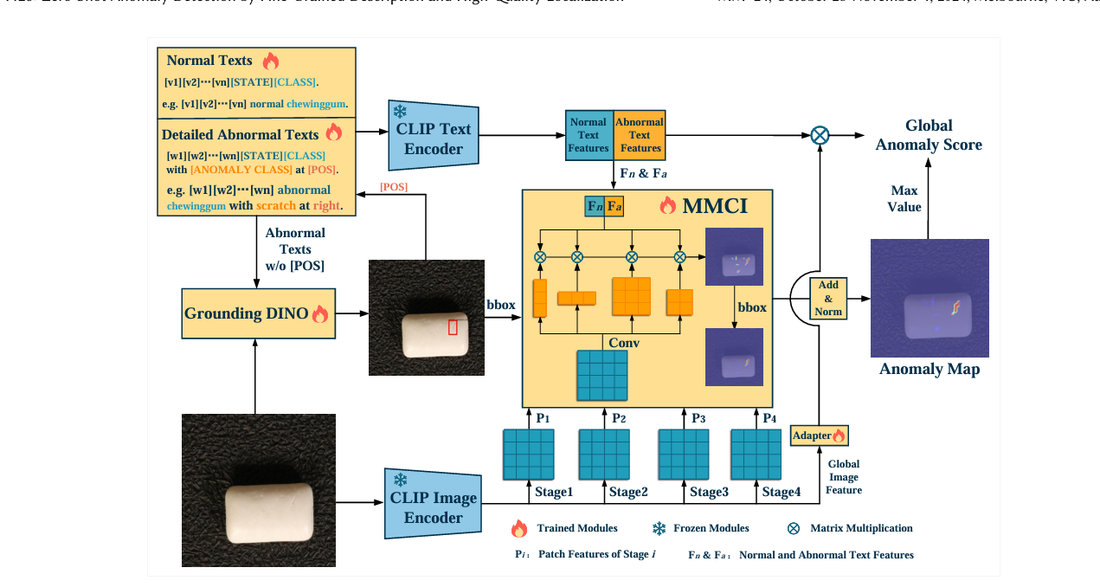
Paper’s Model Architecture
ARCHITECTURE

Slide 7
FiLO Model Architecture
Architecture Overview:
Fine-Grained Description (FG-Des):
Purpose: Enhance anomaly detection accuracy and interpretability by replacing generic "normal/abnormal" descriptors with detailed, category-specific anomaly descriptions.
How it works:
Uses Large Language Models (LLMs) to generate a list of fine-grained anomaly types relevant to the input image's category.
Employs adaptively learned textual templates, realized as learnable vectors, to create precise text descriptions for both normal and abnormal cases.
These text descriptions are encoded using the CLIP Text Encoder to obtain rich, discriminative text features for subsequent similarity computation.

Slide 8
FiLO Model Architecture
Architecture Overview:
2. High-Quality Localization (HQ-Loc):
Purpose: Achieve accurate localization of anomalies of varying sizes and shapes, addressing the challenge of pinpointing specific anomaly locations.
How it works:
Grounding DINO is used for preliminary localization, producing bounding boxes for potential anomaly regions based on the fine-grained text prompts.
Position-Enhanced Text Prompts: The bounding box coordinates are incorporated into the text prompts, further refining the localization process.
Multi-scale Multi-shape Cross-modal Interaction (MMCI) Module: Intermediate patch features from multiple stages of the CLIP Image Encoder are processed with the text features. The MMCI module aggregates information across different scales and shapes to generate anomaly maps for each layer, improving robustness to anomaly size and form

Slide 9
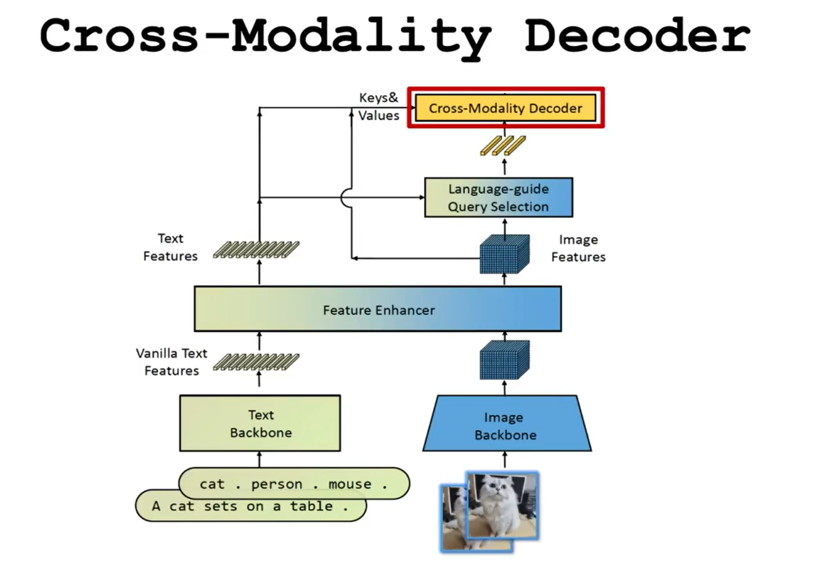
Architecture
Grounding DINO
Architecture:
Built on a transformer-based detection backbone (DINO) with the addition of a grounding module for language-vision fusion.
Text Backbone: Typically a BERT-like transformer that encodes textual prompts (e.g., anomaly descriptions).
Image Backbone: Extracts multi-scale image features (e.g., Swin Transformer).
Feature Enhancer: Fuses image and text features using deformable self-attention for images and standard self-attention for text.
Language-Guided Query Selection: Selects decoder queries most relevant to the input text.
Cross-Modality Decoder: Alternates self-attention, image cross-attention, and text cross-attention to tightly integrate modalities.
Output: Produces bounding boxes, confidence scores, and class labels for regions matching the text prompt, enabling localization of arbitrary objects or anomalies described by language

Slide 10
Architecture
CLIP Text Encoder
Purpose: Converts fine-grained, category-specific anomaly descriptions into dense text feature vectors.
Architecture:
Transformer-based language model (12 layers, typically 512 hidden size, 9 attention heads).
Tokenizes and embeds input text, applies positional encoding, and processes through transformer blocks.
Outputs a pooled feature vector representing the entire prompt.
The text encoder is trained jointly with the image encoder using a contrastive loss to align text and image representations in a shared latent space.
CLIP Image Encoder
Purpose: Extracts visual feature representations from the input image for comparison with text features.
Architecture:
Vision Transformer (ViT-L/14@336px) or ResNet variants.
Splits the image into non-overlapping patches, linearly embeds each patch, adds positional encodings, and processes the sequence with transformer layers.
A [CLS] token is used to represent the global image feature; intermediate patch features are also extracted for fine-grained analysis.
The encoder is trained with the text encoder to produce aligned embeddings for image-text similarity tasks

Slide 11
Architecture
MMCI (Multi-scale Multi-shape Cross-modal Interaction) Module
Purpose: Robustly localizes anomalies of varying sizes and shapes by aggregating patch features and aligning them with position-enhanced text features.
Architecture:
Receives patch features from multiple intermediate layers of the CLIP Image Encoder.
Applies multiple convolutional kernels of different sizes and shapes in parallel to these features, capturing anomalies at various scales and forms.
Aggregates the processed features and computes their similarity with the position-enhanced text features (which include anomaly descriptions and bounding box info).
Generates anomaly and normal maps for each layer, upscales and normalizes them, and fuses them into a final localization map

Slide 12
Architecture
Adapter:
Purpose: Aligns global image and text features for improved similarity computation and anomaly scoring.
Architecture:
Lightweight neural network module (typically two linear layers with activation functions like ReLU and SiLU).
Inserted between the pre-trained CLIP encoders and the anomaly scoring head.
Only the adapter is trained for the downstream anomaly detection task, preserving the knowledge in the original encoders while efficiently adapting to the new objective.
Global Scoring:
Purpose: Produces the final anomaly score for the input image, combining global and local information.
Mechanism:
The adapted global image feature and the global text feature (from the adapter) are compared (e.g., via cosine similarity).
The maximum value from the anomaly map (produced by MMCI) is combined with the global similarity score to yield a robust anomaly score.
This score is used for image-level anomaly detection, while the anomaly map provides pixel-level localization

Slide 13
WORKFLOW
Input Image: An image is provided for anomaly detection.
Fine-Grained Anomaly Generation:
LLM generates a list of possible anomaly types for the image's category.
Adaptively learned templates create detailed text prompts for both normal and abnormal cases.
Text Encoding: Prompts are encoded by the CLIP Text Encoder.
Preliminary Localization:
Text prompts are fed into Grounding DINO, which outputs bounding boxes for potential anomalies.
Position information is added to the text prompts.
Image Feature Extraction:
The image is passed through the CLIP Image Encoder.
Patch features from multiple intermediate layers are extracted.
MMCI Processing:
Patch features are processed with convolutional kernels of different sizes/shapes.
Feature similarity with position-enhanced text features is computed, generating anomaly maps for each layer.

Slide 14
WORKFLOW
Score Aggregation and Filtering:
Anomaly maps are filtered using bounding boxes from Grounding DINO.
Maps are summed and normalized to produce the final anomaly map.
Global Scoring:
Global image features are aligned with text features via the Adapter.
The maximum anomaly map value is combined with the adapted global similarity score to yield the final anomaly score.
Decision and Localization:
The image is classified as normal or anomalous.
The pixel-level anomaly map provides precise localization of the defect.

Slide 15
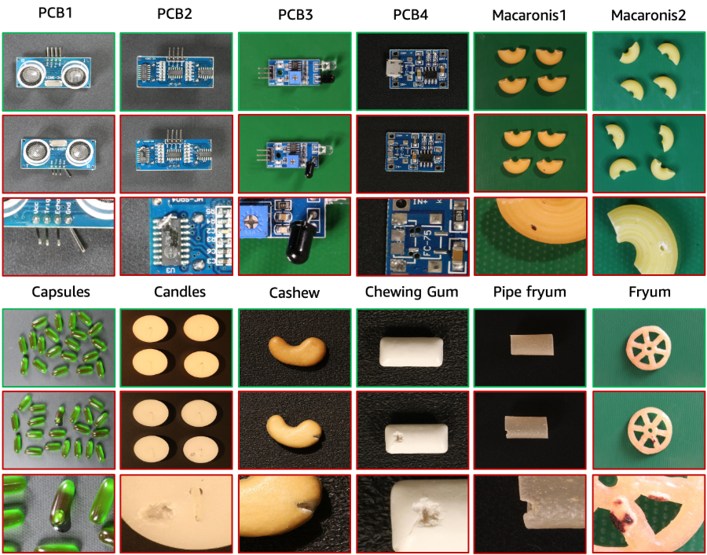
DATASETS USED
VisA Dataset: Introduced by Zou et al. for anomaly detection and segmentation.
Images: 10,821 total (9,621 normal, 1,200 anomalous).
12 Subsets:
4 subsets of printed circuit boards (PCBs) with complex structures.
4 subsets with multiple instances (Capsules, Candles, Macaroni1, Macaroni2) varying in pose and location.
4 subsets of aligned objects (Cashew, Chewing gum, Fryum, Pipe fryum).
Anomalies: Includes surface defects (scratches, dents, cracks) and structural defects (misplacement, missing parts).

Slide 16
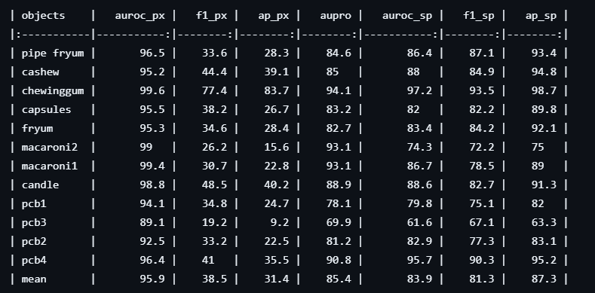
Comparison with Other Models
FiLo vs. State-of-the-Art Methods
State-of-the-Art Performance: Achieves image-level AUC of 83.9% and pixel-level AUC of 95.9% on VisA, outperforming previous methods

Slide 17
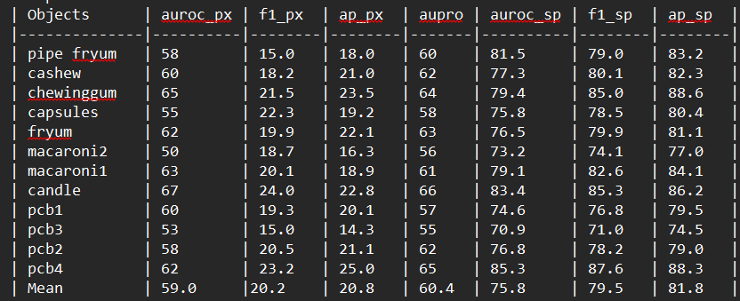
RESULTS
FiLo:
We Achieved Image level AUC of 75.8% and Pixel level AUC of 59%

Slide 18
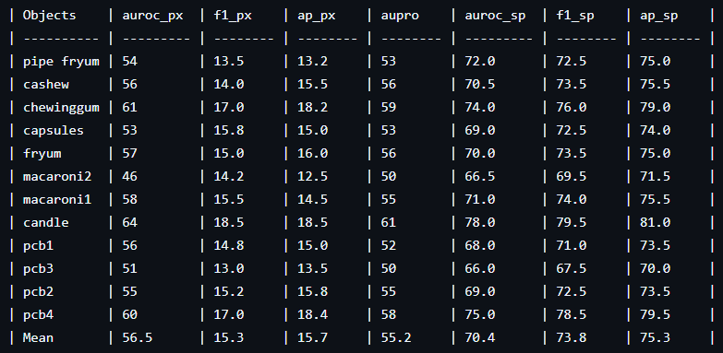
RESULTS
For model analysis We have removed the adapter and checked the results
By removing the adapter we have reduced the parameters by 500k
We Achieved Image level AUC of 70.4% and Pixel level AUC of 56.5%

Slide 19
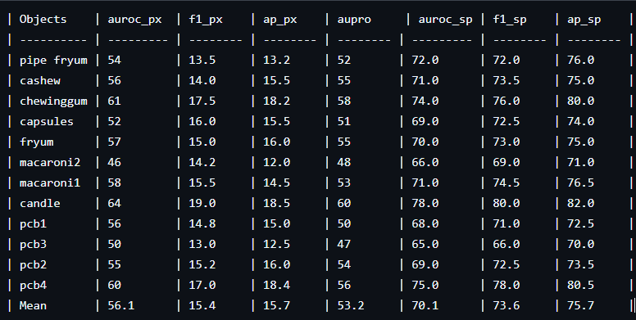
RESULTS
For model analysis We have removed Full HQ-Loc (All Components) and checked the results
By removing the Full HQ-Loc we have reduced the parameters by 23M.
We Achieved Image level AUC of 70.1% and Pixel level AUC of 56.1%

Slide 20
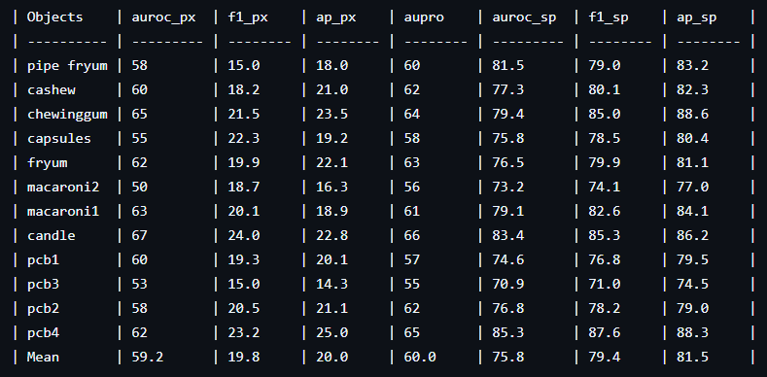
RESULTS
For model analysis We have removed the Grounding Dino and checked the results
By removing the Grounding Dino we have reduced the parameters by 15M.
We Achieved Image level AUC of 75.8% and Pixel level AUC of 59.2%

Slide 21
Future Directions
Improved Interpretability: Further enhancing the model's capacity to explain the anomalies it detects by improving the fine-grained descriptions and their mapping to particular regions in the image.
Architectural Improvements: Investigating more sophisticated vision-language models as backbones or adding other modalities to enhance detection accuracy.
Expansion to Real-World Datasets: Testing on other real-world datasets with more varied object categories and anomaly types would further establish FiLo's generalizability.
Few-Shot Learning Integration: Expanding the framework to include few-shot learning functionality so that it can learn new classes with few examples, as has been proposed recently by the emergence of FiLo++.
Computational Optimization: Optimizing further the MMCI module and others to minimize computation overhead and increase efficiency for real-time use.

Slide 22
REFRENCES
https://paperswithcode.com/dataset/visa
https://github.com/CASIA-IVA-Lab/FiLo/tree/main
https://arxiv.org/abs/2404.13671
https://dl.acm.org/doi/10.1145/3664647.3680685
https://paperswithcode.com/
https://www.geeksforgeeks.org//

Slide 23
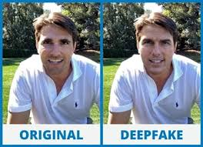
DeepFake Detection
Previous Works were done on deepfake detection by our team

Slide 24
INTRODUCTION
What are Deepfakes?
AI-generated synthetic media (audio, video, images) that manipulate reality.
Why Detect Deepfakes?
Threatens public trust, security, and privacy.
Used in malicious activities such as misinformation, political manipulation, and identity theft.
Challenges
Constantly evolving technology that makes it difficult to spot fakes.
High-quality deepfakes are nearly indistinguishable from real content.
Detection Methods
Visual Analysis: Detecting anomalies like blinking irregularities, facial inconsistencies, or lighting mismatches.
Audio Analysis: Identifying mismatches between voice and lip movements.
Deep Learning Models: Neural networks trained on large datasets to differentiate real from fake content.

Slide 25
PROBLEM STATEMENT
Deepfake detection, especially for images and videos, has become a critical challenge due to the rapid advancements in AI technology. With the ability to create highly realistic but entirely fake media, deepfakes pose significant risks, including misinformation, privacy invasion, and security threats. Identifying these synthetic media is increasingly difficult as deepfakes become more sophisticated and harder to distinguish from real content. Current detection methods, while promising, still struggle with accuracy and efficiency, highlighting the need for more advanced and reliable solutions to ensure the authenticity of digital content.

Slide 26
MOTIVATION
Rising use of deepfakes in misinformation, political manipulation, and fraud.
Increasing demand for reliable detection tools to safeguard privacy and security.
Deepfakes are becoming more convincing, making traditional detection methods insufficient.
Need for advanced AI models to keep up with evolving deepfake technology.
OBJECTIVE
Develop a robust deepfake video detection system using Generative Convolutional Vision Transformer
Leverage the power of transformers and convolutional networks to accurately distinguish between real and fake videos.

Slide 27
RESULTS
LAA-NET (LAA-Net: Localized Artifact Attention Network for Quality-Agnostic and Generalizable Deepfake Detection):
We have used SDFVD: Small-scale Deepfake Forgery Video Dataset
The dataset comprising of a total of 106 videos, with 53 original and 53 deepfake videos.
We have Implemented the LAA-NET on the above dataset trained for 7 epochs got
Accuracy: 52.53%
AUC :56.38%
AP : 53.38
F1:67.80%
GenConViT(GenConViT: Deepfake Video Detection Using Generative Convolutional Vision Transformer):
We have Implemented the GenConViT on Real and Fake Face Detection Dataset
We have got an accuracy of 55% on original implementation
We have done some modifications to the paper’s model and got an accuracy of 53%

Slide 28


Thank You

