Slide 1

AI Based - Email Subject Line Generation
Group No: 17
Team Members
Chandrasekhar B
K Kasi Viswanath

Slide 2
Project Overview: Email Subject Line Generation
Description :
This project aims to generate email subject lines by leveraging generative models in NLP. Unlike tasks such as news summarization or headline generation, this task requires creating extremely short and concise summaries in the form of email subjects.
Dataset:
Models are fine-tuned using the Annotated Enron Subject Line Corpus dataset
Splits and Statistics:
Train / dev / test split sizes: 14,436 / 1,960 / 1,906
Average email length: 75 words
Average subject length: 4 words.

Slide 3
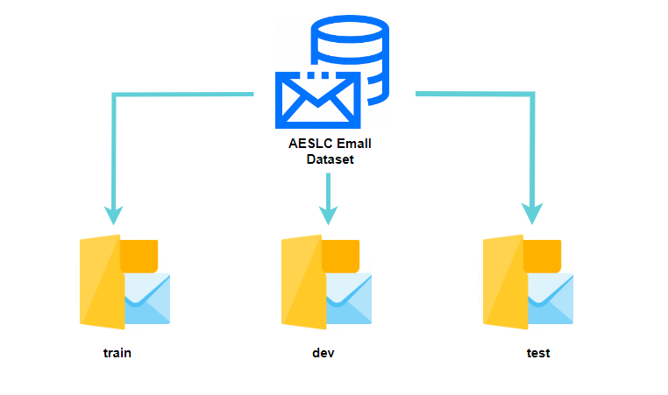
AESLC Email dataset info
14,436
1,960
1,906

Slide 4
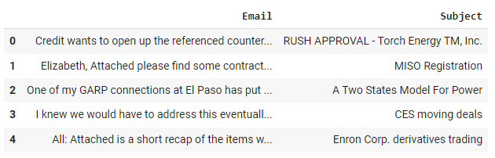


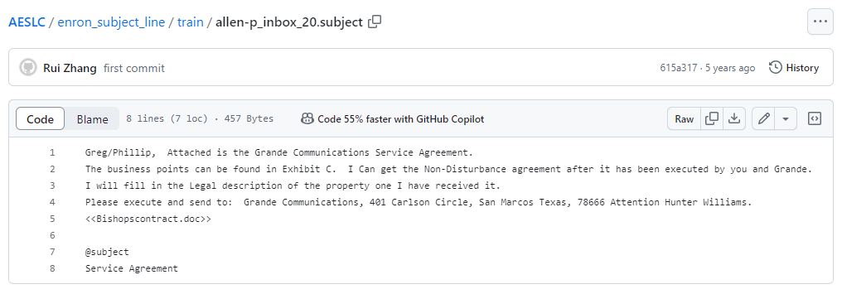
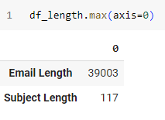
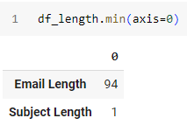
AESLC train dataset preprocess
train folder

Slide 5
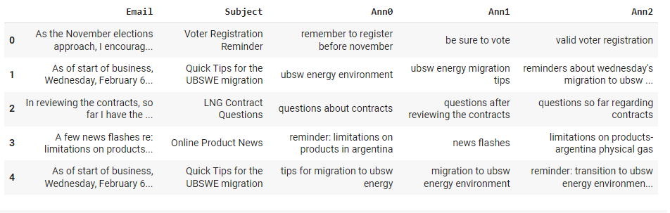


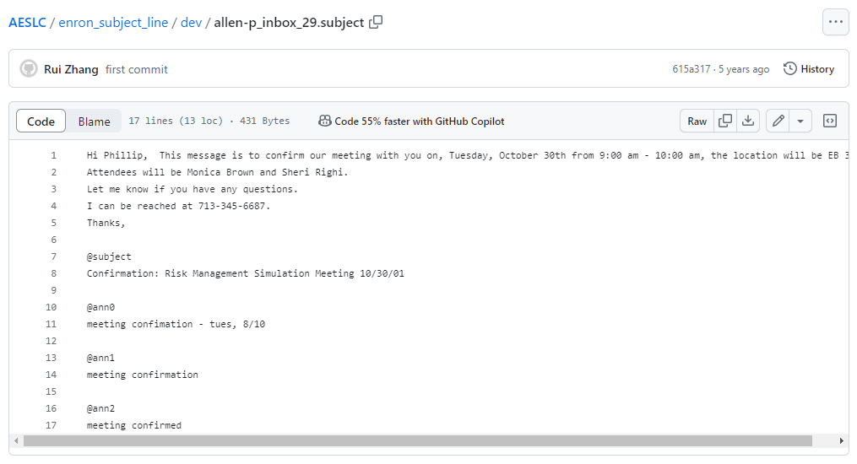
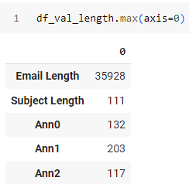
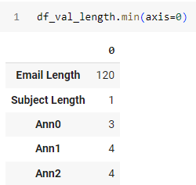
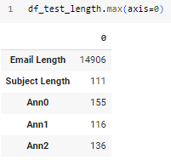
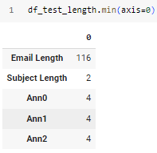
AESLC dev and test dataset preprocess

Slide 6
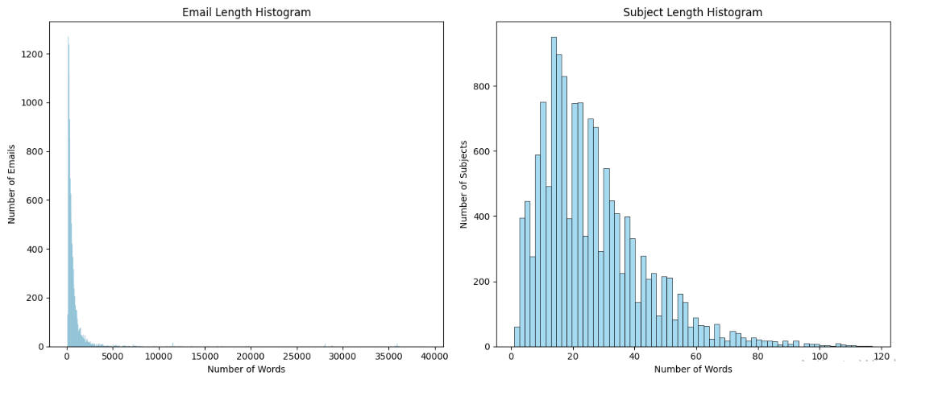
AESLC train dataset visualization

Slide 7
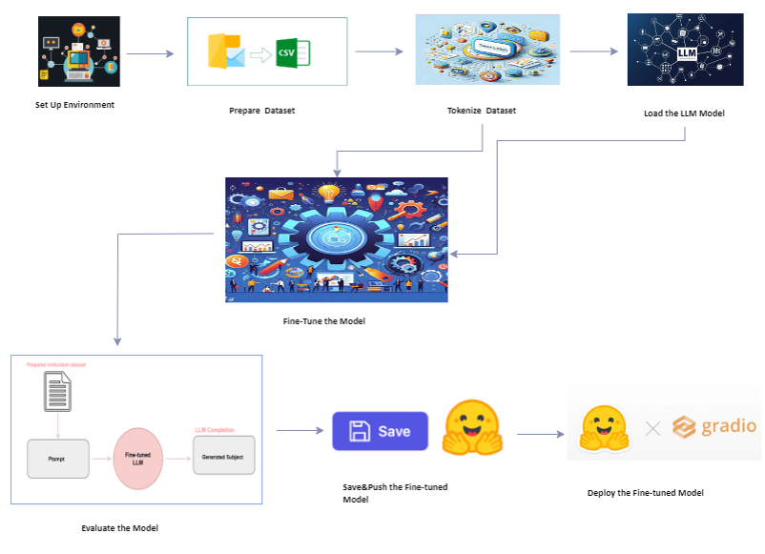
LLM Model Fine-Tune for Email dataset

Slide 8
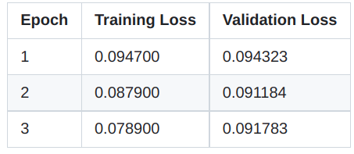
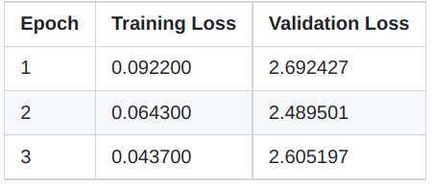
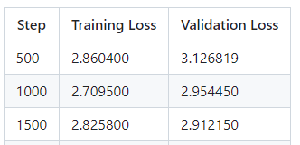
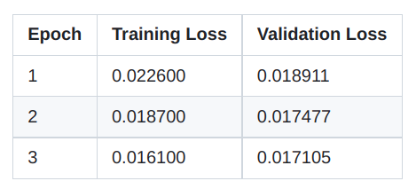
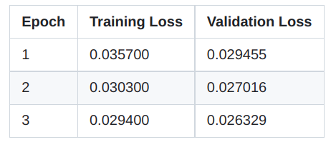
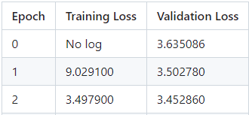
Training Results
GP2
BART Base
BART Large-CNN
T5 Base
T5 Small
distilgpt2

Slide 9
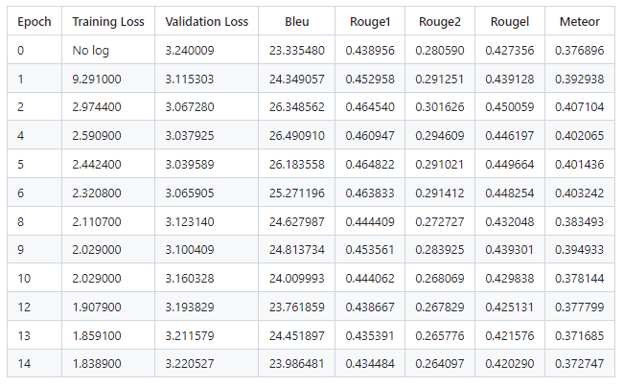
GPT2-Medium Training Results

Slide 10
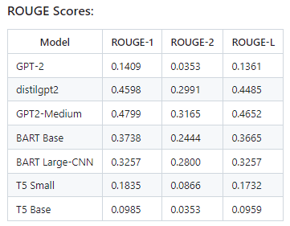
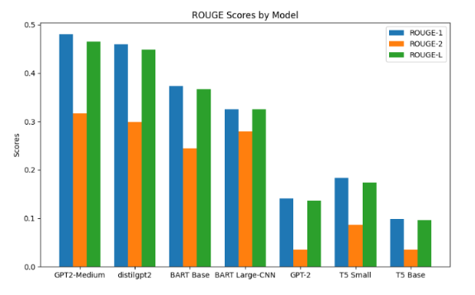
ROUGE Scores

Slide 11
LLM Model Info
Architecture:
  GPT-2 uses a unidirectional, decoder-only architecture.
  BART uses a bidirectional encoder-decoder.
  T5 uses an encoder-decoder but treats every task as a text-to-text problem.
Efficiency:
  GPT-2 is more efficient in simpler generative tasks.
  .BART and T5 are more computationally demanding but versatile for complex sequence-to-sequence tasks.
Training:
  GPT-2 uses a straightforward language modelling objective.
  BART is pre-trained as a denoising autoencoder.
  T5 uses multi-task pre-training to handle various text-to-text tasks.
Usage:
  GPT-2 is best for creative text generation and dialogue systems.
  BART excels in summarization, translation, and tasks requiring deep context understanding.
  T5 is versatile across many NLP tasks, including summarization, translation, question answering

Slide 12
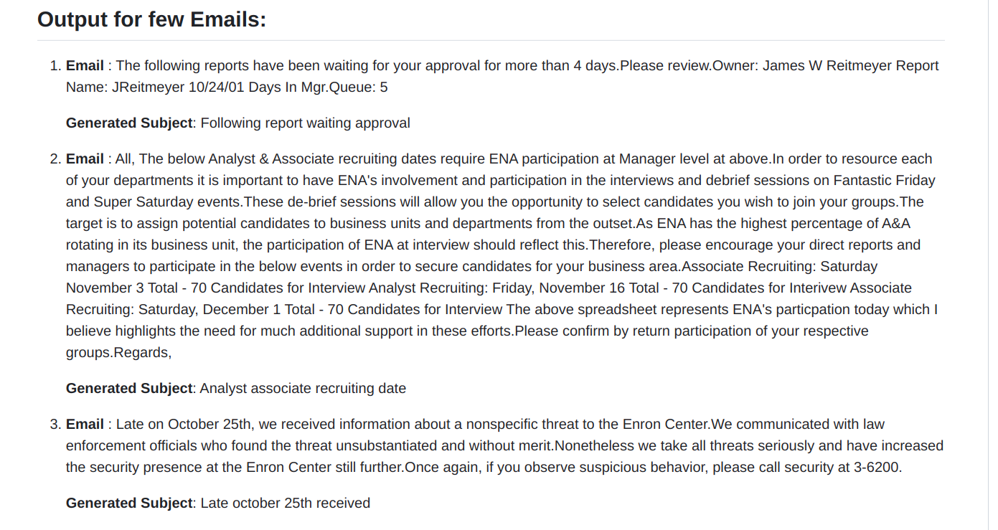
Sample Output Results

Slide 13
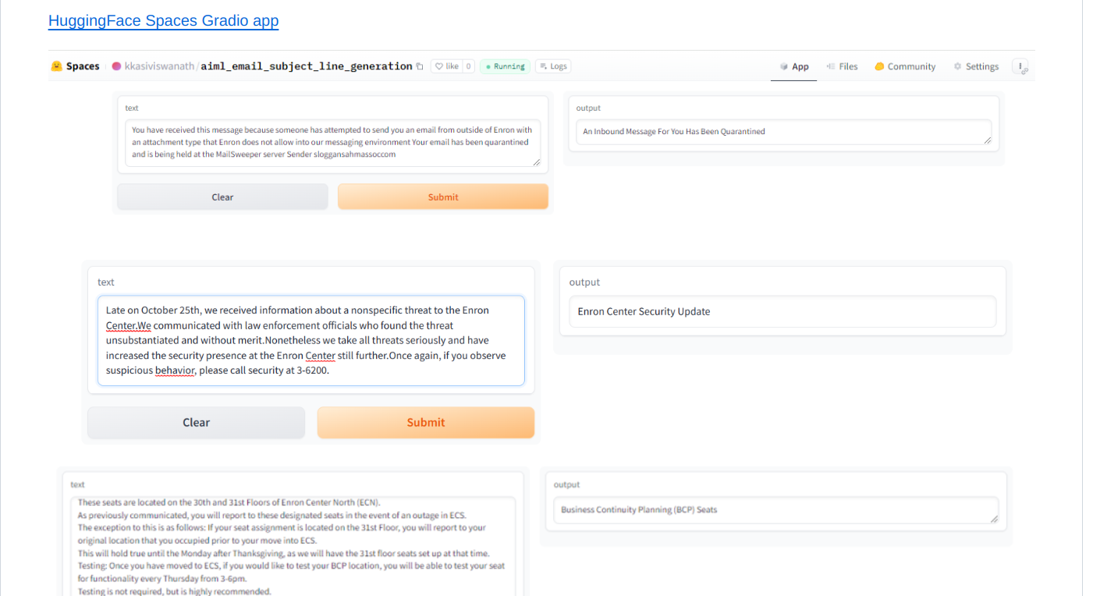
In .. Huggingface Spaces

Slide 14
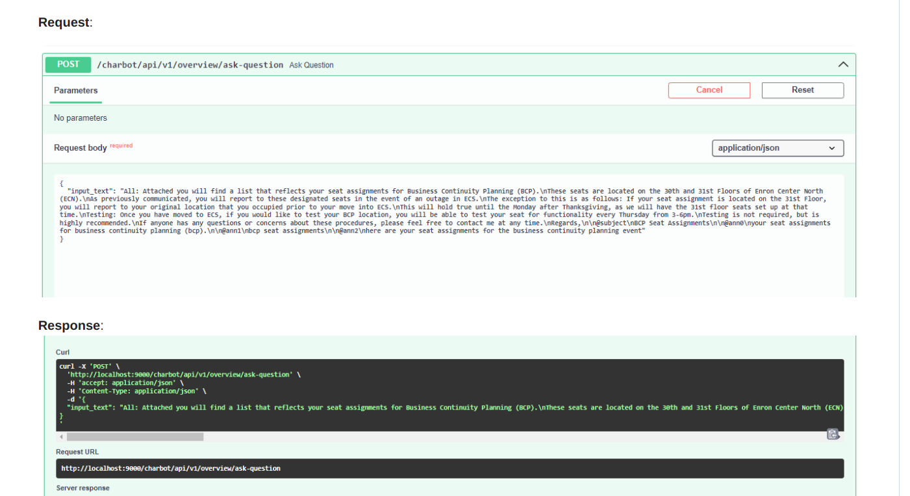
Using Fast API

Slide 15
LLM Model Fine-tuning Challenges
Tokenization Issues:
Identify and using correct tokenizer based on selected LLM model
LLM Model Loading and Fine-Tuning:
1. While Fine-tune LLM models require significant computational power (e.g., high-end GPUs).
2. Unable Fine-tune large models due to lack of GPU’s, it can be cost-prohibitive and time-consuming.
3. To find the right hyperparameters (e.g., learning rate, batch size)
Optimization and Evaluation
Test with various hyperparameters, architectures, and datasets based on selected LLM models.

Slide 16
Thank You

