Slide 1

AI Based - Email Subject Line Generation
Group No: 17
Team Members
Archit Garg
Dinesh
Chandrasekhar B
K Kasi Viswanath

Slide 2
Project Overview: Email Subject Line Generation
Description :
This project aims to generate email subject lines by leveraging generative models in NLP. Unlike tasks such as news summarization or headline generation, this task requires creating extremely short and concise summaries in the form of email subjects.
Dataset:
Models are fine-tuned using the Annotated Enron Subject Line Corpus dataset
Splits and Statistics:
Train / dev / test split sizes: 14,436 / 1,960 / 1,906
Average email length: 75 words
Average subject length: 4 words.

Slide 3
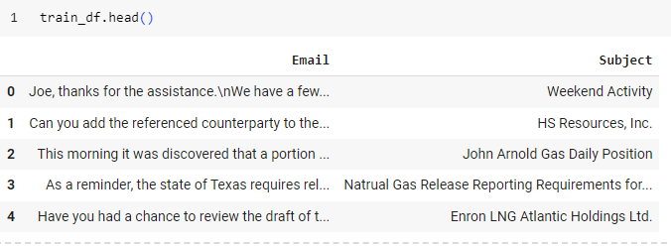
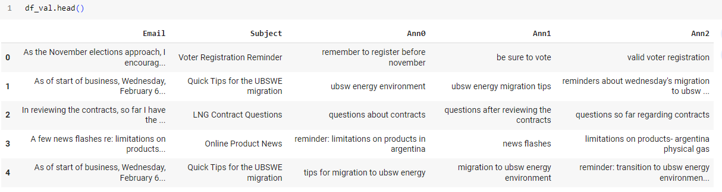


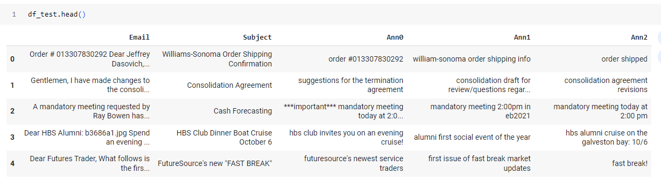

AESLC dataset preprocess

Slide 4
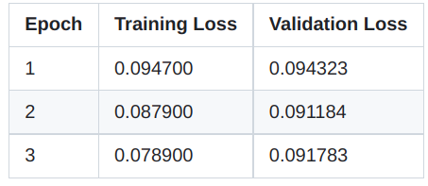
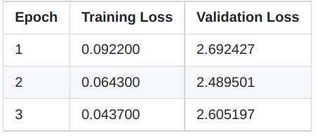
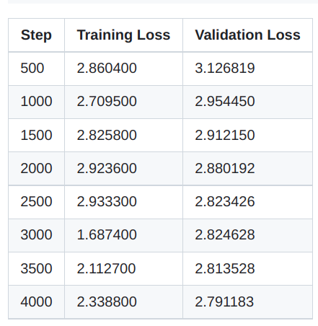
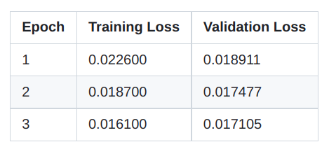
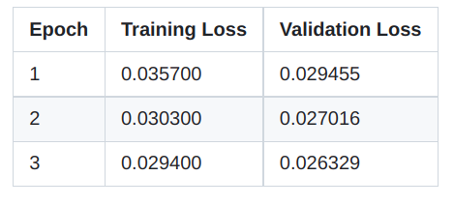
Training Results
GP2
BART Base
BART Large
T5 Base
T5 Small

Slide 5
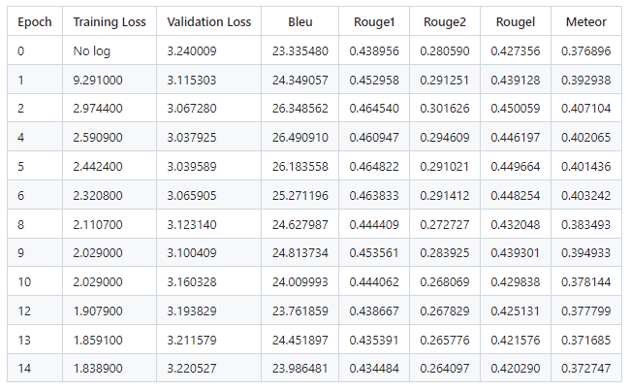
GPT2-Medium Training Results

Slide 6
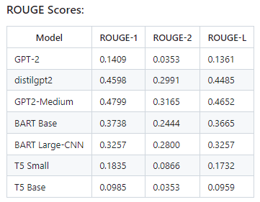
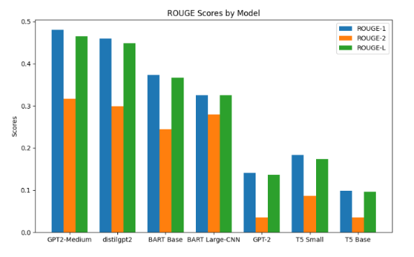
ROUGE Scores

Slide 7
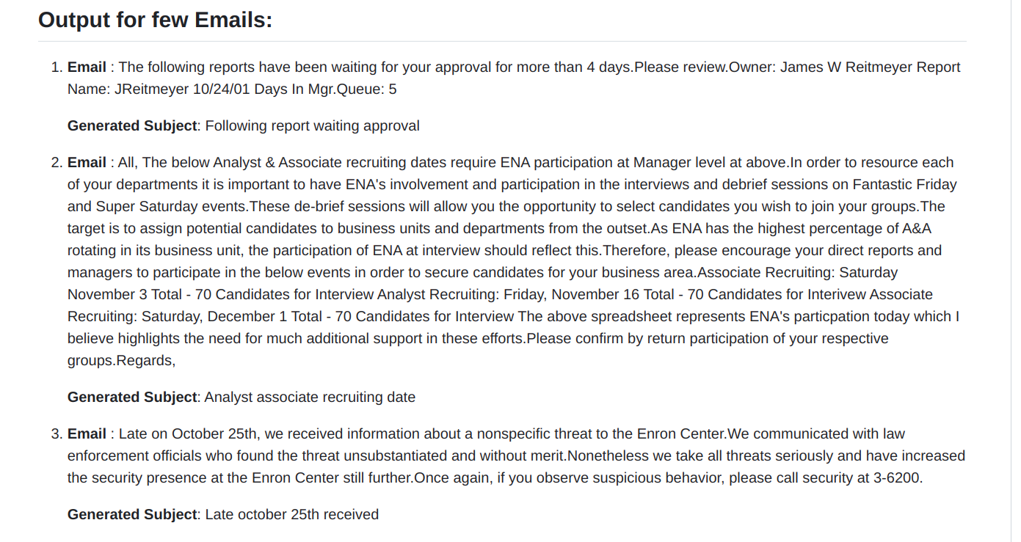
Sample Ouput Results

Slide 8
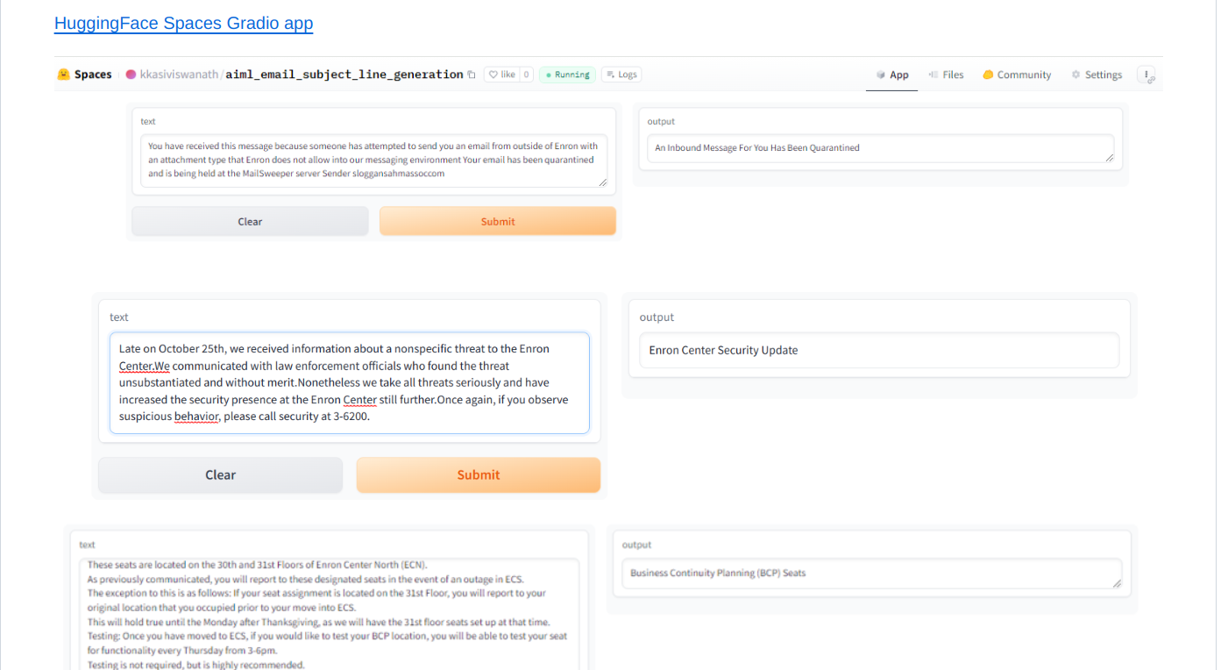
In .. Huggingface Spaces

Slide 9
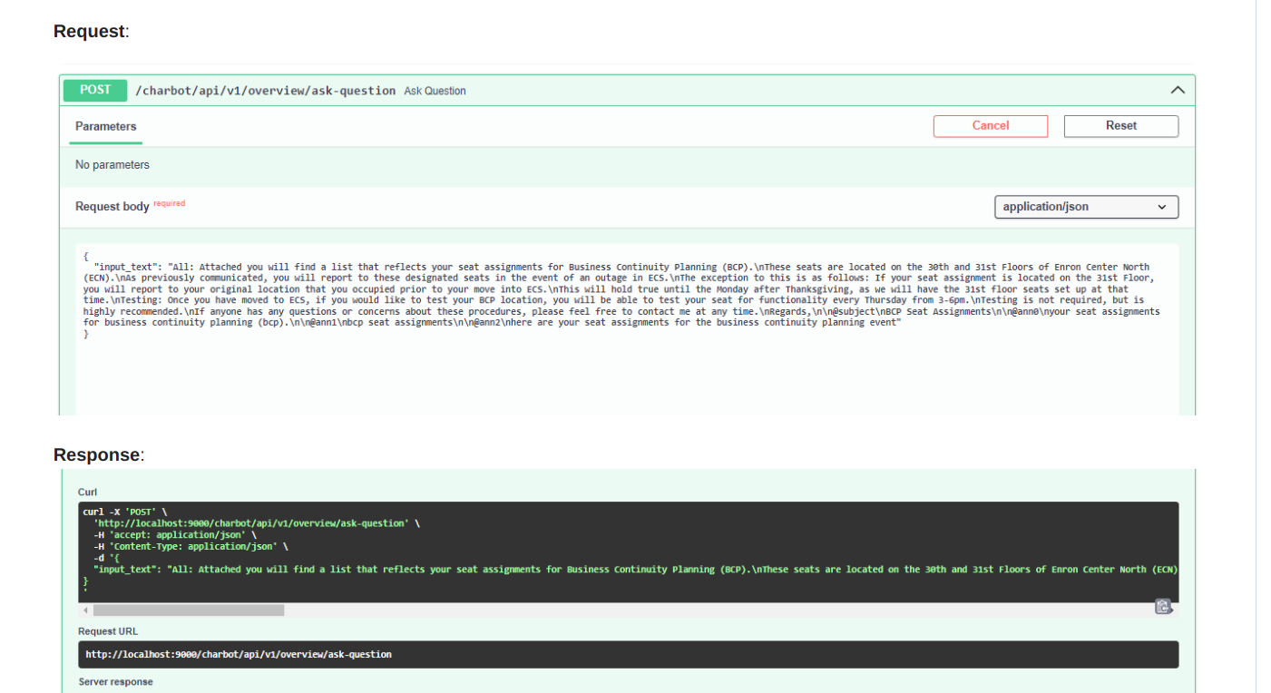
Using Fast API

Slide 10
Thank You

