Slide 1
Kubernetes - By P Nageswara Rao
Gamut Gurus Technologies
Email: info@Gamutgurus.com
Contact: +91- 97393 68768

Slide 2
What is Kubernetes?
Kubernetes is:
Kubernetes is an Orchestrator for containerized Applications
Kubernetes is a Data centre OS

Slide 3
Docker & Kubernetes Integration
What is Docker & Kubernetes?
Docker: You write your application code in your favourite language, Build it, Test it, then use Docker to package it and ship it. Yes… That’s what Docker is.
Then, who will handle the final step of running it on Test or Prod?
Hello Kubernetes
Yes, It’s Kubernetes! Kubernetes Orchestrates your application!!

Slide 4
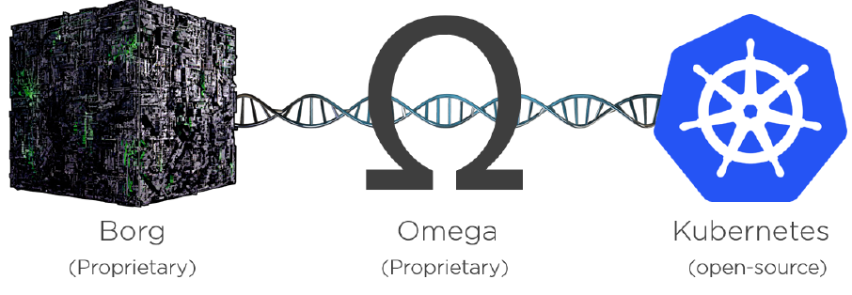
Kubernetes - Background
Kubernetes came out of Google! It was open-sourced on 2014 and Handed over to “Cloud Native Computing Foundation (CNCF).
Google has been running many of it’s systems on containers for years even before Docker came along.
Google goes through billions of containers per week for applications like Gmail, Google Search , GFS (Google File System) ..etc. Lots of Containers hun??
Kubernetes is written in Go (Golang)
Logo – Meaning “the person who
steers the ship”
Kubernetes short name K8S.

Slide 5
Container World Challenges
Application deployment & operational challenges:
Fail over if one or more nodes experience an outage
Scale-up & Scale-down: ability to add or remove containers based on application demand
Zero downtime releases (ZDR)
Application updates & rollbacks
Health checks & Self healing systems
Networking after scaling and self healing, logs, alerting.. Etc
Trafic routing and Load Balancing (LB), & More…

Slide 6
What is an Orchestrator?
What is an Orchestrator?
Orchestrator is a system that performs below without you having to supervise.
Deploy the application
Scale it up and down
Performs rolling updates
Rollbacks
Kubernetes Advantage:
All these we can achieve with declarative configurations.
Declare desired state of the system rather than executing a series of instruction.
Example:
Declare how many containers, replicas are required for your application (replicas = 3)
It’s not about just creating replicas, but it will continuously monitor to ensure the desired state.

Slide 7
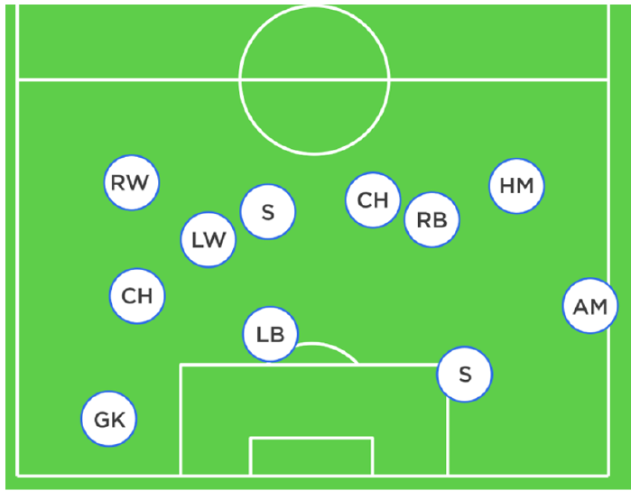
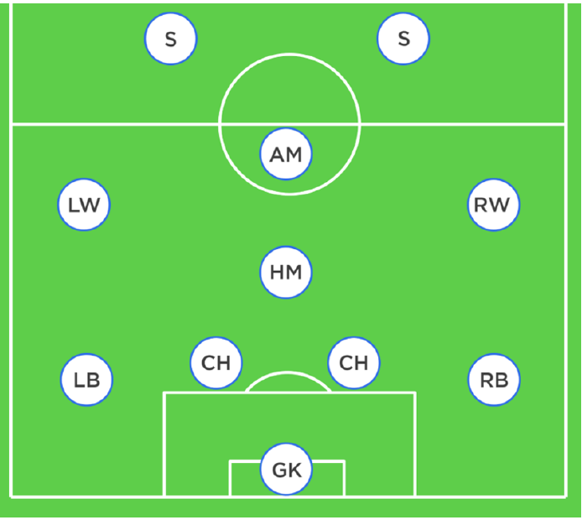
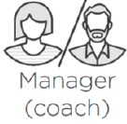
Orchestrator - Simple Analogy
Foot ball team is made of individuals - Coach gives everyone a position and
No two are same organizes them into a team with purpose
Each has different role to play in the team - Coach makes sure that team maintain the formation and stick to the plan
Some defend, some attack, some are great at passing
Some are great at shooting
LW/RW-wingers, LB/RB-backs, AM-attacking mid-fielder

Slide 8
KUBERNETES – By P Nageswara Rao – Gamut Gurus
In Application World:
Some serve Web pages
Some do authentication
Some do Searches
Some do store data
Kubernetes comes along a bit like the coach in the football analogy – and organizes everything into a useful app and keeps things running smoothly.
In the sports world we call this coaching.
In the application world we call it
orchestration.

Slide 9
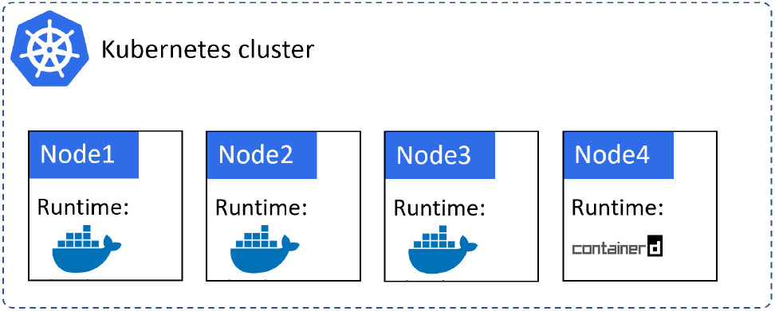
Kubernetes Cluster
The cluster is made up of one or more Masters, and a bunch of Nodes.
You might have K8S cluster with 10 nodes to run your production application.
Behind the scenes each node is running Docker as it’s container runtime.
This means, that Docker is the low-level technology that starts, stops containers etc.
And.. K8S looks after big picture things like.. Deciding when to scale up or down, update, rollback ..etc.
Master
Master

Slide 10
Kubernetes Cluster
Kubernetes abstracts the runtime
Container runtime can be ‘Docker’ or
‘Containerd’
Containerd is overtaking Docker
Containerd is stripped-down version of Docker.
Abstraction:- Facilitated by Container Runtime Interface
using which you can integrate any 3rd party container runtime. Thanks CRI!
Master

Slide 11
Kubernetes Vs Docker Swarm
Orchestrators:
- Docker swarm
- Mesosphere’s DCOS
- Kubernetes
During 2016 and 2017 Orchestrator wars, Kubernetes WON with active development and market-share.

Slide 12
Kubernetes - Data centre OS
What is an Data centre OS?
Sometimes, we call Kubernetes as “Data Center OS”
In modern Data Centre architectures, we are abandoning traditional view of Data Centre as collection of computers. Instead..,
We are viewing it as a single large computer. What does that mean?
To understand that in better way.. Look at this example.
A typical computer is a collection of CPU, RAM, Storage and Networking.
Having OS, for example.. It’s rare for a developer to take care which CPU core or exact Memory address their application uses.
We let the OS decide all of that! Means it abstracts away all of the CPU, Memory details.

Slide 13
Kubernetes - Data centre OS
Now, apply this same abstraction to data center resources.
A typical Data Center is collection of computers. In modern data center architecture, we view the data center as just a pool of compute, network and storage.
This means we no longer need to care about which server or LUN our containers are running on - just leave this up to the data center OS.
Gone are the days of taking your app and saying “Run this part of the app on this node, with this IP, on this specific LUN…“.
In the cloud-native Kubernetes world, we’re more about saying “Hey Kubernetes, I’ve got this app and it consists of these parts… just run it for me please”.
Kubernetes then goes off and does all the hard scheduling and orchestration work.

Slide 14

Data Centre OS - Simple Analogy
Kubernetes is Data Center OS
Think about the process of sending goods via courier services:
You need to only package and put a label on it.
Rest of the complex logistics like which plane, truck, drivers will be taken care by the courier service provider
Kubernetes just does the same in Data Center

Slide 15
Conclusion
You develop your application with Docker and then use Kubernetes to Run/Orchestrate it.
Use Kubernetes to run your containerized Application in Test or Production with Orchestrator capabilities such as Deploy, Scale-up, Scale-down, Perform updates & rollback without much supervision.
Kubernetes and Docker are Complimentary technologies.
We integrate Docker and Kubernetes to Package the application code with dependencies and Run the application on Production or Test.
Kubernetes is a Data centre OS (OS for Dev & Kubernetes for Data centre)

Slide 16
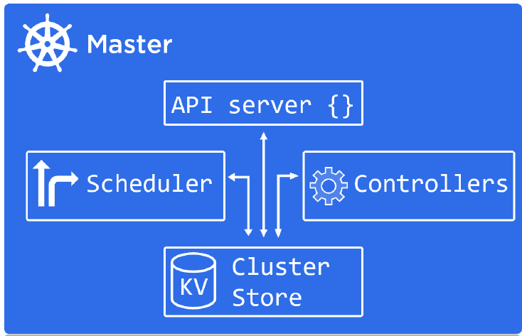
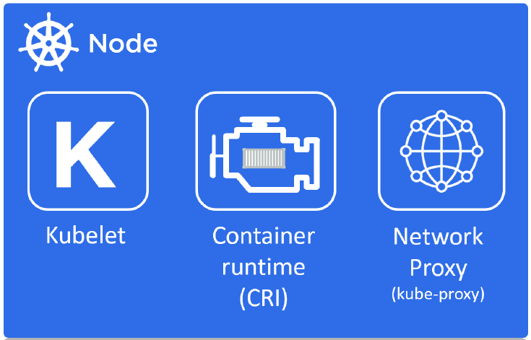
Kubernetes Architecture

Slide 17
Kubernetes Architecture
A Kubernetes cluster is made of Masters and Nodes
Master/Nodes are Linux hosts that can be:
- VMs
- Bare metal servers
- Cloud instances.

Slide 18
Kubernetes Architecture - Master
Master/Control Plane:
The Master is in-charge of the cluster.
Master:
- Makes Scheduling decisions
- Monitors the cluster
- Implement the Changes
- Respond to Events
So, we call Master as Control Plane.

Slide 19
Kubernetes Architecture - Master
Control Plane Components:
API Server
Cluster Store
Control Manager
Scheduler
API Server:
Think of API server as the brains of the cluster.
The API server is front door into Kubernetes.
This is the only component in Control plane we interact with.

Slide 20
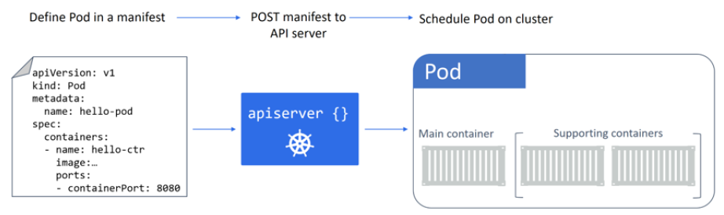
Kubernetes Architecture - Master
We post YAML configuration files (manifests) to API server.
This YAML file is validated, persisted to the Cluster store and deployed to the cluster.
These YAML configuration files contains desired state of the application.
Example: Which container image, Which ports to expose, How many Pod replicas .. Etc.

Slide 21
Kubernetes Architecture - Master
Cluster Store:
The API server is brains of the cluster and
‘Cluster store’ is it’s memory.
It stores the entire configuration and state of
the cluster.
No cluster store, No cluster!
This cluster store is based on etcd, a popular distributed database.

Slide 22
Kubernetes Architecture - Master
Controller Manager:
It implements several control loops that
watch the cluster and respond to events.
These Control loops run in background mode.
They constantly watch API server for changes
Controller Manager’s Aim is to: Ensure the current state of the cluster matches the desired state

Slide 23
Kubernetes Architecture - Master
Scheduler:
The scheduler watches for new work and
assigns it to nodes

Slide 24
Master/Control Plane - Summary
Master Server Summary:
Master takes care of complete cluster controlling
and scheduling.
Master components are:
- API server
- Scheduler
- Controllers
- Cluster store
It’s also considered a good practice not to run application workloads on masters.
This allows masters to concentrate entirely on managing the cluster.

Slide 25
Kubernetes Architecture - Nodes

Slide 26
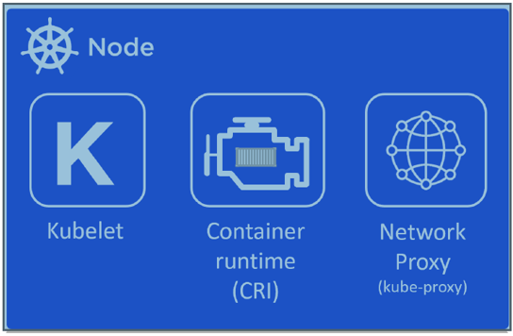
Kubernetes Architecture - Nodes
Nodes/Data Plane:
Nodes are the workers of a Kubernetes cluster
Nodes are where application services run.
Nodes do:
Constantly watch the API Server for new work assignments
Execute new work assignments
Report back to the control plane
- We call Node sometimes as Data Plane.

Slide 27
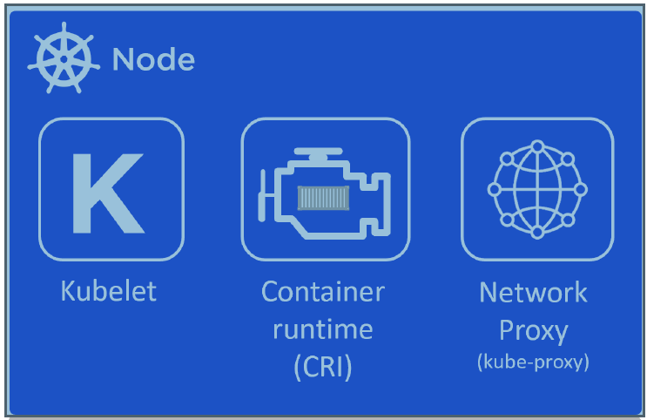
Kubernetes Architecture - Nodes
Node Major Components:
Kubelet
Container Runtime
Kube Proxy
Kubelet:
Kublet is Kubernetes agent that runs on all nodes
In the cluster.
Kublet is the component that watches the API server for new work assignments.
If there is any work, it carries out the task and reports back to master.
If can’t execute any task also, it report back to master and master decides what next.
Ex: If a Pod fails on a node it’s NOT Kubelet’s responsibility to find another. But simply reports to master and master takes care of it.

Slide 28
Kubernetes Architecture - Nodes
Container Runtime:
- Kubelet need Container runtime for:
- Pulling the images
- Starting & Stopping the containers
Kubernetes supports below container runtimes:
- Docker
- Containerd

Slide 29
Kubernetes Architecture - Nodes
Kube-proxy:
Runs on every node of the cluster and is
responsible for local networking.
Example:
It makes sure each node gets it’s own unique IP
Implements IPTables
IPVS rules to handle Load Balancing

Slide 30
Applications Deployments
Applications Deployments

Slide 31
Microservices
- Docker and Kubernetes are especially useful in Microservices world.
There are two architectural styles in application software development.
Monolithic application
Microservices application
The best way to understand Microservices is to compare them with an old, traditional approach for building large applications, the monolithic design.

Slide 32
Microservices Vs Monolithic
kk
m,
account UI
transfer UI
settings UI
UI
Business Logic
Data access
AccountService
TransferService
SettingsService
Data access
Databse
Database
Monolithic Application
Microservices Application

Slide 33
Microservices
Monolithic Design:
The whole application is monolith, a single logical executable. Good for small projects.
To make any change to the system, we must build and deploy whole application.
Scaling up is very difficult. What if we want to scale only one service ex: DB, Login, Video stream ..etc.
Whole server must be provisioned with enough memory and CPU for all. This can be expensive.
Compile and build times become longer. Developers need to checkout whole project from SCM, loading in IDE takes more time.
In case of deployment failure, whole system is unavailable.
Not suitable for Agile development and Continuous integration processes as we need to release almost at once.

Slide 34
Microservices
Microservices Design:
This architecture decomposes the application into smaller pieces.
Microservice Architecture(MSA), is an architectural style and design pattern which says that an application should consist of a collection of loosely-coupled services.
In other words, each of the services will have its own responsibilities or provide specific functionality, independent of others.
Each service is deployed on a separate host.
You don’t need to stop whole system to upgrade a piece of functionality.
When deployed, microservices improve the fault tolerance for entire application.
Ex: if there is any memory leak in once service or some other problem, only this service will be affected and can then be fixed and upgraded without interfering with the rest of the system.
Each microservice is small, easier to understand by developer, easy to develop and deploy.
Better for continuous delivery as small units are easier to manage, test and deploy.

Slide 35
Applications Deployments
Applications Deployments

Slide 36
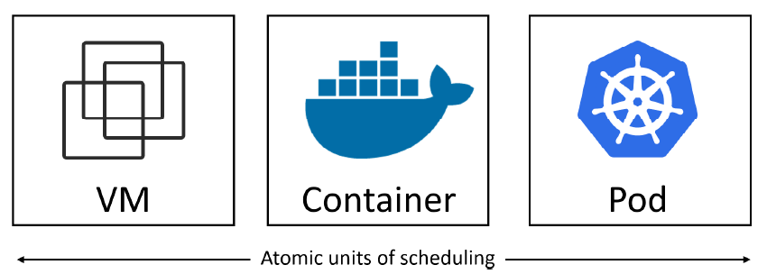
Running Applications on VM, Container & K8S
Virtualization – Virtual Machine
Docker – Container
Kubernetes – Pod (Pods are just a vehicle for deploying applications)

Slide 37
Pods
- Virtualization - World
In the Virtualization world, the atomic unit of scheduling is the Virtual Machine.
That means, We deploy the applications on VMs
- Docker – World
In The Docker world, the atomic unit is the Container.
This means , We deploy the applications inside of containers.
Kubernetes – World
In the Kubernetes world, the atomic unit is the Pod.
This means, We deploy the applications in Pods

Slide 38
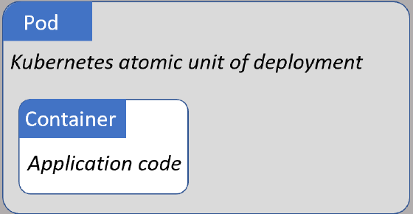
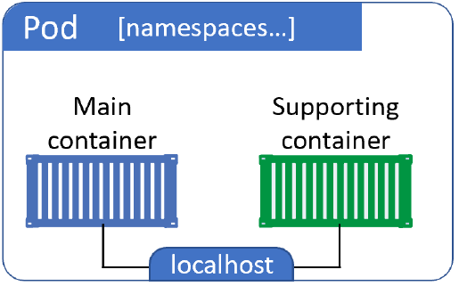

POD
We can’t run a container directly on a Kubernetes cluster
Containers must always run inside of Pods!
Pod can have single or multiple containers. All container share same Pod resources.
Pods connect to each other using Pod’s ‘localhost’ network interface.

Slide 39
Namespace & Cgroups
Docker is built based on below Linux Kernel features:
NameSpace
Cgroups
‘Namespace’ and ‘Cgroups’ isolates the processes from each other.
NameSpace: Isolates processes, networking, file system ..etc.
Cgroups: Limits how much CPU, Memory one of the process/container is using.

Slide 40
Namespace & Cgroups
What is POD:
A Pod is a shared execution environment for one or more containers.
These include: IP address, Ports, Hostname, Memory, Volumes ..etc.

Slide 41
Pods – Atomic Unit
The deployment of Pod is an atomic operation.
If we have to scale application, we add or remove Pods.
We don’t scale by adding more containers to an existing Pod.

Slide 42
Applications Deployments In Kubernetes
Java
Word Press
Maven
Ant
WAR
Docker
Develop the code
Build Application
Create Image
Package
Master
Docker
Create Container
NODE
Kubernetes
Kubernetes
Node
POD
Deploy POD In
Cluster
Wrap Container
In POD
Container

Slide 43
Running Applications on Kubernetes Cluster
Summary:
Write the application as small independent services
Package each service in it’s own container
Wrap each container in it’s own Pod
Deploy the Pods to the cluster

Slide 44
Running Applications on Kubernetes Cluster
1. We declare the desired state of an application in a manifest file
2. We POST it to the Kubernetes API server
3. Kubernetes stores this in the cluster store as the application’s desired state
4. Kubernetes implements the desired state on the cluster
5. Kubernetes implements watch loops to make sure the current state of the
application doesn’t vary from desired state

Slide 45
What’s Next?
Pods don’t:
self-heal
scale
Allow for easy updates

Slide 46
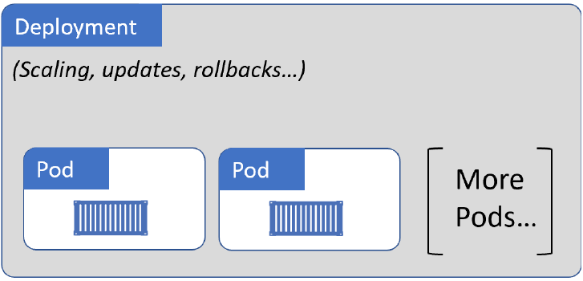
Deployments
Pods don’t self-heal, they don’t scale, and they don’t allow for easy updates.
$ ENTER DEPLOYMENTS..
- Deployments do all things like
- "scale" (scale-up/down)
- "self-heal"
- "rolling updates"
- "roll backs“
- That's why we almost always deploy Pods via 'Deployments"

Slide 47
Desired State.. Current State.. Declarative Model
Just a Concept:
Desired State: is What we want
Current State: is What you have
Declarative Model: is a way of telling Kubernetes what our desired state is, without getting into the detail of how to implement it.

Slide 48
Desired State.. Current Stage..Declarative Model
“Self-healing” with “Deployments”– Deep Dive:
If Pod being manged by Deployment fails, It will be replaced.
Example:
You need 5 FE and 2 BE Pods.
Just declare desired state. Sit back! K8S does all the hard work.
Not just that..
Kubernetes also implements watch loops to make sure current state matches desired state.
If 2 FE Pods go down, Kubernetes automatically detects the discrepancy and brings 2 Pods up without calling you at 4:20 AM. ☺

Slide 49
Deployments
“Scaling” with “Deployments”– Deep Dive:
If a Pod being managed by a Deployment sees increased load, you can easily add more of the same Pod to deal with the load.
Example:
Assume that you have 5 FE Pods.
You post that you need 10 FE Pod replicas.
This will be registered as new desired state.
And the next time when reconciliation loop runs, it will notice the discrepancy and spin-up 5 more pods.

Slide 50
Deployments
“Rolling updates” with “Deployments”– Deep Dive:
Deployments give us Zero-downtime Rolling updates.
Example: This is how we specify desired state.
- In YAML, you declare
How many Pod replicas
What image to use for the Pods containers
What N/W ports to use
Details about how to perform Rolling updates
You POST that YAML file to the API server, and Kubernetes does all of the hard work to implement it.

Slide 51
Deployments
“Rolling updates” with “Deployments”– Deep Dive:
Let’s see how Rolling updates take place:
Assume that you want to update the version of the image that Pods are using.
For that you update the same YAML file with new image version and re-POST it to the API server.
This registers a new desired state on the cluster requesting the same number of Pods, but all running the new version of the image.
How it works:
- Kubernetes creates new ReplicaSet for the Pods with the new image.
- We now have 2 ReplicaSets. One with old image and Second with newer image.
- As Kubernetes increases the number of Pods in the new ReplicaSet it decreases the
number of Pods in the old ReplicaSet.
Net result: we get a smooth rolling update with zero downtime.

Slide 52
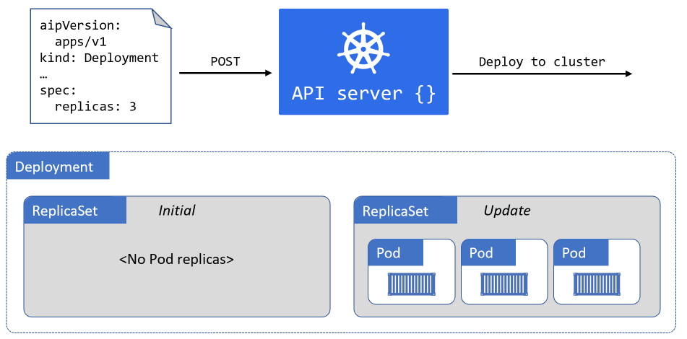
Deployments
Smooth rolling update with zero downtime

Slide 53
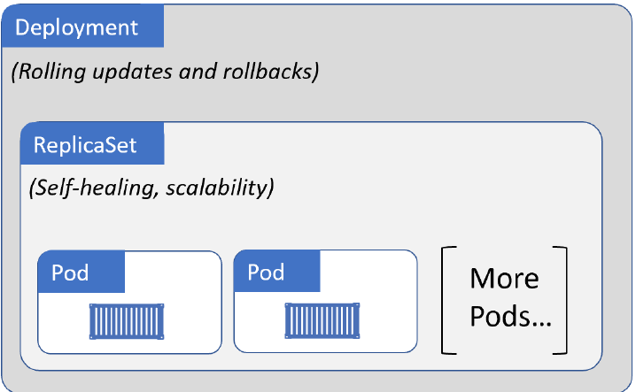
Deployments
Every time you create a Deployment, the deployment creates a ReplicaSet and delegates creating (and deleting) the Pods.
It’s NOT Deployment's job to count the number of Pods and create or delete them.
Deployments use ‘ReplicaSets’ to provide self-healing and scalability bits.
In summary “Deployments manage ReplicaSets and ReplicaSets manage Pods”
We don’t directly manage ReplicaSets.
.

Slide 54
Deployments
“Rollbacks” with “Deployments”– Deep Dive:

Slide 55
Deployments

Slide 56
Deployments

Slide 57
Deployments

Slide 58
KUBERNETES – By P Nageswara Rao – Gamut Gurus
Qns:
SSH to a particular container in a POD
Swap-off impact on actual swap memory

