Slide 1
Predicting Student Performance Using Machine Learning
Leveraging data to analyze and improve academic outcomes
Team Members: Adway(22051135), Aastha(22051219), Kushal(22051172),
Agrima(22051568)

Slide 2
Project Objectives
- Analyze key factors influencing student performance.
- Build a predictive model to forecast final grades (G3).
- Provide actionable insights

Slide 3
Dataset Overview
Source: Student academic performance dataset.
Key Features:
Numerical: Age, study time, previous grades (G1, G2), etc.
Categorical: Internet access, family relationships, etc.
Target Variable: Final Grade (G3).

Slide 4
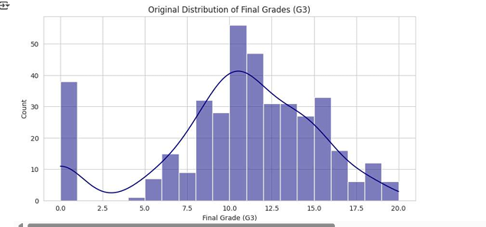
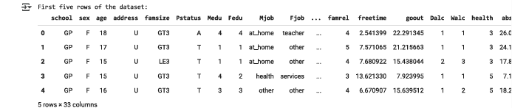
Initial Data Exploration
Insights from the Data:
The majority of students scored around 10-15, suggesting this is the average performance.
The 0 scores could be from students who did not take the exam or failed.
The distribution is slightly asymmetric, indicating that grades are not perfectly normally distributed.

Slide 5
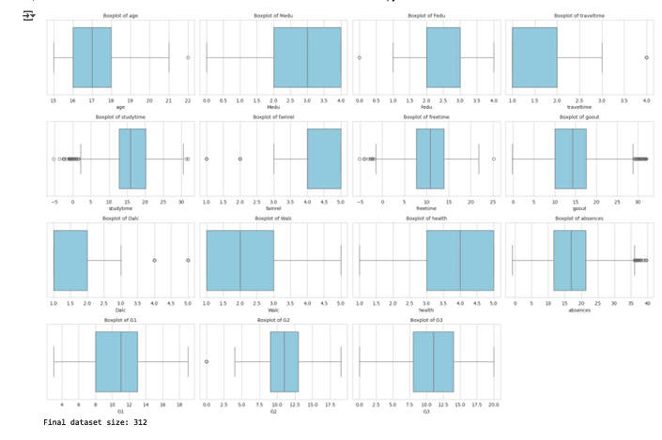
Data Cleaning Process
Key Takeaways
Potential issues in data:
1)Outliers in study time and absences suggest some students may not be attending or studying enough.
2)Outliers in goout and alcohol consumption may indicate behavioral patterns affecting academic performance.
Normal distributions:
Grades (G1, G2, G3) appear to follow a reasonable distribution with minor variations. text here

Slide 6
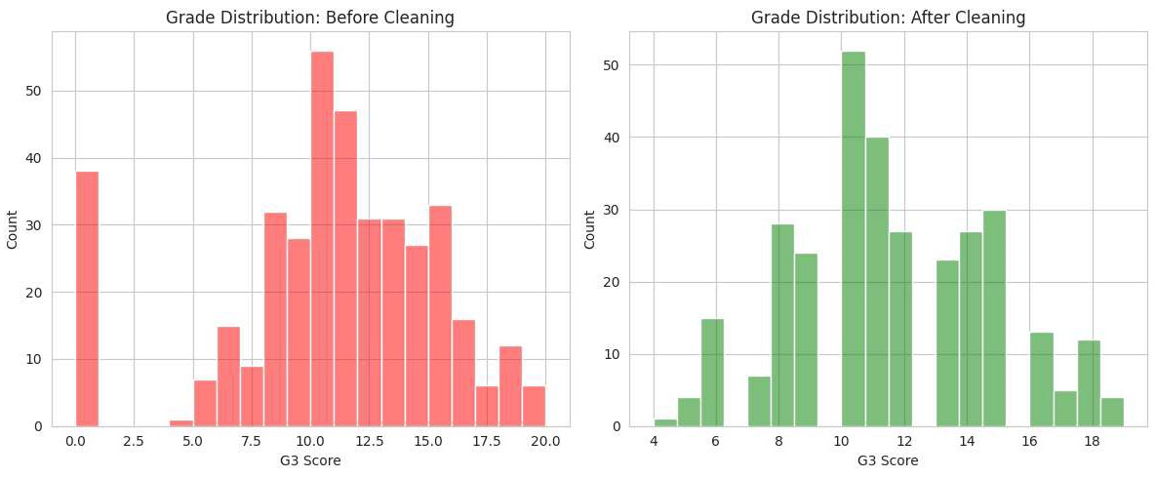
Data Cleaning Process
Key Takeaways
✅ The data cleaning process removed anomalies, likely handling missing values, incorrect entries, or outliers.
✅ The cleaned dataset better represents students' actual grade distribution.

Slide 7
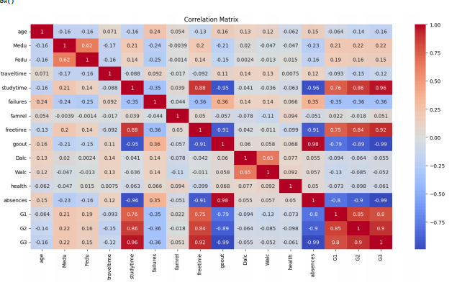
Key Insights from Correlation Analysis
The heatmap effectively visualizes relationships in the data. For predicting G3, strong predictors like G1, G2, failures, and studytime can be prioritized. Other variables like absences and parental education might play smaller roles.

Slide 8
Key Insights from Correlation Analysis
Top Correlations:
G3 and G2: 0.90 (strong positive).
G3 and G1: 0.82 (strong positive).
G3 and Failures: -0.35 (negative).

Slide 9
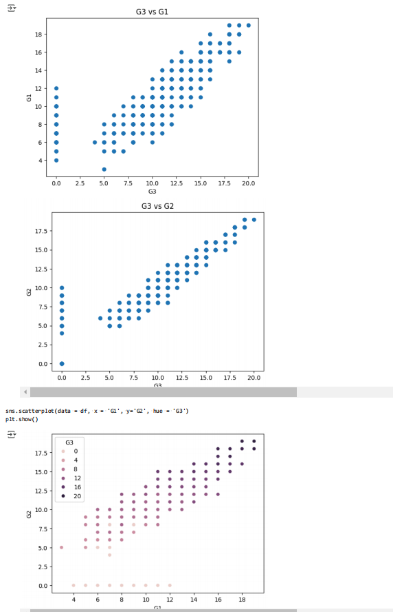

Slide 10
Overall Observations
G1 and G2 are both strong predictors of G3.
A linear trend is evident in all plots, showing that consistent academic performance across all periods leads to higher final grades.
The addition of the hue in the third plot provides a clear visualization of how final grades are influenced by earlier grades.

Slide 11
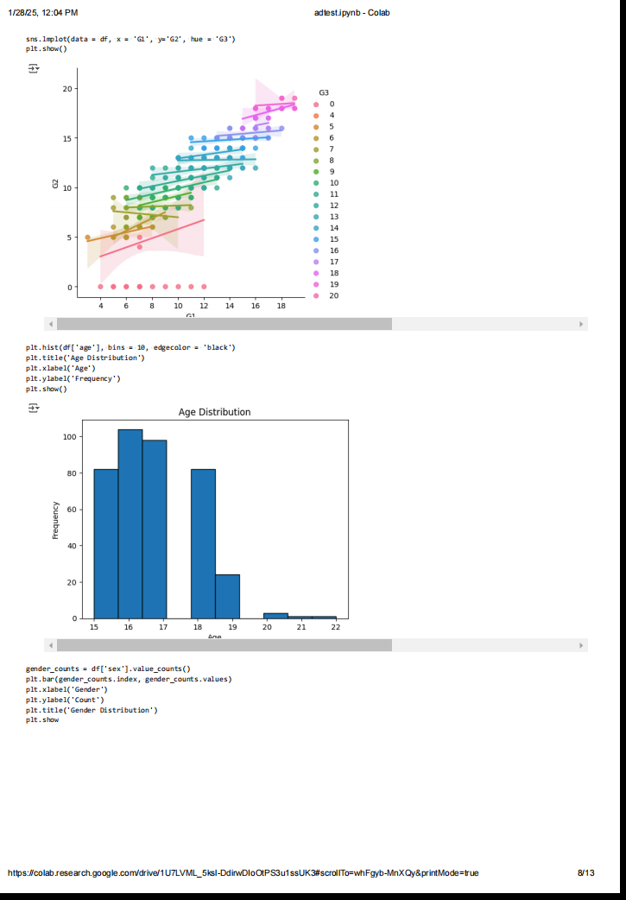
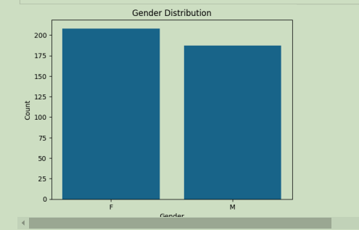
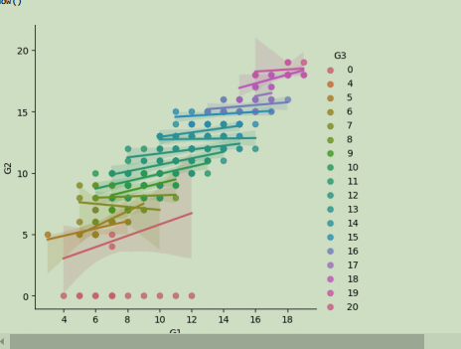

Slide 12
Key takeaways:
The age distribution appears to be roughly normal, with a peak around 17-18 years old.
Most individuals in the dataset are between 15 and 20 years old.
There are more males than females in the dataset.
The exact ratio can be determined from the bar heights.

Slide 13
Multiple Linear Regression Model
- **Features Used**:
- G1, G2, study time, failures, etc.
- **Model Performance**:
- R-squared: 0.854.
- RMSE: [value].
- Accuracy within ±2 points: [percentage]%.
- **Feature Importance**:
- Top contributors: G2, G1, Failures.

Slide 14
Insights from the Analysis
- Non-romantic students perform better on average.
- Higher parental education positively influences grades.
- Students with fewer failures and better study habits excel.

Slide 15
Conclusion
- Predictive models can significantly help identify at-risk students.
- Insights can guide educators to design targeted interventions.
- Future Work:
- Test other models (e.g., Random Forest, XGBoost).
- Integrate real-time data collection for better predictions.

Slide 16
Thank You
- Questions?
- Contact Information: [Your email or LinkedIn]

