Slide 1


K.RAMAKRISHNAN COLLEGE OF TECHNOLOGY (AUTONOMOUS), TRICHY
EXPLORING THE RELATIONSHIP BETWEEN EXERCISE TIME
AND CALORIES BURNED
PRESENTED BY VISWADHARSHINI.TK- 2303811724322124

Slide 2
PRESENTATION OVERVIEW
Problem Identification
Objective
Proposed System
R Programming Used
Advantage of Proposed system

Slide 3
PROBLEM IDENTIFICATION
Exploring the Relationship Between Exercise Time and Calories Burned.
People often struggle to determine the optimal exercise duration for effective calorie burning.
There is a lack of personalized insights on how different exercise durations impact calorie expenditure.
Traditional calorie estimation methods may not be accurate for different individuals based on fitness levels.

Slide 4
OBJECTIVE
Evaluate Model Performance and Accuracy:
Split the data into training and testing sets to perform cross-validation.
Visualize the Relationship and Results:
To create visualizations such as scatter plots, regression lines, and residual plots.
Improve Model by Addressing Overfitting:
Use techniques like cross-validation, regularization or non-linear models to prevent overfitting.

Slide 5
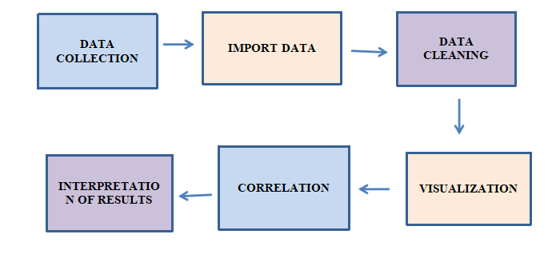
PROPOSED SYSTEM BLOCK DIAGRAM

Slide 6
MACHINE LEARNING USED
Linear Regression
Random Forest Regressor
Support Vector Regression (SVR)
Neural Networks

Slide 7


ADVANTAGES OF PROPOSED SYSTEM
The system uses historical and real-time data to make informed decisions.
The system can generate personalized fitness recommendations based on individual characteristics.
The system allows for real-time monitoring of exercise performance.
The system provides clear and intuitive data visualizations.
The system can evolve with new data and more complex models.

Slide 8
MODULES USED
Data Acquisition Module
Feature Engineering Module
Exploratory Data Analysis (EDA) Module
Genre Clustering Module

Slide 9
MODULES DESCRIPTION
Data Acquisition Module
This module collects exercise and health data from fitness trackers, health APIs, or exported CSV files. Variables include exercise duration, calories burned, activity type, intensity level, and user attributes. The data is imported into R for processing.
Feature Engineering Module
Raw data is transformed into structured inputs. This involves handling missing values, normalizing continuous variables, and encoding categorical data such as activity types. Features like MET (Metabolic Equivalent of Task) may also be derived.

Slide 10
MODULES DESCRIPTION
Exploratory Data Analysis (EDA) Module
This module uncovers data patterns using visual tools (e.g., scatter plots, histograms) and descriptive statistics. Correlation matrices are computed to understand how exercise time aligns with calorie expenditure across different activity types.
Genre Clustering Module
Linear regression and multiple regression models are used to quantify the relationship between exercise time and calories burned. Evaluation involves checking R-squared values, residual plots, and statistical significance. Visualization tools like ggplot2 are used to plot regression lines and interpret model results.

Slide 11
CODING IMPLEMENTATION
# Load necessary library
library(ggplot2)
# Step 1: Create dataset
exercise_time <- c(10, 20, 30, 40, 50, 60, 70, 80, 90, 100)
calories_burned <- c(50, 100, 130, 170, 210, 260, 300, 340, 390, 430)
data <- data.frame(exercise_time, calories_burned)
print("Step 1: Dataset Created")
print(data)
# Step 2: Visualize the data
print("Step 2: Plotting Exercise Time vs Calories Burned")
ggplot(data, aes(x = exercise_time, y = calories_burned)) +
geom_point(color = "blue", size = 3) +
geom_smooth(method = "lm", se = TRUE, color = "red") +
labs(title = "Exercise Time vs Calories Burned",
x = "Exercise Time (minutes)",
y = "Calories Burned") +
theme_minimal()

Slide 12
CODING IMPLEMENTATION
Step 3: Fit Linear Regression Model
print("Step 3: Fitting Linear Regression Model")
model <- lm(calories_burned ~ exercise_time, data = data)
print(summary(model))
# Step 4: Extract and Print Coefficients
intercept <- coef(model)[1]
slope <- coef(model)[2]
print("Step 4: Model Coefficients")
cat("Intercept:", intercept, "\n")
cat("Slope:", slope, "\n")
# Step 5: R-squared
r_squared <- summary(model)$r.squared
print("Step 5: Model Accuracy (R-squared)")
cat("R-squared:", r_squared, "\n")
# Step 6: Confidence Intervals
print("Step 6: Confidence Intervals for Coefficients")
print(confint(model))
# Step 7: Make Predictions
print("Step 7: Predict Calories Burned for New Exercise Times")
new_data <- data.frame(exercise_time = c(25, 55, 85, 105))
predictions <- predict(model, new_data, interval = "confidence")
print(cbind(new_data, predictions))

Slide 13
CODING IMPLEMENTAION
# Step 8: Residual Plot
print("Step 8: Plotting Residuals")
residuals <- resid(model)
fitted <- fitted(model)
plot(fitted, residuals,
main = "Residuals vs Fitted",
xlab = "Fitted Values",
ylab = "Residuals",
col = "darkgreen", pch = 19)
abline(h = 0, col = "red", lwd = 2)
# Step 9: Diagnostic Plots
print("Step 9: Showing Diagnostic Plots")
par(mfrow = c(2, 2))
plot(model)
par(mfrow = c(1, 1))
What This Program Does:
Creates and prints a dataset.
Plots the data and a regression line.
Fits a linear model and prints the summary.
Outputs coefficients and R-squared value.
Predicts

Slide 14
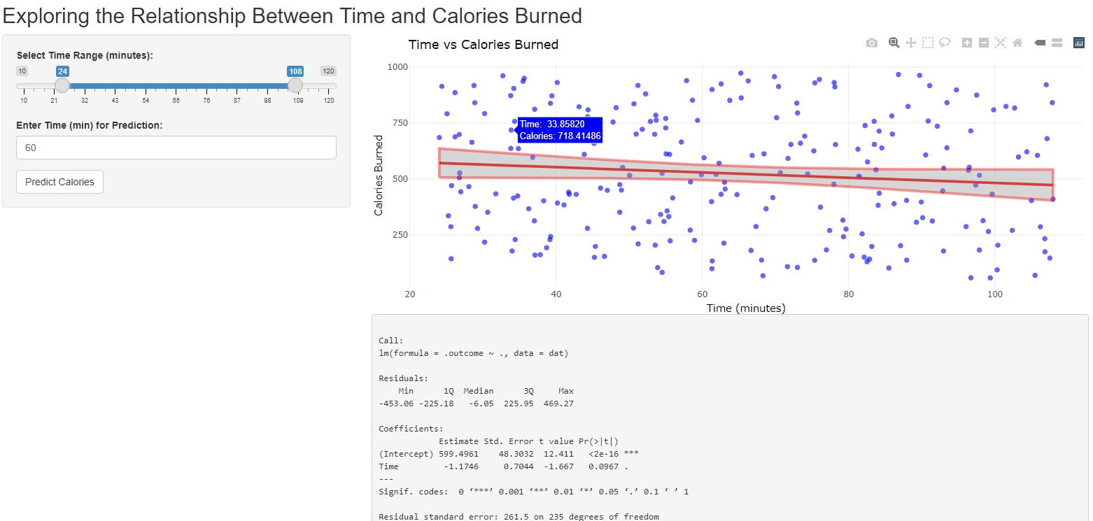
OUTPUT

Slide 15
CONCLUSION
Exercise time is an important predictor of calories burned, but it is often influenced by other factors such as weight, age, and exercise type.
ANN models further contributed by detecting more intricate patterns in the data.
Models like XGBoost and Random Forest can highlight the importance of various features in predicting calorie burn.
XGBoost, a powerful gradient boosting algorithm, showed significant predictive accuracy by leveraging both exercise time and other factors to predict calories burned.

Slide 16


