Slide 1


K.RAMAKRISHNAN COLLEGE OF TECHNOLOGY
(AUTONOMOUS), TRICHY
SMART TRAFFIC MANAGEMENT
PRESENTED BY : SUPERVISOR:
VISWA D, Mr.A.MALARAMANNAN,M.E.,
2303811710421182 AP/CSE.

Slide 2
PRESENTATION OVERVIEW
Objective
Project Introduction
Problem Statement
Methodologies (Programming concepts relevant to problem statement)
Architecture of the proposed system
List of Modules
Merits
Results and Discussion
Queries

Slide 3
OBJECTIVE
The objective of the "Smart Traffic Light Controller" is to develop an interactive and efficient system that dynamically adjusts traffic signal timings based on vehicle density. It ensures smoother traffic flow by optimizing signal cycles and provides a user-friendly graphical interface for monitoring and visualization.

Slide 4
PROBLEM INTRODUCTION
The"Smart Traffic Light Controller" is a Java-based application designed to optimize traffic management at intersections. The system features modules for user input of vehicle density, dynamic adjustment of signal timings, and real-time visualization of traffic lights. It ensures smoother traffic flow and reduces congestion, with provisions for user interaction and system monitoring to maintain efficiency and reliability..

Slide 5
PROBLEM STATEMENT
Traditional traffic light systems operate on fixed cycles, leading to inefficiencies such as unnecessary delays and congestion during peak hours. These systems fail to adapt to varying traffic densities, causing frustration for commuters and increased fuel consumption. The "Smart Traffic Light Controller" aims to address these issues by dynamically adjusting signal timings based on real-time traffic density, ensuring smoother traffic flow and reducing delays at intersections.

Slide 6
Methodologies (Programming Concepts Relevant to Problem Statement):
Java AWT: Used to create an interactive graphical user interface for input and visualization.
Multithreading: Ensures smooth operation by managing traffic light cycles concurrently.
Conditional Logic: Adjusts signal timings dynamically based on vehicle density inputs.
Event Handling: Captures and processes user actions like button clicks for interactivity.

Slide 7
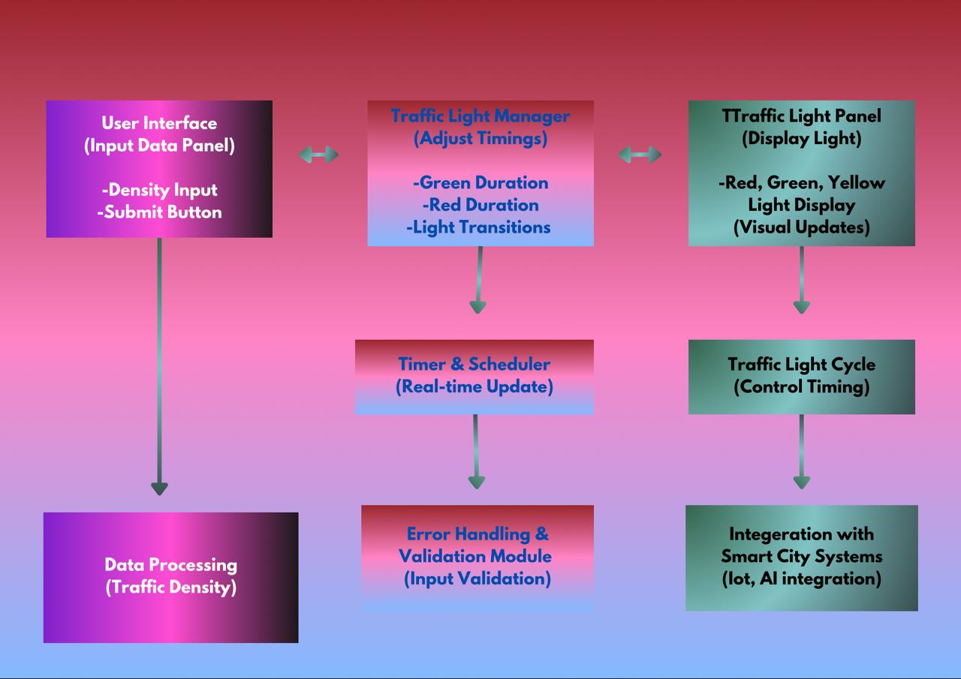
ARCHITECTURE DIAGRAM
IIIIIIIIIIIIIIIIIII
IIIII

Slide 8
MODULES
Input Module: Accepts vehicle density data for all directions through a graphical interface.
Signal Timing Adjustment Module: Dynamically calculates and sets red, yellow, and green light durations based on density inputs.
Traffic Light Simulation Module: Visually represents the current state of traffic lights for all directions.
Cycle Management Module: Controls the sequential toggling of traffic lights using timers and threading.
Error Handling Module: Validates user inputs and provides feedback for invalid or out-of-range values.

Slide 9
MERITS
Dynamically adjusts traffic light timings based on vehicle density.
Enhances traffic flow and reduces congestion at intersections.
Real-time traffic signal updates improve overall commuting experience.
Visual representation of traffic lights provides clear status updates.
Timer and multithreading implementation ensures efficient signal cycling

Slide 10
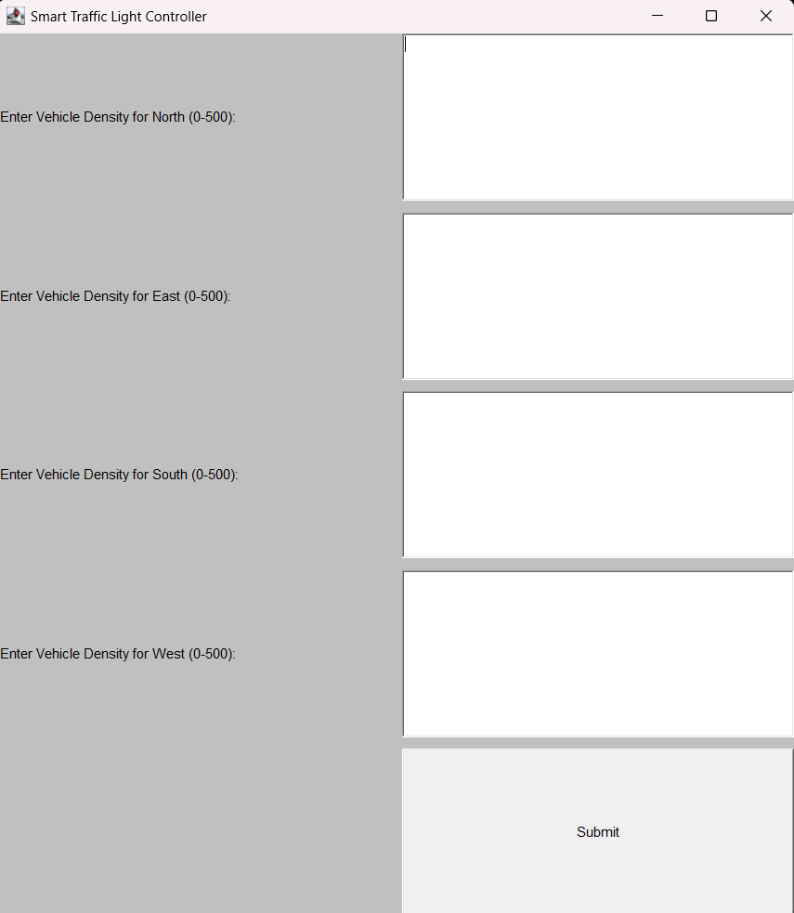
RESULTS AND DISCUSSION
HOME PAGE :

Slide 11
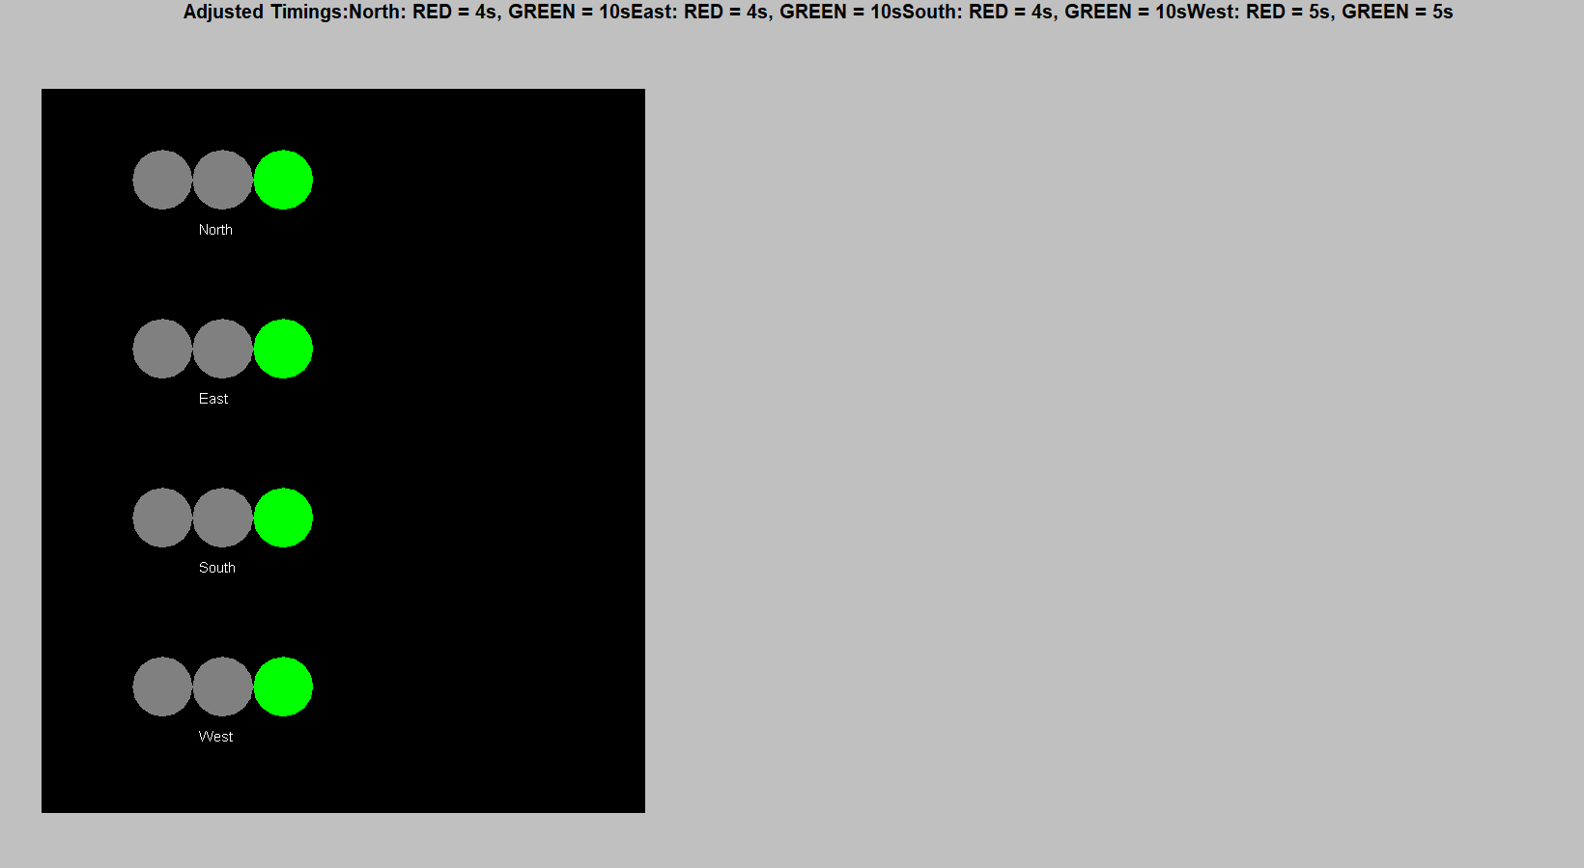
RESULTS AND DISCUSSION
ADJUSTED TIMING:

Slide 12
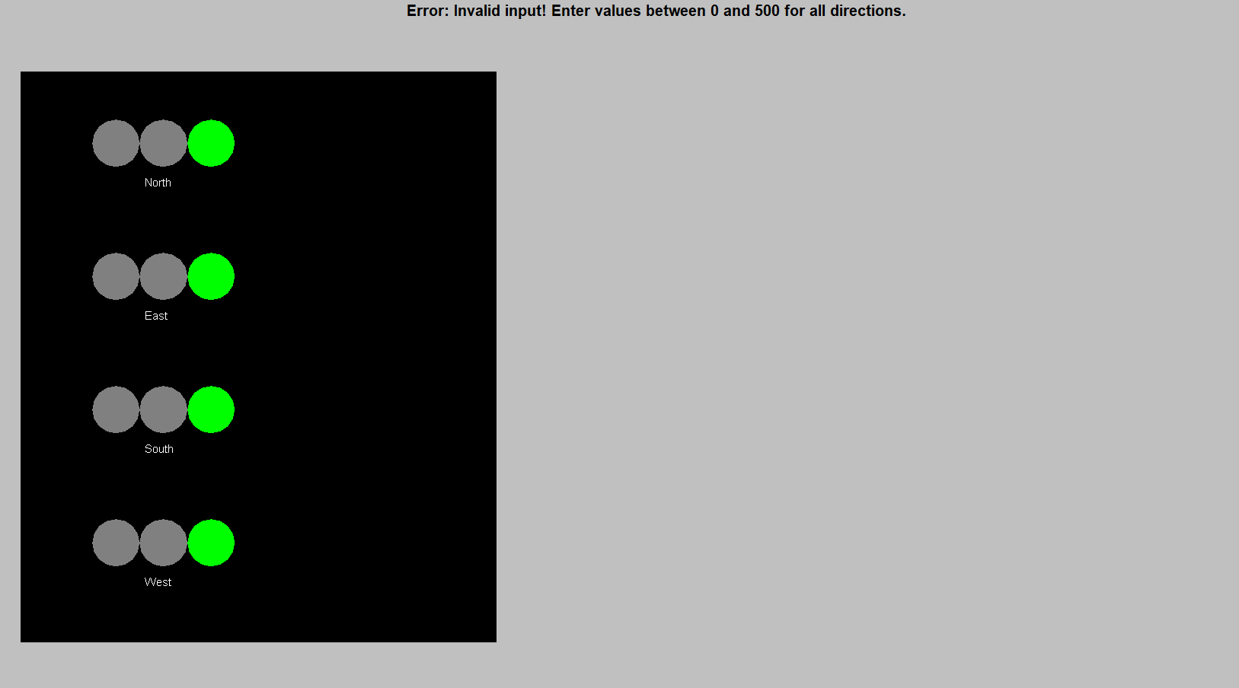
RESULTS AND DISCUSSION
INVALID INPUT :

Slide 13
RESULTS AND DISCUSSION
BACK TO INPUT :

Slide 14
ANY QUERIES ?

