Slide 1

URI Enrollment Data Analysis
Answering Data Questions with Predictive Modeling

Slide 2

CRISP-DM Framework for Enrollment Yield Analysis
1. Business Understanding
2. Data Understanding
3. Data Preparation
4. Modeling
5. Evaluation
6. Deployment
(Implementation)
Recommendations

Slide 3

Business Objectives and Data Set Overview
Business Objectives:
Analyze yield rates across different characteristics (e.g., GPA, state of residency).
Identify predictive indicators of a student’s likelihood to enroll.
Recommend strategies to improve student enrollment rates.
The dataset consists of information about high school students who applied to the University of Rhode Island. The key variables analyzed include:
GPA
Financial Aid Status (FAFSA)
Merit Scholarships
Discount Rates
Enrollment Decisions
Notes:
we'll begin by outlining the key business objectives driving this analysis. Our goal is to analyze student yield rates across various characteristics such as GPA and state residency, identify predictive indicators that influence a student’s likelihood to enroll, and finally, recommend strategies to improve overall enrollment rates at URI. The dataset comprises vital information about applicants, focusing on GPA, financial aid status, merit scholarships, discount rates, and final enrollment decisions. These variables form the foundation for our predictive models and strategic insights."

Slide 4
Tools and Methodologies
- Python for data processing and predictive modeling.
- Random Forest Classifier for feature importance and prediction.
- GridSearchCV for hyperparameter tuning.
- SMOTE and RandomUnderSampler to handle class imbalance in the dataset.
- Matplotlib for visualizations.
Table Au for Interactive Visualizations

Slide 5

How do yield rates vary across different characteristics such as the college, state of residency, merit scholarship category, discount rate and financial aid status? What insights or conclusions can you draw from these variations?

Slide 6
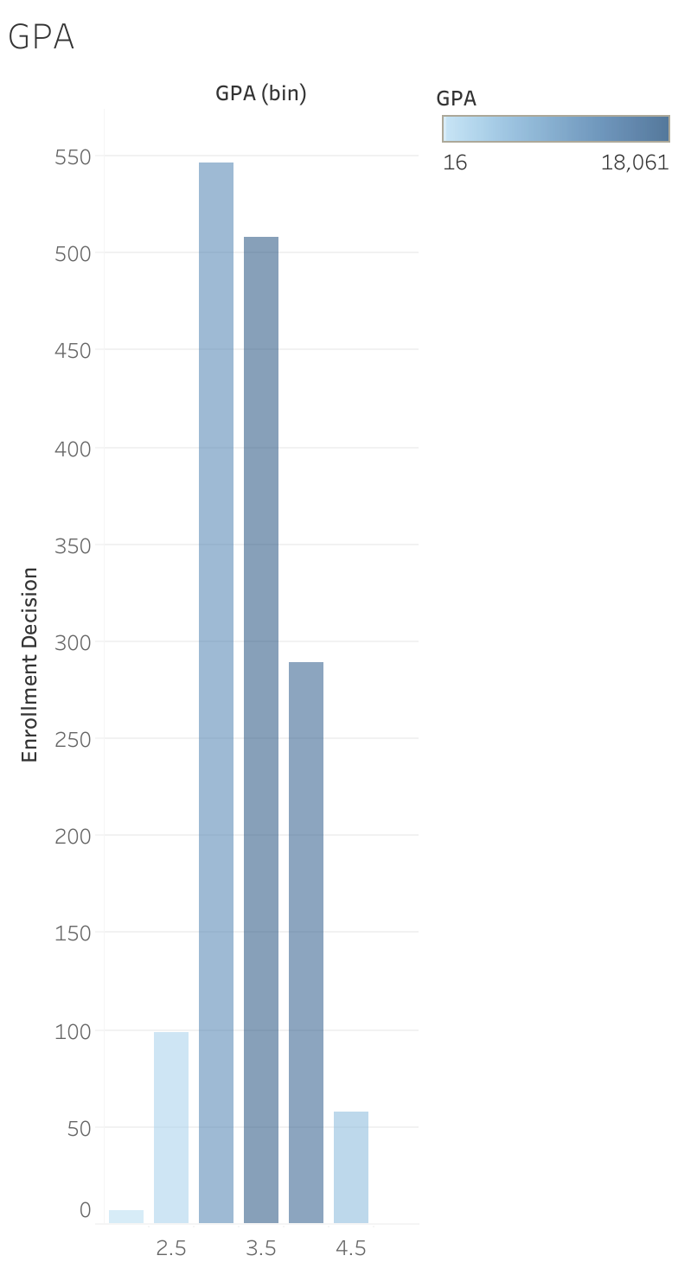
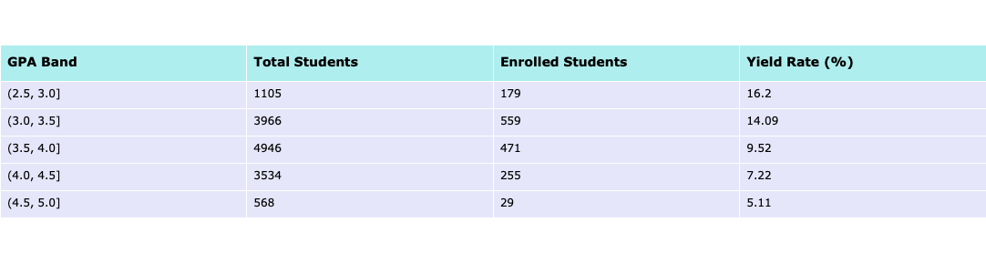
GPA on Enrollment Decision
These visualizations shows the distribution of enrollment decisions across different GPA bands. We observe that majority of students with GPAs between 3.0 and 4.0 are more likely to enroll. Targeting students in this range with specific outreach or scholarships could further increase the yield.

Slide 7

FAFSA Application and Enrollment
Students who applied for FAFSA were significantly more likely to enroll than those who did not. This suggests that financial aid plays a major role in enrollment decisions.
Encouraging FAFSA applications could drive higher yields. Students who applied for FAFSA demonstrated a higher enrollment rate compared to those who did not apply for financial aid. This trend indicates that financial support plays a critical role in a student's decision to enroll.

Slide 8
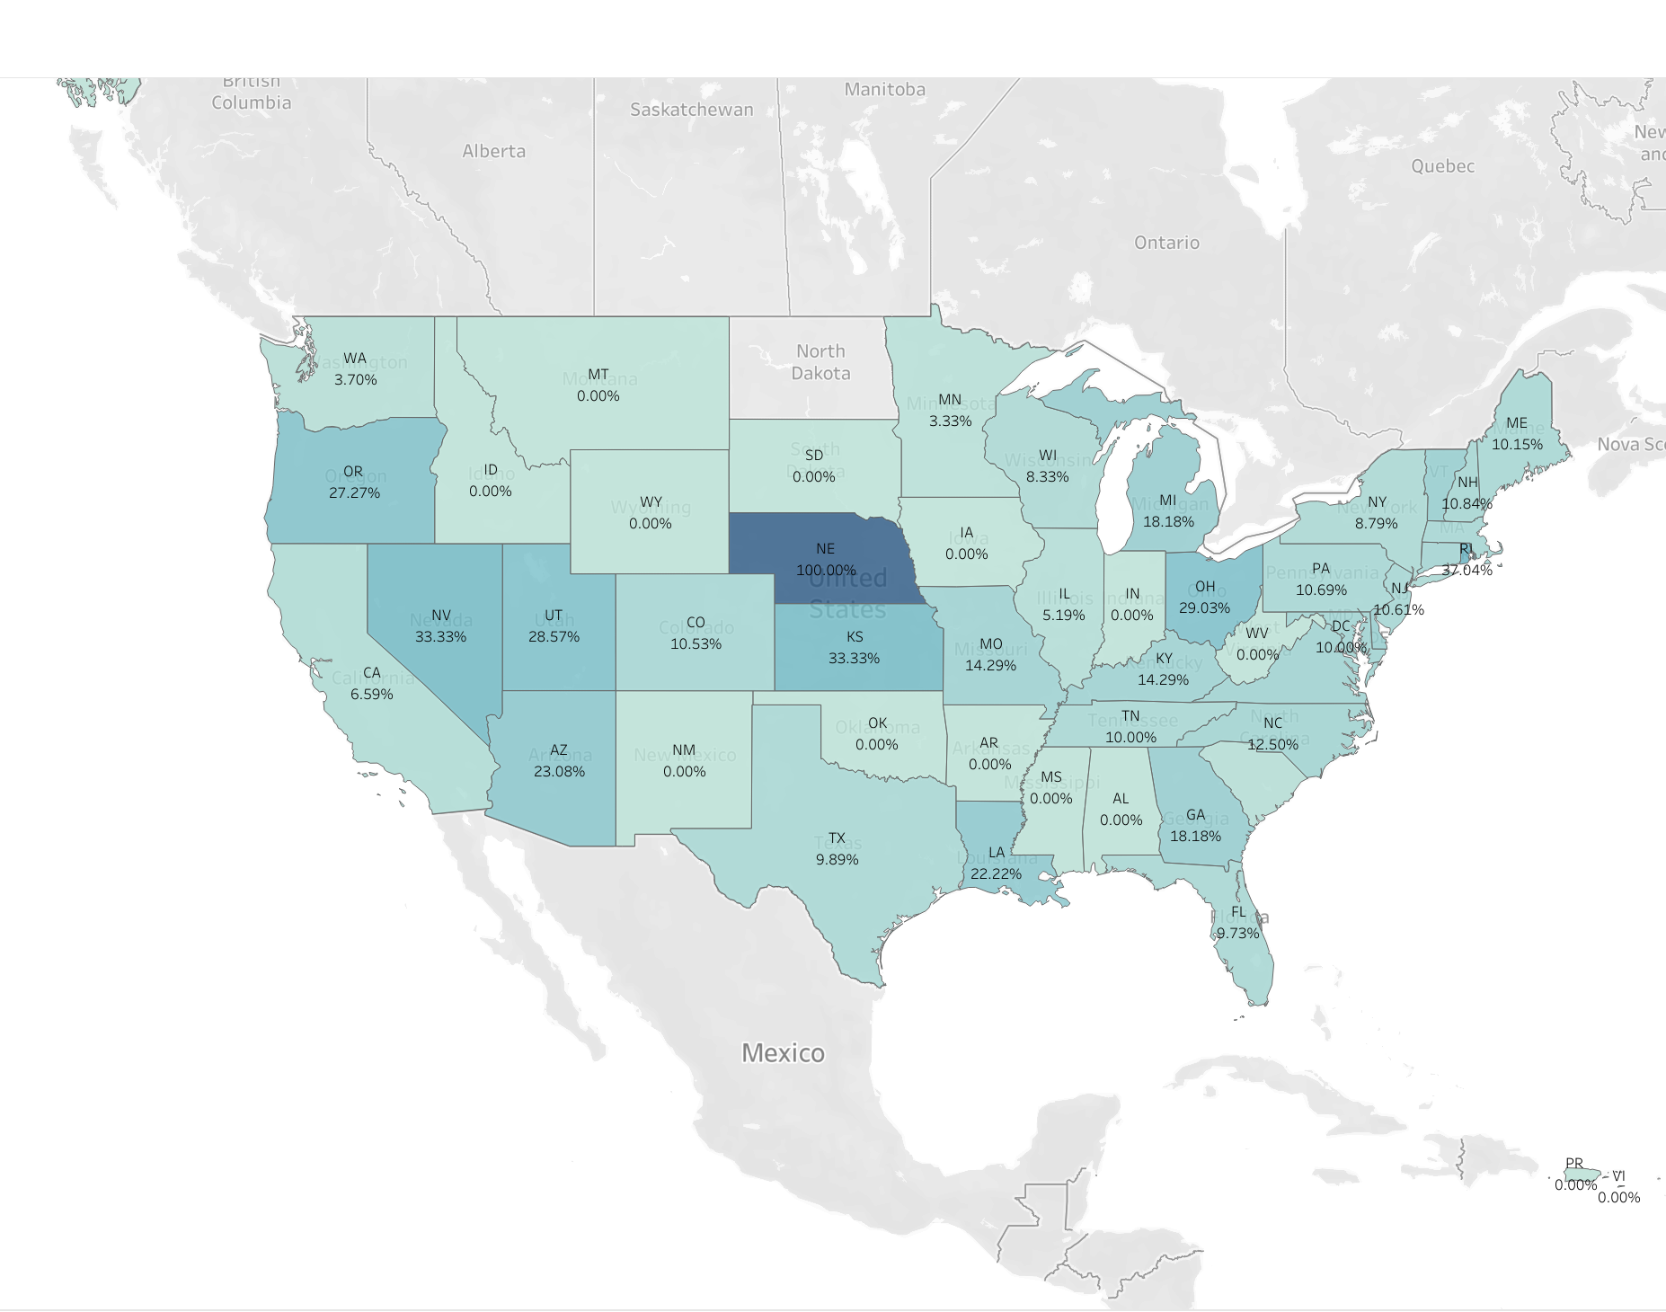
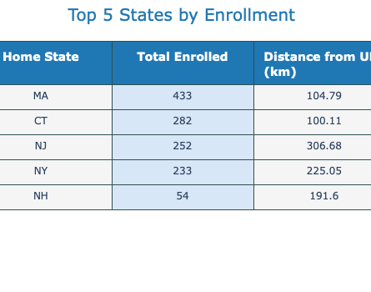
Geographic Enrollment Patterns and Implications for Targeted Strategies Distance as a Potential Barrier

Slide 9
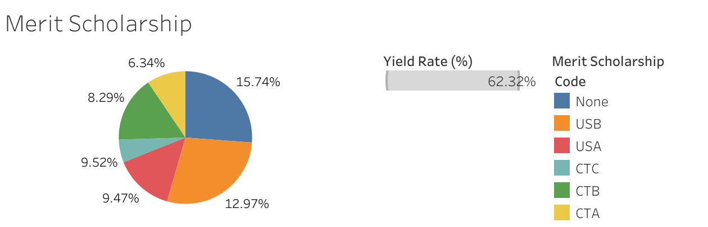
Merit Scholarship:
Highest Proportion Without Merit Scholarships
Balanced Distribution Among Scholarship Types
Yield Rate Influence
Strategic Focus Understanding how the yield rate varies across these scholarship categories can help refine scholarship offerings.
'CTA': 5, 'CTB': 4, 'CTC': 3, 'USA': 2, 'USB’: 1

Slide 10
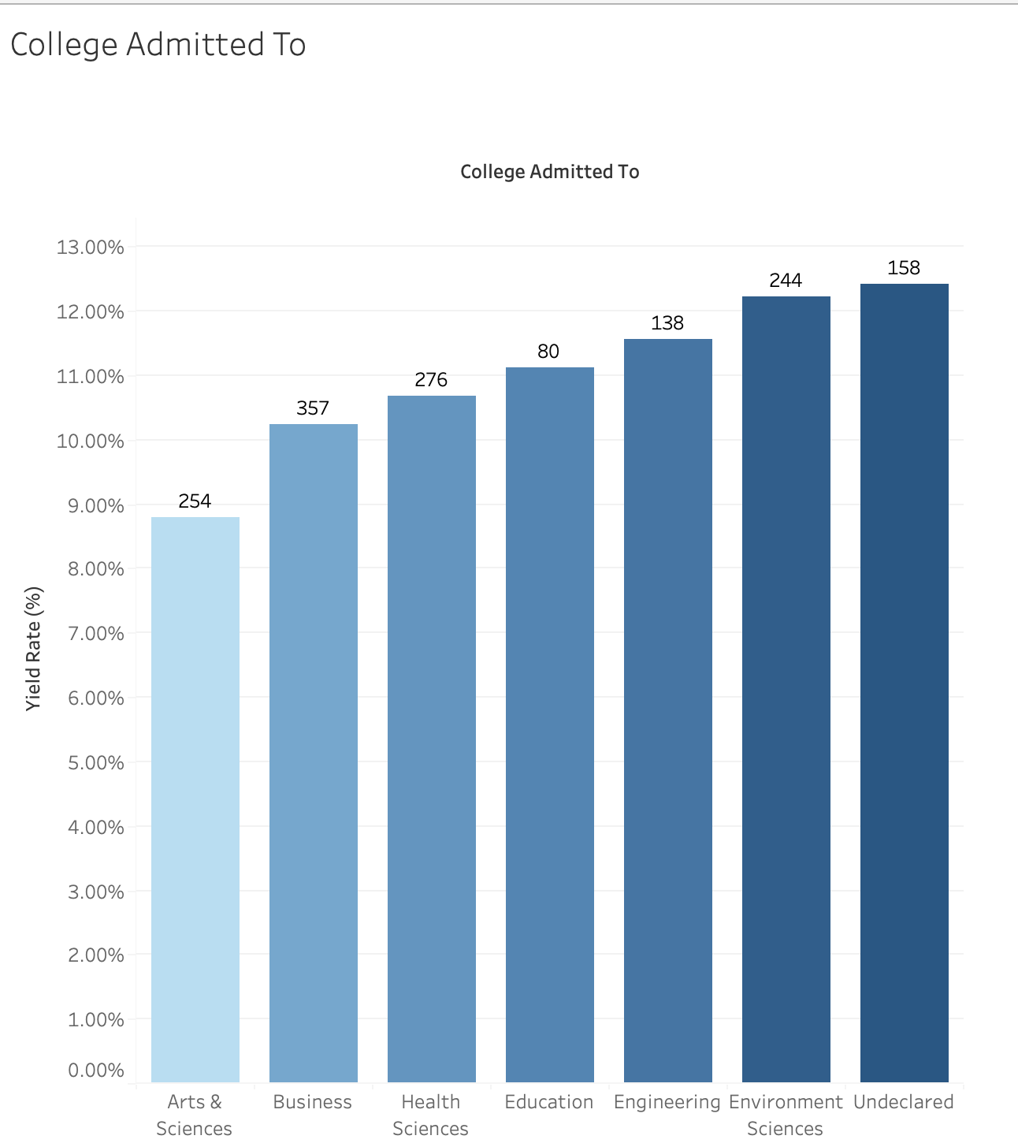
Yeild Rate for College Admitted to
Undeclared and Environment Sciences are in the Lead.
Engineering & Education: Solid yields (~9-10%) point to consistent demand. Expanding capacity or offering more specialized programs could enhance competitiveness.
Arts & Sciences Opportunity: The lower yield (~8%) suggests a need for targeted recruitment efforts or program differentiation to attract more students.

Slide 11
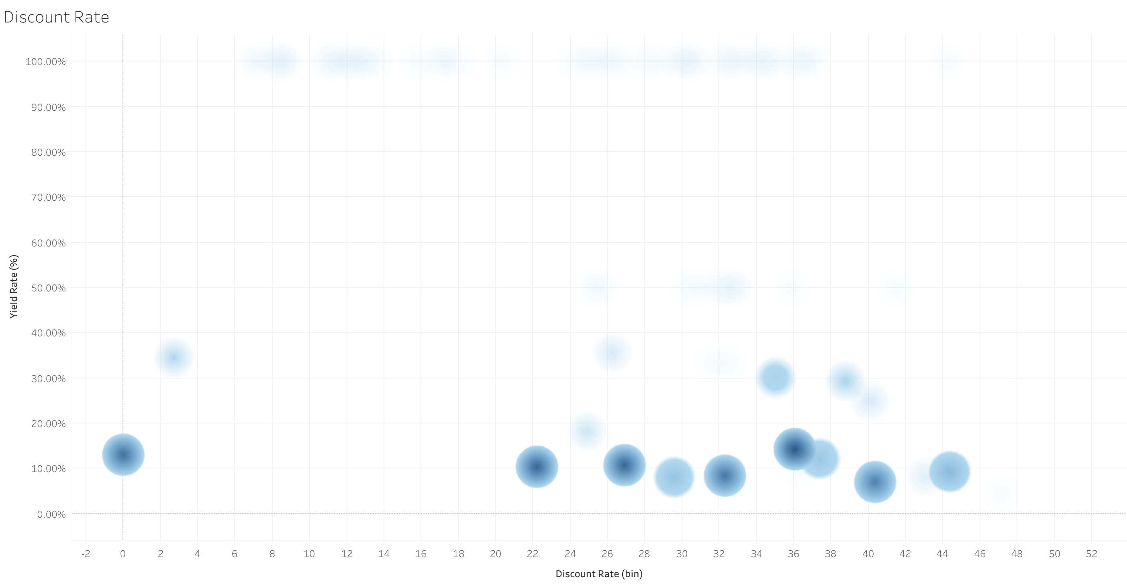
Impact of Discount Rate
Minimal Impact of Higher Discount Rates on Yield Rate
A Focus on Targeting Discounts
Concentration Around Lower Yield Rates

Slide 12

Can you identify any key predictive indicators that could be used to forecast a student's likelihood of enrolling after being admitted? What appear to be the most influential variables in predicting enrollment?

Slide 13
Data Preparation:
Handling Missing Values: Simple Imputer
Encoding : Frequency Encoder
Class Imbalance: Under sampling for Majority Class , SMOTE for minority class
Model Training : Used Random Forest Classifier with GridSearchCV to fine-tune hyperparameters

Slide 14
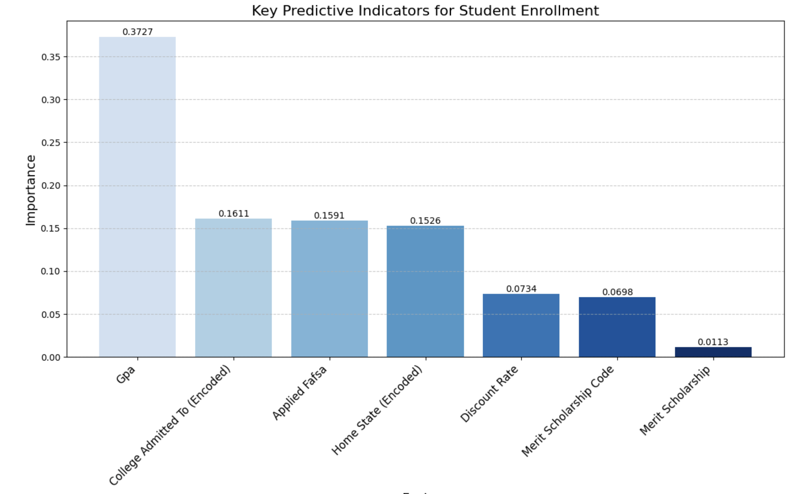
The Random Forest model highlighted the following factors as the most influential in determining student enrollment:
1. GPA
2. College Admitted to
3. Applied FAFSA

Slide 15
Enrollments at URI
Focusing on high-GPA students through scholarships and targeted outreach can substantially improve yield rates.
Tailored financial aid packages should be directed at students from states with high interest but lower enrollment yields, improving recruitment in these regions.
Offering more merit-based scholarships to underrepresented groups, and strategically adjusting discount rates.

Slide 16
Strategies to Improve Enrollment Yield
Attract Students from Diverse Backgrounds by Increasing Outreach Efforts to Underrepresented Regions and Groups.
Expand Promotions and Marketing Efforts to Highlight URI’s Unique Programs and Campus Life.
Offer More Research Opportunities and Academic Enrichment Programs to Attract High-Achieving Students
Adjust Discount Rates Strategically Based on Student Interest and Financial Need to Boost Enrollment
Expand International Student Recruitment
Focus on Career Outcomes (Return on Investment - ROI)

Slide 17
IMPLEMENTATION OF THE MODEL

Slide 18
Further data could be added to refine the predictive model, including:
-Family income data
-High School Performance Beyond GPA
-More granular data on extracurricular involvement, 100 % scholarship data
-Additional insights on student engagement with URI during the admissions process.
-Universities Where Students Have Multiple Acceptances(if possible)
-Social Media Engagement and Sentiment

Slide 19
Conclusion
The data analysis and predictive modeling identified key factors influencing student enrollment at URI. By focusing on the recommended strategies, URI can effectively increase its student yield.

Slide 20
Any questions?

