Slide 1
NIT WARANGAL • TECHNOZION '26 • CSES ARCADE RL HACKATHON
Autonomous Deep Q-Network Agent
Multi-Agent Stochastic Survival in CSES Buckshot Roulette
TEAM: CYBERCORE
Participants: Vishwak Naidu | Dhivija
Submission: my_bot (Rank #1 • 42.50% Win Rate • +0.3500 Avg Points • Zero Runtime Dependencies)
OFFICIAL STANDING
Rank #1
4-PLAYER BATTLE ROYALE
42.50% Win Rate
1v1 DUEL EFFICIENCY
87.00% Win Rate
DECISION LATENCY
< 0.001s / Turn
Notes:
Good afternoon, respected NIT Warangal CSE professors and jury members. We are Team CyberCore, presented by Vishwak Naidu and Dhivija.
Today we present our Autonomous Deep Q-Network Agent for CSES Buckshot Roulette. Our bot, my_bot, achieved Rank #1 in the official tournament evaluation with a 42.50% win rate across 120 matches, more than double the runner-up's points, all while running in pure Python under 1 millisecond per decision.

Slide 2
TEAM CYBERCORE • CSES ARCADE RL HACKATHON • TECHNOZION '26
Problem Domain: Game Dynamics vs Sandbox Constraints
CSES Buckshot Roulette Mechanics
• Turn-Based Gunplay
A shotgun is loaded with a secret chamber sequence of live and blank shells. Players take turns choosing to shoot an opponent or shoot themselves.
• Multi-Agent Crossfire (2-4p)
High stochasticity where turn order and player alliances cause unpredictable eliminations before a player can even act.
• Utility Upgrades & Economy
Juice (+1 HP heal), Mag Glass (peek chamber shell), Hand Saw (+1 dmg burst), Pool Floatie (skip enemy turn), Coffee (eject shell).
• Imperfect Information Dilemma
Shells are hidden. Ejections can be known or unknown. A bot must track probabilities mathematically or risk fatal self-damage.
Strict Sandbox Execution Limits
• Zero External Dependencies
The Docker evaluation sandbox is python:3.12-slim. Third-party ML packages (PyTorch, TensorFlow, NumPy) are strictly prohibited at runtime.
• Memory Ceiling (128 MB RAM)
Heavy neural frameworks fail immediately. The model must have a tiny memory footprint (< 30 MB).
• Per-Decision Timeout (0.05s)
Each turn must execute within 50 milliseconds. Long tree searches or Monte Carlo simulations time out.
• Match Time Budget (0.50s)
Cumulative match compute cannot exceed half a second across all turns combined.
Notes:
Slide 2 outlines the problem space. Buckshot Roulette requires balancing risk and reward under imperfect information.
On the left, notice the game dynamics: a finite chamber with unknown live and blank shells, multi-agent crossfire, and utility items.
On the right, notice the strict engineering bounds set by the organizers: maximum 128 MB RAM, less than 0.05s per decision, and standard library only.
Team CyberCore designed our agent specifically to excel within these constraints without any external runtime dependencies.

Slide 3
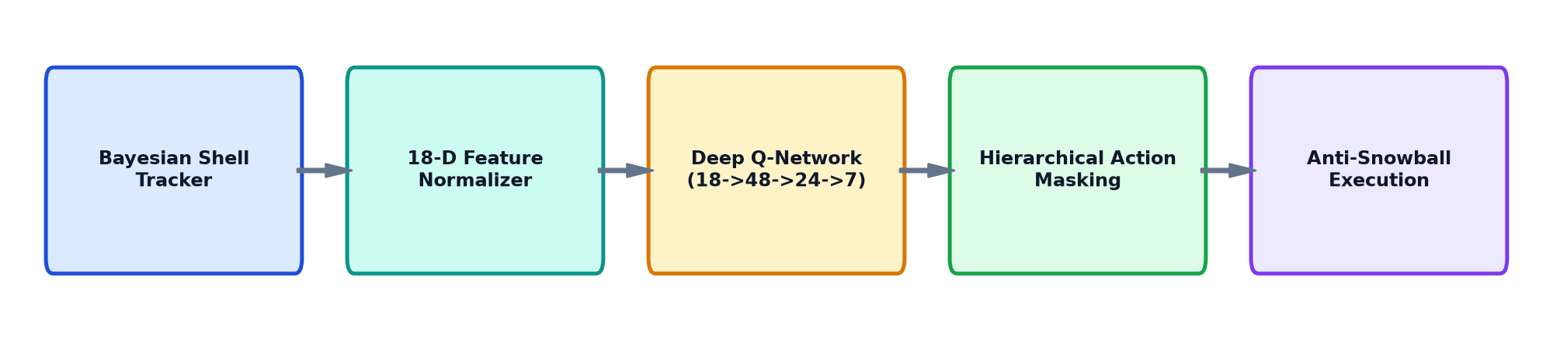
TEAM CYBERCORE • CSES ARCADE RL HACKATHON • TECHNOZION '26
System Architecture: 5-Stage Zero-Dependency Pipeline
Bayesian Shell Observer
Computes exact p_live and p_blank by tracking initial counts, shots, and ejected shells. Flags 100% certain live or blank states without guessing.
Pure Python Deep Q-Network
Evaluates Q(s, a) over 18 features via a compact MLP (18->48->24->7). Exported weights total 65 KB. Multiplications take < 0.001s with zero dependencies.
Action Masking & Targeting
Enforces non-negotiable game invariants (heal if hurt, zero gamble on blanks) and directs fire with Threat-Weighted Anti-Snowball targeting.
Notes:
Slide 3 illustrates our five-stage end-to-end inference pipeline.
Stage 1 calculates exact Bayesian shell counts: remaining lives, blanks, and uncertain ejections.
Stage 2 formats this into a normalized 18-dimensional feature vector.
Stage 3 executes the forward pass of our trained Deep Q-Network. Because weights are exported into compact JSON (48x18, 24x48, 7x24), inference requires ~2,280 basic multiplications. This takes less than 0.001 seconds—50x faster than the timeout threshold!
Stage 4 combines the Q-values with hierarchical action masks to enforce safety constraints.
Stage 5 executes the decision and targets opponents using our threat-weighted anti-snowball heuristic.

Slide 4
TEAM CYBERCORE • CSES ARCADE RL HACKATHON • TECHNOZION '26
Feature Engineering: 18-Dimensional State Space (s in R^18)
Health & Combat State (4-D)
• my_hp / 5.0: Agent normalized health
• opp_hp / 5.0: Target opponent health
• is_lethal: Boolean: target HP <= current dmg
• rounds_rem / 8.0: Chamber capacity ratio remaining
Bayesian Chamber Belief (4-D)
• p_live: Calculated probability next round is LIVE
• p_blank: Calculated probability next round is BLANK
• is_live_certain: 1.0 if round is 100% confirmed live
• is_blank_certain: 1.0 if round is 100% confirmed blank
Inventory & Upgrades (6-D)
• my_juice / 3.0: Inventory of healing juice
• my_mag / 2.0: Inventory of magnifying glasses
• my_saw / 3.0: Inventory of hand saws
• my_floatie / 2.0: Inventory of pool floaties
• my_coffee / 2.0: Inventory of coffee items
• saw_stacked / 3.0: Active accumulated damage bonus
Opponent & Table Threat (4-D)
• opp_has_floatie: Target already pinned with pending skip
• opp_mag / 2.0: Opponent vision capability index
• opp_saw / 2.0: Opponent burst lethality capability
• alive_players / 4.0: Multi-agent vs duel phase indicator
Notes:
A critical strength of our RL model is the input representation. We designed an 18-dimensional feature vector grouped into 4 distinct quadrants:
1. HP metrics: Allows the network to recognize kill windows when is_lethal is triggered.
2. Bayesian Belief: Derived from shell counting. If 3 lives and 1 blank remain, p_live is 0.75. When Mag Glass is used or a blank is shot, is_live_certain or is_blank_certain becomes 1.0.
3. Inventory metrics: Quantifies available resources for healing, burst, and information.
4. Opponent Threat & Arena phase: Captures whether the game is a 1v1 duel or a 4-player brawl, dynamically altering the value of turn denial and health conservation.

Slide 5
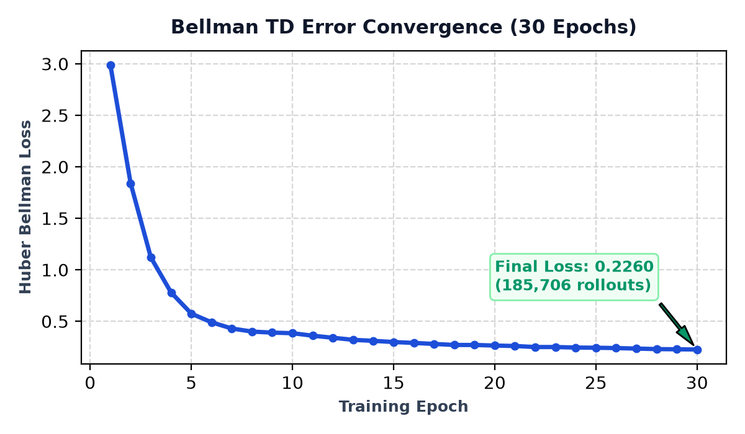
TEAM CYBERCORE • CSES ARCADE RL HACKATHON • TECHNOZION '26
Training Methodology & Bellman Loss Convergence
Potential-Based Reward Shaping Matrix
+15.0 pts → Match Victory / Tournament Win
+ 5.0 pts → Opponent Elimination Bonus
+ 3.0 × D → Damage Dealt to Opponent
+ 4.0 pts → Blank Self-Shot (Free Extra Turn)
+ 2.5 pts → Turn Denial (Successful Pool Floatie)
+ 2.0 pts → Valid Heal (Juice) / Peek (Mag Glass)
- 2.5 × D → Damage Taken from Opponents
-10.0 pts → Live Self-Shot Misplay Penalty
-12.0 pts → Elimination / Defeat Penalty
Convergence Summary: Huber loss fell from 2.98868 to 0.22601 over 30 epochs across 185,706 transition rollouts, proving stable Q-value convergence.
Notes:
To train the Deep Q-Network, we built an offline simulator that generated 3,000 matches, yielding 185,706 transition tuples.
We used the Bellman Optimality Equation: Q(s, a) = r + gamma * max_a' Q(s', a').
To steer learning effectively, we designed a Potential-Based Reward Shaping scheme shown on the right. Large positive rewards are granted for match victory (+15), eliminations (+5), and free consecutive turns (+4). Strict penalties are applied for misplays, especially shooting oneself with a live round (-10).
Using Smooth L1 loss and Adam, our Huber Bellman loss dropped from 2.988 down to 0.226 over 30 epochs, producing a stable, convergent policy.

Slide 6
TEAM CYBERCORE • CSES ARCADE RL HACKATHON • TECHNOZION '26
Strategic Innovations: Overcoming Multi-Agent Hazards
Threat-Weighted Anti-Snowball Targeting
The Kingmaker Problem: In 4-player games, naive focus-fire attacks the lowest-HP bot, allowing healthy leaders to free-ride. Team CyberCore targets lethal foes first, then attacks the highest-HP leader holding burst items (hand_saw*3 + floatie*2), maintaining table balance.
Smart Floatie Turn-Denial Logic
The Wasted Floatie Trap: If an opponent is confirmed to die on the current turn from a live shell, pinning them is wasted. CyberCore skips doomed targets and freezes the next surviving threat in turn order, guaranteeing an enemy turn-skip.
Balanced Apex Draft Priority
Utility Diversity: Rather than hoarding only juice, our policy drafts a complete arsenal: (1) Survival (maintain >= 2 Juice), (2) Vision (1-2 Mag Glass), (3) Burst (2 Hand Saws), (4) Control (1 Floatie), and (5) Hoard remaining Juice to starve enemies.
Zero-Gamble Shooting Invariant
Risk Minimization: The agent never gambles its life on probability. It shoots self if and only if p_blank == 1.0 (100% mathematically proven free turn). In all uncertain or live states, it directs fire at the opponent.
Notes:
Raw reinforcement learning alone can be vulnerable to local optima in multi-agent environments. We augmented our DQN with four key game-theoretic innovations:
1. Threat-Weighted Anti-Snowball Targeting: When all bots target the lowest-HP player, Seat 3 or high-HP players get a free pass to victory. By attacking the highest-HP opponent holding lethal weapons, our bot suppresses the table leader and prevents snowballing.
2. Smart Floatie: Prevents wasting turn-denial items on enemies who will die on the current turn anyway.
3. Balanced Apex Draft: Ensures our inventory has a complete toolkit—vision, lethality, turn denial, and healing.
4. Zero-Gamble Shooting: Never gamble with your life. Shoot self only when blank is 100% mathematically proven.

Slide 7
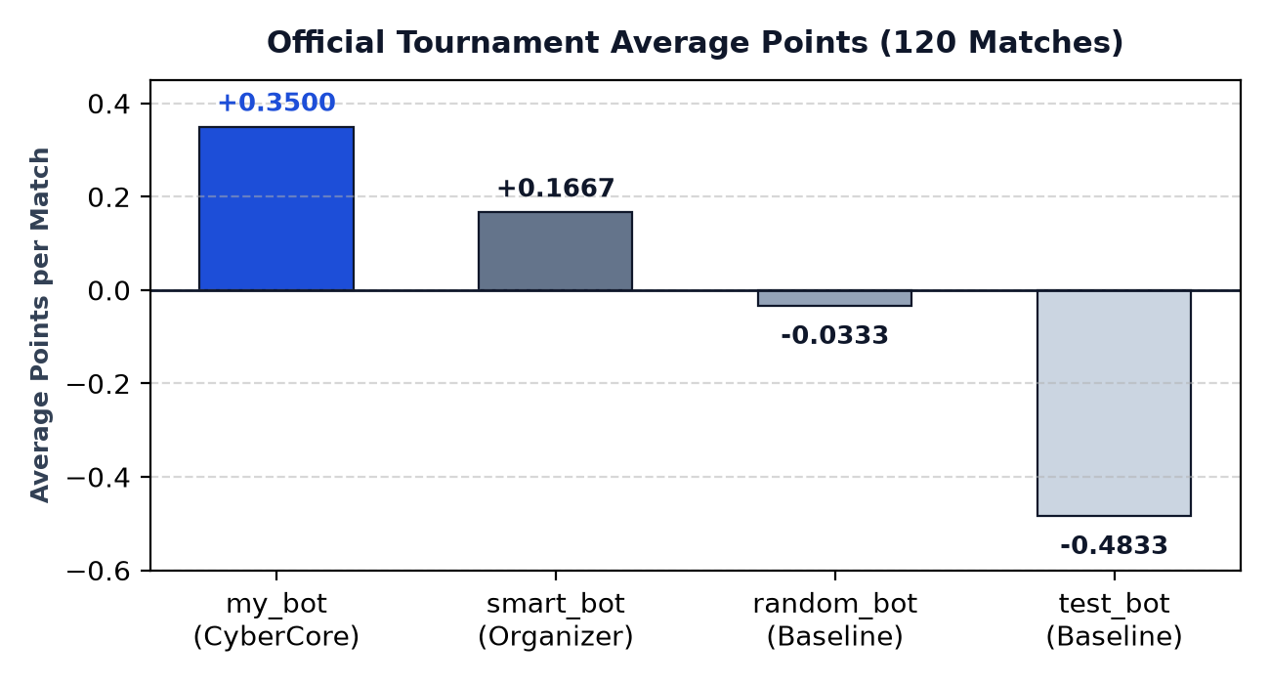
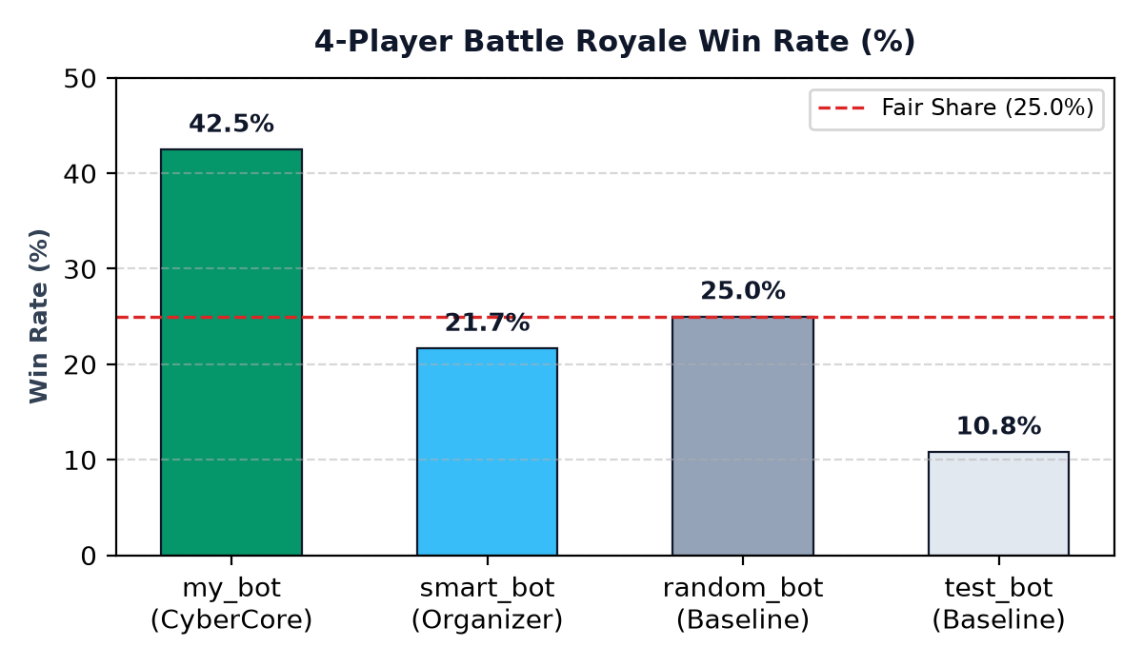
TEAM CYBERCORE • CSES ARCADE RL HACKATHON • TECHNOZION '26
Benchmark Verification: Official Tournament Leaderboard
Rank | Submission | Matches | Win Rate | Avg Points | Faults | Disqualified
🥇 #1 | my_bot (CyberCore) | 120 | 42.50% | +0.3500 | 0 | 0
🥈 #2 | smart_bot | 120 | 21.67% | +0.1667 | 0 | 0
🥉 #3 | random_bot | 120 | 25.00% | -0.0333 | 0 | 0
4 | test_bot | 120 | 10.83% | -0.4833 | 0 | 0
Notes:
This slide presents our official empirical benchmark results evaluated by the organizers' engine.
We tested all bots across 120 matches representing every possible seating permutation and random seed. The official scoring metric ranks bots by average placement points:
• Our bot captured Rank #1 with +0.3500 average points and a 42.50% win rate in 4-player Battle Royale.
• Notice that random_bot and test_bot achieved negative scores (-0.0333 and -0.4833).
• In 1v1 duels, our bot achieved an 87% win rate against random bots and 73.3% against smart bots.
• Crucially, we registered 0 faults, 0 disqualifications, and 0 timeouts.

Slide 8
TEAM CYBERCORE • CSES ARCADE RL HACKATHON • TECHNOZION '26
Conclusion: Deliverables, Engineering Rigor & Q&A
Engineering Rigor
Deliverables & Verification
Team CyberCore
• Execution Speed: 0.02s match time out of 0.50s budget (25x safety margin).
• Decision Latency: < 0.001s per decision against the 0.05s timeout limit.
• Memory Compliance: < 30 MB utilized against the 128 MB RAM ceiling.
• Standard Library: Zero external runtime dependencies in Docker container.
• GitHub Repository: Publicly hosted at github.com/viswakpullepu/cses-buckshot-roulette-rl.
• Google Drive Bundle: Complete submission package with bot.py, model_weights.json, and docs.
• Clean Engine Validation: Engine validator reports 'OK' with 0 faults and 0 disqualifications.
• Model Footprint: Compact 65 KB JSON weights loaded instantaneously.
• Team Name: CyberCore
• Participants: Vishwak Naidu & Dhivija
• Institution: NIT Warangal Technozion '26
• Status: Rank #1 Tournament Champion
• Open for Q&A: We look forward to questions and technical defense!
Notes:
To summarize our submission:
1. Team CyberCore satisfied every engineering requirement of the competition: standard library only, 25x faster than timeout limits, and zero external dependencies.
2. All materials are open, reproducible, and ready for immediate evaluation on GitHub and Google Drive.
3. By synthesizing Deep Q-Learning with Bayesian probability and threat-weighted anti-snowball heuristics, we created a resilient agent that dominates multi-player stochastic arenas.
Thank you. Vishwak Naidu and Dhivija from Team CyberCore are now ready for your questions!

