Slide 1
CAPSTONE 2
AI Hiring Intelligence
System
A multi-agent workflow grounded in RAG, served live via Streamlit.
- Viswa Nalam
n8n
OpenAI
Pinecone
Streamlit
GitHub

Slide 2
01 — PROBLEM
2
Hiring data is rich but underused
↘
⚡
$
Hidden inefficiencies
Slow insights
Fragmented tools
Manual analysis can't keep up with 200+ candidate data points across 8 channels and 10 interviewers.
By the time HR sees patterns in rejection reasons or panel overload, the damage to candidate pipeline is done.
Sourcing, evaluation, offers, and pipeline health live in different dashboards — no unified intelligence layer.

Slide 3
02 — SOLUTION
3
Five specialised agents, one intelligence layer
Each agent owns one domain, runs in parallel, and is grounded in a Pinecone RAG knowledge base of hiring benchmarks.
1
2
3
4
5
Sourcing
Quality
Rejection
Pattern
Panel Load
Balancer
Offer
Insights
Pipeline
Health
Which channels are worth the spend?
Why do candidates get filtered out?
Which interviewers are overloaded?
Why do candidates decline offers?
Where are SLAs at risk?
+ 3 supporting agents — Routing, Evaluation, Optimization

Slide 4
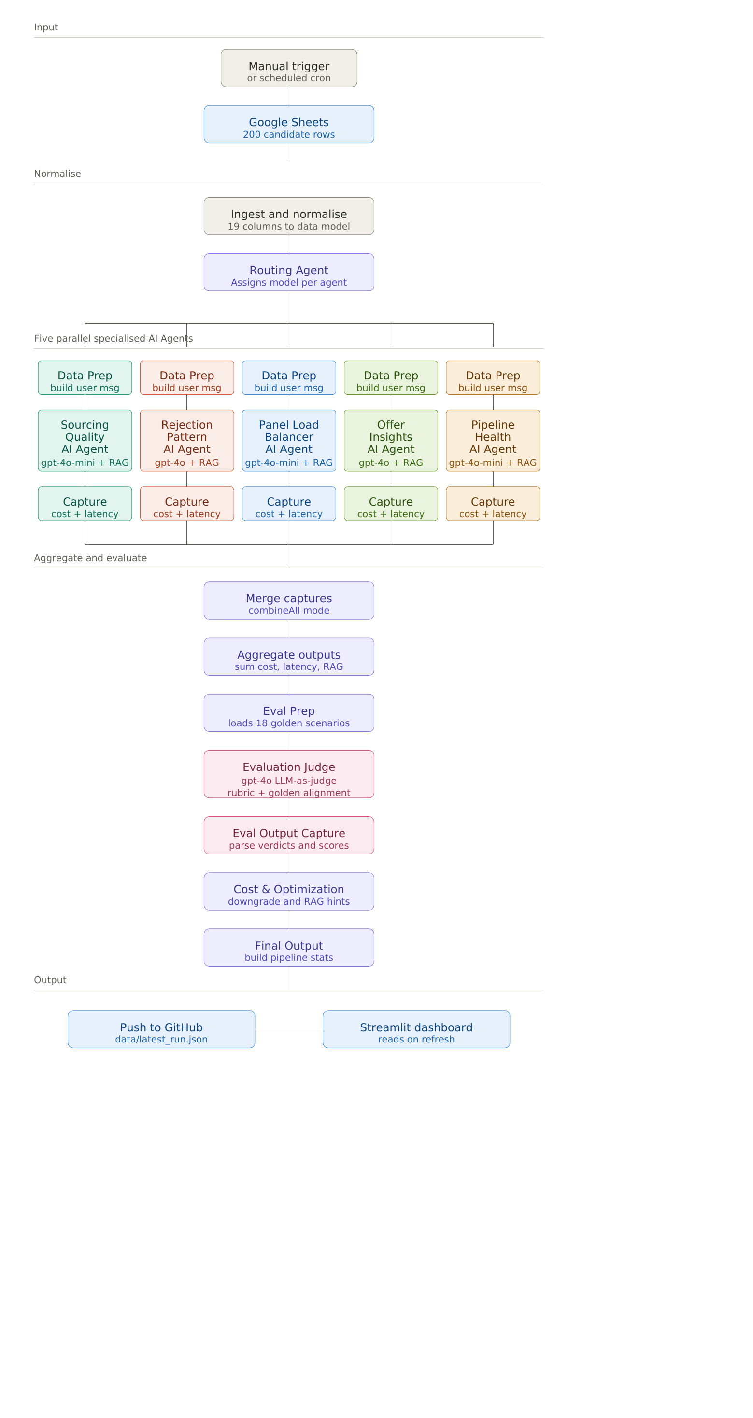
03 — ARCHITECTURE
4
End-to-end workflow
How it flows
1
Input
Manual trigger or scheduled cron pulls 200 candidate rows from Google Sheets.
2
Normalise
Maps 19 CSV columns into structured candidate, interviewer, and role objects.
3
Route
Routing Agent assigns gpt-4o (deep reasoning) or gpt-4o-mini (structured) per agent.
4
Parallel run
5 specialised agents run simultaneously — Embed → RAG → Prompt → LLM → Parse.
5
Aggregate
Merge → Evaluation → Optimization → Final Output (with live pipeline stats).
6
Output
Pushed to GitHub as JSON. Streamlit reads it on next refresh.

Slide 5
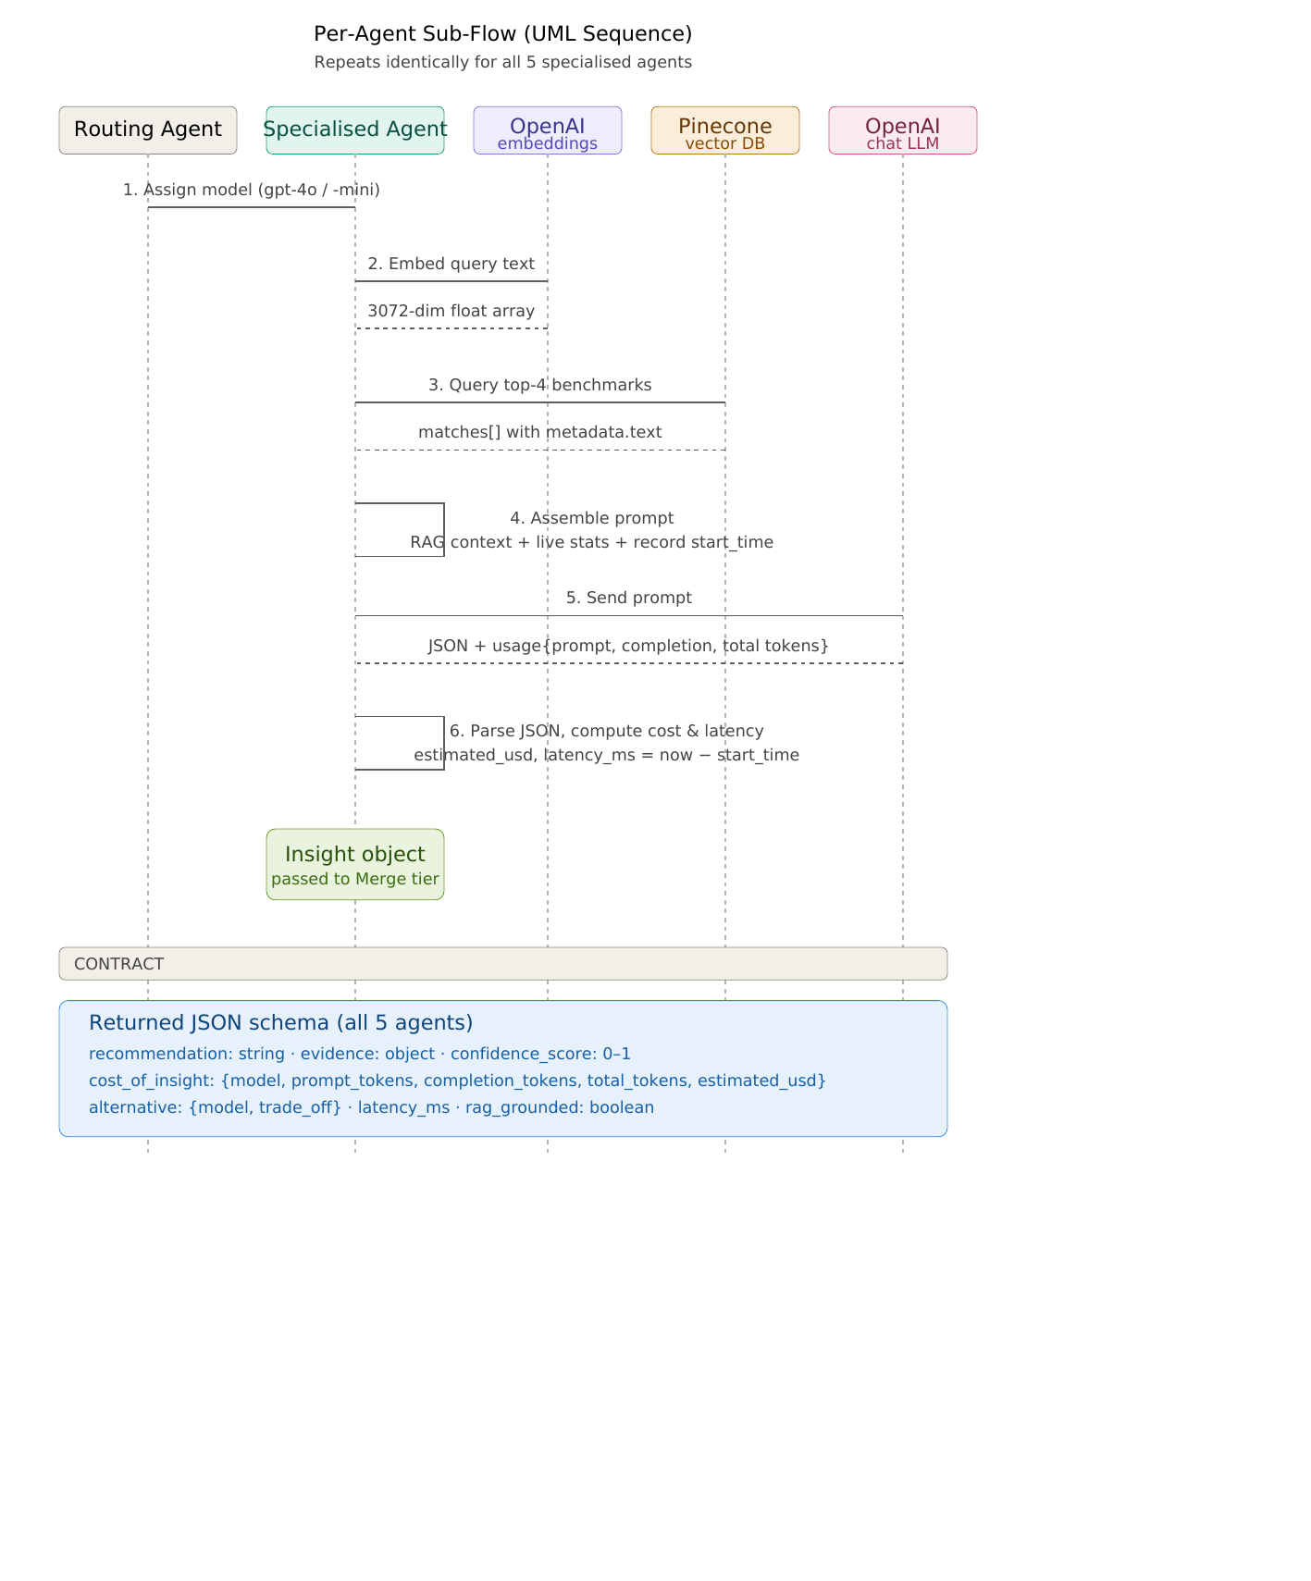
04 — AGENT INTERNALS
5
What each agent does (UML sequence)
What you're seeing
The same six steps repeat for each of the 5 agents. Solid arrows are calls. Dashed arrows are returns.
1
Routing Agent assigns a model to the specialised agent.
2
Agent embeds its query via OpenAI text-embedding-3-large.
3
Agent queries Pinecone for top-4 matching benchmarks.
4
Agent assembles the full prompt and records start_time.
5
Agent sends prompt to OpenAI LLM (gpt-4o or gpt-4o-mini).
6
Agent parses JSON, computes real cost and latency.

Slide 6
05 — CONTRACT
6
Every agent returns the same JSON shape
This shared schema is what makes the system composable — evaluation, optimization, and the dashboard all read these fields.
{
"recommendation": "One clear actionable sentence",
"evidence": {
"key_insight": "Supporting data summary",
"counts": { ... }
},
"confidence_score": 0.88,
"cost_of_insight": {
"model": "gpt-4o-mini",
"prompt_tokens": 1243,
"completion_tokens": 187,
"total_tokens": 1430,
"estimated_usd": 0.000298
},
"alternative": {
"model": "gpt-4o",
"trade_off": "Higher accuracy but 10x cost"
},
"latency_ms": 2800,
"rag_grounded": true
}
recommendation
The headline output — one sentence the user acts on.
evidence
Structured supporting data — counts, rates, key insight.
confidence_score
Agent's self-assessed confidence (0–1).
cost_of_insight
Real token usage and USD cost from OpenAI.
alternative
Trade-off info: which other model could run this.

Slide 7
06 — EVALUATION
7
Every insight is scored across 5 dimensions
Actionability
Recommendation > 60 chars (specific enough to act on)
0.5 or 1.0
Grounding
RAG context returned > 50 chars from Pinecone
0.3 or 1.0
Confidence
Agent's self-reported confidence ≥ 0.7
0.6 or 1.0
Schema Valid
All 5 required fields present in returned JSON
0.0 or 1.0
RAG Grounded
Pinecone returned relevant docs (length > 50)
0.0 or 1.0
Overall score = mean of 5 dimensions. Healthy runs hit 1.0 across all agents.

Slide 8
07 — OPTIMIZATION
8
Cost reduction via model downgrades
BEFORE
AFTER
REDUCTION
N/A
$0.0401
0.0049
per run
per run
if downgrades applied
Quality risk
Rejection Pattern: Low — structured data lends itself to gpt-4o-mini.
Offer Insights: Medium — multi-factor reasoning may suffer. Test for 2 weeks before committing.
Recommendation: Run both on gpt-4o-mini for 2 weeks, measure eval score delta, then commit.

Slide 9
08 — OUTPUT
9
Live dashboard, zero local setup
hiring-intelligence.streamlit.app
What it shows
✓
All 5 agent recommendations
200
57
34
114
29
With confidence, model, cost, latency.
Candidates
Offers
Accepted
Rejected
Active
✓
Live pipeline metrics
Sourcing Quality
Increase Referral by 30% — 41.2% offer rate vs 12.5% LinkedIn.
Funnel, channels, rejection breakdown.
✓
Interviewer load distribution
Rejection Pattern
26.3% of rejections are process failures, not candidate quality.
Identifies overloaded panellists.
✓
Evaluation radar
Panel Load Balancer
Move 12 panels from Sam Rivera to Casey Kim and Morgan Chen.
Quality score across 5 dimensions.
✓
Cost & latency tracking
Offer Insights
Reduce time-to-offer to under 5 days — 39% of declines are speed-related.
Real token usage from OpenAI.

Slide 10
09 — DECISIONS
10
Why we picked these tools
n8n
Visual orchestration with built-in retry, fan-out, and credential management — no Python sidecar.
Pinecone
Serverless free tier with REST API. ChromaDB or FAISS would need a hosted server.
3-large
text-embedding-3-large (3072-dim) — short domain-specific docs benefit from higher quality.
GitHub
Free bridge between n8n and Streamlit. Avoids provisioning a database for JSON output.
Streamlit
Free Cloud, deploys from GitHub in 2 minutes. No server config. Plotly charts work natively.
Full reflections in the documentation package — section 4.4.

Slide 11
THANK YOU
AI Hiring Intelligence System
Questions?
n8n
OpenAI
Pinecone
Streamlit
GitHub

