Slide 1





NAAN MUDHALVAN
Cloud-Hosted Banking Data Analytics and Reporting System on AWS
Project Created by: VISWANAND M, VISHAL R, YASHWANTH KARTHIKEYAN H, LOKESHWARAN T
Project Created Date: 21/Nov/2024
College Code: 3135
College Name: Panimalar Engineering College Chennai City Campus
Team Name: NM2024TMID13810

Slide 2
Project Title : Cloud-hosted Banking Data Analytics and Reporting System on AWS

Slide 3
Abstract
The "Cloud-hosted Banking Data Analytics and Reporting System on AWS" project is a Flask-based cloud banking application deployed on AWS. Key steps include setting up IAM users, an EC2 instance for deployment, and an RDS instance for MySQL database management. The app features user registration, login, account management, and transactions, with templates for essential banking functions. CloudWatch Logs monitor performance and ensure security. Testing covers functionality, security, and load handling, with RDS backups and disaster recovery enhancing reliability. Continuous monitoring and updates optimize performance and cost-effectiveness.

Slide 4
Project description
Cloud-hosted Banking Data Analytics and Reporting System on AWS is a cloud-based banking web application designed to provide seamless banking services such as account management, transactions, and balance inquiries. The project leverages Amazon Web Services (AWS) for a scalable and secure infrastructure, utilizing Amazon EC2 for application hosting, Amazon RDS for efficient and reliable MySQL database management, and AWS CloudWatch for performance monitoring and log management. The system is designed with robust security measures, automated backups, and disaster recovery protocols, ensuring high availability and data integrity.

Slide 5
Project Creation Technique
AWS Setup: Created an AWS account, configured IAM roles, enabled MFA, and set up billing.
Local Development: Installed Python, Flask, and necessary libraries. Organized the project with templates and static files.
Database (RDS): Deployed an Amazon RDS MySQL instance with secure configuration for data management.
Instance Creation: Launched an Amazon Linux EC2 instance, configured security groups (SSH, HTTP/HTTPS), and installed required software (Python, pip).
App Development: Developed core banking features (registration, login, transactions) using Flask, HTML, CSS, and JavaScript.
Deployment (EC2): Transferred application files, set environment variables, and hosted the app on EC2.
Monitoring: Configured AWS CloudWatch for logs, system metrics, and performance alerts.
Testing & Security: Conducted functionality, security, and load testing with automated RDS backups and disaster recovery setup.
Continuous Improvement: Regularly updated resources, monitored usage, and optimized costs for efficiency.

Slide 6
Project Frontend
The Cloud-hosted Banking Data Analytics and Reporting System on AWS frontend is designed to deliver a user-friendly and responsive banking experience. It includes the following:
HTML Templates: Home Page , User Registration and Login Pages , Account Dashboard , Transaction, Balance Inquiry, and Statement PagesServices and Contact Pages
CSS Styling: Custom CSS files for consistent and appealing design. Responsive layouts for seamless use across devices.
JavaScript Functionality: Dynamic interactions for forms and user actions. Input validations and enhanced user experience.
Directory Structure:
Templates Directory: Stores all HTML templates.
Static Directory: Contains CSS and JavaScript files.

Slide 7
Project Database Creation
The Cloud-hosted Banking Data Analytics and Reporting System on AWS database is designed and managed using Amazon RDS with the following steps:
RDS Instance Setup: Selected MySQL as the database engine. Configured instance settings (db.t3.micro for testing).
Set up a master username, password, and database name.
Secure Configuration: Allowed access from specific IPs for development and testing. Configured security groups for controlled database access.
Schema Design: Created tables for users, accounts, transactions, and balances.Ensured normalization for efficient data storage and retrieval.
Database Connection: Connected the Flask application to the RDS instance using mysql-connector-python.Stored connection details securely as environment variables.
Backup and Recovery: Enabled automated RDS snapshots for periodic backups. Designed a disaster recovery plan for failover in case of issues.

Slide 8
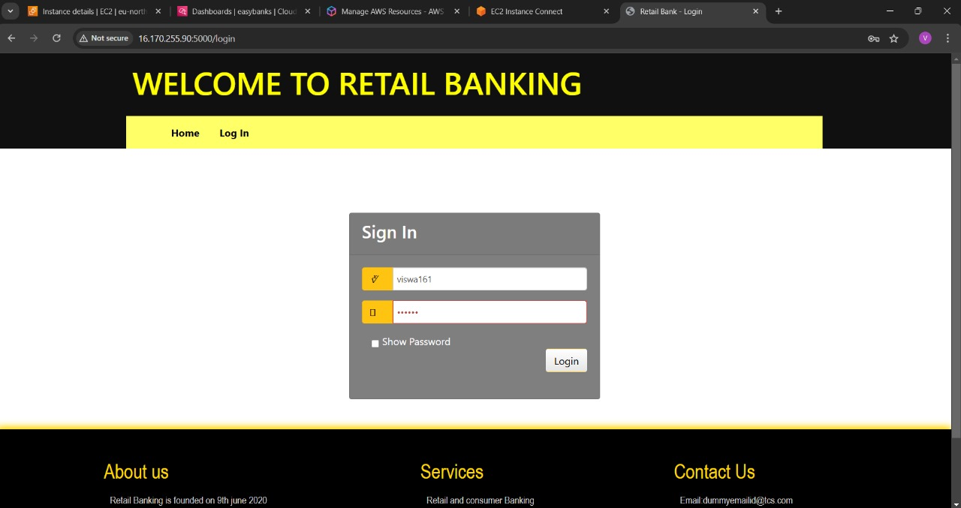

Slide 9
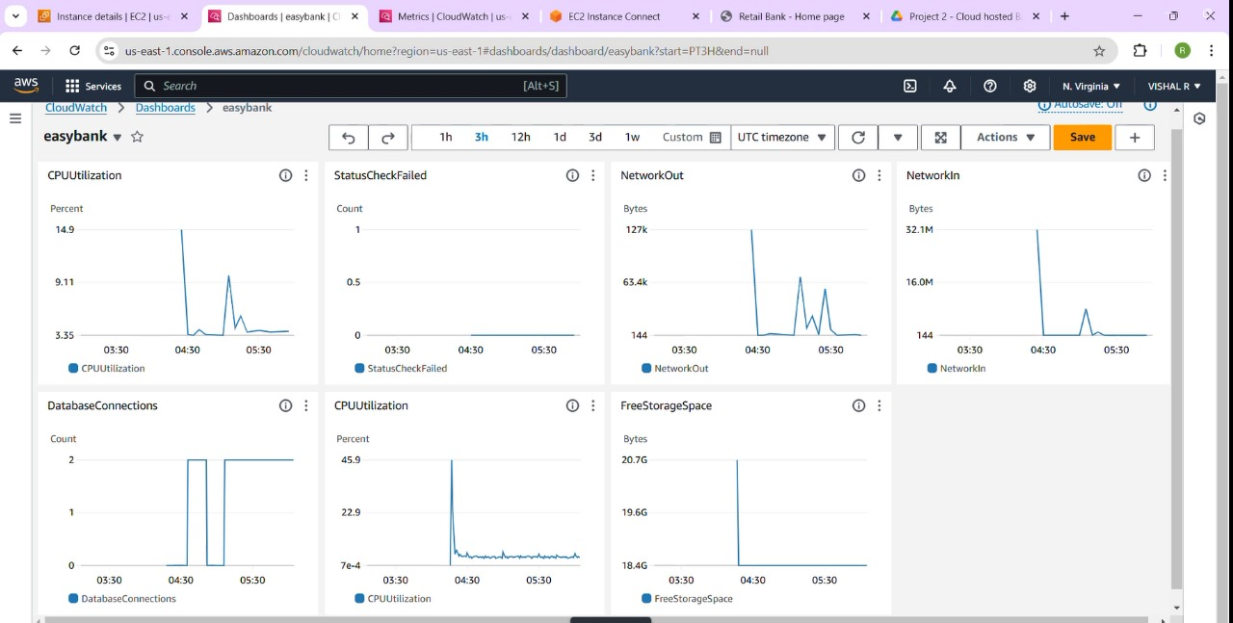

Slide 10
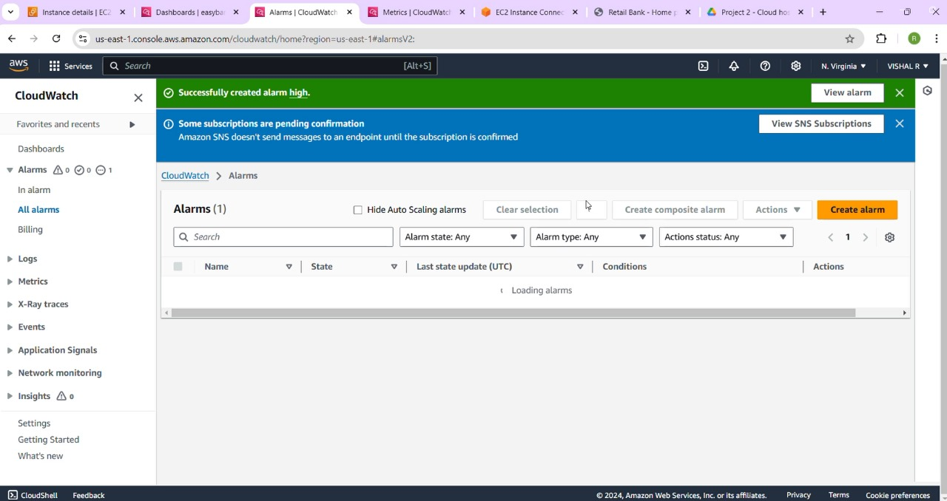

Slide 11
Conclusion
Deploying a cloud-hosted Banking Data Analytics and Reporting System on AWS empowers financial institutions to harness the full potential of their data. By leveraging AWS’s comprehensive and secure cloud platform, banks can achieve enhanced operational efficiency, better risk management, and superior customer insights.

