Slide 1
LAPTOP PRICE ANALYSIS
Presented by: K. Sri Viswanath
Roll Number: B2025047210
Batch: RP-36
DA/DS: May-2025
Mode: Offline

Slide 2
INTRODUCTION
Wide variety of laptops makes choosing difficult
Dataset includes brand, CPU, RAM, storage, display size, OS
Goal: Understand factors affecting laptop pricing and performance

Slide 3
OBJECTIVE
Identify key features that influence cost
Clean and process data for clear analysis
Use charts and metrics for better insights
Help buyers compare options easily

Slide 4
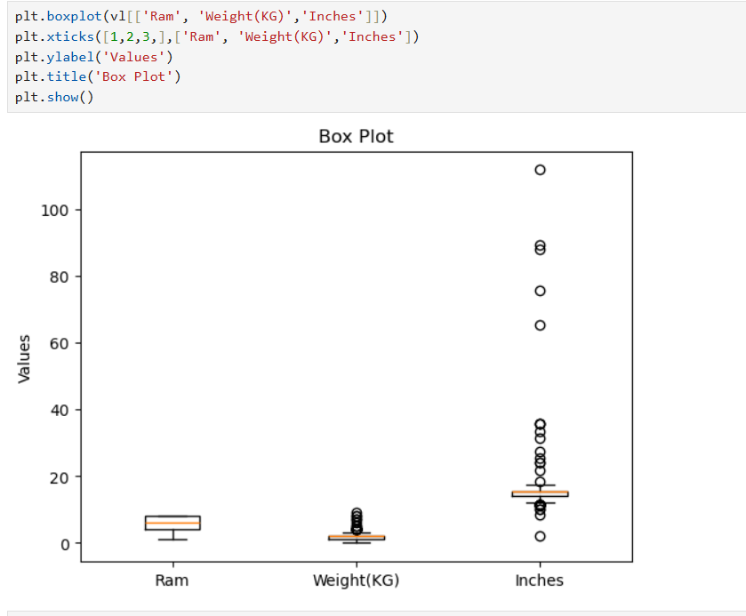
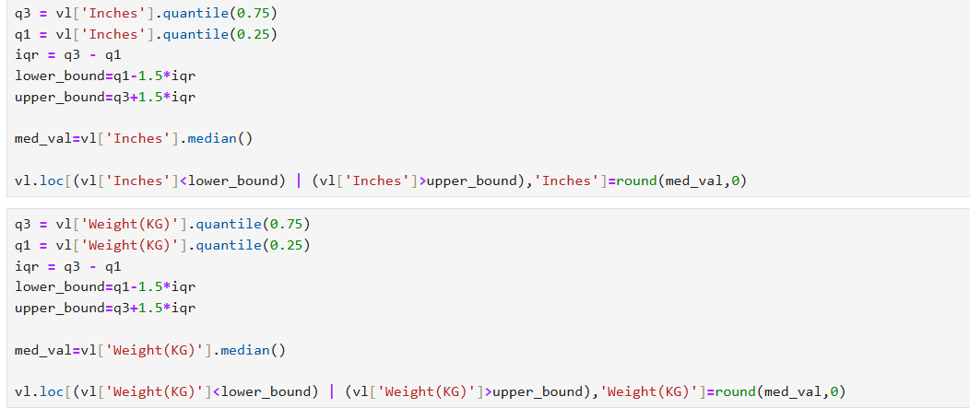

DATA CLEANING
Some fields like display size, model type, and RAM had missing entries. We used forward-fill and backward-fill to address this. For numerical columns, missing values were filled using mean imputation.
Outliers in numerical fields such as price or weight can mislead analysis. We used box plots and value checks to detect and understand anomalies. Unrealistic outliers were flagged but only removed if proven invalid
Data rows with faulty or duplicate entries were removed. This step ensured that the final dataset only included credible and relevant laptop data.

Slide 5
FUTURE ENGINEERING
Split RAM column into number and unit
Cleaned Inches and Weight to numeric
Added Price per Inch and RAM per Rupee metrics
Marked SSD storage and dedicated GPU as binary columns
Grouped Weight & Price into categories
Extracted CPU generation where possible

Slide 6
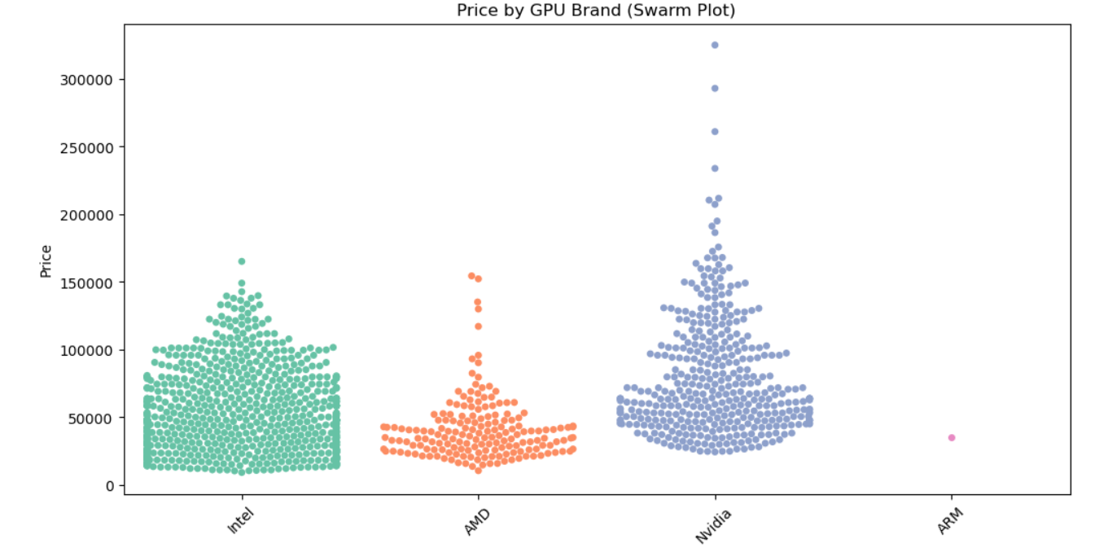
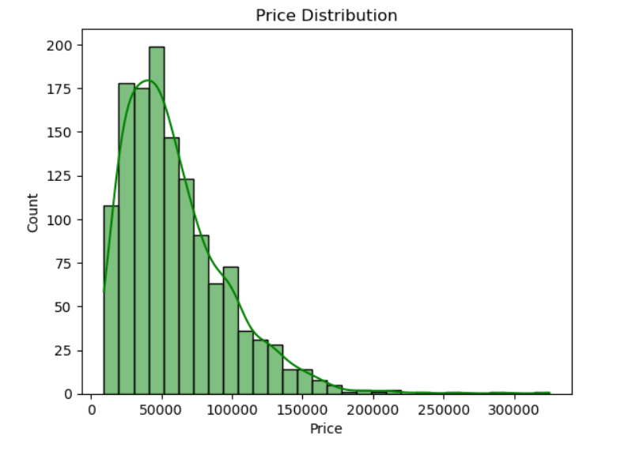
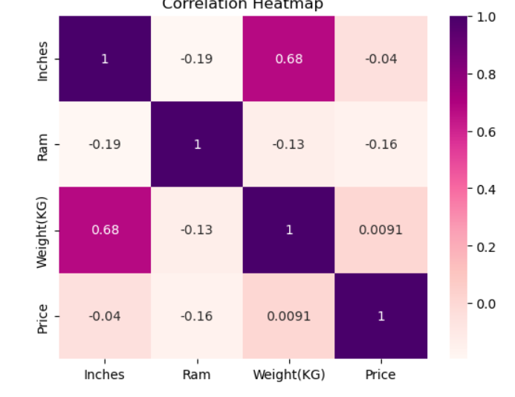
EDA (Exploratory Data Analysis)
Univariate: Histograms, bar plot for Price, RAM, Screen Size
Bivariate: Price vs. RAM, Price vs. Type, Price vs. Inches
Multivariate: Pair plots, heatmaps, group-wise brand comparison

Slide 7
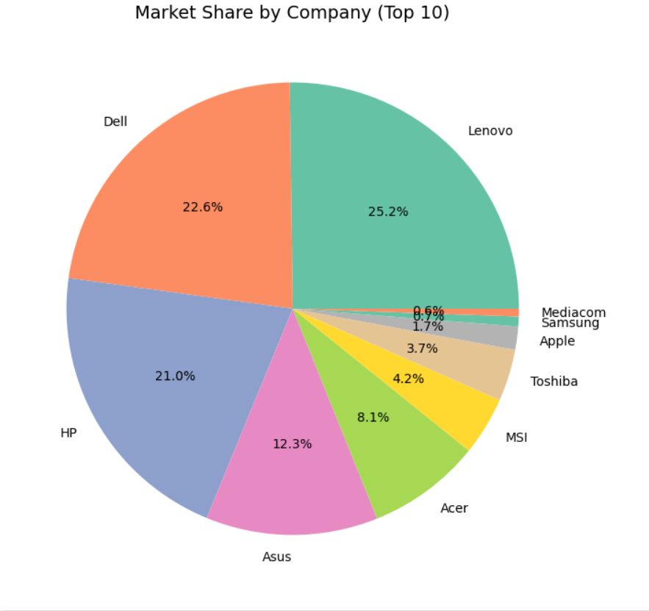
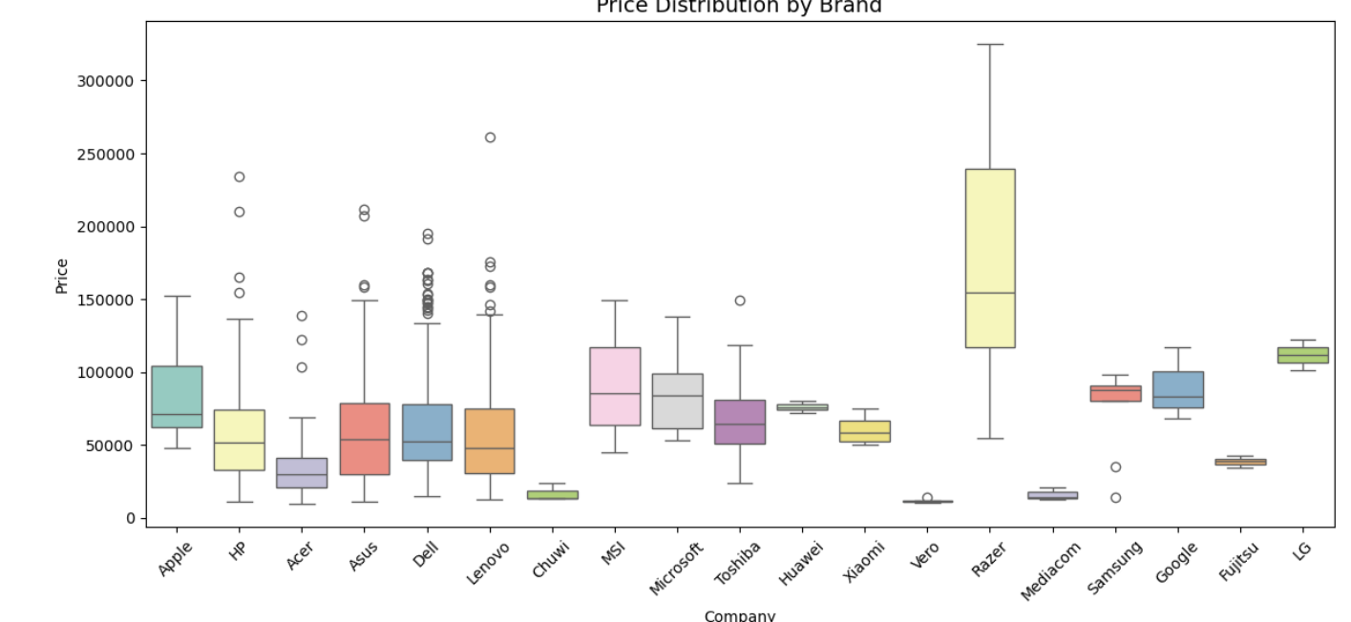
VISUALIZATIONS
Charts show trends: higher RAM & bigger screens cost more
Heatmaps show correlation between specs and price
Boxplots and scatterplots for spotting outliers and relationships

Slide 8
INSIGHTS
Most laptops are mid-priced
Gaming laptops cost the most
More RAM and bigger screens increase price up to a limit
Premium brands like Apple are costlier for similar specs
SSDs & dedicated GPUs raise prices
CPU generation impacts cost
New metrics help compare value for money

Slide 9
CONCLUSION
Clean data + feature engineering reveals clear price drivers
Helps buyers choose wisely
Can support price prediction tools in future

Slide 10
THANK YOU

