Slide 1
HACKETHON
Smart Surveillance
Darshana Sayare
210550354008
Gitesh Shewatkar
(210550354009)
Viswanth sai srinadh
(210550354010)
JYOTHULA RAMKI
(210550354011)
Manasa Batchu
(2105503540012)

Slide 2
Introduction
We are introducing a smart surveillance system
This surveillance system does not required person presence all the time

Slide 3
Project objective
All data is stored in the cloud
Alert the user automatically
Measure the distance between human and fence

Slide 4
Hardware
ESP8266(Nodemcu)
PIR Sensor(Passive Infrared)
Ultrasonic sensor
Buzzer

Slide 5
Software
Arduino IDE
Thinkspeak

Slide 6
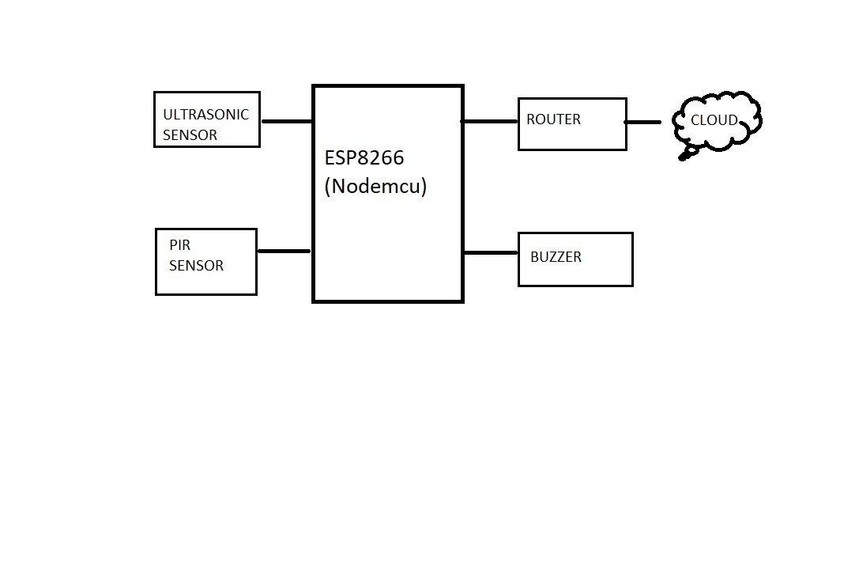
BLOCK DAIGRAM

Slide 7
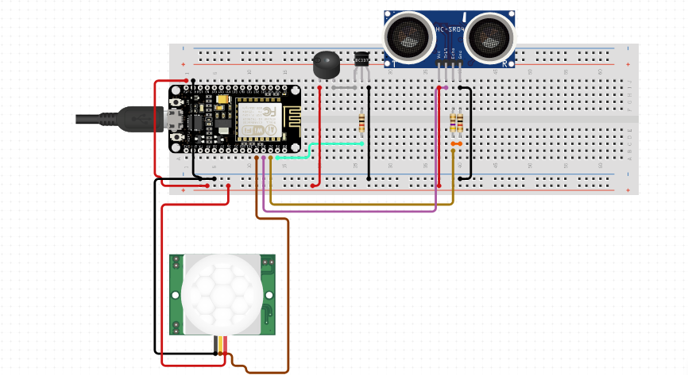
CIRCUIT DAIGRAM

Slide 8
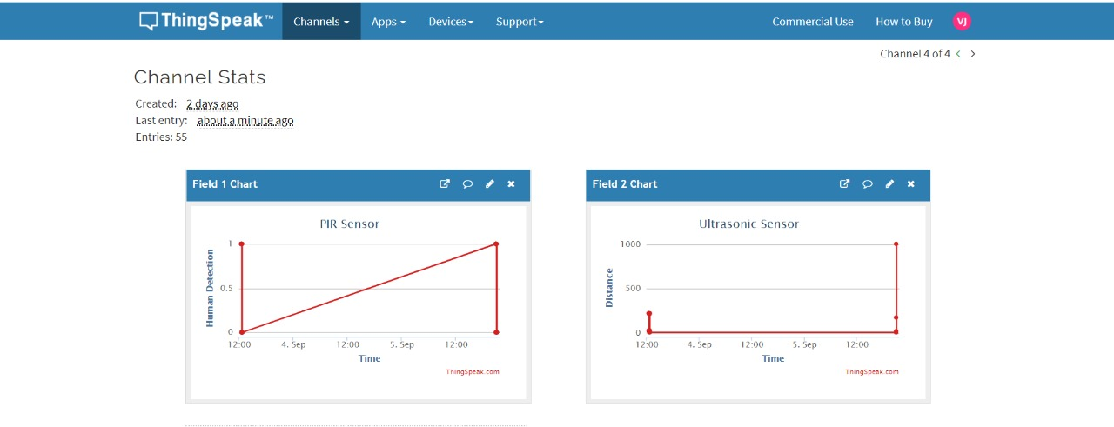
OUTPUT

Slide 9
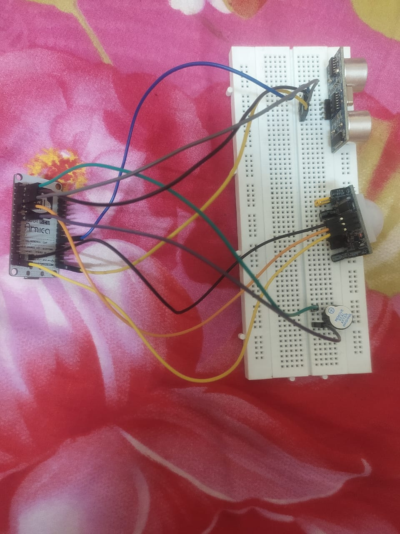
HARDWARE IMPLEMENTATION

Slide 10
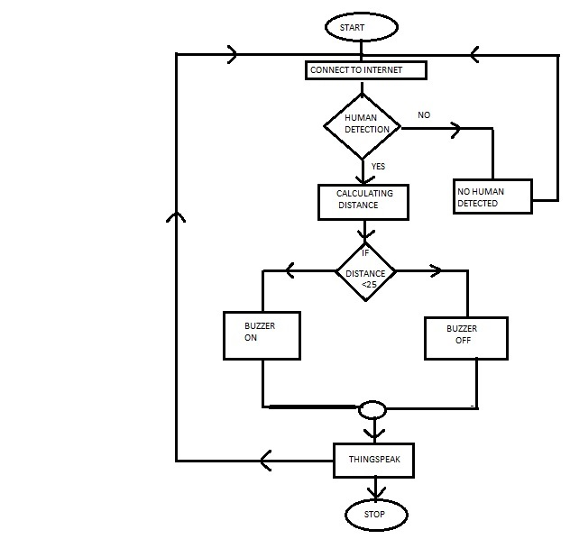
FLOWCHART

Slide 11
ADVANTAGES
Low installation cost
Less human interaction
Power efficient

Slide 12
FUTURE SCOPE
We can use camera model
Thermal detection camera
Face detection

Slide 13


