Slide 1


Title: Web Scraping and Exploratory Data Analysis of Chimneys

Slide 2
About Us:
We are Bhargava Sai, Viswa, Sriram B.Tech graduate passionate about Data Analytics and Visualization.
Exploring data-driven insights through real-world datasets.
Interested in web data extraction and business trend analysis.
LINKEDIN: https://www.linkedin.com/in/viswas-atyam-100193253/
GITHUB: https://github.com/viswas25/EDA-Project

Slide 3
Introduction:
The project aims to analyze chimney products available on Flipkart using data obtained through web scraping, to understand customer preferences, pricing trends, and brand performance.
The main objective of this study is to perform Exploratory Data Analysis (EDA) on the collected data to identify trends, customer preferences, and pricing patterns within the online chimney market.
The dataset was cleaned and processed to remove irrelevant or duplicate information, making it suitable for analysis. This ensures that the results and insights derived from the data are accurate and meaningful.
Through this project, insights were drawn regarding the most popular brands, most common suction capacities, frequently preferred sizes, and how price and ratings influence customer buying behavior on Flipkart.

Slide 4
Business Problem:
The online home appliance market is highly competitive, and brands struggle to understand which factors — such as price, ratings, or suction capacity — most influence customer purchase decisions for chimneys.
Companies lack data-driven insights on how pricing, ratings, and customer reviews affect product popularity and brand performance on e-commerce platforms like Flipkart.
There is a need to analyze Flipkart product data to uncover patterns in customer preferences, pricing trends, and ratings to help brands improve marketing and pricing strategies effectively.

Slide 5
Objectives:
To collect and organize chimney product data from Flipkart through web scraping, including attributes such as brand, price, rating, reviews, suction capacity, and size.
To perform Exploratory Data Analysis (EDA) to identify patterns, trends, and relationships between different product features like price, rating, and brand performance.
To visualize the data using charts and plots for better understanding of customer preferences and market distribution.
To derive meaningful business insights that can help brands optimize pricing, improve customer satisfaction, and enhance product visibility in the online market.

Slide 6
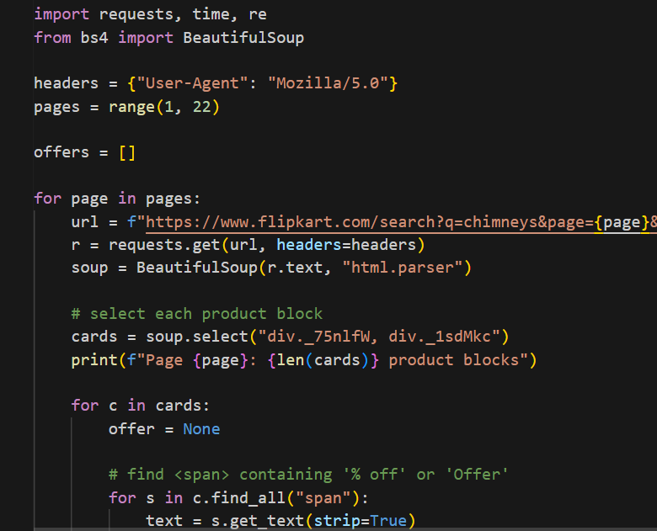
Web Scraping:
Flipkart’s official website was selected as the primary data source for extracting chimney-related product information.
The data was scraped using Python libraries — BeautifulSoup and Requests to collect structured details of various chimney products.
The extracted attributes included: Product Name, Brand, Price, Rating, Offer, Review Count, Suction Capacity,Size, Offer_clean, Suction_clean, Rating_Performance, suction_bins.
                The scraped data was cleaned and saved in a CSV file format for further data analysis and visualization.

Slide 7





Tools Used:

Slide 8
Data Cleaning Steps:
The raw dataset obtained from Flipkart contained 456 rows and 8 columns, which included duplicate and incomplete records.
Missing values in columns such as Price, Rating, and Review Count were identified and handled using appropriate cleaning methods like removal or imputation.
Duplicate product entries and irrelevant data were removed to ensure data consistency and reliability. Data types were converted into suitable formats — for example, Price was converted from text to numeric and Rating from string to float values.
Additional useful features such as Offer Percentage and Brand Category were extracted from existing columns to enhance analysis.
After cleaning and preprocessing, the final dataset contained 451 rows and 10 well-structured columns, ensuring it was accurate, consistent, and ready for Exploratory Data Analysis (EDA).

Slide 9
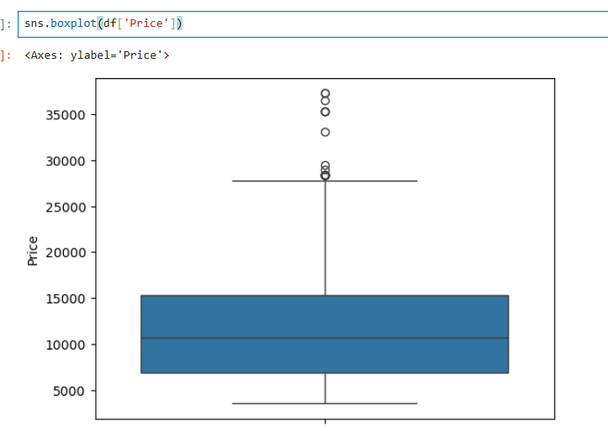
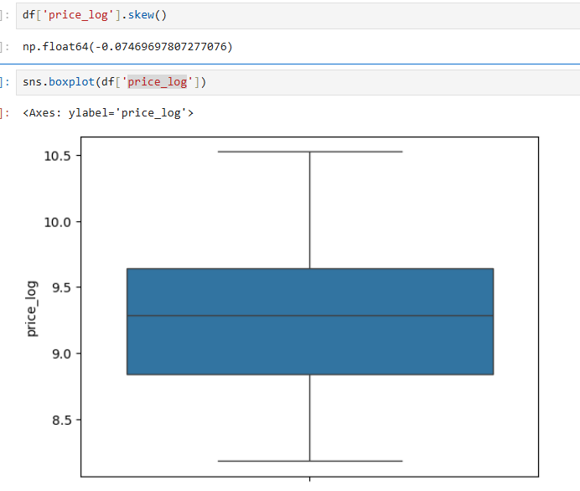
Removing Outliers using Log Transformation

Slide 10
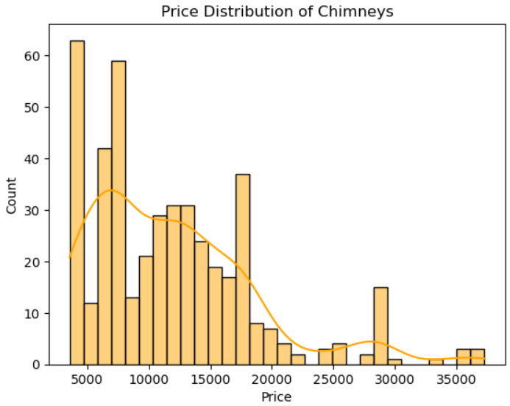
Price Distribution of Chimneys:
Most chimneys are priced between ₹5,000 – 20,000.
Only a few premium models go above ₹20,000.
Distribution is right-skewed, showing affordability focus.
Represents a price-sensitive market segment.
Most chimneys are mid-range products, indicating brands target budget-conscious customers.

Slide 11
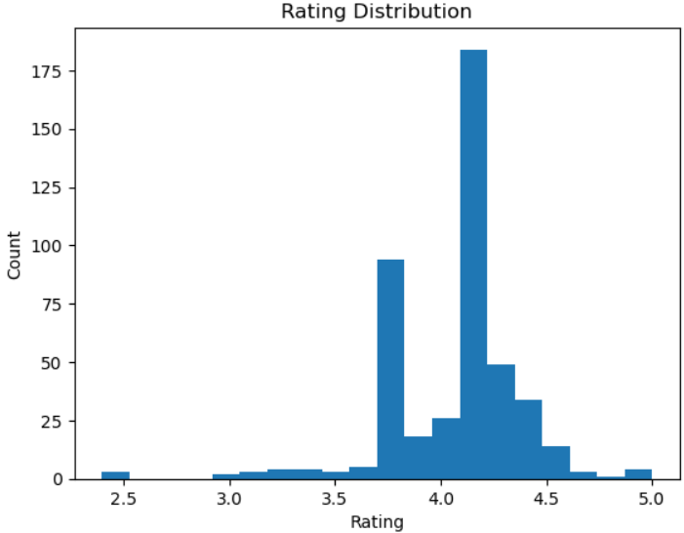
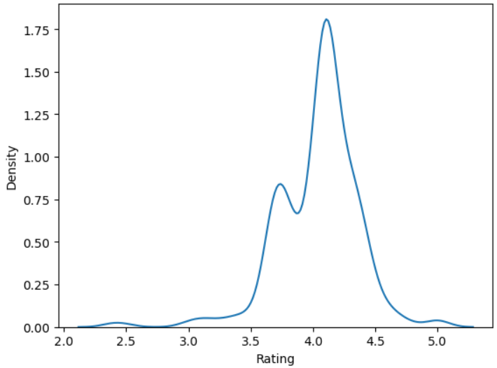
Customer Rating Distribution :
Majority of chimneys have ratings between 3.8 and 4.5.
Indicates consistently positive customer satisfaction.
Very few products fall below 3 — minimal negative feedback.
Slightly left-skewed, showing overall good reviews.
In this the summary is customers are generally happy, showing that most chimney models are reliable and well-received.

Slide 12
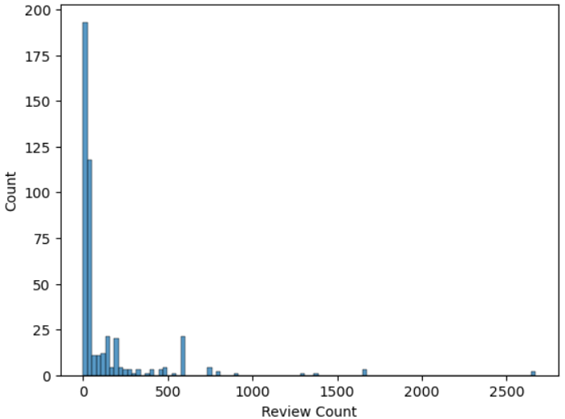
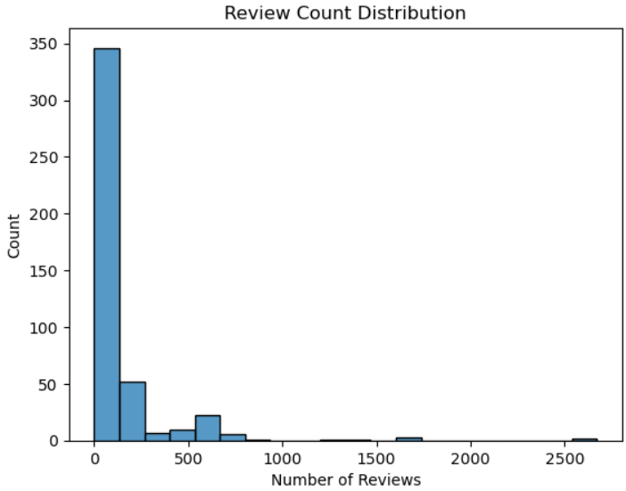
Review Count Distribution :
The review counts are highly right-skewed, meaning most products have very few reviews.
A majority of products have under 100 reviews, showing relatively low customer engagement.
However, a small number of products have extremely high reviews (500–2000+), indicating clear bestsellers.
This suggests that a few popular models are driving most of the attention and customer trust in the market.
Overall Summary:
The market’s popularity is not evenly spread-a handful of top models dominate, while the majority remain less noticed.

Slide 13
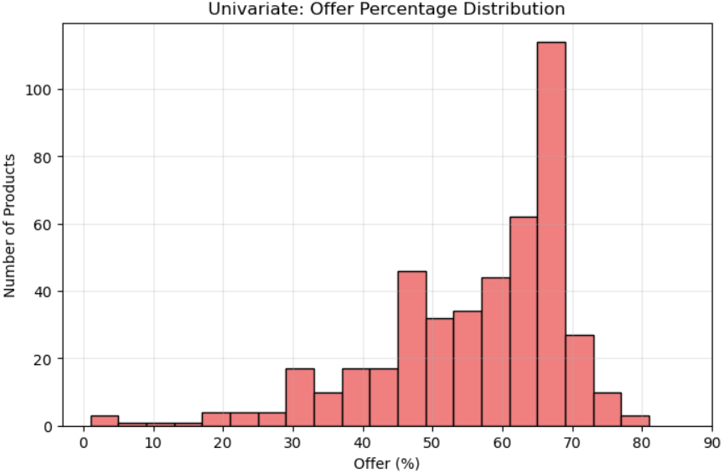
Discount Offers on Chimneys :
Most products are offered at 40% to 70% discounts.
There is a noticeable peak around 60–70%, which appears to be the most common discount range.
This indicates a highly competitive and discount-focused market.
Brands seem to use discounts strategically to attract price-sensitive, mid-range buyers.
Overall Summary:
Heavy discounting is a key marketing tactic used to drive sales and stand out in a crowded market segment.

Slide 14
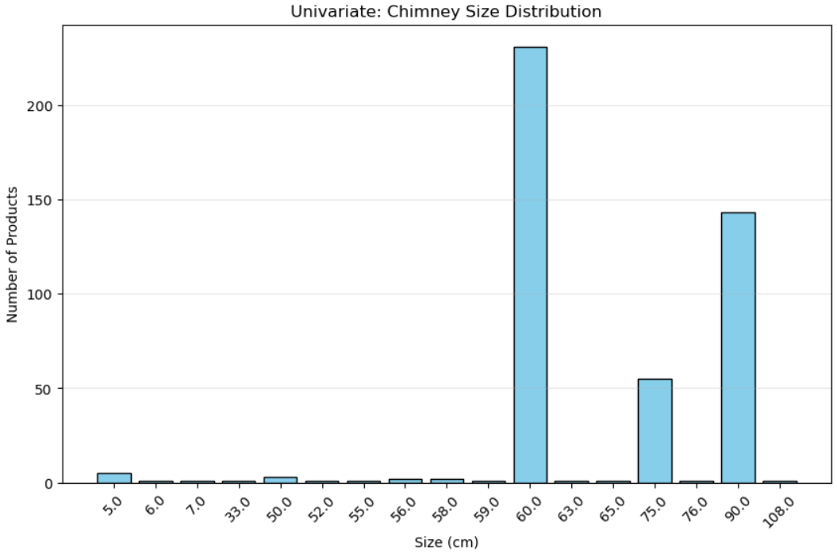
Popular Chimney Sizes :
60 cm models are the most common, dominating the market.
90 cm chimneys come next in popularity.
Only a small number of products are available in other sizes (e.g., 75 cm, 108 cm).
This reflects a focus on typical Indian kitchen dimensions.
Overall Summary:
The 60 cm size is the standard choice for most households, aligning well with average stove widths and kitchen layouts.

Slide 15
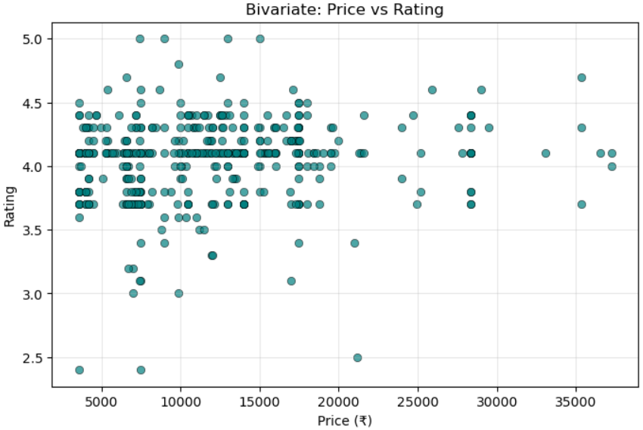
Price VS Rating :
There is no clear correlation between product price and customer ratings.
Ratings generally remain within the 3.8 to 4.5 range, regardless of price.
This suggests customers prioritize quality and performance over cost.
Higher-priced products do not necessarily receive better ratings.
Overall Summary:
Price does not guarantee satisfaction — customers often favor reliable mid-range products that deliver good performance for the value.

Slide 16
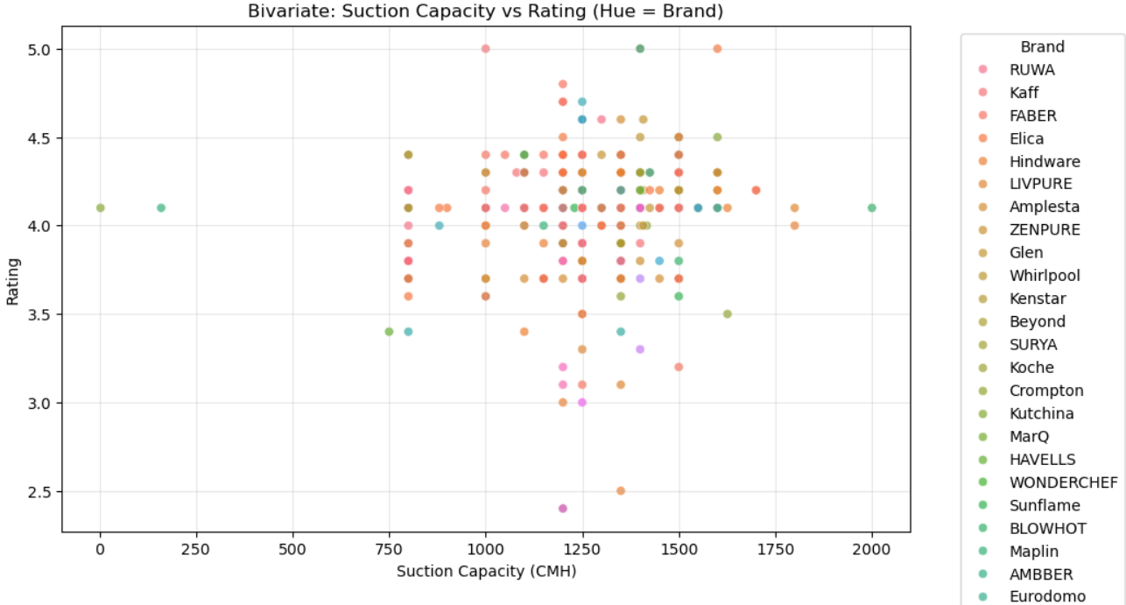
Brand Performance: Suction Capacity vs Rating :
Ratings remain consistently high across different brands.
There is no strong link between suction power and customer ratings.
Some brands achieve high ratings even with mid-range suction levels.
This suggests that brand trust and reputation play a major role in customer satisfaction.
Overall Summary:
Customer satisfaction is driven more by brand credibility than by technical specifications alone.

Slide 17
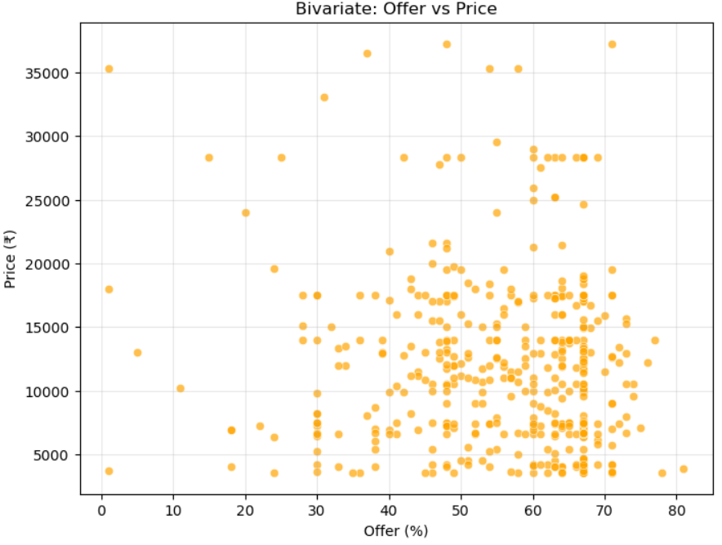
Offer Percentage VS Price :
There is a slightly negative trend — higher-priced models tend to have smaller discounts.
Mid-range products (₹8K–₹15K) usually offer the highest discounts.
This suggests brands use strategic discounting to boost sales in the mid-range segment.
It helps attract a larger mass-market audience looking for value.
Overall Summary:
Discounts are maximized in the mid-price category to appeal to everyday buyers and increase sales volume.

Slide 18
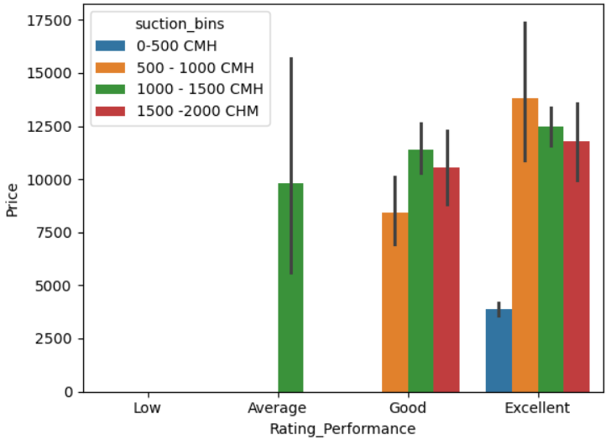
3D Analysis: Price, Rating & Suction Capacity :
Best-rated chimneys cluster between ₹10K–₹15K and 1200–1500 CMH.
High-end models don’t always have better ratings.
Optimal range: mid-price + high suction = best satisfaction.
Overall Summary:
Chimneys offering 1200–1500 CMH suction at a mid-range price give the best customer ratings.

Slide 19
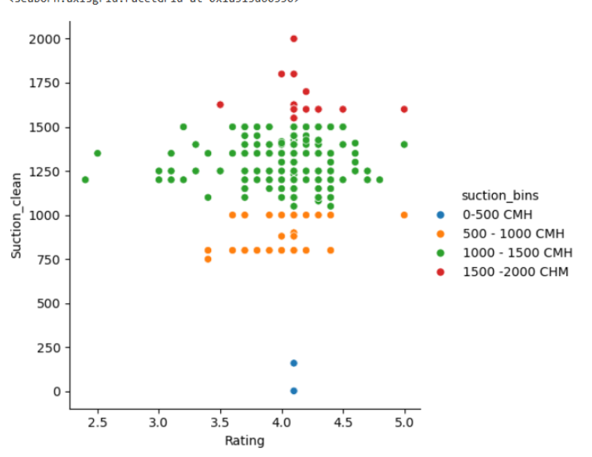
Average Price Across Rating Categories & Suction Bins:
Chimneys in higher suction ranges cost more.
“Good” and “Excellent” rated chimneys mostly in 1000–2000 CMH.
Lower suction models correspond with lower prices and ratings.
Overall Summary:
Higher suction capacity correlates with premium pricing and better customer satisfaction.

Slide 20
Key Findings & Business Insights
The chimney market is dominated by affordable, mid-range products.
60 cm models are most popular; 90 cm for larger kitchens.
Ratings (4★ avg) show high customer satisfaction overall.
Discounts (50–70%) are a key marketing strategy.
Suction capacity (1200–1500 CMH) gives the best value.
Brand reputation outweighs technical specifications in customer ratings.
Overall Summary:
Overall, the chimney market thrives on mid-range, high-value products where affordability, brand trust, and balanced performance drive customer satisfaction.

Slide 21
Conclusion:
Insights on Market Trends
The analysis revealed that most chimneys listed on Flipkart are mid-range products priced between ₹7,000–₹15,000, indicating strong customer preference for affordable and value-based appliances.
2. Customer Satisfaction and Ratings
Average customer ratings were around 4.0, showing overall positive satisfaction levels. Premium brands like Elica and Faber maintained consistent ratings across different models
3. Brand and Product Insights
Brands such as Faber, Hindware, and Amplesta dominated the listings, while smaller brands like Omniya and Greenchef received higher customer ratings, proving that quality isn’t limited to brand popularity.
4. Key Patterns and Correlations
No strong correlation was found between price and rating, implying that expensive products don’t always guarantee better performance or satisfaction. Mid-range chimneys with 1200–1500 CMH suction capacity were found to be most preferred.
5. Overall Conclusion
Through effective web scraping and Exploratory Data Analysis, valuable business insights were derived that can help brands optimize pricing strategies, improve product quality, and enhance customer satisfaction in the online chimney market.

Slide 22
Experience– Web Scraping & Data Analysis:
Learned how to clean, preprocess, and structure unorganized web data into a usable CSV format for analysis.
Gained hands-on experience in extracting real-world product data from Flipkart using Python libraries such as BeautifulSoup and Requests.
Enhanced understanding of Exploratory Data Analysis (EDA) by applying univariate, bivariate, and multivariate visualizations using Pandas, Matplotlib, and Seaborn.
Developed the ability to interpret patterns and business insights, such as identifying top-rated brands, pricing trends, and customer preferences.
Strengthened technical and analytical skills by converting raw scraped data into meaningful, decision-supporting insights.

Slide 23
Challenges – Web Scraping & Data Analysis:
Encountered missing values and inconsistent data formats in fields like ratings and review counts, which needed cleaning and transformation.
Managed duplicate product entries and incomplete details while merging multiple scraped pages into one dataset.
Ensured accuracy and consistency during data cleaning — reducing dataset shape from (456, 8) to (451, 10) after removing invalid or redundant entries.
Overcame challenges in visualizing and interpreting trends, by applying different plots and statistical summaries to bring out clear, data-driven conclusions

Slide 24
