Slide 1
Web Scraping and Exploratory Data Analysis on Kitchen Chimney Dataset
By: Atyam Viswas

Slide 2
About Us:
Iam G.Mukesh Sai B.Tech graduate passionate about Data Analytics and Visualization.
Exploring data-driven insights through real-world datasets.
Interested in web data extraction and business trend analysis.
LINKEDIN: https://www.linkedin.com/in/mukeshsai-gunty-23b32328a/
GITHUB: https://github.com/mukeshsaigunty

Slide 3

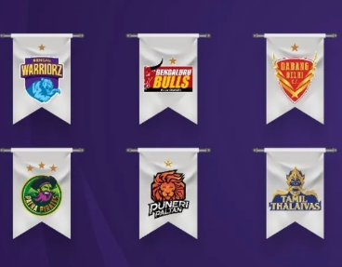
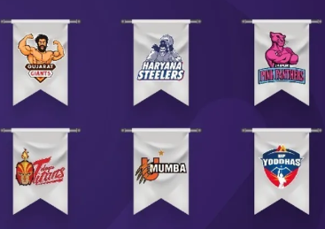
Introduction:
Pro Kabaddi League (PKL) is India’s premier professional kabaddi tournament.
It was launched in July 2014 by Mashal Sports and Disney Star, with support from the Amateur Kabaddi Federation of India.
The league began with 8 teams and quickly expanded to 12, featuring top players from India and abroad.
PKL transformed kabaddi from a rural game into an internationally recognized, fast-paced sport.
Matches are played in major indoor stadiums across the country, with a franchise-based format and playoffs.
PKL has become one of the most-watched sports events in India, second only to the IPL, and continues to attract millions of fans every season.

Slide 4
Business Problem:
PKL match data is unstructured and spread across diverse online sources and formats.
Teams and organizers have difficulty benchmarking performance and stadium impact across seasons.
Fans and stakeholders lack easily accessible, data-driven insights into team strength and match competitiveness.
There is a need for comprehensive analytics to unify match statistics, track trends, and support better strategic decisions.

Slide 5
Objectives:
To analyze and compare Pro Kabaddi League teams using historical match data, winning records, and venue performance
To provide data-driven insights that help franchises, fans, and analysts understand team strengths, scoring patterns, and competitive trends
To explore season-wise team progress, venue effects, and evolving strategies throughout PKL history
To explore season-by-season changes in team success, venue impacts, and Kabaddi match strategies.

Slide 6
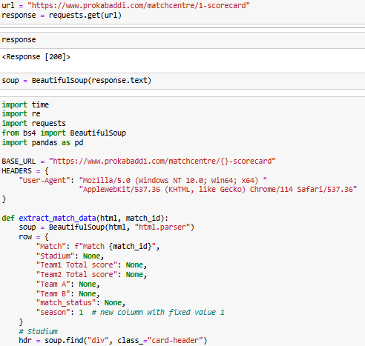
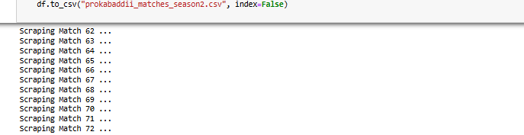
Web Scraping:
Pro Kabaddi League's official website was selected as the main data source
Used browser developer tools (Inspect Element) to identify relevant HTML elements in match data pages
Used BeautifulSoup and Requests libraries in Python to extract structured data from the web pages
Sent HTTP requests to automate the retrieval of multiple match records across seasons
Cleaned and consolidated scraped data for further analysis and visualization.

Slide 7






Tools Used:

