Slide 1

REGRESSION MODELING FOR PERSONAL MEDICAL COSTS
Regression for Applied Data Science (ADSC2020)
Winter 2024
By:
Akansha Bhargavi - T00736533
Solomon Maccarthy - T00734513
Viswateja Adothi - T00736529

Slide 2
Introduction
In the realm of predicting medical insurance costs, several factors stand out as significant determinants. Notably, Smoker Status emerges as a critical variable, showcasing a substantial impact on medical expenses.
Smokers tend to bear higher costs on average compared to non-smokers.
Furthermore, Age and BMI exhibit a positive correlation with insurance charges. Advanced age and higher BMI levels are associated with increased medical costs, emphasizing the importance of considering these factors in insurance cost estimations.
This project aims to conduct a thorough examination of the various factors influencing insurance costs, providing invaluable insights for insurance companies, policymakers, and individuals alike.

Slide 3
Dataset
Age: Age of the primary beneficiary
Sex: Gender of the insurance contractor (female, male)
BMI: Body mass index, indicating relative weight to height
Children: Number of children covered by health insurance / Number of dependents
Smoker: Smoking status
Region: Residential area of the beneficiary in the US (northeast, southeast, southwest, northwest)
Charges: Individual medical costs billed by health insurance

Slide 4
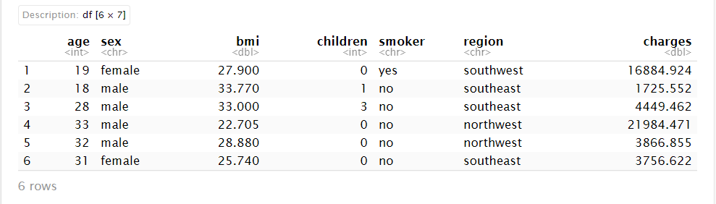
Dataset

Slide 5
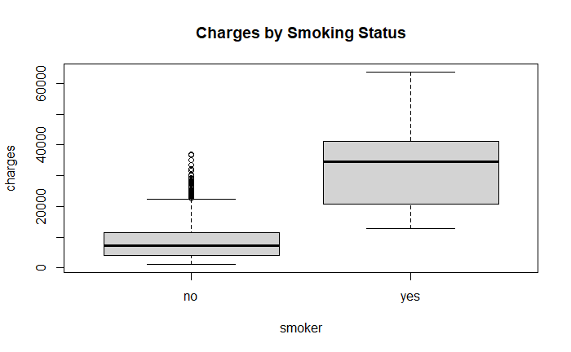
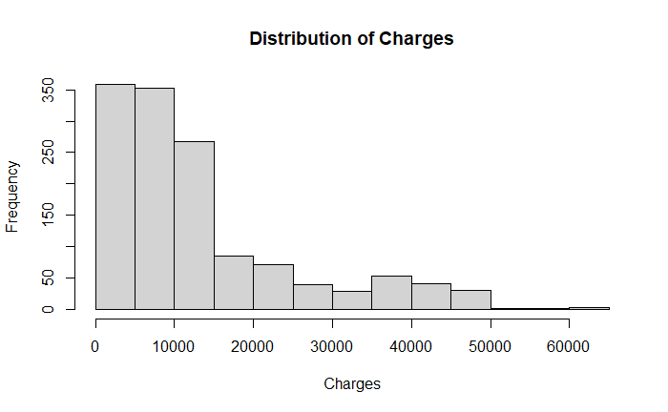
Exploratory Data Analysis (EDA)

Slide 6
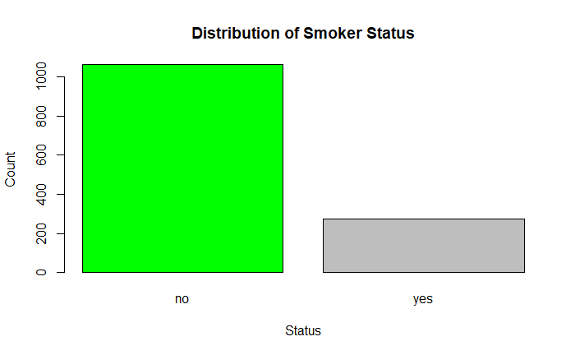
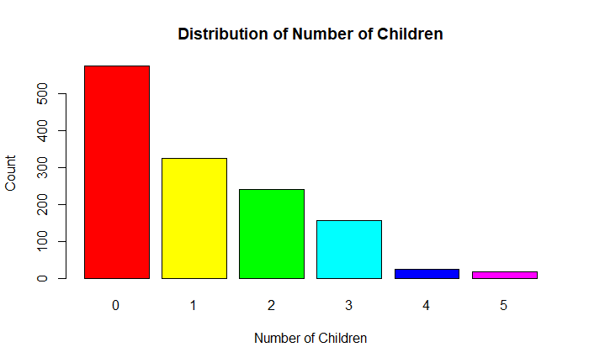
Distributions of smokers’ status, number of children

Slide 7
Variable selection
Correlation:
Age and BMI are important to consider in models predicting insurance charges. Other factors also have significantly influence insurance charges
VIF: The multicollinearity diagnostics indicate that the variables selected for the model do not suffer from high multicollinearity

Slide 8



Simple Linear Regression
Model 1: charges ~ age
Model 2: charges ~ BMI
Model 3:charges ~smoker

Slide 9
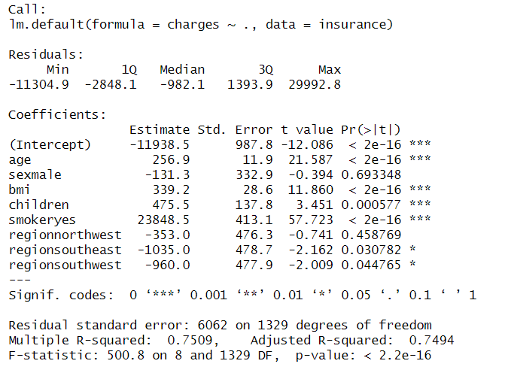
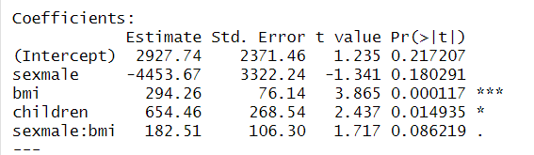
Multiple Linear Regression charges ~ sex + bmi + children + sex*bmi lm(charges~.,data=insurance)

Slide 10
Model Diagnostics
Assumption | P-value
Linearity | Violated
Normality | Violated
Homoscedasticity | Violated
Independence | P-value = 0.096

Slide 11
Addressing Model Assumption Violations
Transformation techniques such as Box-Cox and logarithmic transformations were performed.
Despite transformation efforts, diagnostic checks revealed violations of model assumptions.
Generalized Linear Models (GLM):
Transitioning to Generalized Linear Models (GLM) to accommodate non-normally distributed response variables.

Slide 12
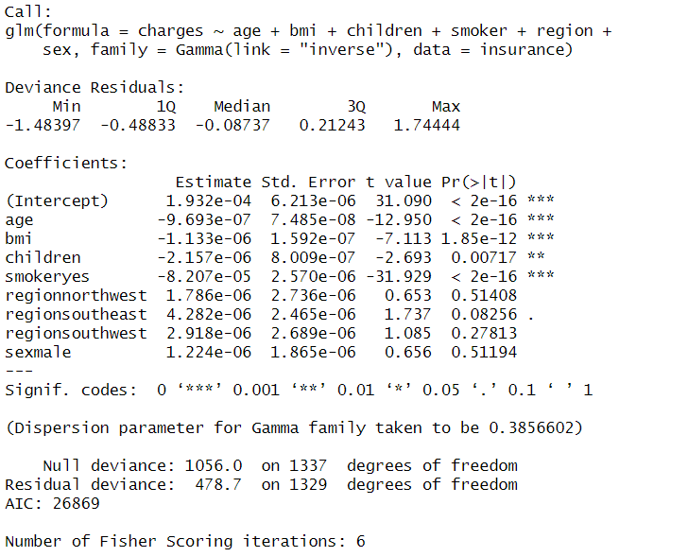
GLM
Overdispersion : 0.3601945
Model Assumptions:
Linearity – Passed

Slide 13
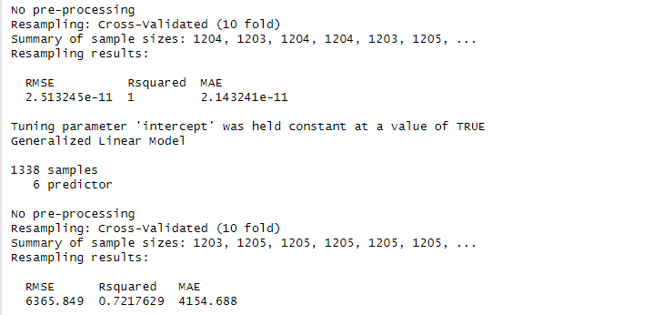
Prediction

Slide 14
THANK YOU

