Slide 1

End-to-End Retail Performance and Behavioral Analytics
Prepared By: Viswesh
Company : (RetailNova Inc.)
Course: Diploma in Data Analytics with Generative AI
Date: 12 January 2026

Slide 2

Project Overview
• End-to-end retail analytics project
• Sales, Customers, Products, Stores, Returns
• Goal: Business insights using data
• Tools: SQL, Python, Power BI

Slide 3

Business Problem
• No clear visibility on sales and profit
• Hard to identify high-value customers
• Product returns impact revenue
• Store performance unclear

Slide 4

Project Objectives
• Analyze revenue and quantity
• Identify top products & customers
• Understand customer behavior
• Evaluate store performance
• Analyze returns

Slide 5

Data Used
• Sales transactions
• Customer demographics
• Product cost and category
• Store details & operating cost
• Returns data

Slide 6

Python Work
• Loaded datasets using pandas
• Validated data & null values
• Merged sales with product cost
• Calculated profit per transaction
Profit = Total Amount - (Cost Price × Quantity)

Slide 7

SQL Work
• Cleaned tables
• Added keys & indexes
• Answered 10 business questions
• Revenue, profit, returns, store analysis

Slide 8
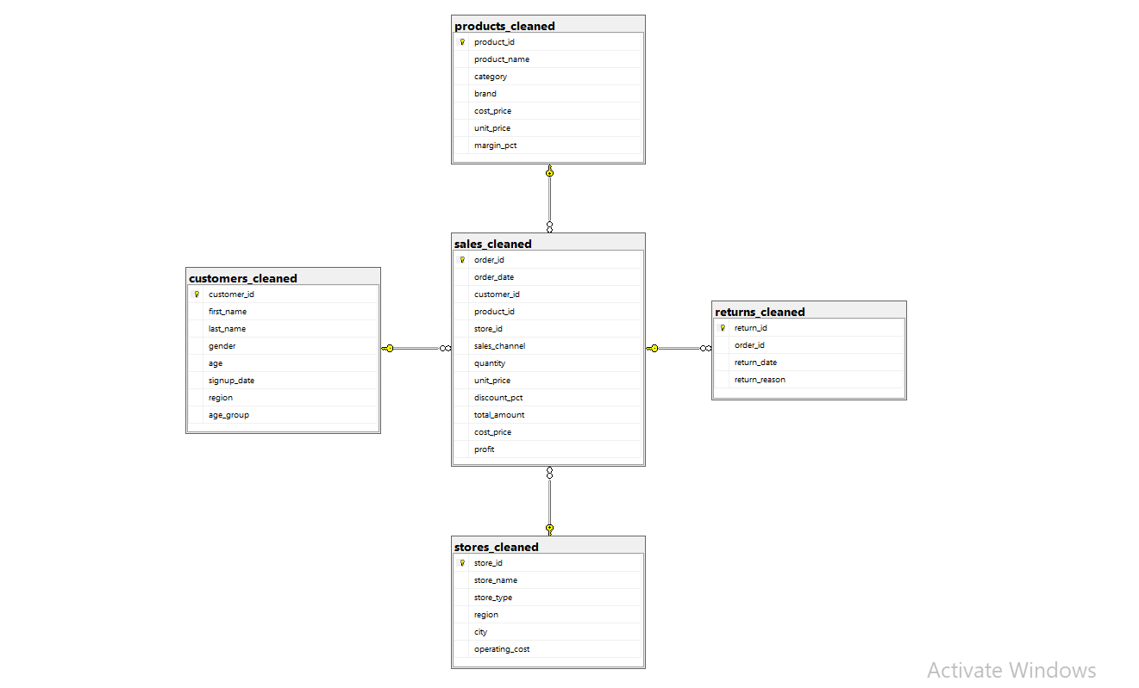
Data Modeling
• Sales as fact table
• Other tables as dimensions
• Star schema design
• Proper relationships

Slide 9
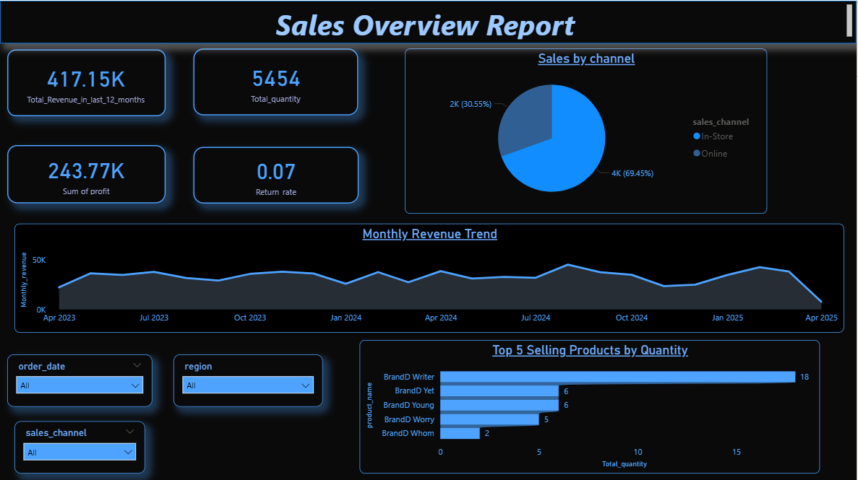
Sales Overview Dashboard
Sales Performance Insights
Sales show clear seasonal trends with certain months performing significantly better.
A small set of products contributes a large share of total sales.
Online and in-store channels show different performance patterns.

Slide 10
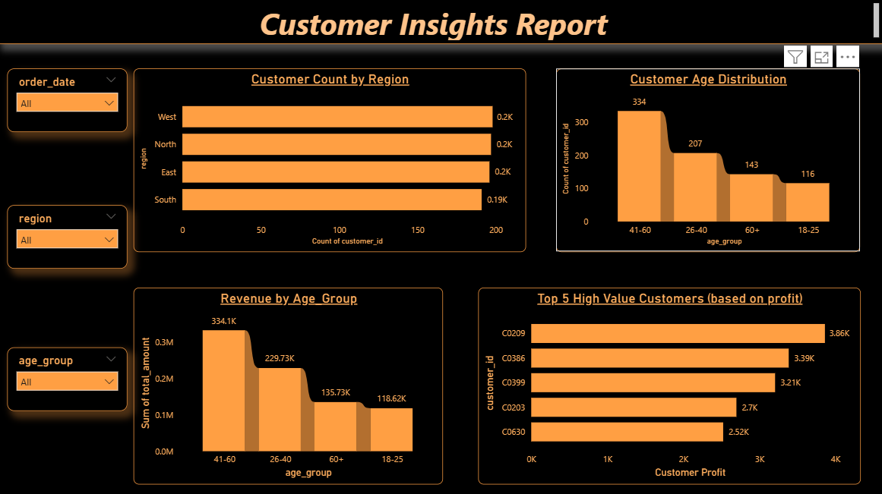
Customer Insights Dashboard
customer Insights
Customers from specific regions contribute more to revenue.
Certain age groups generate higher average revenue than others.
A small number of customers contribute disproportionately to total profit.

Slide 11
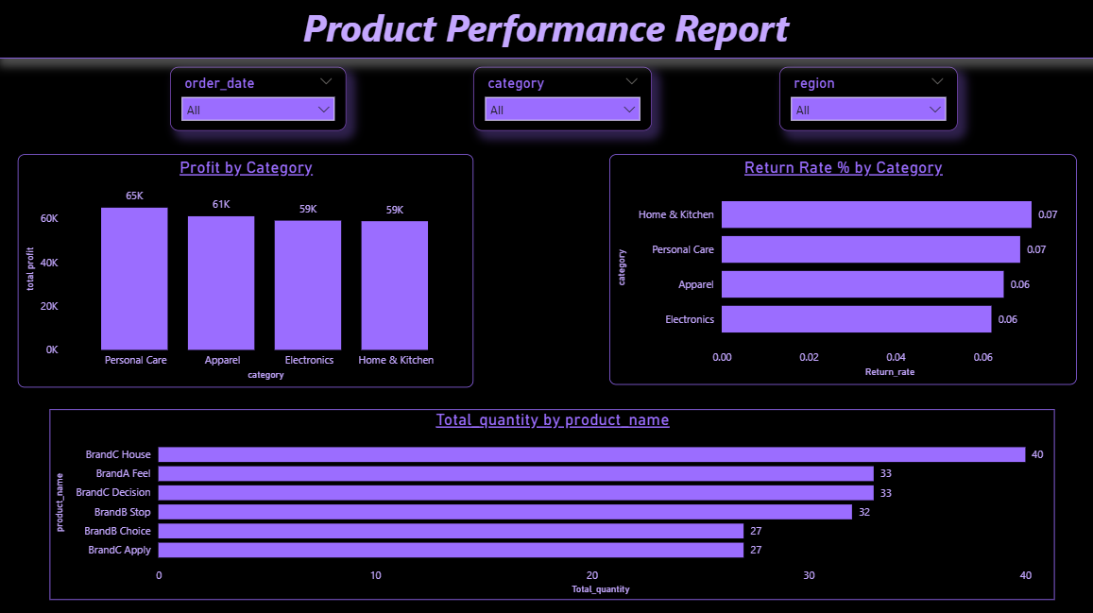
Product Performance Dashboard
Product Performance Insights
Some product categories are consistently more profitable than others.
A few products have high sales volume but lower profitability due to returns or discounts.
Return rates are concentrated in specific product categories.

Slide 12
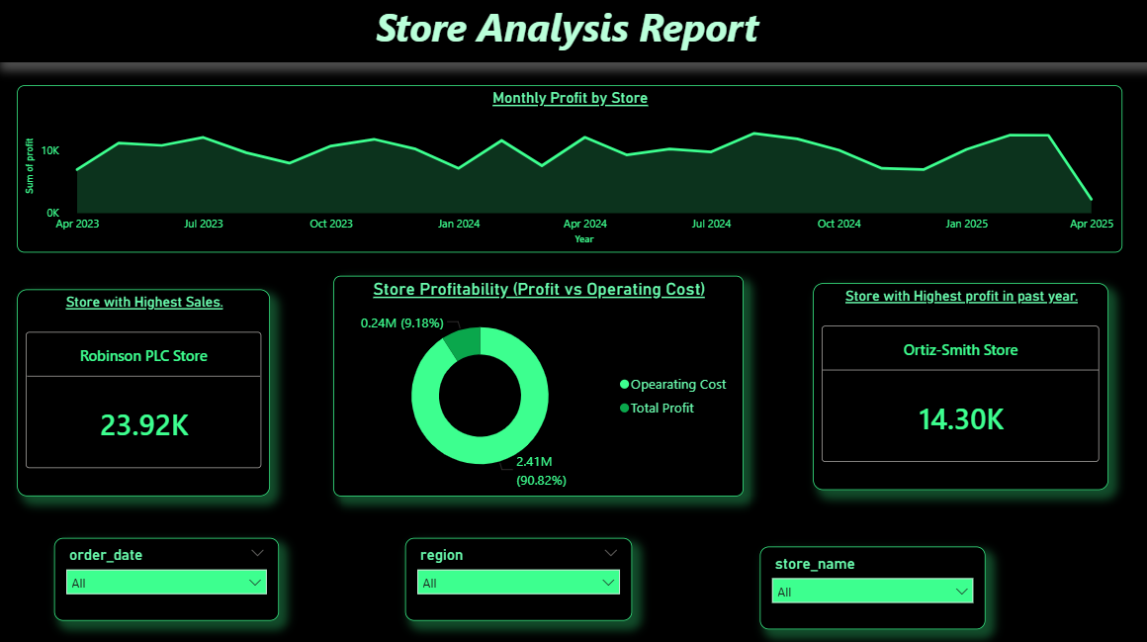
Store Analysis Dashboard
Store Performance Insights
Not all stores are equally profitable despite similar sales levels.
High operating costs reduce profitability for some stores.
Store performance varies significantly across regions.

Slide 13
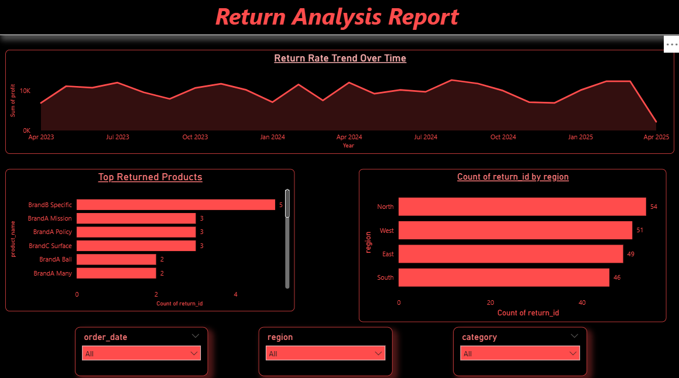
Return Analysis Dashboard
Return Analysis Insights
Return rates have increased over time in specific categories.
Certain products and regions account for most returns.
High return rates negatively impact overall profitability

Slide 14

Key Business Insights
• Few customers/products generate most profit
• Operating cost impacts stores
• Some categories have high returns

Slide 15

Conclusion
• Built end-to-end analytics solution
• Integrated Python, SQL, Power BI
• Delivered business-ready dashboards

