Slide 1
Welcome to Devops
Kishor Kumar

Slide 2
Who can take this course?
Beginners(Freshers)
Tester
Devloper
System admins
Project Admin
Anyone who have interest.
Note: No coding knowledge is required.

Slide 3
Why Devops
IT company expectations
Learning Path
Syllabus
Pre-req for this course
Test lab for this course
Q/A

Slide 4
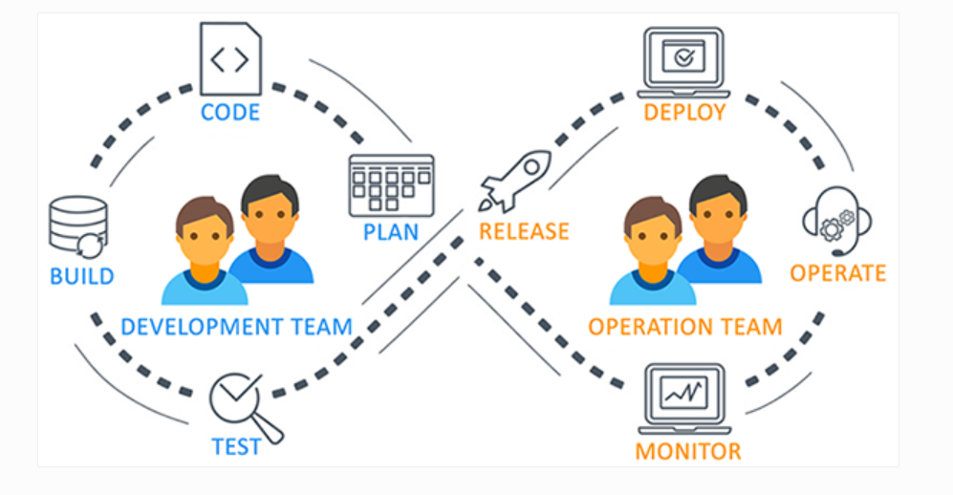
What is Devops?

Slide 5
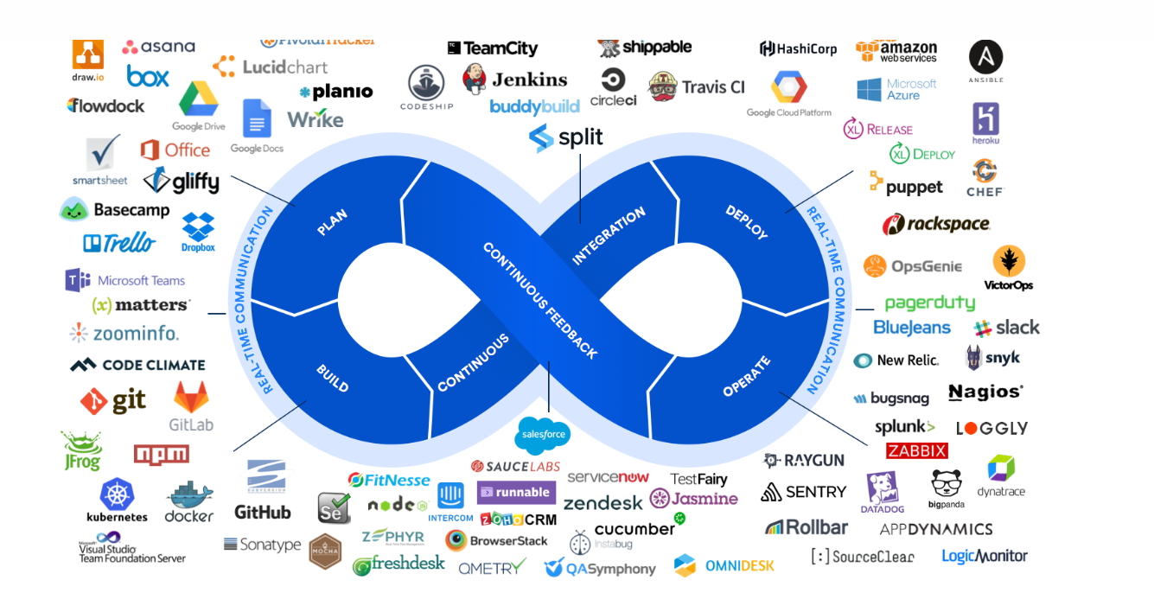

Slide 6
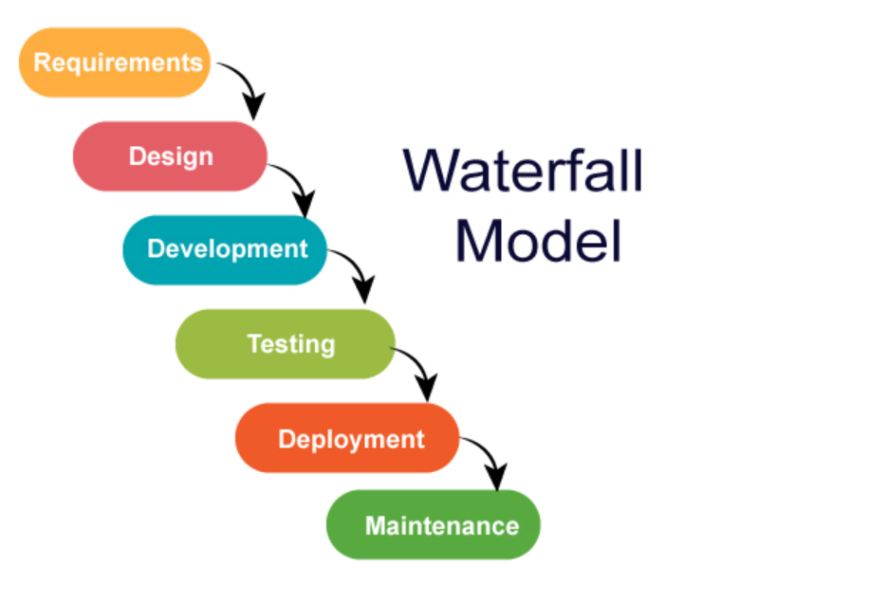
Waterfall Model

Slide 7
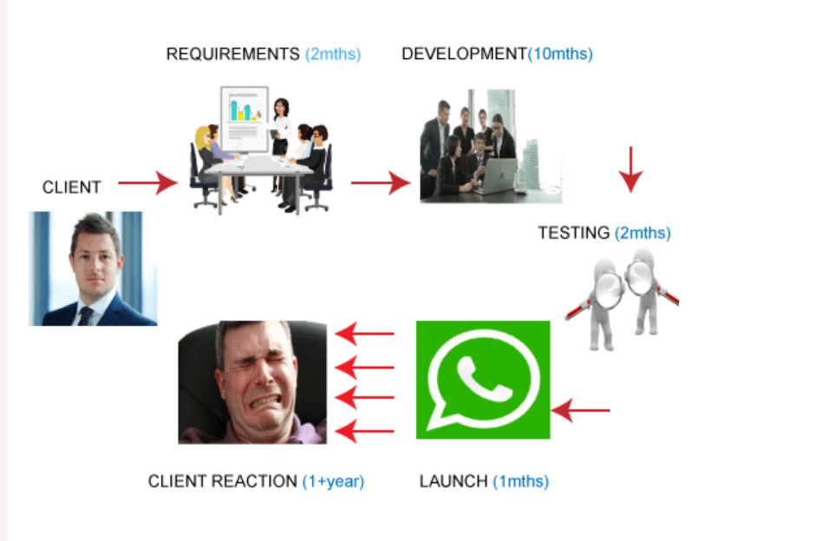

Slide 8
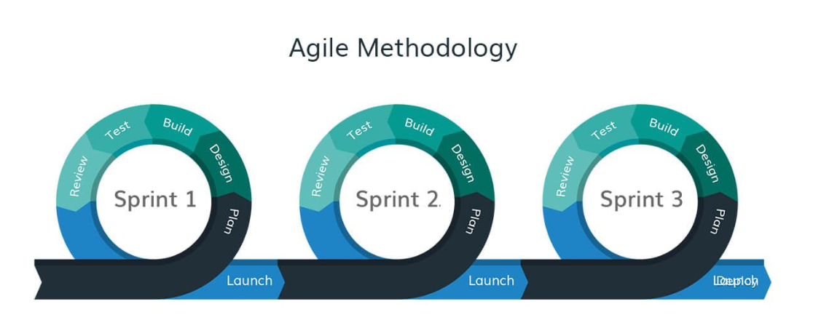

Slide 9
Advantages of Agile Methodology
Faster releases
Client requirement can be done
Development and testing can be done parallelly
Challenges of Ops Team:
Deployment is Manual

Slide 10
