Slide 1
DMart Sales & Operational Excellence
Business Requirements, KPI Framework and Decision Models

Slide 2
5W Analysis & Objectives
Who, What, When, Where, Why analysis with measurable KPIs

Slide 3
BRD / FRD Framework
KPIs, dashboards, charts, graphs and reporting requirements

Slide 4
PRD Analysis
Demand-supply patterns, SWOT, RCA, 5 Why, Fishbone, Product Performance

Slide 5
Business Decision Models
ROI, BCG Matrix and Porter's Five Forces

Slide 6
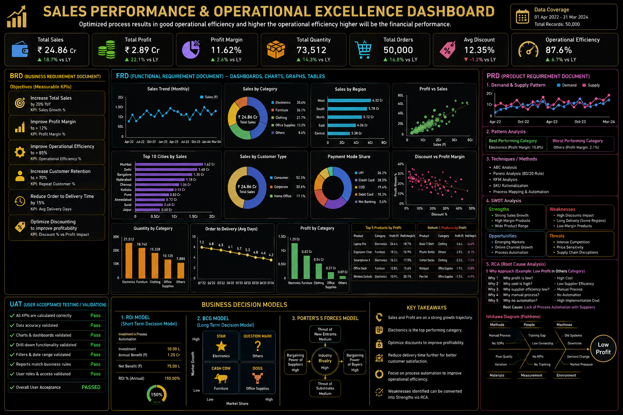
Executive Dashboard

