Slide 1
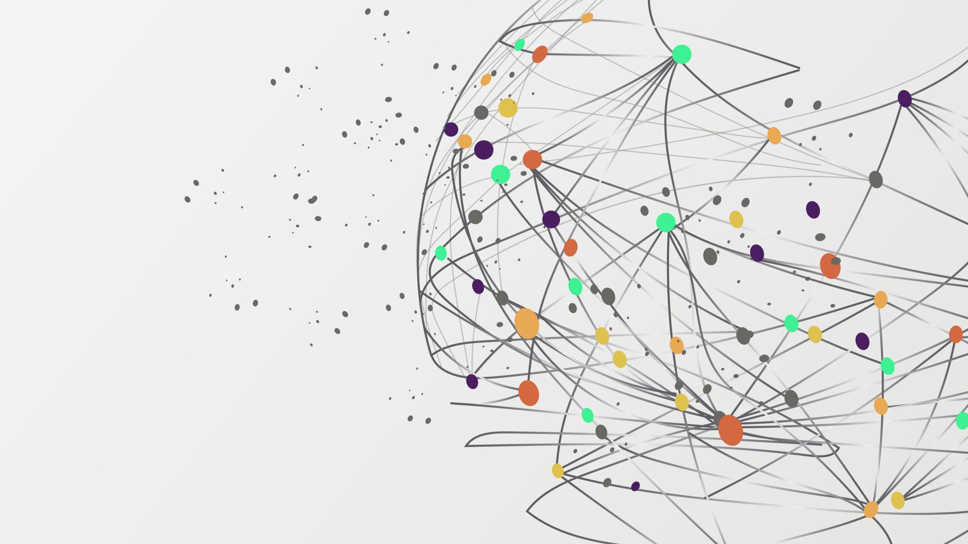
SAC ONLINE vs OFFLINE LEARNING
An investigation into sample efficiency
Viswak RB – 124104338
M.Sc. Data science & Analytics - UCC

Slide 2
Reinforcement Learning (RL)
Reinforcement Learning (RL) is a way to train an agent to make decisions by trial and error. The agent interacts with an environment by:
Observing a state
Taking an action
Receiving a reward
Moving to a new state
Over time, the agent learns a policy that maximizes total reward.
Two main training styles:
Online RL: The agent learns by actively interacting with the environment.
Offline RL: The agent is trained on a pre-recorded dataset — no new environment interaction is allowed.

Slide 3
SAC (Soft Actor-Critic)
SAC is a modern RL algorithm designed for continuous action spaces.
It uses both actor–critic architecture and entropy regularization
The actor learns a stochastic policy (samples actions from a Gaussian)
Two critics estimate how good actions are (Q-values)
The entropy term in the objective encourages exploration and avoids premature convergence
Why SAC?
Stable
Sample-efficient
Works well even in complex, continuous environments

Slide 4
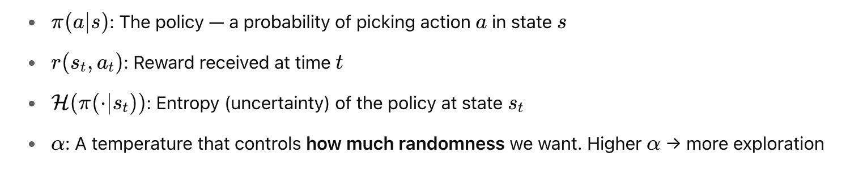
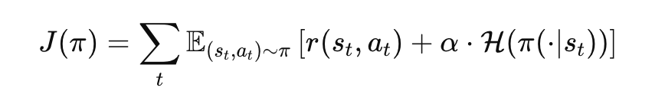
SAC in Online Learning
SAC tries to maximize two things at once:
The total reward it gets from the environment
The amount of randomness/ flexibility in its actions (Entropy)
So, the main goal is : Maximize: ∑[Reward+α⋅Entropy]
Mathematically represented as -

Slide 5
Why Online Learning works better?
In online learning, SAC works great because it:
Collects new data that matches its current policy π
Keeps improving the policy using good and up-to-date information
So, policy π is learning from data that was generated by itself, the Q-values it learns are better

Slide 6
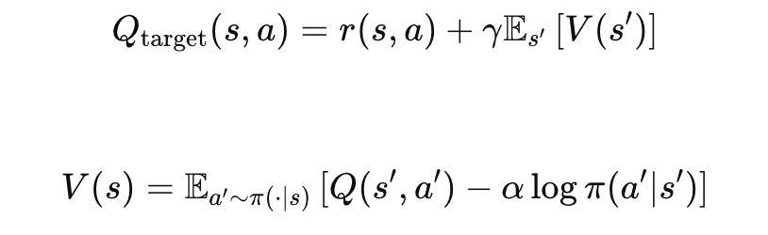
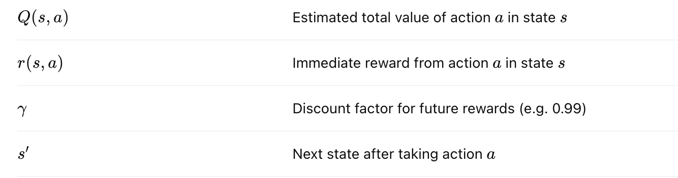
Soft Bellman Backup
The Soft Bellman Backup is the core update rule that SAC uses to learn the Q-values, and it reveals - Why SAC works so well when collecting its own data
Where,
This further confirms Why Online SAC Works Well
In online training, the agent is constantly gathering data using its current policy π.
This means the actions a′ used in the soft Bellman backup actually exist in the replay buffer.
So, the Q-values it learns are grounded in real, seen transitions.
This makes the estimate of future rewards (the Q-values) accurate and stable.

Slide 7
Why SAC Struggles in Offline?
1. In offline RL, we train using a fixed dataset D={(s,a,r,s′)} collected by another policy, not by interacting with the environment. This causes overestimation of Q Values
The dataset policy β(a∣s) is different from the current policy π(a∣s) :
Actions in buffer were chosen by β
But SAC updates using π, which may assign high probability to out-of-distribution (OOD) actions
This causes Q-values to be overestimated.

Slide 8
Why SAC Struggles in Offline? (Cont.)
2. Unseen Actions :
SAC samples actions a′∼π(a∣s′) during learning.
But in offline RL, these actions may not exist in the dataset.
When the Q-function tries to evaluate Q(s′,a′), it tries random guesses.
3. This could be even worsened by Entropy Term (−αlogπ(a∣s) ), as it can push the policy toward diverse actions not supported by the dataset

Slide 9
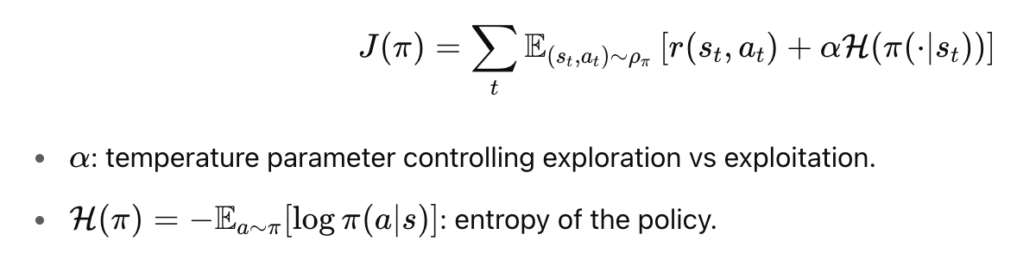

Why SAC Works Across Many Environments?
1. SAC maximizes both expected reward and entropy:
This encourages diverse actions, improving exploration in continuous and sparse reward environments.
2. Soft Bellman Backup Stabilizes Learning
This smooths out overestimation errors and helps convergence.
with soft value function,

Slide 10

Why SAC Works Across Many Environments?
3. Off-Policy and Sample Efficient
SAC is off-policy, meaning it reuses past transitions via a replay buffer.
This improves sample efficiency
SAC is more generalized as it can handle
Continuous action spaces (e.g., Pendulum, LunarLanderContinuous), High-dimensional observations, Stochastic or deterministic dynamics
replay buffer D stores past experience tuples

Slide 11
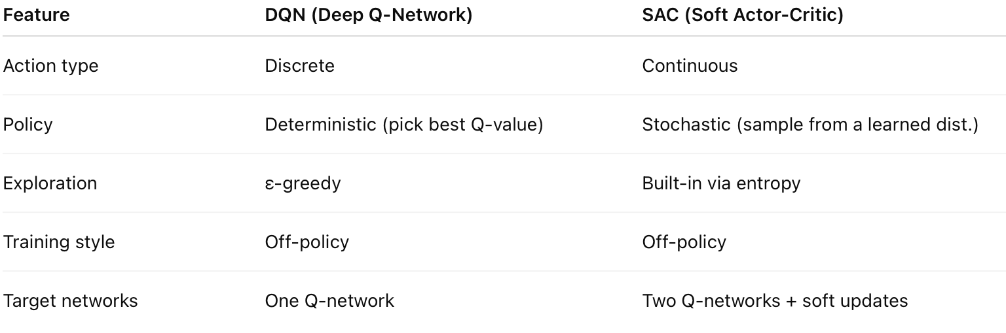
SAC vs DQN
Key difference:
DQN works well for simple, discrete problems like Atari games.
SAC is designed for more complex tasks like robotic control, where actions are continuous and noisy.

Slide 12
Task Summary
We wanted to explore how SAC performs when trained:
Online — the agent interacts with the environment while learning
Offline — the agent is trained only on a fixed dataset collected earlier
We ran this experiment on two environments:
LunarLanderContinuous-v2 : A simulated lunar module must land softly on a designated pad using thrusters. Action space: 2 continuous controls (main engine + side thrusters) Reward depends on landing speed, position, angle, and fuel efficiency.
Pendulum-v1 : A simple inverted pendulum must be balanced upright by applying torque. Action space: 1 continuous torque value Reward penalizes angle deviation and high velocity.
For each:
We trained online for 1,000 episodes
Collected the replay buffer
Used it to train a new agent offline
Compared convergence and final performance

Slide 13
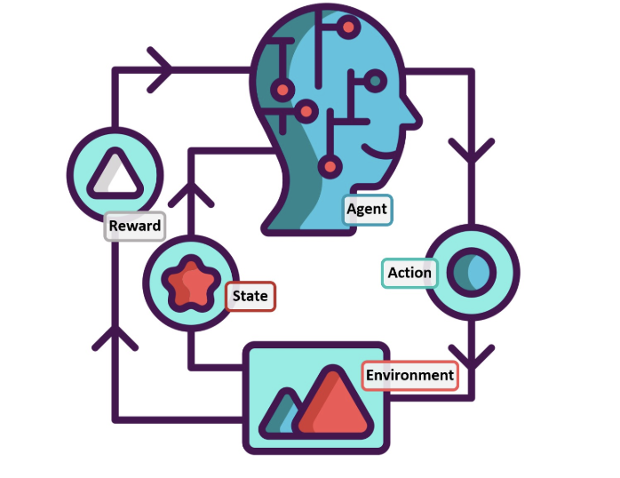
SACv1: Provided Custom Implementation
Custom/Provided neural network architecture for policy and Q-networks

Slide 14
Code Structure (.py Files)
sac_torch.py The heart of the SAC agent. Defines:
Actor and critic networks
Replay buffer
Training loop (learn())
networks.py Contains the neural network models for actor and critic.
utils.py Simple utility for plotting learning curves
main_sac.py
Handles online training:
Interacts with the environment
Stores data
Trains and saves models and dataset
main_sac_offline.py
Handles offline training:
Loads dataset
Trains without any new interaction.

Slide 15
Online and Offline Code Flow
Online Training Flow (main_sac.py)
Agent runs episodes in the environment
After every step:
Saves transition to replay buffer
Learns from sampled batches
All transitions are saved as a .pkl file for offline use
Plots learning curve during training
Offline Training Flow (main_sac_offline.py)
Loads the .pkl dataset into replay buffer
Trains the agent entirely from this fixed data (no new steps in the env)
Every few thousand steps:
Evaluates policy in the environment
Plots performance
By reusing the same agent class across both flows, we minimized code duplication while testing both training setups.

Slide 16
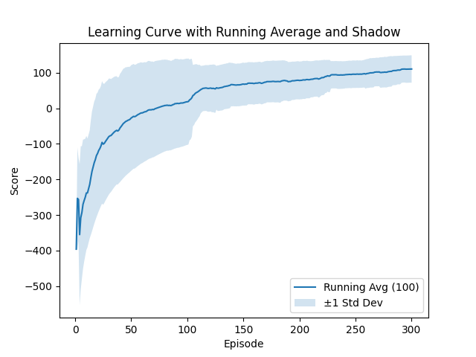
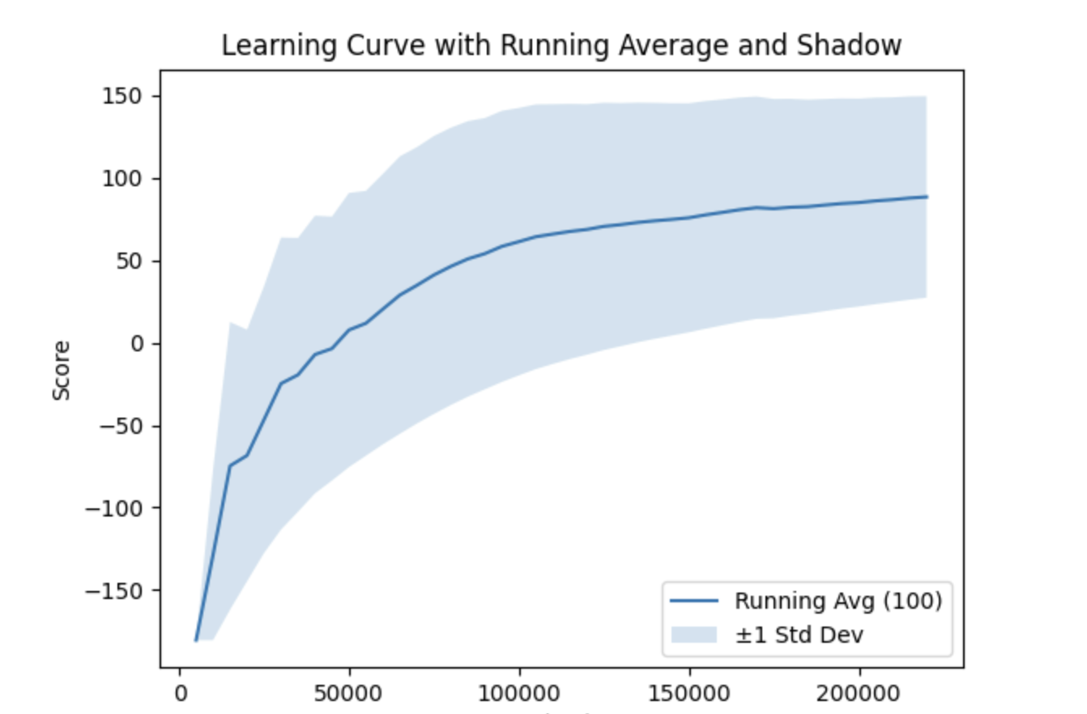
Results Overview - LunarLanderContinuousv2
ONLINE
OFFLINE

Slide 17
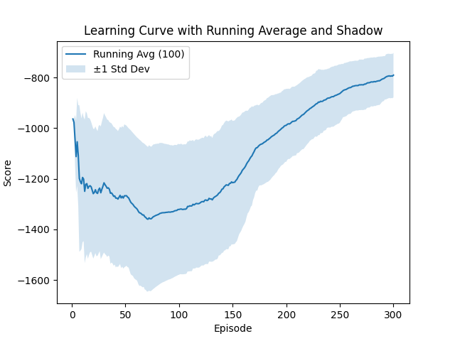
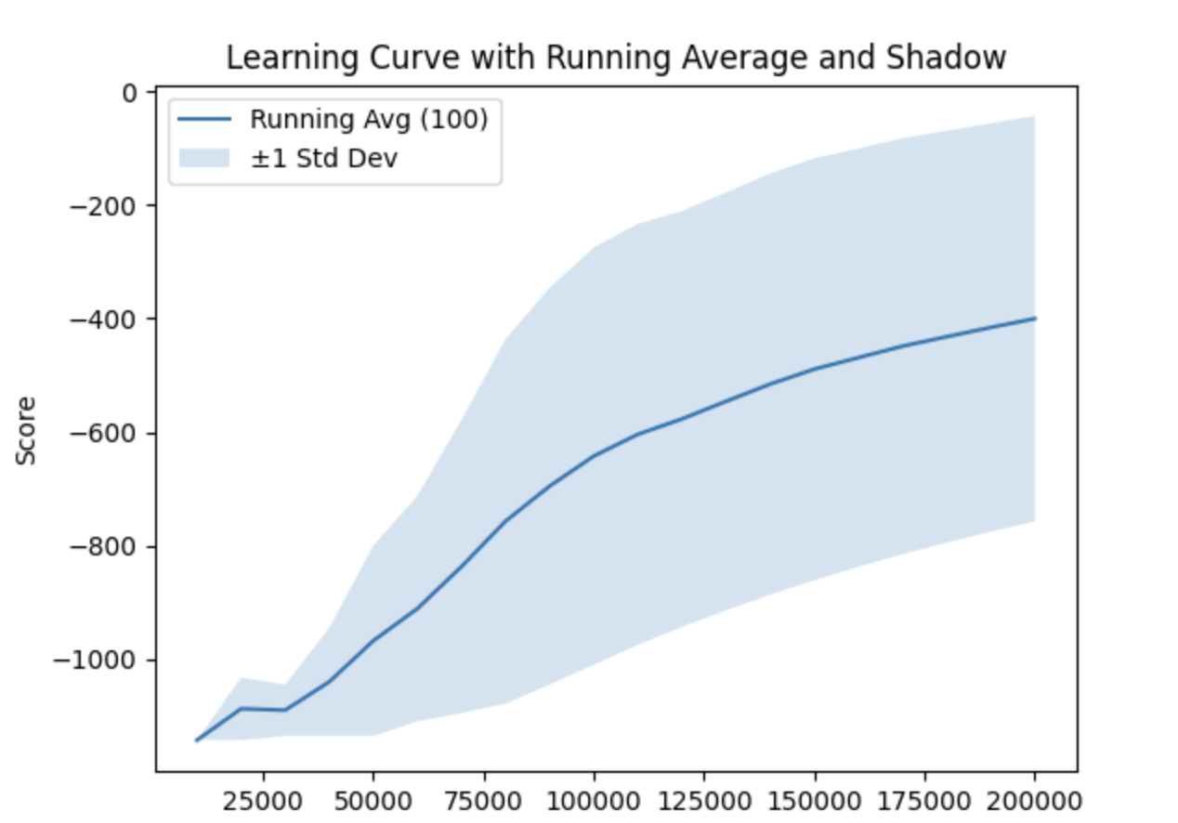
Results Overview - Pendulum V1
ONLINE
OFFLINE

Slide 18
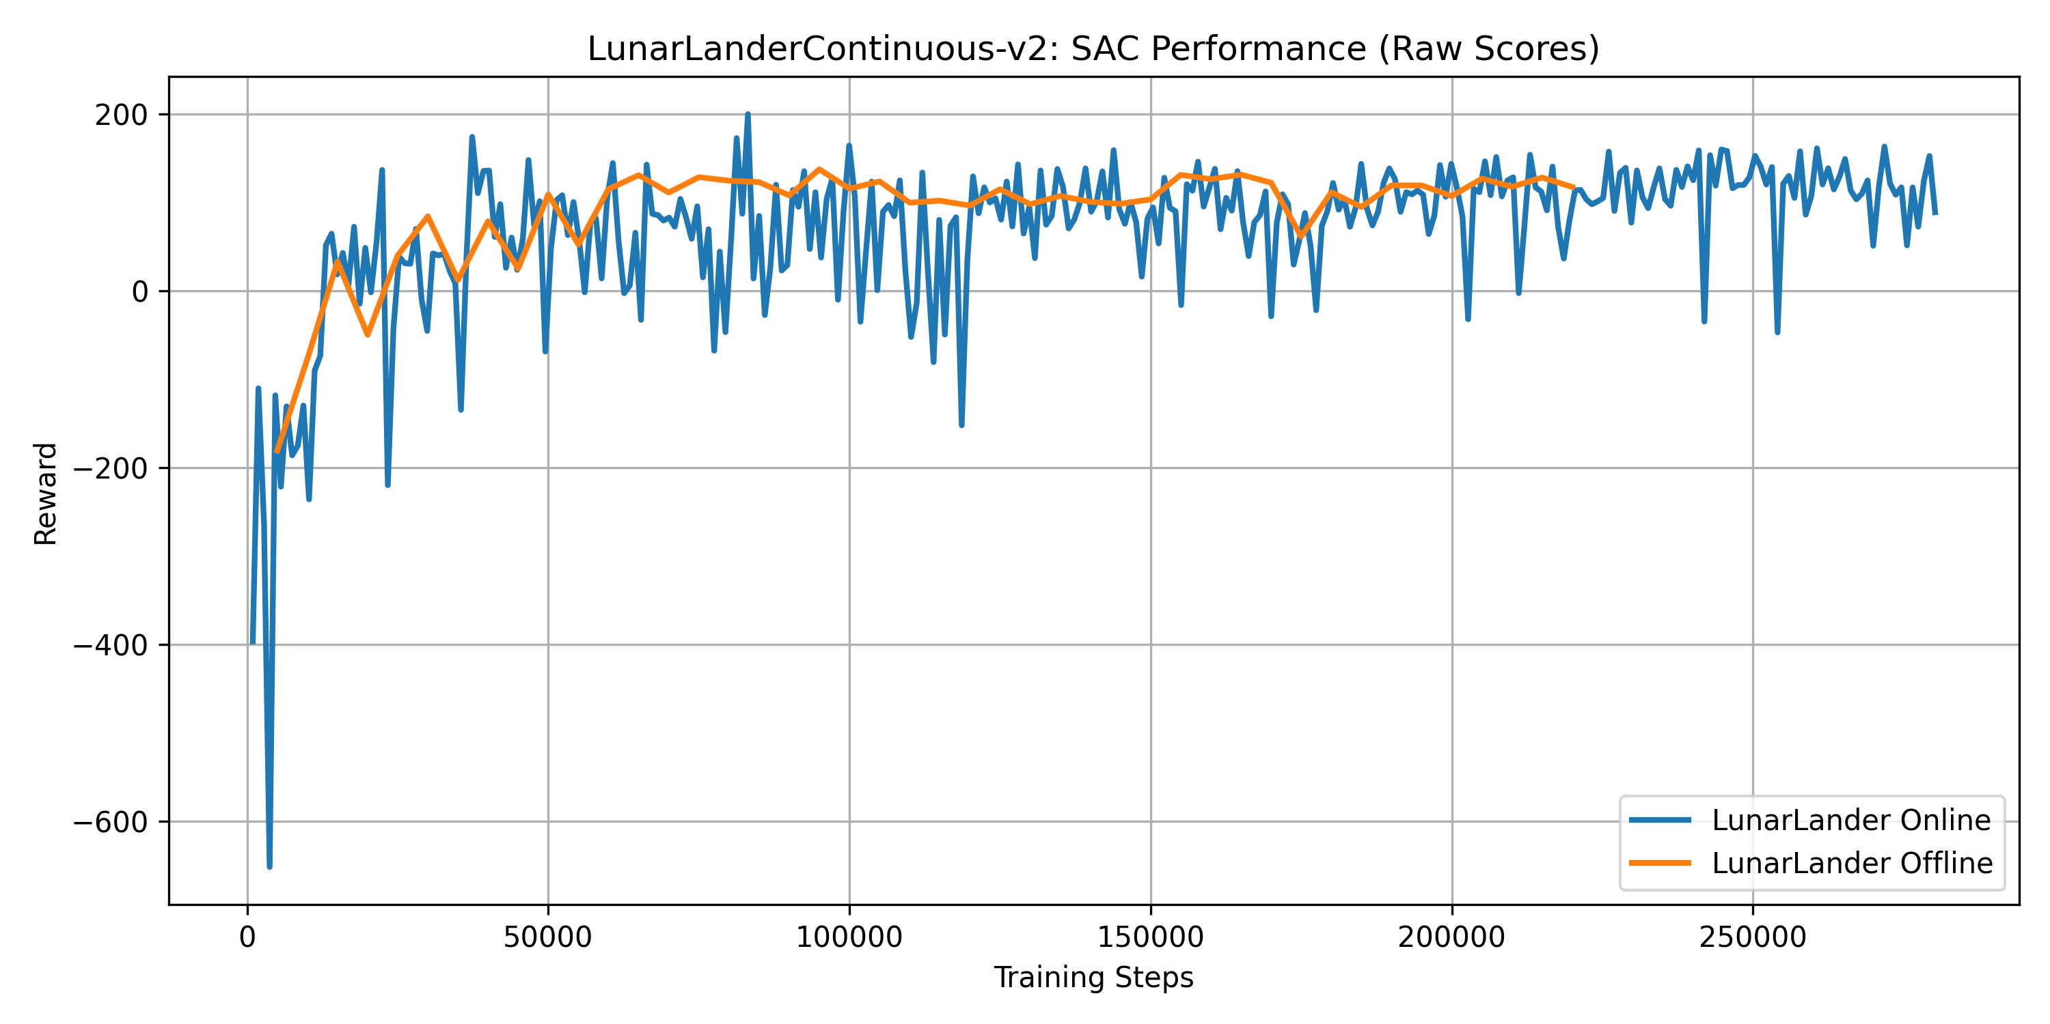
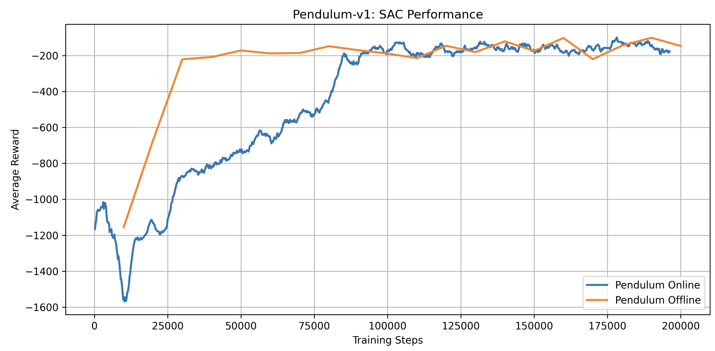
Results Comparison - Lunar & Pendulum
Lunar- Online v Offline
Pendulum- Online v Offline

Slide 19
Key Challenges
1. NaNs During Training (Pendulum)
When we ran SAC on Pendulum, training exploded — the policy outputs and losses became NaN early on. This happened because Pendulum gives small, consistent negative rewards (–16 to 0), making it easy for unstable gradients to blow up.
Fixed:
Added a random warm-up phase (5,000–10,000 steps) before learning started
Clamped log standard deviation (log σ) to stay in a safe range [–20, +2]
Limited σ values themselves to avoid zero or extreme variance
Added gradient clipping to stop huge updates from destabilizing learning
These tweaks made the training smooth and reproducible.

Slide 20
Key Challenges (Cont.)
2. Gym API Changes
The latest version of Gym changed how env.reset() works — it started returning a tuple (obs, info) instead of just obs. If not handled, this broke the input to the agent and caused crashes or silent bugs.
We unpacked the tuple properly before passing observations to the network.
3. Missing Folders During Model Saving
Our model checkpoints were failing to save because folders like models/ or tmp/ didn’t exist.
We fixed this by calling os.makedirs(..., exist_ok=True) before each torch.save().

Slide 21
Interpretation
LunarLander Online: The agent’s rolling average climbs from negative to about +100 by episode 300 but never reliably reaches the “solved” threshold of 200, indicating it learned a decent landing policy but not an optimal one.
LunarLander Offline: Starting from a static replay buffer, offline SAC quickly reaches ~+100 reward by ~30 000 gradient steps and plateaus there—never hitting 200 because the dataset lacked enough high-reward trajectories.
Pendulum Online: Returns drop to ~–1 350 around episode 60 then steadily improve to ~–800 by episode 300; the agent is learning but remains far from the ideal (near 0), showing slow and unstable on-policy progress.
Pendulum Offline: From pre-collected data, offline SAC jumps to ~–200 by 40 000 steps and edges to ~–150 by 200 000 steps, but a wide ±300–400 spread persists, reflecting that the fixed dataset did not cover all swing-up scenarios.

Slide 22
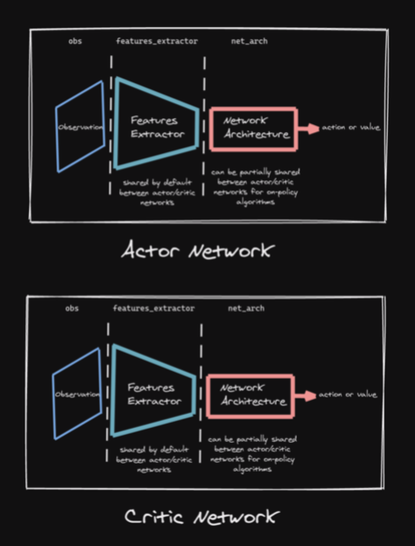
SAC SB3 (Stable-Baselines3)
Uses SB3’s Built-in training loop
Default MLPPolicy

Slide 23
SAC SB3?
SAC SB3 is the Soft Actor-Critic algorithm implemented in the Stable-Baselines3 (SB3) library, using a standard Multi-Layer Perceptron (MLP) policy. It provides a reliable, high-level API for training reinforcement learning agents with minimal setup.
Why ? – Key Points
Off-the-shelf SAC implementation from Stable-Baselines3.
Uses default MLP policy (2 hidden layers, 256 units).
Handles training logic, replay buffer, and updates internally.
More stable and easier to use than custom code.
Ideal for fast, reliable experimentation.

Slide 24
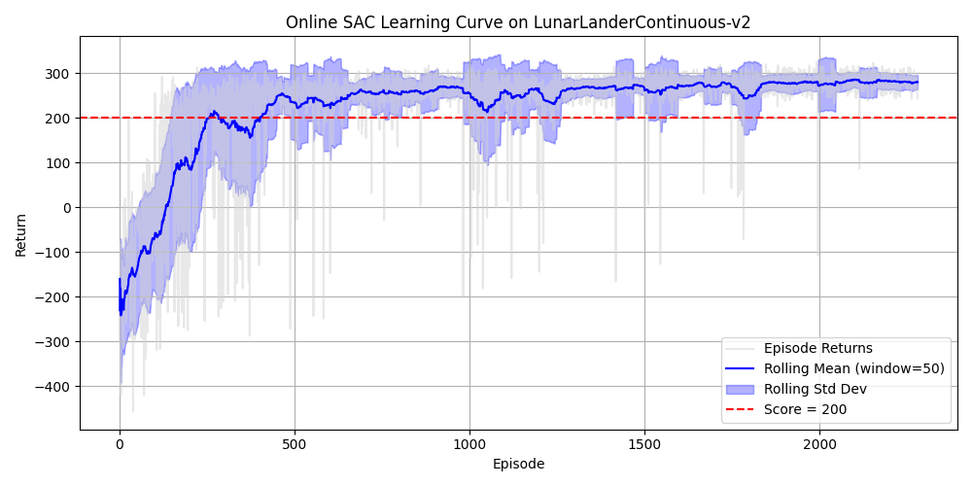
Results Overview - LunarLanderContv2 Online

Slide 25
Interpretation
Rapid Learning: By around episode 200, the agent went from mostly crashing (returns ≪ 0) to consistently scoring ≥ 200, showing it “solved” the task within those first few hundred episodes.
High Final Performance: After ~400 episodes, the rolling mean stabilized around 280–300 return, indicating near‐optimal landings with minimal fuel usage.
Low Variability: In later episodes (1,500–2,280), the ±1 STD band tightened to ±20 points, meaning nearly every landing was consistently good (returns ~260–320).
Expected or Better: Achieving ~300 average reward is on par with or slightly above typical SAC baselines for LunarLanderContinuous-v2, so performance meets expectations and is at the high end of reported results.

Slide 26
Why SACv1 Underperformed vs SAC SB3
Observation:
Our custom SACv1 struggled to reach the target score of 200+ on LunarLanderContinuous-v2.
SAC SB3, however, consistently achieved higher, stable performance.
Initial Hypothesis:
Suspected the issue might be with network architecture (e.g., underpowered MLP).
What We Found:
Both SACv1 and SB3 used the same architecture: 2 hidden layers, 256 units each (ReLU).
Replay buffer size, batch size, reward scaling, and update rules were also aligned.
Root Cause Identified:
SACv1 uses a fixed entropy coefficient α (implicitly = 1).
SAC SB3 uses automatic entropy tuning, dynamically adjusting α for balanced exploration

Slide 27
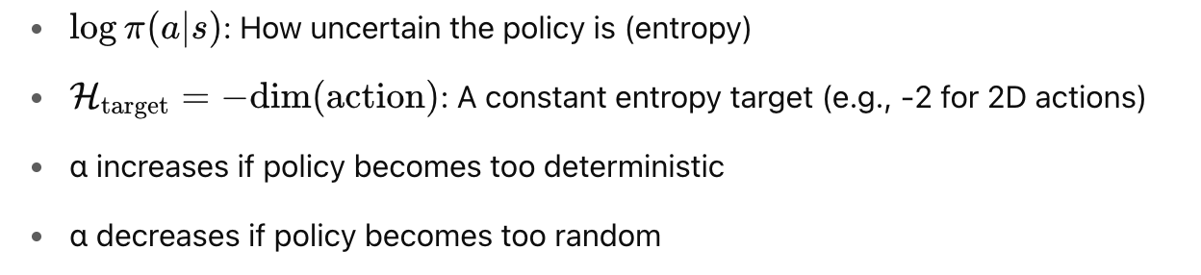

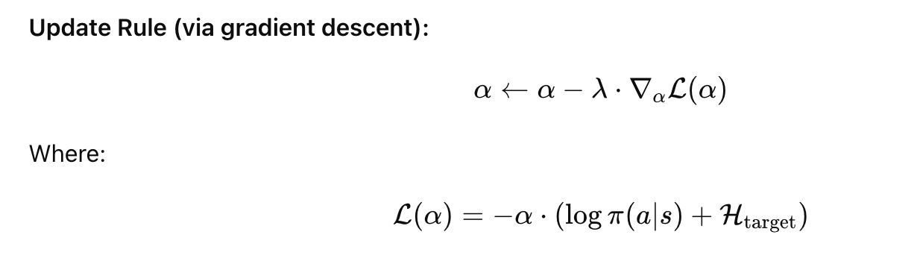
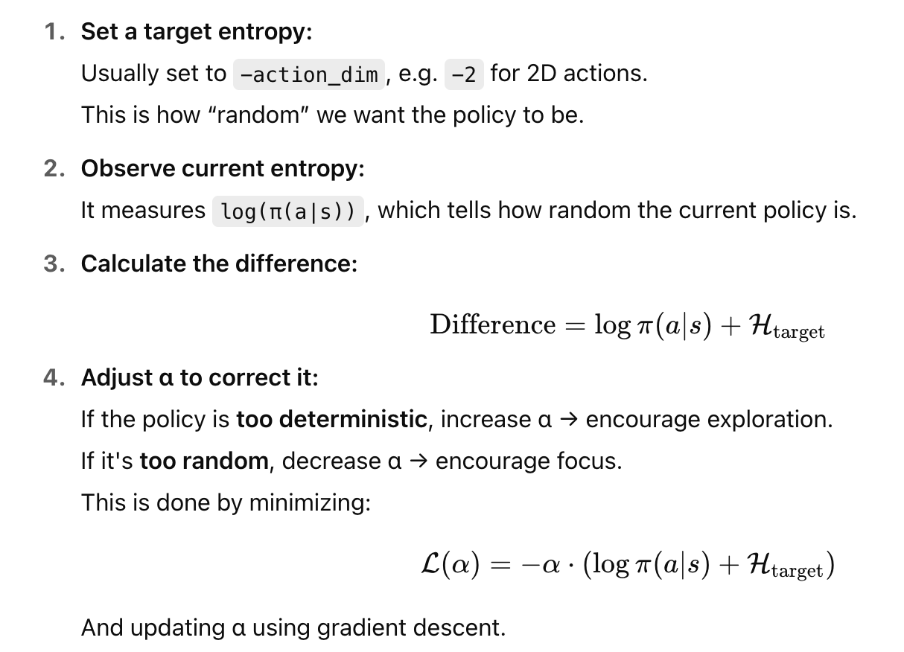
SAC Auto Entropy Tuning
Paper: Soft Actor-Critic Algorithms and Applications Tuomas Haarnoja et al., arXiv:1812.05905
Key Idea : Automatically adjust the entropy coefficient α during training to maintain the right level of policy randomness (exploration). Formulates α tuning as a dual optimization problem to match policy entropy with a target entropy level:
Result:
SAC adapts exploration automatically
More stable learning across tasks

Slide 28
Key papers - on why SAC struggles in Offline RL
1. Off-Policy Deep Reinforcement Learning without Exploration - Fujimoto et al., ICML 2019 This foundational paper introduces the problem of extrapolation error in offline RL — SAC and other off-policy algorithms may assign high value to unseen (out-of-distribution) actions, causing poor policies. The authors propose BCQ (Batch-Constrained Q-learning) to restrict actions to those seen in the dataset, which greatly improves stability and performance in offline settings. Read here
2. Stabilizing Off-Policy Q-Learning via Bootstrapping Error Reduction (BEAR) - Kumar et al., NeurIPS 2019 BEAR highlights bootstrapping error — the repeated use of inaccurate value estimates for unseen actions in SAC’s critic leads to divergence. It proposes constraining the learned policy to remain close to the data distribution using a similarity metric, effectively improving stability. Read here
3. Behavior Regularized Offline Reinforcement Learning (BRAC) - Wu et al., 2019 (Google Research) BRAC shows that SAC fails offline mainly due to unconstrained policy deviation. By adding a regularization term (e.g., KL divergence) between the learned and behavior policy, SAC becomes significantly more stable and effective in offline training. Read here
4. Conservative Q-Learning for Offline Reinforcement Learning (CQL) - Kumar et al., NeurIPS 2020 CQL addresses SAC's offline failure by making Q-learning conservative — penalizing Q-values of actions not in the dataset. This reduces overestimation and prevents the agent from exploiting erroneous Q-values for out-of-distribution actions. Read here

Slide 29
Key papers - on why SAC struggles in Offline RL
5. A Minimalist Approach to Offline Reinforcement Learning (TD3+BC) - Fujimoto & Gu, NeurIPS 2021 This simple approach shows that just adding a behavior cloning loss to SAC or TD3's policy update significantly improves offline performance. It confirms that SAC mainly fails offline due to its policy choosing actions too far from those in the dataset. Read here
6. Offline Reinforcement Learning with Implicit Q-Learning (IQL) - Kostrikov et al., ICLR 2022 IQL avoids the failure of SAC in offline RL by never querying out-of-distribution actions. It trains a value function using expectile regression and performs advantage-weighted behavior cloning, bypassing the pitfalls of standard SAC’s critic updates. Read here
7. Uncertainty-Based Offline Reinforcement Learning with Diversified Q-Ensemble (EDAC) - An et al., NeurIPS 2021 EDAC enhances SAC by using a Q-network ensemble to estimate uncertainty and conservatively penalize high-variance value predictions. This helps mitigate SAC’s tendency to overestimate Q-values for out-of-distribution actions. Read here
8. SpOiLer: Offline Reinforcement Learning using Scaled Penalties - Srinivasan & Knottenbelt, PMLR 2024 SpOiLer modifies SAC’s Bellman backups by adding a penalty proportional to the action's likelihood under the dataset, making value estimates more pessimistic for unfamiliar actions. This method avoids overestimation without needing ensembles or behavior cloning.
Read here

Slide 30
References
https://github.com/rail-berkeley/d4rl
https://huggingface.co/blog/offline-rl
https://github.com/vwxyzjn/cleanrl/blob/master/cleanrl/sac_continuous_action.py
https://spinningup.openai.com/en/latest/algorithms/sac.html

