Slide 1
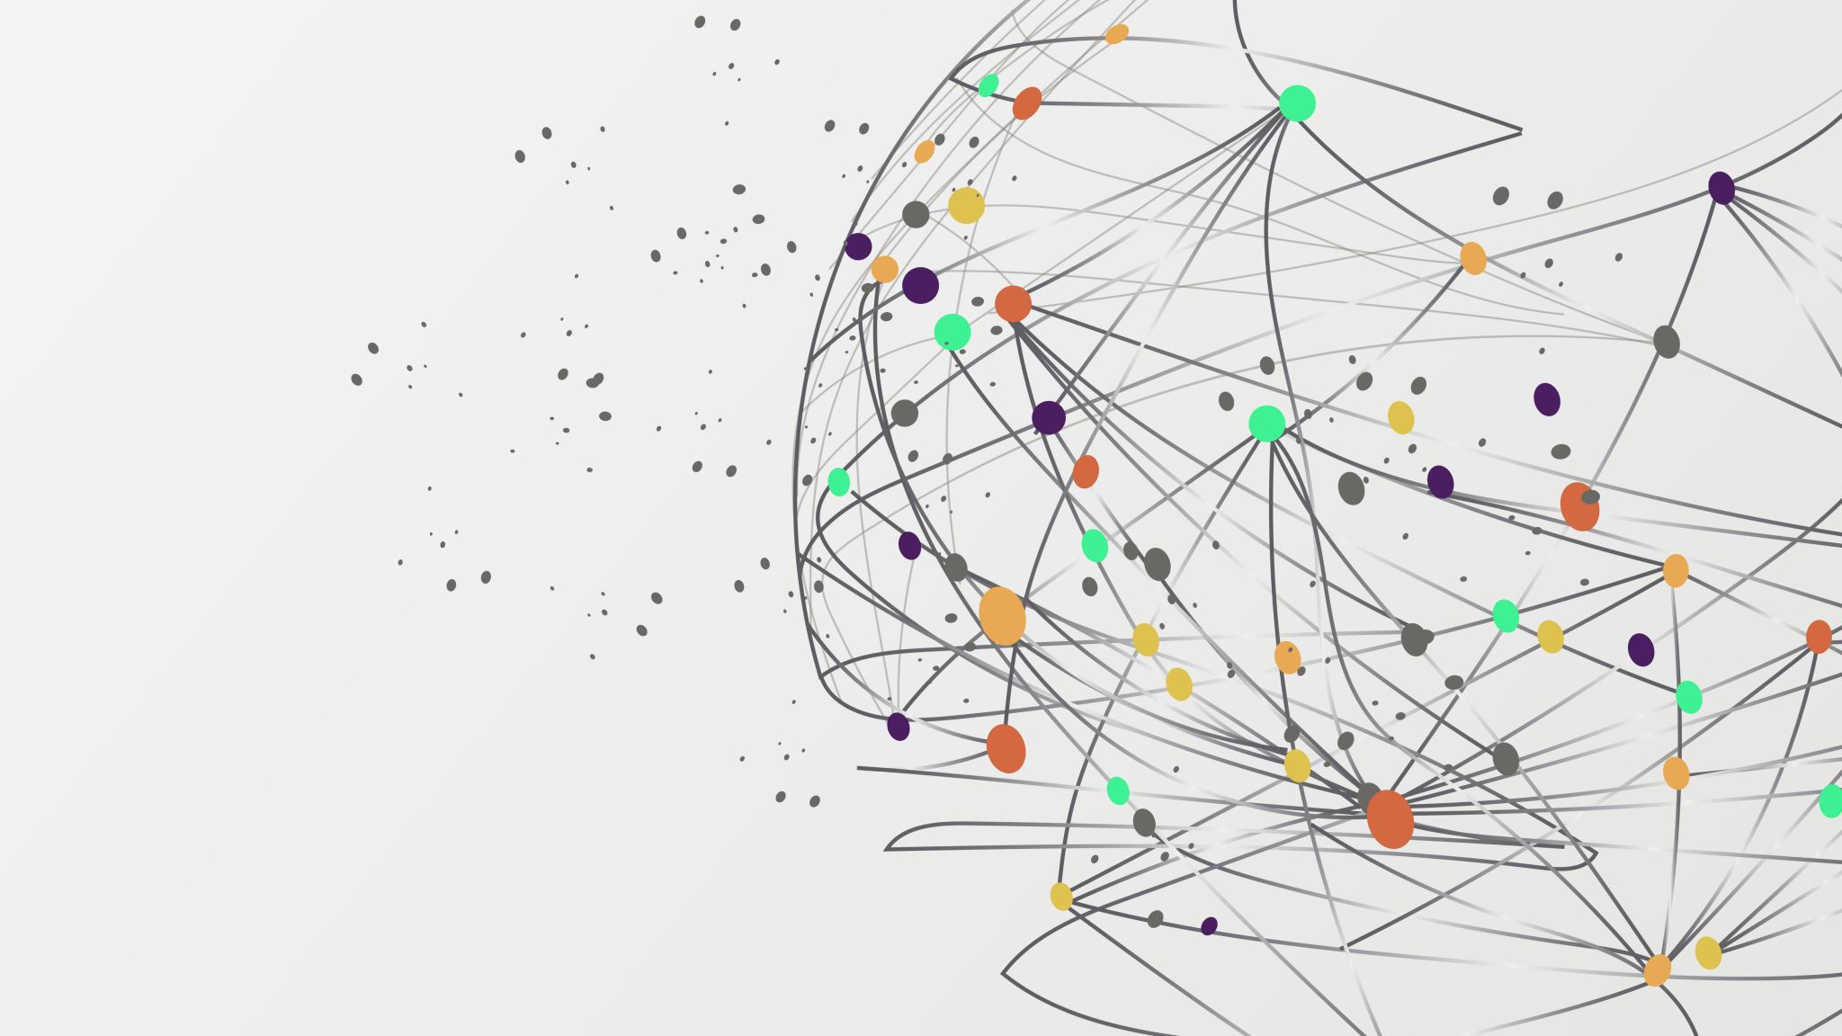
SAC ONLINE vs OFFLINE LEARNING
An investigation into sample efficiency
Viswak RB – 124104338
M.Sc. Data science & Analytics - UCC

Slide 2
Reinforcement Learning (RL)
Reinforcement Learning (RL) is a way to train an agent to make decisions by trial and error. The agent interacts with an environment by:
Observing a state
Taking an action
Receiving a reward
Moving to a new state
Over time, the agent learns a policy that maximizes total reward.
Two main training styles:
Online RL: The agent learns by actively interacting with the environment.
Offline RL: The agent is trained on a pre-recorded dataset — no new environment interaction is allowed.

Slide 3
SAC (Soft Actor-Critic)
SAC is a modern RL algorithm designed for continuous action spaces.
It uses both actor–critic architecture and entropy regularization
The actor learns a stochastic policy (samples actions from a Gaussian)
Two critics estimate how good actions are (Q-values)
The entropy term in the objective encourages exploration and avoids premature convergence
Why SAC?
Stable
Sample-efficient
Works well even in complex, continuous environments

Slide 4
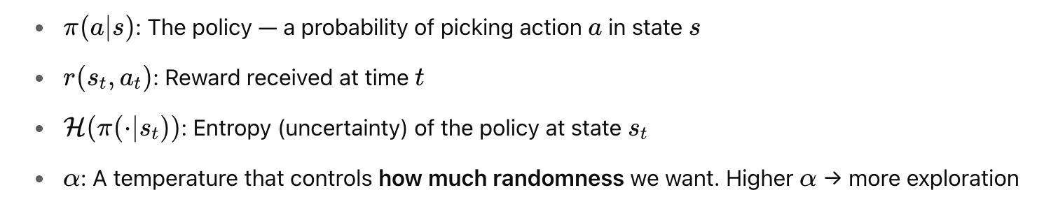
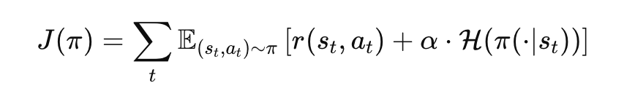
SAC in Online Learning
SAC tries to maximize two things at once:
The total reward it gets from the environment
The amount of randomness/ flexibility in its actions (Entropy)
So, the main goal is : Maximize: ∑[Reward+α⋅Entropy]
Mathematically represented as -

Slide 5
Why Online Learning works better?
In online learning, SAC works great because it:
Collects new data that matches its current policy π
Keeps improving the policy using good and up-to-date information
So, policy π is learning from data that was generated by itself, the Q-values it learns are better

Slide 6
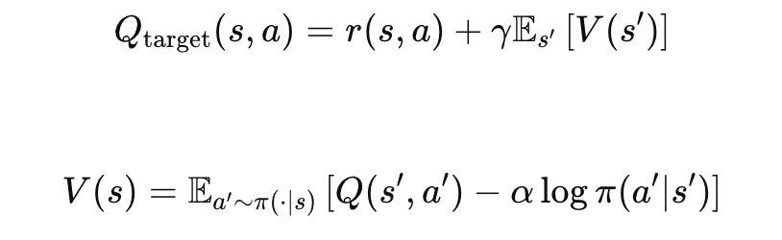
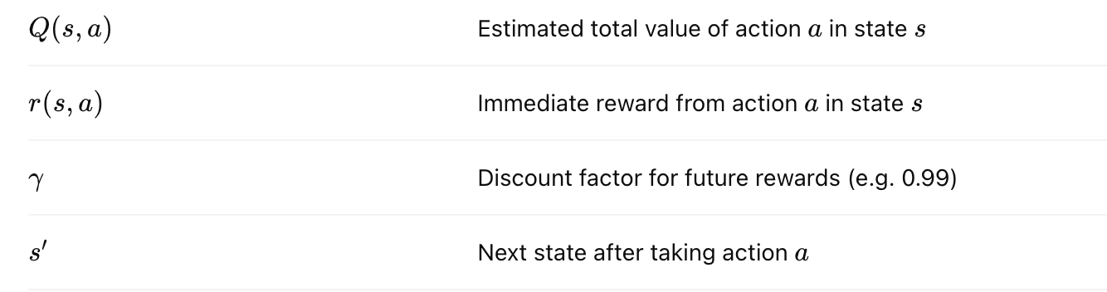
Soft Bellman Backup
The Soft Bellman Backup is the core update rule that SAC uses to learn the Q-values, and it reveals - Why SAC works so well when collecting its own data
Where,
This further confirms Why Online SAC Works Well
In online training, the agent is constantly gathering data using its current policy π.
This means the actions a′ used in the soft Bellman backup actually exist in the replay buffer.
So, the Q-values it learns are grounded in real, seen transitions.
This makes the estimate of future rewards (the Q-values) accurate and stable.

Slide 7
Why SAC Struggles in Offline?
1. In offline RL, we train using a fixed dataset D={(s,a,r,s′)} collected by another policy, not by interacting with the environment. This causes overestimation of Q Values
The dataset policy β(a∣s) is different from the current policy π(a∣s) :
Actions in buffer were chosen by β
But SAC updates using π, which may assign high probability to out-of-distribution (OOD) actions
This causes Q-values to be overestimated.

Slide 8
Why SAC Struggles in Offline? (Cont.)
2. Unseen Actions :
SAC samples actions a′∼π(a∣s′) during learning.
But in offline RL, these actions may not exist in the dataset.
When the Q-function tries to evaluate Q(s′,a′), it tries random guesses.
3. This could be even worsened by Entropy Term (−αlogπ(a∣s) ), as it can push the policy toward diverse actions not supported by the dataset

Slide 9
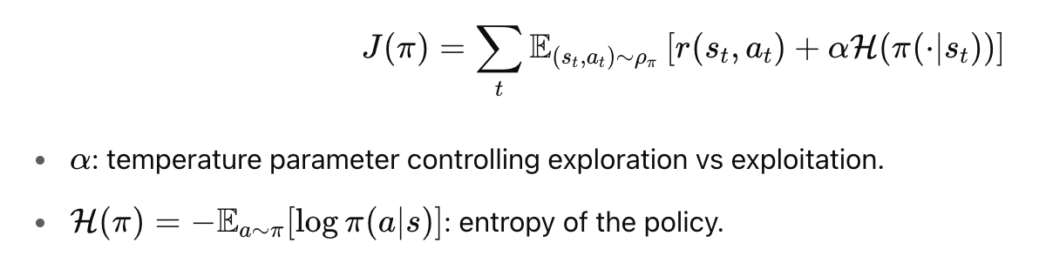

Why SAC Works Across Many Environments?
1. SAC maximizes both expected reward and entropy:
This encourages diverse actions, improving exploration in continuous and sparse reward environments.
2. Soft Bellman Backup Stabilizes Learning
This smooths out overestimation errors and helps convergence.
with soft value function,

Slide 10

Why SAC Works Across Many Environments?
3. Off-Policy and Sample Efficient
SAC is off-policy, meaning it reuses past transitions via a replay buffer.
This improves sample efficiency
SAC is more generalized as it can handle
Continuous action spaces (e.g., Pendulum, LunarLanderContinuous), High-dimensional observations, Stochastic or deterministic dynamics
replay buffer D stores past experience tuples

Slide 11
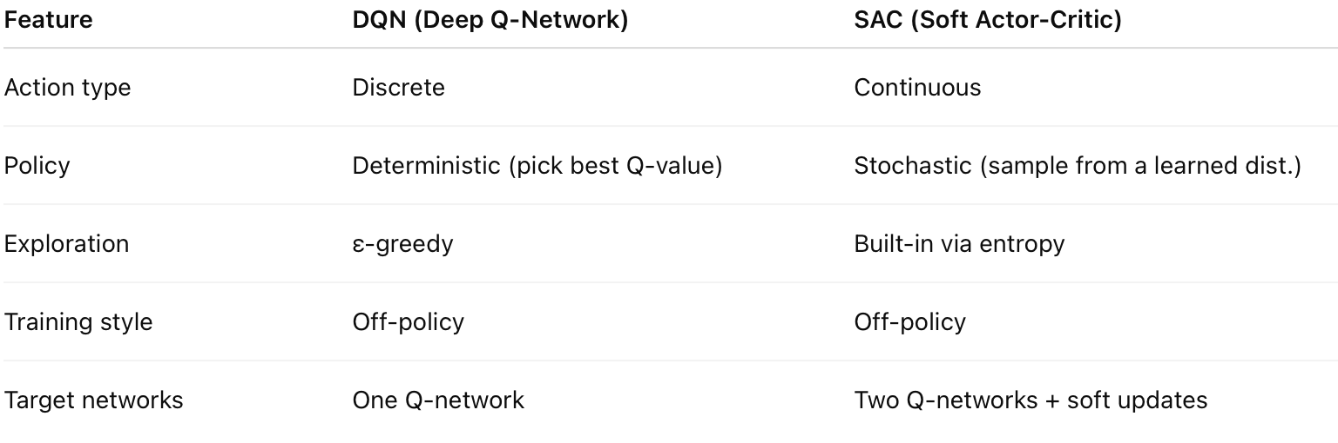
SAC vs DQN
Key difference:
DQN works well for simple, discrete problems like Atari games.
SAC is designed for more complex tasks like robotic control, where actions are continuous and noisy.

Slide 12
Task Summary
We wanted to explore how SAC performs when trained:
Online — the agent interacts with the environment while learning
Offline — the agent is trained only on a fixed dataset collected earlier
We ran this experiment on two environments:
LunarLanderContinuous-v2 : A simulated lunar module must land softly on a designated pad using thrusters. Action space: 2 continuous controls (main engine + side thrusters) Reward depends on landing speed, position, angle, and fuel efficiency.
Pendulum-v1 : A simple inverted pendulum must be balanced upright by applying torque. Action space: 1 continuous torque value Reward penalizes angle deviation and high velocity.
For each:
We trained online for 1,000 episodes
Collected the replay buffer
Used it to train a new agent offline
Compared convergence and final performance

Slide 13
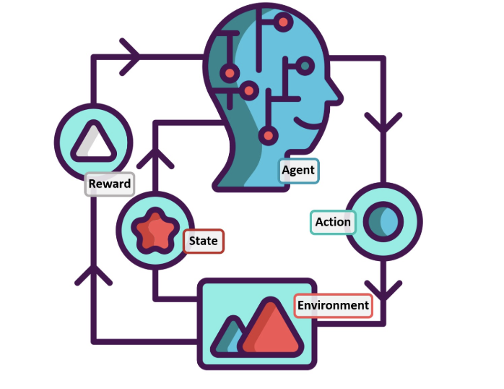
SAC: Implementation on LunarLanderv2
Custom/Provided neural network architecture for policy and Q-networks

Slide 14
Code Structure (.py Files)
sac_torch.py The heart of the SAC agent. Defines:
Actor and critic networks
Replay buffer
Training loop (learn())
networks.py Contains the neural network models for actor and critic.
utils.py Simple utility for plotting learning curves
main_sac.py
Handles online training:
Interacts with the environment
Stores data
Trains and saves models and dataset
main_sac_offline.py
Handles offline training:
Loads dataset
Trains without any new interaction.

Slide 15
Online and Offline Code Flow
Online Training Flow (main_sac.py)
Agent runs episodes in the environment
After every step:
Saves transition to replay buffer
Learns from sampled batches
All transitions are saved as a .pkl file for offline use
Plots learning curve during training
Offline Training Flow (main_sac_offline.py)
Loads the .pkl dataset into replay buffer
Trains the agent entirely from this fixed data (no new steps in the env)
Every few thousand steps:
Evaluates policy in the environment
Plots performance
By reusing the same agent class across both flows, we minimized code duplication while testing both training setups.

Slide 16
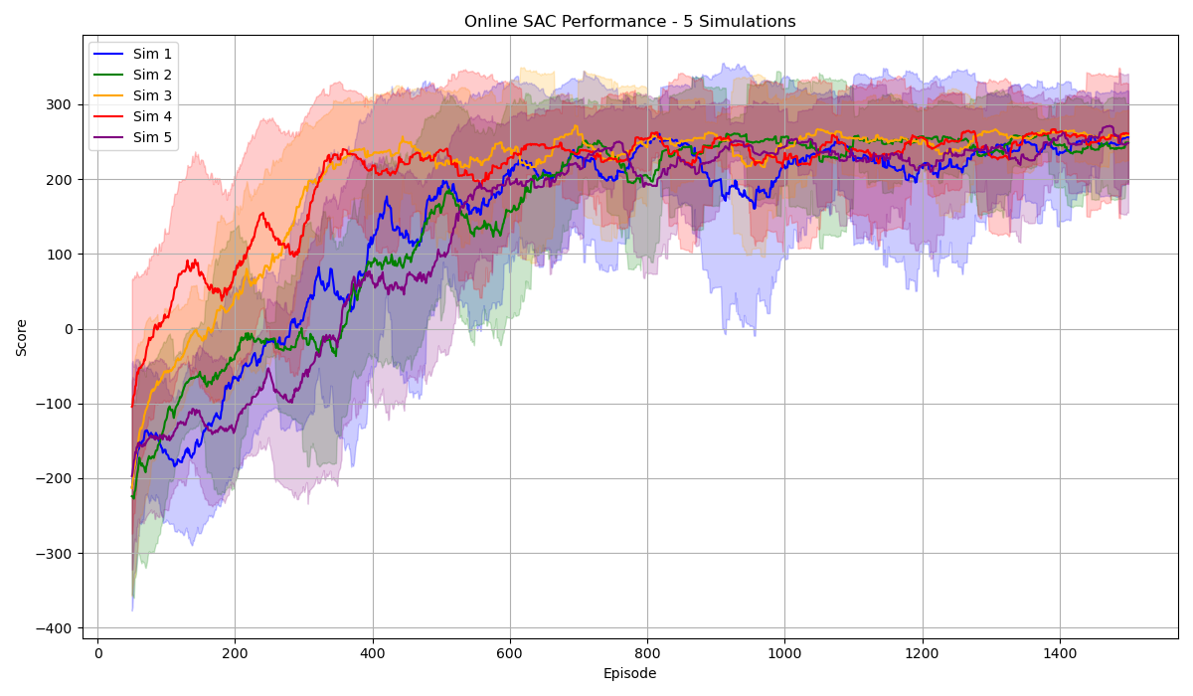
Results Overview - LunarLanderContinuousv2 Online

Slide 17
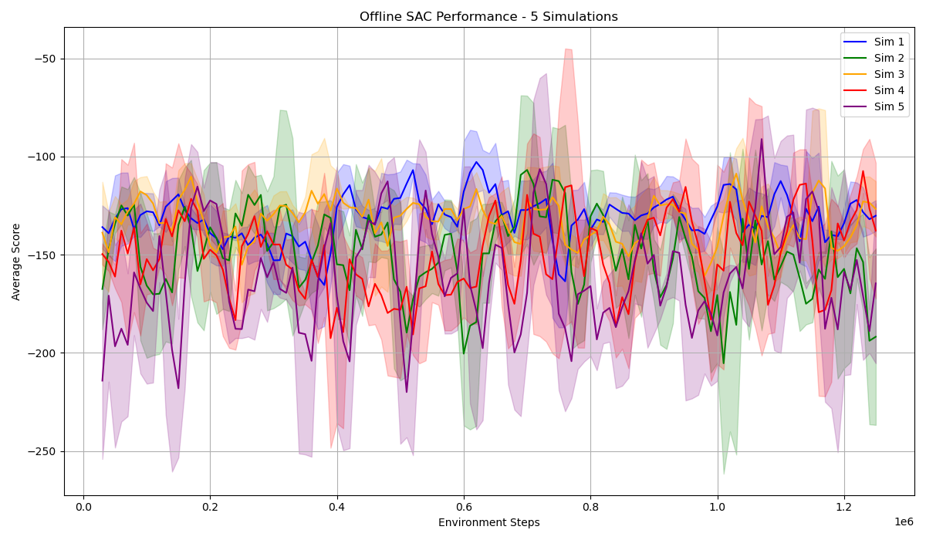
Results Overview - LunarLanderContinuousv2 Offline

Slide 18
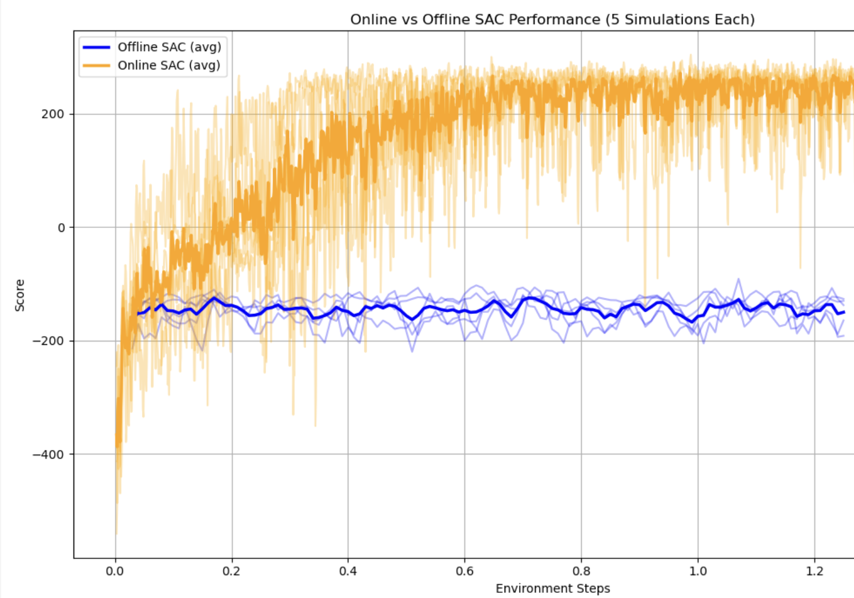
Results Comparison - Lunar Online vs Offline

Slide 19
Sample Efficiency- Lunar Online vs Offline
Metric | Online SAC | Offline SAC
Solved Task (≥200) | Yes | No
Success % | 100.0% | 0.0%
Total Steps | 1,500,000 | 1,250,000
Total Data Used | 12,000,000 | 10,000,000
Steps to Reach 200 | 305,000 | —
Data to Reach 200 | 2,440,000 | —

Slide 20
Poor Offline SAC - Expected
Q-function thinks bad actions are good (overestimates their value).
Policy learns to choose those bad actions.
During evaluation, the environment executes those actions, which are:
OOD (never seen in the dataset)
Unsafe or ineffective
Misleadingly rated as high-value
Result in
Low or negative reward
No improvement in average score
Policy keeps following “bad advice” from a misled Q-function

Slide 21
Poor Offline SAC - Expected
Kumar et al. (2020) (CQL):
"Standard off-policy RL methods like SAC fail in offline settings due to overestimation on OOD actions and lack of pessimism."
Lyu et al. (2022) (MCQ):
"Offline SAC tends to learn degenerate or unstable policies unless explicitly regularized for distributional shift."
Fu et al. (2021):
"Without policy or value constraints, offline SAC performs poorly due to distributional mismatch."

Slide 22
CQL Implementation
Penalize overestimation of out-of-distribution (OOD) actions by minimizing Q-values on randomly sampled actions from the action space.
Method Highlights:
Adds a conservative regularization term to the Bellman loss.
Prevents exploitation of bad Q estimates from unseen actions.
Works well across a range of continuous control tasks.
Title: Conservative Q-Learning for Offline Reinforcement Learning Authors: Aviral Kumar, Aurick Zhou, George Tucker, Sergey Levine Published: NeurIPS 2020 Link: https://arxiv.org/abs/2006.04779

Slide 23
Code Structure (.py Files) – Key Changes for CQL
Followed a modular approach without altering core files like networks.py or buffer.py.
New File: sac_torch_cql.py
Introduced a SAC_CQL class that extends offline SAC with CQL logic.
Imported existing ActorNetwork and CriticNetwork from networks.py.
Added a TwinCritic wrapper for computing Q1 and Q2.
Created a new Python class called SAC_CQL that builds on top of our existing offline SAC implementation and adds the Conservative Q-Learning (CQL) logic.
In the train() function:
We added the log-sum-exp penalty over sampled actions to the Q-function loss:

Slide 24
Code Structure (.py Files) – Key Changes for CQL
The only change happens in the critic update step (loss function), so, resued everything else from offline SAC: replay buffer, actor updates, entropy terms.
q_loss += cql_alpha * (logsumexp(Q_rand) – Q_dataset)
Sampled random actions and policy actions to compute the log-sum-exp penalty.
Used min(Q1, Q2) as target Q-value (same as SAC and paper).
Introduced new hyperparameter: cql_alpha (strength of conservative penalty).

Slide 25
Key Implementations for CQL
Implementation | Description | Reason
New agent file sac_torch_cql_final.py | SAC_CQL class that inherits SAC’s structure but overrides the critic-update step. | Keeps SAC code intact and isolates all CQL logic in one place.
Twin Q-networks | TwinCritic wrapper instantiates two CriticNetworks and returns Q1, Q2. | Matches SAC/CQL requirement to use min(Q1,Q2) for targets and apply the CQL penalty to both critics.
Conservative critic loss | Added log-sum-exp penalty:q_loss += cql_alpha * (logsumexp(Q_rand) – Q_dataset) | Implements the core idea from the CQL paper—push Q-values down on unseen actions to avoid overestimation.
Action sampling for penalty | For each state we now sample 2 uniform random actions 2 policy actions (detached) | Provides the ood actions required in the CQL loss while keeping runtime low.
Hyper-parameter | cql_alpha (default 0.1) controls strength of the conservative penalty. | Allows easy tuning between too-conservative and too-optimistic learning.
Actor calls | Replaced all actor.forward(…) with actor.sample_normal(…) to obtain (action, log π) as required by SAC/CQL. | Ensures proper stochastic policy sampling without editing ActorNetwork.
Training script cql_sac.py | Imports SAC_CQL instead of SAC• Uses offline replay buffer• Evaluates every 10 k steps• Saves results to plots/cql_scores_*.npy | Provides a drop-in runner that mirrors the original offline-SAC script for apples-to-apples comparison.

Slide 26
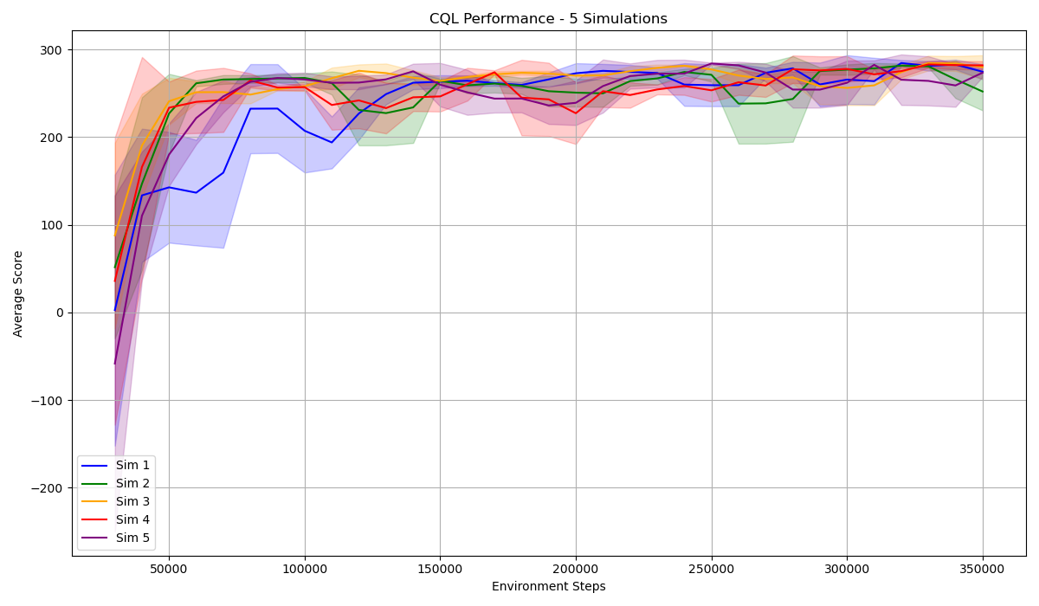
Results Overview - LunarLanderContinuousv2 CQL

Slide 27
Sample Efficiency- LunarLander V2
CQL is 7× more sample efficient than Online SAC
Metric | Online SAC | Offline SAC | CQL (Offline)
Solved Task (≥200) | Yes | No | Yes
Success % | 100.0% | 0.0% | 100.0%
Total Steps | 1,500,000 | 1,250,000 | 350,000
Total Data Used | 12,000,000 | 10,000,000 | 2,800,000
Steps to Reach 200 | 450,000 | — | 70,000
Data to Reach 200 | 3,600,000 | — | 500,000
CQL requires ~85% less data to solve the task

Slide 28
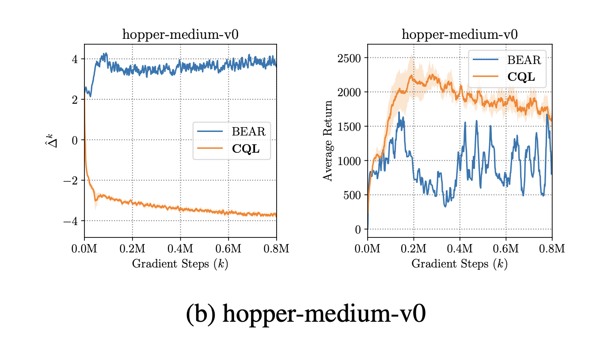
Expected Results? – Benchmark Comparison
TBU
This figure from the paper shows CQL reaching good performance in under 300k steps on Hopper. Our own CQL on LunarLander follows a similar trend solving the task in ~250k steps with much better sample efficiency than baseline offline SAC. That suggests our implementation behaves as expected
This result matches the paper’s claim:
"CQL enables learning from offline datasets at a level comparable to online RL with greater stability and sample efficiency
From the paper Conservative Q-Learning for Offline Reinforcement Learning}

Slide 29
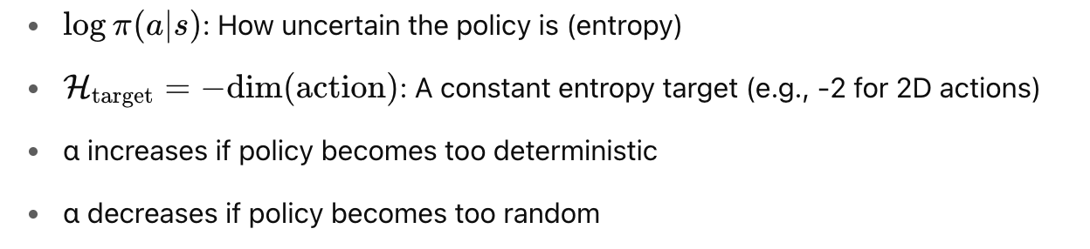

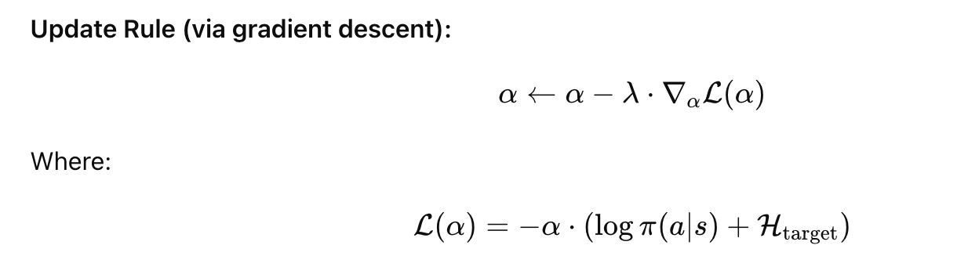
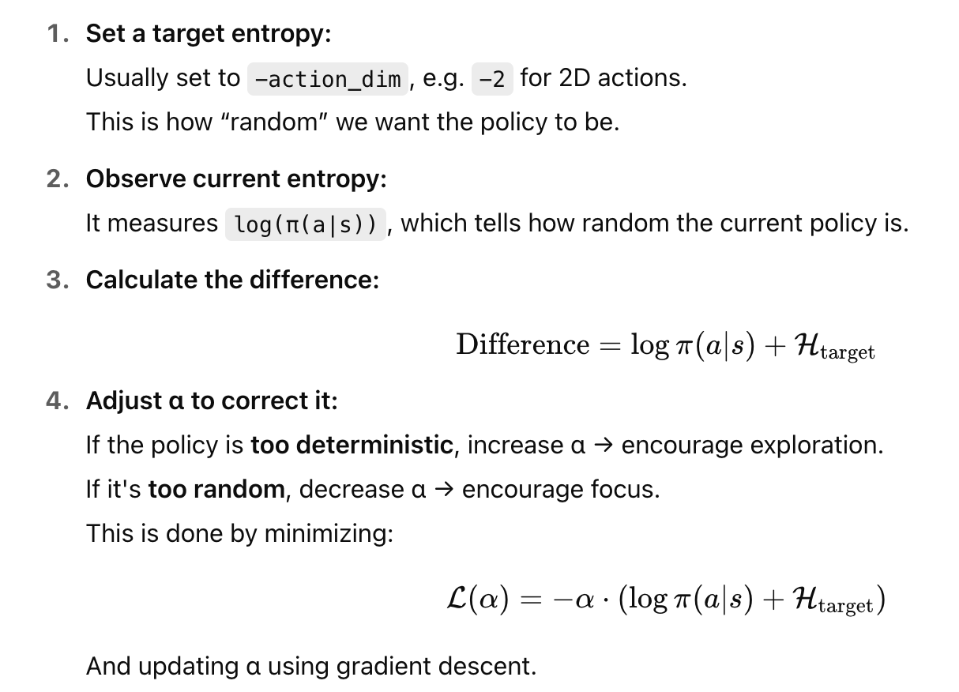
SAC Auto Entropy Tuning
TBU
Paper: Soft Actor-Critic Algorithms and Applications Tuomas Haarnoja et al., arXiv:1812.05905
Key Idea : Automatically adjust the entropy coefficient α during training to maintain the right level of policy randomness (exploration). Formulates α tuning as a dual optimization problem to match policy entropy with a target entropy level:
Result:
SAC adapts exploration automatically
More stable learning across tasks

Slide 30
Key papers - on why SAC struggles in Offline RL
1. Off-Policy Deep Reinforcement Learning without Exploration - Fujimoto et al., ICML 2019 This foundational paper introduces the problem of extrapolation error in offline RL — SAC and other off-policy algorithms may assign high value to unseen (out-of-distribution) actions, causing poor policies. The authors propose BCQ (Batch-Constrained Q-learning) to restrict actions to those seen in the dataset, which greatly improves stability and performance in offline settings. Read here
2. Stabilizing Off-Policy Q-Learning via Bootstrapping Error Reduction (BEAR) - Kumar et al., NeurIPS 2019 BEAR highlights bootstrapping error — the repeated use of inaccurate value estimates for unseen actions in SAC’s critic leads to divergence. It proposes constraining the learned policy to remain close to the data distribution using a similarity metric, effectively improving stability. Read here
3. Behavior Regularized Offline Reinforcement Learning (BRAC) - Wu et al., 2019 (Google Research) BRAC shows that SAC fails offline mainly due to unconstrained policy deviation. By adding a regularization term (e.g., KL divergence) between the learned and behavior policy, SAC becomes significantly more stable and effective in offline training. Read here
4. Conservative Q-Learning for Offline Reinforcement Learning (CQL) - Kumar et al., NeurIPS 2020 CQL addresses SAC's offline failure by making Q-learning conservative — penalizing Q-values of actions not in the dataset. This reduces overestimation and prevents the agent from exploiting erroneous Q-values for out-of-distribution actions. Read here

Slide 31
Key papers - on why SAC struggles in Offline RL
5. A Minimalist Approach to Offline Reinforcement Learning (TD3+BC) - Fujimoto & Gu, NeurIPS 2021 This simple approach shows that just adding a behavior cloning loss to SAC or TD3's policy update significantly improves offline performance. It confirms that SAC mainly fails offline due to its policy choosing actions too far from those in the dataset. Read here
6. Offline Reinforcement Learning with Implicit Q-Learning (IQL) - Kostrikov et al., ICLR 2022 IQL avoids the failure of SAC in offline RL by never querying out-of-distribution actions. It trains a value function using expectile regression and performs advantage-weighted behavior cloning, bypassing the pitfalls of standard SAC’s critic updates. Read here
7. Uncertainty-Based Offline Reinforcement Learning with Diversified Q-Ensemble (EDAC) - An et al., NeurIPS 2021 EDAC enhances SAC by using a Q-network ensemble to estimate uncertainty and conservatively penalize high-variance value predictions. This helps mitigate SAC’s tendency to overestimate Q-values for out-of-distribution actions. Read here
8. SpOiLer: Offline Reinforcement Learning using Scaled Penalties - Srinivasan & Knottenbelt, PMLR 2024 SpOiLer modifies SAC’s Bellman backups by adding a penalty proportional to the action's likelihood under the dataset, making value estimates more pessimistic for unfamiliar actions. This method avoids overestimation without needing ensembles or behavior cloning.
Read here

Slide 32
References
https://github.com/rail-berkeley/d4rl
https://huggingface.co/blog/offline-rl
https://github.com/vwxyzjn/cleanrl/blob/master/cleanrl/sac_continuous_action.py
https://spinningup.openai.com/en/latest/algorithms/sac.html

Slide 33
Dimensionality Reduction of State Space using Variational Autoencoder (VAE)
A Variational Autoencoder (VAE) is a generative model that learns a compressed, probabilistic latent representation of input data, while also being able to reconstruct the input from this latent space.
Encoder: Compresses input x into a latent vector z
Latent Space: Represents underlying structure in lower dimensions
Decoder: Reconstructs the original input x^ from z
Adds a KL-divergence term to encourage smooth latent distributions

Slide 34
How VAE Works
Encoder:
Maps the input state x to a latent distribution z∼N(μ,σ)
Produces a compressed latent representation: a vector that captures the most important information in the input.
Decoder:
Samples from the latent space z and reconstructs the input x^.
Tries to generate a version of the original input using only the compressed code.
Loss Function:
Combines Reconstruction Loss (how close x^ is to x) and KL Divergence (how close the latent distribution is to a standard normal).
Total loss = MSE(x,x^)+KL(q(z∣x)∥p(z))

Slide 35
Why Use VAE?
Improve Sample Efficiency in Offline Reinforcement Learning Compressing states helps the agent learn faster from limited data
Reduce Input Dimensionality for Downstream Agents (CQL / SAC) Smaller state spaces speed up learning and reduce overfitting
Regularize State Representations Latent encodings enforce smoother, more structured representations
Encourage Generalization in Data-Scarce Settings Especially useful when the dataset is fixed and cannot be expanded
We apply this approach to LunarLanderContinuous-v2 to assess the impact of learned latent representations on policy performance.

Slide 36
VAE Implementation
Trained Variational Autoencoder (VAE) using normalized state vectors from the offline replay buffer (States were normalized before training to zero mean and unit variance and to Ensures stable VAE learning and balanced gradients)
Input dimension: 8 (original LunarLander state)
Trained models with varying latent dimensions:
6D – Moderate compression
4D – Higher compression
Trained VAE weights saved as .pt files and Normalization stats (mean, std) saved as .pkl for consistent use during encoding

Slide 37
VAE Integration with CQL
During both training and evaluation, the agent processes states as follows:
Raw State → Normalized → Encoded by VAE → Passed to Policy & Critic Networks
Normalization: Raw environment states are first normalized using the dataset’s mean and standard deviation to ensure consistent input scaling.
VAE Encoding: The normalized state is passed through the trained VAE encoder, which compresses it into a lower-dimensional latent vector. This vector captures the essential structure of the state while filtering out noise.
Input to CQL: The resulting latent representation is used as input to the CQL agent’s policy (actor) and Q-function (critic) networks instead of the full original state.
This approach allows the CQL agent to learn from a compressed, denoised, and regularized representation of the environment, which can improve sample efficiency

Slide 38
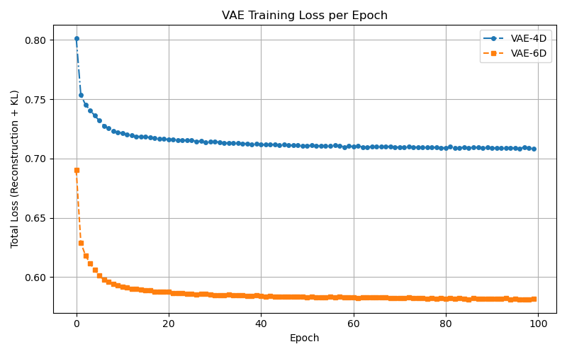
VAE Training - Results
The VAE models with 4D and 6D latent spaces were successfully trained and converged within 100 epochs. As expected, the 6D model achieved a lower loss than the 4D model, indicating better reconstruction accuracy.
The 6D model retained more information from the original state, the 4D model offered stronger compression at the cost of some fidelity. Both results are within acceptable ranges, confirming that our VAE is functional and ready for RL integration.

Slide 39
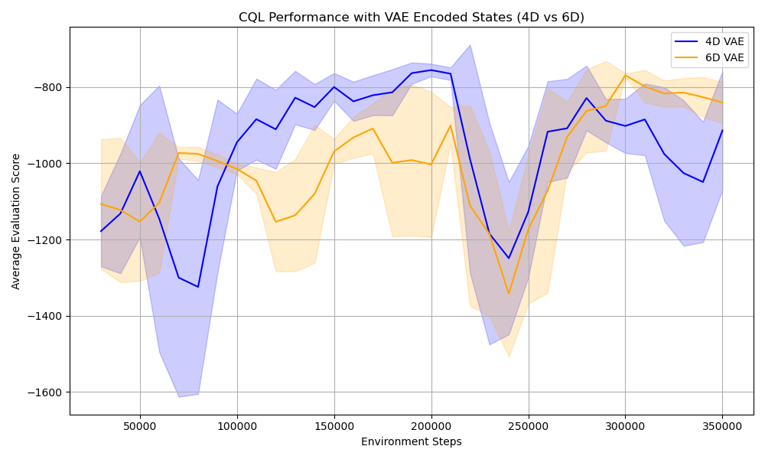
CQL SAC Performance with VAE (6D, 4D)
The results were poor compared to our previous ones and overall, both models operate in a low-scoring regime, This indicates a trade-off: the 4D model benefits from more aggressive compression, which might force better generalization in some phases, while the 6D model offers more stability by retaining more information.

Slide 40
Why VAE doesn’t improve LunarLander
LunarLanderContinuous-v2 has 8 continuous state features: x-pos, y-pos, x-vel, y-vel, angle, angular-vel, left-leg-contact, right-leg-contact.
When we apply a VAE, we are:
Encoding this 8D vector into a smaller latent space (e.g., 4D or 6D).
LunarLander was due to information loss during VAE encoding

Slide 41
Why VAE doesn’t improve LunarLander
Lunar’s state is already low-dimensional (just 8 features), so reducing it further (e.g., to 4D) is aggressive.
This means:
Some detail will be lost, especially subtle dynamics (e.g., leg contacts, fine velocity changes).
The agent trained on compressed states may perform worse unless the latent space captures the right structure.

Slide 42
Evaluating State Reconstruction
To verify our hypothesis that performance degradation in LunarLander was due to information loss during VAE encoding, and that applying dimensionality reduction on already low-dimensional environments like LunarLander can lead to significant information loss –
Reconstructed a few sample states using trained VAEs with 4D and 6D latent spaces.
Compared the reconstructed states to the original states across each feature dimension (e.g., position, velocity, angles, etc.).
Visualized these side-by-side to observe how much each VAE model altered or discarded critical information.

Slide 43
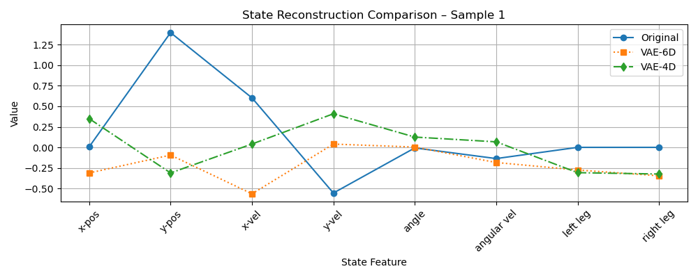
Evaluating State Reconstruction – Sample 1
The charts above visualize the reconstruction accuracy of the VAE on five individual state samples randomly taken from the offline dataset. Each sample represents a full 8D state vector from one timestep of the environment. The blue line represents the original normalized state, while the orange and green lines show the reconstructions from 6D and 4D VAE models, respectively.

Slide 44
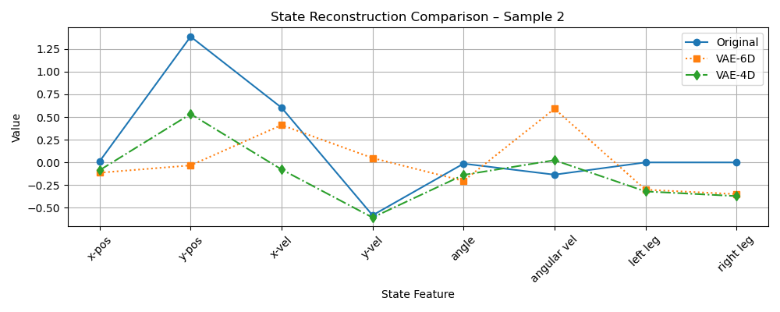
Evaluating State Reconstruction - Sample 2

Slide 45
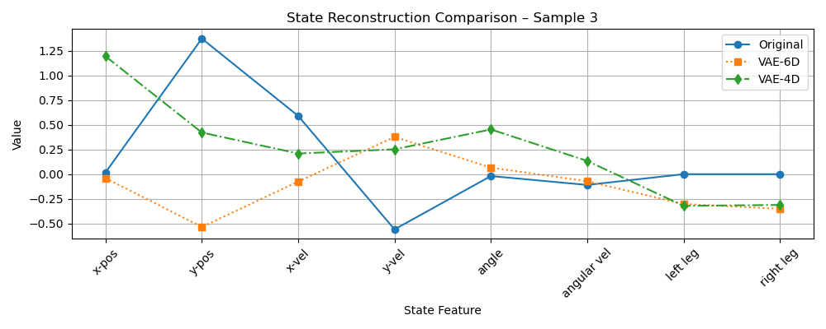
Evaluating State Reconstruction - Sample 3

Slide 46
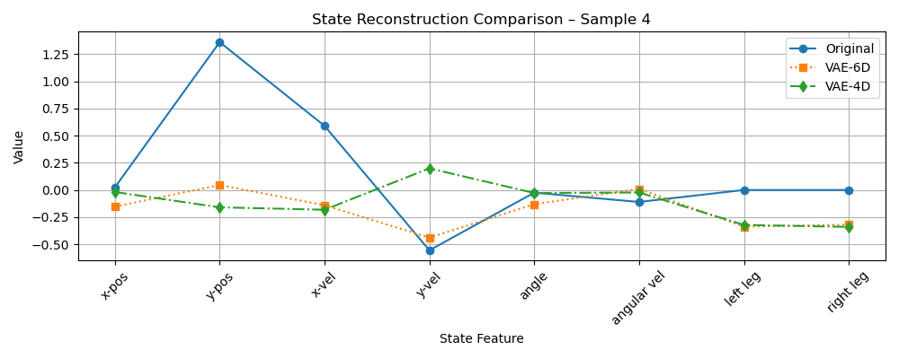
Evaluating State Reconstruction - Sample 4

Slide 47
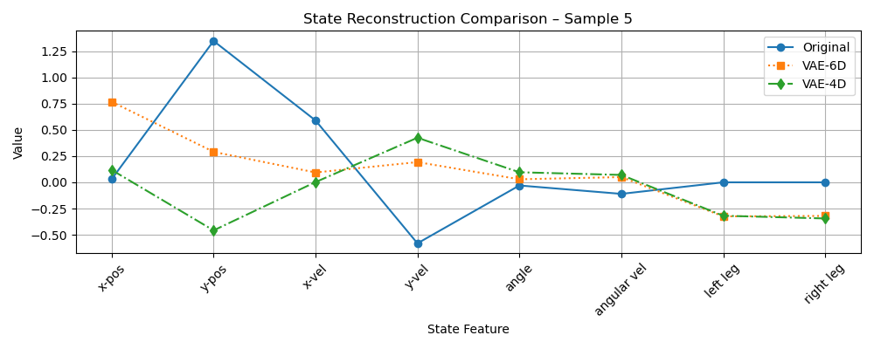
Evaluating State Reconstruction - Sample 5

Slide 48
Evaluating State Reconstruction - Interpretation
These visual results confirms the issue : compressing an already compact state space can degrade representational quality, potentially impeding the agent’s ability to learn meaningful policies. Thus, while VAE could offer generalization benefits in high-dimensional domains, their use in low-dimensional problems like LunarLander doesn’t improve sample efficiency due to information loss.

