Slide 1
Project Ideas
Book management
VD group
Version 19.05

Slide 2
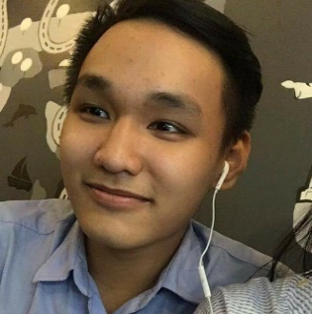

Who Are We?
Lê Phương Vinh
Mobile: 0587512999
Email: vinhlpse130092@fpt...
FB:Phương Vinh
Đời mà … code thôi.
Đỗ Minh Đức
Mobile: 000 có
Email: ducdmse130171@fpt...
FB: Minh Đức
Avatar đen để đời đỡ đen.

Slide 3
Agenda
01
Background
02
Operational Concepts (What is it?)
Basic Layouts
03
System Architecture
04
Conclusion
05

Slide 4
01
Background

Slide 5





01
Background
Too hard to control all book.
Hard to find a book in library.

Slide 6
02
Operational Concepts (What is it?)

Slide 7
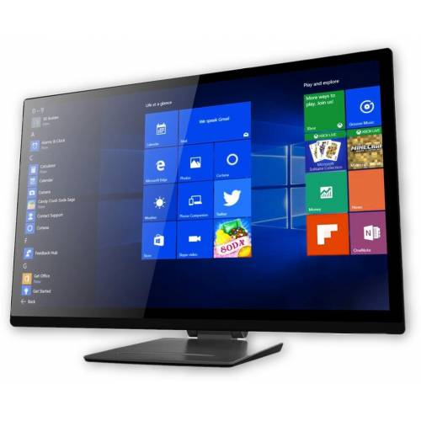
02
Operational Concepts (What is it?)
Search and see book by this screen
Borrow and return your book
Library manager easily to manage book.

Slide 8
03
Basic Layouts

Slide 9
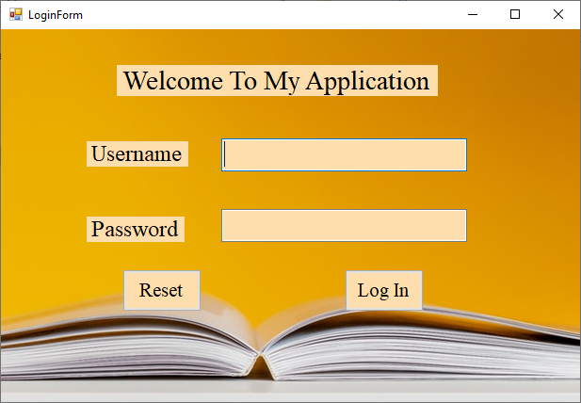
03
Login Form

Slide 10
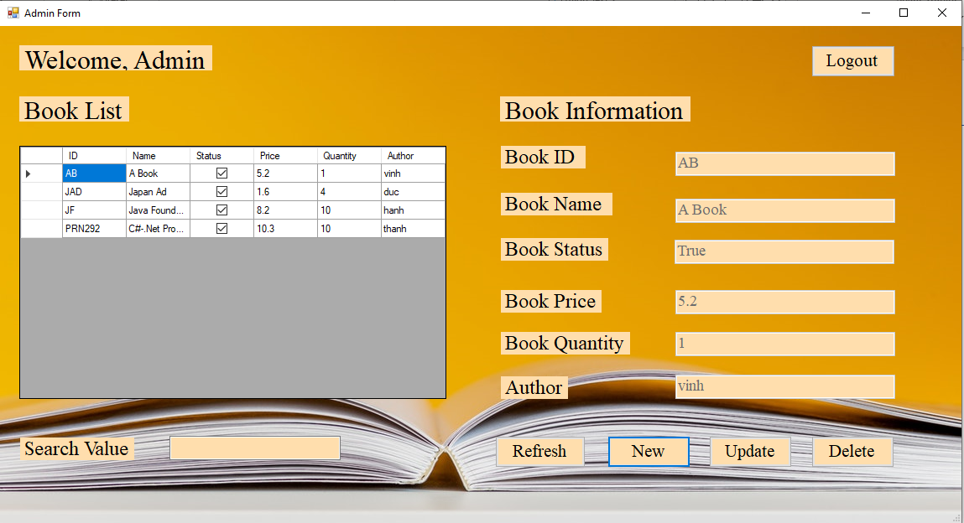
03
Admin form

Slide 11
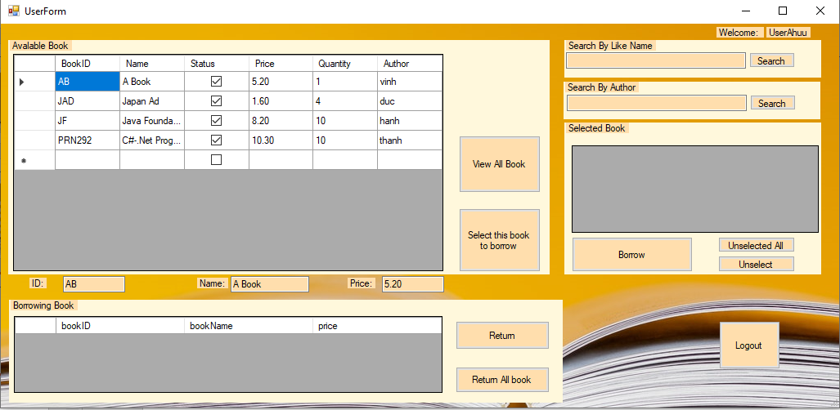
03
User Form

Slide 12
04
System Architecture

Slide 13
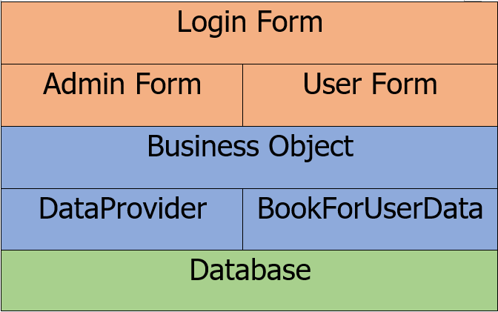
04
System Architecture

Slide 14
05
Conclusion

Slide 15
05
Conclusion
This is useful software.
Help a lot of things for our library
It will be update more function in the future.

Slide 16

THANK YOU

