Slide 1

Extreme Augmentation for skeletal action recognition
Killian Hinard
Master in Robotics
10 ECTS
TA : Mohamed Ossama Ahmed Abdelfattah
January 2024

Slide 2
Problem definition :
Self-supervised learning is becoming more and more popular recently and contrastive learning based network are showing promising result. Action recognition an important field of deep learnings with plenty of applications.
We want to study the effect of extreme data augmentation on transformer-based methods, using a contrastive learning framework to do an action recognition task.
INPUT: Sequence of 3D skeleton joints
OUTPUT: Predicted action in the sequence

Slide 3
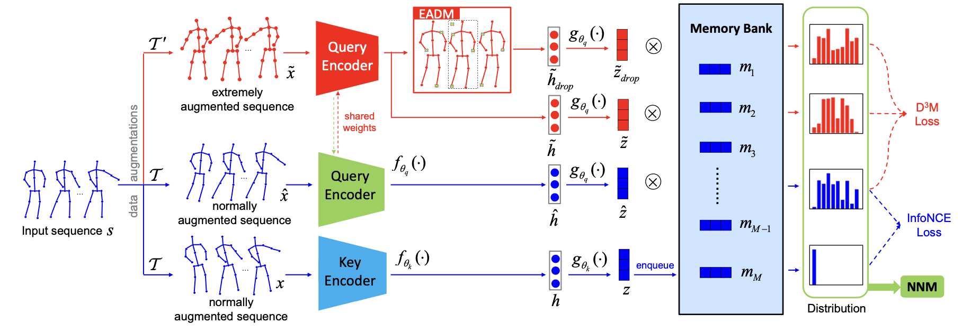
Previous Work :
AIMCLR : Contrastive Learning from Extremely Augmented Skeleton Sequences for Self-supervised Action Recognition :
A proposed method to apply extreme data augmentation to a GCN-based encoder.

Slide 4
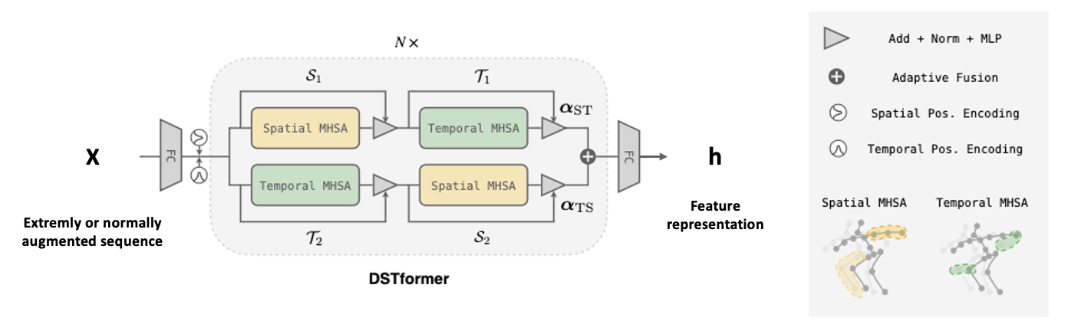
Proposed Method:
In order to study the effect of extreme data augmention on transformer based model, the proposed method is the following : We want to adopt AimCLR approach to pretrain MotionBERT.
To do that we will replace the encoder in AimCLR by the DSTformer backbone from MotionBERT and the classification head of AimCLR by the action head of MotionBERT.
Extremely or normally augmented sequence

Slide 5
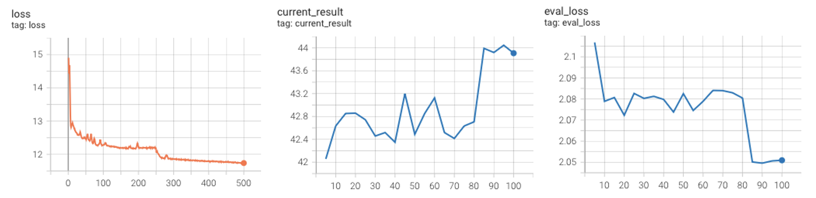
Experiment :
Dataset : NTU-RGB 60, xsub
Model backbone : Vanilla Transformer
Evaluation Method : linear evaluation from AimCLR
Results :
Pretraining : 500 epochs
Linear Eval :100 epochs, top1 accuracy = 44.05%

Slide 6
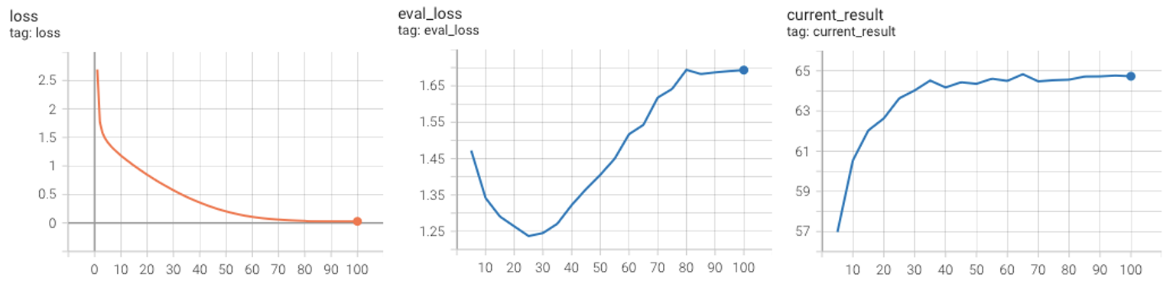
Experiment :
Dataset : NTU-RGB 60, xsub
Model backbone : DSTformer from MotionBERT
Evaluation Method : Action Head from MotionBERT
Results :
Pretraining : 150 epochs
Linear Eval :100 epochs, top1 accuracy = 64.83%

Slide 7
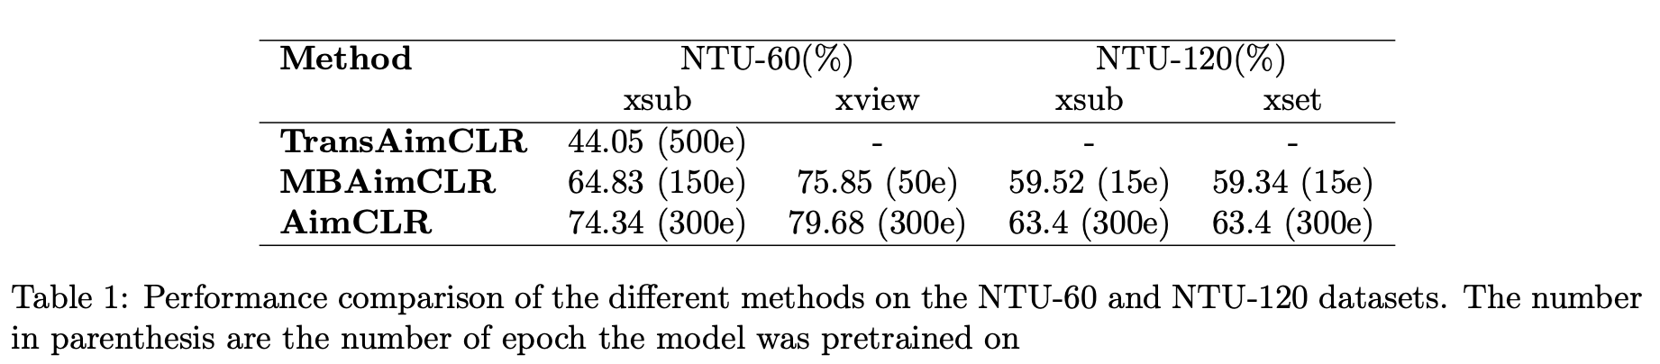
Experiment :
Summary of the different experiment result and comparison of the different models on the NTU RGB+D 60 and 120 datasets

