Slide 1
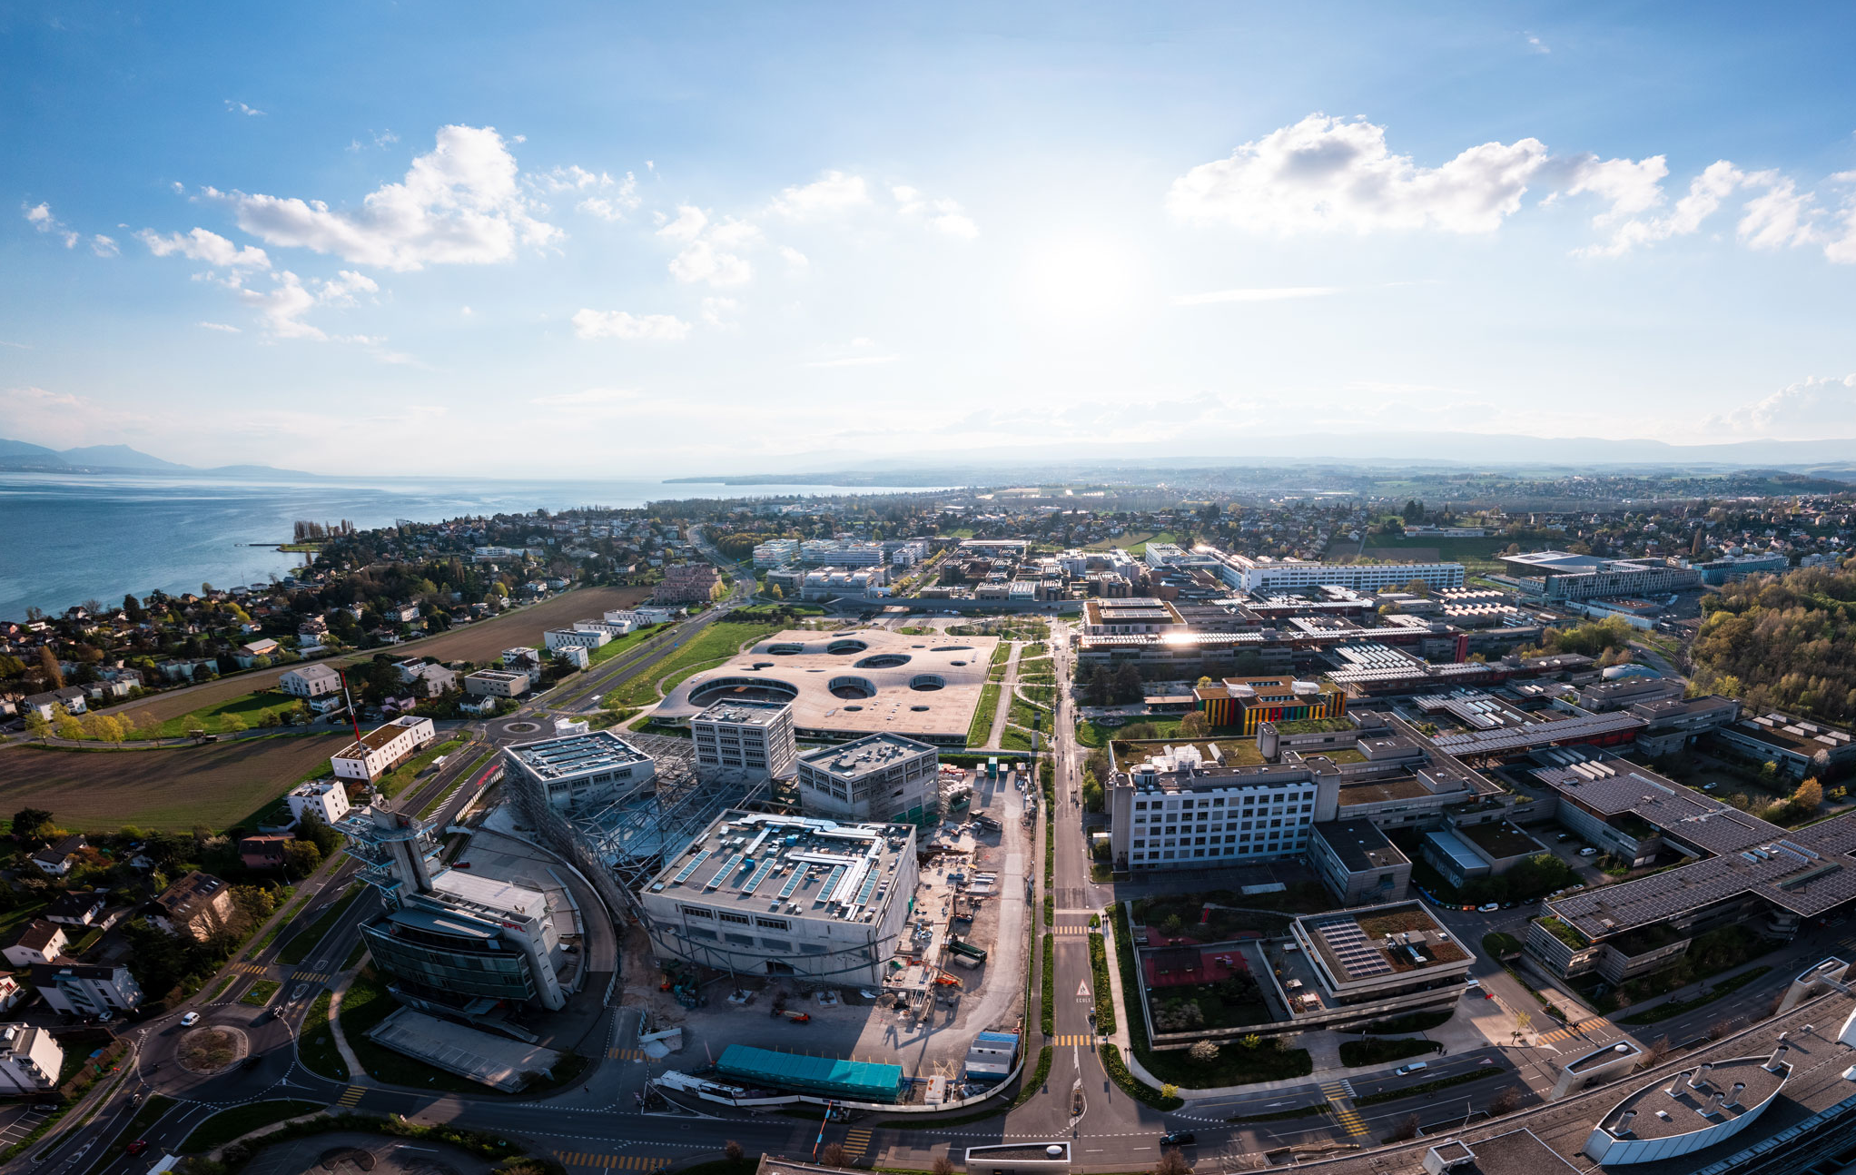

Self-Suprervised Skeleton-based Action Recognition
Student: Ruihang Jiang (Master in Computer Science)
Supervisor: Mohamed Abdelfattah
Alexandre Alahi
Optional Semester Project: 8 Credits
April 2024

Slide 2
Problem
How to classify or predict actions with limited supervised data?
Self-Supervised Learning
How to construct models with promising performance in various down-stream tasks?

Slide 3
Problem
How to construct models with promising performance in various down-stream tasks?
Pretraining Stage
Input: Joints Coordinates
Output: High-level features
Trained Model Parameters
Finetuning Stage
Input: Joints Coordinates
Output based on distinct down-stream tasks:
Action Classification
3D Pose Estimation

Slide 4
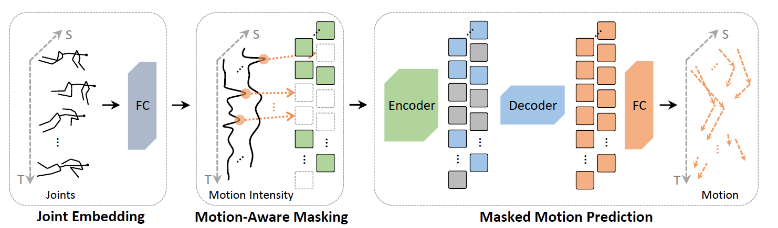
Previous Work
MAMP^{[1]}
Motion + Spatial Encoder Model
[1] Mao, Yunyao, et al. "Masked motion predictors are strong 3d action representation learners." Proceedings of the IEEE/CVF International Conference on Computer Vision. 2023.

Slide 5
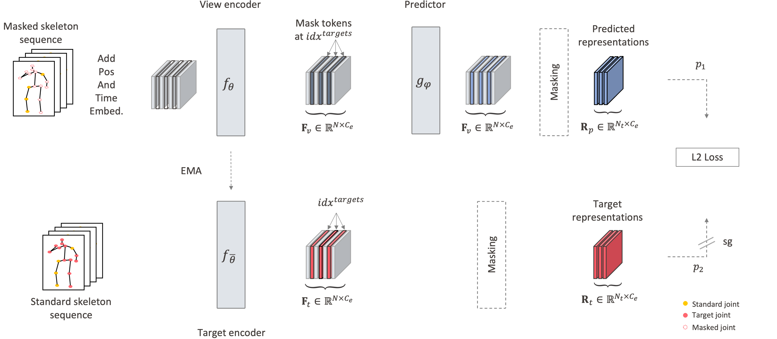
Proposed Method
Pretrained Stage: Spatial/Temporal Encoder
Knowledge Distillation^{[2]}: Predictor + EMA
[2] Caron, Mathilde, et al. "Emerging properties in self-supervised vision transformers." Proceedings of the IEEE/CVF international conference on computer vision. 2021.

Slide 6
Proposed Method
Finetune Stage: Spatial/Temporal Student Encoder + Simple MLP
MLP

Slide 7
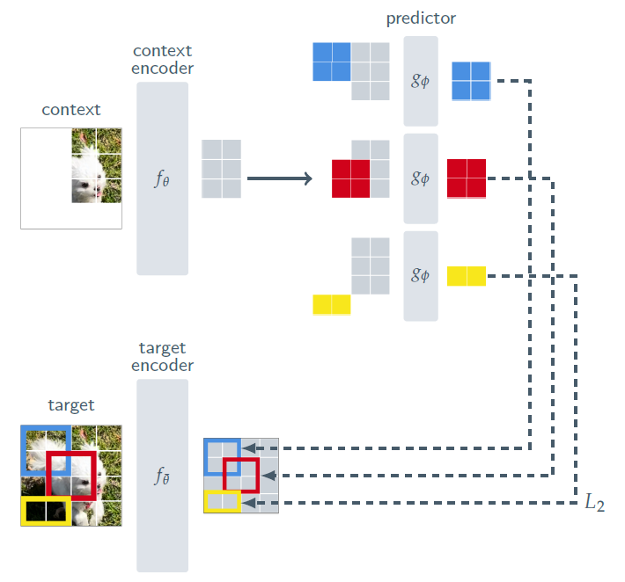
Motivation
What’s the difference and Why?
Teacher-Student Network:
Teacher Network: Global context
Student Network: Local context
Teacher instruct student learning
Output High Dimension Features in Pretrain Stage
High-level representations
Spatial & Temporal Encoder
Spatial: Relationship among joints
Temporal: Relationship across time steps
I-JEPA^{[3]}
[3] Assran, Mahmoud, et al. "Self-supervised learning from images with a joint-embedding predictive architecture."
Proceedings of the IEEE/CVF Conference on Computer Vision and Pattern Recognition. 2023.

Slide 8
Experiment
Dataset: NTU-60 X-sub
Pretrained Stage: MSE
Finetune Stage:
Action Classification: Accuracy
3D Pose Estimation: MPJPE(Mean per joint position error )

Slide 9
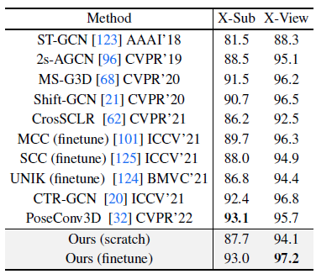
Experiment
Pretrained Model (Spatial & Temporal Encoders) with 200 Epochs
Save model per 20 epochs
Finetune(1-2 Epochs) and Evaluate Action Classification
Partially done but still left to work
Adapt the Encoder and Predictor Hyperparameter
Still left to work
Performance of state of the art on the same task^{[4]}
[4] Zhu, Wentao, et al. "Motionbert: A unified perspective on learning human motion representations." Proceedings of the IEEE/CVF International Conference on Computer Vision. 2023.

Slide 10

Thank you

